Slide 1
Innovation Spillovers across U.S. Tech Clusters
Xavier Giroud
Columbia University,
NBER & CEPR
Ernest Liu
Princeton University
& NBER
Holger Mueller
New York University, NBER & CEPR
NBER SI, July 2025

Slide 2
Introduction
Innovative activity is unevenly distributed across space.
A few large tech clusters account for disproportionate share of innovative output (e.g., Silicon Valley, Boston Rt. 128, New York, Los Angeles, San Diego, Seattle, …).
Larger tech clusters not only produce more patents but also more patents per inventor.
Not because more productive inventors select into larger clusters, but because larger clusters make inventors more productive (Moretti, 2021).
What explains productivity gain? Marshallian agglomeration economies, especially local (“within-cluster”) knowledge spillovers.
“Every year there was some place, the Wagon Wheel, Chez Yvonne, Rickey’s, the Roundhouse, where members of this esoteric fraternity, the young men and women of the semiconductor industry, would head after work to have a drink and gossip and brag and trade war stories […]” (Saxenian, 1994).
Large empirical literature showing that patent citations are geographically localized.
Atkin, Chen, and Popov (2022): identify face-to-face meetings between workers of different firms in Silicon Valley using smartphone geolocation data. Meetings lead to significantly higher subsequent mutual patent citations.

Slide 3
Introduction
Little known fact: 80.7% of U.S. inventors work for firms that also have inventors in other tech clusters (based on USPTO data).
If knowledge diffuses locally across inventors of different firms, would expect these inventors to pass on this knowledge to other productive units within same firm, including inventors and plants in other tech clusters, thus generating “cross-cluster innovation spillovers.”
Within the firm, knowledge diffusion does not need to rely on face-to-face interactions but can take place through conventional channels, such as emails, internal memos, video conferencing, etc.
Knowledge is non-rival within the firm => can be used by other productive units at little or no additional cost, generating significant economies of scale and scope.

Slide 4
Introduction
Central result: larger tech clusters not only make local inventors more productive, but they also raise the productivity of inventors (and plants) in other clusters, who are connected to the focal cluster because they work for a firm that has inventors in both clusters.
Local agglomeration externality spills over to entire country!
Firms only benefit from a larger cluster if they have inventors in the cluster. If a firm has a plant in a cluster but no inventors, then a larger cluster does not benefit the firm’s local plant, nor does it benefit other plants or inventors of the firm.
Inventors effectively act as “antennas” who process local knowledge and pass it on to other inventors and plants of the firm, in other clusters.
Cohen and Levinthal’s (1989) concept of “absorptive capacity:”
“Firms invest in R&D not only to pursue directly new process and product innovation, but also to [...] exploit externally available information.”

Slide 5
Introduction
Within- and cross-cluster spillovers: firms are unlikely to internalize effects on other firms’ innovative activities => underinvestment in innovation.
To inform policy which locations underinvest the most in innovation, develop tractable model of spatial innovation and derive model-based sufficient statistic—“social-private innovation wedge”—that captures gap between social and private returns to innovation in a location.
Rank all U.S. tech clusters based on wedge. While larger tech clusters exhibit greater wedge, not because of local knowledge spillovers!
Silicon Valley cluster has high social-private innovation wedge not because it is large, and thus generates large local knowledge spillovers, but because it is well connected—through firms' networks of innovating plants—to many other large tech clusters.

Slide 6
Sample
Merge USPTO patent data with US Census Bureau’s LBD.
Assign patents to BEA economic areas (“cities”) based on inventor’s address.
Assign firm inventors to establishments in LBD.
Match inventor to firm establishment that is nearest to inventor’s address.
Link establishments in LBD to CMF/ASM.
Manufacturing industries account for 66.3% of U.S. patents in 2013.
Provides us with productivity measure (TFP) also for plants without inventors!
Aggregate observations to plant-year level.
134,000 plant-year observations (“within-cluster spillover sample”).
Exclude plant-year observations if firm has no other “innovating plants” (= plants with inventors) in same field in different city in same year.
57,000 plant-year observations (“cross-cluster spillover sample”).

Slide 7
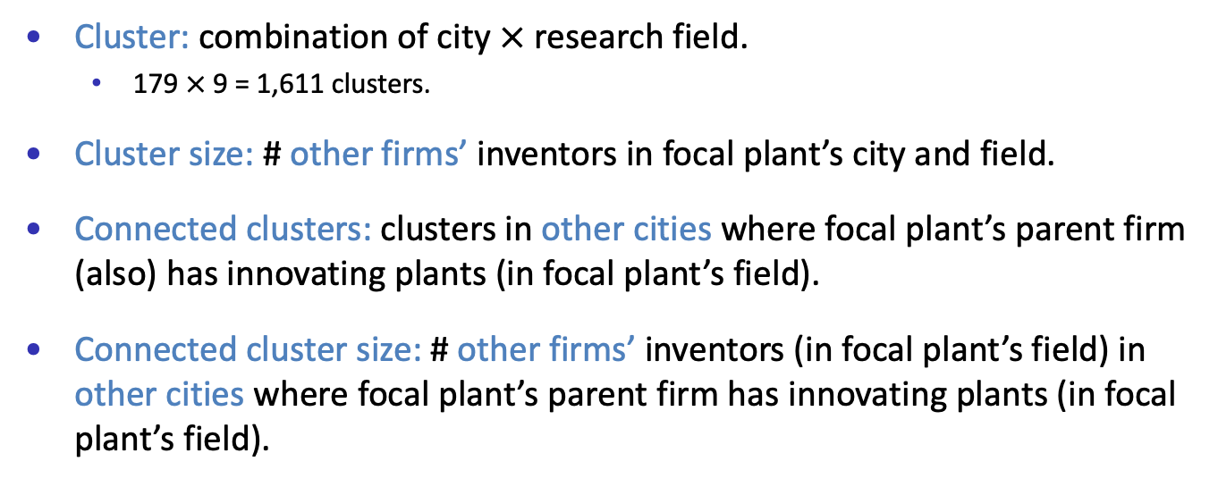
Innovation Clusters
Cluster: combination of city $×$ research field.
179 $×$9 = 1,611 clusters.
Cluster size: # other firms’ inventors in focal plant’s city and field.
Connected clusters: clusters in other cities where focal plant’s parent firm (also) has innovating plants (in focal plant’s field).
Connected cluster size: # other firms’ inventors (in focal plant’s field) in other cities where focal plant’s parent firm has innovating plants (in focal plant’s field).

Slide 8



Within-Cluster Innovation Spillovers
Silicon Valley

Slide 9
Within-Cluster Innovation Spillovers
10% increase in cluster size raises plant-level inventor productivity by 0.76% and plant-level TFP by 0.23%
Moretti (2021): 10% increase in cluster size raises inventor-level productivity by 0.676%.

Slide 10

Cross-Cluster Innovation Spillovers
Seattle
San Diego
Focal plant: Silicon Valley Plant (red)
Connected cluster size: # other firms’ inventors (in focal plant’s field) in Seattle & San Diego (blue)
Connected clusters: Seattle & San Diego
Silicon Valley

Slide 11
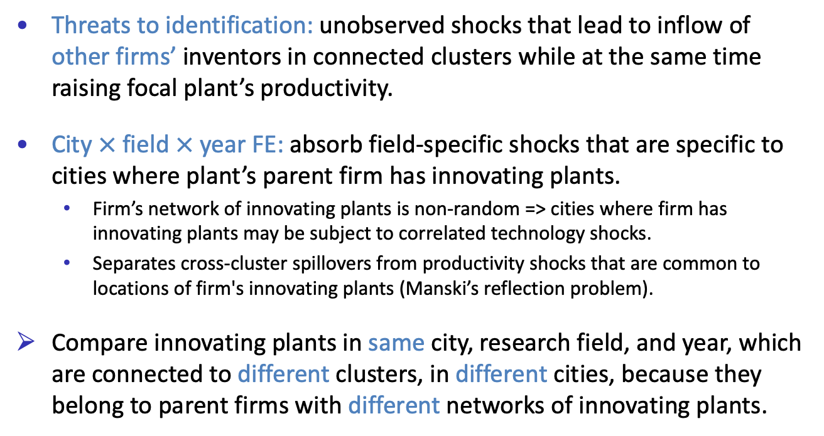
Cross-Cluster Innovation Spillovers
Threats to identification: unobserved shocks that lead to inflow of other firms’ inventors in connected clusters while at the same time raising focal plant’s productivity.
City $×$ field $×$ year FE: absorb field-specific shocks that are specific to cities where plant’s parent firm has innovating plants.
Firm’s network of innovating plants is non-random => cities where firm has innovating plants may be subject to correlated technology shocks.
Separates cross-cluster spillovers from productivity shocks that are common to locations of firm's innovating plants (Manski’s reflection problem).
Compare innovating plants in same city, research field, and year, which are connected to different clusters, in different cities, because they belong to parent firms with different networks of innovating plants.

Slide 12
Cross-Cluster Innovation Spillovers
Within-cluster elasticity: 0.076 and 0.023
Some (but not all) of the local information is useful to other inventors and plants of same firm. (Or: some information may be “soft” and thus difficult to pass on.)

Slide 13
Non-Innovating Plants (I)
Seattle
San Diego
Focal plant: innovating plant
Connected clusters: non-innovating plants
Silicon Valley

Slide 14
Non-Innovating Plants (I)
Focal plant: innovating plant
Connected clusters: non-innovating plants
Cross-cluster innovation spillovers do not simply originate from any cluster in which firm has plants but only from clusters in which it has innovating plants.

Slide 15
Non-Innovating Plants (II)
Seattle
San Diego
Focal plant: non-innovating plant
Connected clusters: innovating plants
Silicon Valley

Slide 16
Non-Innovating Plants (II)
Focal plant: non-innovating plant
Connected clusters: innovating plants
Some of the information that is disseminated via cross-cluster spillovers is relevant for productivity more broadly, beyond raising inventors' productivity.

Slide 17

IV Estimation
Boston
New York
Los Angeles
Seattle
San Diego
Instrument: # other firms’ inventors (in focal plant’s field) in Boston, New York, and Los Angeles (green)
Silicon Valley

Slide 18
IV Estimation
OLS: 0.021
OLS: 0.012

Slide 19
Mechanism
Additional evidence consistent with knowledge diffusion:
Geographical distance:
Knowledge diffusion within the firm can take place trough conventional channels, such as emails, internal memos, or video conferencing.
Cross-cluster innovation spillovers do not decay with geographical distance!
Backward patent citations:
Patent citations are viewed as evidence of knowledge flows.
Plants cite disproportionately more patents from connected clusters as the size of those clusters increases!

Slide 20
Theoretical Framework
Spatial equilibrium model in which multi-plant, multi-location firms choose “innovation investments” (R&D, # inventors) in each of their plants.
Plant knowledge (=> productivity) depends on plant’s own innovation, local knowledge, innovation of firm’s other plants, and (local) knowledge in those other plants’ locations.
Recursive formulation: local knowledge depends on knowledge of all local plants (and thus on their innovation investments).
Within- and cross-location knowledge spillovers interact => higher-order spillovers which propagate throughout the economy.
“Social-private innovation wedge:” location-specific sufficient statistic that captures gap (=> underinvestment) between social and private returns to innovation in a location. Can be measured in the data!
More details

Slide 21
Social-Private Innovation Wedge

Slide 22
Social-Private Innovation Wedge
Is it (just) cluster size? No, location size per se is unrelated to ranking!
In fact, if it was only for local knowledge spillovers, social-private innovation wedge would be invariant to cluster size! (Can be formally shown in model.)
(Echoes well-known result in urban economics.)
What is instead driving location ranking is extent to which clusters are interconnected through firms’ networks of innovating plants.
(In the data, connectedness is correlated with cluster size; hence appearance that ranking is driven by size.)
Innovation policy should focus on well-connected clusters, from where innovations spill over to other, well-connected tech clusters, and so on.
Biggest “bang for the buck.”

Slide 23
Increasing Interconnectedness of U.S. Tech Clusters

Slide 24
Thank You!

Slide 25
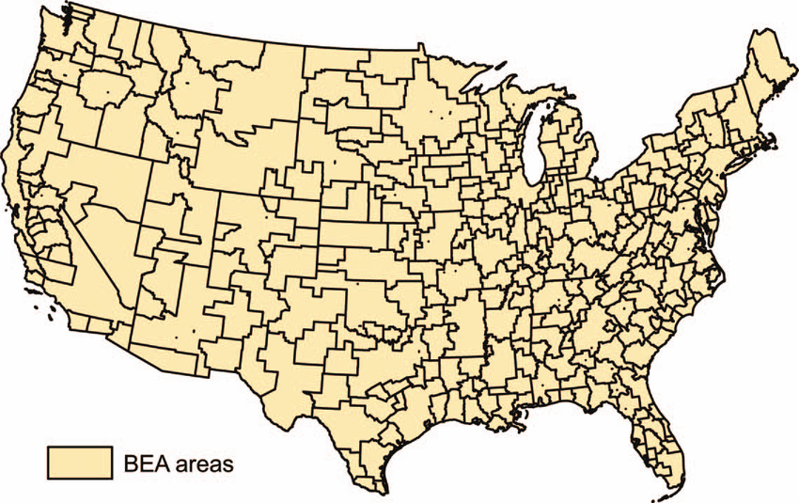
BEA Economic Areas
back

Slide 26

1-Digit CPC Codes
back

Slide 27
Robustness
Assign inventor to nearest firm plant in same city
All fields (not just modal) in which plant has patents
Inventors work in cluster in between patent filings
All LBD establishments
back

Slide 28
Number of Plant Inventors
Focal plant
Innovating plants in connected clusters
back

Slide 29
Aggregation to Cluster Level
Sum of connected clusters
Average of connected clusters
Plant-level results aggregate to cluster level, with similar magnitudes.
back

Slide 30
Patent Output
back

Slide 31
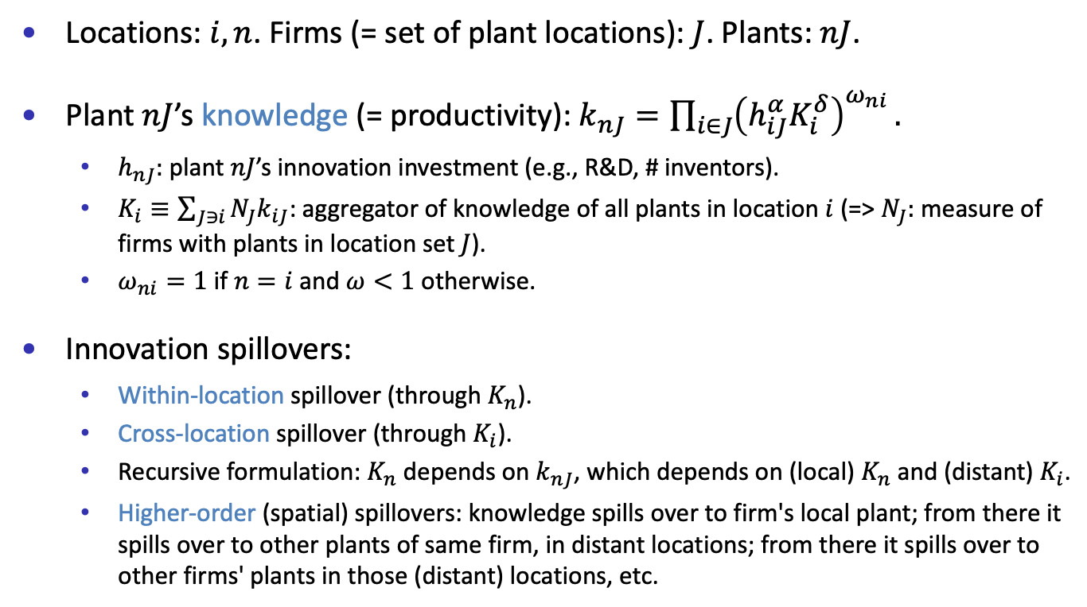
Model Setup
Locations: $i,n$. Firms (= set of plant locations): $J$. Plants: $nJ$.
Plant $nJ$’s knowledge (= productivity): $k_{nJ}=\prod_{i∈J}{{\left(h_{iJ}^{α}K_{i}^{δ}\right)}^{ω_{ni}}}.$
$h_{nJ}:$ plant $nJ$’s innovation investment (e.g., R&D, # inventors).
$K_{i}≡\sum_{J∋i}{{N_{J}k}_{iJ}}$: aggregator of knowledge of all plants in location $i$ (=> $N_{J}:$ measure of firms with plants in location set $J$).
$ω_{ni}=1$ if $n=i$ and $ω<1$ otherwise.
Innovation spillovers:
Within-location spillover (through $K_{n}$).
Cross-location spillover (through $K_{i}$).
Recursive formulation: $K_{n}$ depends on $k_{nJ}$, which depends on (local) $K_{n}$ and (distant) $K_{i}$.
Higher-order (spatial) spillovers: knowledge spills over to firm's local plant; from there it spills over to other plants of same firm, in distant locations; from there it spills over to other firms' plants in those (distant) locations, etc.
back

Slide 32
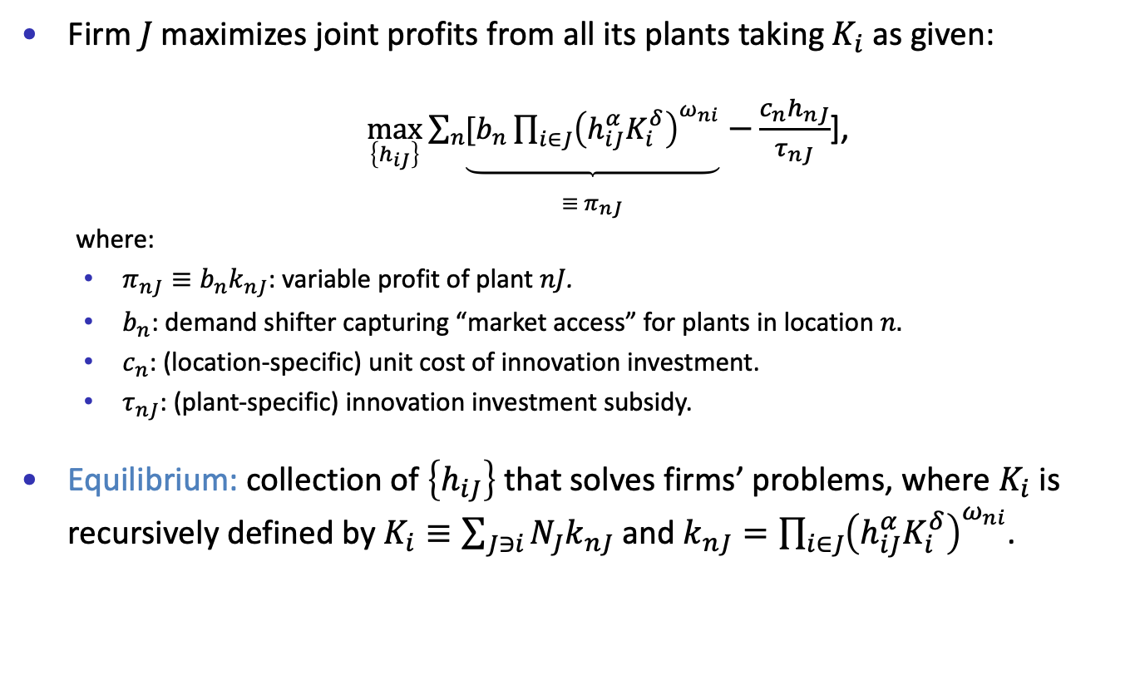
Equilibrium
Firm $J$maximizes joint profits from all its plants taking${ K}_{i}$ as given:
$\max_{\left\{h_{iJ}\right\}}{\sum_{n}{\underset{\begin{matrix} \\ ≡ π_{nJ}\end{matrix}}{\underbrace{[b_{n}\prod_{i∈J}{{\left(h_{iJ}^{α}K_{i}^{δ}\right)}^{ω_{ni}}}}}}}$ $−\frac{c_{n}h_{nJ}}{τ_{nJ}}$],
where:
$π_{nJ}≡{b_{n}k}_{nJ}$: variable profit of plant $nJ$.
$b_{n}$: demand shifter capturing “market access” for plants in location $n.$
$c_{n}$: (location-specific) unit cost of innovation investment.
$τ_{nJ}$: (plant-specific) innovation investment subsidy.
Equilibrium: collection of $\left\{h_{iJ}\right\}$ that solves firms’ problems, where $K_{i}$ is recursively defined by $K_{i}≡\sum_{J∋i}{{N_{J}k}_{nJ}}$ and $k_{nJ}=\prod_{i∈J}{{\left(h_{iJ}^{α}K_{i}^{δ}\right)}^{ω_{ni}}}$.
back

Slide 33
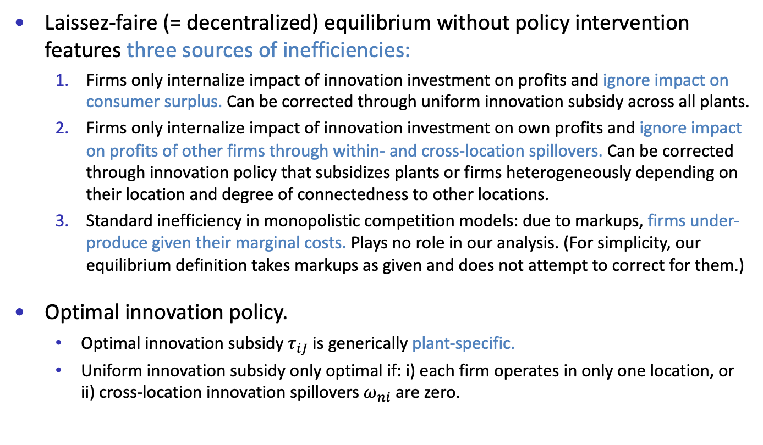
Sources of Inefficiencies
Laissez-faire (= decentralized) equilibrium without policy intervention features three sources of inefficiencies:
Firms only internalize impact of innovation investment on profits and ignore impact on consumer surplus. Can be corrected through uniform innovation subsidy across all plants.
Firms only internalize impact of innovation investment on own profits and ignore impact on profits of other firms through within- and cross-location spillovers. Can be corrected through innovation policy that subsidizes plants or firms heterogeneously depending on their location and degree of connectedness to other locations.
Standard inefficiency in monopolistic competition models: due to markups, firms under-produce given their marginal costs. Plays no role in our analysis. (For simplicity, our equilibrium definition takes markups as given and does not attempt to correct for them.)
Optimal innovation policy.
Optimal innovation subsidy $τ_{iJ}$ is generically plant-specific.
Uniform innovation subsidy only optimal if: i) each firm operates in only one location, or ii) cross-location innovation spillovers $ω_{ni}$ are zero.
back

Slide 34
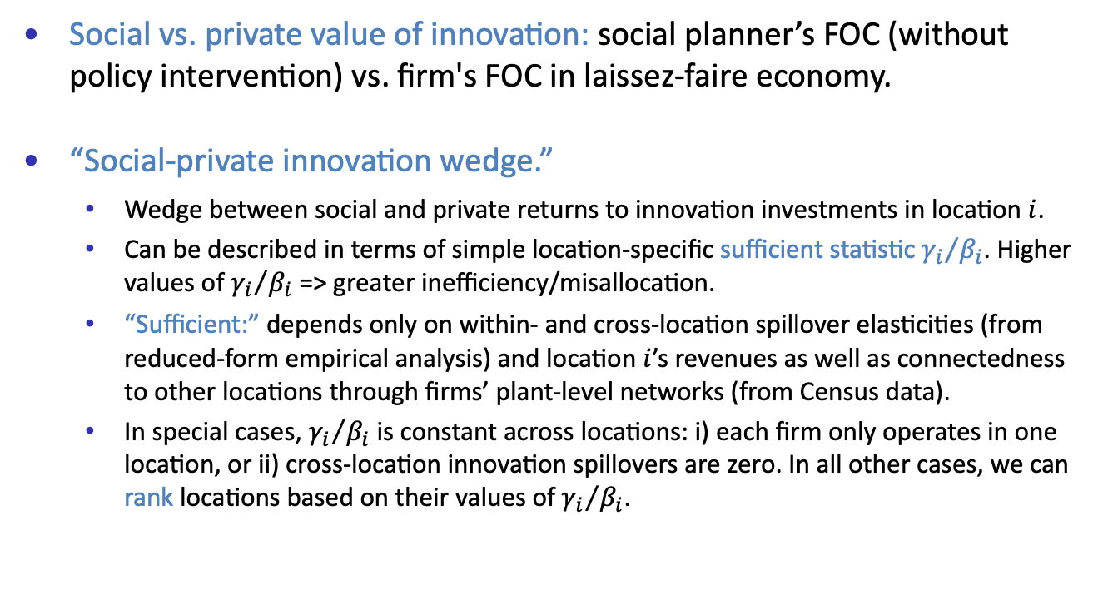
Social vs. Private Value of Innovation
Social vs. private value of innovation: social planner’s FOC (without policy intervention) vs. firm's FOC in laissez-faire economy.
“Social-private innovation wedge.”
Wedge between social and private returns to innovation investments in location $i$.
Can be described in terms of simple location-specific sufficient statistic ${γ_{i}}/{β_{i}}$. Higher values of ${γ_{i}}/{β_{i}}$ => greater inefficiency/misallocation.
“Sufficient:” depends only on within- and cross-location spillover elasticities (from reduced-form empirical analysis) and location $i$’s revenues as well as connectedness to other locations through firms’ plant-level networks (from Census data).
In special cases, ${γ_{i}}/{β_{i}}$ is constant across locations: i) each firm only operates in one location, or ii) cross-location innovation spillovers are zero. In all other cases, we can rank locations based on their values of ${γ_{i}}/{β_{i}}$.
back

