Slide 1
The Intersection of Place and Need
How Lack of Enrollment Offices Deters Participation in the Safety Net
Marianne Bitler, UC Davis & NBER
Jason Cook, University of Utah
Chloe N. East, CU Boulder & NBER
Sonya R. Porter, US Census Bureau
Laura Tiehen, ERS USDA

Slide 2
Support/Disclaimer
Funding
  We gratefully acknowledge funding from various funders. This includes the Institute for Research on Poverty, USDA-ERS Cooperative Agreement 58-4000-8-0049-R, NICHD R01HD0938898, NSF 2417856, and a Tufts/UConn RIDGE Grant. This work does not necessarily represent the opinions of any of these entities or that of the U.S. government.
Census Disclaimer
  Any opinions and conclusions expressed herein are those of the authors and do not represent the views of the U.S. Census Bureau. The Census Bureau has ensured appropriate access and use of confidential data and has reviewed these results for disclosure avoidance protection (Project: 7517251: CBDRB-FY21-CES014- 049, CBDRB-FY23-CES023-005, CBDRB-FY25-0333)

Slide 3
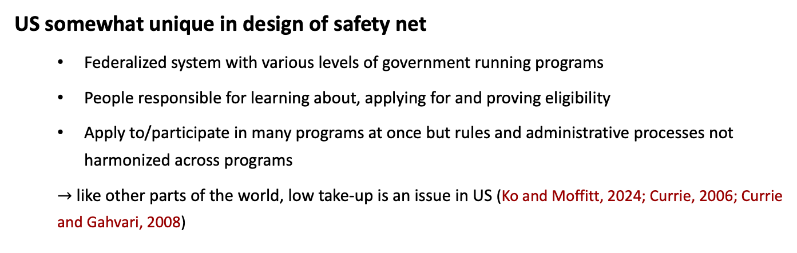
Motivation
US somewhat unique in design of safety net
  Federalized system with various levels of government running programs
  People responsible for learning about, applying for and proving eligibility
  Apply to/participate in many programs at once but rules and administrative processes not harmonized across programs
  $→$ like other parts of the world, low take-up is an issue in US (Ko and Moffitt, 2024; Currie, 2006; Currie and Gahvari, 2008)

Slide 4
Motivation
Program applicants face Administrative Burdens (Ko and Moffitt, 2024; Herd and Moynihan, 2018)
  Incomplete information: Program awareness, eligibility rules
  Stigma: Either concerns about whether you should participate or being judged
  Transaction costs: E.g., travel costs, difficultly with application/documentation, time costs, complexity
  Program Operator Error
Possible way to overcome barriers: Access to program offices
  Many safety net programs utilize program offices as part of administration
    Office location is always choice that must be made
  Visits often required for interviews or application submission (e.g., SNAP, WIC)
  Offices provide:
    Access to knowledgeable caseworkers
    Application/recertification assistance
  Many states expanding outreach with private/non-profit organizations
Limited understanding of consequences of program office access
  WIC (Rossin-Slater, 2013)
  SSDI (Deshpande and Li, 2019)

Slide 5
This Paper
Context: SNAP, the backbone of US safety net
Question: How SNAP office access impacts participation and targeting
Design: Staggered panel; leveraging SNAP office openings/closings
Data: Administrative SNAP records, Census residential locations, manually-collected SNAP office information
Results: Decreasing travel distance dramatically increases participation even when applications/recertifications can be submitted online

Slide 6
Institutional Background

Slide 7
Institutional Background
SNAP: Backbone of US safety net
  Only US safety net program available to nearly all low-income households (right now)
  In 2019, average participation of 35 million people and $56 billion in spending on benefits
  Means tested (income and some asset tests) and includes work requirements for some households (i.e., ABAWDs)
  Certification periods typically 6-12 months (seniors 24+ months; ABAWD 3 months)
7

Slide 8
Institutional Background
Role of SNAP Offices
Provide in-person assistance with applications and recertifications
Resources to help applicants gain access to other safety net programs (e.g., HUD, TANF, Medicaid, LEAP, WIC)
Offices often allow direct applications to other programs (typically TANF)
Applications take an avg of 6.1 hours and required 2.4 trips to the SNAP office (Bartlett et al., 2004)

Slide 9
Institutional Background
Why Do SNAP Offices in Indiana - Open/Close?
Most openings/closings are simply relocations
  State has one office per county
Lease buildings and offices are purposefully moved around for more equal access
Conversations with state SNAP director:
  Target bus lines
  Try to collocate with other government services
  Timing of changes is function of lease end date
    We don’t observe lease terms directly
Offices locate in more impoverished, lower-education tracts (link)
Notes:
-talk about outside of RDC analysis to say more about where office locate
-mention that we will discuss location of offices below

Slide 10
Data

Slide 11
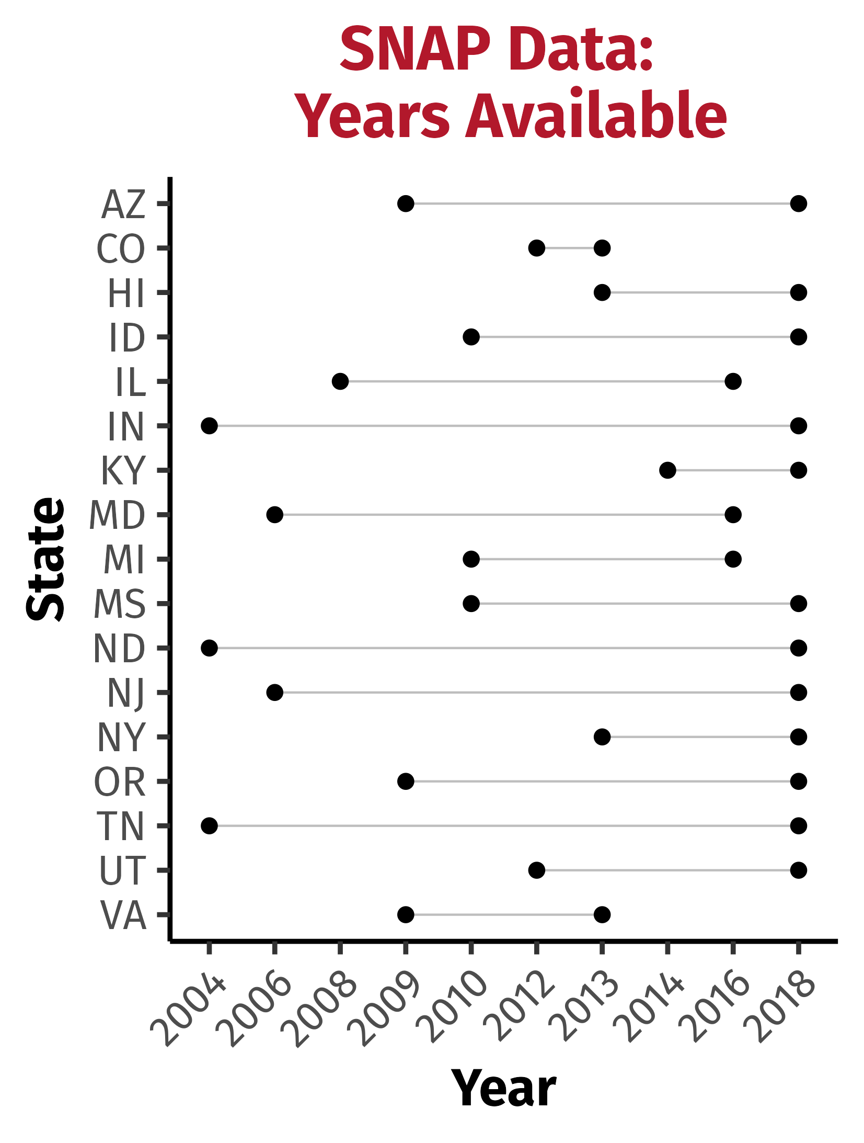
Data
SNAP Administrative Data
SNAP, Medicaid, and TANF Administrative Data
Master Address File
Collected 243 SNAP office closings and 336 openings nationwide
  about half of these in Indiana
Source: SNAP administrative records.

Slide 12

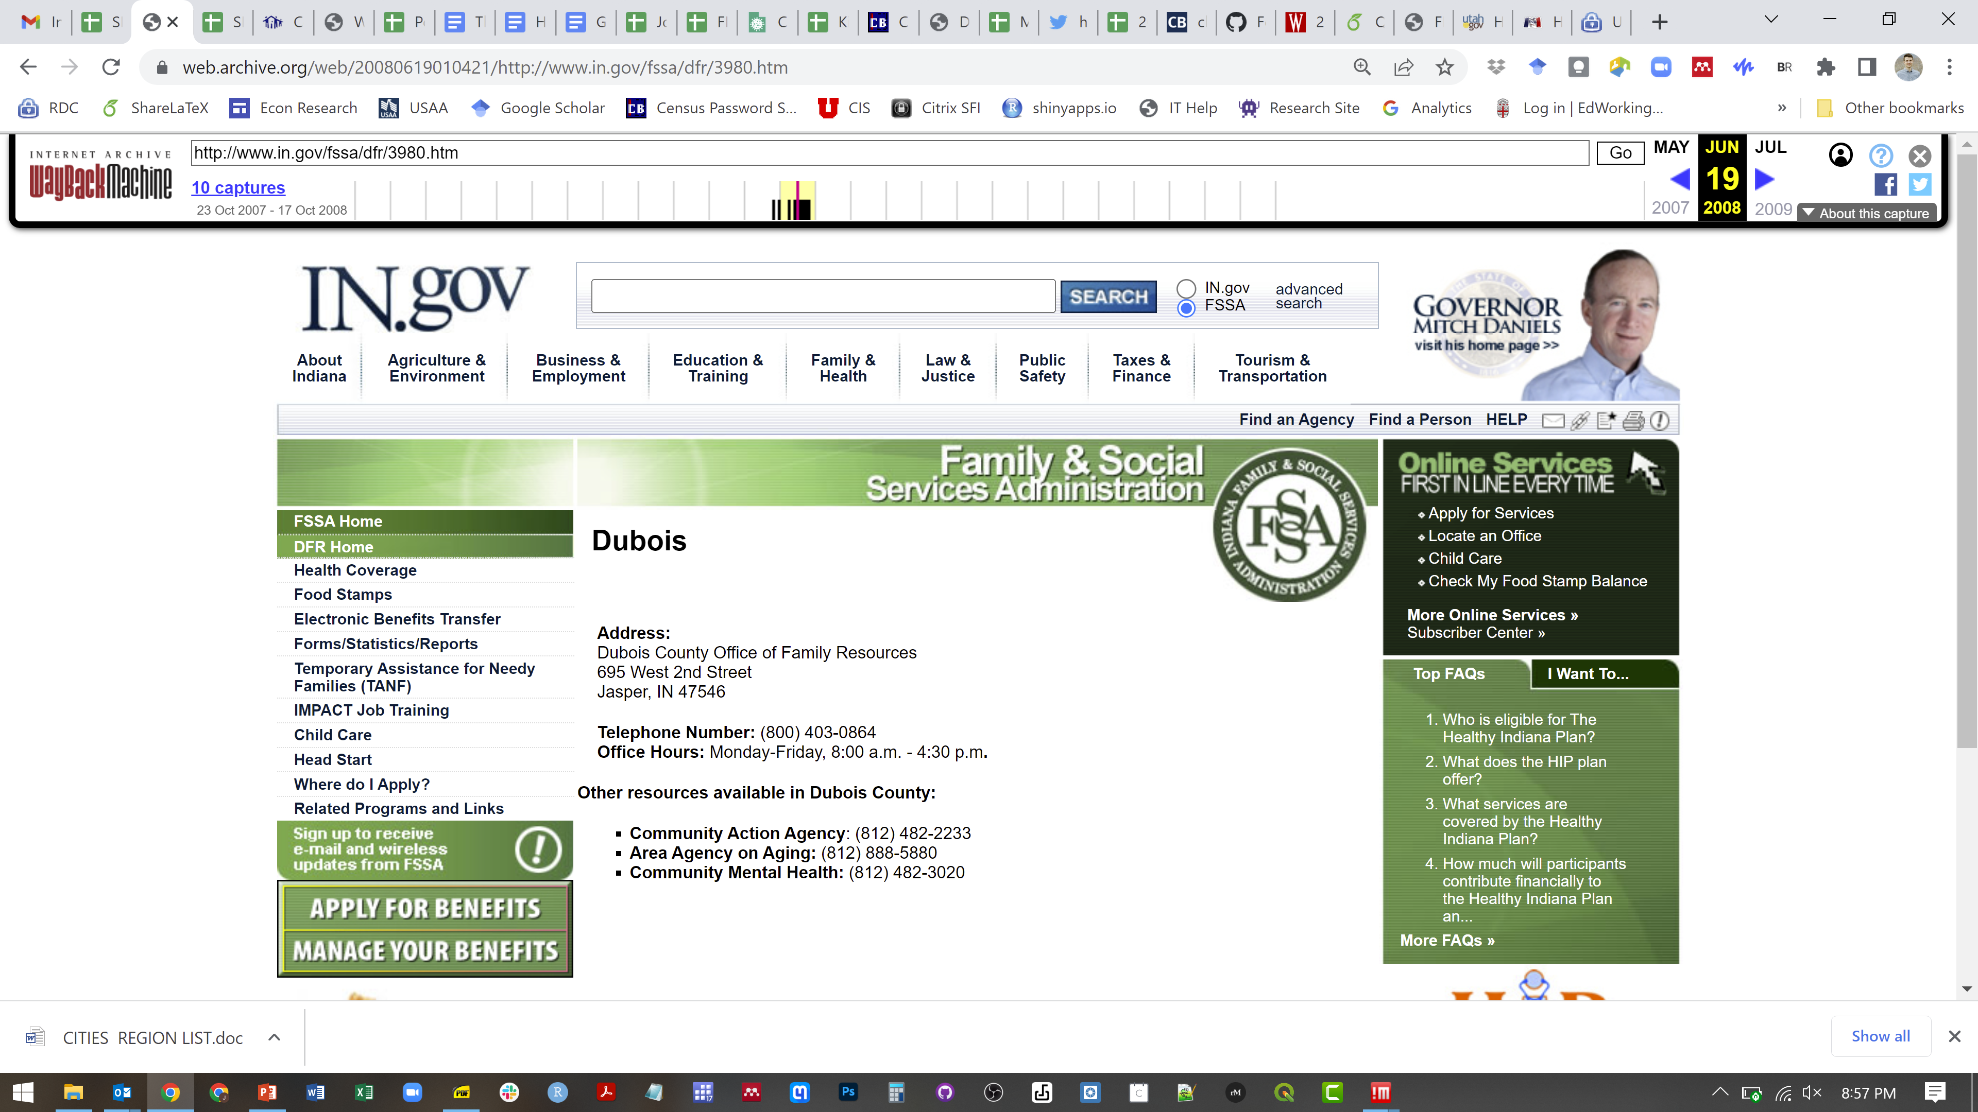
Data
SNAP Office Data Collection
Combination of FOIA, bounding changed addresses from office registries with the Way Back Machine, and phone calls

Slide 13

Data

Slide 14
Sample Selection
Focus on 2005-2018 to avoid pandemic
Remove recipients that are ever either flagged as “unhoused” in the SNAP address files or have a residential address at the SNAP office
  Caseworkers often assign SNAP office as home address
  These addresses automatically change when office moves, making caseload mechanically larger at tract of new office

Slide 15
Empirical Design

Slide 16
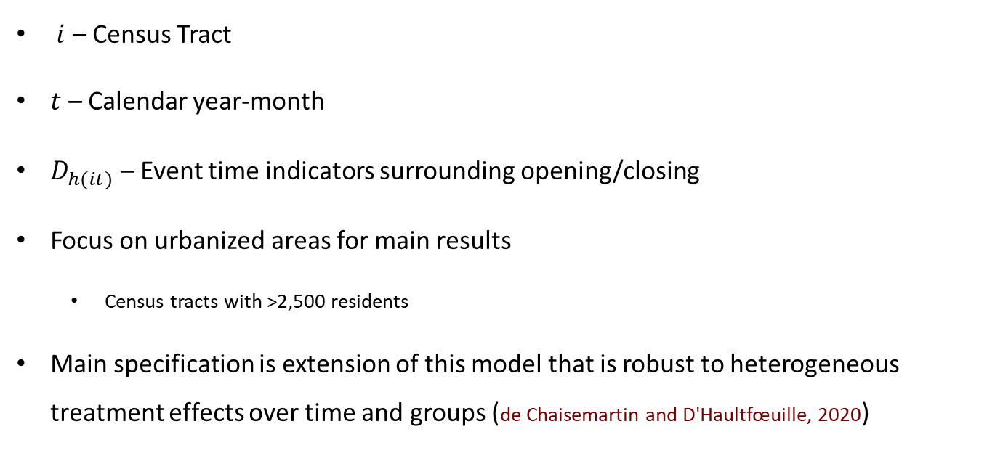

Empirical Design
Two-way Fixed Effects
$$y_{it}=\sum_{τ, τ≠1}{β_{τ}D_{h(it)}+γ_{i}+δ_{t}+ε_{it}}$$
$i$ – Census Tract
$t$ – Calendar year-month
$D_{h(it)}$ – Event time indicators surrounding opening/closing
Focus on urbanized areas for main results
  Census tracts with >2,500 residents
Main specification is extension of this model that is robust to heterogeneous treatment effects over time and groups (de Chaisemartin and D'Haultfœuille, 2020)

Slide 17
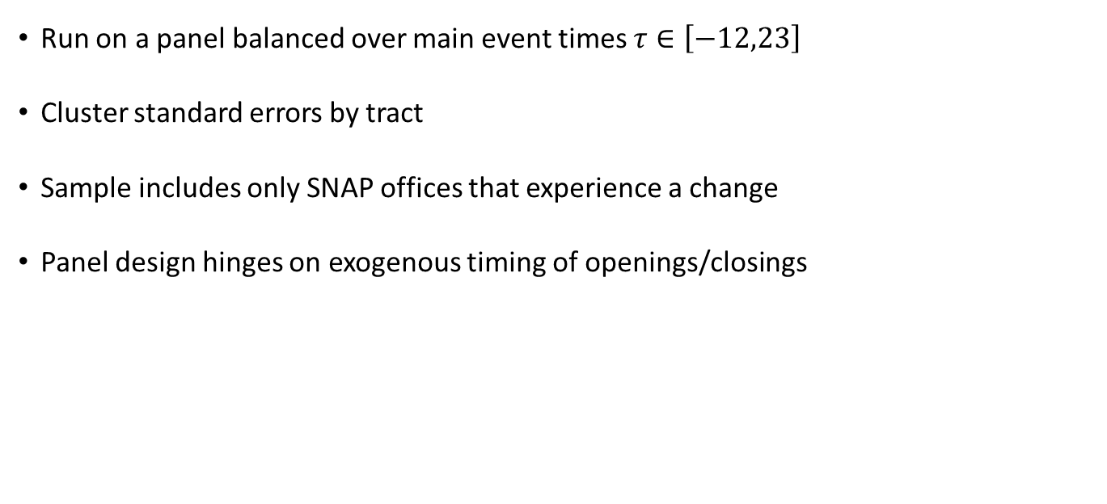
Empirical Design
Two-way Fixed Effects
$$y_{it}=\sum_{τ, τ≠1}{β_{τ}D_{h(it)}+γ_{i}+δ_{t}+ε_{it}}$$
Run on a panel balanced over main event times $τ∈\left[−12,23\right]$
Cluster standard errors by tract
Sample includes only SNAP offices that experience a change
Panel design hinges on exogenous timing of openings/closings
Notes:
-mention that we plan other robustness

Slide 18
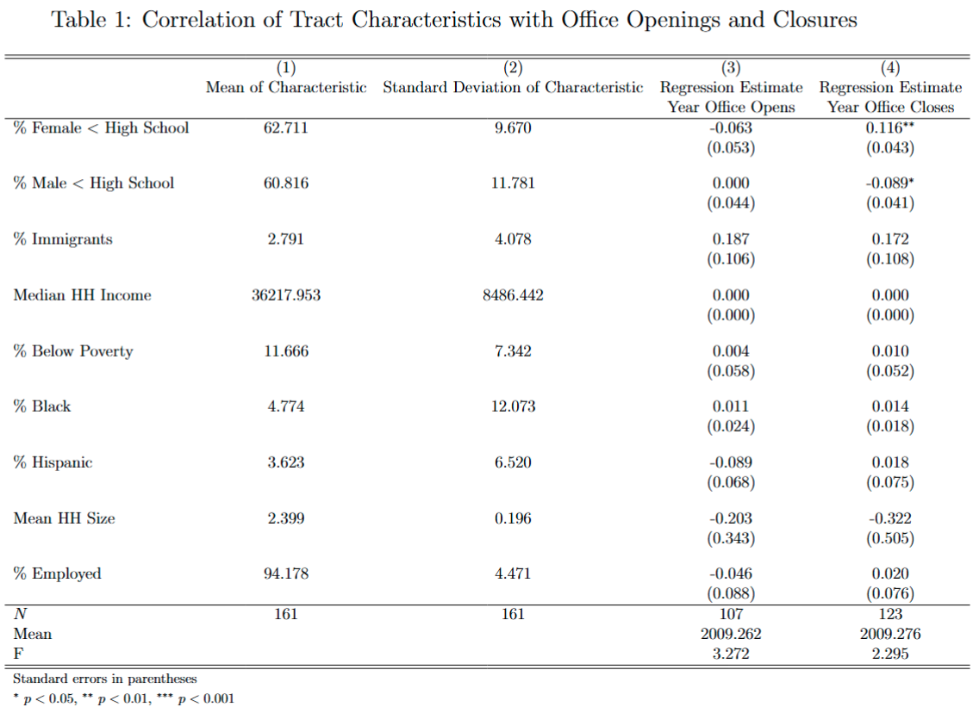
Empirical Design
2000 Census tract characteristics do not explain year of office change
Absence of pre-trends in event studies also support exogenous timing assumption
Data Source: Public-use 2000 Decennial Census and Self-collected SNAP office information.

Slide 19
Measuring Participation
Count number of active cases in each tract-year-month combo
For movers: count participation in tract of current residence
Results robust to static measure of SNAP counts that holds fixed first-observed tract (though less precise)
  Handles movers, but introduces measurement error and noise
Notes:
-mention that we plan other robustness

Slide 20
Results

Slide 21
Results
First Stage: Mean Distance to Office
  Goal: Measure how office openings/closings in each tract impact travel distance for people living in that tract
  Use the Census Master Address file (MAFX); a static file of all known residential locations in US
  Measure average travel distance from every MAFX address in a tract leading up to and following opening/closing

Slide 22
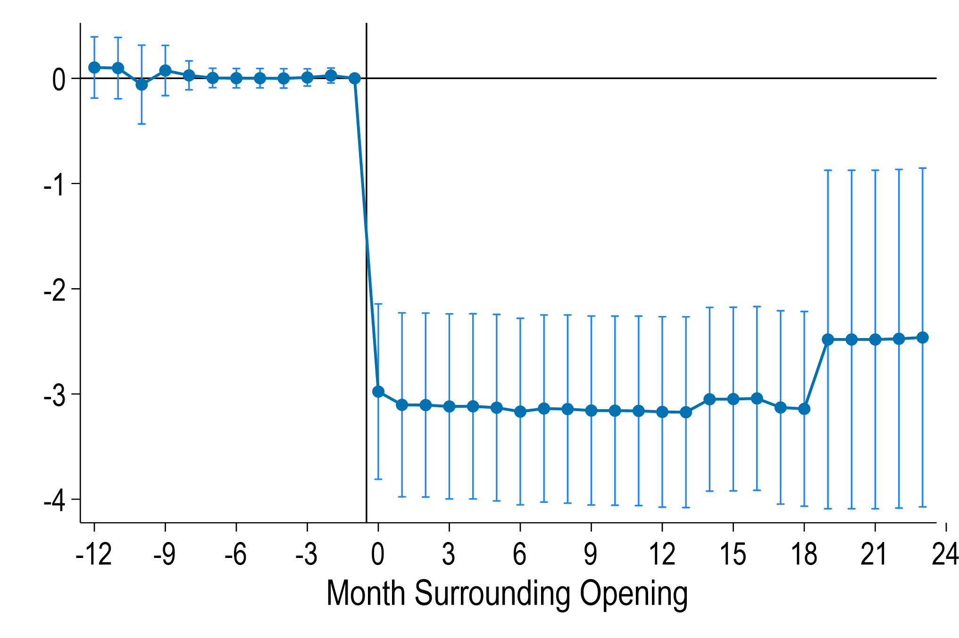
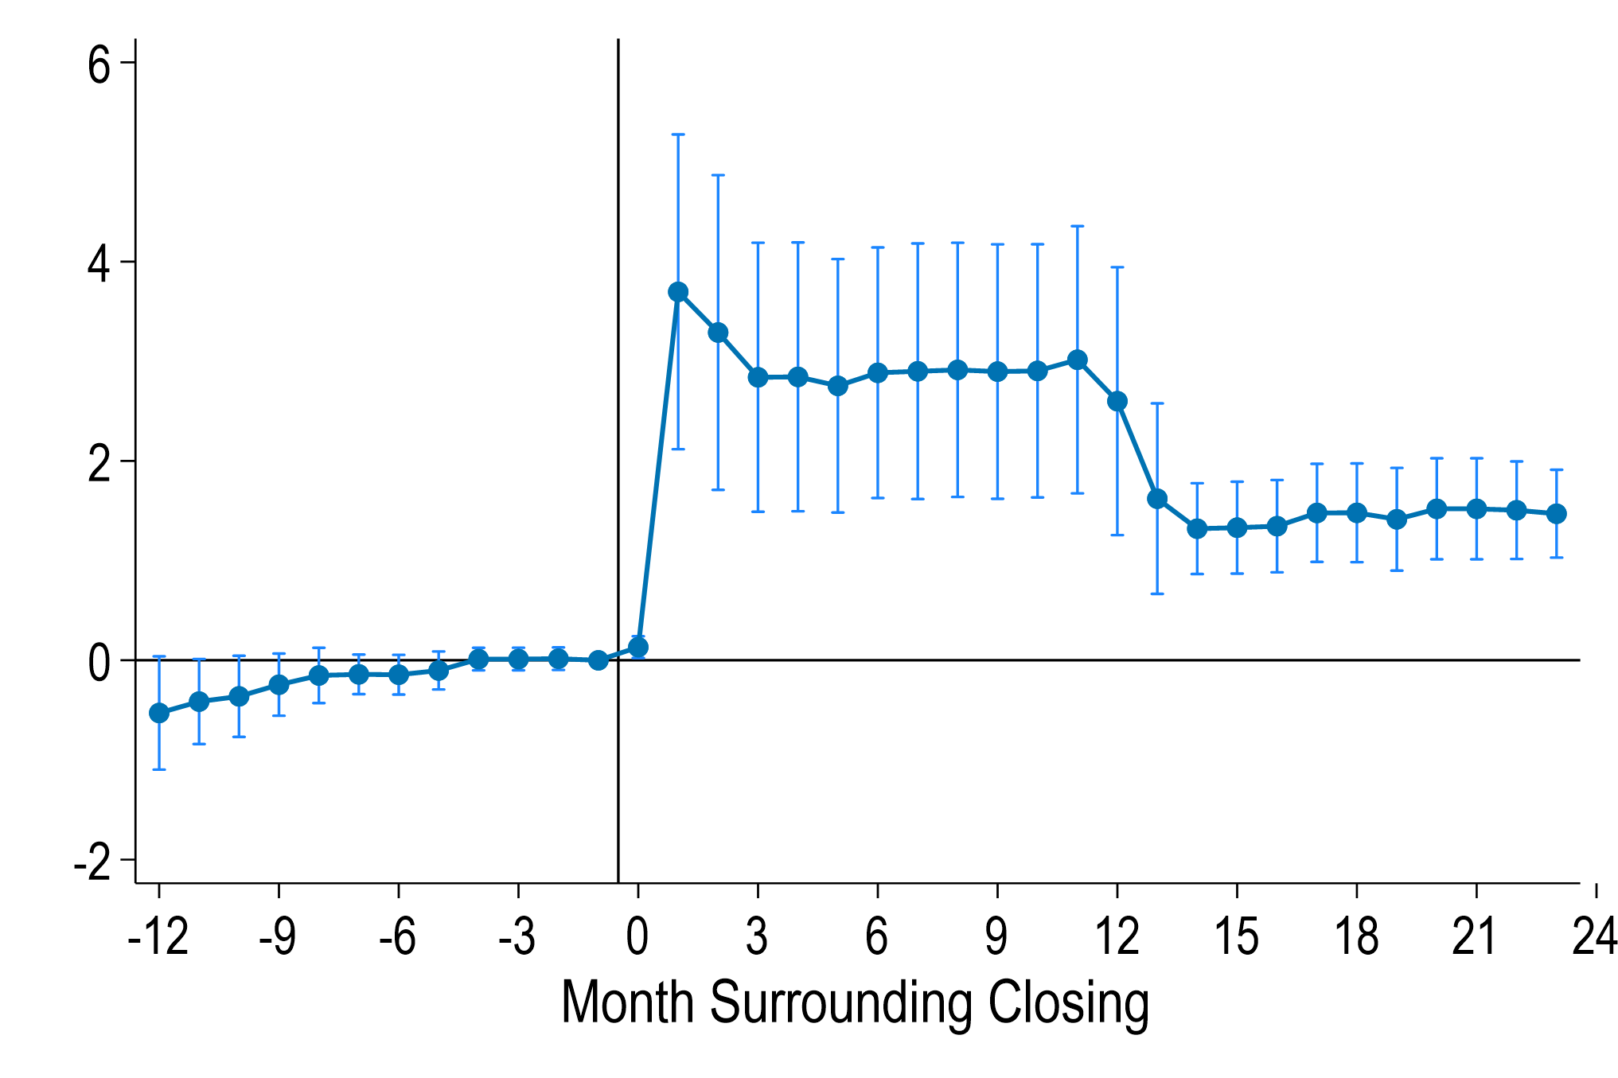
First Stage: Mean Distance to Office
Openings
Closings
Baseline travel distance: 3.3 miles (openings); 0.6 mile (closings)
  Most people travel < 4 miles for groceries (link)
Distances change enough to move from office being walkable to requiring transit to access
Data Source: SNAP Administrative Data; Census Master Address File (MAFX); CBDRB-FY25-0333.

Slide 23
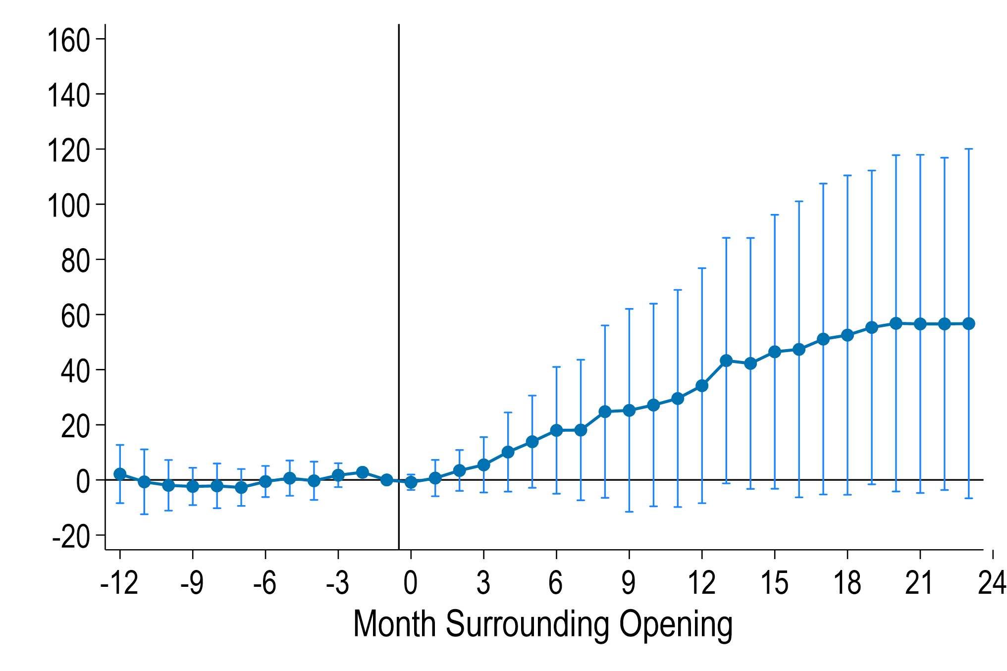
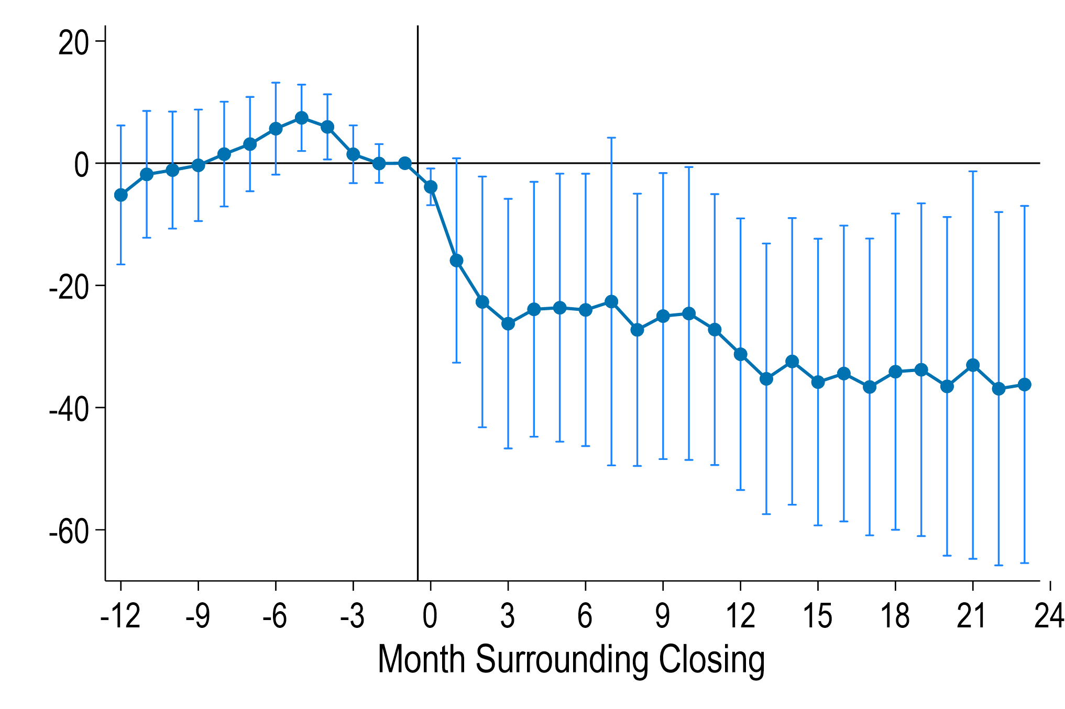
Effect on Number of Active SNAP Cases
Openings
Closings
Baseline cases: 281 (openings); 373 (closings)
Openings increase monthly cases by 21%
Closings decrease monthly cases by 10%
WIC office increases participation by 6% (Rossin-Slater, 2013); SSDI office reduces receipt by 16% (Deshpande and Li, 2019)
Data Source: SNAP Administrative Data; Census Master Address File (MAFX); CBDRB-FY25-0333.

Slide 24
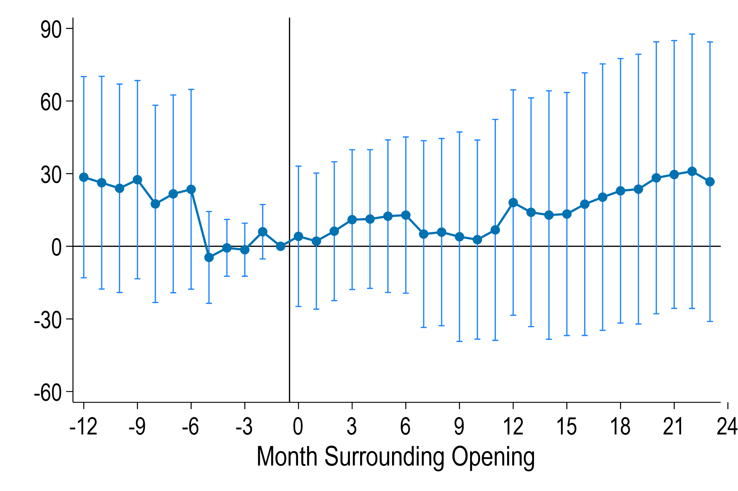
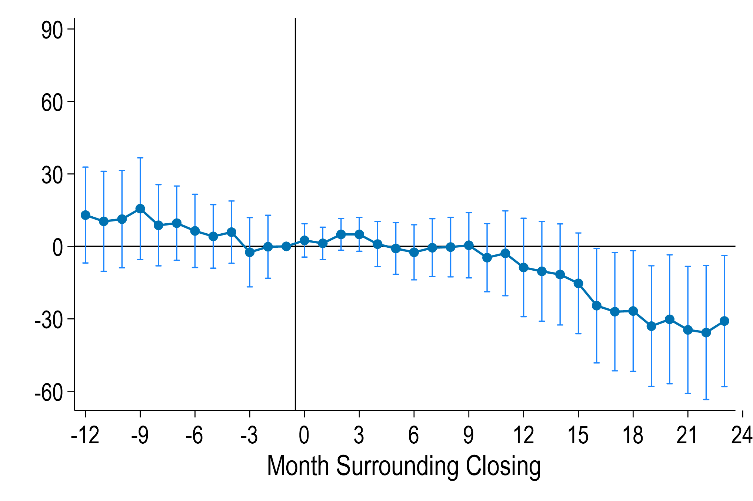
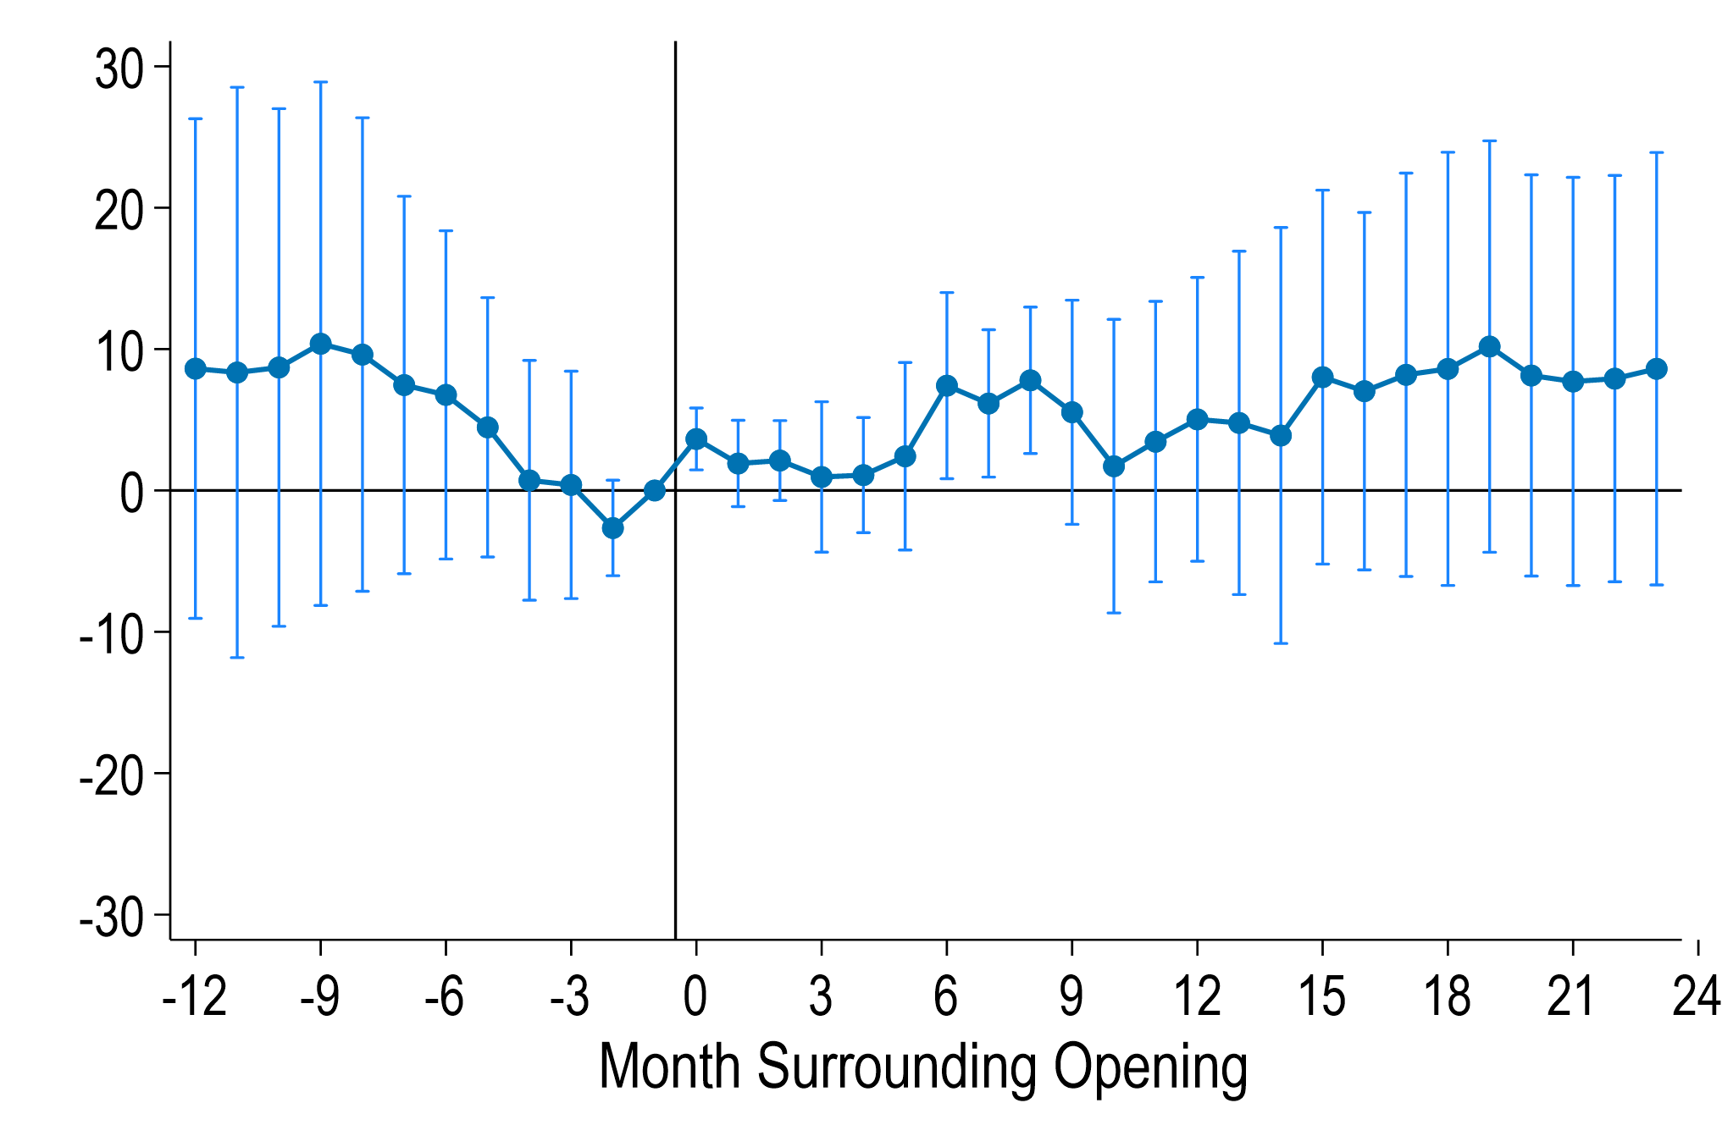
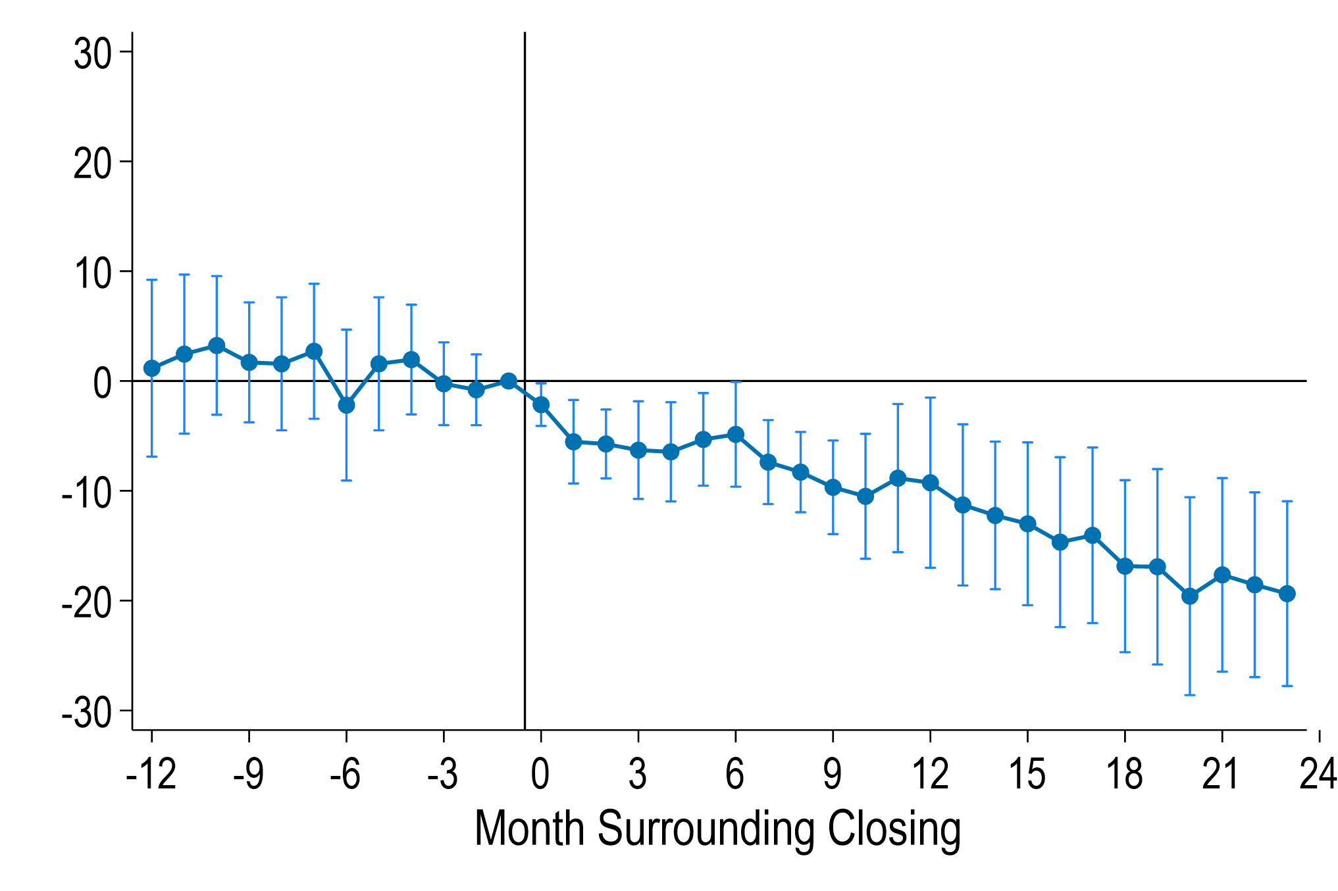
Spillover Effects to Other Programs
Openings—Medicaid
Closings—Medicaid
Openings—TANF
Closings—TANF
Null effects for openings
Closings decrease monthly cases by 4% (Medicaid) and 24% (TANF)
Data Source: Medicaid and TANF Administrative Data; Census Master Address File (MAFX); CBDRB-FY25-0333.

Slide 25
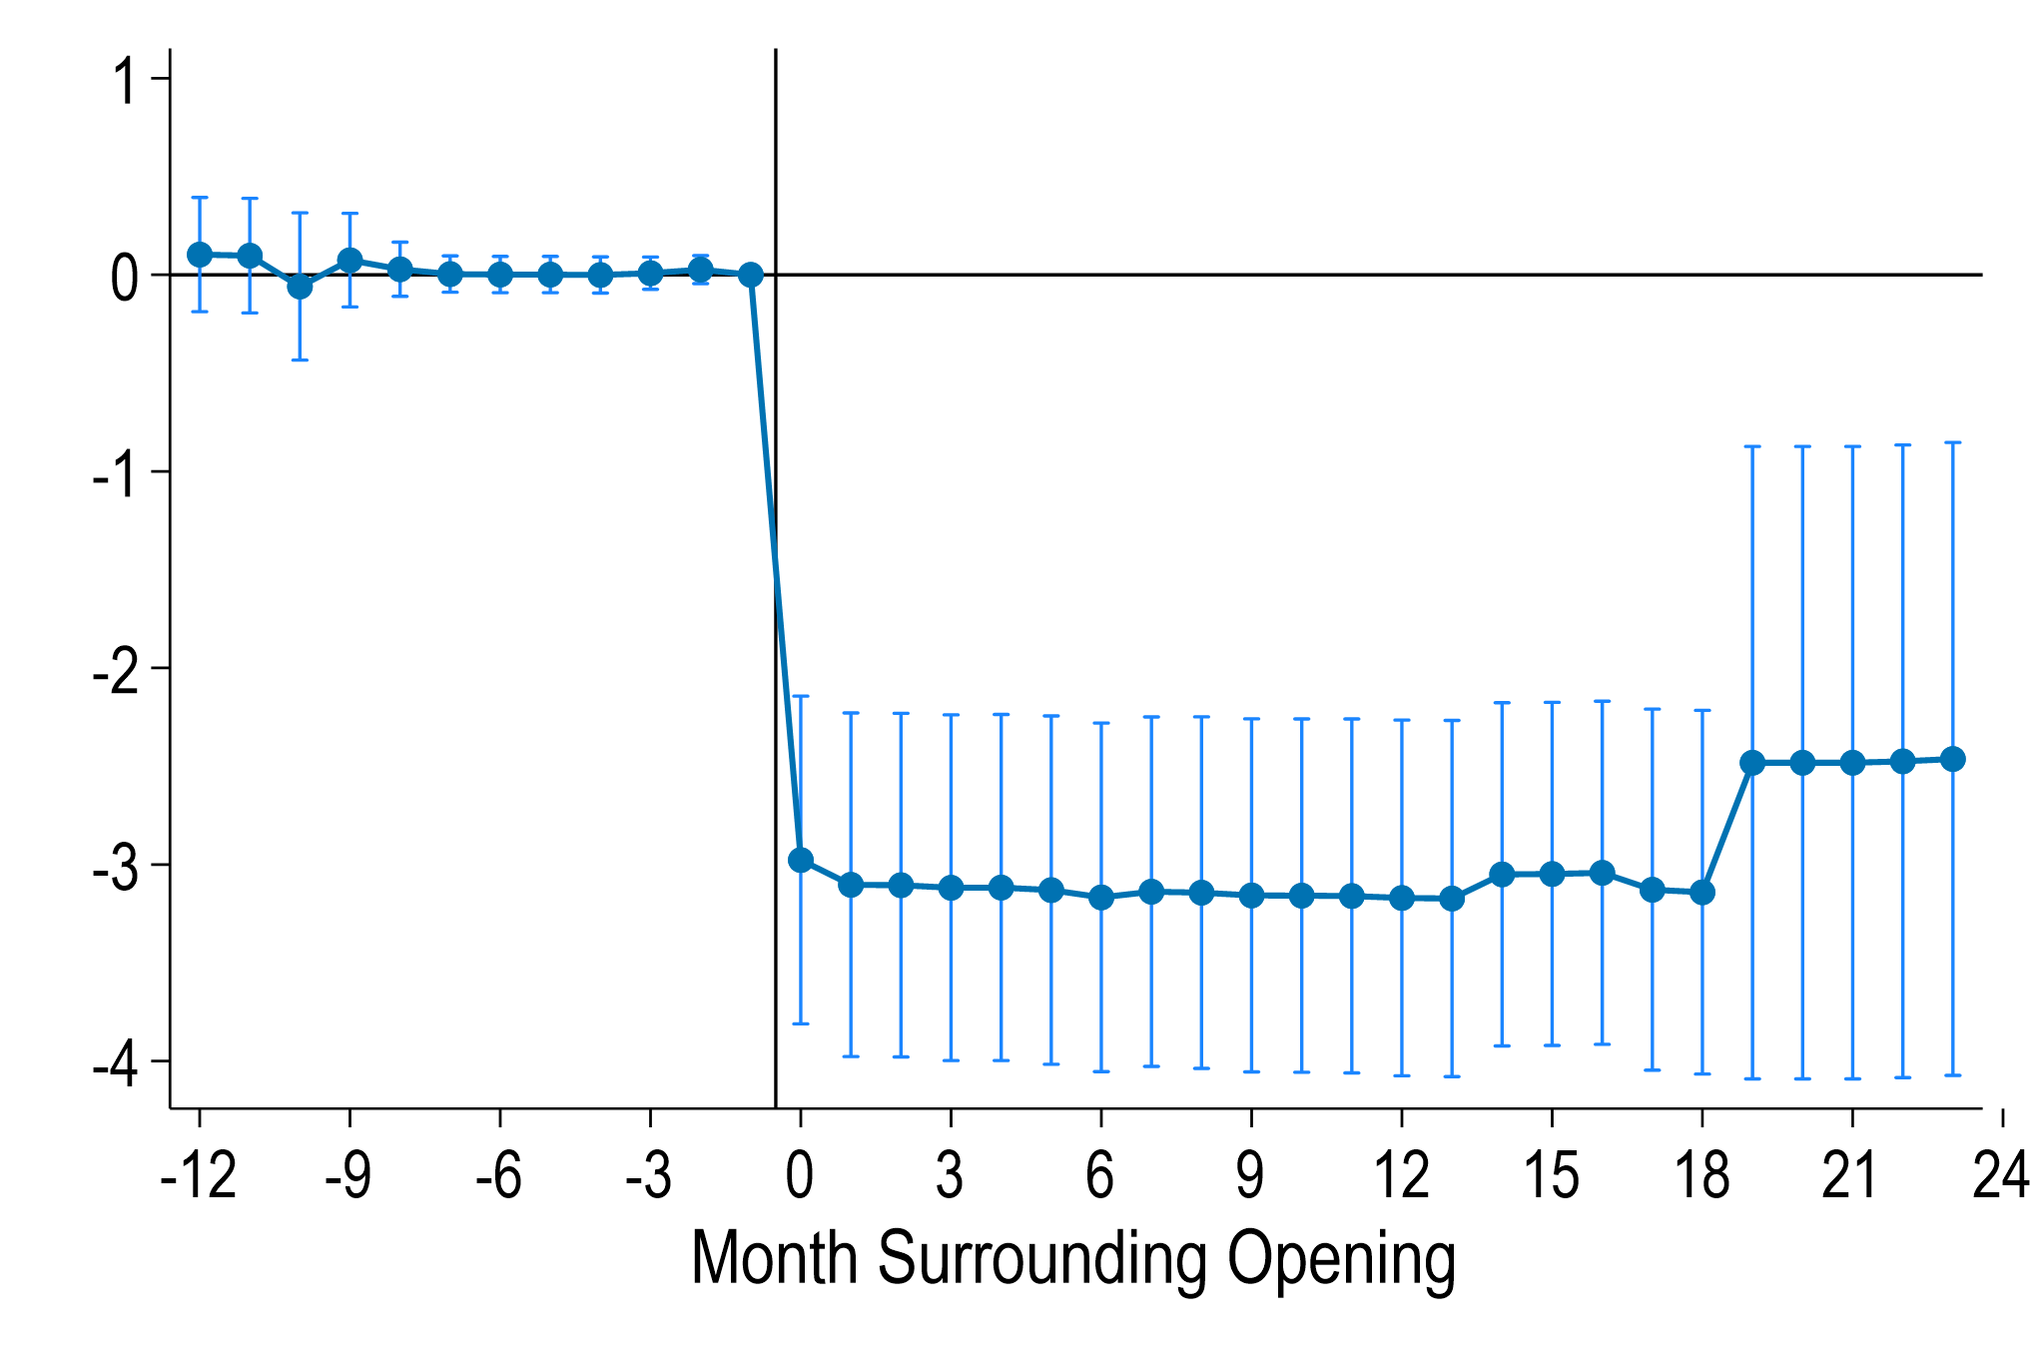
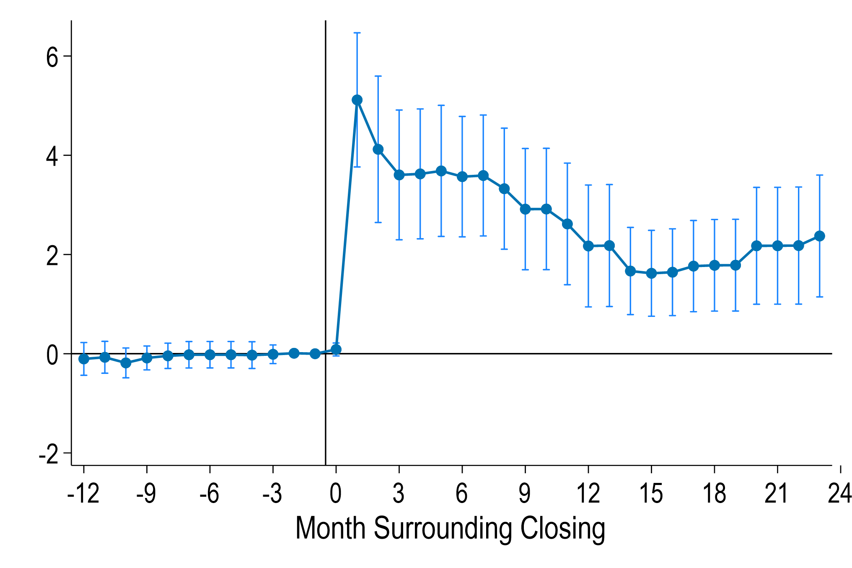
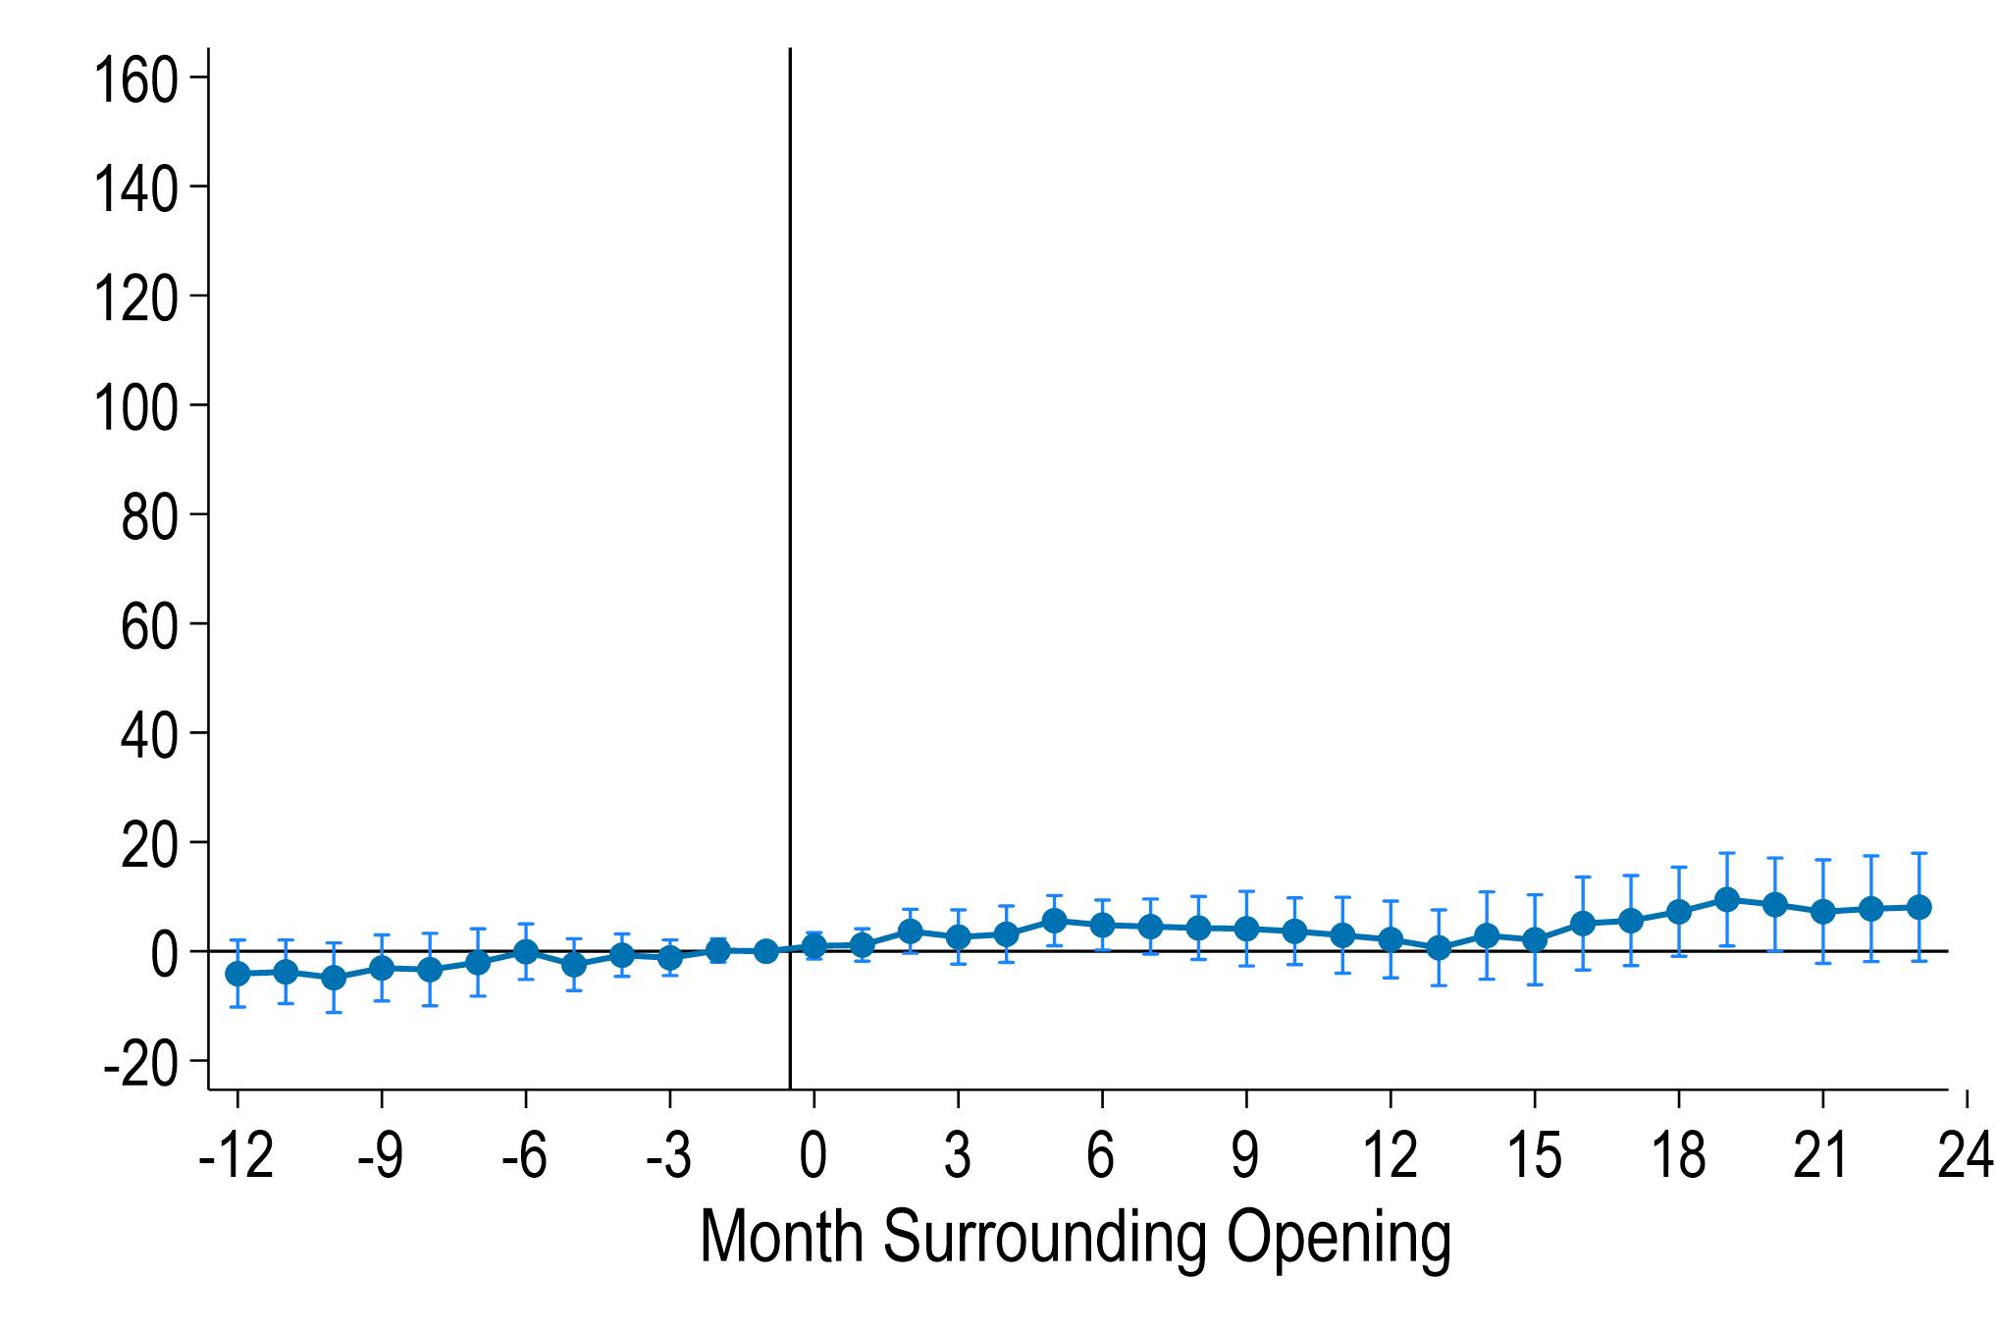
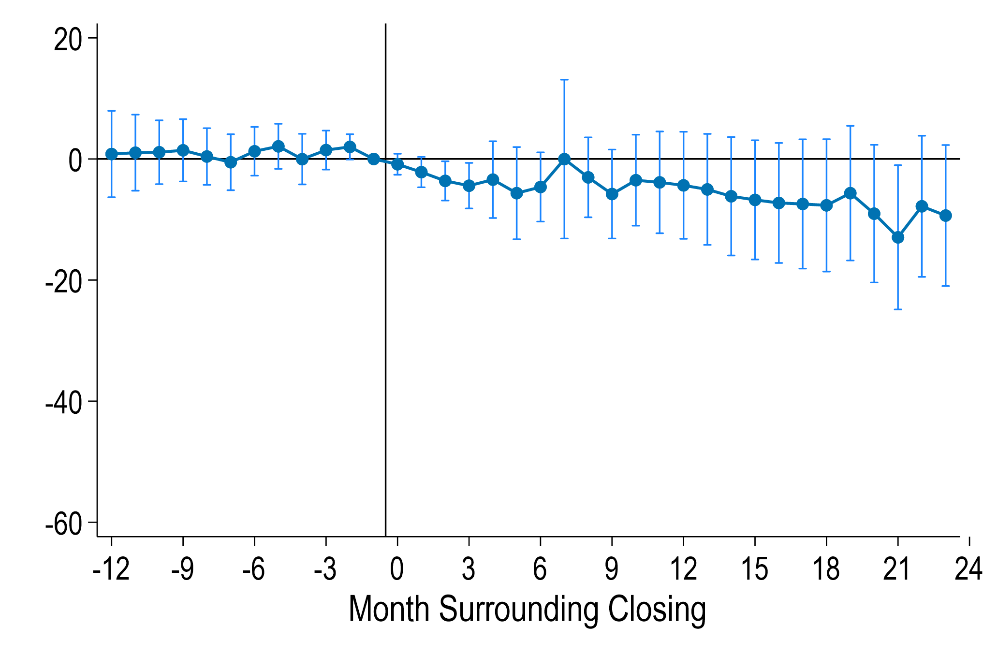
Effect on Active SNAP Cases – Rural Tracts
Openings—Distance
Closings—Distance
Openings—SNAP Cases
Closings—SNAP Cases
Much more muted response in rural areas since likely already driving
Baseline distance: 4.1 miles (openings); 1.5 miles (closings)
Data Source: Medicaid and TANF Administrative Data; Census Master Address File (MAFX); CBDRB-FY25-0333.

Slide 26
Robustness
Similar results with:
  Different models: TWFE, and allowing for multiple treatments (“dynamic DCDH” de Chaisemartin et al., 2024)
  Holding fixed residential address to handle endogenous moves

Slide 27
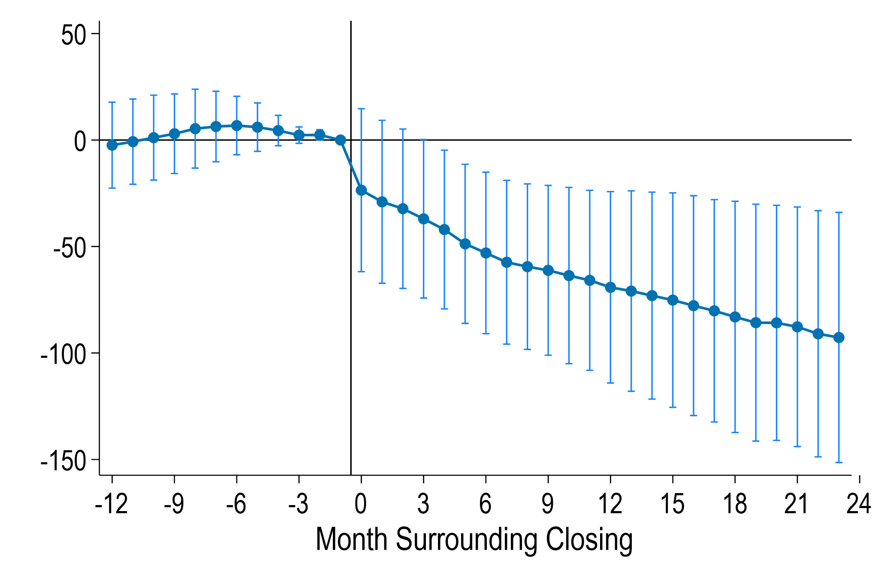
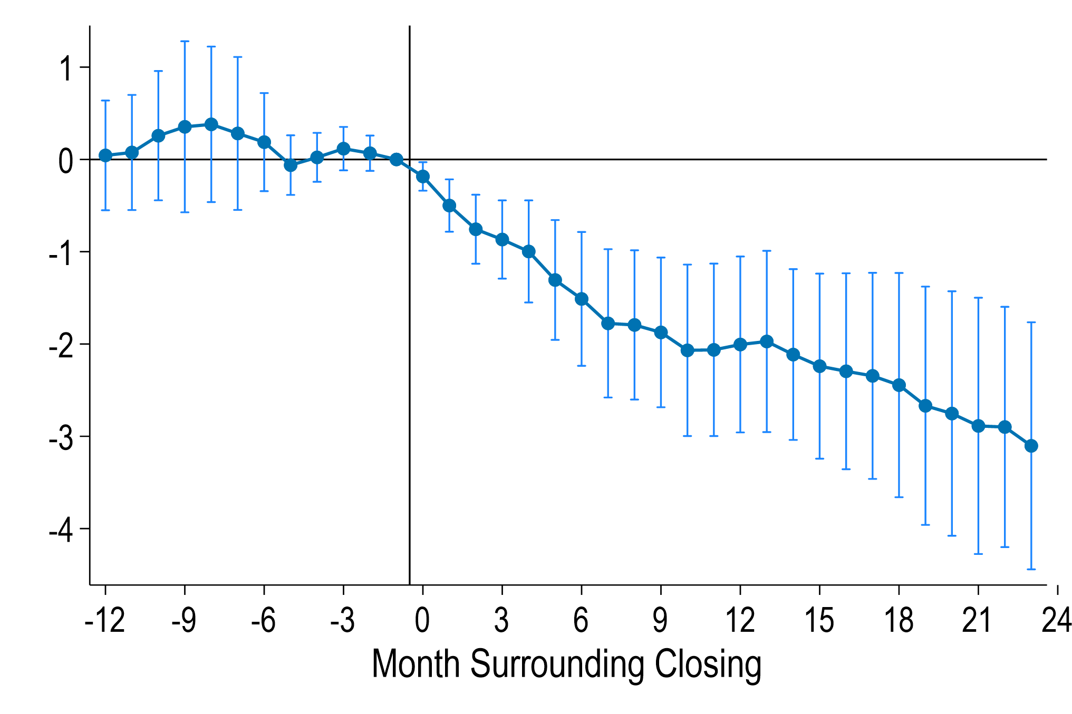

Number of SNAP Cases – Unhoused at $τ$-1; Static Tract
Urban Closings
Rural Closings
Preview of future work
Baseline cases: 110 (urban); 3.4 (rural)
Urban closings decrease cases by 80%
Rural Closings decrease cases by 85%
Unhoused population surprisingly sensitive to place-based policies
Data Source: SNAP Administrative Data; Census Master Address File (MAFX) ; CBDRB-FY25-0333.

Slide 28
Results
Key Takeaways:
  SNAP office openings/closings generates meaningful differences in access
  These differences in access substantially impact urban participation rates
  Particularly notable since applications can be submitted online
  Also impact TANF participation, but Medicaid less impacted
Welfare Implications:
  The unhoused likely have highly marginal utility of consumption, so office access may improve program targeting

Slide 29
The Intersection of Place and Need
How Lack of Enrollment Offices Deters Participation in the Safety Net
Marianne Bitler, UC Davis & NBER
Jason Cook, University of Utah
Chloe N. East, CU Boulder & NBER
Sonya R. Porter, US Census Bureau
Laura Tiehen, ERS USDA

Slide 30
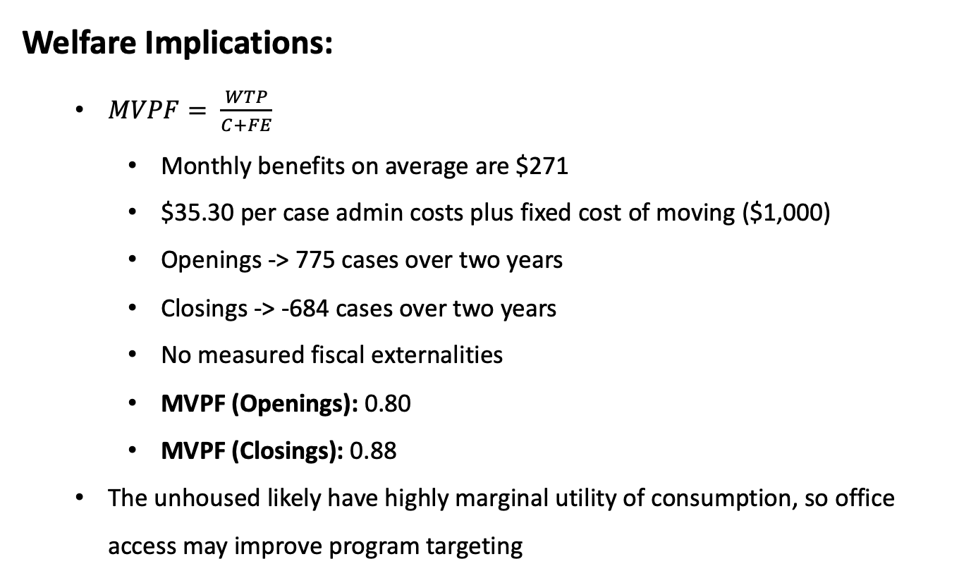
Results
Welfare Implications:
  $MVPF= \frac{WTP}{C+FE}$
    Monthly benefits on average are $271
    $35.30 per case admin costs plus fixed cost of moving ($1,000)
    Openings -> 775 cases over two years
    Closings -> -684 cases over two years
    No measured fiscal externalities
    MVPF (Openings): 0.80
    MVPF (Closings): 0.88
  The unhoused likely have highly marginal utility of consumption, so office access may improve program targeting

Slide 31
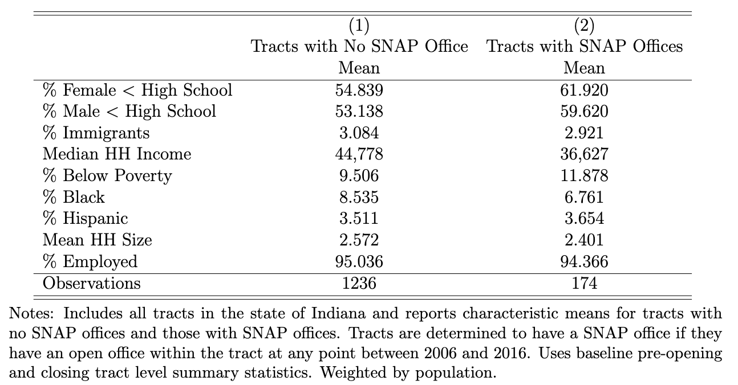
Where offices locate
Offices locate in tracts with lower education attainment and higher poverty
Back
Data Source: Public-use 2000 Decennial Census and Self-collected SNAP office information.
Notes:
-talk about outside of RDC analysis to say more about where office locate
-mention that we will discuss location of offices below

Slide 32
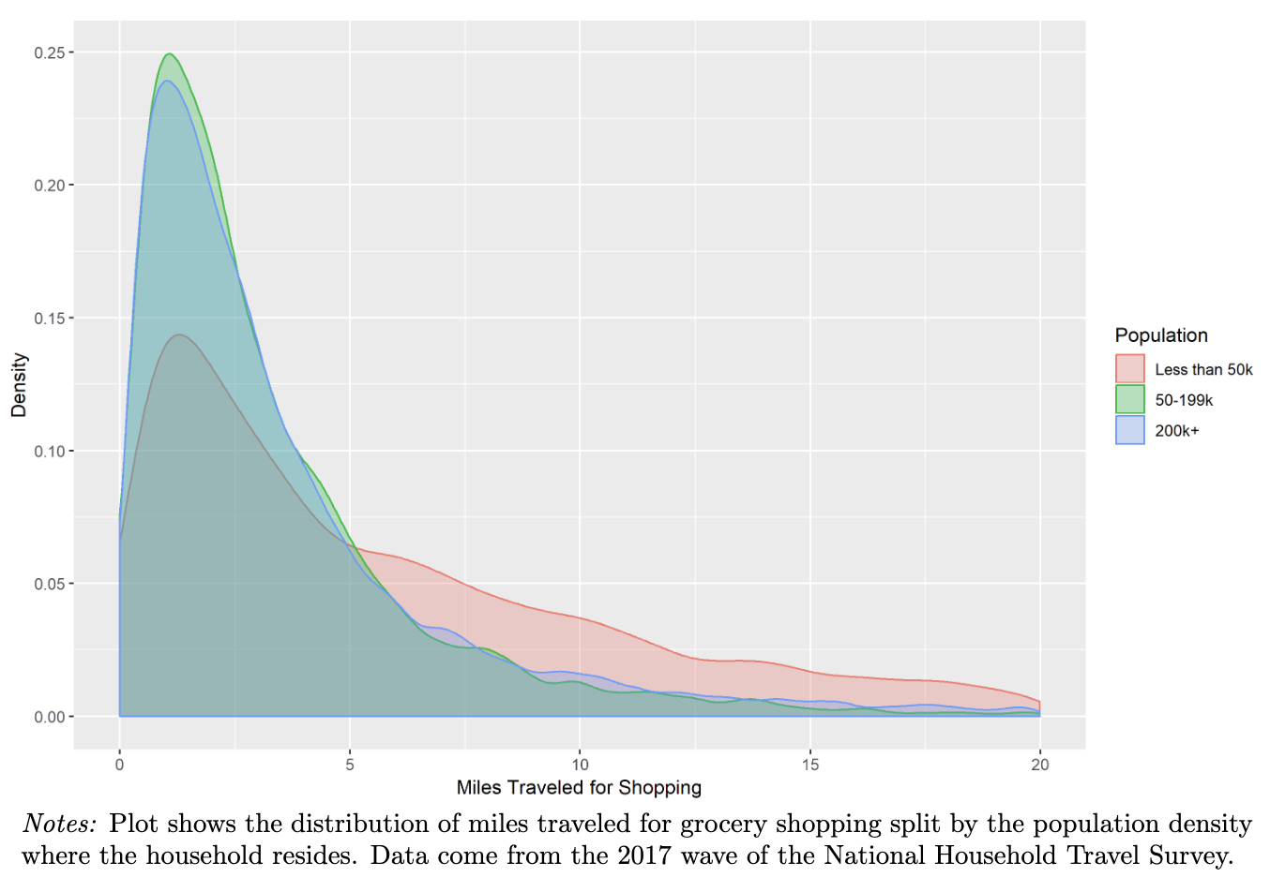
Travel Distance for Grocery Shopping
Back
Data Source: National Household Travel Survey, 2017, public use.

