Slide 1
Drivers of Mental Health Disparities in American Indian Youth: The Effect of Economic Conditions
Patrick Carlin
Emilia Simeonova
Randall Akee

Slide 2
Motivation
According to the Centers for Disease Control (CDC), 7.1 percent of all children (aged 2–17) have diagnosed anxiety, 3.2 percent have diagnosed depression, 9.4 percent have diagnosed Attention Deficit Hyperactivity Disorder (ADHD), and 7.4 percent of children have a diagnosed behavioral disorder.
Little is known about the prevalence in American Indian children; however, they do have some of the highest suicide rates and preventable death rates (Sarche and Spicer 2008; Alcántara and Gone 2007)
Family circumstance is increasingly linked to both the incidence of mental health and behavioral problems and the likelihood that children receive treatment for these issues.
American Indian children may be at the highest risk of mental health due to the dual pathways of family circumstances and on-going exposure to racism, deprivation and marginalization in schools and health care access.
This analysis expands on prior work that examined smaller, individual tribal level surveys.
We use data that covers the nation as a whole for American Indian Children

Slide 3
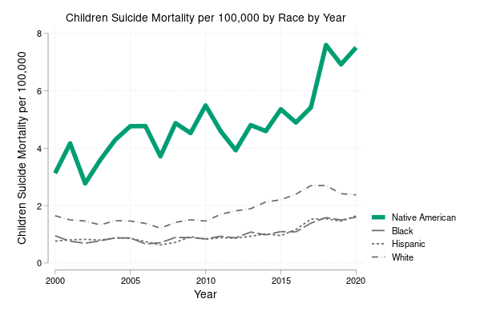
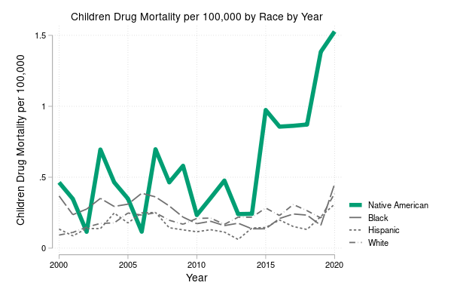
American Indian children have the highest suicide mortality rate And the highest OD mortality rate Neither appears to have peaked by 2020
American Indian children have the worst suicide and OD-related mortality
0-18 Suicide mortality per 100K | 0-18 OD related mortality per 100K

Slide 4
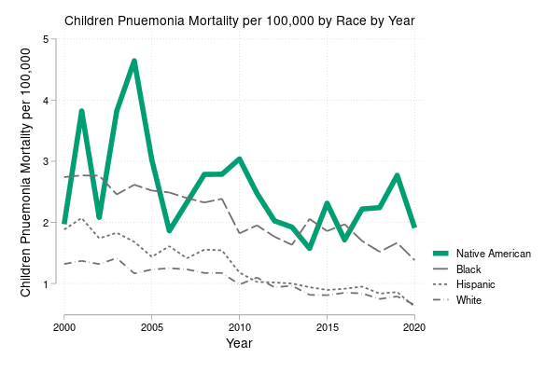
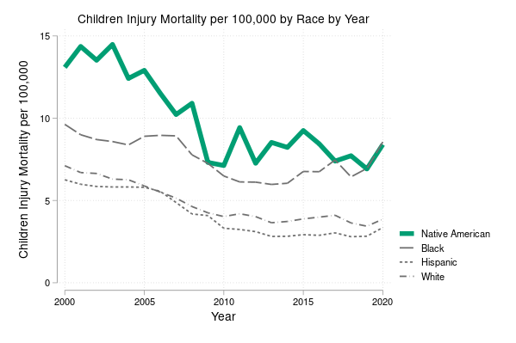
This phenomenon is mental-health specific
0-18 pneumonia mortality per 100K | 0-18 injury-related mortality per 100K

Slide 5
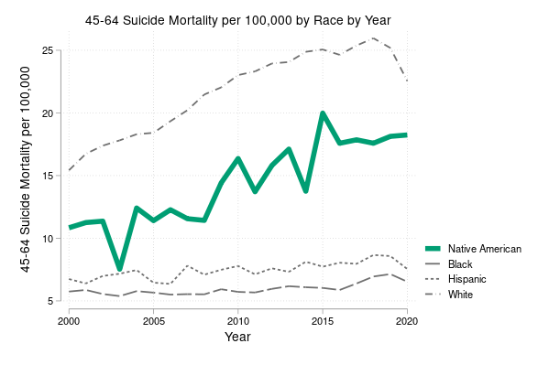
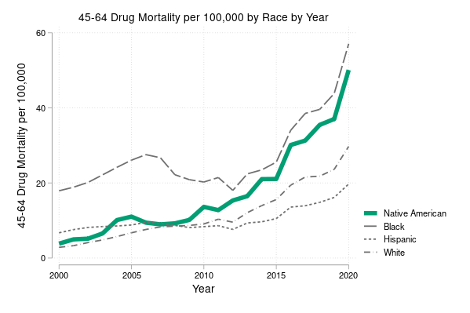
It is also child-specific
45-64 suicide mortality per 100K | 45-64 drug-related mortality per 100K

Slide 6
Prior literature
Relatively high mortality and suicide rates – *may* be attributable to untreated mental health issues
Prior research has also found relatively high rates of suicide, juvenile deaths and “deaths of despair” in American Indian and First Nations populations (Akee, et al 2024; Feir et al 2019; Alcántara and Gone 2007)
In a Minnesota study, 6% of the sample showed signs of severe emotional distress. Eleven percent of the teens surveyed knew someone who had killed himself or herself, and 17% had attempted suicide themselves (Blum et al, 1992)
There is a negative relationship between psychological distress in childhood and adolescence and economic well-being in adulthood (Currie and Stabile 2007; Fletcher 2014; Smith and Smith 2010)

Slide 7
Prior literature, cont.
Access to Medical Services is inadequate and uneven
Long Distances to receive treatment for on-reservation populations (Indian Health Service, 2019; Quintero et al, 2021)
American Indian children used fewer mental health services than their White counterparts (Costello et al, 2011).
Relationship between Income and Mental Health
Positive Income Shocks May Improve Adult Mental Health Outcomes ( Apouey and Clark 2015; Haushofer and Shapiro 2016, Wolfe et al )
Additional work has shown an improvement in child outcomes for American Indians (Akee et al 2022)
Evidence that Childhood Mental Health Issues may matter more than physical health for long-run outcomes(Currie, Manivong, and Roos 2010)
Akee et al. (2018, 2010) show that additional unearned household income improves educational attainment and personality traits by ages 19 and 16, respectively, all of which likely contribute substantially to long-term economic success.

Slide 8
Challenges
Changes in definitions of disorders and additions of new categories
DSM IV vs DSM V
Childhood disorders and diagnoses do not map into adult disorders and diagnoses
Following the mental health trajectory of a single individual over time and treatments is challenging
Population is hard to define, and impossible to study in publicly available data due to small samples (Akee and Simeonova, NAS report 2015)

Slide 9
What we do
https://docs.google.com/document/d/1evHa-zxc5kc4CYzQ6l9qKagXRIfLb6DvxH83XuIieEk/edit?usp=sharing
Pull all AIAN records and 20 percent of other records from the Medicaid inpatient and outpatient files starting in 1999 until 2021
Use geographic identifiers (zip) to locate residences on AI reservations
Merge in tribal information based on reservation location
Among nonelderly AIAN people, uninsured rates are higher among those who identify as AIAN alone (22%) and AIAN and Hispanic (20%) (KFF, 2023)
20% of AIAN (all) are in poverty, and 26% of AIAN alone are poor
30% of non-elderly AIAN have Medicaid coverage
44% of AIAN children are covered by Medicaid (9% are uninsured)

Slide 10
Economic opportunity and AIAN child mental health
Combine Medicaid data with reservation-specific data on tribal gaming (Akee, Simeonova and co-authors, various years)
Restrict initial analysis to California, which is home to about 15 percent of the nation’s AIAN population
Study the effects of the expansion of tribal gaming on child mental health utilization and outcomes as captured by Medicaid

Slide 11
Data Construction: AI/AN children in Medicaid
~47,000 inpatient visits per year (537 per year in CA)
~12.5m outpatient visits per year (~650,000 per year in CA)
~3,000 mental health inpatient visits per year (~65 per year in CA)
~1.4m mental health outpatient visits per year (47,000 per year in CA)
~400 substance abuse inpatient visits per year (~10 per year in CA)
~53,000 substance abuse outpatient visits per year (~1,700 per year in CA)

Slide 12
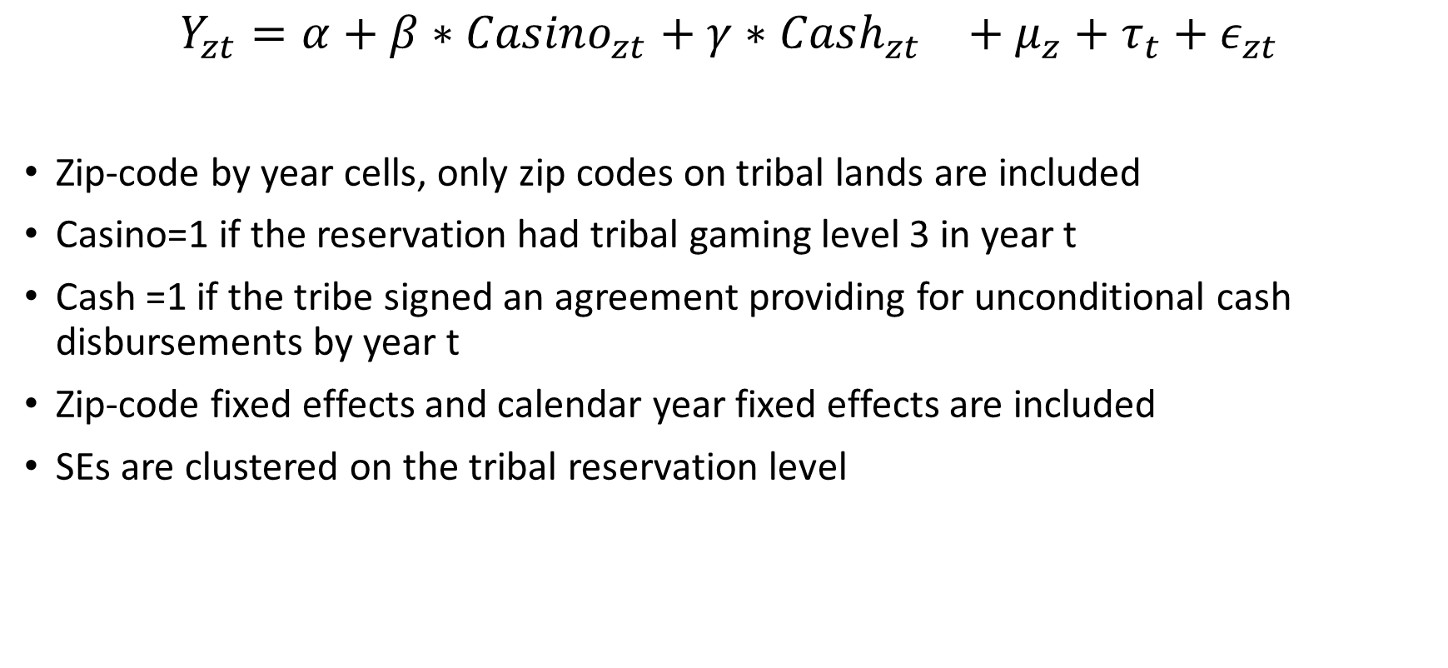
Basic estimation strategy
$$Y_{zt}=α+β∗{Casino}_{zt}+γ∗{Cash_{zt}}_{}+μ_{z}+τ_{t}+ε_{zt}$$
Zip-code by year cells, only zip codes on tribal lands are included
Casino=1 if the reservation had tribal gaming level 3 in year t
Cash =1 if the tribe signed an agreement providing for unconditional cash disbursements by year t
Zip-code fixed effects and calendar year fixed effects are included
SEs are clustered on the tribal reservation level

Slide 13
AIAN Medicaid users aged 0-18

Slide 14
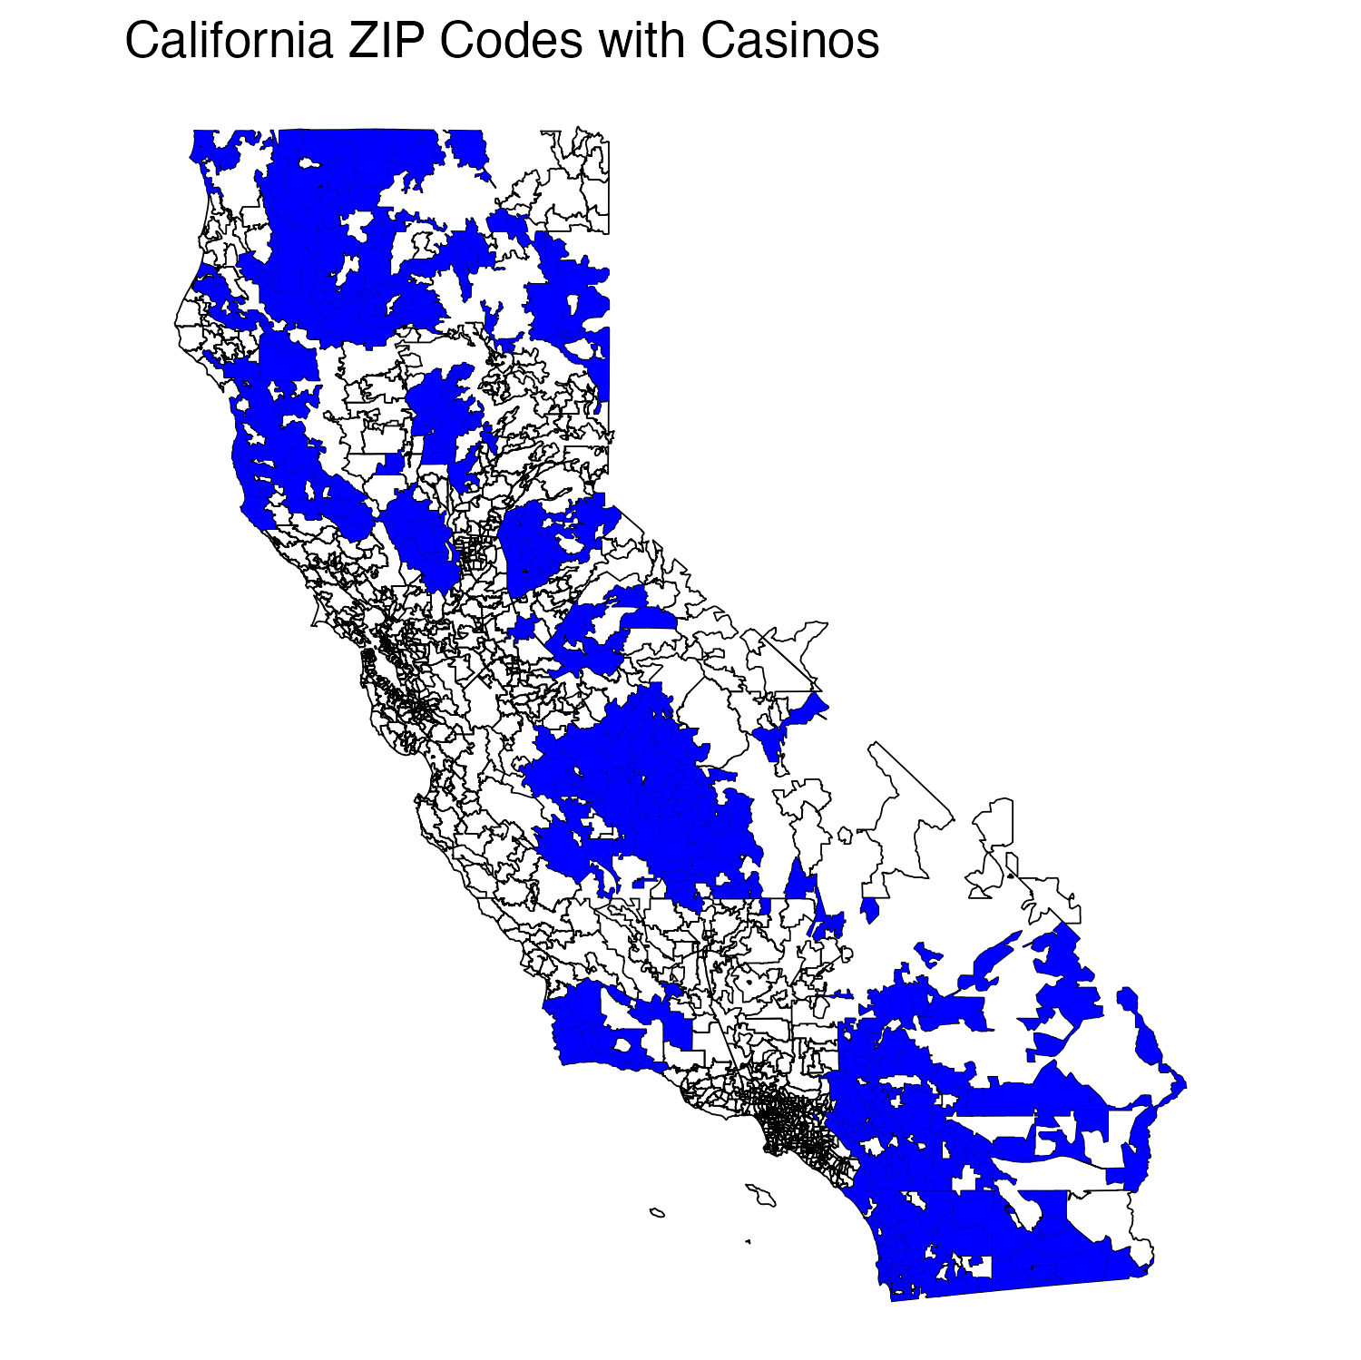
Tribal casinos in California

Slide 15
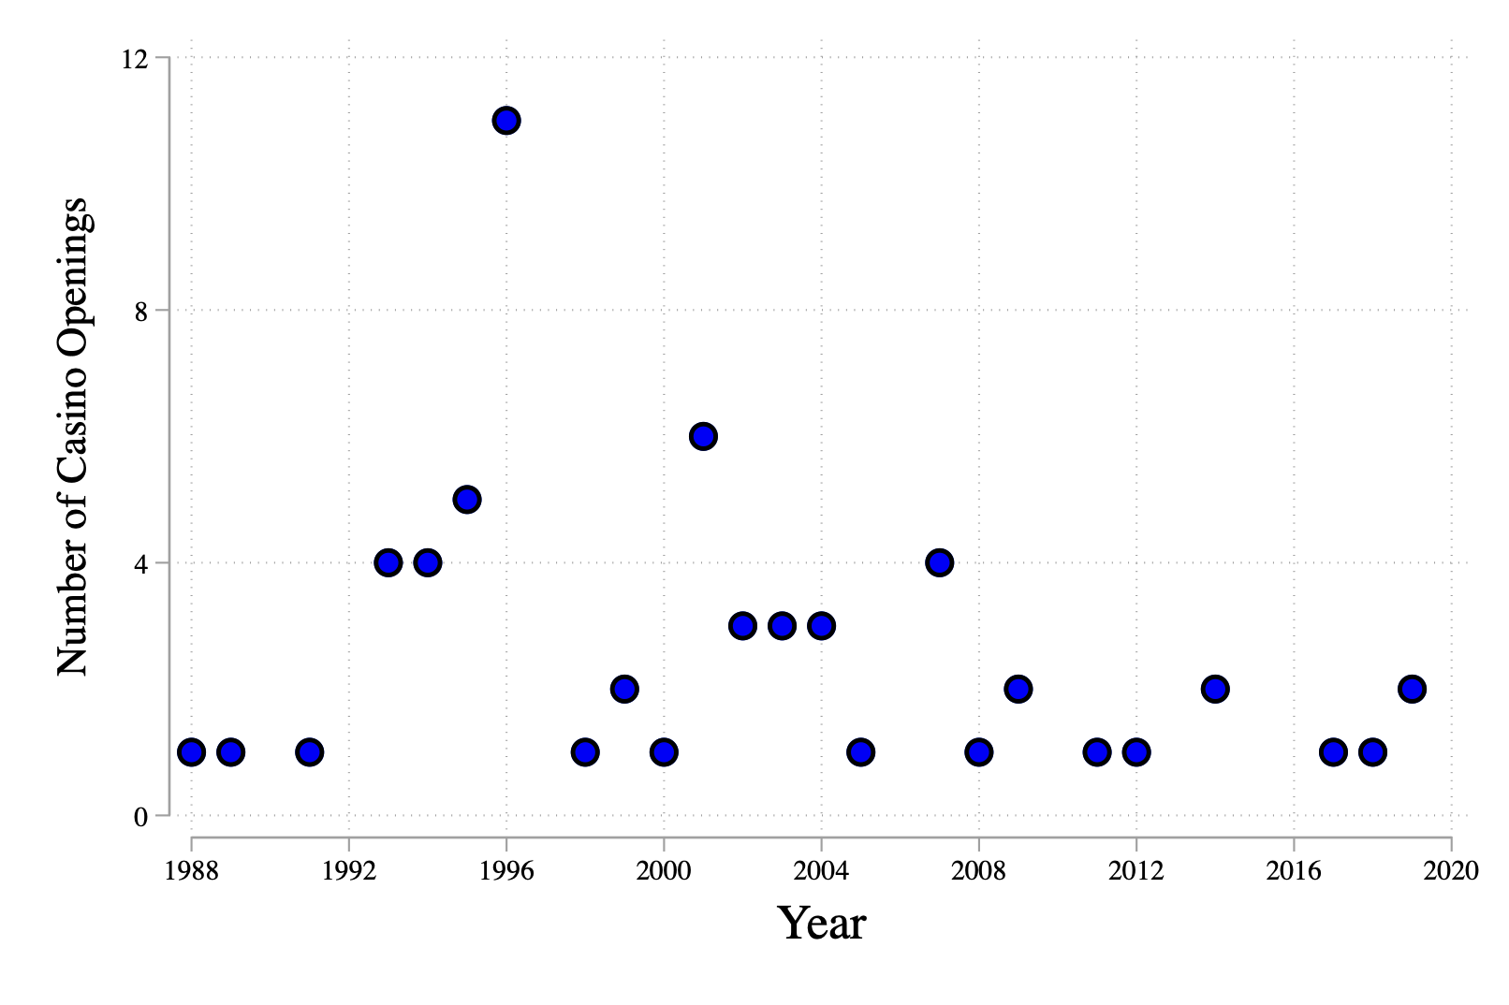
Casino openings by year

Slide 16
Means of main outcomes by tribal gaming status
 | 0-6 year olds |  | 7-12 year olds |  | 13-18 year olds
 | No Casino | Ever Casino | No Casino | Ever Casino | No Casino | Ever Casino
N Medicaid ID | 21.48 | 14.46 | 14.88 | 11.76 | 14.24 | 10.58
 | 38.86 | 17.25 | 27.88 | 13.34 | 24.23 | 12.05
N visits | 57.61 | 43.46 | 57.40 | 48.28 | 60.42 | 50.47
 | 87.09 | 49.08 | 73.09 | 53.53 | 101.27 | 64.77
MH visits | 1.68 | 1.00 | 7.09 | 4.04 | 10.77 | 7.31
 | 8.12 | 7.73 | 24.81 | 16.73 | 61.46 | 28.53
SA visits | 0 | 0.01 | 0 | 0.00 | 0.57 | 0.72
 | 0 | 0.18 | 0 | 0.03 | 4.72 | 5.17
Utilization | 5.38 | 5.35 | 6.58 | 6.88 | 7.20 | 8.56
 | 12.27 | 8.21 | 6.92 | 12.85 | 12.73 | 21.59
MH Utilization | 0.08 | 0.14 | 0.64 | 0.79 | 1.25 | 1.38
 | 0.31 | 1.61 | 2.06 | 6.98 | 9.44 | 8.97
SA utilization | 0 | 0.00 | 0 | 0 | 0.03 | 0.17
 | 0 | 0.03 | 0 | 0 | 0.23 | 1.91
zip5 by year cells | 261 | 1,205 | 245 | 1081 | 235 | 1030

Slide 17
Tribal Gaming and AIAN Medicaid Utilization in CA
 | Number of IDs in outpatient files
 | 0-6 year olds |  | 7-12 year olds |  | 13-18 year olds
Variable | coefficient |  | coefficient |  | coefficient
Casino | -4.43 | -4.27 | -2.00 | -0.86 | 0.35 | 1.31
 | 1.24 | 1.05 | 1.99 | 1.51 | 2.23 | 1.87
Transfer |  | -0.38 |  | -2.96 |  | -2.39
 |  | 0.98 |  | 1.35 |  | 1.55
Zip5 Fes | Y | Y | Y | Y | Y | Y
N obs | 25,507 | 25507 | 24803 | 24803 | 24714 | 24714
Adj R2 | 0.945 | 0.945 | 0.946 | 0.946 | 0.945 | 0.946
 | Utilization - Visits per person
 | 0-6 year olds |  | 7-12 year olds |  | 13-18 year olds
Variable | coefficient |  | coefficient |  | coefficient
Casino | 0.87 | 0.96 | 1.25 | 1.10 | -1.68 | -2.34
 | 0.57 | 0.68 | 0.92 | 1.04 | 1.70 | 1.86
Transfer |  | -0.23 |  | 0.38 |  | 1.63
 |  | 0.57 |  | 0.60 |  | 1.23
Zip5 Fes | Y | Y | Y | Y | Y | Y
N obs | 25507 | 25507 | 24803 | 24803 | 24714 | 24714
Adj R2 | 0.343 | 0.343 | 0.355 | 0.355 | 0.329 | 0.329
Standard errors under the coefficient, clustered on the reservation level

Slide 18
Tribal Gaming and AIAN Medicaid Utilization in CA
 | N Mental health visits
 | 0-6 year olds |  | 7-12 year olds |  | 13-18 year olds
Variable | coefficient |  | coefficient |  | coefficient
Casino | -1.15 | -0.71 | 0.64 | 1.85 | 2.34 | 1.34
 | 0.57 | 0.55 | 1.18 | 1.01 | 1.31 | 1.61
Transfer |  | -1.07 |  | -3.04 |  | 2.43
 |  | 0.40 |  | 1.28 |  | 1.65
Zip5 Fes | Y | Y | Y | Y | Y | Y
N obs | 25507 | 25507 | 24803 | 24803 | 24714 | 24714
Adj R2 | 0.031 | 0.031 | 0.021 | 0.021 | 0.0388 | 0.039
 | Mental health utilization
 | 0-6 year olds |  | 7-12 year olds |  | 13-18 year olds
Variable | coefficient |  | coefficient |  | coefficient
Casino | -0.12 | 0.02 | 0.82 | 0.91 | 0.28 | 0.00
 | 0.11 | 0.12 | 0.38 | 0.45 | 0.61 | 0.49
Transfer |  | -0.36 |  | -0.24 |  | 0.69
 |  | 0.19 |  | 0.30 |  | 0.62
Zip5 Fes | Y | Y | Y | Y | Y | Y
N obs | 25507 | 25507 | 24803 | 24803 | 24714 | 24714
Adj R2 | 0.101 | 0.101 | 0.227 | 0.227 | 0.237 | 0.237
Standard errors under the coefficient, clustered on the reservation level

Slide 19
Conclusions
The drivers of child mental health are poorly understood
Family circumstance, and in particular financial wellbeing, is a potentially contributing factor
AIAN children have the worst suicide and OD mortality
Little is known about AIAN mental health utilization; existing evidence suggests barriers to utilization arising from poverty
Using Medicaid data from CA, we show that local economic engines –tribal gaming operations, reduce Medicaid utilization, MH visits, and MH utilization per person for young children
No corresponding effects were found for the non-AIAN children residing on CA reservations
Currently expanding the analysis to the national level

Slide 20
Thank you!
esimeon1@jhu.edu

Slide 21
Appendix

Slide 22
Data Construction: Counts of Visits
Examined inpatient and outpatient separately
ICD-10 Codes:
F01-F48 for adult mental health
F90-F98 for childhood onset of mental health issues
F10-F19 for substance abuse
ICD-9 Codes:
290-316 for adult mental health
312-316 for childhood mental health
305 and 292 for substance abuse

