Slide 1
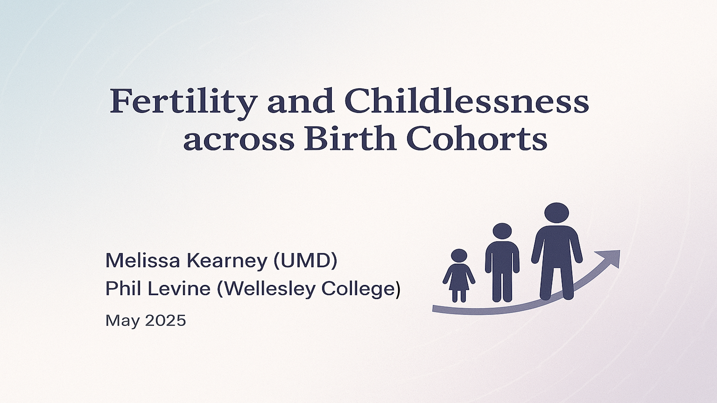

Slide 2
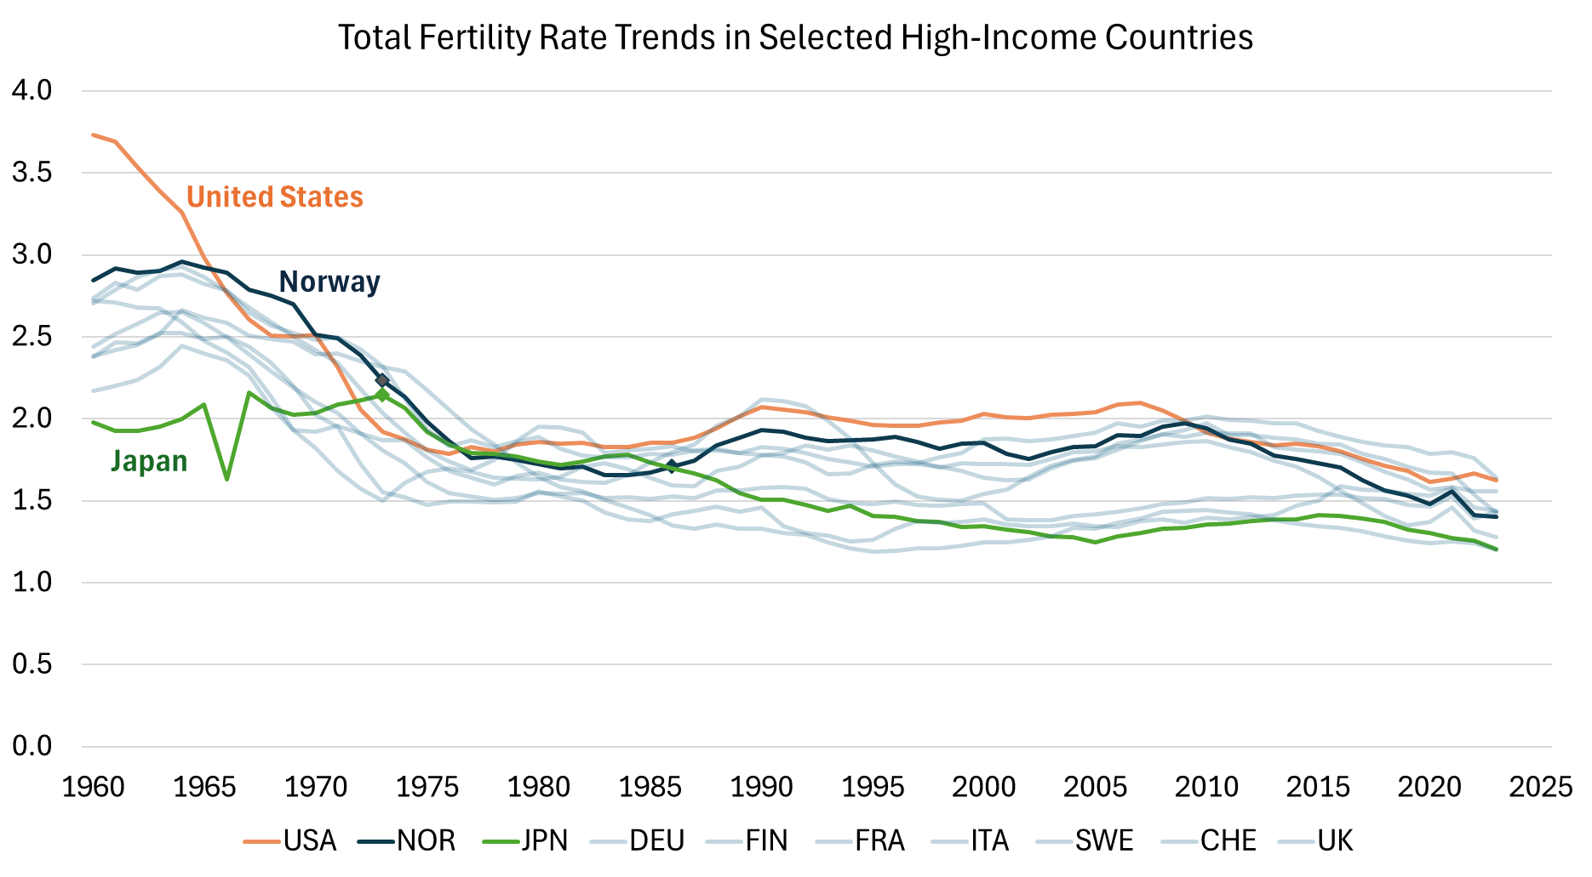
TFR Trends in Selected High-Income Countries

Slide 3
Past Efforts Examining Declining Fertility
Economists:
Focus: causal factors contributing to the changes in birth rates
Hard to find period-specific factors that “work”
Conclusion from our earlier JEP paper: “to understand the factors behind falling annual birth rates, we should be looking for circumstances related to cohorts, as opposed to contemporaneous years.”
Demographers:
Focus: often to forecast longer-term population change
Work by Norm Ryder, John Bongaarts, others going back decades
Major improvements in data availability to examine cohort patterns (Human Fertility Database)
Tempo versus quantum effects

Slide 4
This Paper
Use these concepts/data to assess cohort trends in US, where decline started later
Focus on Norway and Japan: different patterns and data availability
Emphasis on childlessness and births by parity
Draw inferences about potential causes of falling birth rate

Slide 5
Children Ever Born
by Women’s Age
and Birth Cohort

Slide 6
Childlessness
by Women’s Age
and Birth Cohort

Slide 7
First Birth
Empirical Hazard Rates
by Age across Cohorts

Slide 8
Second Birth
Empirical Hazard Rates
by Age across Cohorts

Slide 9
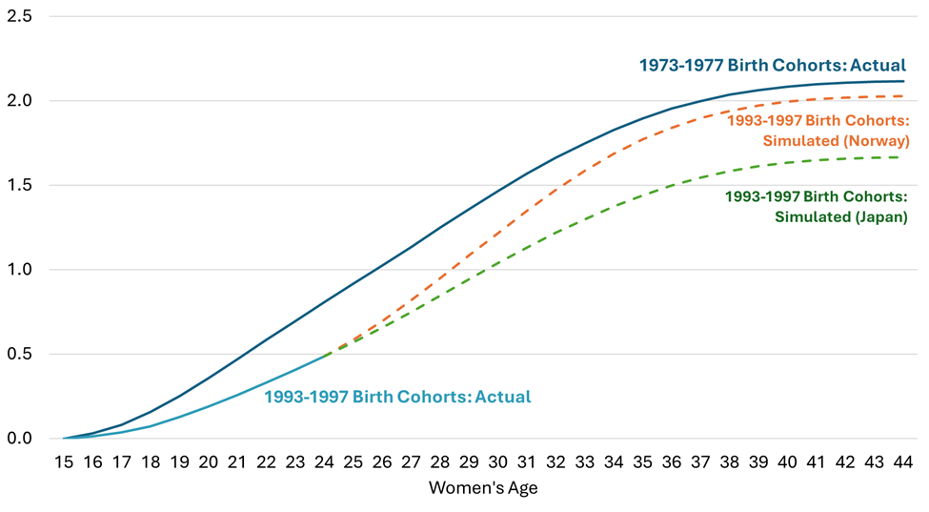
Figure 7: US Actual and Simulated Completed Fertility with Alternative “Catch-Up Rates”

Slide 10
How Long Can Delay Extend?
Norway Today

