Slide 1
GEOGRAPHIC RESOLUTION IN ENVIRONMENTAL POLICY: EPA’S SHIFT FROM REGIONS TO COUNTIES UNDER THE CAA Maureen Cropper University of Maryland and RFF Mengjia Hu University of Maryland Nick Muller Carnegie Mellon University Yongjoon Park University of Massachusetts, Amherst

Slide 2
Motivation and Questions Addressed
Prior to 1978, EPA designated nonattainment with the NAAQS by Air Quality Control Region (AQCR), contiguous counties in an airshed
All counties in the same AQCR-state pair received the same designation
Starting in 1978, nonattainment status was designated by county
Why did EPA move from AQCR to county in designating nonattainment?
What were the consequences of this shift for the causal impact of nonattainment (NA) status on:
Ambient TSP
Employment in manufacturing industries that were big emitters of TSP, CO, SO2, or ozone precursors?

Slide 3
Our Approach
We estimate DiD models to examine the impact of NA status on ambient TSP using balanced panels of monitors:
Over the 1969-76 period, using 1972 NA status
Over the 1975-88 period, using 1978 NA status
We examine the impact of NA with TSP, CO, ozone and SO2 on dirty manufacturing employment using County Business Pattern data to estimate border-pair and DiD models
Over the 1969-76 period, using 1972 NA status
Over the 1975-88 period, using 1978 NA status
Notes:
Note that there were 309 counties with a balanced panel of monitors for the 1969-76 period and 402 counties for the 1975-88 period

Slide 4
Preview of Results
EPA’s NA status did not have a statistically significant causal impact on ambient TSP or dirty manufacturing employment until NA was designated by county
TSP NA in 1978-88 period reduced ambient TSP by 6-7 ug/m3 more in NA than attainment counties
In DiD models of ratio of dirty mfg/total employment
NA with TSP only or NA with TSP + another pollutant significantly reduced dirty manufacturing jobs in NA v. attainment counties by an average of 525,000 jobs between 1978-88
Notes:
State verbally that there is no statistically significant impact of 1972 NA in DiD models when parallel trends are satisfied.

Slide 5
Interpretation of Results
AQCR NA status grouped counties that didn’t violate the NAAQS with highly polluting counties
This explains lack of significance of AQCR NA status in DiD models
In contrast, using Greenstone’s definition of 1972 NA does have a significant impact on TSP, reducing it by 5-6 ug/m3
In reality, enforcement efforts were concentrated on dirty counties
Imposing the stringent regulations of the 1977 CAAA on AQCR regions would have stifled economic growth
Notes:
“in attainment with the NAAQS” means that the NAAQS were not violated
Note that the 1977 CAAA required use of LAER by major sources in NA counties and required new firms entering NA counties to buy emissions offsets from existing firms.

Slide 6
Organization of Talk
Definition of Nonattainment Status Under the CAA
Impact of Attainment Status on TSP, 1969-76, 1975-88
Impact of Attainment Status on Manufacturing Employment, 1969-76, 1975-88
Impact of Nonattainment Status for Individual Pollutants (TSP, CO, Ozone, SO2)
Impact of Nonattainment for Groups of Pollutants
Conclusions

Slide 7
1972 NA Status by AQCR v. Traditional Literature
EPA assigned NA status for each of the criteria pollutants by AQCR in 1972
247 AQCRs – map on next page shows NA status for TSP in 1972 by AQCR
All counties within an AQCR-state pair receive the same status: 2,069 counties out of attainment for TSP in 1972; 1,044 in attainment
Approach followed in the literature was to define attainment status for each county based on monitoring readings for the county
Michael Greenstone identified 288 counties as NA for TSP in 1972
Counties with TSP monitors in 1970 (565), 1971 (765) and 1972 (1059)
In 1978, EPA assigned NA status by county (also used in the literature)
433 counties in TSP NA in 1978
Notes:
Note that defining county NA status by monitor reading limits the number of counties that can be categorized
Counties with TSP monitors in 1970 (565), 1971 (765) and 1972 (1059)

Slide 8
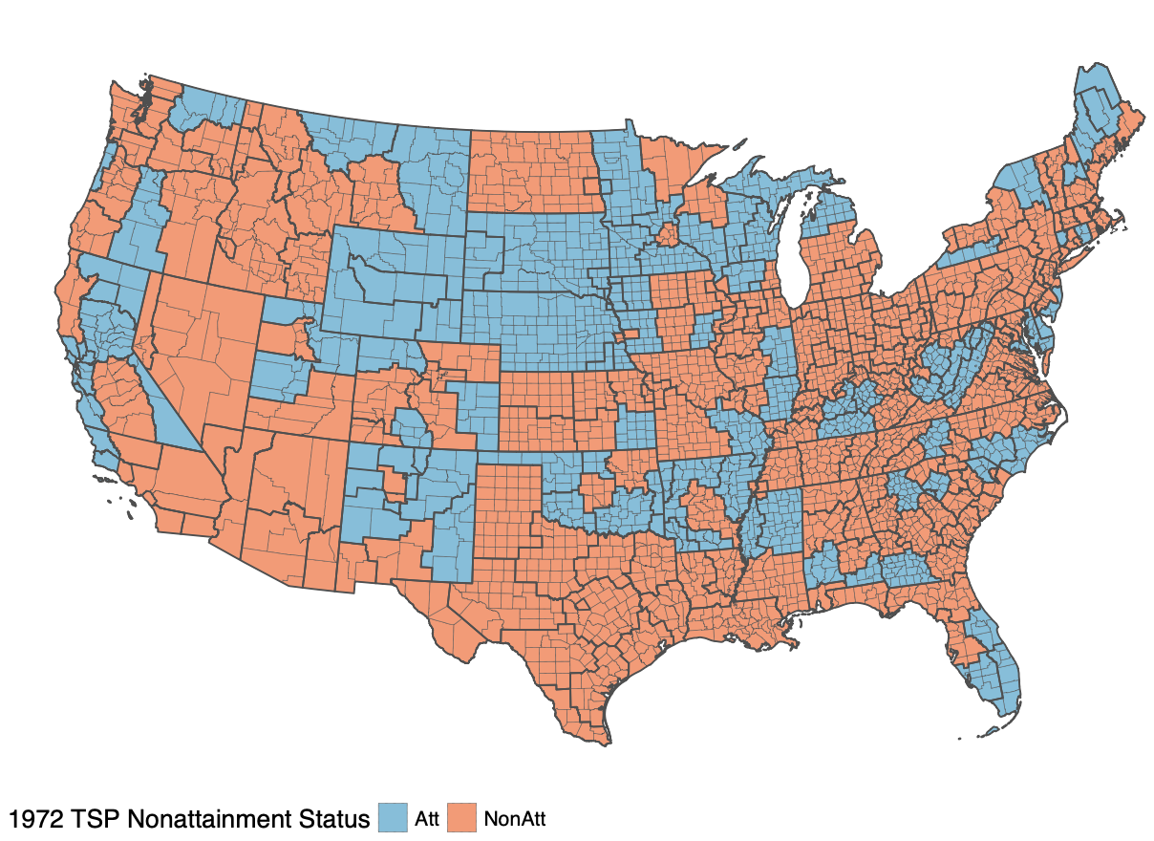
Nonattainment Status for TSP in 1972

Slide 9
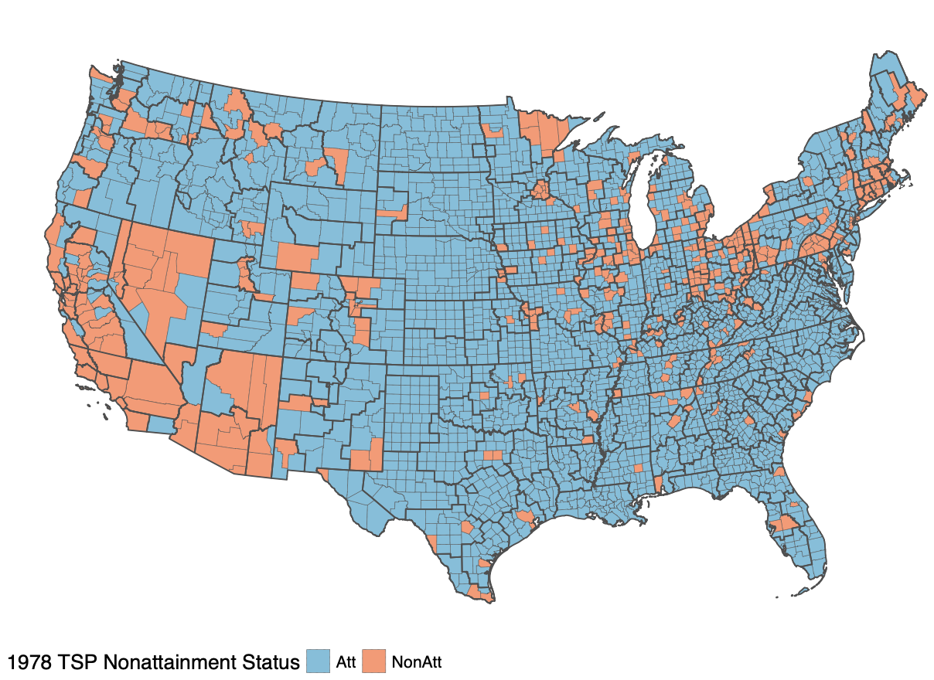
Nonattainment Status for TSP in 1978

Slide 10
Impact of Attainment Status on TSP, 1969-76 and 1975-88

Slide 11
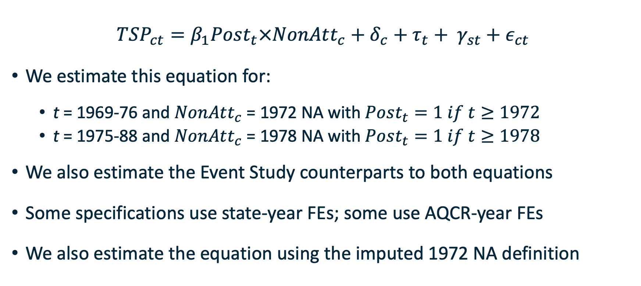
Effects of NA Status on TSP at the County Level
$$TSP_{ct}=β_{1}Post_{t}×NonAtt_{c}+δ_{c}+τ_{t}+ γ_{st}+ε_{ct}$$
We estimate this equation for:
t = 1969-76 and $NonAtt_{c}$ = 1972 NA with $Post_{t}=1 if t≥1972$
t = 1975-88 and $NonAtt_{c}$ = 1978 NA with $Post_{t}=1 if t≥1978$
We also estimate the Event Study counterparts to both equations
Some specifications use state-year FEs; some use AQCR-year FEs
We also estimate the equation using the imputed 1972 NA definition
Notes:
The first term measures the impact of being out of attainment with TSP after attainment status was declared.

Slide 12
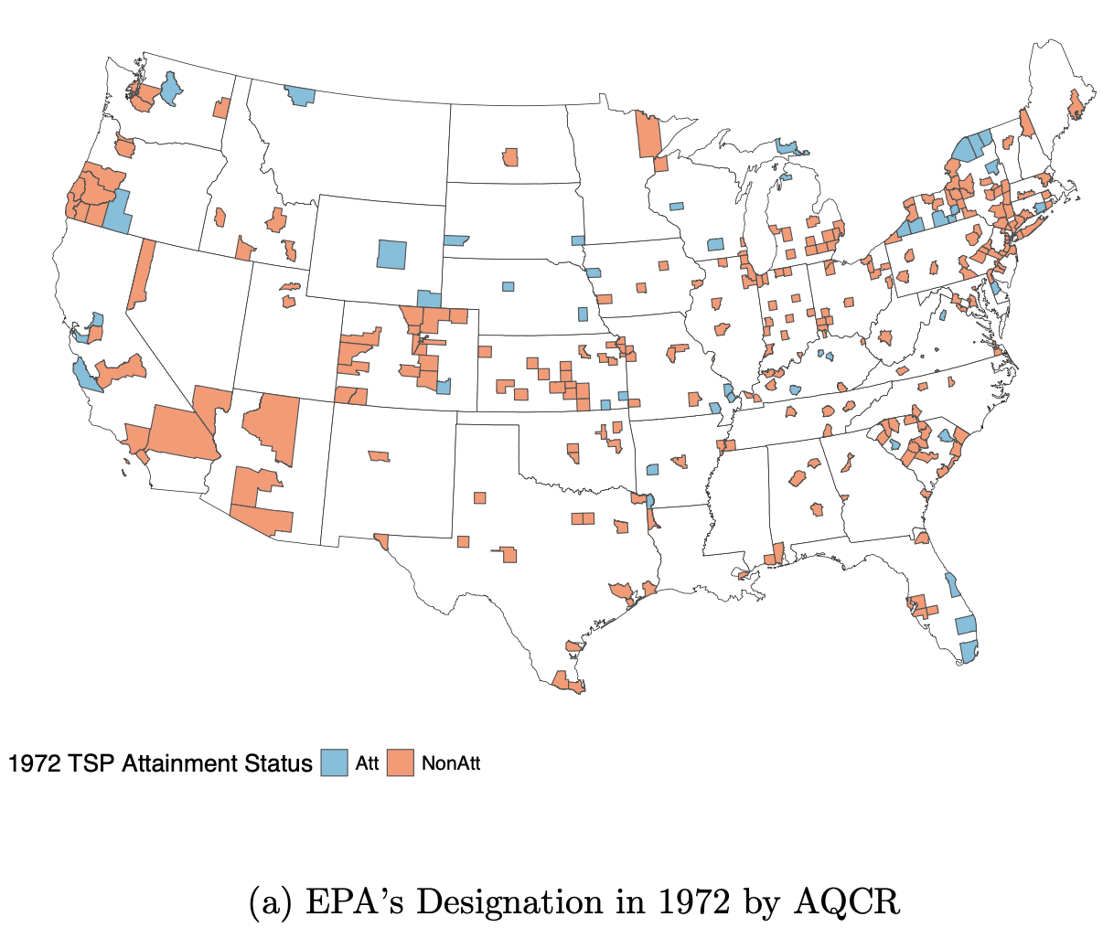
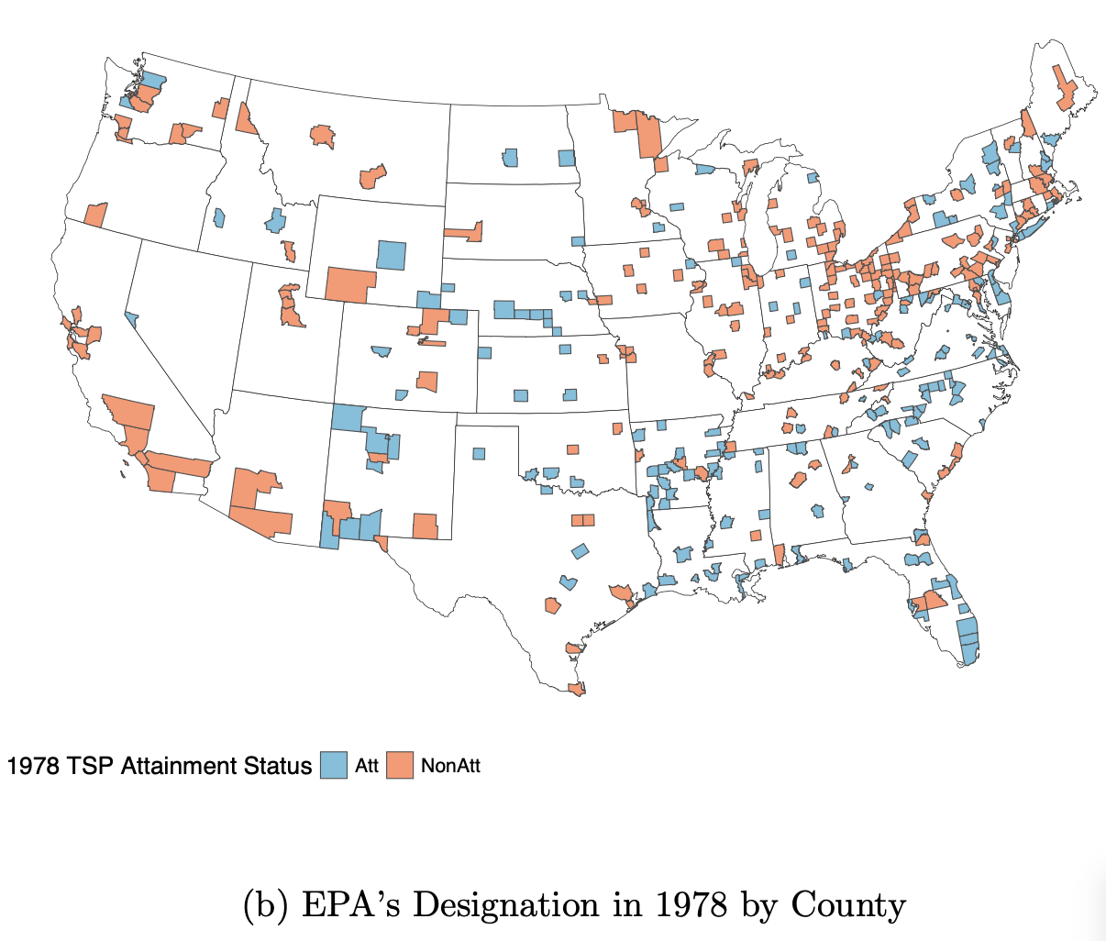
Balanced Monitor Counties 1969-76, 1975-88

Slide 13
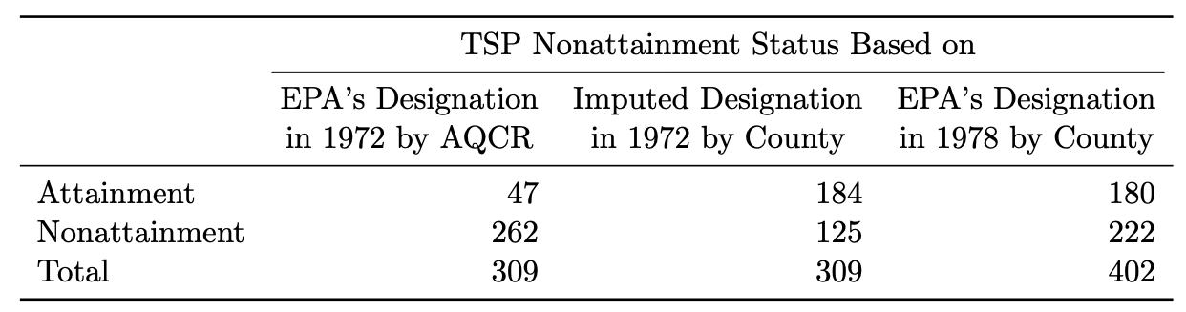
Number of Counties with Balanced Monitors by TSP Attainment Status

Slide 14
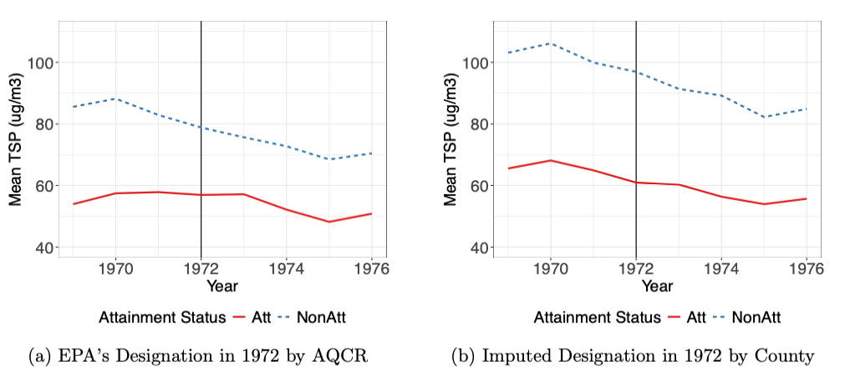
Average TSP Levels by Attainment Status, 1969-76

Slide 15
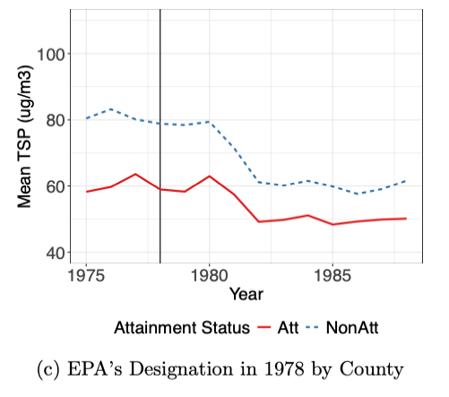
Average TSP Levels by Attainment Status, 1975-88

Slide 16
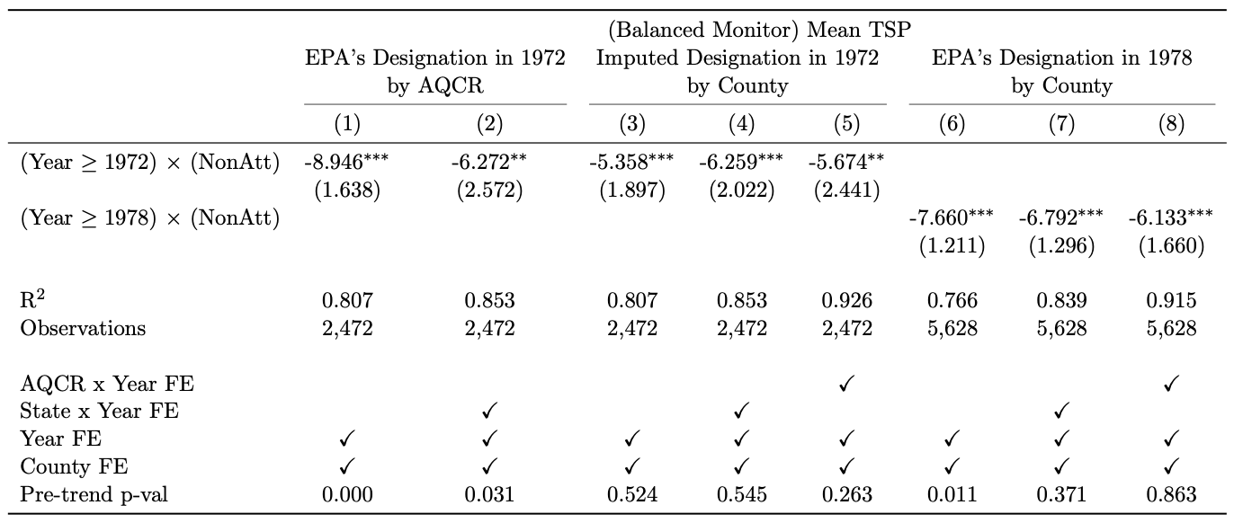
Impact of Nonattainment on Ambient TSP
Notes:
The pre-trend p value is the probability of making an error if you reject the null hypothesis of parallel trends.
Emphasize period over which reduction applies:
TSP falls by 5-6 ug/m3 over the 1972-76 period in counties designated NA by Greenstone in 1972
It falls in counties designated NA by EPA in 1978 6-7 ug/m3 over the 1978-88 period.

Slide 17
Event Studies for 1972 TSP NA

Slide 18
Impact of Attainment Status on Manufacturing Employment

Slide 19
Greenstone: Employment Effects of the CAA
Greenstone (2002) uses plant-level data from the Annual Survey of Manufactures (1967-87) to estimate the impact of NA status on manufacturing employment, 1972-87
NA status imputed in 1972, measured officially in 1978, 1982
Analysis relates percent change in employment over each 5-year period to county NA (by pollutant) and whether plant is a high emitter of the pollutant
Impact of NA status on employment estimated for TSP, CO, O3, SO2
Impact on all dirty manufacturing employment = 590,000 jobs lost
Notes:
What Michael did was to look at the percentage change in employment for each 5 year period, comparing firms in a high-emitting industry (e.g., a high TSP emitting industry) in counties out of attainment for TSP with firms in the same industry in counties in attainment for TSP.

Slide 20
Our Approach to Employment Effects of the CAA
Employment by county and industry comes from Eckert et al.’s County Business Pattern Data (Eckert et al., 2020, 2022)
Regress fraction of employment in dirty manufacturing in county c and year t on whether county is out of attainment for TSP, CO, O3, SO2
Do this for 1969-76 and NA1972; for 1975-88 and NA1978
A dirty manufacturing industry is one that is a high emitter of (any of) TSP, CO, ozone precursors or SO2 using Greenstone (2002) definitions
Estimate models to examine impact of NA for TSP, CO, Ozone, SO2 individually and also in combination.
Notes:
When we talk about a NAICS code indicating a high emitting industry for a particular pollutant, we use Michael Greenstone’s definition of high emitting.
Controls are counties in attainment for all pollutants.

Slide 21
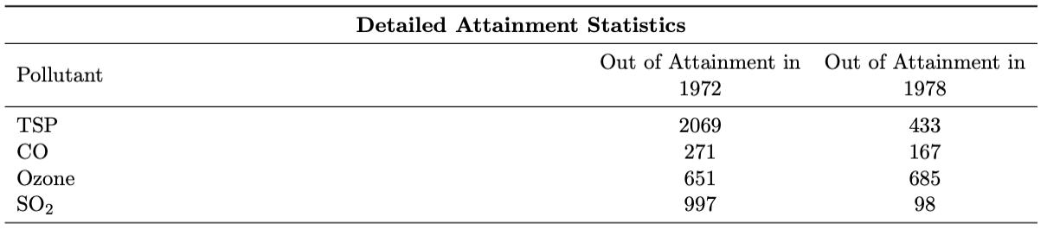
Counties Out of Attainment in 1972 and 1978

Slide 22
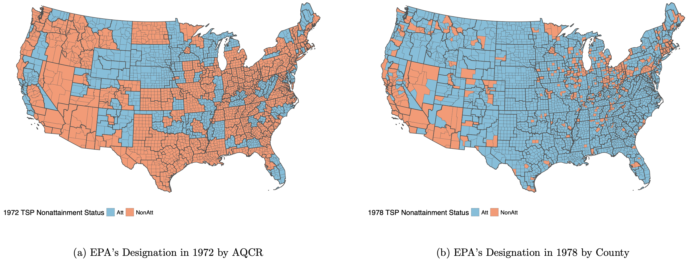
NA Counties for TSP in 1972 and 1978

Slide 23
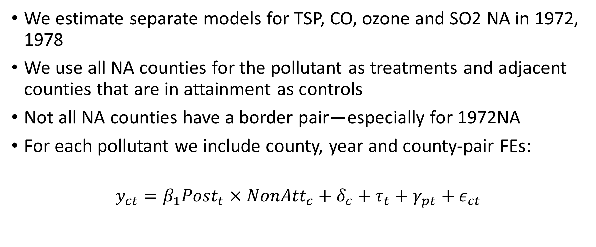
Estimating DiD Models Using Border Pairs
We estimate separate models for TSP, CO, ozone and SO2 NA in 1972, 1978
We use all NA counties for the pollutant as treatments and adjacent counties that are in attainment as controls
Not all NA counties have a border pair—especially for 1972NA
For each pollutant we include county, year and county-pair FEs:
$$y_{ct}=β_{1}Post_{t}×NonAtt_{c}+δ_{c}+τ_{t}+γ_{pt}+ε_{ct}$$

Slide 24
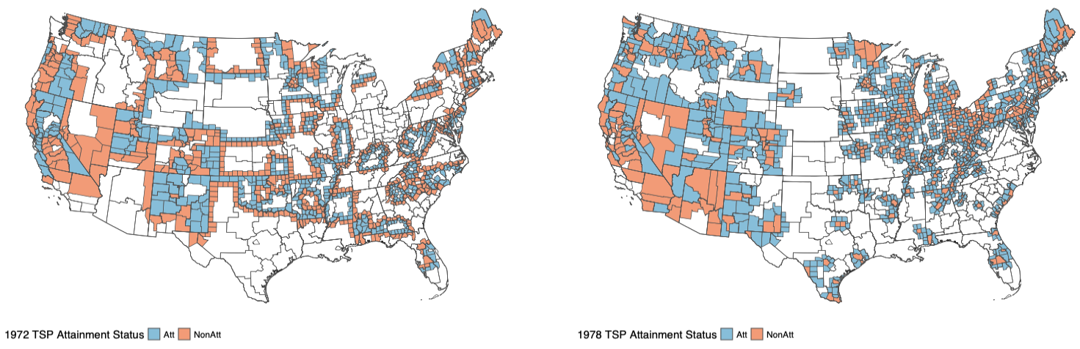
NA Status for TSP in Border-Pair Analysis

Slide 25
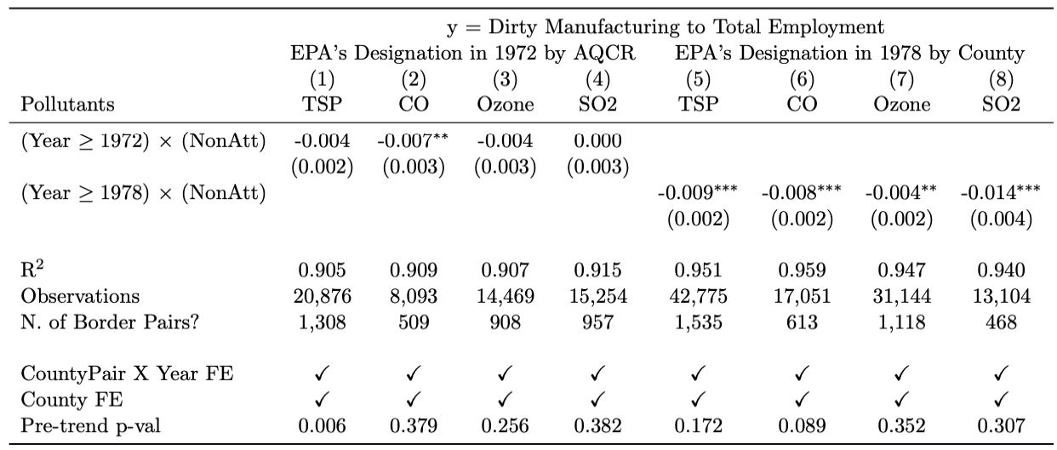
Border-Pair Analysis Results

Slide 26
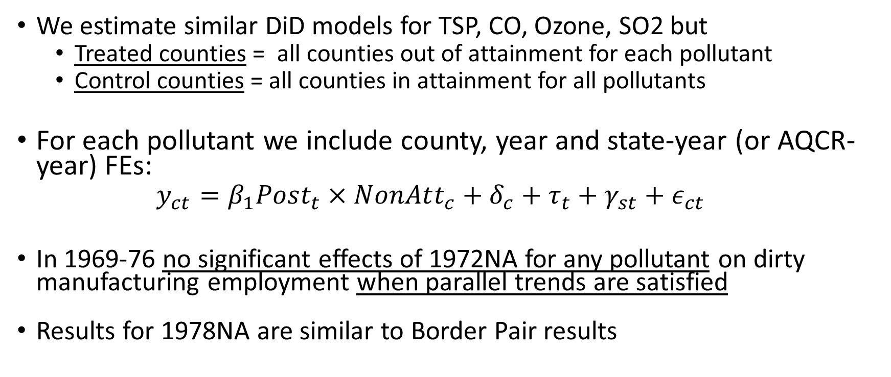
Estimating DiD Models
We estimate similar DiD models for TSP, CO, Ozone, SO2 but
Treated counties = all counties out of attainment for each pollutant
Control counties = all counties in attainment for all pollutants
For each pollutant we include county, year and state-year (or AQCR-year) FEs:
$$y_{ct}=β_{1}Post_{t}×NonAtt_{c}+δ_{c}+τ_{t}+γ_{st}+ε_{ct}$$
In 1969-76 no significant effects of 1972NA for any pollutant on dirty manufacturing employment when parallel trends are satisfied
Results for 1978NA are similar to Border Pair results

Slide 27
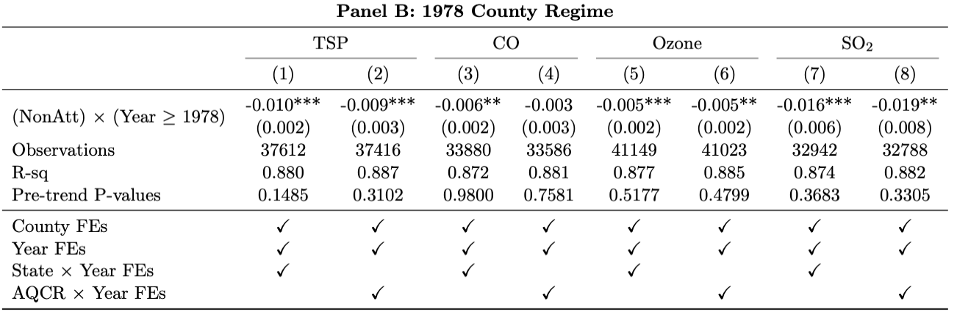
DiD Results (1978 NA)

Slide 28
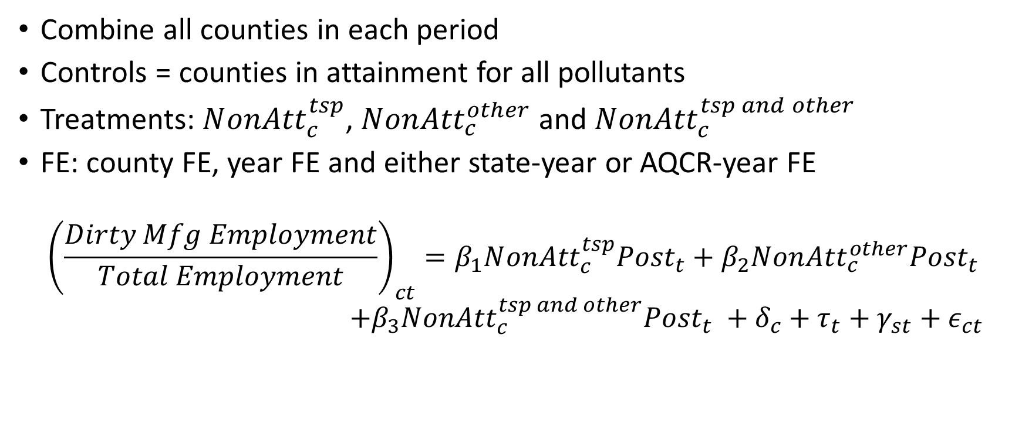
Multi-Pollutant DiD Models
Combine all counties in each period
Controls = counties in attainment for all pollutants
Treatments: $N{onAtt}_{c}^{tsp}$, $Non{Att}_{c}^{other}$ and $Non{Att}_{c}^{tsp and other}$
FE: county FE, year FE and either state-year or AQCR-year FE
$${\left(\frac{Dirty Mfg Employment}{Total Employment}\right)}_{ct}=β_{1}N{onAtt}_{c}^{tsp}Post_{t}+β_{2}Non{Att}_{c}^{other}Post_{t} \\ +β_{3}Non{Att}_{c}^{tsp and other}Post_{t} +δ_{c}+τ_{t}+γ_{st}+ε_{ct}$$

Slide 29
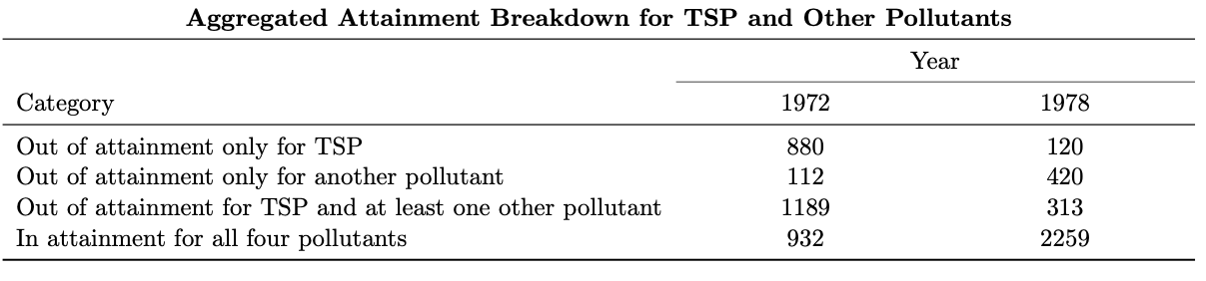
Counties Out of Attainment by Pollutant

Slide 30
Dirty Manufacturing Employment, 1969-1976

Slide 31
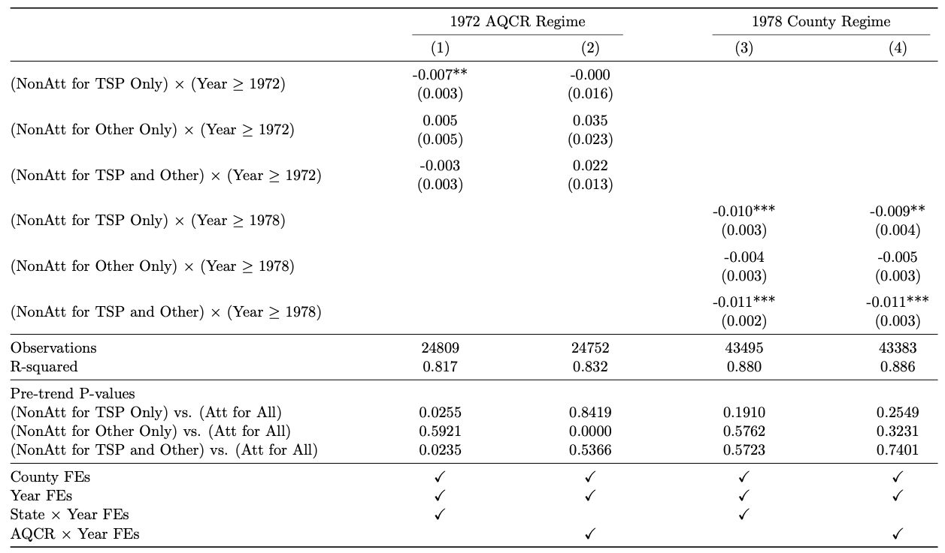
Impact of 1972 NA Status on Emp, 1969-76
Notes:
For 1972 NA there are no cases where NA has a significant impact on employment and parallel trends hold.

Slide 32
Dirty Manufacturing Employment, 1975-1988

Slide 33
Impact of 1978 NA Status on Emp, 1975-88
Notes:
In the case of 1978 NA status, which was assigned by county, parallel trends hold for all treatments and the impacts of NA on manufacturing employment are significant in counties out of attainment for TSP, or TSP and something else.

Slide 34
Implications for Manufacturing Employment
Model (3) implies a loss of 526,646 (328,908, 722,530) dirty manufacturing jobs over the 1978-88 period.
Model (4) implies a loss of 524,479 (280,863, 814,719) dirty manufacturing jobs over the 1978-88 period
525,000 dirty manufacturing jobs is about 10% of total dirty manufacturing jobs over the period or 3.25% of all manufacturing jobs.
Greenstone (2002) finds a loss of 592,000 manufacturing jobs, 1972-87
We find similar results using a different dataset, but: No impacts prior to 1978 and TSP NA driving the results rather than CO NA

Slide 35
Significance of Our Results
We are the first to examine the impact of EPA’s official NA status on ambient TSP and manufacturing employment for 1972-88
Results for 1972 AQCR NA suggest no causal impact on TSP or dirty manufacturing employment; however, 1978 NA does have significant impacts
Results hint at superiority of county-level NA designations, which EPA moved to with 1977 CAAA
1977 CAAA also responsible for our results: major sources required to buy offsets when entering or expanding in NA areas, use LAER emission controls
Notes:
Note verbally the role that the 1977 CAAA played in our results.

