Slide 1
“Bid Shopping” in Procurement Auctions with Subcontracting
Ray Deneckere
University of Wisconsin
Dan Quint
University of Wisconsin
October 18, 2024
NBER Market Design Working Group

Slide 2
Context: procurement auctions with subcontracting
Lots of procurement (government and other) uses auctions
U.S.: federal, state, and local governments spend ~$300 Bn/year on construction, most of it by competitive bid
Winning contractors often subcontract some of the work
Electrical, plumbing, and other specialty work
On large construction projects, could be dozens of subcontractors, collectively performing more than half the total work
Contractors solicit subcontracting agreements before bidding
Want to know their costs, to bid correctly on project

Slide 3
An interesting legal asymmetry in the U.S.
Pre-auction subcontractor bids are typically binding on subcontractors, but not on winning general contractor
Drennan v. Star Paving (1958) – winning contractor reasonably relied on subcontractor’s offer when bidding in the auction, can enforce it
But winning contractor can’t accept subcontractor’s offer unless and until they’re awarded the project, aren’t bound by it
This leads to a range of behaviors by winning contractors
Bid shopping – soliciting new subcontractor bids after winning, often by showing existing subcontractor’s bid to competitors
Bid chopping/bid chiseling – using this threat to induce price cut
Bid peddling – losing subcontractors trying to undercut competitors after auction

Slide 4
Unclear how prevalent these are – but contractors see them as significant
75% of electrical contractors surveyed avoid sub-bidding on Federal construction jobs; of those, “93% gave the prevalence of bid shopping as their reason”
1955 U.S. Senate report
2005 survey of U.S./Canadian construction contractors
32% said “they have bid shopped or peddled themselves”
80% knew of others who have
“All participants indicated that bid shopping in the electrical and mechanical service trades occurred in at least 30% of all tenders…”
2009 survey of subcontractors in Auckland NZ
Notes:
1955 U.S. Senate report
Bid shopping “prevalent” in Federal projects involving “mechanical specialty” subcontractors (electrical, plumbing, sheet metal…)
75% of electrical contractors surveyed avoid sub-bidding on Federal construction jobs; “93% gave the prevalence of bid shopping as their reason”
2005 survey of top U.S. contractors and owner firms (“buyers”)
“How often do general contractors shop bids to select their subcontractors after the contract is awarded?” (0 = never, 1 = sometimes, 2 = often, 3 = always)
Subcontractors 1.42, owners 1.36, general contractors 0.18
2008 survey of U.S. and Canadian construction contractors
32% said “they have bid shopped or peddled themselves”
80% said they “know of others who have engaged in bid shopping or peddling”
2009 survey of subcontractors in Auckland: "all participants indicated that bid shopping in the electrical and mechanical services trades occurred in at least 30% of all tenders for which quotations were submitted.“
(Arditi and Chotibhonds 2005)
(Gregory and Travers 2010)
(Thurnell and Lee 2009)

Slide 5
Professional organizations condemn these practices in strong terms
“Bid shopping or bid peddling are abhorrent business practices that threaten the integrity of the competitive bidding system…”
(Joint guidelines issued by the Association of General Contractors of America, American Subcontractors Association, and Associated Specialty Contractors)
“This practice is unethical, unfair and is in direct violation of this Code of Ethics”
(Code of Ethics, American Society of Professional Estimators)
“All contractors… should avoid any activity that could be construed as bid shopping or bid peddling.”
(Canadian Construction Association)
Notes:
“Bid shopping or bid peddling are abhorrent business practices that threaten the integrity of the competitive bidding system…”
(Joint guidelines issued by the Association of General Contractors of America, American Subcontractors Association, and Associated Specialty Contractors)
“This practice is unethical, unfair and is in direct violation of this Code of Ethics”
(Code of Ethics of American Society of Professional Estimators)
“All contractors (Prime Contractors and Subcontractors)… should avoid any activity that could be construed as bid shopping or bid peddling.”
(Canadian Construction Association)
“The bid amount of one competitor should not be divulged to another before the award of the subcontract or order, nor should it be used by the contractor to secure a lower proposal from another bidder on that project”
“It is unethical to disclose to others… any information that is provided…”

Slide 6
Various attempts to prevent bid shopping
Unilateral contract terms – have not been enforced
Bid depositories
Organized by trade associations
Vanished in U.S. after deemed antitrust violations in 1950s
Legislation
Federal bans have been introduced in U.S. Congress, never enacted
About half of U.S. states effectively ban bid shopping on state contracts…
…typically through “bid listing” requirement (other methods in a few states)
Canada: if subcontractor is named in prime contractor’s bid, subcontracting agreement is binding on both…
…and CCA guidelines encourage contractors to do so
Notes:
Bid depositories are central facilities that receive subcontractor bids, distribute them to prime contractors – voluntary, but rules prohibit participating contractors from accepting outside sub-bids or shopping the bids after winning. Starting in the 1950s, these restrictions were deemed antitrust violations, and bid depositories have basically vanished in the US.
Federal legislation first proposed in 1932, proposed many times since but never passed. Small Business Administration rules do encourage PC to make a “good faith effort” to use small business subcontractors it used in preparing its bid, though.
State laws began in 1925 – by 1993, 18 states had bid listing requirement; recent count is 22.

Slide 7
To our knowledge, nobody’s studied the “equilibrium effects” of bid shopping
U.S. Senate report (1955):
“Present bidding procedures cause the subcontractor submitting a bid “to bid so high that he, the subcontractor, can still come down and get the job.” As long as subcontractors will not submit their final price prior to the award of the prime contract because of bid shopping after the award, the Government cannot get the full benefit of the low competitive price.”
But if prime contractors anticipate post-auction cost reductions, won’t that be incorporated into bids?
If everyone adapts behavior to bid shopping, what is net effect?
Let’s take a stab at figuring it out!
Notes:
“Under present bidding procedures the price the Government gets is not only too high because of the thinness of competition but because it does not reflect the final price of the mechanical specialty work… Present bidding procedures cause the subcontractor submitting a bid “To bid so high that he, the subcontractor, can still come down and get the job.”
Other “pernicious effects” mentioned elsewhere:
“promoting lower-quality work; incentivizing corner-cutting; increase claims and change orders; delaying project completion; and generally worsening the business environment.”

Slide 8
What do we do?
Construct and analyze a model of post-award bid shopping
Focus on cost heterogeneity among subcontractors (so there could be efficiency gain from getting another quote)
Assume there are bid preparation costs for subcontractors, and bid shopping may allow late bidder to avoid them
Compare equilibrium with bid shopping to equilibrium when bid shopping is illegal/impossible
Focus on effect of bid shopping on total surplus

Slide 9
What do we find?
Shopping bids to “insiders” (subs who already submitted losing bids)
Can only decrease total surplus
Shopping bids to “outsiders” (subs who haven’t bid yet)
Can only increase total surplus if they otherwise wouldn’t have bid
Can increase or decrease total surplus if they otherwise would have bid
If subs’ bid preparation costs are sufficiently high, no subcontractor will choose to wait, so bid shopping can only increase total surplus
If subs’ bid preparation costs are sufficiently low and bid shopping doesn’t attract new bidders, can only decrease total surplus
Distributional effects are complex; other caveats

Slide 10
Introduction Related Literature Model/Results Benchmark Model (No Bid Shopping) Bid Shopping to “Insiders” Bid Shopping to “Outsiders” Discussion/Conclusion

Slide 11
Literature: lots on procurement, some on subcontracting, nothing on bid shopping
Modeling competition among subcontractors
Wambach (2009), Nakabayashi (2011)
Watanabe and Nakabayashi (2011)
Effect of allowing or banning subcontracting
Gale, Hausch and Stegeman (2000), Marion (2015)
Jeziorski and Krasnokutskaya (2016)
Other aspects of subcontracting in procurement
Branzoli and Decarolis (2015), Moretti and Valbonesi (2012)
Marechal and Morand (2003), Balat, Komarova and Krasnokutskaya (2017)
Procurement auctions (but not about subcontracting)
Incompleteness of procurement contracts, post-award revision: Bajari and Tadelis (2001), Bajari, Houghton and Tadelis (2011), Bajari, McMillan and Tadelis (2008), Tadelis (2012), De Silva et al. (2016), Miller (2014), Gil and Marion (2011)
Other topics in procurement auctions: Lewis and Bajari (2011), Porter and Zona (1993), Krasnokutskaya and Seim (2011), Bolotnyy and Vasserman (2019), Li and Zheng (2009), Krasnokutskaya (2011), Balat (2017), Somaini (2020)
Nothing on bid shopping that we’ve found
Notes:
Gale Hausch Stegeman – two firms, increasing marginal costs, can sub to each other – subcontracting is efficient ex post, but also leads to more aggressive bidding and can hurt ex ante.
Marion also does horizontal – empirically, little effect.
Jeziorski Krasno – sequential auctions, subcontracting helps firms manage capacity constraints – 12% reduction in costs

Slide 12
Introduction Related Literature Model/Results Benchmark Model (No Bid Shopping) Bid Shopping to “Insiders” Bid Shopping to “Outsiders” Discussion/Conclusion

Slide 13
Introduction Related Literature Model/Results Benchmark Model (No Bid Shopping) Bid Shopping to “Insiders” Bid Shopping to “Outsiders” Discussion/Conclusion

Slide 14
Benchmark model without bid shopping
Procurer (buyer)
One project, completion is valued at v
Holds second-price auction, reserve price r
Prime contractors (general contractors, she)
Participate in procurement auction, must subcontract one part of project
Identical costs for non-subcontracted portion of project (normalized to 0)
Each has her own network of subcontractors, solicits “sub-bids” before auction
Pre-auction Subcontractors (specialists, he)
Independent private costs y_{i} ~ F to complete subcontracted portion of project
Identical costs c > 0 to prepare a bid
Already know y_{i} when deciding whether to bid
Procurer
Prime Contractor
Prime Contractor
Prime Contractor
Sub con trac tor
Sub con trac tor
Sub con trac tor
Sub con trac tor
Sub con trac tor
Sub con trac tor
Sub con trac tor
Sub con trac tor
Sub con trac tor
Timing
Subcontractors learn costs, decide whether to bid, submit sub-bids to prime contractors
Prime contractors who received a bid submit bids in prime auction
Winner is chosen, gets paid second-highest prime contractor bid (or reserve price), pays subcontractor his sub-bid, they complete the project, and the game ends
Notes:
(We assume subcontractors know their cost yi when they decide whether to incur the bid prep cost c and submit a bid to the prime contractor)

Slide 15
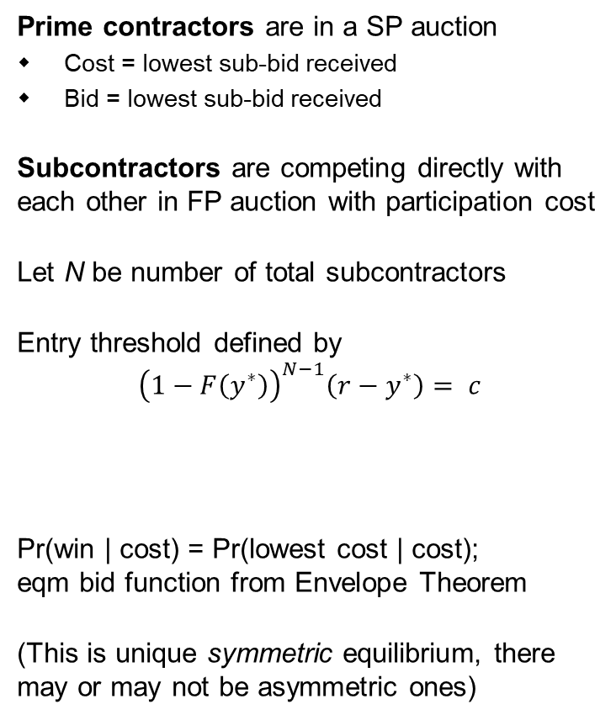
Benchmark model has unique symmetric equilibrium
Prime contractors are in a SP auction
Cost = lowest sub-bid received
Bid = lowest sub-bid received
Subcontractors are competing directly with each other in FP auction with participation cost
Let N be number of total subcontractors
Entry threshold defined by
$${\left(1−F\left(y^{∗}\right)\right)}^{N−1}\left(r−y^{∗}\right)= c$$
Pr(win | cost) = Pr(lowest cost | cost); eqm bid function from Envelope Theorem
(This is unique symmetric equilibrium, there may or may not be asymmetric ones)
Procurer
Prime Contractor
Prime Contractor
Prime Contractor
Sub con trac tor
Sub con trac tor
Sub con trac tor
Sub con trac tor
Sub con trac tor
Sub con trac tor
Sub con trac tor
Sub con trac tor
Sub con trac tor
Probability none of my opponents bid
Surplus if I bid r and win
Sunk cost to bid
Notes:
(We assume subcontractors know their cost yi when they decide whether to incur the bid prep cost c and submit a bid to the prime contractor)

Slide 16
Introduction Related Literature Model/Results Benchmark Model (No Bid Shopping) Bid Shopping to “Insiders” Bid Shopping to “Outsiders” Discussion/Conclusion

Slide 17
Post-auction bid shopping to “insiders”
Restrict the model so each prime has same number of subcontractors
After auction, winning prime contractor returns to her losing subcontractors…
…shows them her best pre-auction bid…
…and invites them to undercut…
…then returns to low bidder with new lower bid, and so on
Simpler way to model: winning prime holds second-price auction among her subcontractors
Her cost is lower of…
Her lowest-cost sub’s pre-auction bid
Her second-lowest-cost sub’s cost
Procurer
Prime Contractor
Prime Contractor
Prime Contractor
Sub con trac tor
Sub con trac tor
Sub con trac tor
Sub con trac tor
Sub con trac tor
Sub con trac tor
Sub con trac tor
Sub con trac tor
Sub con trac tor
All of this is anticipated
Subcontractors know it will happen, bid accordingly
Prime contractors anticipate cost reductions they’ll get, bid accordingly

Slide 18
Post-auction bid shopping to “insiders”
Key difference: conditional on entry, lowest-cost subcontractor will not always be the winner
Equilibrium allocation is now more complicated
Pr(win) ≠ Pr(lowest cost among subs)
Can’t easily recover bid function from envelope theorem
Proposition. A symmetric monotone equilibrium exists.
Proof follows Athey (2001) – sequence of discretized games, monotone equilibrium of each, limit is an equilibrium of continuous game
Procurer
$14k
$15k
Prime Contractor
Prime Contractor
Prime Contractor
$18k
$21k
$15k
Sub con trac tor
Sub con trac tor
Sub con trac tor
Sub con trac tor
Sub con trac tor
Sub con trac tor
Sub con trac tor
Sub con trac tor
Sub con trac tor
COSTS
$12k
$14k
$10k
Notes:
Single Crossing Properties and the Existence of Pure Strategy Equilibria in Games of Incomplete Information

Slide 19
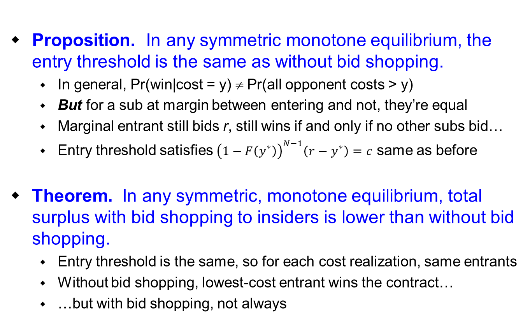
Post-auction bid shopping to “insiders” – welfare effects
Proposition. In any symmetric monotone equilibrium, the entry threshold is the same as without bid shopping.
In general, Pr(win|cost = y) ≠ Pr(all opponent costs > y)
But for a sub at margin between entering and not, they’re equal
Marginal entrant still bids r, still wins if and only if no other subs bid…
Entry threshold satisfies ${\left(1−F\left(y^{∗}\right)\right)}^{N−1}\left(r−y^{∗}\right)=c$ same as before
Theorem. In any symmetric, monotone equilibrium, total surplus with bid shopping to insiders is lower than without bid shopping.
Entry threshold is the same, so for each cost realization, same entrants
Without bid shopping, lowest-cost entrant wins the contract…
…but with bid shopping, not always

Slide 20
Post-auction bid shopping to “insiders” – distributional effects
Distributional effects are complicated, no general results
Our intuition is that bid shopping to insiders “typically”…
Benefits prime contractors
Benefits subcontractors if cost distribution F is log-concave
Hurts procurer (by increasing expected price paid)

Slide 21
Post-auction bid shopping to “insiders” – distributional effects
Distributional effects are complicated, no general results
Our intuition is that bid shopping to insiders “typically”…
Benefits prime contractors
Benefits subcontractors if cost distribution F is log-concave
Hurts procurer (by increasing expected price paid)
Prime contractor’s cost distribution has wider support with bid shopping
Winning contractor’s surplus is difference between lowest and second-lowest prime contractors’ costs
→ “spreading out” of prime contractors’ costs should help

Slide 22
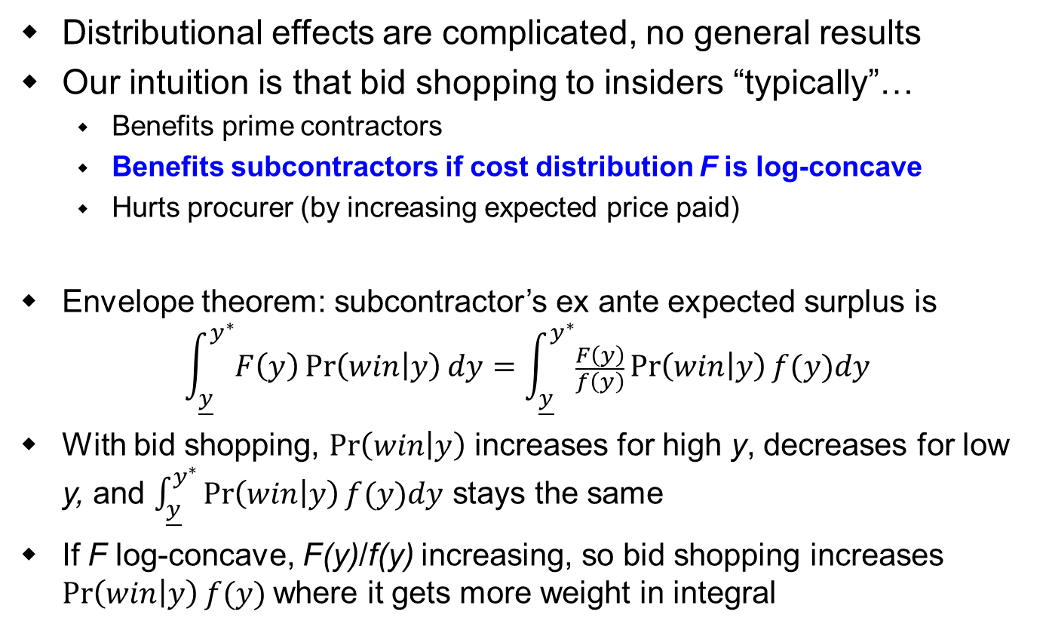
Post-auction bid shopping to “insiders” – distributional effects
Distributional effects are complicated, no general results
Our intuition is that bid shopping to insiders “typically”…
Benefits prime contractors
Benefits subcontractors if cost distribution F is log-concave
Hurts procurer (by increasing expected price paid)
Envelope theorem: subcontractor’s ex ante expected surplus is
$$\int_{\underline{y}}^{y^{∗}}{F\left(y\right)\operatorname{Pr}\left(win | y\right)dy}=\int_{\underline{y}}^{y^{∗}}{\frac{F\left(y\right)}{f\left(y\right)}\operatorname{Pr}\left(win | y\right)f(y)dy}$$
With bid shopping, $\operatorname{Pr}\left(win | y\right)$ increases for high y, decreases for low y, and $\int_{\underline{y}}^{y^{∗}}{\operatorname{Pr}\left(win | y\right)f(y)dy}$ stays the same
If F log-concave, F(y)/f(y) increasing, so bid shopping increases $\operatorname{Pr}\left(win | y\right)f(y)$where it gets more weight in integral

Slide 23
Post-auction bid shopping to “insiders” – distributional effects
Distributional effects are complicated, no general results
Our intuition is that bid shopping to insiders “typically”…
Benefits prime contractors
Benefits subcontractors if cost distribution F is log-concave
Hurts procurer (by increasing expected price paid)
No clear intuition for why procurer suffers from bid shopping…
But we know total surplus goes down…
So if prime contractors and subs benefit, procurer surplus must fall
Probability of successful sale is same, so must be through higher average price paid

Slide 24
Introduction Related Literature Model/Results Benchmark Model (No Bid Shopping) Bid Shopping to “Insiders” Bid Shopping to “Outsiders” Discussion/Conclusion

Slide 25
Bid shopping to “outsiders”
After auction, winning prime contractor will approach one new subcontractor…
…show him her best pre-auction bid…
…and invite him to bid against incumbent in a second-price auction
New subcontractor has cost y₀ ~ F, bid preparation cost αc ≤ c
Correctly infers incumbent’s cost y
If y₀ > y – αc, new sub doesn’t bid, so incumbent keeps job at original bid b
If y₀ < y – αc, new sub enters and wins, at price y (incumbent’s actual cost)
Procurer
Prime Contractor
Prime Contractor
Prime Contractor
New sub
Sub con trac tor
Sub con trac tor
Sub con trac tor
Sub con trac tor
Sub con trac tor
Sub con trac tor
Sub con trac tor
Sub con trac tor
Sub con trac tor
Again, this is all anticipated
Subcontractors know it will happen, bid accordingly
Prime contractors know they may reduce cost if they win, bid accordingly
(Everyone is risk-neutral)

Slide 26
Who is this “outsider”?
Not a sub who already bid and “lost” – already covered
Not a sub who didn’t bid because y > y*
revealed to have higher cost than those who bid, haven’t yet sunk c
Still two possibilities:
Sub who never had chance to bid pre-auction (“not one of the N”)
Sub who chose to wait and bid post-auction instead (“one of the N”)
Welfare effect depends on which – because it depends on whether bid shopping reduces number of pre-auction bidders

Slide 27
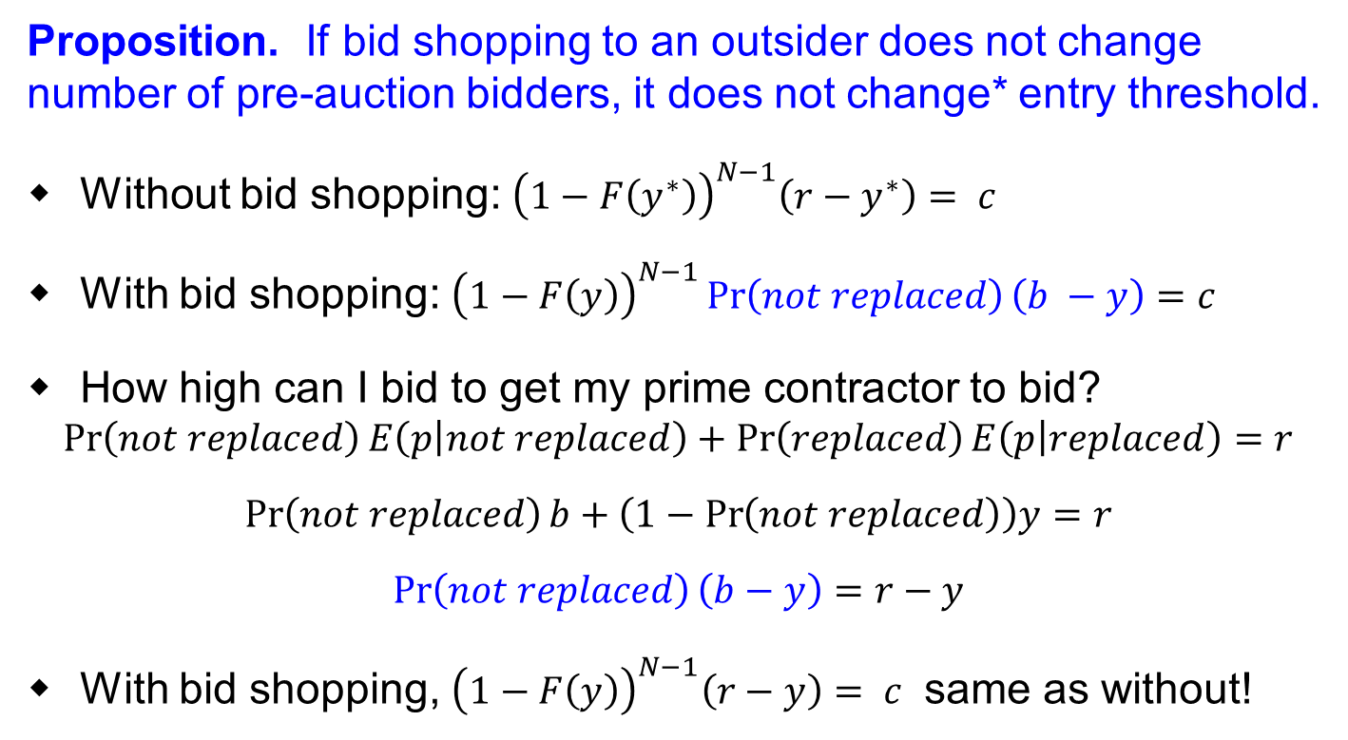
Case 1: Bid shopping does not reduce number of pre-auction bidders
Proposition. If bid shopping to an outsider does not change number of pre-auction bidders, it does not change* entry threshold.
Without bid shopping: ${\left(1−F\left(y^{∗}\right)\right)}^{N−1}\left(r−y^{∗}\right)= c$
With bid shopping: ${\left(1−F\left(y\right)\right)}^{N−1}\operatorname{Pr}\left(not replaced\right)\left(b −y\right)=c$
How high can I bid to get my prime contractor to bid?
$$\operatorname{Pr}\left(not replaced\right)E\left(p | not replaced\right)+\operatorname{Pr}\left(replaced\right)E\left(p | replaced\right)=r$$
$$\operatorname{Pr}\left(not replaced\right)b+\left(1−\operatorname{Pr}\left(not replaced\right)\right)y=r$$
$$\operatorname{Pr}\left(not replaced\right)\left(b−y\right)=r−y$$
With bid shopping, ${\left(1−F\left(y\right)\right)}^{N−1}\left(r−y\right)= c$ same as without!
r – y
b
y
* Subject to an equilibrium multiplicity issue I’ll mention later

Slide 28
Case 1: Bid shopping does not reduce number of pre-auction bidders
Theorem. If bid shopping to an outsider does not change number of pre-auction bidders, it increases total surplus.
Entry threshold doesn’t change, so for each realization of costs, same subcontractors bid as would have without bid shopping
If lowest bidder is replaced, he competes down to his cost level y…
…so his lost profits b(y) – y are the same as the procurer’s cost reduction
Combined surplus of procurer, prime contractors, and pre-auction subcontractors is unchanged (ex post, therefore ex ante)…
…so total surplus changes by surplus of post-auction subs, which must be positive in equilibrium
Distributional effects
In this case, bid shopping hurts existing subs, benefits procurer
Effect on prime contractors is ambiguous

Slide 29
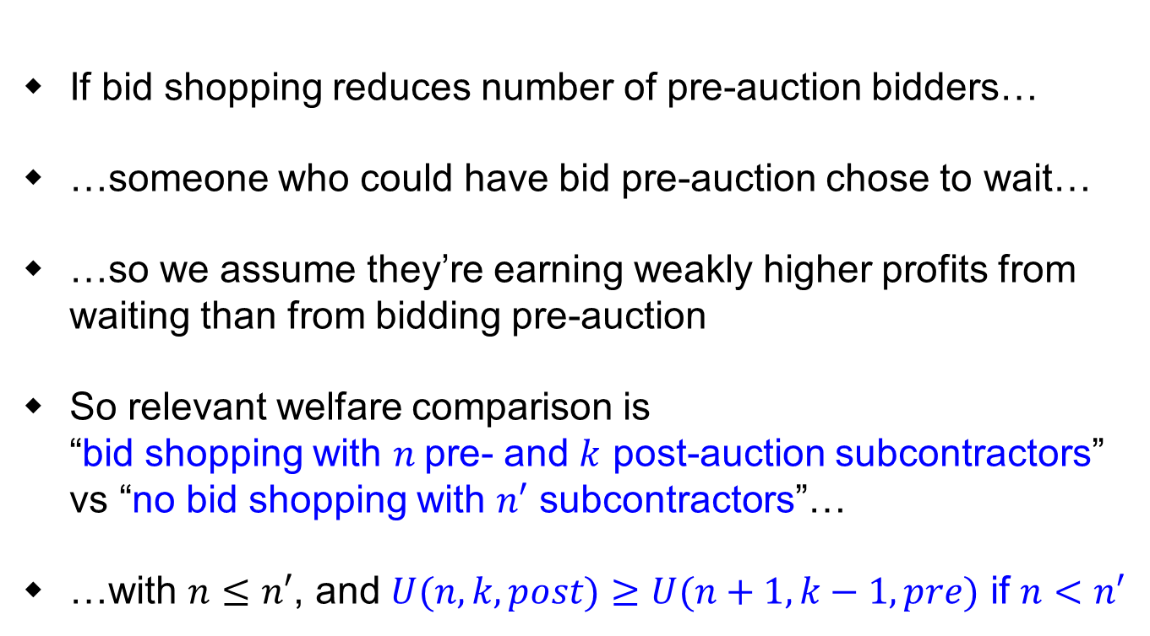
Case 2: Bid shopping reduces number of pre-auction bidders
If bid shopping reduces number of pre-auction bidders…
…someone who could have bid pre-auction chose to wait…
…so we assume they’re earning weakly higher profits from waiting than from bidding pre-auction
So relevant welfare comparison is “bid shopping with $n$pre- and $k$ post-auction subcontractors” vs “no bid shopping with $n′$ subcontractors”…
…with $n≤n′$, and $U(n,k,post)≥U(n+1,k−1,pre)$ if $n<n′$
Expected surplus of a “post-auction subcontractor” when there are n pre- and k post-auction subs
Expected surplus of a “pre-auction subcontractor” when there are n+1 pre- and k-1 post-auction subs

Slide 30
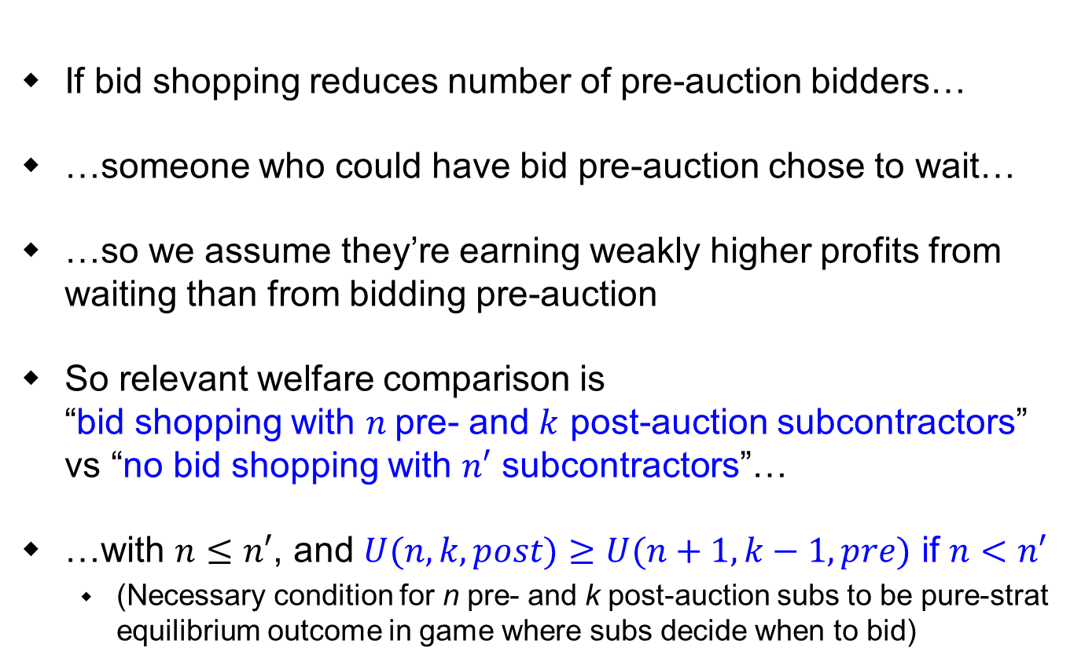
Case 2: Bid shopping reduces number of pre-auction bidders
If bid shopping reduces number of pre-auction bidders…
…someone who could have bid pre-auction chose to wait…
…so we assume they’re earning weakly higher profits from waiting than from bidding pre-auction
So relevant welfare comparison is “bid shopping with $n$pre- and $k$ post-auction subcontractors” vs “no bid shopping with $n′$ subcontractors”…
…with $n≤n′$, and $U(n,k,post)≥U(n+1,k−1,pre)$ if $n<n′$
(Necessary condition for n pre- and k post-auction subs to be pure-strat equilibrium outcome in game where subs decide when to bid)

Slide 31
Case 2: Bid shopping reduces number of pre-auction bidders
Theorem. If c is sufficiently large, bid shopping to outsiders can only increase total surplus.
If c is large enough, U(n,k,post) < U(n+1,k-1,pre) for any k > 0
So no sub who could bid pre-auction would choose to wait
So bid shopping doesn’t reduce number of pre-auction subs → only changes outcome if it attracts “new” outsiders
Theorem. If c is sufficiently small and bid shopping attracts no “new” outsiders, it can only decrease total surplus.
If c is small enough, U(n,1,post) < U(n+1,0,pre)…
…so if no “new” outsiders, bid shopping only changes outcome if two or more subs wait to bid post-auction
If c is small enough, that decreases surplus

Slide 32
Summing up results
Bid shopping to insiders doesn’t change participation, can only decrease total surplus (seemingly at expense of procurer)
Bid shopping to “new” outsiders doesn’t change participation, can only increase total surplus (to procurer’s benefit)
If c is large, existing subcontractors won’t choose to delay bidding, so this is the case that matters
But bid shopping to outsiders could induce some subs to postpone bidding to after auction
If c is small and no new outsiders arrive, bid shopping to outsiders can only decrease total surplus

Slide 33
In paper, we consider several extensions…
Reserve price is endogenous (so changes with bid shopping)
Equilibrium multiplicity with bid shopping to outsiders
If bid shopping involves additional costs
One fun one I’ll show quickly…

Slide 34
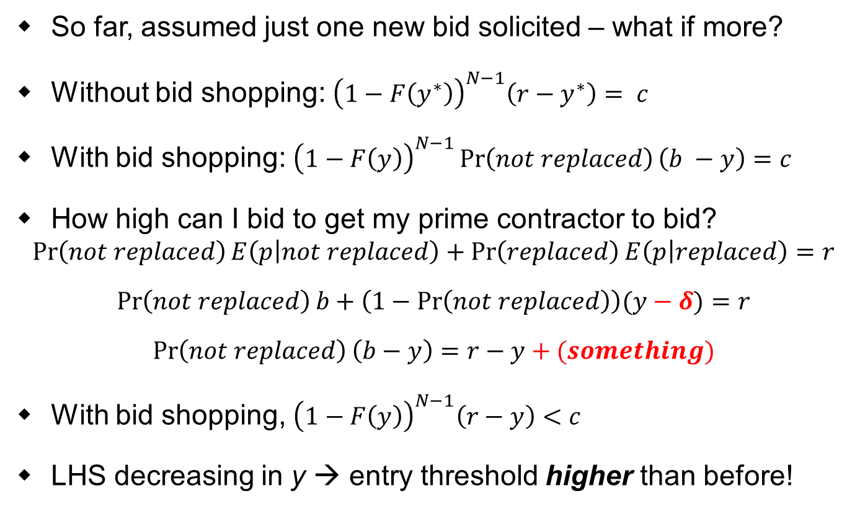
One extension: what if winning prime approaches multiple outsiders?
So far, assumed just one new bid solicited – what if more?
Without bid shopping: ${\left(1−F\left(y^{∗}\right)\right)}^{N−1}\left(r−y^{∗}\right)= c$
With bid shopping: ${\left(1−F\left(y\right)\right)}^{N−1}\operatorname{Pr}\left(not replaced\right)\left(b −y\right)=c$
How high can I bid to get my prime contractor to bid?
$$\operatorname{Pr}\left(not replaced\right)E\left(p | not replaced\right)+\operatorname{Pr}\left(replaced\right)E\left(p | replaced\right)=r$$
$$\operatorname{Pr}\left(not replaced\right)b+\left(1−\operatorname{Pr}\left(not replaced\right)\right)(y−δ)=r$$
$$\operatorname{Pr}\left(not replaced\right)\left(b−y\right)=r−y+(something)$$
With bid shopping, ${\left(1−F\left(y\right)\right)}^{N−1}\left(r−y\right)<c$
LHS decreasing in y → entry threshold higher than before!
> (1-F(y))^{N-1}(r – y)
b
< y

Slide 35
Introduction Related Literature Model/Results Benchmark Model (No Bid Shopping) Bid Shopping to “Insiders” Bid Shopping to “Outsiders” Discussion/Conclusion

Slide 36
Discussion/Conclusion
Bid shopping to subcontractors who have already bid decreases total surplus
(Reminiscent of McAdams and Schwartz (2007 IJIO), “Who Pays When Auction Rules Are Bent?”)
Bid shopping to subcontractors who haven’t yet bid can either increase or decrease total surplus
Increases surplus when these bidders wouldn’t have bid otherwise, and when bid preparation cost is large
Decreases surplus when bid prep cost is small and it doesn’t pull in any new subcontractors

Slide 37
Discussion/Conclusion
We abstract away from other potential concerns
“Pernicious effects” of bid shopping mentioned elsewhere: “promoting lower-quality work; incentivizing corner-cutting; increasing claims and change orders; delaying project completion; and generally worsening the business environment”
Other concerns we see
Ex post regret from winning prime contractor
→ breach? renegotiation? insolvency?
Two obvious candidate policies to address make things worse!
Reduced subcontractor profitability
→ fewer subs/less competition over time?
Upshot: “it’s complicated”
Whether bid shopping is “good” or “bad,” and for who, depends on who bids are being shopped to
Notes:
Other “pernicious effects” mentioned elsewhere:
“promoting lower-quality work; incentivizing corner-cutting; increase claims and change orders; delaying project completion; and generally worsening the business environment.”

Slide 38
Thank you!
37
Notes:
37

