Slide 1
NBER Presentation
May 5, 2024

Slide 2
How is FLOW Different than Industry Data Visibility?
FLOW is not a container track and trace solution
FLOW is a shared platform to forecast supply chain disruption
FLOW is modeled after a decades-long air carrier program to optimize the national airspace

Slide 3
FLOW Principles
Voluntary
FLOW is a voluntary, market-based public-private partnership
Secure
Member data is not subject to FOIA, subpoena/legal discovery, or regulatory use
Participatory
Access to FLOW data requires providing qualified data—the data can’t be shared publicly

Slide 4
How does the FLOW data exchange work?
Companies confidentially submit freight activity information to USDOT
Manual upload or SFTP (API coming)
USDOT aggregates FLOW data to show total incoming freight demand, throughput, and regional capacity
FLOW participants access FLOW data for their planning efforts
API and CSV download access

Slide 5
Who participates in FLOW?
FLOW is currently scoped for import containerized freight (exports to come later this year)
Eligible participants include shippers and logistics service providers (tech vendors can be 3rd parties, not direct participants)
Importer POs
Origin Manufacturing
Origin Trucking
Origin Ports & Drayage
Ocean Carrier/NVOCC Bookings
Domestic Ports
& Drayage Utilization
Domestic Rail Utilization
Domestic Warehouse Utilization
Domestic Retailers & Manufacturing
(Beneficial Cargo Owners)
~90 Days Ahead
~45 Days Ahead
Today
Shipment Time

Slide 6
What FLOW Data is Available Today?
Demand Data
Supply Data
Throughput Data
Purchase Orders
Terminal Utilization
Terminal Gate Moves
Tractor Utilization
Import Bookings
Chassis Utilization
CBP Manifest
Warehouse Utilization
*Items with lighter shade are to come in future releases

Slide 7
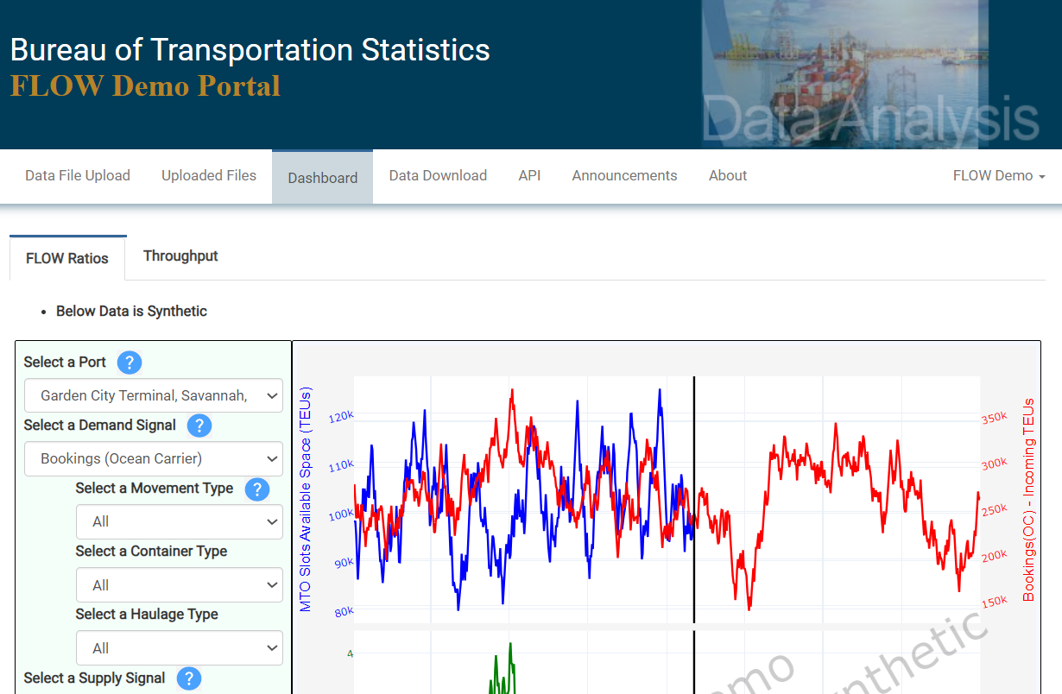
FLOW Data Dashboard
(synthetic data)
Downloadable container supply, demand, and throughout data
API access

Slide 8
How can industry use FLOW data?
Demand Forecasting
Throughput Forecasting
Estimating transit/cycle times
Improving routing decisions
Improving expectation management, scheduling, and resourcing
Improving inventory stocking levels for goods
Service Optimization
Setting Contract and Spot-Market Freight Resourcing Levels
Setting Service-Mix Expectations
Linking Dynamic Pricing with Service Commitments

Slide 9
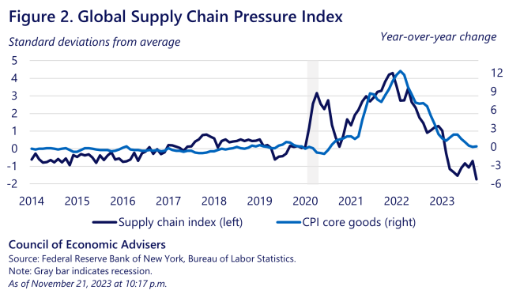
Public Benefits of FLOW – Lowering Costs
CEA Issue Brief on Supply Chain Resilience
“During the global pandemic, it became clear that global supply chains were propagating micro shocks into macro-level effects...
In the transportation and logistics industry specifically, a series of supply chain disruptions and delays at ports during the pandemic led to historically high prices for imports to the United States during the pandemic…
Specifically, the Department of Transportation established the Freight Logistics Optimization Works (FLOW) initiative in March 2022, run by the Department’s new Office of Multimodal Freight and Infrastructure Policy…
Increasing the transparency of supply chain data among market participants can improve market functioning, including by sending demand signals ahead of supply chain disruptions.”

Slide 10
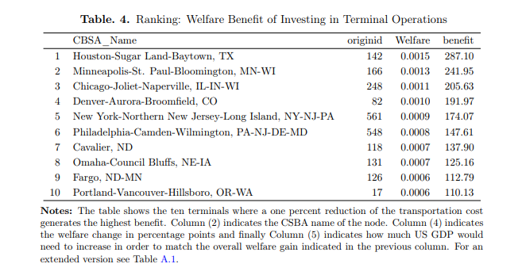
Public Benefits of FLOW – Guiding Investment
Understanding Welfare Benefit of Freight Investment
FLOW provides new data on how freight was distributed from the rest of the world into the U.S. in ocean freight.
The Multimodal Freight Office seeks to understand the welfare impact on investing in freight infrastructure (see right).
We are just now considering study of this as the FLOW data collection has matured.

