Slide 1
Expanding the Frontier of Economic Statistics Using Big Data: A Case Study of Regional Employment
Abe Dunn (BEA), Eric English (Census), Kyle Hood (BEA), Lowell Mason (BLS, Presenting), Brian Quistorff (BEA, Presenting)
NBER SI 2024 CRIW
July 15, 2024
Any opinions and conclusions expressed herein are those of the authors and do not represent the views of the U.S. Census Bureau, the Bureau of Economic Analysis, or the Bureau of Labor Statistics. This paper does not use any confidential Census Bureau data.

Slide 2
Motivation and background
There's been a dramatic increase in the amount of data available
Simultaneously, there has been a decline in survey response rates
Can statistical agencies:
Leverage this data to produce timely, high-frequency and granular statistics
If so, are they an improvement?
Third party data have issues
Non-random sample
Unstable sample
How do statistical agencies currently weigh the advantages and disadvantages of official data sources and data releases?

Slide 3
Production possibility frontier for economic measurement
3

Slide 4
What we do
Application to county- and state-by-industry employment
Assess current error tolerance from official sources (CES)
Use alternative payroll data to produce alternative estimates (state- and county-by-industry level)
Evaluate the accuracy (i.e., error/revision) of these alternative estimates
Compare accuracy to tolerance levels from official sources to determine the value of the new estimates

Slide 5
What we find
For currently targeted estimates, solely using alternative payroll data produces errors higher than tolerance levels → combine with CES
Alternative payroll data (combined with CES) shows some improvement in the accuracy of state-level employment series
Alternative payroll data (combined with CES) produces new county-level estimates in line with tolerance level for this amount of granularity
We apply new estimates to examine resource allocation around the pandemic → We find improved timeliness/accuracy in identifying worst hit counties

Slide 6
Data
Quarterly Census of Employment and Wages (QCEW)
Released quarterly, 5 months after the end of the quarter
County by industry level
Current Employment Statistics (CES) survey
National by industry level - ~3 weeks after the 12th
State/MSA by industry level - ~5 weeks after the 12th
Payroll processor
Paycheck level aggregated to county by industry
Lag/period is customizable
All series measure employment on the 12th of the month
Period: 01/2017 to 06/2021
Main focus is state and county by industry series

Slide 7
Payroll processor data
Over 5% market share
Mostly small- and medium-sized businesses
Includes 2-digit NAICS
Coverage across all industries
Micro data, aggregated monthly
Open to changes in data delivery

Slide 8
Payroll data processing
All employers or continuing units?
Payroll company has attracted many new clients → use continuing units
Paycheck level data
Payroll processor gets data at the end of each pay period
Most employees are paid weekly, bi-weekly or monthly
More data comes in as time passes
How long do we want to wait to collect the data?

Slide 9
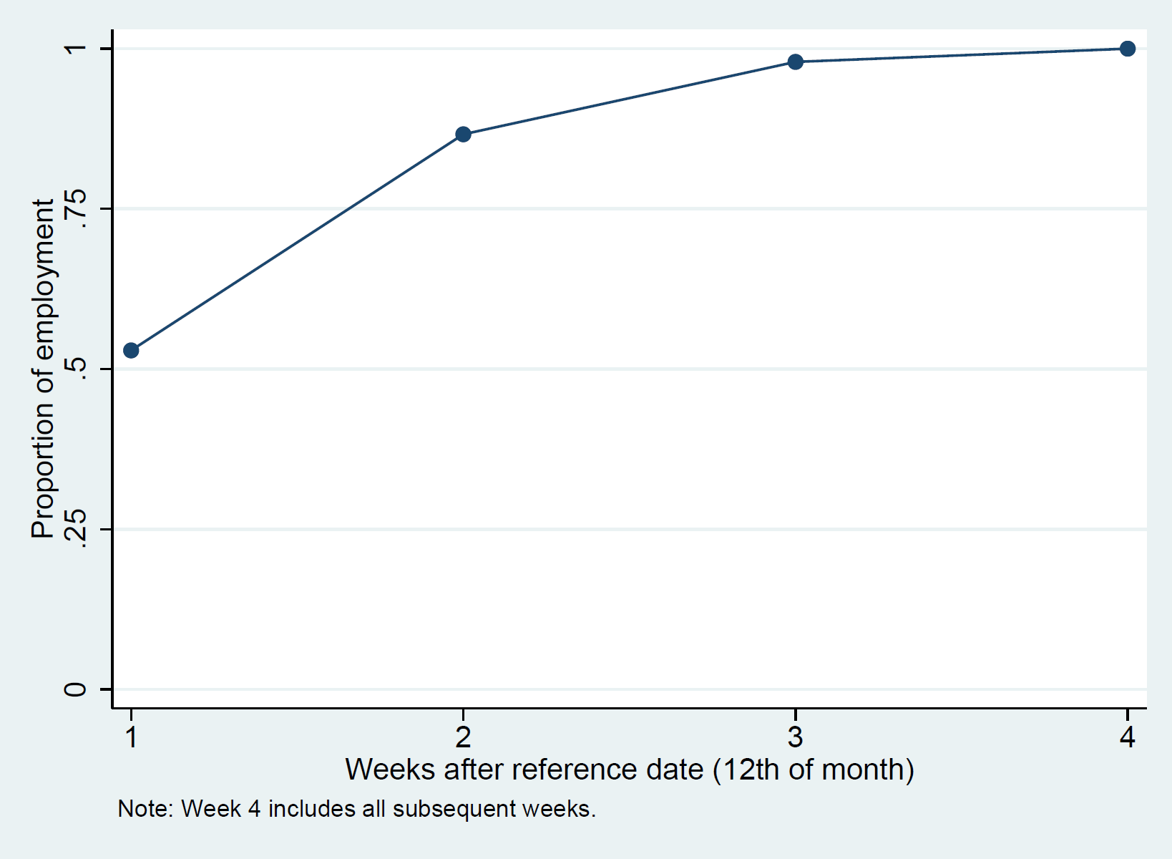
Payroll frequency and payroll timing

Slide 10
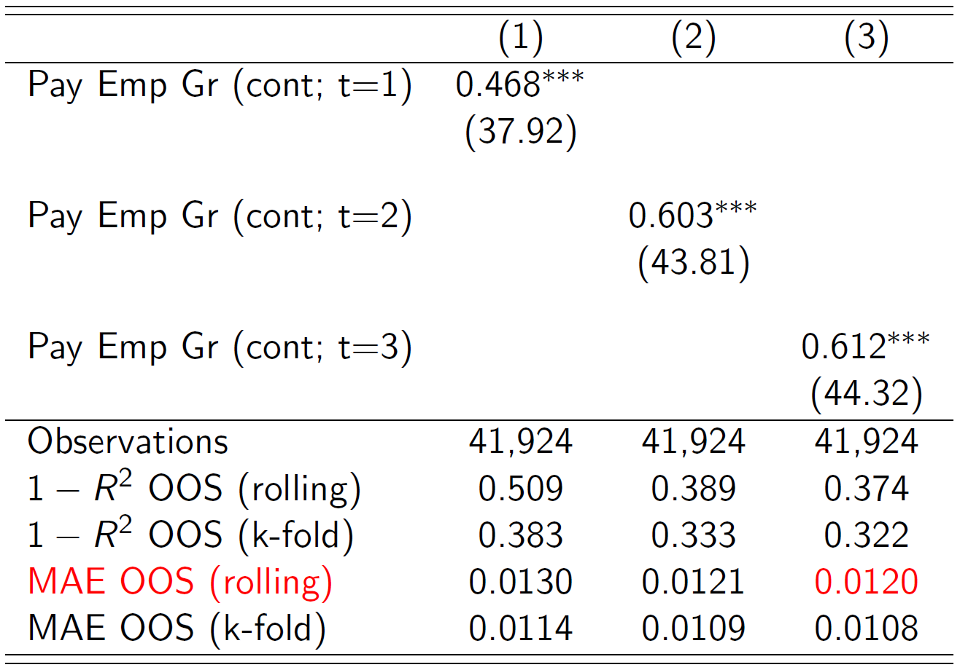
Comparison of input data: weeks from reference period (state)

Slide 11
Framework for evaluating statistics
Assess tolerance of existing statistics across types of granularity
Use Mean Absolute Error (MAE) for presentation
CES initial release vs. final QCEW
Types of granularity:
Geography: County, MSA, State or National
Industry: All industries, 2-digit and 3-digit NAICS
Produce new or improved statistics (i.e., county/state-level employment growth)
Calculate errors and compare to tolerance levels

Slide 12
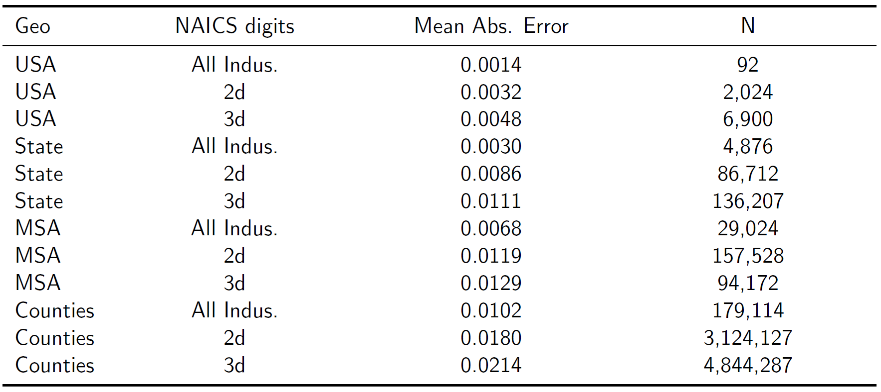
Error Tolerance (CES initial vs QCEW)

Slide 13
Prediction equation
We wanted to compare (unmodelled) CES with models that include CES and Payroll data.
Monthly QCEW Employment Growth = f (CES, Payroll) + Error
f () — linear functional form
We try various specifications (CES only, Payroll only, CES + Payroll)
We also include some characteristics of the Payroll data
E.g. Payroll coverage
13

Slide 14
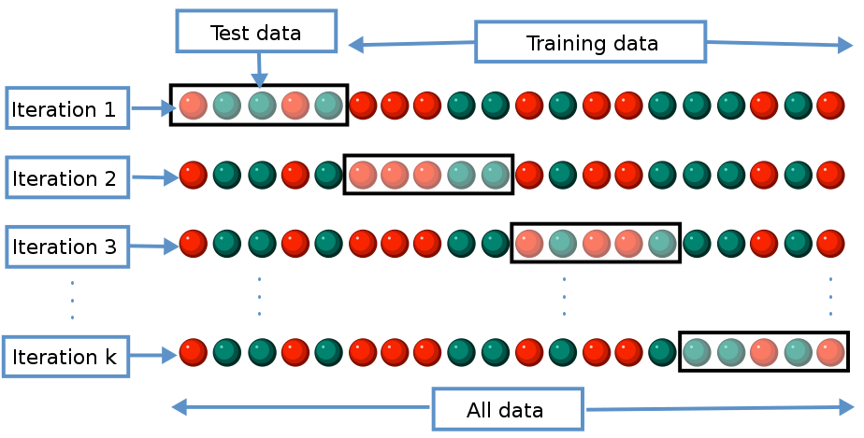
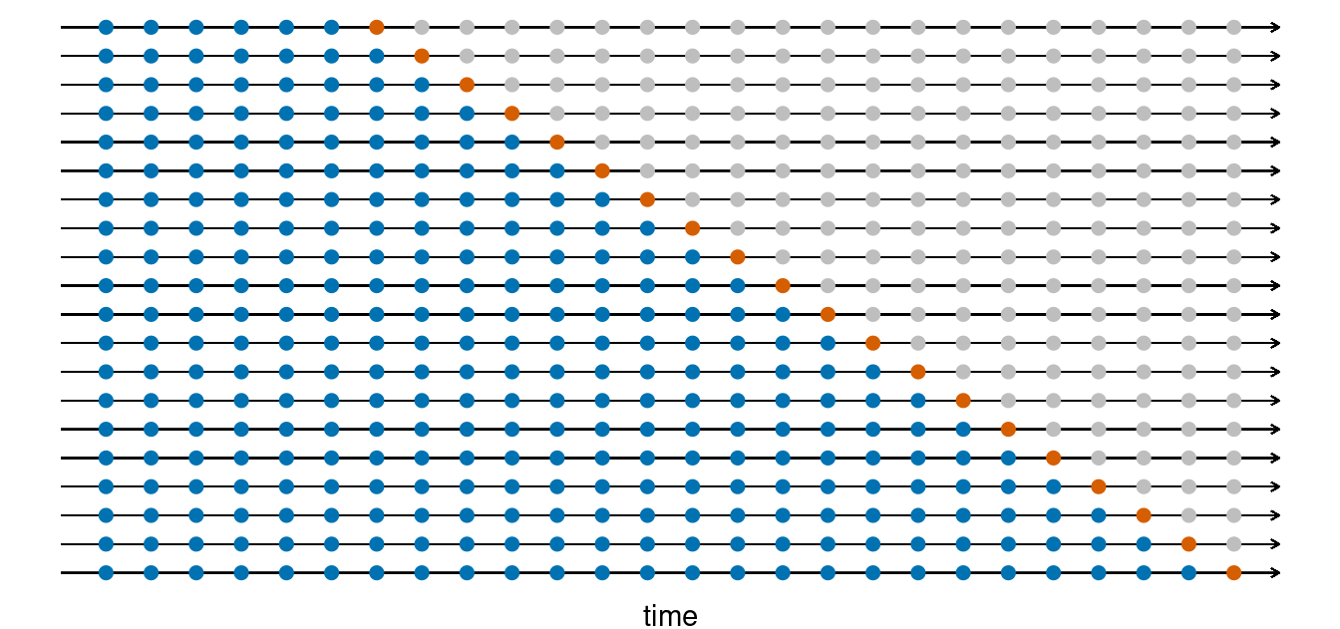
Evaluation criteria
Two out-of-sample approaches:
K-fold cross validation:
Advantage – Uses all time-series variation in the data
Disadvantage – Does not match how estimation will work in practice
Rolling one-step-ahead estimation:
Advantage – Closer to how estimation would work in practice
Disadvantage – Does not use the full time series variation
14

Slide 15
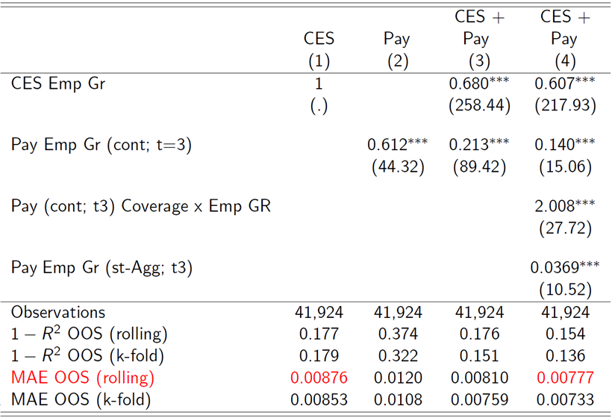
Improved state-level estimates?
15

Slide 16
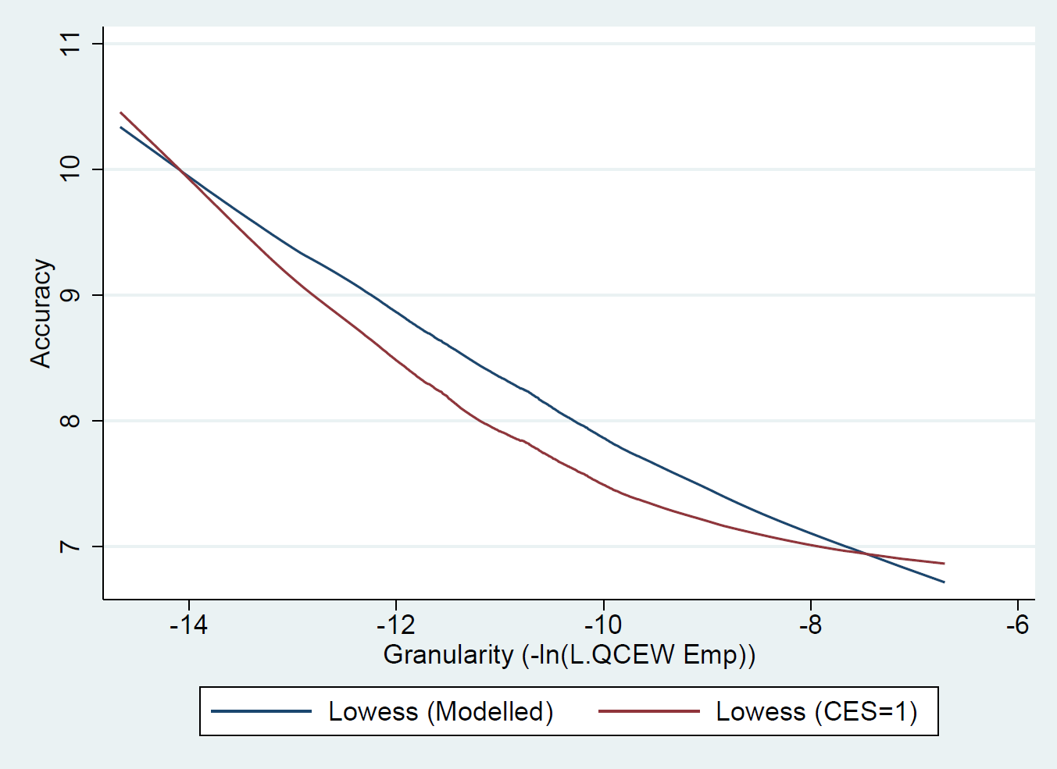
Expanding the PPF for state estimates
16

Slide 17
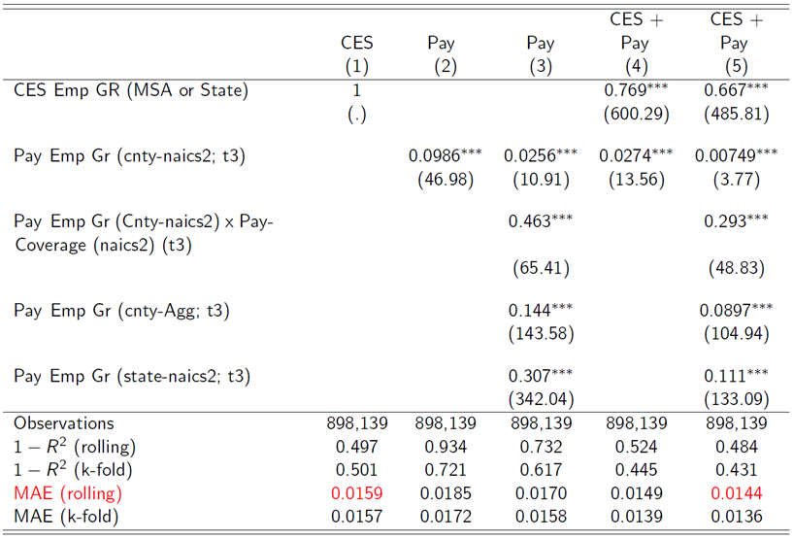
New county-level estimates?
17

Slide 18
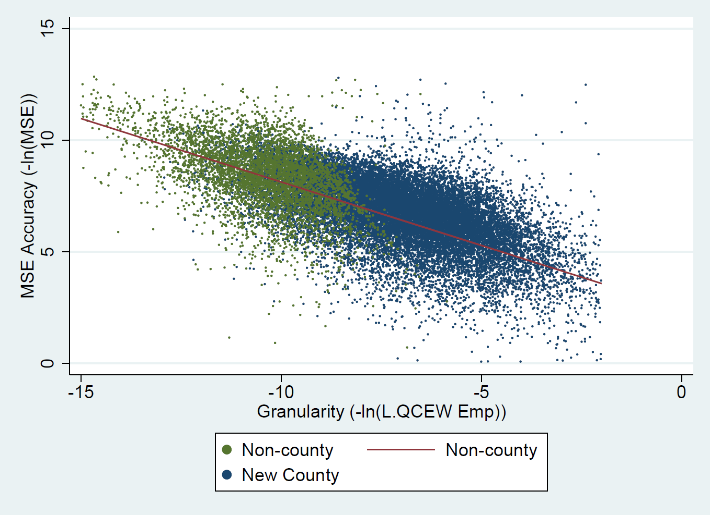
Comparing Accuracy of Existing Statistics and New County Estimates
18

Slide 19
Application of alternative data to COVID-19 pandemic
Suppose we wanted to target government aid that was quickly dispersed (the Paycheck Protection Program was not targeted).
Can Payroll data help us identify the hardest hit counties?
Payroll + CES
No better in April
Improvements in the rest of 2020
Payroll alone
Gives meaningful signal
Could have been available in late March instead of early May
19

Slide 20
Counterfactual: Identifying hardest hit counties
Identify 25% of counties with the lowest increase in employment
What percent of the bottom 25% overlap
20

Slide 21
Conclusions
Current estimates provide guidance for “tolerance” for new or improved estimates
Some evidence of improved estimates at the state level (about 11 percent reduction in error)
County-level estimates appear promising and at reasonable accuracy standard
Demonstrate benefits of alternative data for improving policy and efficiently allocating resource
21

Slide 22
Acknowledgements
Opportunity Insights for their exceptional research in this area as well as their committed partnership and support of the statistical agencies throughout this process.
Payroll data provider for the generosity of allowing the statistical agencies to work with their valuable data leading to new statistics and insights that would not be possible without their involvement.
22

Slide 23
Contact
Abe.Dunn@bea.gov
Eric.English@census.gov
Kyle.Hood@bea.gov
Mason.Lowell@bls.gov
Brian.Quistorff@bea.gov

