Slide 1

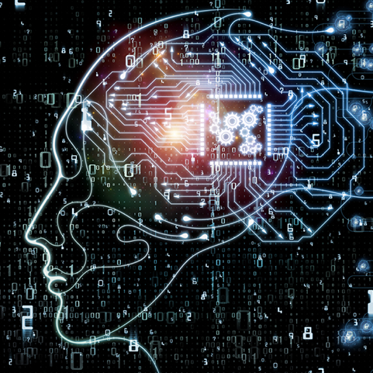


The Block Center for Technology and Society Future of Work Initiative https://www.cmu.edu/block-center/
Quantifying the impact of AI on productivity and labor demand: evidence from U.S. Census microdata
Dean Alderucci, Sagar Baviskar, Lee Branstetter, Nathan Goldschlag, Eduard Hovy, Andrew Runge, Prasana Table, and Nick Zolas
Notes:
Good afternoon, everyone. I’d like to thank the organizers for the opportunity to participate in this session, and I also want to acknowledge with gratitute my interdisciplinary and multiorganizational coauthorship team, whose members are listed here.

Slide 2
This paper provides new measures of AI-related innovation that complement existing studies
There have been impressive efforts efforts to directly measure AI adoption (McElheran et al., 2024; Zolas et al, 2019)…
And efforts to measure the impact of the hiring of AI workers as reflected in online job ad data (Babina et al., 2022, 2024)…
And more recent experimental studies of the impact of particular kinds of AI in particular work contexts (Brynjolfsson et al., 2023; Noy and Zhang, 2023).
We build on and extend the efforts of Cockburn et al. (2019), Webb et al. (2019), and Giczy et al. (2021) to identify AI-related patents…
And we examine the impact of these AI inventions on the AI-inventing firms, using Census micro-data, finding evidence that suggests significant effects on productivity
We are also beginning to measure the impact of elite academic scientists on AI-related invention, through collaboration and the employment of their doctoral students.
Notes:
This is an exciting time to be working on AI. Even as AI technology advances in fundamental ways, our ability to measure its economic impact at the firm level is also advancing rapidly, thanks to the creative and informative research efforts led by many in this room.
*A valuable effort to directly survey AI use by US firms has been spearheaded by my discussant and co-authored by some of my own Census-based coauthors.
*The exciting and influential work of Tania and her coauthors have used data on the hiring of AI workers as reflected in online job data to gain new empirical measures of the impact of investment in and use of AI.
*We’ve learned much from both efforts. But, unfortunately, neither paper has provided strong evidence of the kind of productivity boost we are hoping to eventually receive from the AI revolution.
*Now, more recent experimental work by Erik, Danielle, and Lindsay Raymond, and others provides compelling evidence of AI-generated productivity gains, but we don’t yet know whether and how these productivity results generalize beyond the very specific work contexts in which they were documented.
*We think our work provides a useful complement to these existing streams of literature.
*We build on and extend earlier efforts to identify AI-related patents, we match these patents to the inventing firms in the Census micro data, and find evidence that is consistent with positive and significant effects on productivity, especially labor productivity – and this comes from a sample of firms that is distributed across industries, technologies, and geographies; the kind of broad-based productivity boost we have been looking for in the data.
*The paper also describes ongoing efforts to quantify the impact of elite academic scientists on AI-related invention, through direct collaboration with firms and through the employment of their doctoral students in those firms, and we’d love to hear what you think about those ideas.

Slide 3
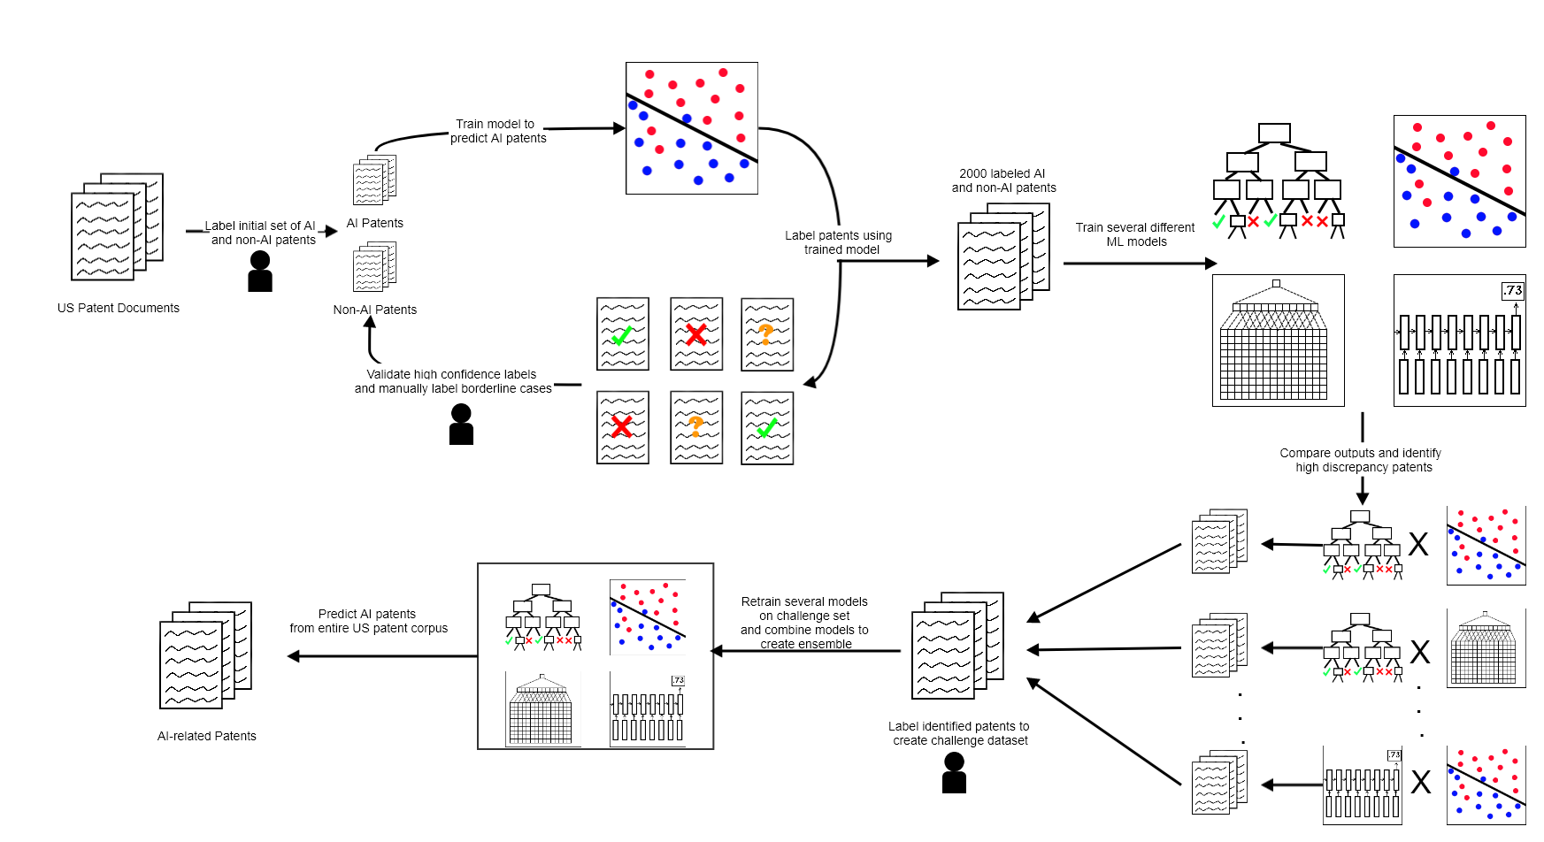
Using AI to find AI inventions (1) Begin with “hand-curated” AI (and non-AI) patents
Notes:
Given our time constraints, I do not really have time to delve too deeply into our somewhat complicated methodology for finding AI patents. The details are in the paper. I’ll just say this: we use AI to find AI-related patents granted by the USPTO.
Starting with a previously identified, hand-curated set of AI patents,

Slide 4
Using AI to find AI inventions (2) Train a SVM to identify more AI (and non-AI) patents (with human input)
Notes:
…with human input to validate high confidence cases and manually label borderline cases.

Slide 5
Using AI to find AI inventions (3) Train several different ML models on the expanded training data set
Notes:
[Read]. At various stages in the process, we utilize a naïve Bayes model, a logistic regression, a random forest model, a linear support vector machine, a convolutional neural network, a recurrent neural network, and a hierarchical attention network.

Slide 6
Using AI to find AI inventions (4) Compare outputs and identify high-discrepancy patents
Notes:
We identify documents concerning which the models disagree, and label these to create a challenge dataset,

Slide 7
Using AI to find AI inventions (5) Create a “challenge” data set
Notes:
Which we can then use to further improve our training and also to evaluate our final performance.

Slide 8
Using AI to find AI inventions (6) Retrain the models on the challenge data set, combine models to create an “ensemble”
Notes:
We ultimately use this procedure to identify AI patents granted by the USPTO between 1990-2018.

Slide 9
Using AI to find AI inventions (7) Predict the “AI-ness” of every U.S. patent, 1990-2018
Notes:
A useful feature of our algorithm is that it not only tags patents as AI-related, but also gives us a univariate measure of how AI-related a particular patent is, so that we can use more and less stringent thresholds for determining which patents are truly AI-related

Slide 10
Our methods find far more AI patents than previous approaches taken by some economists
Cockburn et al. (2019) take a “standard approach,” focusing on a relatively small set of key words and patent classes.
This approach identifies fewer than 14,000 patents between 1990 and 2014, and it includes large numbers of ”robotics hardware” patents.
Webb et al. (2019) take a similar, more focused approach, identifying 2,000+ patents related to ”machine learning” and 4,000+ related to “neural networks.”
Our approach identifies 52,896 patents that are AI related with 95% confidence and 146,952 patents that are AI related with 70% confidence (through 2018).
We identify most of the AI patents tagged by other economists as ”AI patents” but also capture a very large number that many earlier approaches omit.
However, our methods find far fewer patents than do recent efforts by the USPTO to apply machine learning methods to patent data (Giczy et al., 2021).
Notes:
We are certainly not the first researchers to search patent records for evidence of AI invention.
Our work is inspired by Cockburn et al, who…Webb et al…
Our approach uses the whole text of the patent, is not limited to a narrow set of key words or phrases,…
CMU versus USPTO
Nearly all of our AI patents are in their data set, but most of their AI patents are not in our data set. In the paper, we run some statistical horse races between our AI patent definition and the USPTO’s, the results of which suggest our approach may have some advantages. And I am happy to talk about that during the Q&A.
But even though I think we strike a better balance than other papers in the literature, I would be the first to concede that AI patents are challenging to identify from patent text, ex ante reasonable approaches can yield very different definitional boundaries, and all approaches are likely to generate some amount of “noise.” Our ongoing efforts to update our AI patent data through mid-2024 are also leveraging recent advances in LLMs to produce an ever more precise definition of AI patents – and I’m also happy to talk about THAT in the Q&A.

Slide 11
AI patenting has grown rapidly over our sample period
Notes:
Once we settle on a definition of AI patents, we can use our data to map the flow of AI-related invention across time. Our methodology suggests that AI patenting has grown very rapidly over time…

Slide 12
AI patenting is widely distributed across patent classes…
Notes:
We find that AI patenting is widely distributed across patent classes, with only a small fraction of patents lying in the USPTO’s officially designated AI patent class (706).

Slide 13
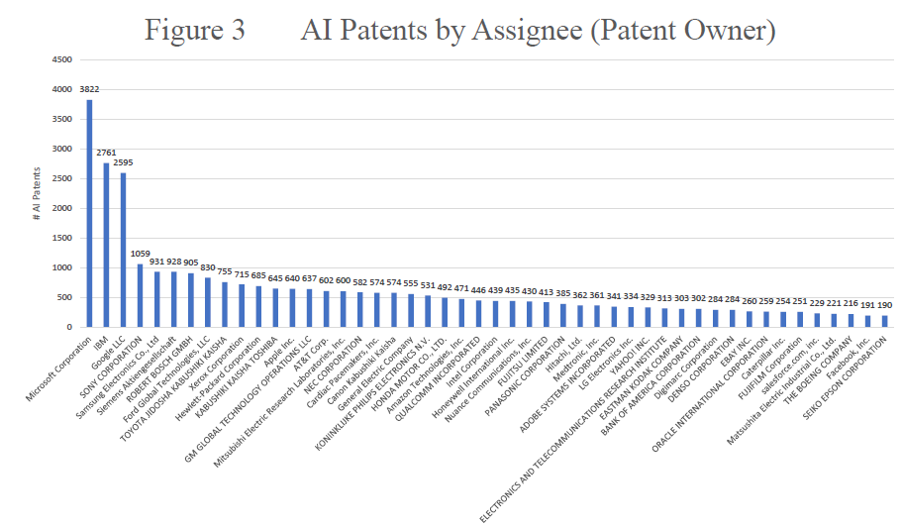
And across firms….
Notes:
We can also look at the distribution of AI-related patenting across firms. And we see lots of different firms from lots of different industries showing up as AI patentees – it’s definitely not only big tech.

Slide 14
AI patenting is concentrated in a few metro areas within the United States…
Notes:
We can also use the rich information contained within patent documents to map AI invention across space – this graph shows the distribution of AI patents across cities in the US, with significant concentration in the tech hubs of Silicon Valley, Seattle, Southern California and New York, but much activity outside those hubs.

Slide 15
Methodology for impact assessment
Use existing USPTO-Census patent-to-firm crosswalk (Graham et al. 2018), augmented by our own work to link the AI patents with a Census FirmID
Incorporate various outcome measures including:
Employment, Revenue and Revenue per Employee (Revenue-enhanced LBD)
Value-added, Total Factor Productivity, Production Worker Share (ASM and CMF)
90-10, 90-50 and 50-10 earnings ratio by firm (LEHD)
Measure within-firm changes from AI innovations at the extensive and intensive margins.
Construct a “control” group of firms to which AI-inventing firms can be compared and perform an event-study analysis
Use propensity score/exact matching to construct a control group using size, age, industry (4-digit NAICS), payroll, and patenting activity as predictors
Event study centered around the timing of the first AI patent filed by the AI-inventing firm.
Notes:
But we don’t just what to create cute pictures with patent data. We want to see what impact AI invention is having on the AI-inventing firms. Thankfully, we have an existing USPTO patent to Census crosswalk to link patents to firm- and establishment-level measures of employment, revenue, revenue per worker, TFP, value-added, production worker shares, and even data on the complete distribution of wages within the firm from the LEHD.
To measure the impact of AI invention, we can use firm fixed effects models to measure the within-firm changes that are associated with AI inventions. We can examine both the extensive margin – transition into AI patenting -- and the intensive margin, which is captured by growth in a firm’s stock of AI patents.
We can also create groups of non-AI-inventing firms to which we can compare the AI-inventing firms. This is done through propensity score matching at the firm level using known firm characteristics, such as size, age, 4-digit NAICS industry, multinational status, and other firm characteristics as controls. We can then perform an event study centered around the timing of the first AI patent with a treatment and control group to measure whether there are benefits to employment or productivity resulting from AI activity.
This is the point at which I have to state that our work is primarily descriptive, and that we are not advancing strong claims about causal identification. At least not yet.

Slide 16
AI Invention and firm productivity
Notes:
Using fixed effects models, (click) we find strong evidence that the transition into AI patenting yields an increase in measured labor productivity of 23-27% and an increase of more than 8% into total factor productivity. These are large effects, and they are not limited to the extensive margin – that is, the transition into patenting (click).
We also find that as the stock of AI patents rises, labor productivity and TFP increase even more. The elasticity for the former is 10-15%, for the latter nearly 6%. Again, these are not just statistically significant, but also quite sizable.

Slide 17
Event study on employment and labor productivity (all firms, not just manufacturing)
Notes:
When we use propensity score matching techniques to match AI-inventing firms with their closest same industry peer firms that don’t generate AI patents and take an event study approach with this matched sample, we still get strong results (click) suggesting the transition into AI patenting is associated with a 14% increase in employment and a 16% increase in labor productivity. The event study approach focuses only on the extensive margin, but allows us some additional empirical leverage around OVB and other inference challenges.

Slide 18
Does AI widen income inequality?
Earlier generations of IT innovation dramatically expanded income inequality by raising demand for skill in the U.S. labor market.
Will AI continue – or even worsen – this longstanding trend?
We can examine the impact of AI on demand for production workers.
By linking data on our AI-inventing firms to the LEHD, we can also examine the the association between AI invention and actual changes in within-firm earnings inequality.
We measure earnings inequality using the 90th percentile – 10th percentile, 90th-50th, and 50th-10th income ratios.
Notes:
So far, we see evidence that AI invention boosts revenue per employee, suggesting significant and positive productivity effects.
And the overall impact of the transition to AI invention on employment within the AI inventing firms appears to be positive, as we’ve seen in earlier slides. But might AI invention also widen income inequality? <>
A previous generation of IT inventions brought strongly skill-biased technological change to the American labor market, dramatically widening income inequality. <> Many worry that AI could continue and perhaps even exacerbate these trends.
<> To determine whether this is the case, we can look at the impact of AI invention on the production worker non-production worker ratio and we can link our census microdata on AI-inventing firms to the Longitudinal Employer Household Dynamics data set or LEHD, which allows us to measure the entire worker income distribution of each firm by quarter. And we can examine whether the transition to AI invention leads to greater within firm earnings inequality inside the AI-inventing firm,<> as measured by the widely used 90-10, 90-50, and 50-10 income ratios.

Slide 19
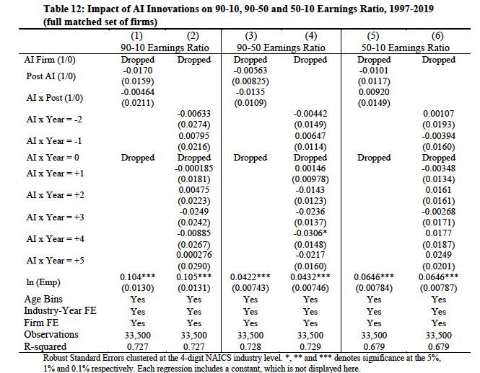
Does AI invention increase within-firm income inequality (in event study models)?
Notes:
Bottom line is that in our most stringent regression specifications, we don’t see statistically significant effects of AI invention on inequality. The effects on production worker share are generally not robust ot the inclusion of firm fixed effects. The effects on the earnings ratios generally don’t survive in our event study specifications.
So, we find significant, positive effects on productivity that are economically large – and no significant adverse effects on wage inequality.
Is the Second Machine Age at hand?

Slide 20
AI knowledge: Measuring AI transfer to industry by tracking the movement of experts
Any firm seeking to apply frontier AI technology to a particular problem requires a “pyramid” consisting of workers with different levels of AI skills.
At the moment, the high-level “software architects” who can guide the application of frontier technology are in especially short supply.
The allocation of these elite software architects across firms, industries, and projects may be especially predictive of success.
Can one track the high-level architects as they move across firms that employ them?
We find the leading AI scientists using Elsevier publication data and measure their direct collaboration with firms using coauthored papers. We use faculty websites and other sources to identify their (doctoral/post-doc) students.
We are then using Revelio data to trace the movements of these students across organizational boundaries over time.
We can use U.S. Census data to test the hypothesis that the emergence of a “critical mass” of frontier AI researchers within a firm leads to increases in output, employment, and productivity.
Notes:
But we are also trying to go beyond what patent data can teach us, because we are very aware that not all AI inventions are patented.
For example, the quantitative hedge fund industry that Tania knows well has been hiring large numbers of elite AI experts, but is generating very few patents. In contexts like this, how do we find the data trail that reflects firm investment in the use of AI to re-engineer firm products or services or create new ones?
In pursuing these questions, we are inspired by Tania Babina’s work and that of her colleagues, but we take a somewhat different tack.
Our aim is to follow the finite number of experts with frontier AI knowledge.
[read bullets]

Slide 21








Tracing the impact generated by AI experts across time and organizational boundaries
We can measure the impact of an accumulating stock of AI experts on firm productivity and other outcomes
Event study models
Production functions (with fixed effects)
Notes:
To make this a bit more concrete, imagine that we could identify Dr. Who (ck), who acquires a PHD in machine learning in the 2010s from CMU’s School of Computer Science (ck), focusing on image processing.
Dr. Who graduates from CMU and (ck) moves to Google Deep Mind, where he hones his skills in a corporate environment, beginning to apply his image analytics skills to diagnostic imaging.
Then (ck) he carries these skills further into the health care domain by joining Siemens Healthineers division, a global leader in AI-driven diagnostic imaging.
Then (ck) he joins a smaller, newer entrant, Arterys, were he leads a successsful effort to create a new suite of products that disrupts the market.
Imagine that we were able to follow all such individuals, wherever they went and examine how the output, productivity, and employment of firms changed as they moved.
Imagine that we could create a stock of such individuals at a company-year level that reflect arrivals and departures, and further imagine that we could use standard empirical methods to measure the effects

Slide 22
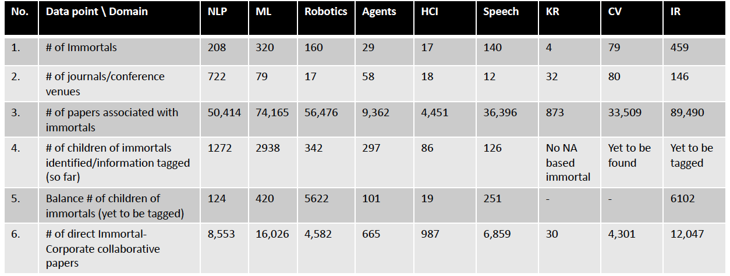
A report on our (ongoing) progress…
Notes:
Well, we’re not there yet, but
We’ve identified about 2,000 super-elite AI scientists whom we dub “the Immortals” across 10 AI subdomains –
We’ve identified more than 347,000 papers associated with these immortals
Of these, more than 54,000 papers are directly coauthored with corporate scientists, linking our Immortals to specific companies
We’ve also identified well over 6,000 graduate students – the academic progeny of the 2000+ immortals, and we expect to identify thousands more over the rest of the summer.

Slide 23
Some (very!) preliminary evidence on collaboration with star scientists…
Notes:
The one component of these new data we have been able to match to Census micro data is data on direct collaborations between elite AI scientists and companies.
Because of the Census disclosure process we cannot give you regression coefficients, but we can provide this table, which describes the signs and significance levels of the coefficients from simple fixed effects regressions of flows and stocks of collaborative papers on various firm-level outcomes.
This is purely correlational evidence, and the incorporation of the various fixed effects of listed here only gets you so far. With those caveats, we find fairly robust assocations between this measure of direct collaboration on the one hand and average pay and the number of AI patents on the other.
As it turns out, direct collaboration is highly concentrated in a small number of firms. The diaspora of students into industry is a broader phenomenon, and one that may be more important in determining firm-level outcomes.
Much more to come – please stay tuned.

Slide 24
(Preliminary) Conclusions
ML-based approaches can identify AI-related patents.
We find strong relationships between AI invention and the subsequent (labor) productivity growth of AI-inventing firms!
Current results omit the impact of recent advances in LLMs and generative AI; currently updating our AI patents to include these recent advances.

Slide 25
Next steps
Measure direct collaboration between elite AI scientists and U.S. firms.
Obtain data on the movement of the students of elite AI scientist into U.S. firms.
Examine the impact of this elite human capital (if any) on U.S. firm output, employment, and productivity.

Slide 26
Thanks!
Notes:
[Read title]

