Slide 1
Discrimination During Eviction Moratoria
Alina Arefeva Kay Jowers
UW-Madison Duke University
Wisconsin School of Business Kenan Institute & Nicholas Institute
Qihui Hu Christopher Timmins
Carnegie Mellon UW-Madison
Heinz School of Public Policy Wisconsin School of Business

Slide 2
Motivation: Housing Discrimination
Evidence of discrimination in many stages of the housing market:
Search (Hanson and Hawley 2011, Ewens et al. 2014, Christensen and Timmins 2022)
Price/rent negotiation (Bayer et al. 2017)
Home appraisal (Ambrose et al. 2021)
Home assessment (Avenancio-Leon and Howard 2022)
Mortgage lending (Bartlett, Morse, Stanton and Wallace 2022)
Consequences of discrimination:
Steering (Yinger 1995, Galster and Godfrey 2005, Dymski 2006, Christensen and Timmins 2022)
Increased search costs (Bergman et al. 2023)
Constrained choice set (Christensen and Timmins 2023)

Slide 3
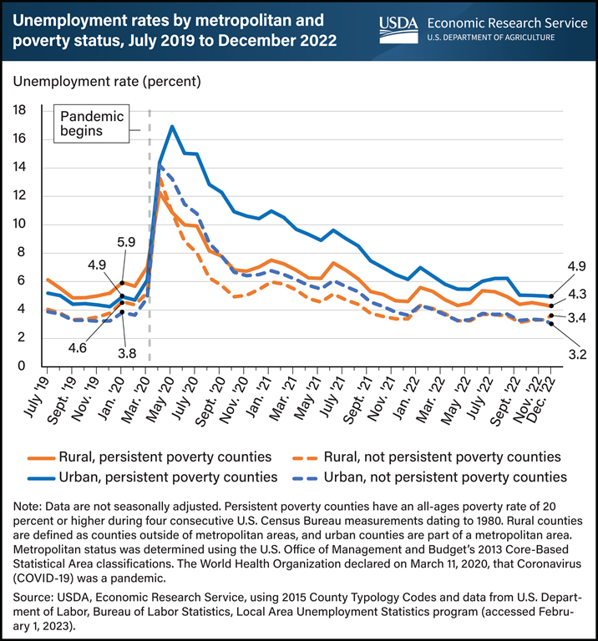
Motivation: COVID-19
COVID-19 pandemic both a health and economic crisis.
Economic shutdown → mass job-loss over a short period of time.
Increased risk of eviction for renters and foreclosure for owners.

Slide 4
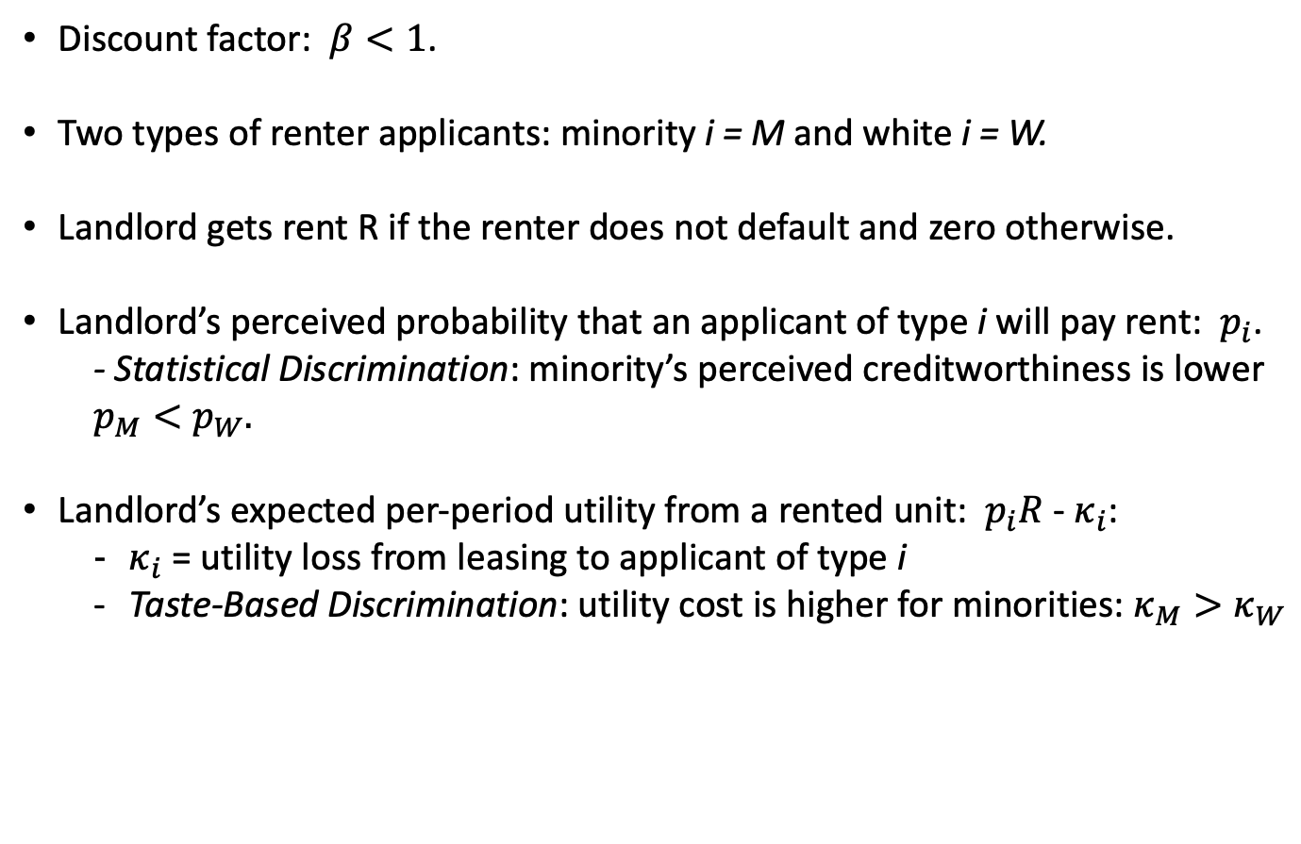
Model: Assumptions
Discount factor: $β<1$.
Two types of renter applicants: minority i = M and white i = W.
Landlord gets rent R if the renter does not default and zero otherwise.
Landlord’s perceived probability that an applicant of type i will pay rent: $p_{i}$.
- Statistical Discrimination: minority’s perceived creditworthiness is lower $p_{M}<p_{W}.$
Landlord’s expected per-period utility from a rented unit: $p_{i}R$- $κ_{i}$:
$κ_{i}$ = utility loss from leasing to applicant of type i
Taste-Based Discrimination: utility cost is higher for minorities: $κ_{M}>κ_{W}$

Slide 5

Model: Assumptions
Tenant stays in the unit if pays the rent and is evicted otherwise.
If evicted, landlord searches for a new tenant by posting the listing and replying to applicants’ inquiries.
Replying to an inquiry is costly: the cost of calling minority net of cost of calling white: $ψ∼F\left(.\right)$ (not a source of discrimination: $Εψ=0$).

Slide 6
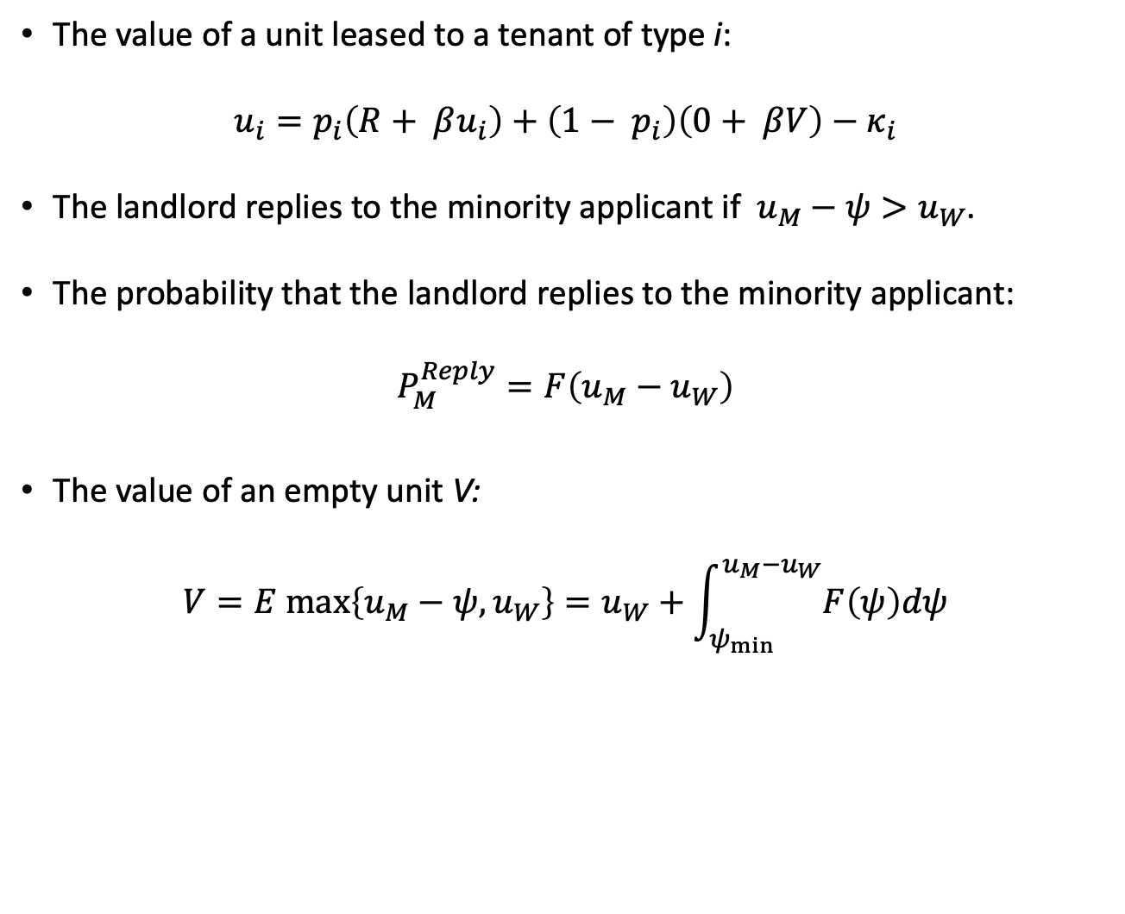
Model: Solution
The value of a unit leased to a tenant of type i:
$$u_{i}=p_{i}\left(R+ βu_{i}\right)+\left(1− p_{i}\right)\left(0+ βV\right)−κ_{i}$$
The landlord replies to the minority applicant if ${ u}_{M} − ψ>u_{W}$.
The probability that the landlord replies to the minority applicant:
$$P_{M}^{Reply}=F\left(u_{M}−u_{W}\right)$$
The value of an empty unit V:
$$V=E max\left\{u_{M}−ψ, u_{W}\right\}=u_{W}+\int_{ψ_{min}}^{u_{M}−u_{W}}{F\left(ψ\right)dψ}$$

Slide 7
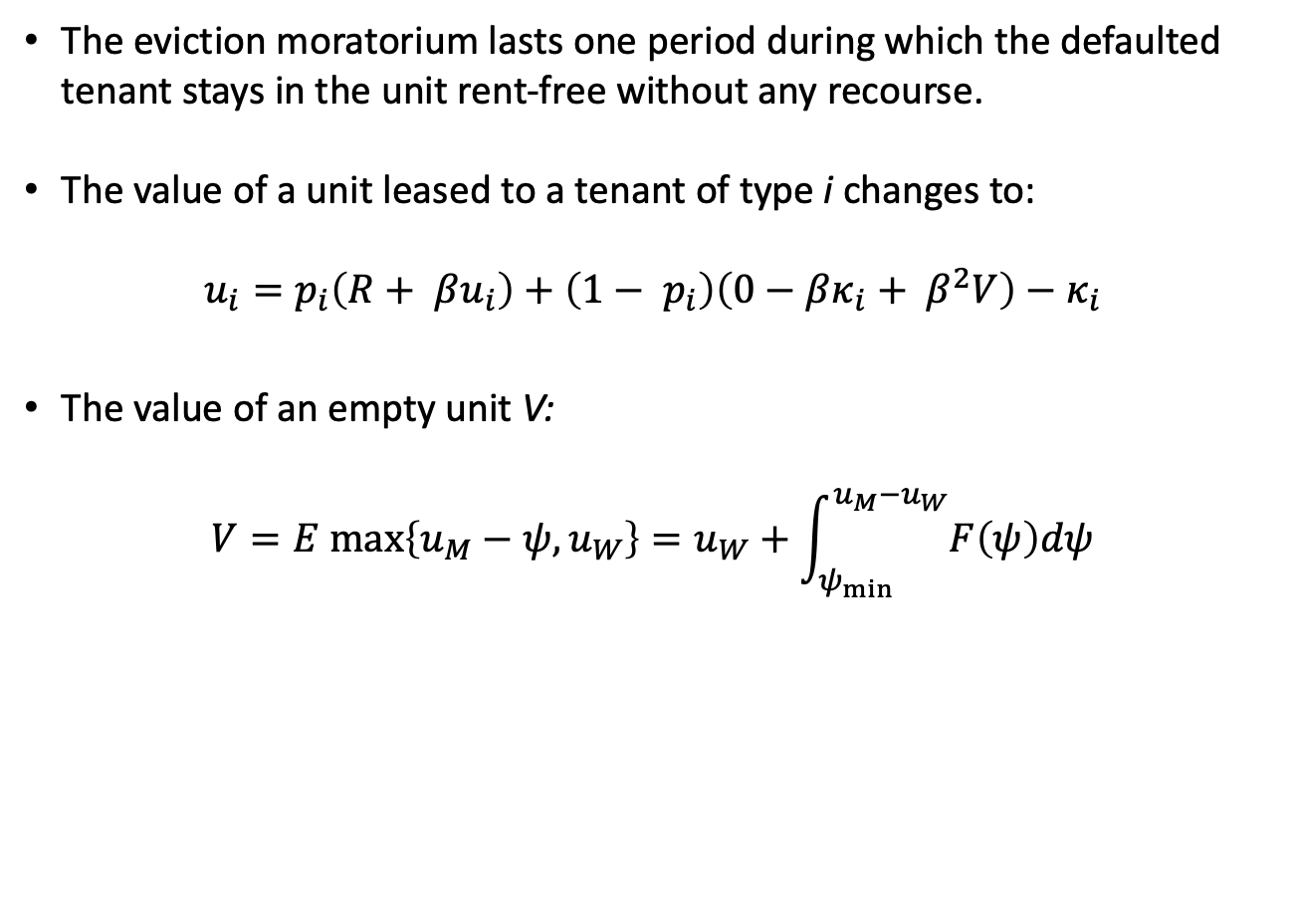
Model: Eviction Moratorium
The eviction moratorium lasts one period during which the defaulted tenant stays in the unit rent-free without any recourse.
The value of a unit leased to a tenant of type i changes to:
$$u_{i}=p_{i}\left(R+ βu_{i}\right)+\left(1− p_{i}\right)\left(0−βκ_{i}+ β^{2}V\right)−κ_{i}$$
The value of an empty unit V:
$$V=E max\left\{u_{M}−ψ, u_{W}\right\}=u_{W}+\int_{ψ_{min}}^{u_{M}−u_{W}}{F\left(ψ\right)dψ}$$

Slide 8
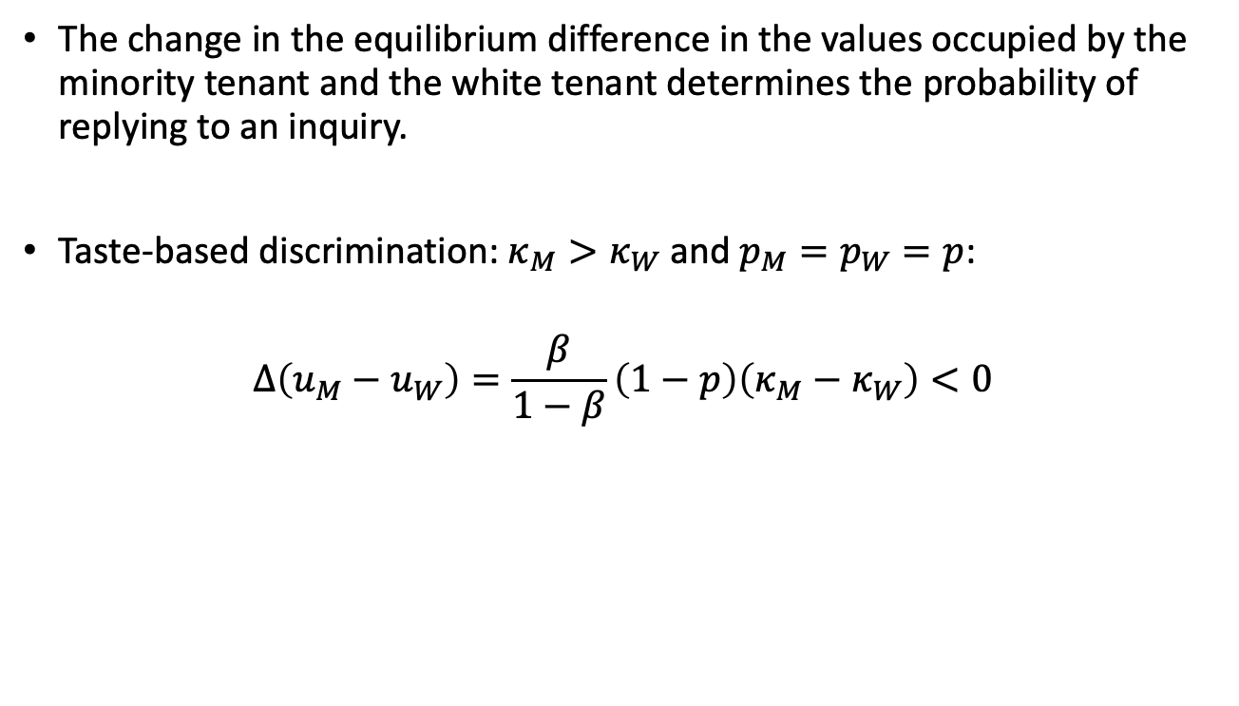
Model: Eviction Moratorium
The change in the equilibrium difference in the values occupied by the minority tenant and the white tenant determines the probability of replying to an inquiry.
Taste-based discrimination: $κ_{M}>κ_{W}$ and $p_{M}=p_{W}=p$:
$$Δ\left(u_{M}−u_{W}\right)=\frac{β}{1−β}\left(1−p\right)\left(κ_{M}−κ_{W}\right)<0$$

Slide 9
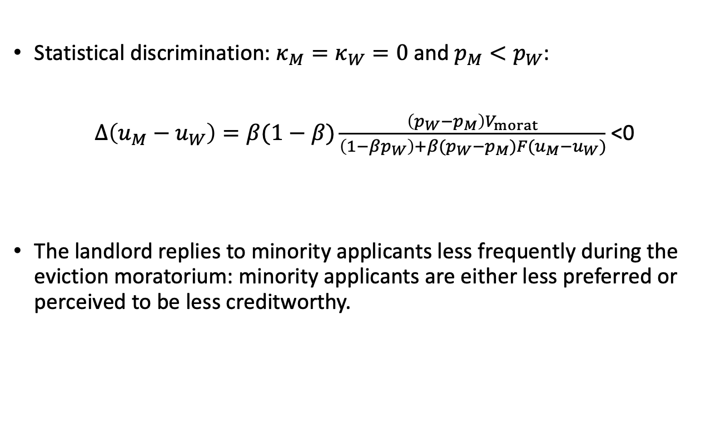
Model: Eviction Moratorium
Statistical discrimination: $κ_{M}=κ_{W}=0$ and $p_{M}<p_{W}$:
$Δ\left(u_{M}−u_{W}\right)=β(1−β)\frac{\left(p_{W}−p_{M}\right)V_{morat}}{\left(1−βp_{W}\right)+β(p_{W}−p_{M})F(u_{M}−u_{W})}$ <0
The landlord replies to minority applicants less frequently during the eviction moratorium: minority applicants are either less preferred or perceived to be less creditworthy.

Slide 10
Model: Effect of Eviction Moratorium
Minority applicants are either
less preferred in the case of taste-based discrimination or
perceived to be less creditworthy in the case of statistical discrimination.
These differences are exacerbated by the eviction moratorium.
During the eviction moratorium, the landlord replies to minority applicants less frequently.
Notes:
Psi variable

Slide 11
Experimental Evidence
Peter Christensen, Ignacio Sarmiento-Barbieri, and Christopher Timmins (2021). "Racial Discrimination and Housing Outcomes in the United States Rental Market,” NBER WP #29516

Slide 12
Experimental Design
Experiment covered February 6 – July 31, 2020.
Random sequence of interactions sent to 8,476 property managers across 50 largest metropolitan housing markets on major online rental housing platform.
Targeted listings in downtown and suburban areas starting the day after each property was listed on the platform.

Slide 13
Experimental Design
One inquiry per day using fictitious identities.
Randomized sequence of and interval between inquiries.
Responses from property managers were registered as such if they were received within 7 days and indicated that the property was available.
Fictitious identities drawn in random sequence from a set of 18 first/last name pairs selected to elicit cognitive associations with one of the racial/ethnic categories:
African American
Hispanic
White
Stratified sampling of first names using maternal educational attainment and gender.

Slide 14
Experimental Design: Names
African American | Hispanic | White
Nia Harris | Isabella Lopez | Aubrey Murphy
Jalen Jackson | Jorge Rodriguez | Caleb Peterson
Ebony James | Mariana Morales | Erica Cox
Lamar Williams | Pedro Sanchez | Charlie Myers
Shanice Thomas | Jimena Ramirez | Leslie Wood
DaQuan Robinson | Luis Torres | Ronnie Miller
Source: Gaddis 2017 from the New York State birth records and Census.

Slide 15
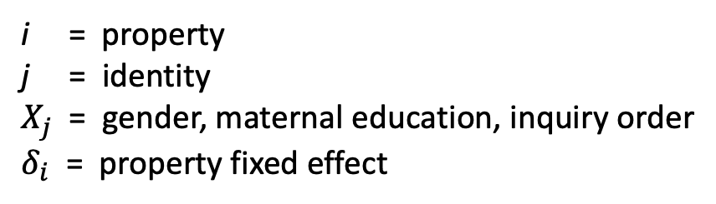
Baseline Analysis
$${Response}_{ij}= δ_{i}+ β^{AA}{AfricanAmerican}_{j}+β^{H}{Hispanic}_{j}+ X_{j}^{′}θ+ ε_{ij}$$
i = property
j = identity
$X_{j}$ = gender, maternal education, inquiry order
$δ_{i}$ = property fixed effect

Slide 16
Baseline Analysis

Slide 17
Defining Treatment
Most moratoria that were put into place were initiated over a relatively short period of time near the start of the pandemic.
Literature has focused on what happens when a moratorium ends (Benfer et al. 2021, Hatamyar and Parmeter 2023).
T = 1 if eviction moratorium has ended ( = 0 if still in place).
Drop 8 states that never implement moratorium.
Drop observations prior to when moratorium is started (sample begins March 13, 2020).
First lifted moratorium: May 15, 2020.
Last lifted moratorium: July 15, 2020.

Slide 18
Defining Treatment
Map

Slide 19
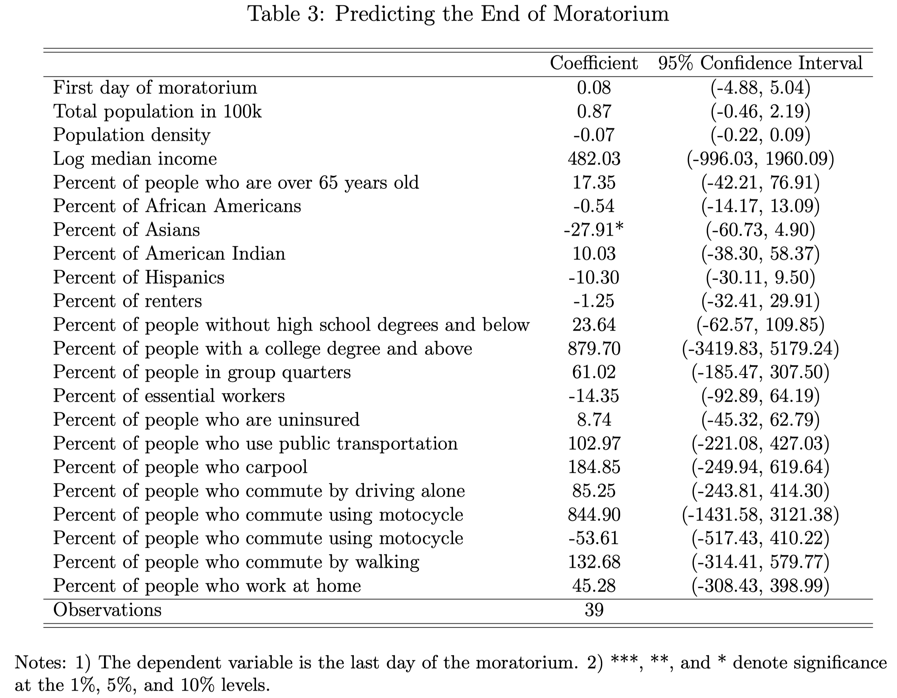
Treatment Endogeneity

Slide 20
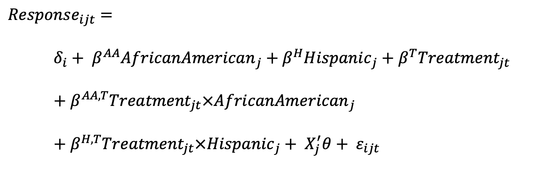
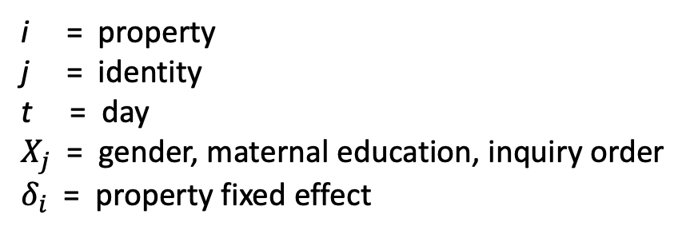
Difference-in-Differences
${Response}_{ijt}=$
$δ_{i}+ β^{AA}{AfricanAmerican}_{j}+β^{H}{Hispanic}_{j}+β^{T}{Treatment}_{jt}$
$+ β^{AA,T}{Treatment}_{jt}×{AfricanAmerican}_{j}$
$+{ β}^{H,T}{Treatment}_{jt}×{Hispanic}_{j}+ X_{j}^{′}θ+ ε_{ijt}$
i = property
j = identity
t = day
$X_{j}$ = gender, maternal education, inquiry order
$δ_{i}$ = property fixed effect

Slide 21
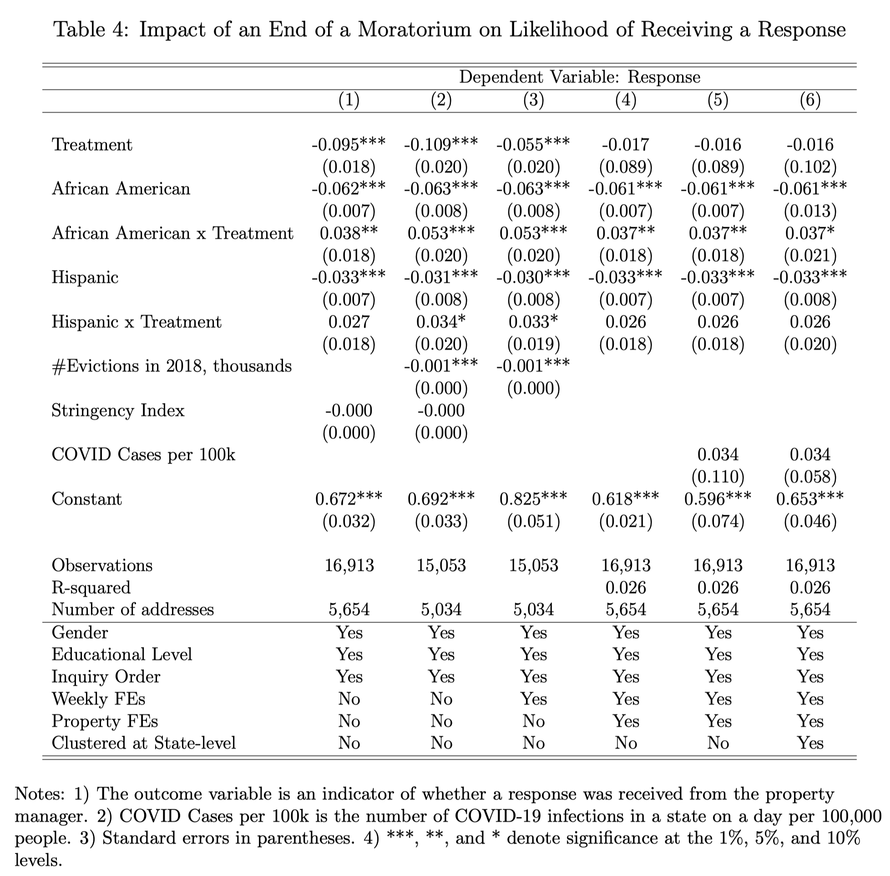

Slide 22
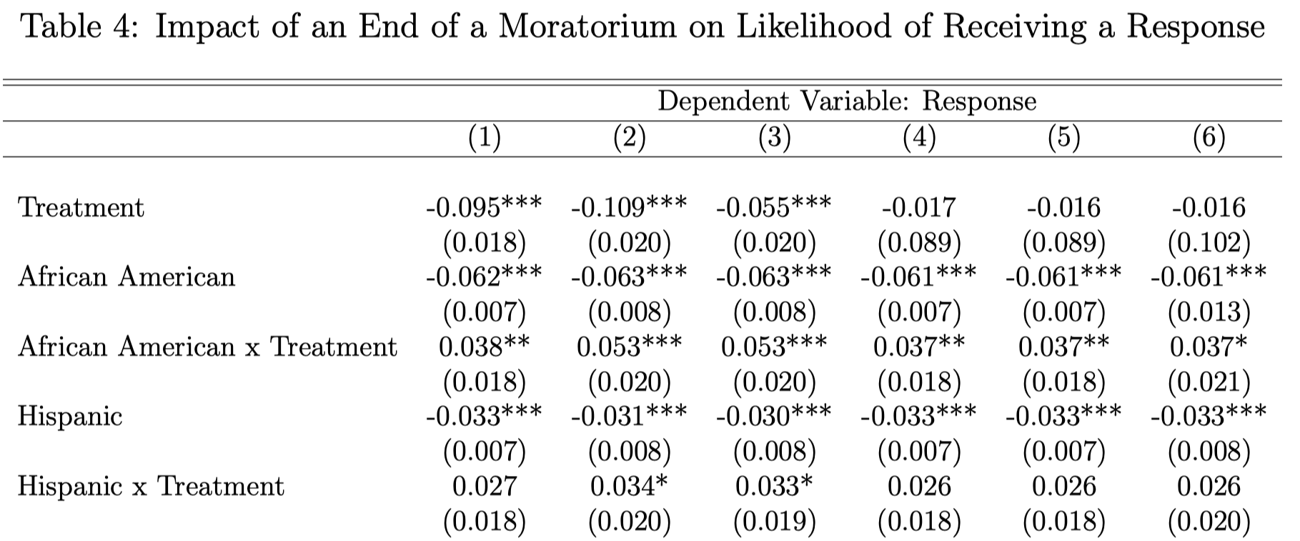
White identities received a response 57.36% of the time during moratoria.
African American with the same education, gender, and inquiry order would only receive a response 51.26% of the time.
Relative response ratio = 0.89 during a moratorium.
When the moratorium expires, relative response ratio increases to 0.96.

Slide 23
Results are Robust to
Staggered Differences-in-Differences: 2-stages:
Form a panel of day x state relative response ratios from a smoothed logit.
Use this panel to estimate the ATT with and without propensity score matching on the # of daily COVID-19 cases in a state.
Staggered Differences-in-Differences but calculating the standard errors using bootstrap with clustering by states to account for the errors from the first stage.
Details Table A Table B

Slide 25
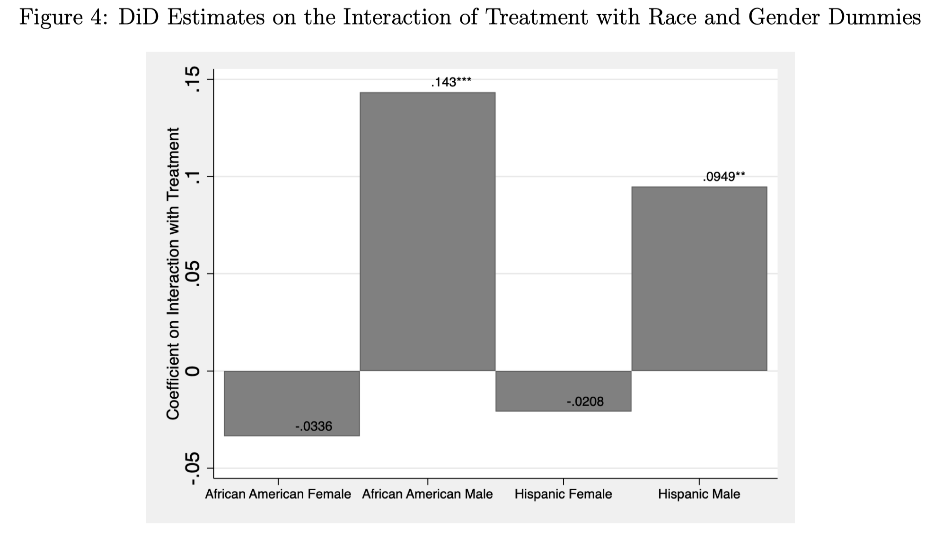
Heterogeneity by Gender

Slide 26
Appendix

Slide 27
Motivation: Consequences of Eviction
Eviction is associated with an array of negative economic consequences that may extend years beyond the initial event:
job loss
missed educational opportunities
increased child maltreatment
barriers to securing subsequent rental housing
reduced access to healthcare
negative health consequences
adverse birth outcomes
maternal and adolescent depression
increased exposure to sexually transmitted diseases

Slide 28
Motivation: Eviction Policy
``Right-to-Counsel” laws
Rules governing the filing of eviction lawsuits
Role of tenant screening tools
Role of racial and ethnic discrimination in decisions to evict
Role of policies intended to ensure decent and affordable housing
Rent support and eviction moratoria

Slide 29
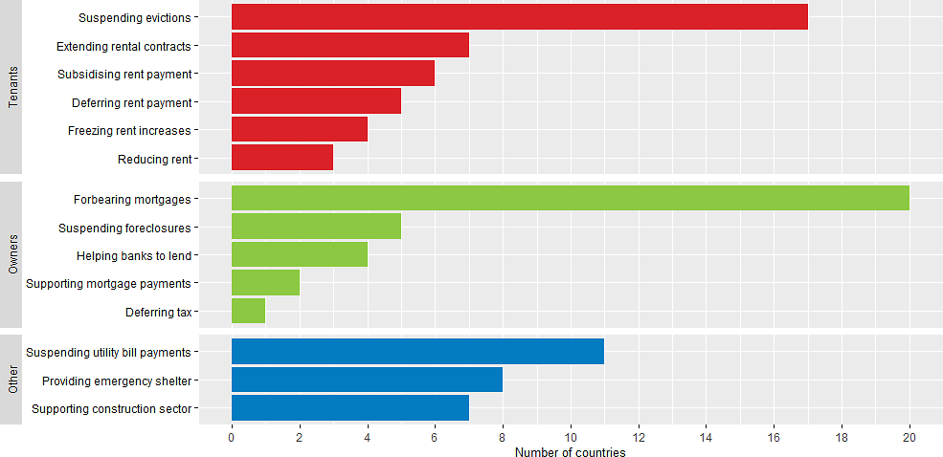
Motivation: Housing Insecurity
Government policies to preserve housing stability implemented as a public health measure at the local, state and federal levels.
Note: The sample includes all 37 OECD and 9 non-OECD countries. See detailed country-coverage in the Annex. Source: OECD (2020[4]), DIW, Arena Housing Project.

Slide 30
Eviction Moratoria
E.g., Wisconsin
https://www.murphydesmond.com/wisconsins-temporary-ban-on-evictions-and-foreclosures-due-to-covid19
https://urbantriage.org/our-work/covid-19

Slide 31
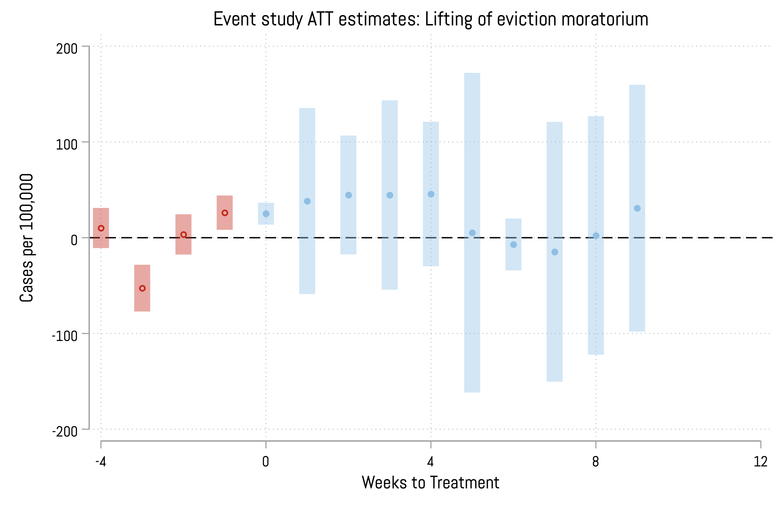
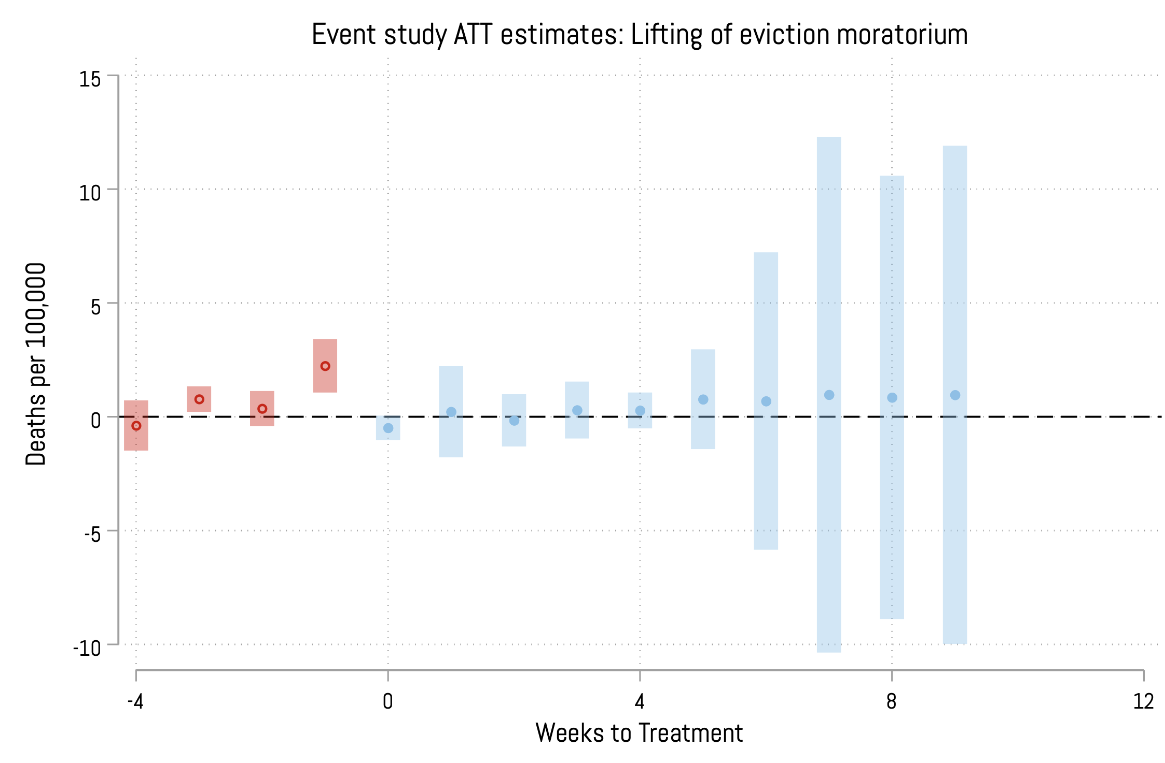
Eviction Moratorium: COVID-19 Rates
De Chaisemartin, Clément, and Xavier d’Haultfoeuille. "Two-way fixed effects estimators with heterogeneous treatment effects." American Economic Review 110, no. 9 (2020): 2964-2996.

Slide 32
Peter Christensen, Ignacio Sarmiento-Barbieri, and Christopher Timmins (2021). "Racial Discrimination and Housing Outcomes in the United States Rental Market,” NBER WP #29516

Slide 33
Back

Slide 34
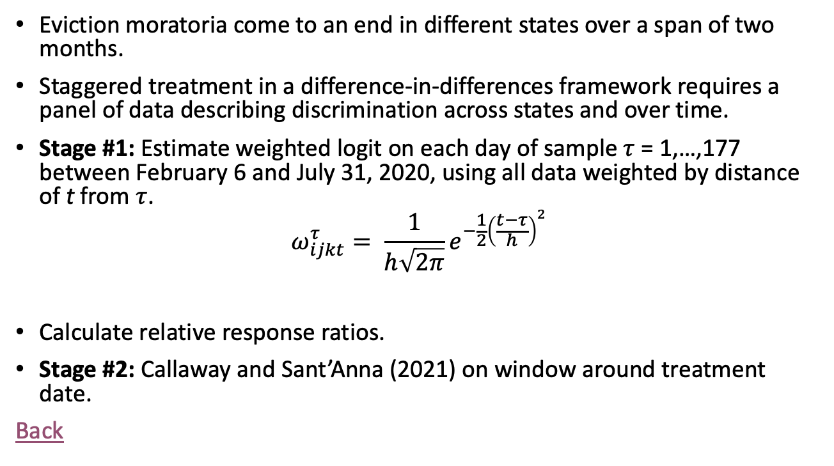
Staggered Diff-in-Diff
Eviction moratoria come to an end in different states over a span of two months.
Staggered treatment in a difference-in-differences framework requires a panel of data describing discrimination across states and over time.
Stage #1: Estimate weighted logit on each day of sample $τ$ = 1,…,177 between February 6 and July 31, 2020, using all data weighted by distance of t from $τ$.
$$ω_{ijkt}^{τ}= \frac{1}{h\sqrt{2π}}e^{−\frac{1}{2}{\left(\frac{t−τ}{h}\right)}^{2}}$$
Calculate relative response ratios.
Stage #2: Callaway and Sant’Anna (2021) on window around treatment date.
Back

Slide 35
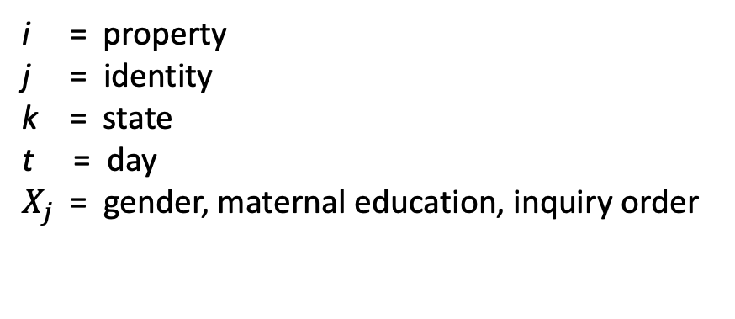
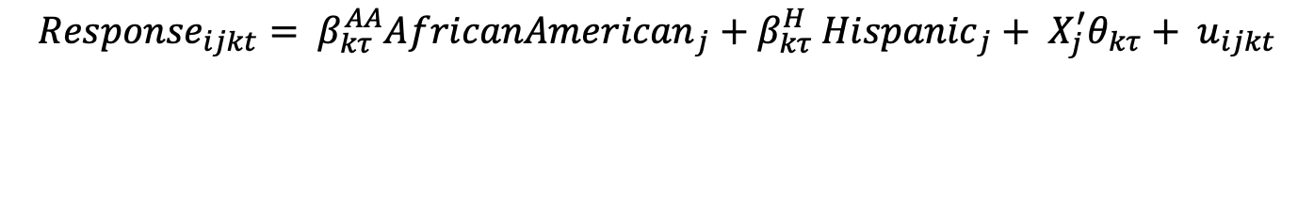
Staggered Diff-in-Diff
Stage #1: Weighted Logits
$${Response}_{ijkt}= β_{kτ}^{AA}{AfricanAmerican}_{j}+β_{kτ}^{H} {Hispanic}_{j}+ X_{j}^{′}θ_{kτ}+ u_{ijkt}$$
i = property
j = identity
k = state
t = day
$X_{j}$ = gender, maternal education, inquiry order
Back

Slide 36
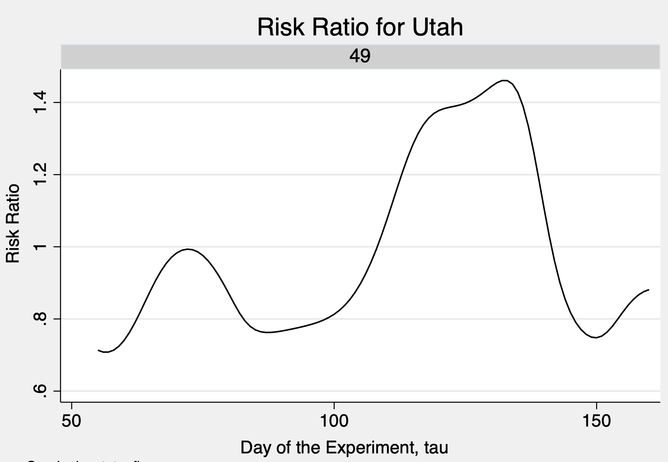
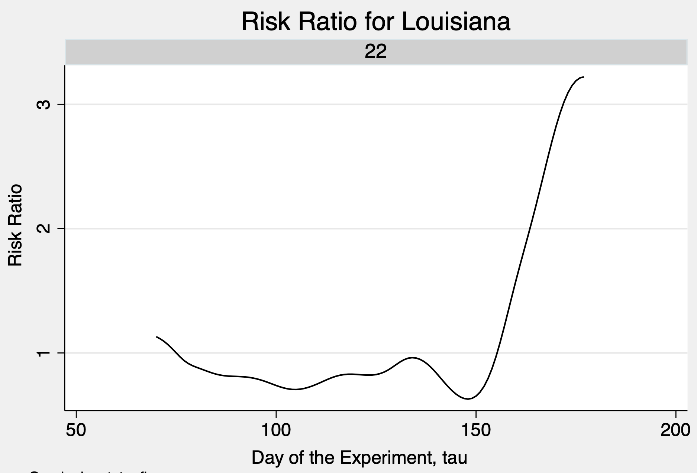
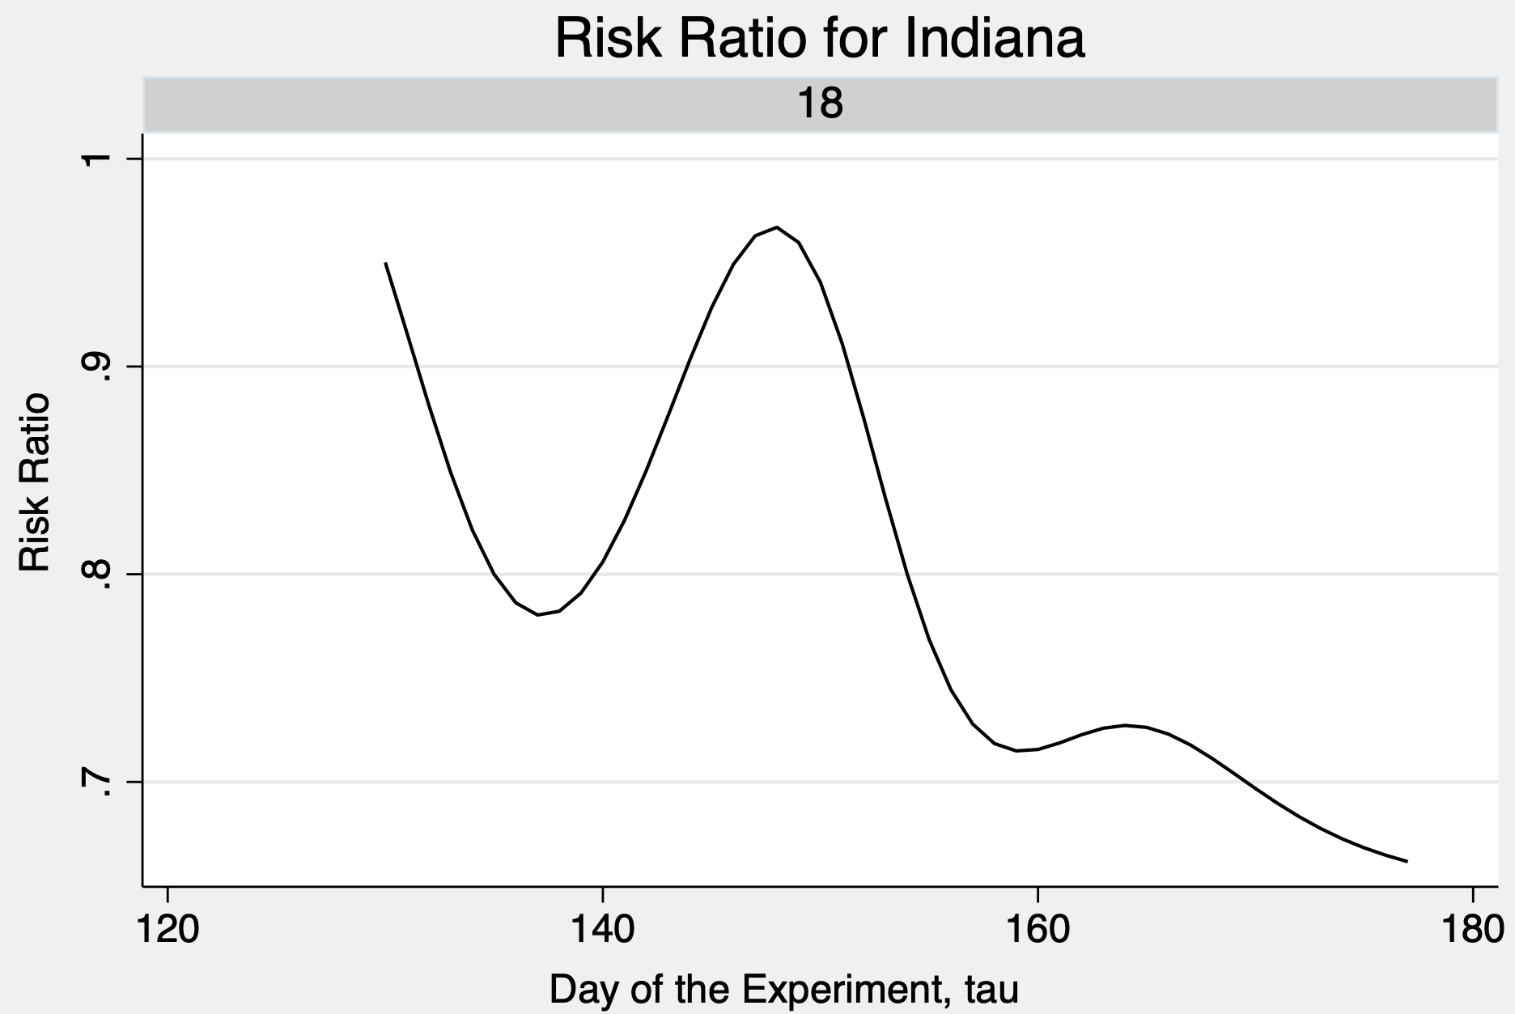
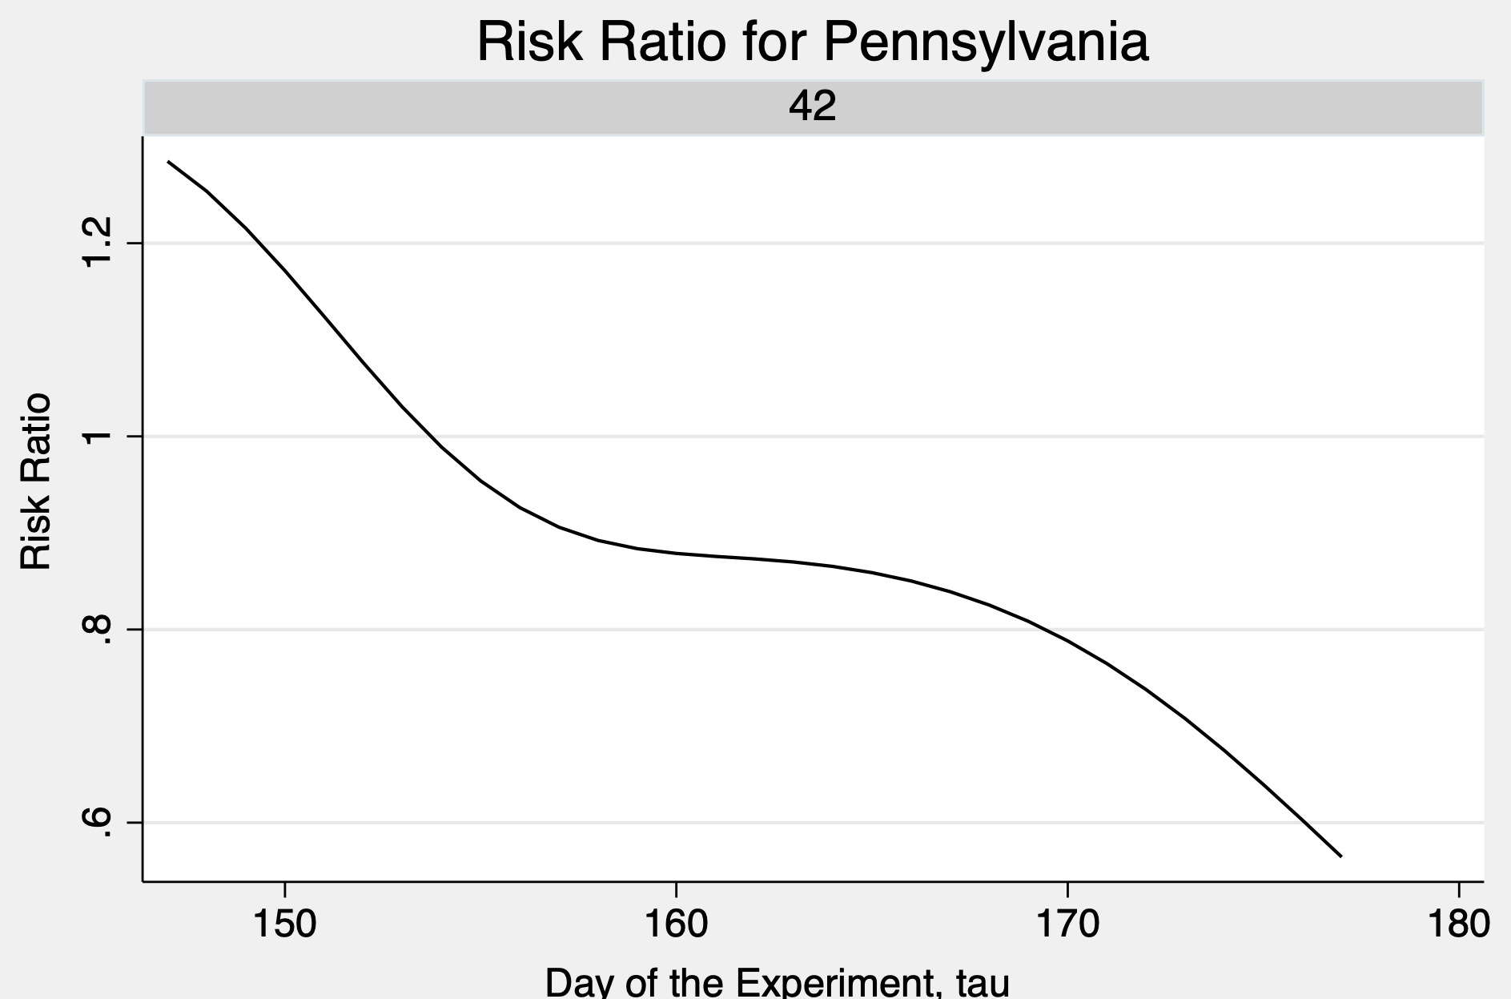
Smoothed Relative Response Ratios (h = 7)

Slide 37
Staggered Diff-in-Diff
Stage #2: Moratorium effect on the relative response ratio
$\frac{ρ_{kτ}^{R}}{ρ_{kτ}^{W}}= α_{0}^{g}$ + $α_{1}^{g}{TREAT}_{kτ}+ α_{2}^{g}{POST}_{kτ}+α_{3}^{g}{TREAT}_{kτ}×{ POST}_{kτ}+ ν_{kτ}$
k = state
𝜏 = day of the experiment
g = day of the experiment when eviction moratoria ended
𝑅∈(𝐴𝐴, 𝐻) = race
Back

Slide 38
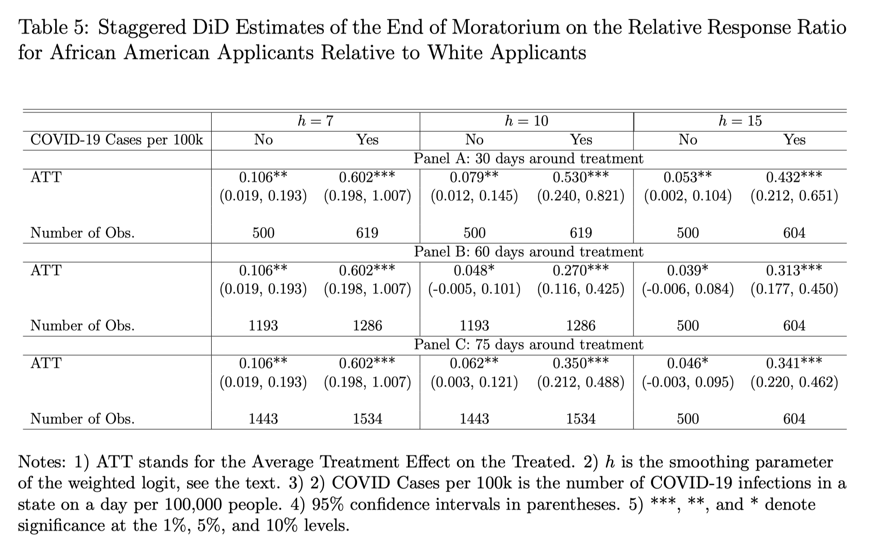
Back

Slide 39
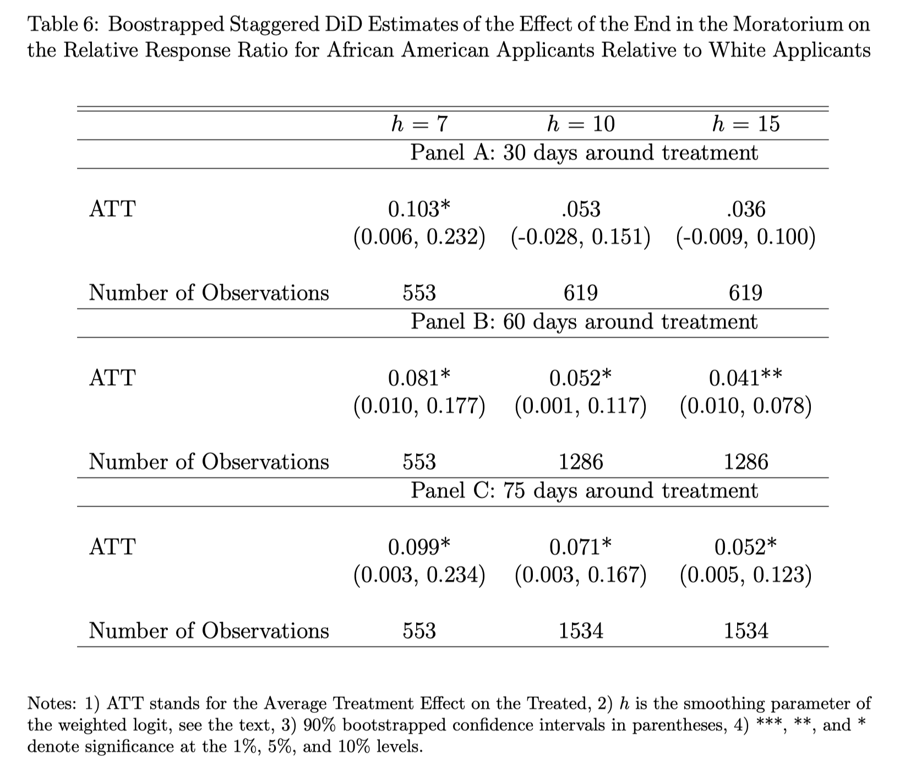
Back

