Slide 1
Occupational Hazard? An Analysis of Birth Outcomes Among Physician Mothers
Bapu Jena ¹ ³ David Slusky ² ³ ⁴ Lilly Springer ²
¹ Harvard Medical School
²University of Kansas
³ NBER ⁴IZA
^{May 2, 2024}

Slide 2
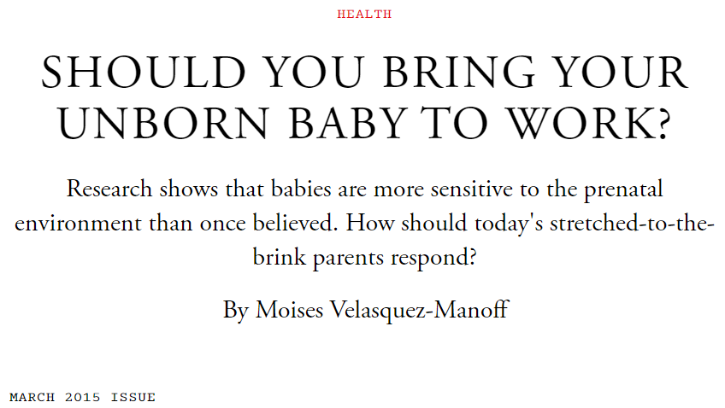
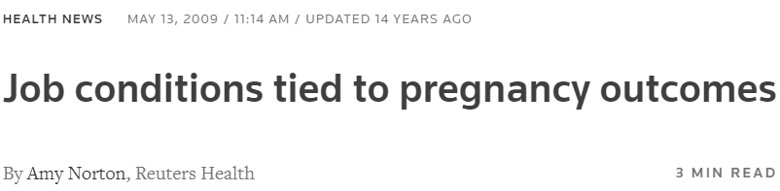
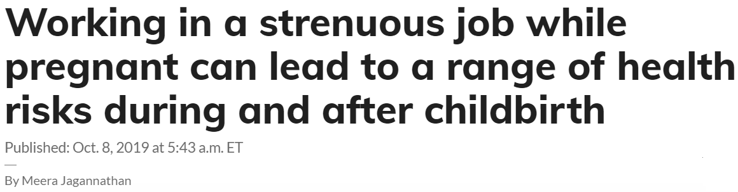
Stressful work environments are bad for pregnancy

Slide 3
Compare birth outcomes of physician moms to lawyer moms’
Estimate the impact of a 2011 duty hour reform on physician birth outcomes
  Reform limited number of consecutive hours a first-year resident could work
Contribute evidence to:
  Fetal Origins Hypothesis (Barker 1990, Almond & Currie 2011, Currie et al. 2023, Lauderdale 2006, Duncan et al. 2017)
  How physicians behave as patients (Johnson & Rehavi 2016, Frakes et al. 2021, Finkelstein et al. 2022)

Slide 4
Use Texas births records
From 2007 to 2014 where at least one parent has a doctorate or terminal, professional degree
  Includes parent’s occupation and first and last name
Sample includes women ages 26-45 who list their occupation as an equivalent to “physician” or “lawyer”
Matched physician mother’s name with the CMS NPI registry to find their specialty
  Identified about 70% of physician specialties
Created sub-sample of surgeons
Descriptive Statistics

Slide 5
Estimate a descriptive and DID model
Physician mother
Demographic & behavior controls
Birth Outcome
→
→
→
$Y_{ict}=β_{1}physician_{i}+$ $δX_{i}+α_{t}+α_{c}+ε_{ict}$
→
→
Year & county FE
Birth post duty hour reform
→
$$Y_{ict}=β_{1}physician_{i}+β_{2}postrule_{i}+β_{3}\left(physician_{i}∗postrule_{i}\right)$$
$$+δX_{i}+α_{t}+α_{c}+ε_{ict}$$

Slide 6
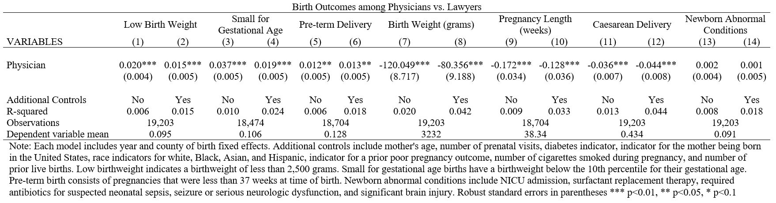
Physicians’ kids have worse outcomes!

Slide 7
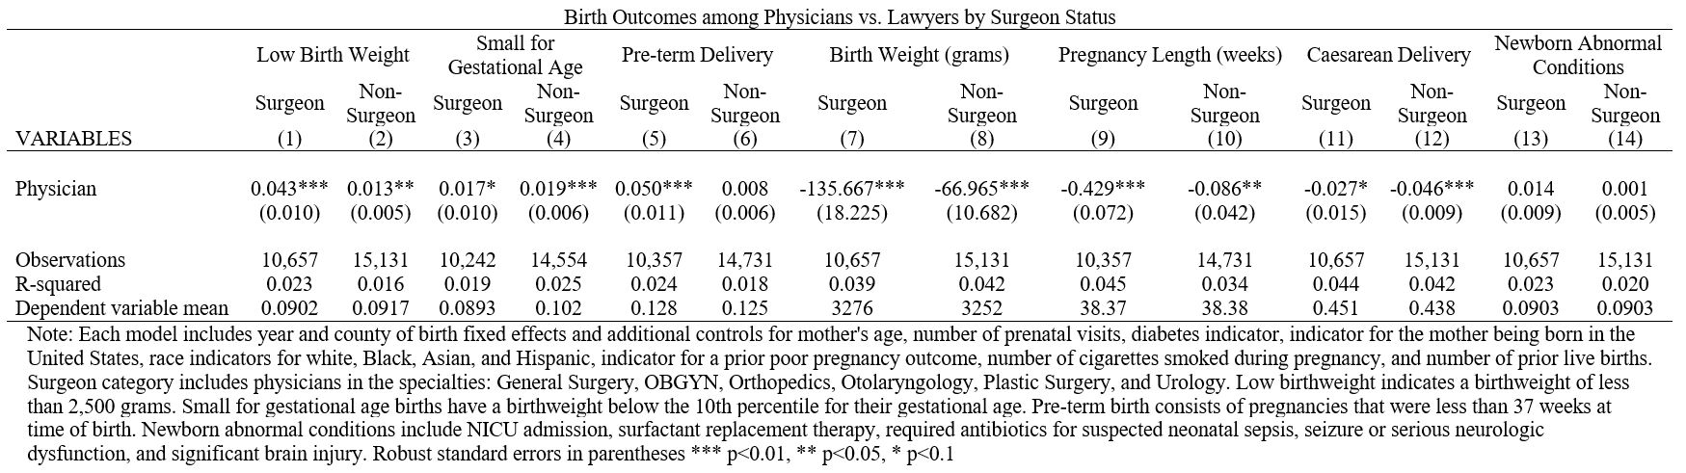
Surgeons appear to be driving our results
Physician Only Analysis

Slide 8
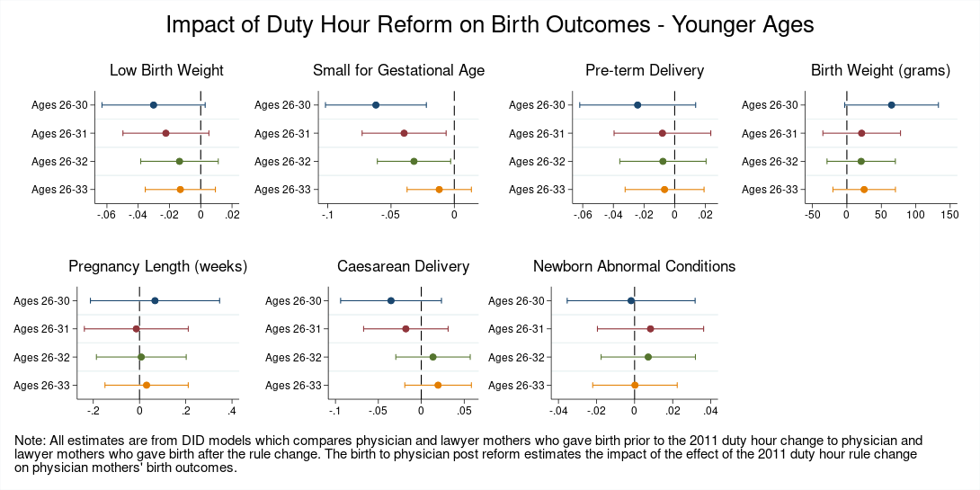
Young physicians were helped by the reform
Tables
Event Studies

Slide 9
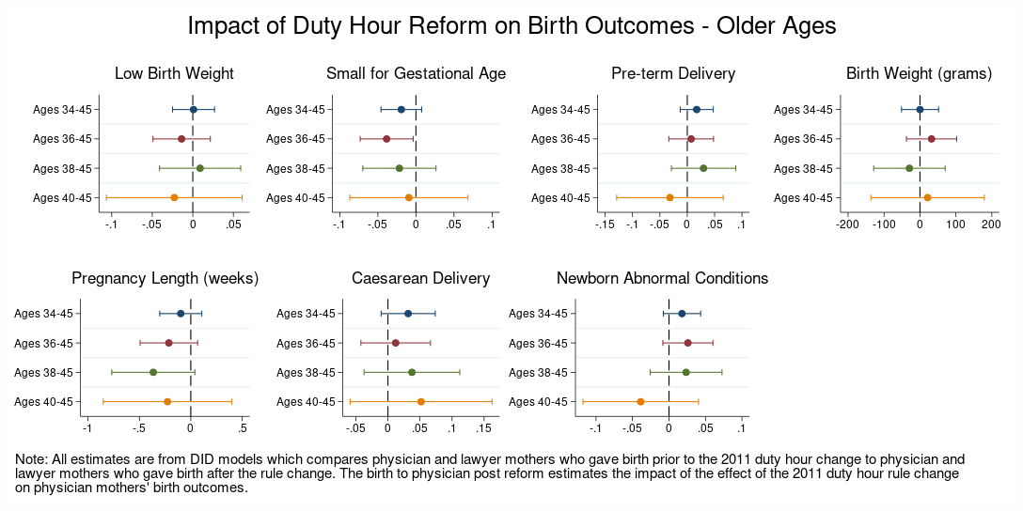
Reform didn’t impact older physicians’ kids
Tables
Event Studies

Slide 10
Robust to other explanations and specifications
Additional Explanations
Robustness Checks
Physicians by Age
Model with race & birthplace interaction
Physicians by Residency Length
First-Time Mothers
Physicians by Burnout Level
Without judges (descriptive model)
Physicians by Share of Women in Specialty
Without judges (work reform model)
Physicians by High Call/Shift Length
Physicians by Radiation Exposure

Slide 11
Conclusion: physician have worse birth outcomes
Physicians have worse birth outcomes than lawyers, a comparable group
Surgeons appear to be driving the adverse birth outcomes
The 2011 ACGME duty hour reform improved birth outcomes for the young physicians who were targeted by the reform

Slide 12
Thank you!
Questions?
david.slusky@ku.edu
lilly.springer@ku.edu

Slide 13
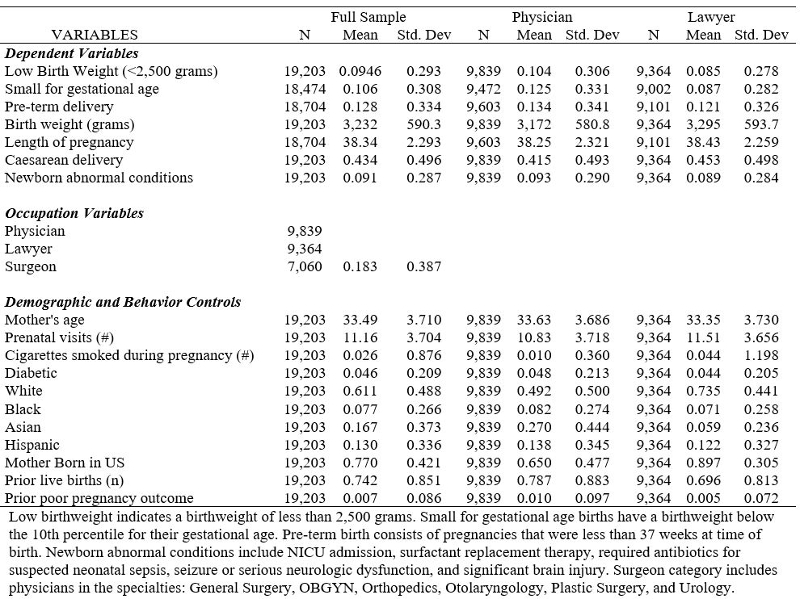
Demographically physicians and lawyers are similar
Back

Slide 14
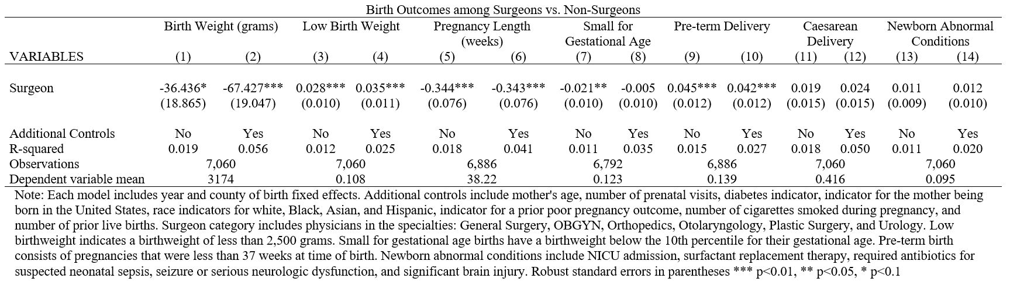
For just physicians, surgeons drive results
Back

Slide 15
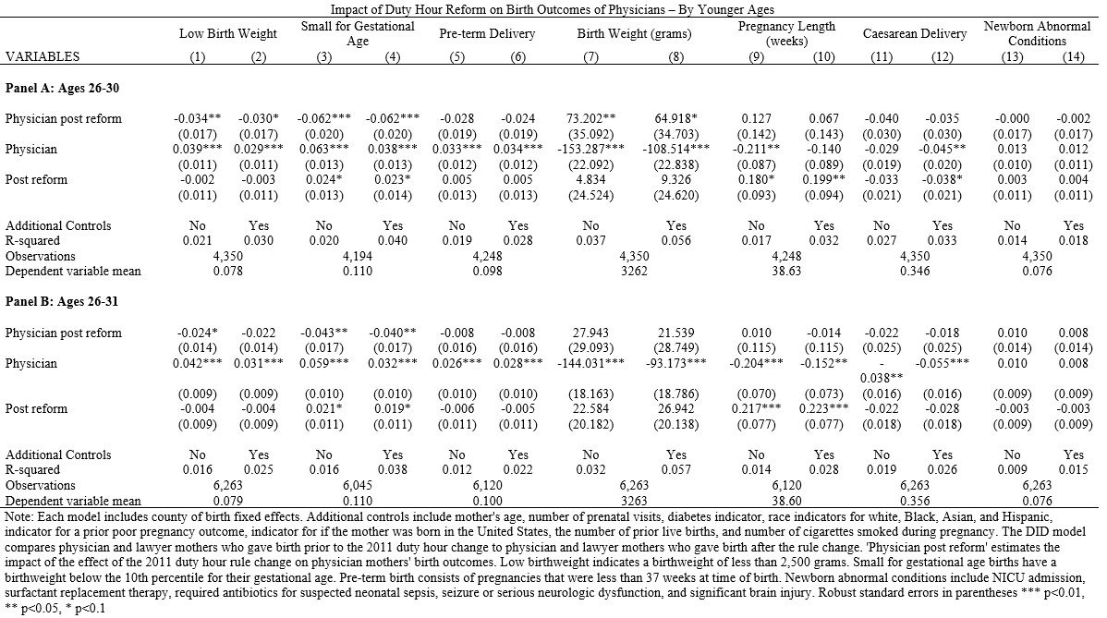
26-30 & 26-31 show results
Table Continued

Slide 16
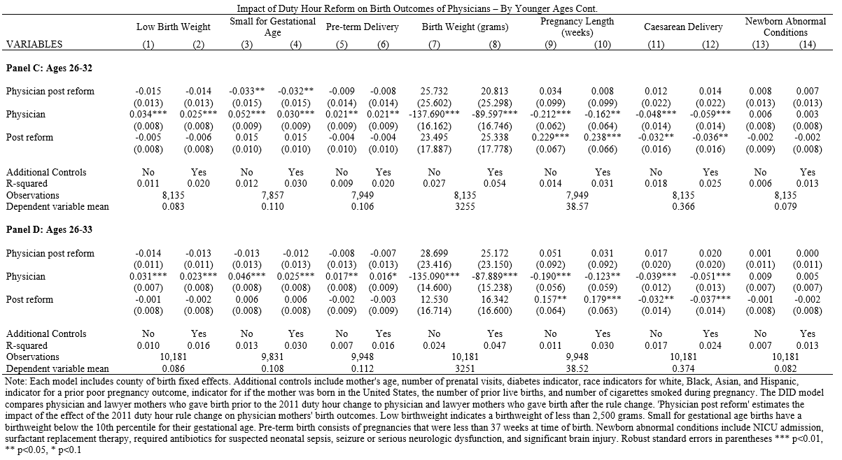
Less and less for 26-32 and 26-33
Back

Slide 17
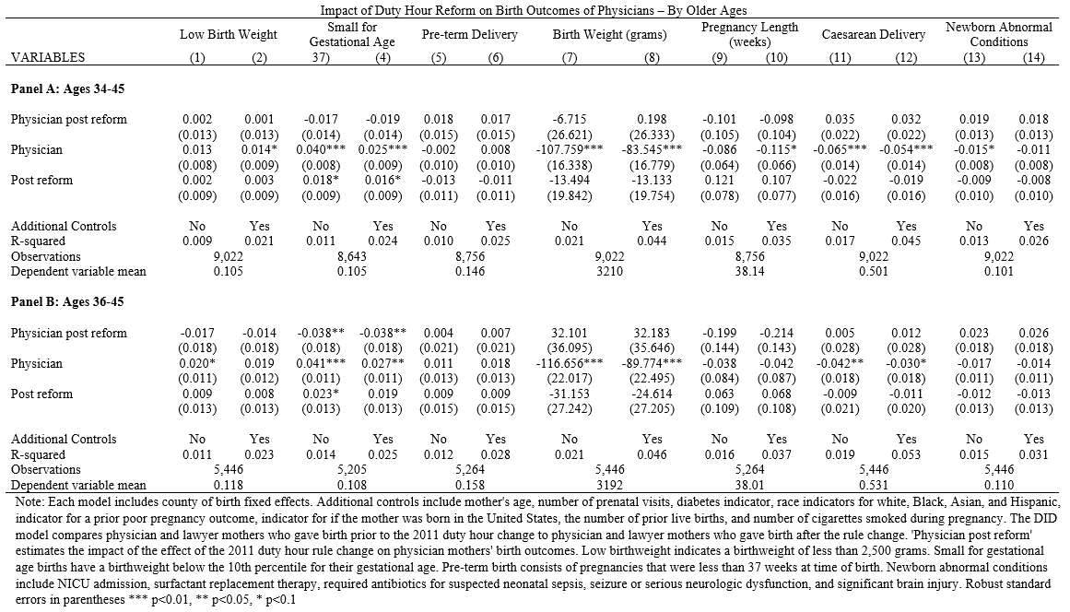
No effect for older parents
Table Continued

Slide 18
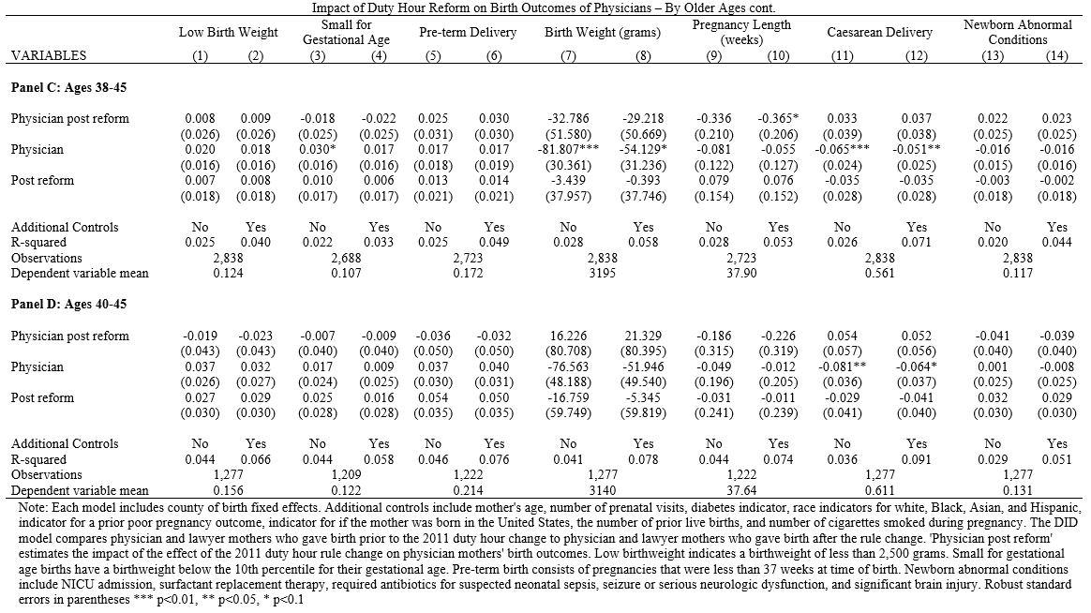
No effect for older parents (2)
Back

Slide 19
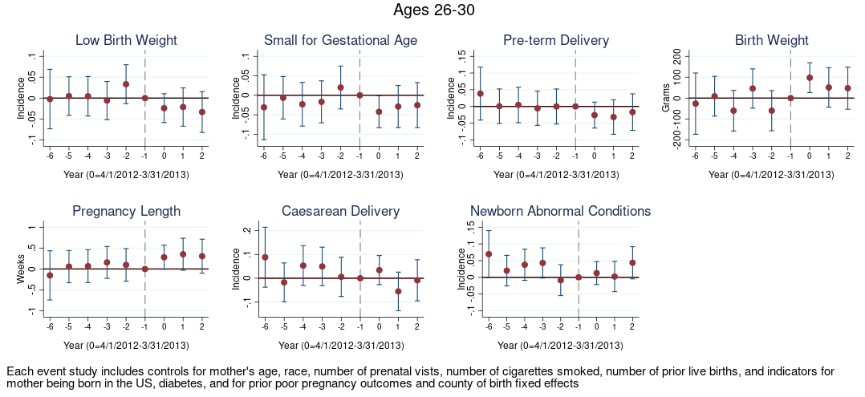
Event studies show this for the 26-30 age group
Back

Slide 20
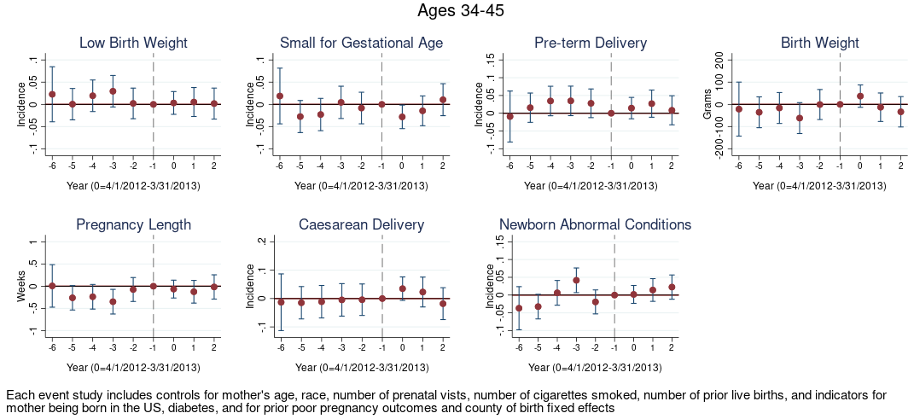
But nothing for the 34-45 age group
Back

Slide 21
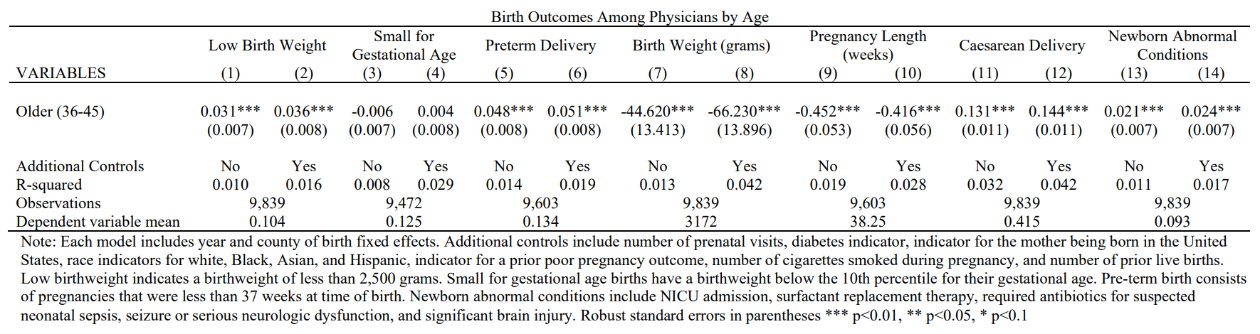
Older physicians do have worse outcomes
Back

Slide 22
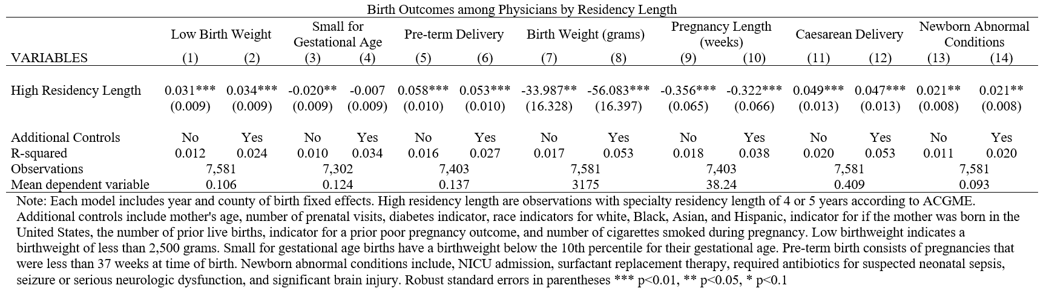
Higher residency length -> worse outcomes
Back

Slide 23
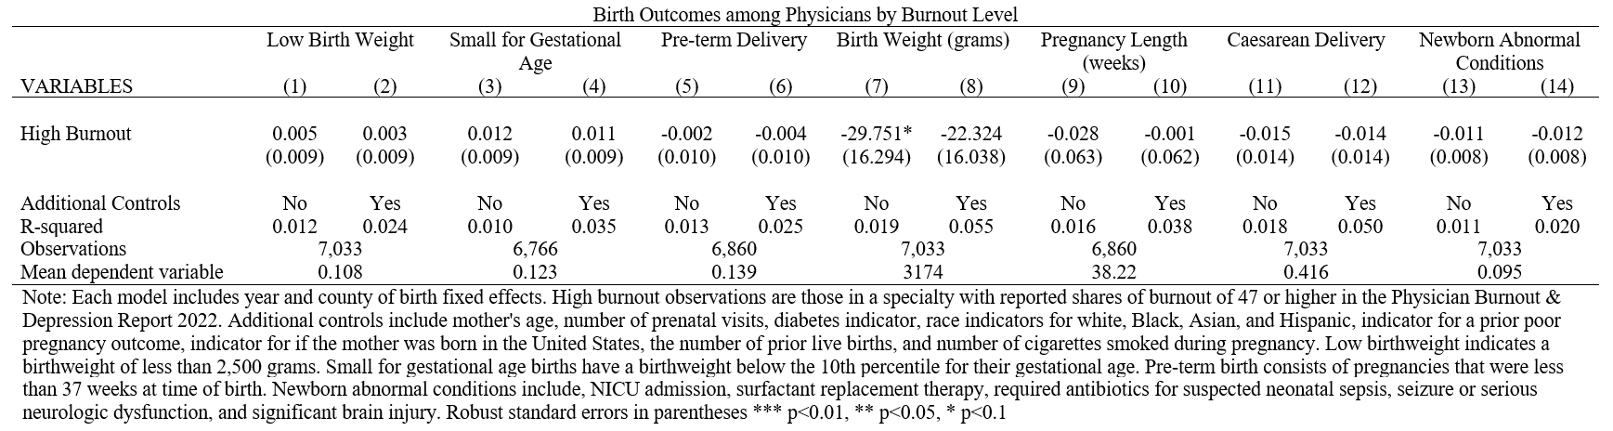
No difference based on burnout levels
Back

Slide 24
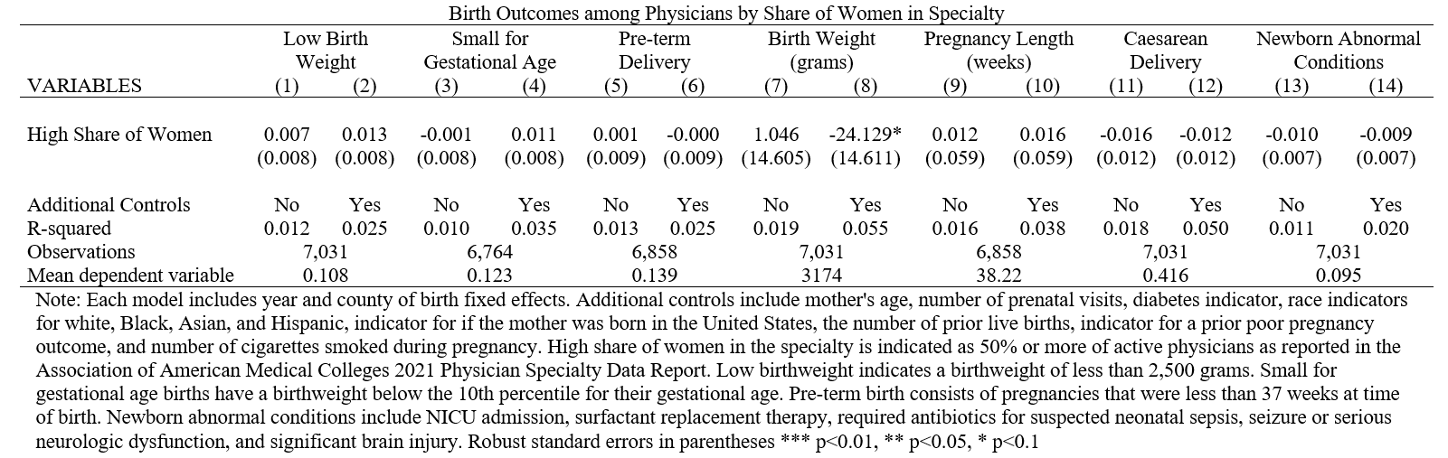
No difference based on share of women
Back

Slide 25
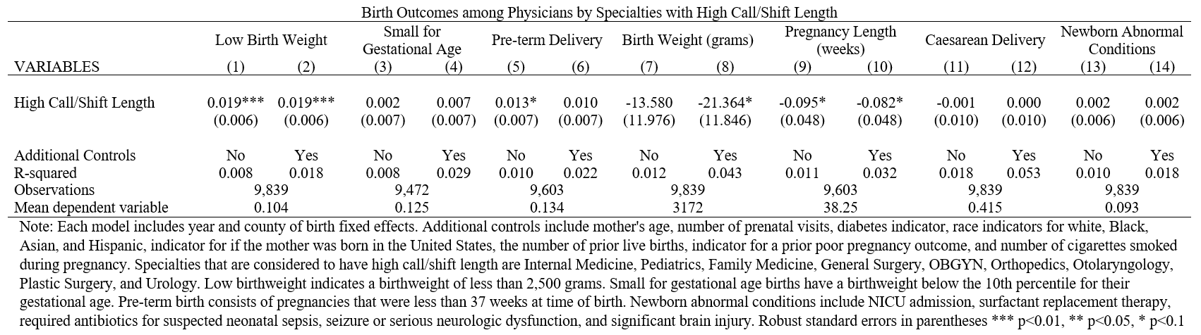
No difference for high call/shift length
Back

Slide 26
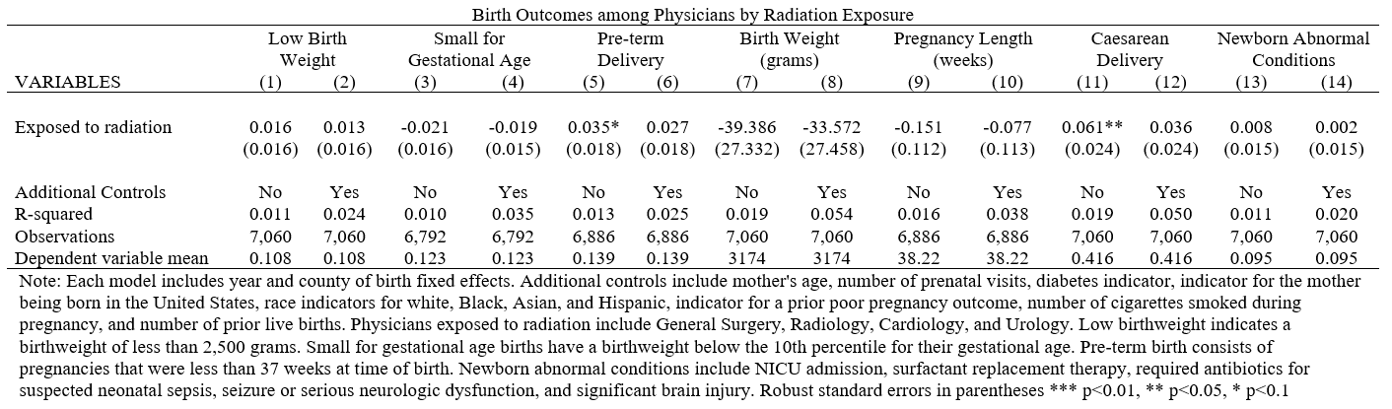
No difference for radiation exposure
Back

Slide 27
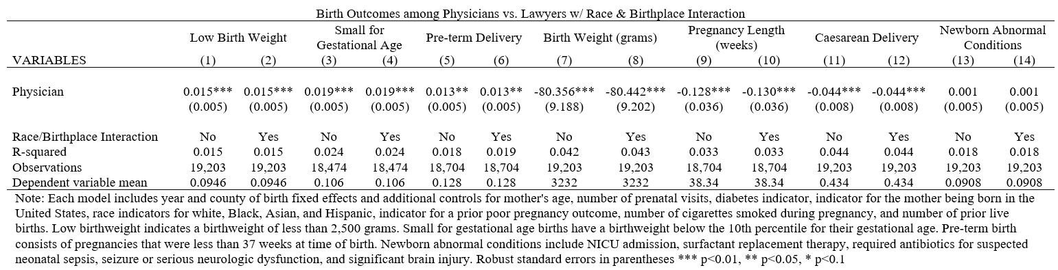
Results hold w/ race & birthplace interacted
Back

Slide 28
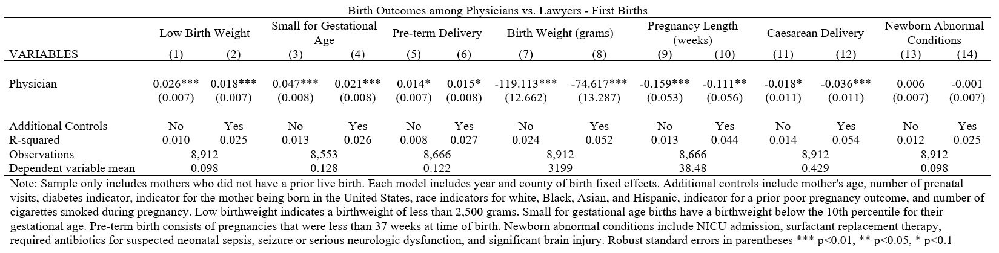
Results hold for just first time mothers
Back

Slide 29
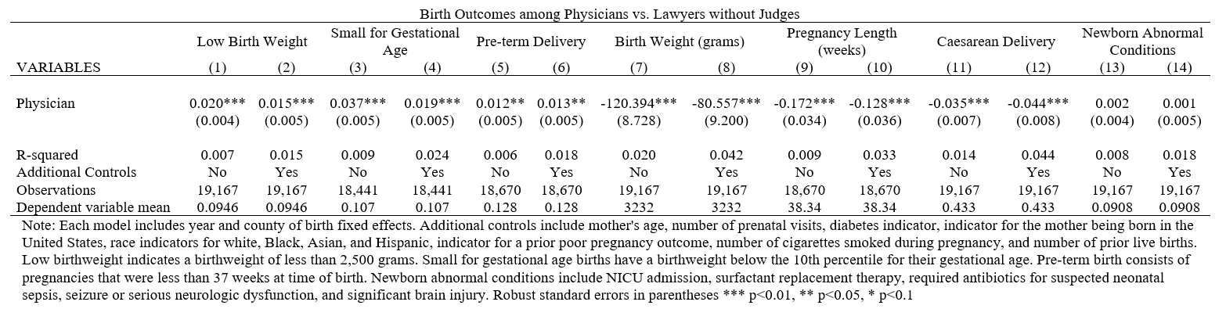
Excluding judges doesn’t matter
Back

Slide 30
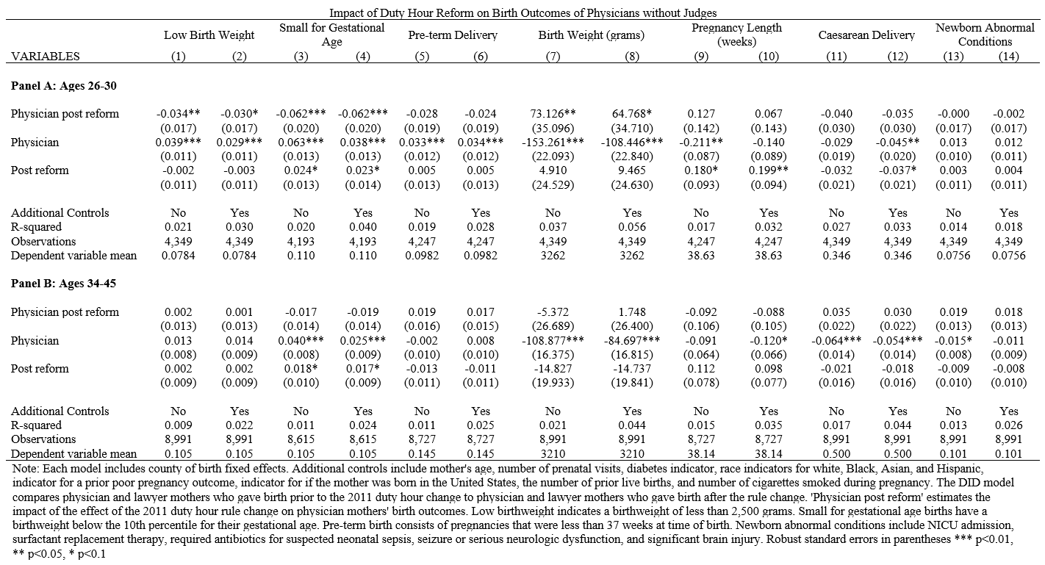
Excluding judges doesn’t impact work reform results
Back

