Slide 1
Rationality and Disposition Effect in Algorithmic Trading
Karolis Liaudinskas
(Norges Bank)
NBER Summer Institute 2024
The views are those of the author and do not necessarily reflect those of Norges Bank.

Slide 2
Motivation
AI and automated decision making are becoming ubiquitous
One potential advantage - the ability to reduce psychology-related human errors
No evidence that algorithms avoid cognitive biases
Research question: To what extent do algorithms avoid cognitive biases documented in economics (e.g., overconfidence, loss aversion, etc.)?
Contribution: First study to examine the economic rationality of algorithmic decision making
Implications: for economic theory, financial markets, real economy
1/11

Slide 3
This paper
Data: transaction-level data from the NASDAQ Copenhagen Stock Exchange (2016-2017)
Algorithmic traders (ATs) – trade “with no human involvement” (Nasdaq, 2018)
Disposition effect (DE) – the tendency to realize gains faster than losses – challenges the rationality assumption, e.g., the expected utility theory (von Neumann and Morgenstern, 1947)
Hypotheses (RQ: to what extent do algorithms avoid cognitive biases?):
ATs exhibit a smaller disposition effect than humans
The difference is at least partially caused by psychology
Any apparent DE among ATs can be explained by rational explanations
Findings:
As a group, ATs on average do not exhibit DE while similarly trading humans do
The difference increases on colder mornings (as humans’ DE is sensitive to the weather), which suggests that it is at least partially driven by psychology, e.g. mood and cognition
Some (17%) algorithms show DE but it is explained by (profitable) contrarian trading
2/11

Slide 4
Data
Transaction-level data from the NASDAQ Copenhagen Stock Exchange (2016-2017)
Every trade shows trader id, institution name, human/algorithm, proprietary/broker, execution time, stock name, price and number of shares
102 m transactions in 159 stocks
52 m transactions – 146 algorithms
16 m transactions – 1,151 humans
The rest – routing accounts
Around half of trades are proprietary trades
I observe cities where traders are located and merge this data with hourly weather data (sunshine, temperature, precipitation, air pressure, etc.) from Meteoblue
Run analysis three times:
Full sample of ATs and humans
Using ATs and humans that are matched on their average trading frequency
Using trader-day level matching on: (1) number of trades, (2) turnover in EUR, (3) portfolio size in EUR, etc.
3/11

Slide 5
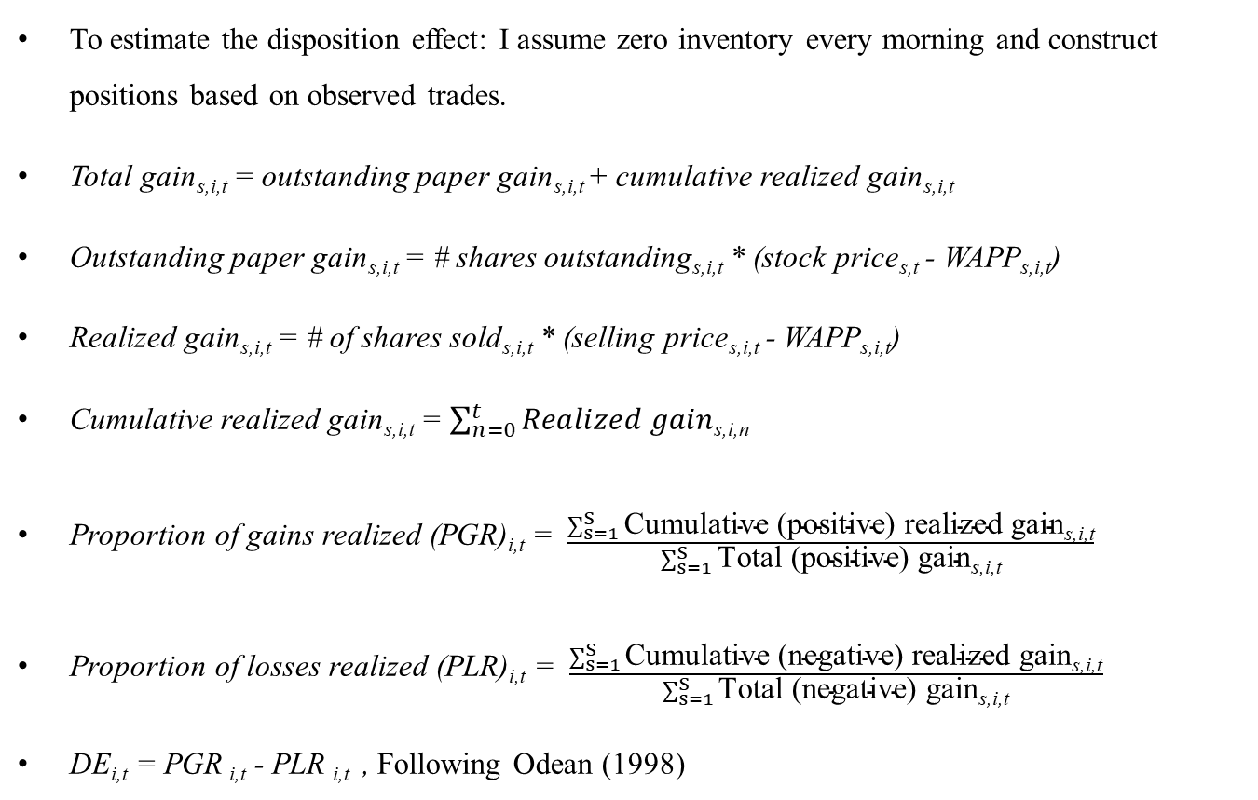
Estimation of the dispositions effect
To estimate the disposition effect: I assume zero inventory every morning and construct positions based on observed trades.
Total gain_{s,i,t} = outstanding paper gain_{s,i,t} + cumulative realized gain_{s,i,t}
Outstanding paper gain_{s,i,t} = # shares outstanding_{s,i,t} * (stock price_{s,t} - WAPP_{s,i,t})
Realized gain_{s,i,t} = # of shares sold_{s,i,t} * (selling price_{s,i,t} - WAPP_{s,i,t})
Cumulative realized gain_{s,i,t} = $\sum_{n=0}^{t}{Realized gain\text{s}\text{,}\text{i}\text{,}\text{n}}$
Proportion of gains realized (PGR)_{i,t} = $\frac{\sum_{s=1}^{S}{\text{Cumulative}\text{ (}\text{positive}\text{) }\text{realized} \text{gain}\text{s}\text{,}\text{i}\text{,}\text{t}}}{\sum_{s=1}^{S}{\text{Total} \text{(}\text{positive}\text{) }\text{gain}\text{s}\text{,}\text{i}\text{,}\text{t}}}$
Proportion of losses realized (PLR)_{i,t} = $\frac{\sum_{s=1}^{S}{\text{Cumulative}\text{ (}\text{negative}\text{) }\text{realized} \text{gain}\text{s}\text{,}\text{i}\text{,}\text{t}}}{\sum_{s=1}^{S}{\text{Total}\text{ (}\text{negative}\text{) }\text{gain}\text{s}\text{,}\text{i}\text{,}\text{t}}}$
DE_{i,t} = PGR _{i,t} - PLR _{i,t} , Following Odean (1998)
4/11

Slide 6
Results: average disposition effect
${\text{D}\text{E}}_{i,t}=α+{ε }_{i,t}$
${\text{D}\text{E}}_{i,t}=α+β{ \text{Human}}_{i}+{ε }_{i,t}$
${\text{Human} }_{i}$ is a dummy equal to 1 if trader i is a human and 0 if it is an algorithm
5/11

Slide 7
Results: average disposition effect
6/11

Slide 8
Results: weather effect
${\text{DE}}_{i,t}=α+β{\text{Temp}\text{erature}}_{i,t}+{ε }_{i,t}$
${\text{DE}}_{i,t}=α+β_{1}{\text{Temp}erature}_{i,t}+β_{2}{\text{Human}}_{i}+β_{3}{\text{Temp}\text{erature}}_{i,t}×{\text{Human}}_{i}+{ε }_{i,t}$
${\text{Temp}\text{erature}}_{i,t}$ is a dummy equal to 1 if the temperature between 8 am and 9 am of day t in the traders i‘s city is higher than median of that month.
7/11

Slide 9
Results: robustness
The main results remain similar if:
Include other weather variables as controls: humidity, air pressure, precipitation, cloud cover, sunshine duration, radiation and wind speed
Include trader-fixed effects and time-fixed effects
Measure the temperature in degrees instead of a dummy
Use 3-dimensional panel (trader, day, stock) and include interactive fixed effects
Consider either only long or only short positions
8/11

Slide 10
Results: potential mechanisms
The results suggest that psychology at least partially affects the difference in disposition effect between humans and algorithms
Psychology literature finds evidence that higher air temperature improves both mood and cognition (e.g., Keller et al., 2005)
Prospect theory (Kahneman and Tversky, 1979): investors care about gains and losses relative to a reference point and are loss-averse.
Temperature cognition cognitive biases disposition effect
Realization utility (Barberis and Xiong, 2012): realization of gains (losses) causes pleasure (pain), and repairs mood.
Temperature mood need for mood repair disposition effect
9/11

Slide 11
Why do some ATs exhibit DE?
25 out of 146 (17%) algorithms do exhibit positive DE, while 18 show inverse DE
ATs with DE<0 – momentum traders
ATs with DE>0 – contrarian traders
DE>0 for algorithms can be fully explained by (profitable) contrarian trading
10/11

Slide 12
Conclusion
On average, ATs no not exhibit the disposition effect while similarly trading humans do
The difference is sensitive to the weather
This suggests that
The disposition effect for humans is at least partially driven by psychology (e.g., mood and cognition)
AT behave more in line with rational economic models
Some algorithms show a positive disposition effect but it can be fully explained by the (profitable and, thus, arguably rational) contrarian trading strategy
11/11

