Slide 1
Competing for Talent: Large Firms and Startup Growth
James Bessen (BU), Felix Poege (Bocconi), Ronja Röttger (BU)

Slide 2
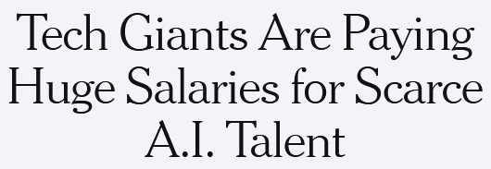
Notes:
https://www.forbes.com/sites/forbesbusinesscouncil/2022/07/08/the-war-for-talent-in-the-new-normal/?sh=5941c228689e
Many debates about labor shortages and back-to-office mandates

Slide 3
Startup
Agglomeration
Large firms
Spillovers
Talent
Suppliers/customers
Competition in hiring?

Slide 4
A threat for startups?
Talent war
Large firms aggressively compete for talent
Challenge for startup growth
Startups face a trade-off
Locate near large firms – benefits from agglomeration (Shaver and Flyer 2000; Sorenson and Audia 2000; Stuart and Sorenson 2003; McCann and Folta 2011; Guzman 2019)
Competition for talent – possibly harmful for startup performance, e.g. lower survival, slower growth, less likely IPO (see e.g., Stuart and Sorenson 2005)

Slide 5
A threat for startups?
Focus: Big firm share of hiring (not level)
Startups particularly vulnerable to competition from big firms because
Big firms pay higher wages, perhaps from rent sharing
Big firms hire more of the type of workers that startups need
Little known what factors influence startups’ challenge of large firm hiring

Slide 6
Research Question
How does large firms’ hiring influence startup performance in local labor markets?
Build dataset linking job advertisements to small and large firms 2010-2020
Show that large firm hiring “crowds out” startups in the labor market
Startups offer higher wage premiums → less startup growth
Factors: Spillovers from related businesses, role of markups, employee mobility
Minority/Women-founded or led startups

Slide 7
Motivating the trade-off in a model
Employees have heterogeneous preferences over employers
Large firms: Amenities and long-term security
Startups: Greater personal opportunities, greater reward (also non-pecuniary), but greater risk of failing
Hotelling-type model (following Bhaskar, Manning and To, 2002)
Relative preferences of employees

Slide 8
Motivating the trade-off in a model
Results:
Productivity and demand shocks affecting large firms → increase hiring in local labor markets
Increase startup wage premiums and decrease profits
Motivates focus on markups of large firms and spillovers to startups

Slide 9
Preview of Findings
Big firm hiring in local labor market
Higher startup pay
Slower startup growth
Worse startup outcomes
Crowding effect
Weaker with more mobile employees
Weaker for startups in proximate businesses (spillovers)
Stronger with big firm markups

Slide 10
Literature
Startup hiring key to growth
Glaeser and Kerr 2009; Dahl and Klepper 2015; Karahan, Pugsley, and Şahin 2019; Balsmeier et al. 2020; Guzman and Stern 2020; Chen, Hshieh, and Zhang 2021; Dimmock, Huang, and Weisbenner 2022
Agglomeration benefits attract startups
Shaver and Flyer 2000; Sorenson and Audia 2000; Stuart and Sorenson 2003; McCann and Folta 2011; Guzman 2019
But startups often perform poorly in clusters
Pe’er and Keil 2013, Shaver and Flyer 2000; Sorenson and Audia 2000; Stuart and Sorenson 2005
Large firms raise wages, attract startups
Greenstone and Moretti 2003; Greenstone, Hornbeck, and Moretti 2010; Gupta 2022; Slattery and Zidar 2020; Qian and Tan 2021; Bhardwaj et al. 2023

Slide 11
Data Description

Slide 12
Matching Crunchbase with job ad postings
Startups: Crunchbase firms with founding date since 2010 (N=148,000)
Ad postings: Burning Glass Technologies 2010-2020 (N=181 million)
Big firms: >1000 employees from Compustat (publicly listed)
Fuzzy matching
Stock symbol, fuzzy, manual
BGT
Crunchbase
Compustat
Startups: 30% (N=42,000) with an ad
Big firms: 92% (N=3,100) with an ad
Matched: 88% (98% of employment)

Slide 13
Other Data
Local labor market = Commuting Zone
Commuting zone characteristics, such as: mobility, safety net measures
Markups of large companies (Compustat)
$m=θ\frac{revenue}{cost of goods sold}$; where $θ=$ cost share of variable inputs (BLS)
Proximity
Cosine similarity of business descriptions
Minority and women-led/founded firms (Crunchbase)

Slide 14
Empirical Strategy

Slide 15
Empirical Strategy
To identify the impact of large firm hiring on startup success,
we estimate
Big Firm Share (BFS): Ads by large firms / Total number of ads within a commuting zone
Commuting zone $c$, firm $f$, year $t$, and ad counts $N$
$$\ln{{Salary}_{it}=β_{1}Startup_{i}+β_{2}{BFS}_{ct}+β_{3}Startup_{i}∙{BFS}_{ct}+γX_{it}+μ_{c}+δ_{t}+ε_{it}}$$

Slide 16
Confounders
Startup hiring
Exogenous shocks,
$$∆p_{L}$$
$$BFS_{ct}$$
Commuting Zone shocks
Shocks affect both startup pay & big firm hiring:
- Labor market conditions ⇒ CZ fixed effects
- Time varying labor demand ⇒ IV

Slide 17
Instrumental variable approach
Focus on variation from firm-level shocks across commuting zones within large firms
Idea: Instrument using change in big firm hiring in other locations
Reason:
Centralized decisions about firm growth and hiring (Hazell et al, 2022; Hjort et al, 2020)
Propagation of local shocks through firms‘ establishment networks (Giroud and Mueller, 2019, Bena et al. 2022)
Shift-share instrument (Borusyak et al., 2021)
Hiring of the firms in other CZ: $g_{f,−c,t}^{∗}$ (Exogenous shocks)
Share of pre-period hiring in this CZ: $s_{f,c,t−1}$ (Endogenous shares)
Firm-level growth in other CZ
National growth in other CZ

Slide 18
Results

Slide 19
Startup wage premium

Slide 20
Big firm hiring increases wage premiums…
^{13 September 2024 20}
Note: standardized coefficients; dependent variable x 100
Controls: education, exp., exp^2, parttime, industry, occupation, commuting zone, year

Slide 21
…specifically for key occupations
^{13 September 2024 21}
Note: standardized coefficients; dependent variable x 100
Controls: education, exp., exp^2, parttime, industry, occupation, commuting zone, year

Slide 22
Startups have to pay higher wages
^{13 September 2024 22}
Implication?
Model predicts: Higher shares of big firm hiring associated with poorer startup profits
Higher pay – lower margins
How does big firm hiring affect startup performance?
More profitable startups → more likely to grow

Slide 23
Startup performance

Slide 24
BFS and ad growth
^{13 September 2024 24}
Wage residual: From Mincer regression, i.e. adjusting for education, experience, occupation, industry, …
Ad hazard = P[ firm advertises 1st time in observation year]

Slide 25
Emergence of startup growth
^{13 September 2024 25}
Following Lee and Kim (2024): Job postings as measure of startup scaling
Founding
Viability
Employment, job ads
t

Slide 26
Big firm hiring reduces startup growth
^{13 September 2024 26}
1 std. deviation increase in BFS ➔ 36% decrease in startup growth

Slide 27
Spillovers and markups
^{13 September 2024 27}
Do startups indirectly benefit from large firms?
Spillovers:
Big firm productivity ➔ increases startup productivity
But only for “close” firms, and counteracted by markups
What does ‘close’ mean? High text similarity of business descriptions (Startups vs. big firms)
We adjust the big firm share BFS by proximity $λ$ to startup $i$ and big firm markups $m$
$s_{fct}$ → $s_{fct}\frac{λ_{if}}{m_{ft}}$ (And adjusted BFS is the sum)
Startup-specific → Standardized
Robustness: Only using proximity without markup adjustment

Slide 28
Spillovers weaken crowding effect
^{13 September 2024 28}
Quartiles

Slide 29
^{13 September 2024 29}
Reduced ad growth =
Decreased employment growth &
worse performance?

Slide 30
Ad growth correlated to employment growth
^{13 September 2024 30}
Exhibit A: Employment as of 2021 (Crunchbase)

Slide 31
Ad growth correlated to performance measures
^{13 September 2024 31}
Exhibit B: Funding, operating status, exits (as of 2021)

Slide 32
Robustness
^{13 September 2024 32}
Large firm definition
Instrumental variable (headquarters only)
Alternative proximity definition
Markup measure (DeLoecker et al., 2020)
Women led/founded firms
Checks for sample selection for ad posting salaries, tech startups, earlier startup data (2013), excluding startup moves

Slide 33
Conclusion

Slide 34
Findings and Implications
^{13 September 2024 34}
Main findings: Crowding
1 std. deviation increase in BFS ➔ 4% higher startup pay
5-10% higher for managers, STEM, & sales
1 std. deviation increase in BFS ➔ 36% drop in ad growth
Spillovers and employee mobility help, markups hurt
Implications
Challenge: Balance agglomeration benefits vs. crowding
Support employee mobility and industrial specialization
More startups closer to large firms in technology/business

Slide 35
^{13 September 2024 35}
Thank you
Ronja Roettger
rcroettg@bu.edu

Slide 36
Appendix

Slide 37
Alternative measure (intensive)
BF residual
$$ε_{L}$$
Exogenous shocks,
$$∆p_{L}$$
Startup hiring
$$∆p_{L}∝∆w_{L}$$
Mincer residual: $\ln{w_{L}=βX+ε_{L}}$
$X$= education, occupation, CZ,…
Commuting Zone shocks

Slide 38
Salary premium, other measures
Note: standardized coefficients; dependent variable x 100
Controls: education, exp., exp^2, parttime, industry, occupation, commuting zone, year

Slide 39
Is crowding the result of higher productivity?
Not necessarily, but we find
Wage premium offered by big firms (Mincer regression) leads to higher startup premium
Similar results for measures of big firm productivity and markups

Slide 40
Crowding, profits, & growth
Crowding ➔ Lower profits
E.g., 5% higher pay ➔ on 15% margins ➔ 33% drop
Lower profits ➔ less investment ➔ slower growth
Crowding ➔ Slower search
BF competition also slows hiring rate…

Slide 41
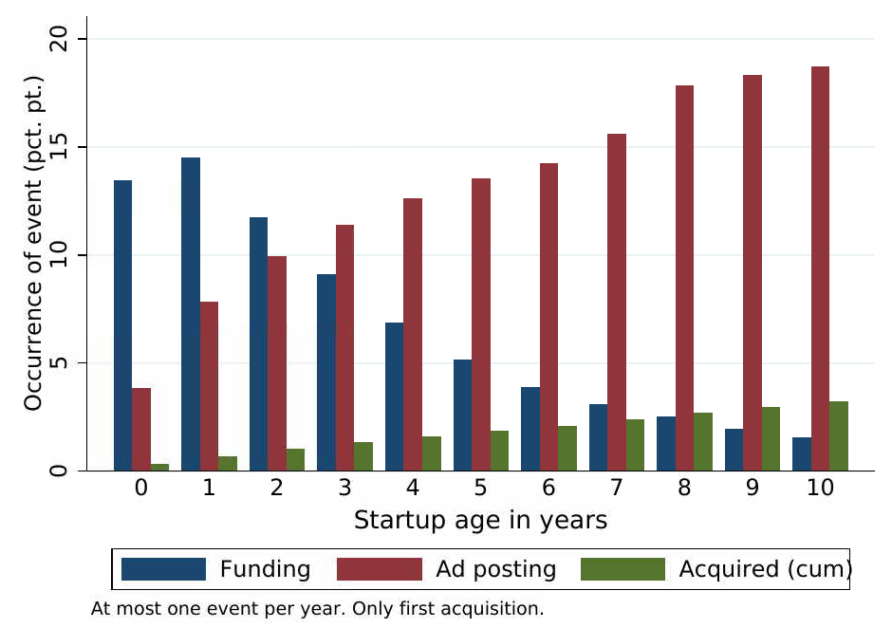
Emergence of startup growth
Success events occur in stages
Funding: Early (blue)
Ads/Acquisition: Late (red)

Slide 42
Net effect
$E\left[ads\right]=P\left[advertising\right]∗E\left[ads \right| advertising]$
With 1 std. deviation more BFS,
$P\left[advertising\right]$ is 25% less
$E\left[ads \right| advertising]$ is 14.2% less
$E\left[ads\right]$ is (1-.25)*(1-.142) = 64% of baseline
Net decrease in ads with BFS increase = 1 - .64 = 36%
With OLS estimates, 47% decrease

Slide 43
Minority/Female led/founded firms

Slide 44
Do large firms crowd out startups? / Why do big firms matter for startups?
Large firms
Hire STEM and other critical workers
Pay higher wages (Brown & Medoff, 1989)
Higher markups may play a particular role for higher pay
Effects of crowding?
Startup pay premium
Slower growth
Worse outcomes

Slide 45
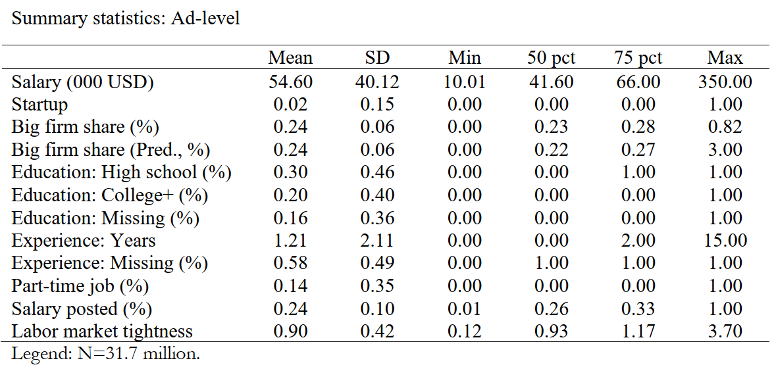
Summary statistics: Ad-level

Slide 46
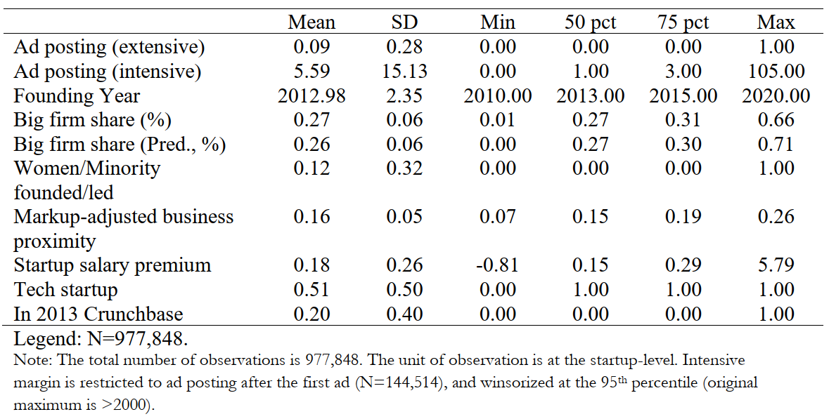
Summary statistics: Startup-year level

Slide 47
First-stage regressions

Slide 48
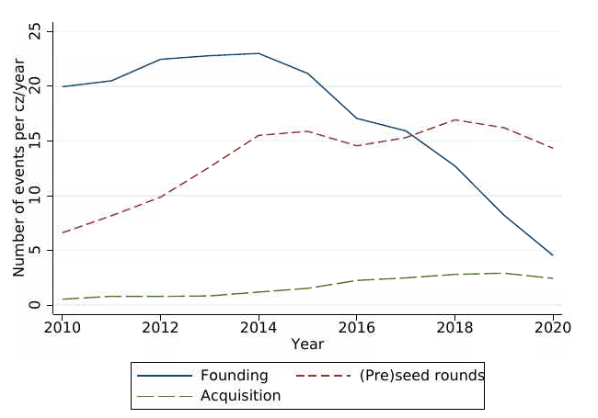
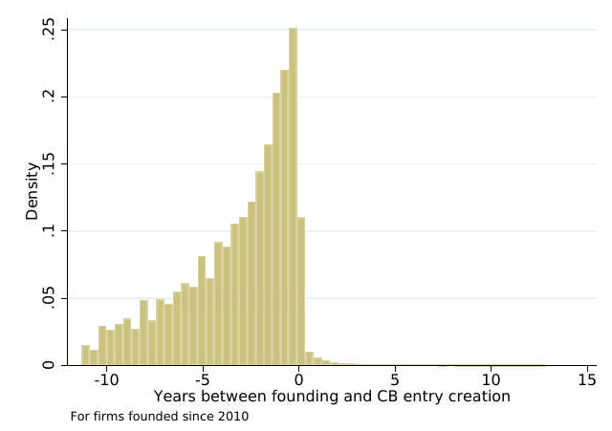
Number of startups over time

Slide 49
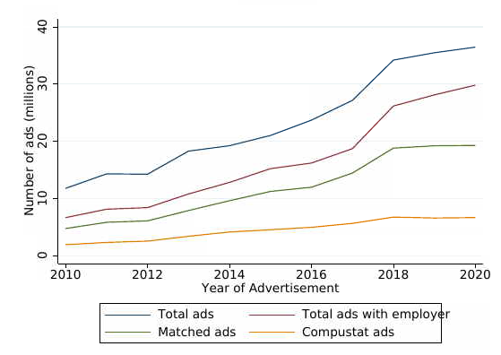
Match Descriptives
Recruiting agencies
(probably)

Slide 50
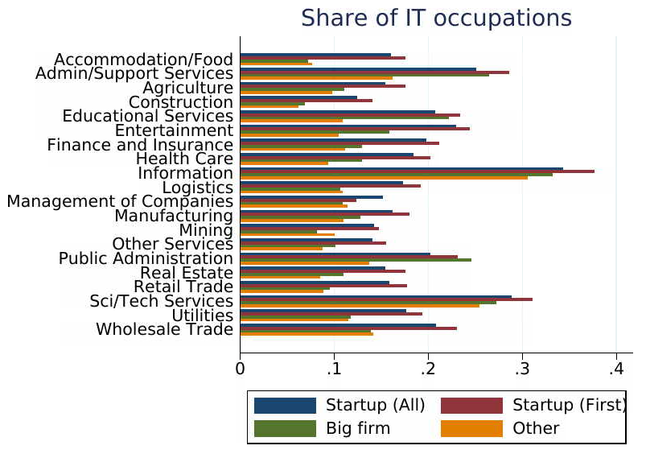
Occupation Composition

Slide 51
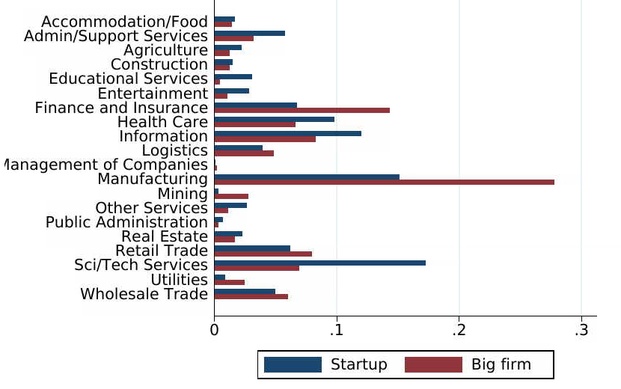
Industry Composition

Slide 52
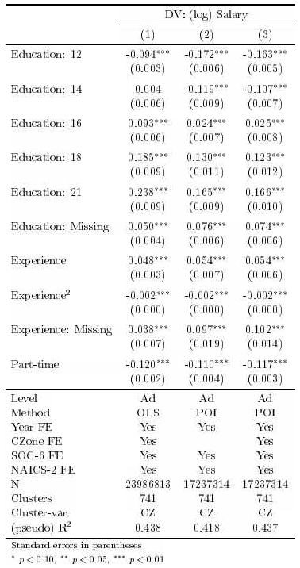
Mincer regression: Posted salary
We use residuals from column 1 or predictions from column 2
For the subsample of startups, averages by commuting zone and year
Baselines:
No education requirements (0 years)
No experience requirement (0 years)

Slide 53
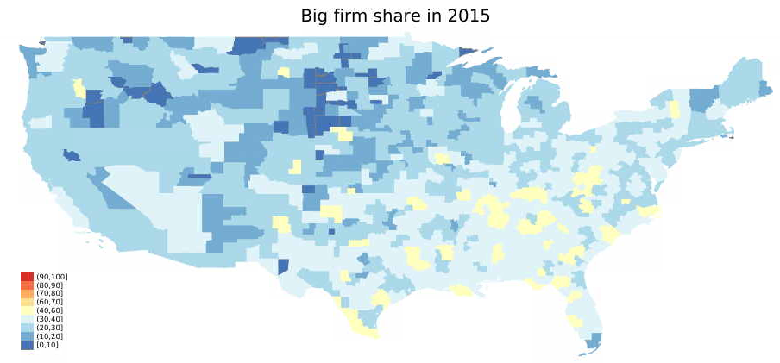
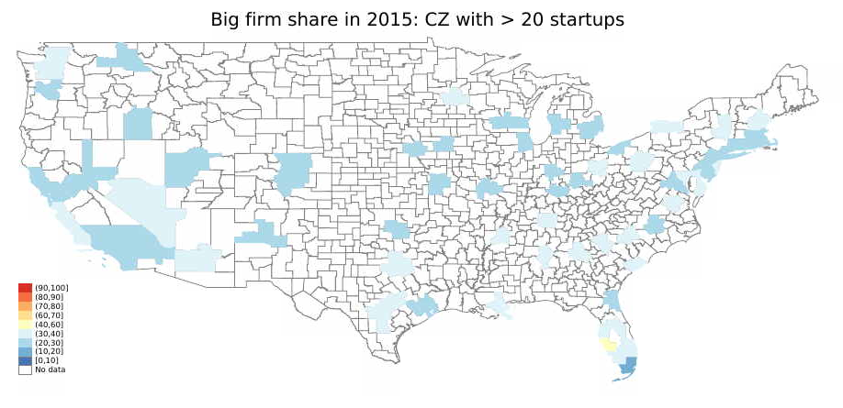

Slide 54
Model

Slide 55
Imperfect labor markets
Workers have heterogeneous preferences over firm size (Hotelling model)
Large firms
Financial security
Long term career path
Better amenities
Startups
Independence
Possibility of large returns

Slide 56
Assumptions
Workers face
Transport costs to commute to work (i.e. disutility of distance)
Might differ in commuting distance from different employers (i.e. preference space)
Duopsony: large firm and startups
Firms offer: different wages and different non-wage amenities
Workers have different preferences over non-wage characteristics

Slide 57
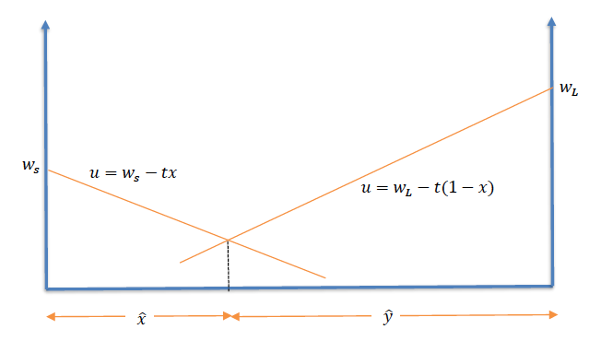
Hotelling labor market
Startup, s
Big firm, L

Slide 58
Nash equilibrium
Revenue productivities $p_{s}, p_{L}$
Profits $π_{s}=\left(p_{s}−w_{s}\right)x, π_{L}=\left(p_{L}−w_{L}\right)y$
Equilibrium
$\hat{y}=\frac{p_{L}−p_{s}}{6t}+\frac{1}{2}$
${\hat{w}}_{s}=p_{s}−2t\left(1−\hat{y}\right)$
${\hat{π}}_{s}=2t{\left(1−\hat{y}\right)}^{2}$

Slide 59
Big firm productivity/demand shocks
Raise local share of big firm hiring
Raise wages startups offer
Reduces startup profits
Slows startup growth

Slide 60
Extensions
Mobility ➔ less crowding
Proximity: Spillovers ➔ less net crowding
Big firm markups ➔ worse crowding

