Slide 1
Fiscal Influences on Inflation in OECD Countries, 2020-2022
Robert J. Barro, Harvard University, and
Francesco Bianchi, Johns Hopkins University

Slide 2
Fiscal Theory of Price Level, FTPL, and Fiscal Dominance
COVID crisis 2020-2023: surge of inflation along with surge in fiscal deficits in many countries made economists receptive to idea that fiscal factors key to recent inflation.
By inflating away real public debt, inflation—unanticipated as of 2019—substantial source of effective real government revenue; amounts to partial debt default.
Analyze conceptually in context of government intertemporal budget constraint. Focus on frictionless version of model, no nominal rigidities.
Apply empirically to 37 OECD countries, 2020-22. Updating now to 2023.

Slide 3
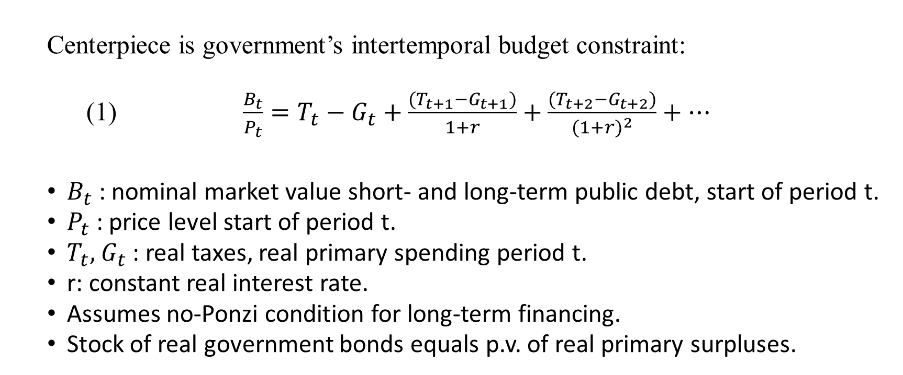
Government Intertemporal Budget Constraint
Centerpiece is government’s intertemporal budget constraint:
(1) $\frac{B_{t}}{P_{t}}={T_{t}−G}_{t}+\frac{(T_{t+1}−G_{t+1})}{1+r}+\frac{{(T_{t+2}−G}_{t+2})}{{(1+r)}^{2}}+…$
$B_{t}$: nominal market value short- and long-term public debt, start of period t.
$P_{t}$: price level start of period t.
$T_{t},$ $G_{t}$: real taxes, real primary spending period t.
r: constant real interest rate.
Assumes no-Ponzi condition for long-term financing.
Stock of real government bonds equals p.v. of real primary surpluses.

Slide 4
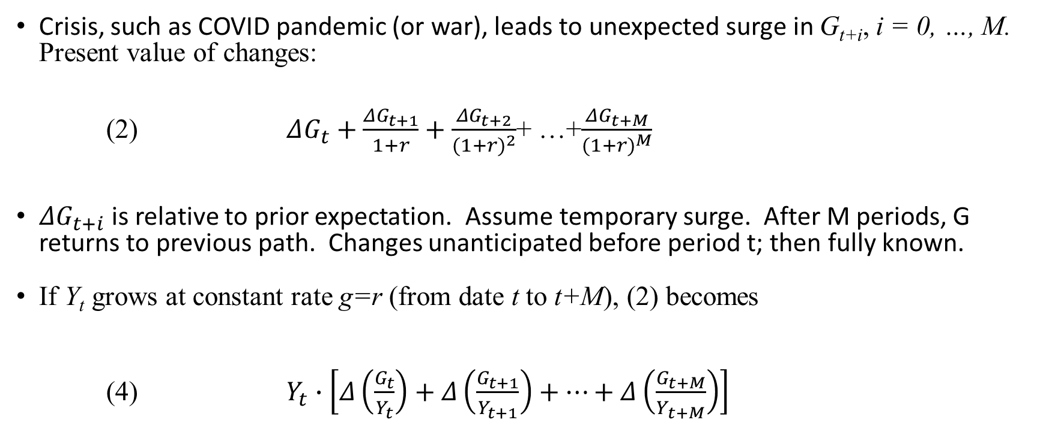
Spending Surge
Crisis, such as COVID pandemic (or war), leads to unexpected surge in G_{t+i}, i = 0, …, M. Present value of changes:
(2) $ΔG_{t}+\frac{ΔG_{t+1}}{1+r}+\frac{ΔG_{t+2}}{{(1+r)}^{2}}$+ …+$\frac{ΔG_{t+M}}{{(1+r)}^{M}}$
$ΔG_{t+i}$is relative to prior expectation. Assume temporary surge. After M periods, G returns to previous path. Changes unanticipated before period t; then fully known.
If Y_{t} grows at constant rate g=r (from date t to t+M), (2) becomes
(4) $Y_{t}∙\left[Δ\left(\frac{G_{t}}{Y_{t}}\right)+Δ\left(\frac{G_{t+1}}{Y_{t+1}}\right)+…+Δ\left(\frac{G_{t+M}}{Y_{t+M}}\right)\right]$

Slide 5
Government Bonds
Use simplifying assumptions about structure of nominally-denominated public debt. Total of coupon and principal payments rise over time with expected path of nominal GDP. Otherwise, amounts uniform out to maximum debt maturity, T.
Reaction to surge in spending assumed to be surge in inflation rates, π_{t+1}, …, π_{t+T} , above target, π*, with π* assumed fixed. Shifts in inflation rates, when anticipated, appear in nominal interest rates and lower market value of bonds outstanding. Effectively pays for part of increase in present value of real spending.
Assume that monetary authority arranges path of inflation dictated by fiscal considerations. Do not detail this process. Fiscal & monetary authorities cooperate.

Slide 6
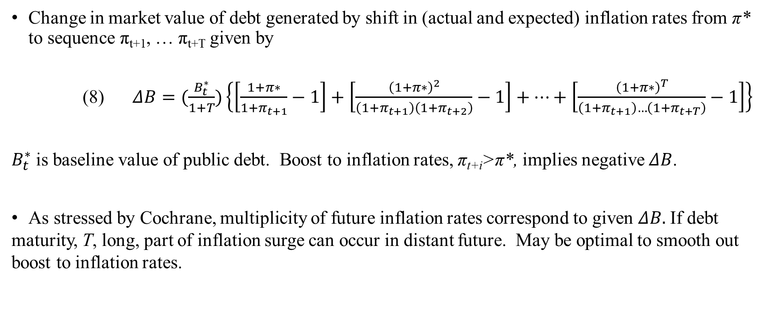
Change in Value of Public Debt
Change in market value of debt generated by shift in (actual and expected) inflation rates from π* to sequence π_{t+1}, … π_{t+T} given by
(8) $ΔB=(\frac{B_{t}^{∗}}{1+T})\left\{\left[\frac{1+π∗}{1+π_{t+1}}−1\right]+\left[\frac{{\left(1+π∗\right)}^{2}}{\left(1+π_{t+1}\right)\left(1+π_{t+2}\right)}−1\right]+…+\left[\frac{{\left(1+π∗\right)}^{T}}{\left(1+π_{t+1}\right)…\left(1+π_{t+T}\right)}−1\right]\right\}$
$B_{t}^{∗}$ is baseline value of public debt. Boost to inflation rates, π_{t+i}>π*, implies negative $ΔB$.
As stressed by Cochrane, multiplicity of future inflation rates correspond to given $ΔB.$If debt maturity, T, long, part of inflation surge can occur in distant future. May be optimal to smooth out boost to inflation rates.

Slide 7
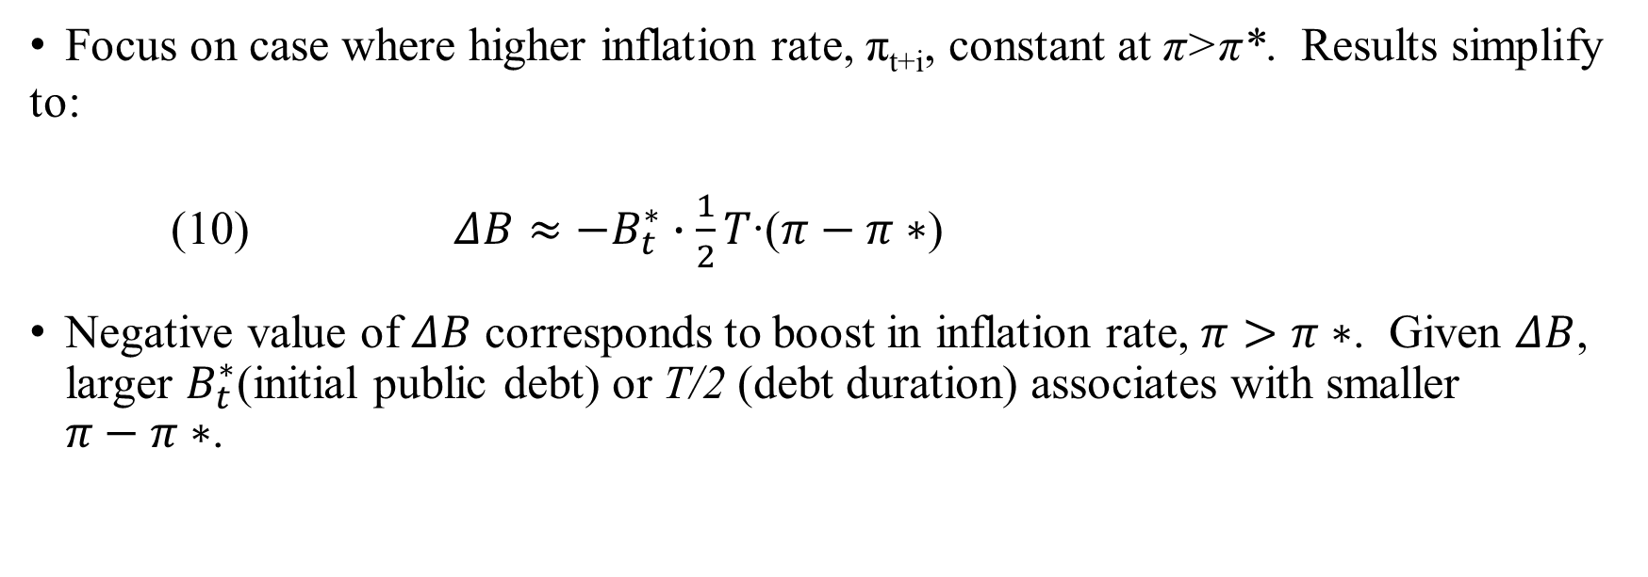
Required Inflation Rate
Focus on case where higher inflation rate, π_{t+i}, constant at π>π*. Results simplify to:
(10) $ΔB≈−B_{t}^{∗}∙\frac{1}{2}T$∙($π−π∗$)
Negative value of $ΔB$ corresponds to boost in inflation rate, $π>π∗$. Given $ΔB$, larger $B_{t}^{∗}$(initial public debt) or T/2 (debt duration) associates with smaller $π−π∗$.

Slide 8
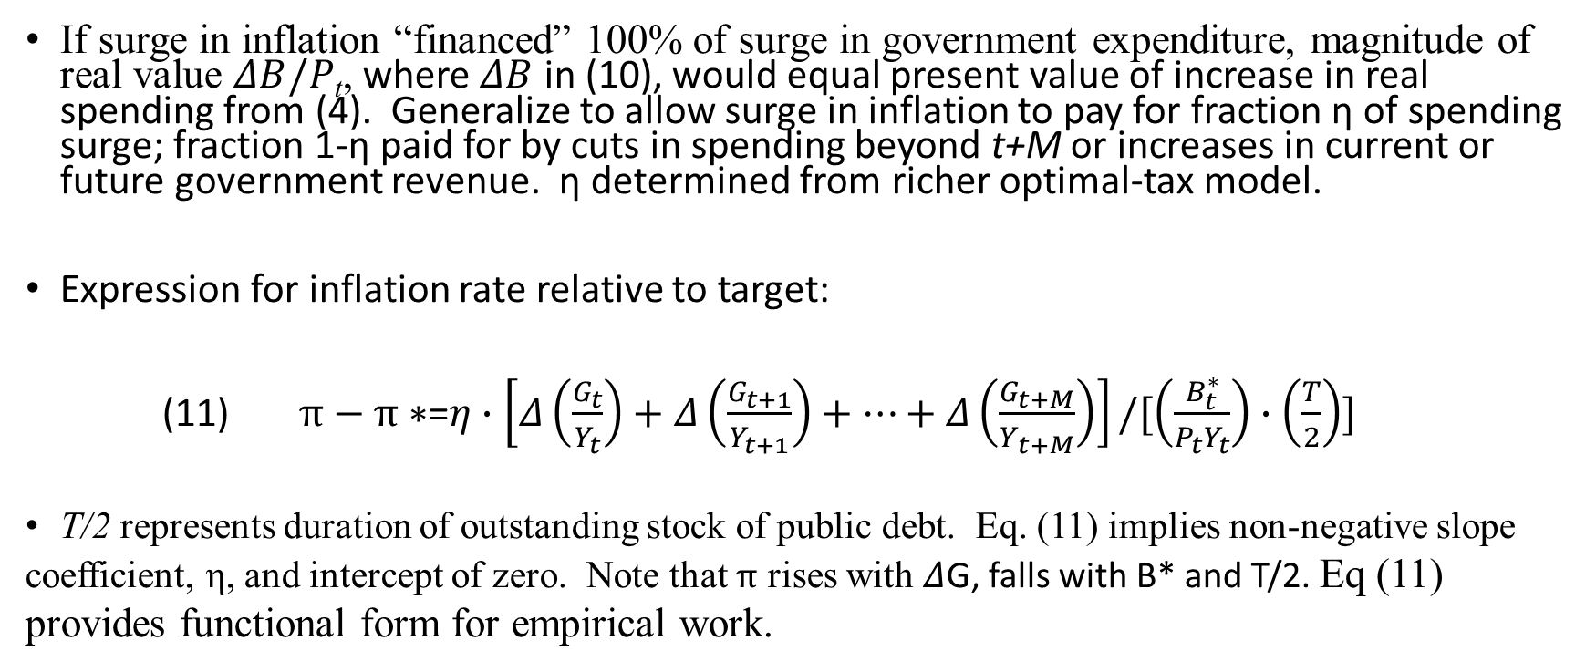
Formula for Inflation Rate
If surge in inflation “financed” 100% of surge in government expenditure, magnitude of real value $ΔB/P$_{t}, where $ΔB$ in (10), would equal present value of increase in real spending from (4). Generalize to allow surge in inflation to pay for fraction η of spending surge; fraction 1-η paid for by cuts in spending beyond t+M or increases in current or future government revenue. η determined from richer optimal-tax model.
Expression for inflation rate relative to target:
(11) $π−π∗$=$η∙\left[Δ\left(\frac{G_{t}}{Y_{t}}\right)+Δ\left(\frac{G_{t+1}}{Y_{t+1}}\right)+…+Δ\left(\frac{G_{t+M}}{Y_{t+M}}\right)\right]/[\left(\frac{B_{t}^{∗}}{P_{t}Y_{t}}\right)∙\left(\frac{T}{2}\right)]$
T/2 represents duration of outstanding stock of public debt. Eq. (11) implies non-negative slope coefficient, η, and intercept of zero. Note that $π$ rises with $Δ$G, falls with B* and T/2. Eq (11) provides functional form for empirical work.

Slide 9
State-Contingent Public Finance
η=0 when surge in government spending matched by expectations of offsetting cuts in spending further in future or increases in current and future government revenue. Corresponds to standard intertemporal public finance in sense of government always respecting constraint that increase in today’s real primary deficit balanced by corresponding reductions in future real primary deficits (all measured as real present values).
η=0 holds in most circumstances, with η>0 applying only during economic emergencies, such as COVID crisis or large war. Discussion fits with state-contingent fiscal-deficit policies of Lucas/ Stokey (1983) in context of wartime, notably WWII. Upshot is fiscal deficits and inflation not much related during “normal” economic times but could be closely connected during unusual events. Perspective fits with empirical application to OECD countries in context of COVID crisis.

Slide 10
Ukraine-Russia War
Model says inflation rate reacts to composite government-spending variable, which equals cumulative surge in ratios of government spending to GDP divided by initial debt-GDP ratio and average debt maturity.
Empirical application allows for additional effect from Ukraine-Russia War (started 2022). Countries that share common border with Ukraine or Russia found to have higher inflation rates than would otherwise be predicted.

Slide 11
Data
CPI Inflation rates
Headline and core CPI inflation rates from OECD.STAT.
Government spending
Data from IMF (mostly WEO) on ratio of general govt spending exclusive of interest payments to GDP.
Quantities of public debt
Data from IMF (mostly WEO) on ratio of general govt gross public debt to GDP.
Adjustment for amounts denominated in foreign currency or inflation-linked form?
Net versus gross debt?
Treatment of central bank?

Slide 12
Data
Duration of public debt
Data from OECD on “average remaining maturity” of general govt gross public debt (also BIS). Refers to principal payments, not coupons. Approximation to calculate duration of debt, using formula that factors in stated maturity along with current and lagged nominal interest rates on government bonds.
Euro-area data
Weighted averages of 17 countries with Euro area viewed as single economy.
Proximity to war in Ukraine
Assembled information related to distances and trade shares. Empirically, results best with simple dummy variable for whether country shares common border with Ukraine or Russia (8 OECD countries).

Slide 13
Identification
Assume composite govt-spending variable exogenous with respect to inflation. Empirically, spending variable relates negligibly to extent of economic downturn gauged by real GDP growth 2019-2020. Have not found good instruments—COVID outcomes do not work.
Identification comes from cross-sectional variation across OECD countries. Results similar using annual time series of inflation 2010-2022 with country fixed effects (picking up constant inflation target for each country).

Slide 14
Empirical Setup
Sample comprises 37 OECD countries (all except Turkey), 20 outside Euro zone, 17 Euro. Because of common currency with single central bank, main setting treats Euro zone as single economy (with variables measured as weighted averages).
Table 1, cols. 1 & 2, has headline inflation; cols. 3 & 4, core inflation. Cols. 1 & 3 use only composite govt-spending variable. Cols. 2 & 4 add Ukraine-Russia border dummy.
Coefficient of govt-spending variable corresponds to η in model; share of spending “financed” by unanticipated inflation.

Slide 15
Table 1: Regressions for change in inflation rate Euro zone treated as one economy
 | Headline CPI inflation rate |  | Core CPI inflation rate
 | (1) | (2) | (3) | (4)
Constant | 0.0134** (0.0037) | 0.0080*** (0.0025) | 0.0038 (0.0033) | -0.0005 (0.0025)
Excess govt spending/(gross debt)*duration | 0.369*** (0.099) | 0.423*** (0.062) | 0.422*** (0.087) | 0.465*** (0.062)
Border with Ukraine or Russia | -- | 0.0278*** (0.0049) | -- | 0.0222*** (0.0049)
Number of observations | 21 | 21 | 21 | 21
R-squared | 0.423 | 0.791 | 0.555 | 0.790
s.e. of regression | 0.0126 | 0.0078 | 0.0111 | 0.0078
Regressions by OLS, s.e.’s in parentheses. Dependent variable is inflation rate for 2020-22 less that for 2010-19.
***significant at 1%, **significant at 5%, *significant at 10%

Slide 16
Empirical results on government spending
Estimated coefficients of govt-spending variable in cols. 1 & 3 positive, around 0.4-0.5, highly significant.
In cols. 2 & 4, Ukraine-Russia border dummy positive, highly significant, sharply raises R-squared. Moderately raises coefficient of govt-spending variable—to 0.42 and 0.46 for headline, core, respectively.
Estimated coefficients of govt-spending variable significantly less than one. Around 40-50% of spending surge financed by unanticipated inflation, rest by standard public finance.

Slide 17
Inflation versus Govt Spending
Figures 1 & 2 depict relationship between change in CPI inflation rate (headline & core, respectively) and govt-spending variable. (Effects of border dummy filtered out here.)
U.S. not outlier. Lies moderately above average for govt-spending variable (0.034 vs. 0.025) and changes in inflation rates (headline: 0.029 vs. 0.023; core: 0.020 vs. 0.015). Euro area below U.S. for inflation (headline: 0.023; core: 0.009) and govt-spending variable (0.029).
Figures show clear positive slopes that do not seem to be driven by extreme observations.

Slide 18
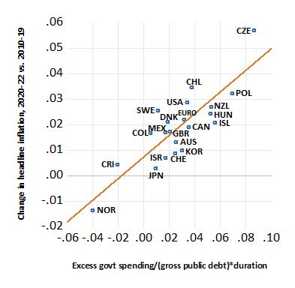
Figure 1 Change in headline CPI inflation rate versus composite govt-spending variable

Slide 19
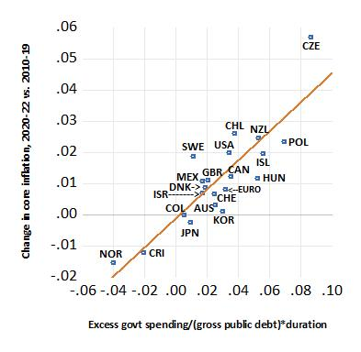
Figure 2 Change in core CPI inflation rate versus composite govt-spending variable

Slide 20
Components of Govt-Spending Variable
Assess how statistical significance of composite government-spending variable relates to 3 components: Δ(G/Y), debt-GDP ratio, debt duration. Focus on cases from Table 5, columns 2 and 4, that include border dummy for Ukraine/Russia.
Each component of government-spending variable set, one at a time, at sample mean. That is, designated variable restricted not to contribute to explanation of cross-sectional variations in inflation rates. Think of constraint as amounting to one coefficient restriction imposed on estimation. Then test validity of restriction from condition that ‑2*log(likelihood ratio) distributed asymptotically as Chi-squared variable with one degree of freedom.

Slide 21
Results for govt spending, initial public debt, initial debt duration
p-value for Δ(G/Y) 0.000 for headline and core inflation rates.
Same conclusion for 2019 ratio of public debt to GDP.
Duration of public debt in 2019 also significant (p-value 0.007 for headline inflation, 0.025 for core).
Can use linear approximation to express right side as 3 separate terms: values relative to sample means of spending surge, initial debt-GDP ratio, initial debt duration. Get three separate coeffs, significantly +, -, -. Accept hypothesis that coeffs equal size with this sign pattern.

Slide 22
Including only Fiscal Surge
Positive connection between change in inflation rate and incremental government spending, Δ(G/Y), not surprising from Keynesian perspective that emphasizes effect of government spending on aggregate demand. Distinguishing feature of present model is two scaling variables—initial values of debt-GDP ratio and debt duration. In particular, effect of debt-GDP ratio on boost to inflation negative for given Δ(G/Y), whereas aggregate-demand model might generate opposite sign.
If fiscal variable enters just as Δ(G/Y), get estimated coefficients positive but only marginally significant. R‑squared 0.37 for headline inflation, 0.30 for core, compared to 0.8 in Table 1. Results with fiscal variable entered as Δ(G/Y) look as shown in Figures 3 (headline CPI) and 4 (core CPI). Positive relationship between excess government spending and increase in each inflation rate but results only marginally statistically significant. In contrast, relationships clearly positive in Figures 1 and 2.

Slide 23
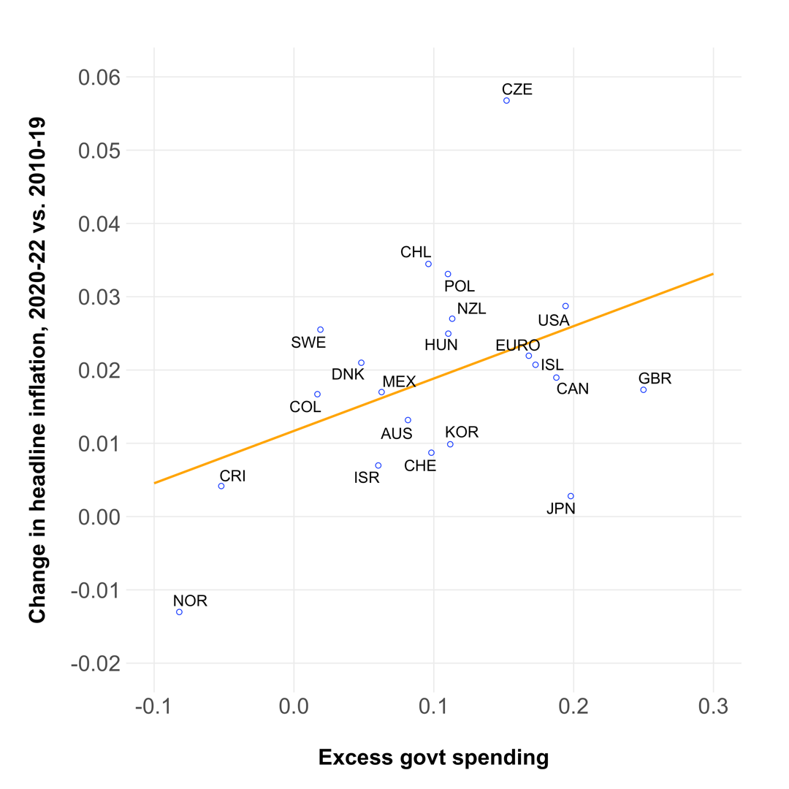
Figure 3 Change in headline CPI inflation rate versus excess govt spending

Slide 24
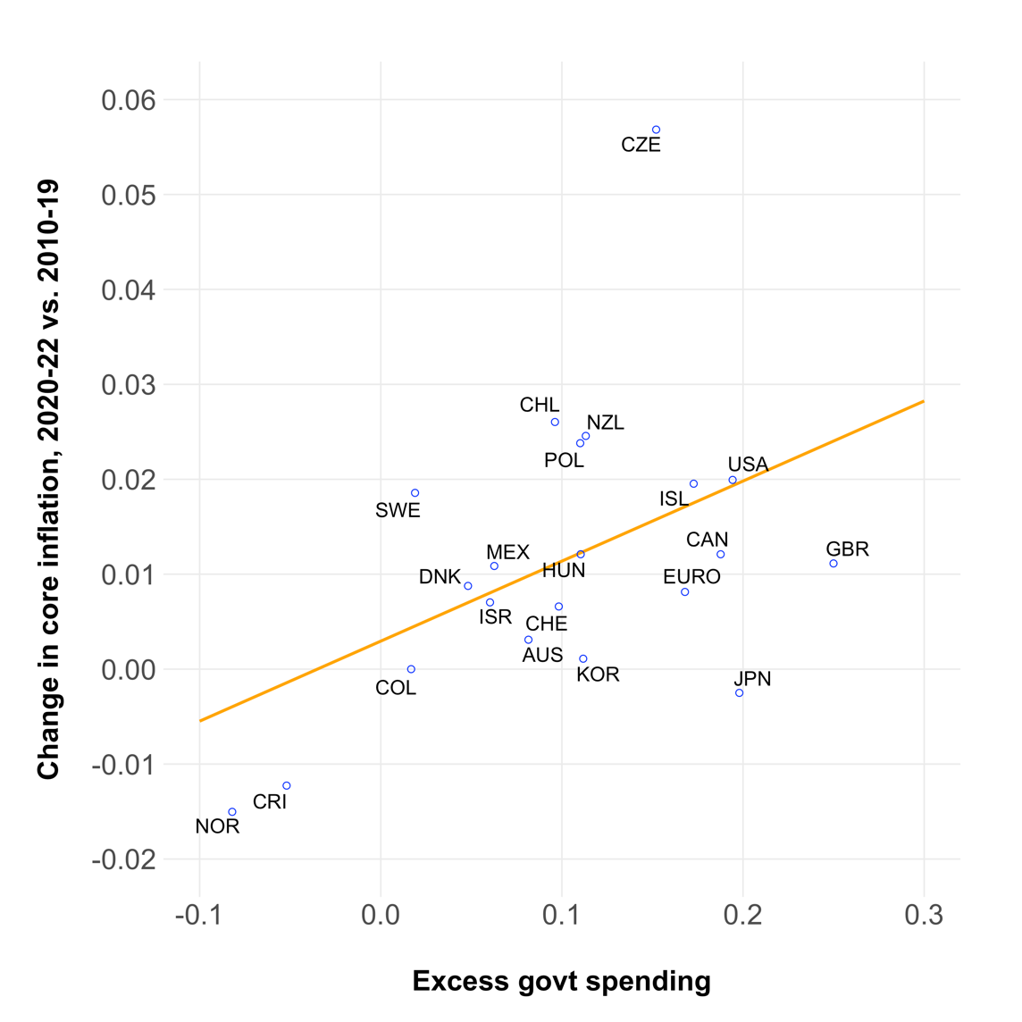
Figure 4 Change in core CPI inflation rate versus excess govt spending

Slide 25
Euro-zone countries entered separately
In Table 2, first G-variable same as Table 1; Euro countries have Euro-area weighted average. Second G-variable for Euro zone is individual G variable relative to Euro-area average. Estimated coefficient on second variable differs insignificantly from zero at 5% level: 0.12 (0.07) headline, 0.00 (0.07) core.
Main conclusion is aggregating Euro-zone countries into one economy satisfactory for analyzing effects of G variable on inflation rates.

Slide 26
Table 2: Regressions for Change in Inflation Rate Euro-zone countries entered individually
 | Headline CPI inflation rate |  | Core CPI inflation rate
 | (1) | (2) | (3) | (4)
Constant | 0.0152*** (0.0034) | 0.0092*** (0.0022) | 0.0032 (0.0028) | -0.0010 (0.0022)
Excess govt spending/(gross debt)*duration: Table 1 | 0.374*** (0.099) | 0.422*** (0.061) | 0.420*** (0.083) | 0.455*** (0.062)
Excess govt spending/(gross debt)*duration: Euro area | 0.353*** (0.109) | 0.125* (0.073) | 0.160* (0.092) | -0.005 (0.074)
Border with Ukraine or Russia | -- | 0.0258*** (0.0034) | -- | 0.0186*** (0.0034)
Number of observations | 37 | 37 | 37 | 37
R-squared | 0.424 | 0.790 | 0.460 | 0.714
s.e. of regression | 0.0126 | 0.0077 | 0.0106 | 0.0078
Regressions by OLS, s.e.’s in parentheses. Dependent variable is inflation rate for 2020-22 less that for 2010-19.
***significant at 1%, **significant at 5%, *significant at 10%

Slide 27
Additional Results
Prediction that duration of high inflation corresponds to duration of public debt. For U.S., this is 5 years, starting 2020. Higher duration for UK (10-12 years), Euro area (7).
Figure 5 shows evolution of ratios of gross public debt to GDP—U.S. and GDP-weighted average for 21 economies. Surge in 2020 with fiscal deficits. Down since—effects of rising nominal GDP and decline in market value of debt because of rising nominal interest rates.

Slide 28
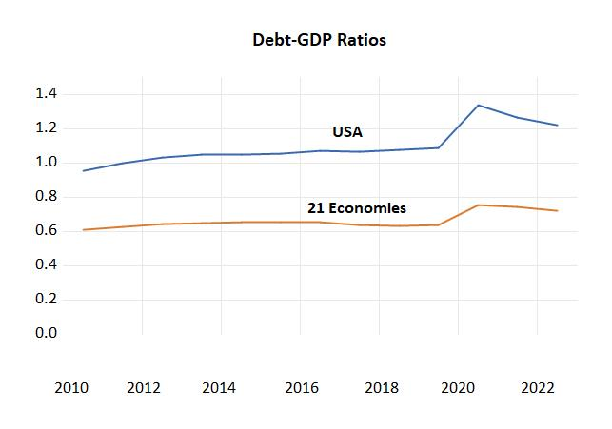
Figure 5 Ratio of Gross Public Debt to GDP

Slide 29
Current Research
Adding 9 non-OECD countries with data: Brazil, Croatia, India, Indonesia, Malaysia, Peru, Singapore, South Africa, Thailand.
Adding data for 2023.
Will apply to U.S. states. Analogous to Euro zone?
Policy implications: was it mistake to have inflation surge, contingent on paths of government spending?

