Slide 1
National Identity, Public Goods, and Modern Economic Development Stergios Skaperdas (UC Irvine) and Patrick Testa (Tulane)
April 18, 2024
NBER conference on Diversity, Identity, and Nation Building

Slide 2
The Modern State and Modern Economic Growth
Modern Economic Growth and Modern State co-evolved since (about) the 18th century
What is different about Modern (Nation-)state?
Citizens – no longer subjects - tend to identify with their respective nations
The states themselves expect loyalty and identification with the state from their citizens
Some instruments for instilling National Identification : wars, public schooling, national flags, anthems, rituals, sports, information campaigns or propaganda

Slide 3
This Paper
How National Identification might affect the economy?
Model of economy with psychological payoffs due to identity
National identity (NI) promoted by elites to attract “commoners”
Higher NI reduces internal conflicts between elites and others
Higher NI also increases public good provision and economic growth
NI can induce elites to, self-interestedly, extend political rights
Complementarity among all these factors
Case study: England 1600-1920

Slide 4
Prerequisite for economic growth: Security and Internal Cohesion
Differences in languages, ethnicities, religions, classes, ideologies
Internal Conflicts endemic in emerging modern states, even in most successful ones
England: Glorious Revolution, Jacobite rebellions, various "riots", incorporating the "Celtic fringe“
France: Revolution, 1848, 1871, 1968
US: Civil War, Native Americans wars, legacy of slavery
Conflict has high economic costs - how do you reduce them? National identification?

Slide 5
Related Literature
State Capacity and Economic Growth (Besley and Persson, 2011; McBride, Milante, and Skaperdas, 2011; Johnson and Koyama, 2017)
Institutions and Economic Performance (North, 1990; Acemoglu, Johnson, and Robinson, 2005; North, Wallis, and Weingast, 2009)
Economics and Identity (Akerlof and Kranton, 2000; Sen, 2006; Carvalho et al, 2022a)
Identity, Conflict, and the State (Sambanis and Shayo, 2013; Sambanis, Skaperdas, and Wohlforth, 2015, 2020; Bandiera, Mohnen, Rasul, and Viarengo, 2019; Alesina, Reich, and Riboni, 2020; Almargo and Andres-Cerezo, 2020)

Slide 6
Elements of the Model
Two identities: National and Alternative
National identity initially emanates from the elite.
Psychological payoffs associated with each identity:
Status/prestige (can vary in salience/is manipulable)
and distance from those in power
Commoners can choose between the two identities, based on both psychological and economic payoffs
Conflict between Elites and Alternative identifiers over insecure income (e.g., natural resources or production of commoners)
(Secure) national income depends on public good

Slide 7
Elements of the Model (continued)
Elites choose taxes and public good
Elites want to attract commoners to (i) enhance status of national income and (ii) share in taxation
But cannot attract commoners unless they commit to not overly tax them
To restrain their expropriation, need for political rights to commoners

Slide 8
Basic Framework

Slide 9
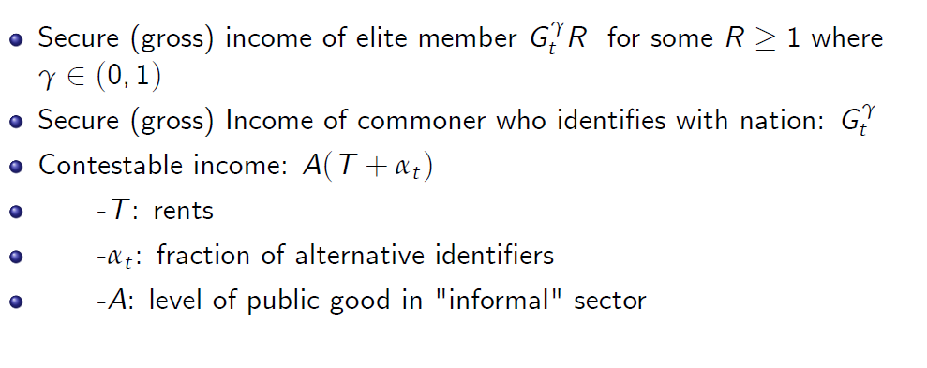
Incomes

Slide 10
Material Payoffs

Slide 11
Psychological and Total Payoffs

Slide 12
Timing

Slide 13
What is “choice” of identity?
May not be conscious decision
Involves both material and psychological payoffs
May involve psychological transformation, orienting preferences toward elite imitation or what is perceived to be mainstream
May correspond to explicit or tacit acquiescence to government’s legitimacy
Registering land
Using country’s courts (instead of customary or informal justice systems of the village, tribe, or favela)
Enrolling children in government schools

Slide 14
Equilibrium Insecure Incomes

Slide 15
Elite conflict payoffs higher, the
lower is the collective organization of commoners
greater is the repressive capacity of the state
higher are the rents to be extracted
Higher the proportion of commoners that identifies with the alternative identity

Slide 16
Absence of political restraints
Prevents commoners from identifying with nation
Still, investment in public good is increasing in national status (as well as increasing in elite initial resources)
A “very narrow” nation

Slide 17
National vs Alternative Identity

Slide 18
Incentives for commoners to adopt National Identity
High status of National Identity
Low status of Alternative Identity
Low degree of collective organization of commoners
High repressive capacity by the State
Low rents (and local public goods) in alternative economy
Low individual distance from NI

Slide 19
Choices under fiscal restraints

Slide 20
Choices under fiscal restraints
Public Good higher because it attracts commoners to the National Identity
who pay a share of taxes
and increases National Income (and status/prestige of country)
But, it increases payoff of elites only if
collective organization of commoners is high enough
repressive capacity of the state is low enough
rents to be extracted are low enough
status/prestige of nation is high enough
(High insecure incomes for the elites and low status of NI, does not favor political rights – Guatemala as an example)

Slide 21
Shaping National Identities
Historical factors
Language
Ethnic boundaries
Pre-existing states
Shaped by elites in government and civil society
Around language and ethnicity, using education (Blanc and Kubo, 2024)
Around opposition to external rule (e.g., Latin America – Anderson, 1983)
More inclusive conceptions (Canada, Mexico, India)
Exogenous and endogenous “shocks”
Wars (victory, defeat, stalemate – Sambanis et al, 2015; Alesina et al, 2020)
Other external influences (subsidies, arms and trade agreements, proxy conflicts – Sambanis et al, 2020)
Even sports events

Slide 22
Investing in the salience of National Identity

Slide 23
Investing in NI and the public good

Slide 24
Politico-economic “packages” or “bundles”
Complementarities among:
Investment in public goods
Reduction in conflict
Political restraints
Investments in salience of national status
High per-capita incomes
Higher levels of National Identification by commoners
Prerequisites for take-off:
-sufficiently low levels of insecure income for elites (low resource rents, low repressive capacity, high collective organization of alternative identity)
-initially sufficiently high levels of national status.

Slide 25
England, 1600-1920
The first modern “nation?” (Greenfeld, 2001)
1600-1700: building a (very) narrow nation (King and Parliament)
1700-1830: Expanding the nation
Continuing conflicts (Jacobite and other rebellions, enclosures and class-based riots, Catholic resistance and incorporating the “Celtic fringe”), yet…
Growing alignment between elites and emergent middle class, across English and Scotland (“Britishness”)
Investments in infrastructural public goods and the Industrial Revolution
1830-1920: Consolidating Britishness
Conflict and continual expansion of voting franchise
Irish independence
Massive increases in tax revenue, public good provision
Shared identity of economic progress and domination further unites the Isles

Slide 26
Summary Remarks
National Identification universal in modern states
How does it contribute to economic performance?
Through reducing internal conflicts
Through inducing elites to adopt political constraints
Through increasing public good provision
Complementarity among all these factors
Other possibilities:
Role of State Capacity
Capital Accumulation

