Slide 1
Select Synthetic Data Generation Methods Toward a Public Use File for a Longitudinal Survey
Minsun Riddles¹ Tom Krenzke¹ Natalie Shlomo² Wan-Ying Chang³
Angela Chen¹ Lin Li¹ Robyn Ferg¹ Medha Uppala¹
¹Westat
²University of Manchester
³National Center for Science and Engineering Statistics, U.S. National Science Foundation
Conference on Data Privacy Protection and the Conduct of Applied Research: Methods, Approaches and their Consequences

Slide 2
Disclaimer
This presentation provides results of exploratory research by the National Center for Science and Engineering Statistics (NCSES) within the National Science Foundation (NSF). This information is shared to inform interested parties of ongoing activities and to encourage further discussion. Views expressed are those of the presenters and not necessarily those of NCSES or NSF.

Slide 3
Outline
Background and Data
Challenges and Solutions
Data Treatments
Synthetic Data - Experiment
Evaluation Measures
Summary
Notes:
First start with the background, including the brief description of the survey of interest to introduce the motivation for our research.
Highlight the challenges and solutions!
Go through a few data treatment options
Then come back to the main body of the research.
Finally conclude with a summary.

Slide 4
Background and Data

Slide 5
Survey of Doctorate Recipients (SDR)
Biennial survey of U.S. research doctorate holders in science, engineering, and health fields
Launched in 1973
Conducted by the National Center for Science and Engineering Statistics within the National Science Foundation
With sponsorship from the National Institutes of Health
Provides demographic, education, and career history information
Target population contains U.S. research doctorate holders residing both within and outside the United States

Slide 6
SDR Sample Design
Stratified by field of study, sex, and underrepresented minority status
Maintains a continuing cohort until aged out
Replenishes sample with new PhDs in every cycle
Generating cross-sectional data
and longitudinal data

Slide 7
Longitudinal SDR (L-SDR) 2015-2025 Sample
Drawn from SDR 2015 respondents who were age 65 or younger as of 2015
Stratified by
Reported employment sector in 2015
Age
Underrepresented minority status
Sex

Slide 8
Current Microdata Availability | Tiered Access
CS-SDR = Cross-sectional SDR
L-SDR = Longitudinal SDR
RUF = Restricted use file
PUF = Public use file
In need of a PUF for longitudinal data
 | Cross-sectional SDR |  | Longitudinal SDR
 | RUF | PUF | RUF | PUF
Available? | Yes | Yes | Yes | No

Slide 9
Challenges and Solutions

Slide 10
Challenges and Key Features
Longitudinal structure → increased risk
An L-SDR PUF will increase disclosure risks of CS-SDR PUFs
Some protection due to anonymization, data coarsening, variable suppression, imputation
Majority of cases on L-SDR can be uniquely and correctly matched to a record in CS-SDR PUFs using demographic and survey variables → More information can be added to both L-SDR and CS-SDR data
Survey data with weights, skip patterns, and various types of variables
Variance estimation
Notes:
Records in cross-sectional PUFs are not easily matched

Slide 11
Path to Public Use Longitudinal Microdata
Data treatments are needed with two objectives
Reducing risk to protect individuals from re-identification and maintain data confidentiality
Maintaining utility to protect the integrity of the data
Solutions
Measuring risk, utility
Sequential model-assisted constrained approach
Extensive quality control checks
Variance estimation solution developing

Slide 12
Data Treatments

Slide 13
Data Coarsening
Types
Variable suppression
Recoding e.g., Date of birth → single year of age, or age groups
Top-coding e.g., All older than 80 to age 80 or older
Rounding
All data coarsening procedures result in a loss of information/data utility
Notes:
To reduce risk, one can keep dropping variables, but the resulting data will not be useful.

Slide 14
Data Synthesis
Goal is to preserve aggregates, summaries, and multivariate associations
Introduced by Rubin (1993) and based on the multiple imputation (MI) framework
Methodology on drawing valid inferences from synthetic data exists (Raghunathan et al, 2003; Reiter, 2003; Reiter, 2005)

Slide 15
Fully Synthetic Data
Treat non-sampled units as missing data
Impute the population (including non-sampled units) using the MI framework
Simple random samples from the imputed population to release to public

Slide 16
Data Synthesis – Partial and Select Synthetic Data
Partially synthetic data
Little (1993) proposed synthesizing observed values for select variables with multiple imputations
Synthesize only a subset of variables selected based on disclosure risk
Select synthetic data
Driven by two objectives of reducing risks and maintaining utility
Synthesize a subset of variables of a subset of randomly selected cases, targeting high-risk variables of high-risk domains/records

Slide 17
Partially Synthetic Data Example
Original Data
Patient ID | Age | Sex | Race | At Educational Institution? | R&D Work Activities?
1 | 23 | F | White | Y | Y
2 | 35 | M | White | Y | N
3 | 45 | M | Native | N | Y
4 | 52 | F | Black | N | Y
5 | 38 | M | Asian | Y | Y
Partial Synthetic Data
1 | 23 | F | White | Y | N
2 | 35 | M | White | Y | Y
3 | 45 | M | Native | Y | Y
4 | 52 | F | Black | N | Y
5 | 38 | M | Asian | N | Y

Slide 18
Select Synthetic Data Example
Original Data
Patient ID | Age | Birth Sex | Race | At Educational Institution? | R&D Work Activities?
1 | 23 | F | White | Y | Y
2 | 35 | M | White | Y | N
3 | 45 | M | Native | N | Y
4 | 52 | F | Black | N | Y
5 | 38 | M | Asian | Y | Y
Select Synthetic Data
1 | 23 | F | White | Y | Y
2 | 35 | M | Asian | Y | N
3 | 45 | M | Native | N | Y
4 | 52 | F | Black | Y | N
5 | 38 | M | Black | N | Y

Slide 19
Synthetic Data - Experiment

Slide 20
Objectives of Public Use Longitudinal Microdata Creation
 | Data Coarsening | Partial Data Synthesis | Select Data Synthesis
Reducing Risk | √ | √ | √
Maintaining Utility | X | √ | √√
√ effective
√√ more effective
X ineffective

Slide 21
Experimental Factors
Degree of select data synthesis
Select data synthesis approach
Variance estimation approach

Slide 22
Degree of Select Data Synthesis
Three scenarios for overall data synthesis rates of 83%, 50%, 15%
% cases randomly selected for data synthesis
Varying data treatment rates by risk strata
Four groups were formed by whether a record can be uniquely and correctly (UC) matched to a record in cross-sectional PUFs
Stratum 1: UC matched to a record in all three cross-sectional PUFs
Stratum 2: UC matched to a record in two cross-sectional PUFs
Stratum 3: UC matched to a record in one cross-sectional PUFs
Stratum 4: Not UC matched to any record in cross-sectional PUFs
Considerably higher rates for risk stratum 1

Slide 23
Select Data Synthesis Approach 1 | Imputation
Leveraging an existing hot-deck imputation method for survey item missing
Select associated variables In SDR, carefully selected through examining variable importance from random forest
Form groups of similar cases defined by selected associated variables
Replace missing values with observed values of randomly selected cases in the group
Modified to add noise while respecting critical associations

Slide 24
Select Data Synthesis Approach 2 | MACH
Model-assisted constrained hotdeck (MACH) process
Fit parametric model
Form groups on predicted values
Exchange observed values within the group
Westat developed the algorithm for Census Bureau and AASHTO/FHWA for perturbing American Community Survey data for the Census Transportation and Planning Products
Handles skip patterns and includes safeguards to respect critical relationships

Slide 25
Select Data Synthesis Approach 3 | Synthpop
Developed as part of UK Economic and Social Research Council-funded Synthetic Data Estimation for UK Longitudinal Studies (SYLLS) project
Classification and regression trees (CART) are default conditional models used for synthesis
Various parametric alternatives are also available
Open source package available in R, including options for drawing inferences from the synthetic data and comparing to original data outcomes

Slide 26
Variance Estimation Consideration
Releasing multiple implicates
Inspired by multiple imputation
Generate and release multiple implicates
Data users can obtain valid variance estimates in any analysis
Reveals which records are synthesized, potentially increasing risks
Releasing general variance factors
Does not reveal which records are synthesized
Accuracy of variance estimates may vary by analysis
Notes:
In each combination,
we create implicates for this.
Nature of select synthetic data → releasing implicates may increase risk

Slide 27
Evaluation Measures

Slide 28
Evaluation of Data Treatments | Risk
Reduction in risk
Repeat record matching using the same set of variables but with select synthetic data
Compare risks to original risk
% uniquely and correctly matched to a record in cross-sectional PUFs
Notes:
The evaluation is done to check how well the objectives are met, so circling back the objectives,

Slide 29
Evaluation of Data Treatments | Utility
Maintenance of utility through various measures
Quality control checks for consistencies
Distance between raw and synthetic data
Weighted cell counts – e.g., Hellinger’s Distance
Weighted cell means
Pairwise associations – variables themselves, ranks
Multivariate associations
Point estimates not included in original confidence intervals
Confidence intervals
Notes:
The evaluation is done to check how well the objectives are met, so circling back the objectives,

Slide 30
Risk-Utility Trade-off
Risk mitigation
Quantifying risk reduction
Comparing percentage of records accurately (uniquely and correctly) matched to their corresponding records in all three cross-sectional PUFs before and after data synthesis
Utility preservation
Assessing the proximity between original and synthetic data
Summarizing several utility/distance measures in different units by computing the average utility measure relative to that under the scenario of imputation approach with 15% data synthesis
Notes:
Alternative measures should be considered

Slide 31
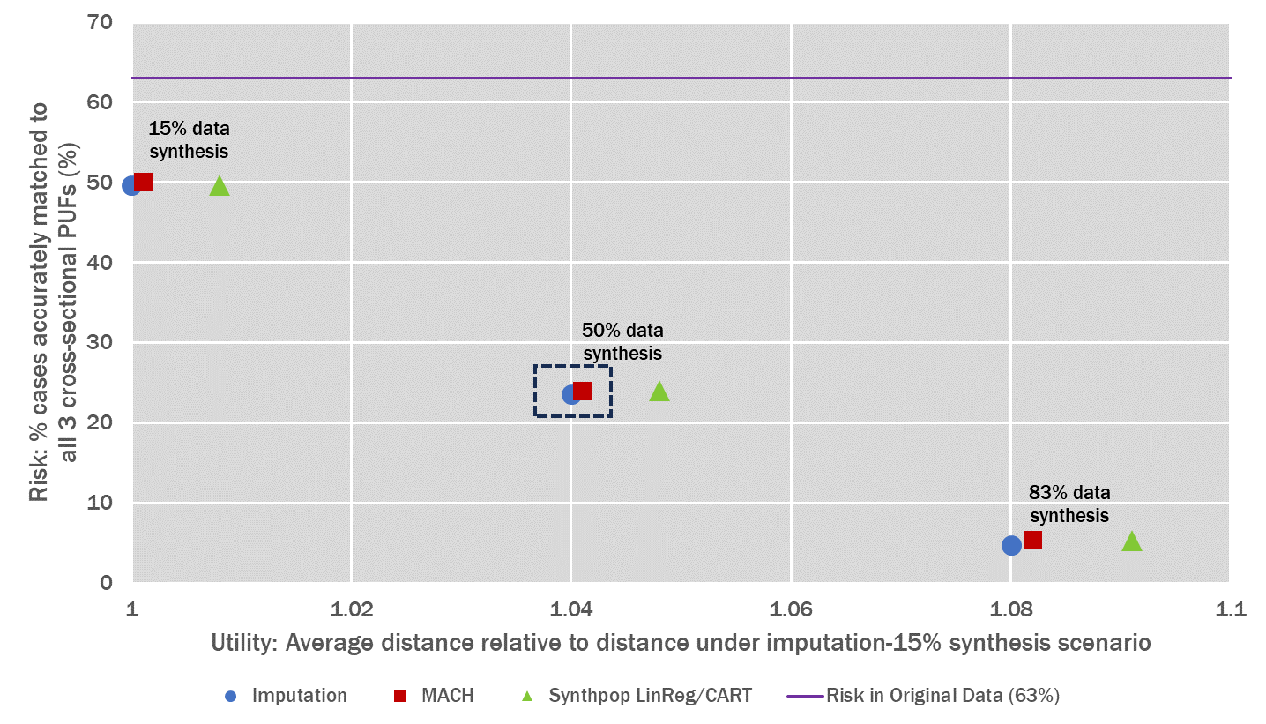
Risk-Utility Trade-off (continued)
Notes:
Non linear

Slide 32
Summary

Slide 33
Summary
A national longitudinal study in need of public use files with low risk, high utility, and capabilities of valid variance estimation
An experiment with
Degree of select data synthesis: 83%, 50%, 15%
Select data synthesis approach: imputation, MACH, synthpop
Variance estimation approach: multiple implicates, factors

Slide 34
Summary | Findings
Degree of select data synthesis
As the data synthesis rate increases, there is a greater reduction in risk, but it also entails a more significant compromise in utility
Selected 50% due to considerable risk reduction without substantial compromise in utility
Select data synthesis approach
MACH and imputation approaches presented similar performance
Selected MACH for its features, including the ability to handle skip patterns and safeguards to uphold relationships
Variance estimation approach
Continuing to evaluate the merits and drawbacks

Slide 35
Toward a Public Use File
Currently, in the process of
Risk-utility evaluation for the synthetic public use file created with the complete list of variables under the choices from the experiment
Variance estimation method development potentially through replicate weights

Slide 36
Thank You
For more information, please contact:
MinsunRiddles@westat.com

