Slide 1
The social value of temporary carbon removals and delayed emissions
Frank Venmans
Ben Groom

Slide 2
Motivation

Slide 3
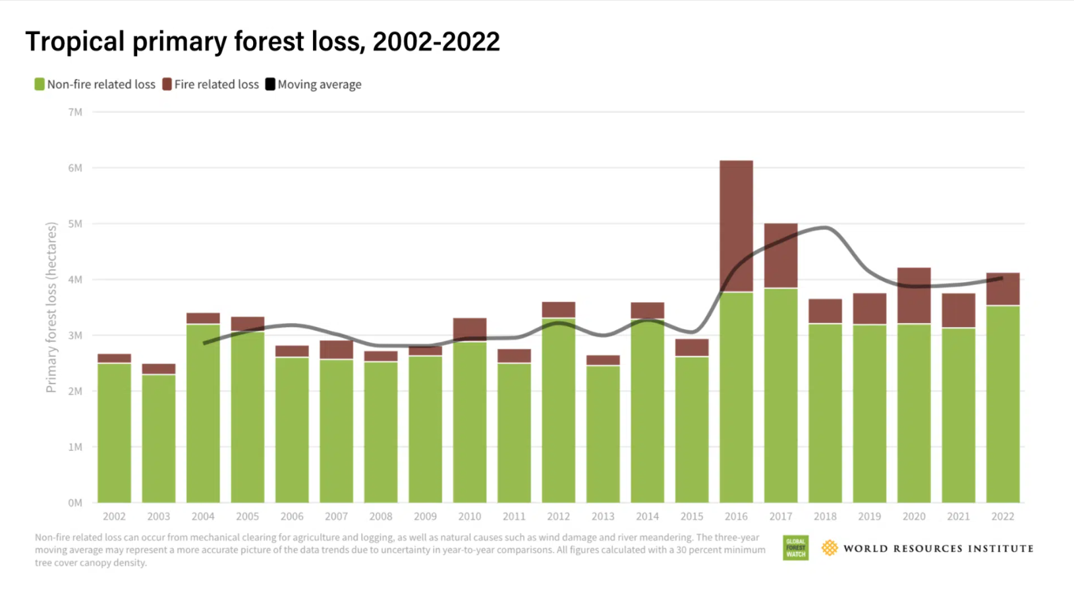
Notes:
Maryland is2.5Mha, Belgium is 3Mha.

Slide 4
The challenge
Deforestation, loss of carbon in soils, vanishing seagrass... are cheap to avoid and have a high social value.
1151 of the 2000 largest companies have zero emission targets (BP, Shell...). Most of them plan to buy offsets.
Currently certified offsetting credits total 2.1 Billion tCO2.
The current offsetting market lacks transparency.
But if we can make it work, the welfare potential is huge.

Slide 5
Applications of valuing temporary removal
How much carbon should be stored in a temporary and risky offsetting project to compensate an emission of 1 tonne of CO2?
How should we rank temporary and permanent removal projects?
Life cycle analysis: pellets vs fossil fuels.
Carbon debt and atmospheric storage costs.

Slide 6
Integrating physical science and economics

Slide 7
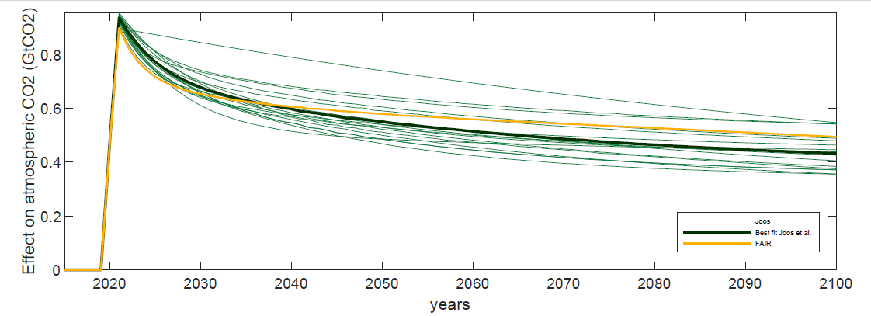
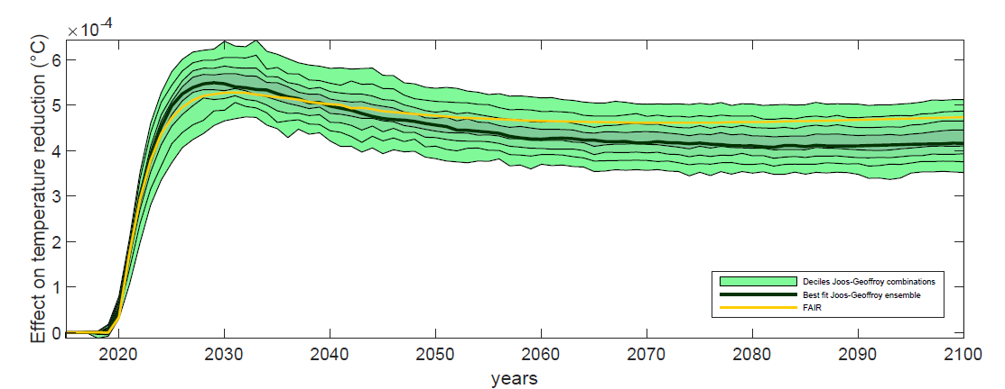
=> Temperature is proportional to cumulative emissions with a short delay $ξ$
Notes:
Explain the GWP method.

Slide 8
Social Cost of Carbon
Social cost of carbon is the discounted sum of marginal damages
$$SCC_{0}=\int_{0}^{∞}{e^{−r\left(t+ξ\right)} ζ\underset{marg damage}{\underbrace{D_{T_{t+ξ}}}}dt}$$

Slide 9
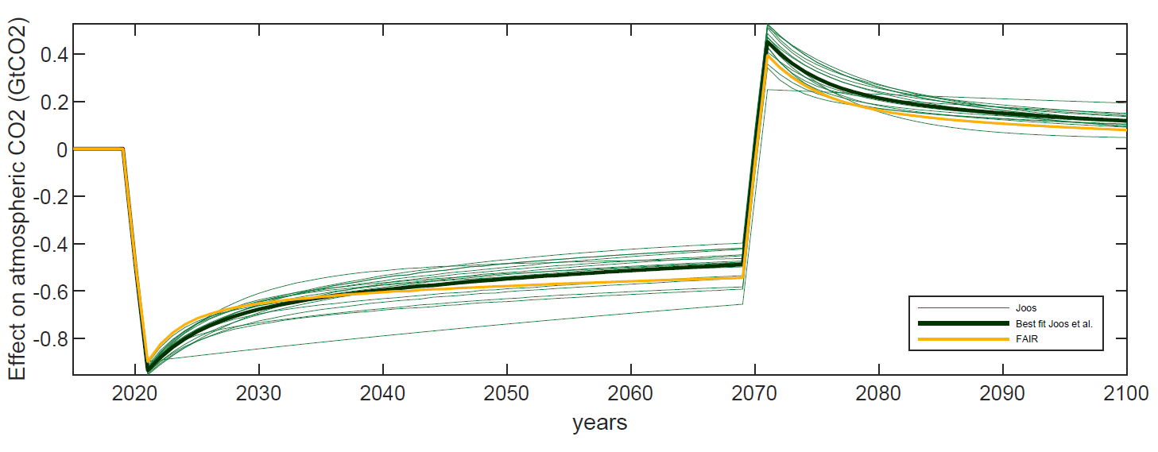
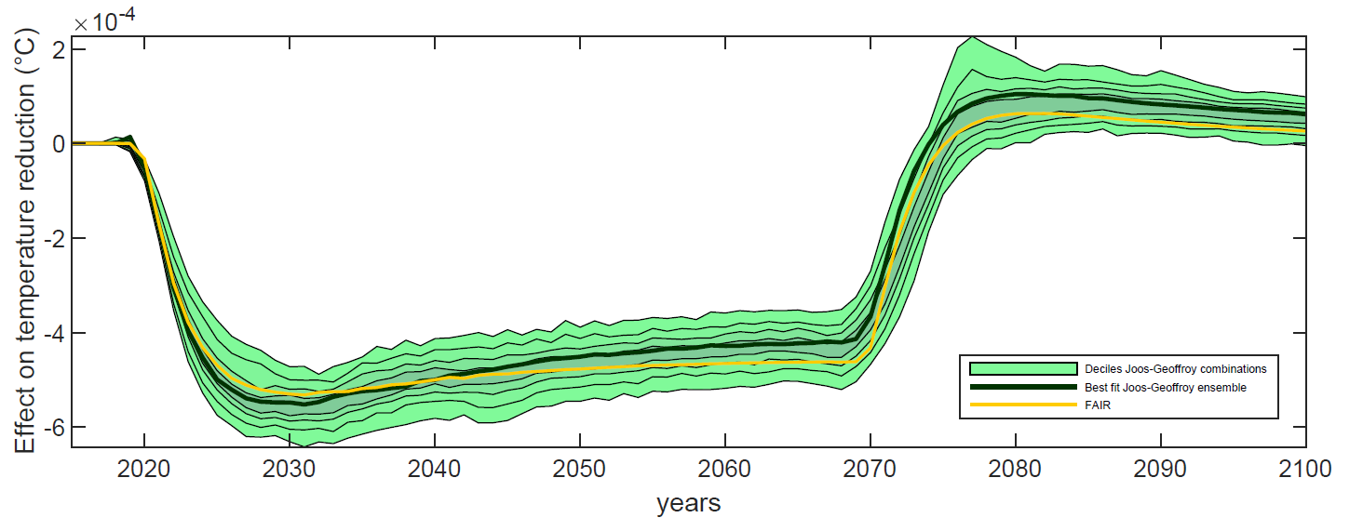

Slide 10
Social Value of a Temporary Removal
$$SV{TR}_{0,τ_{}}=\int_{0}^{τ_{}}{e^{−r\left(t+ξ\right)}ζ\underset{marg damage}{\underbrace{D_{T_{t+ξ}}}}dt}$$
$$=SCC_{0}−\underset{impermanence}{\underbrace{e^{−rτ_{}}SCC_{τ_{}}}}$$
Proof: SCC always increases at a rate below the discount rate.
Formula is the same when there is a temperature constraint.
In cost-effectiveness analysis the carbon price increases at discount rate.

Slide 11
Failure and additionality

Slide 12
A temporary removal with failure risk
Assume that each year, there is a constant probability $φ$ that the project fails.
Survival probability beyond time t is $e^{−φt}$
$$SVO_{0,τ_{}}=\int_{0}^{τ_{}}{e^{−(r+φ)\left(t+ξ\right)} ζ\underset{marg damage}{\underbrace{D_{T_{t+ξ}}}}dt}$$

Slide 13
Additionality risk
Time of failure of the project
Failure risk
time
Non-additionality for reforestation project
Causal (additional) effect of the project
Time of reforestation in baseline scenario
time
Non-additionality for forest preservation project
time
Time when the forest is cut in the baseline scenario

Slide 14
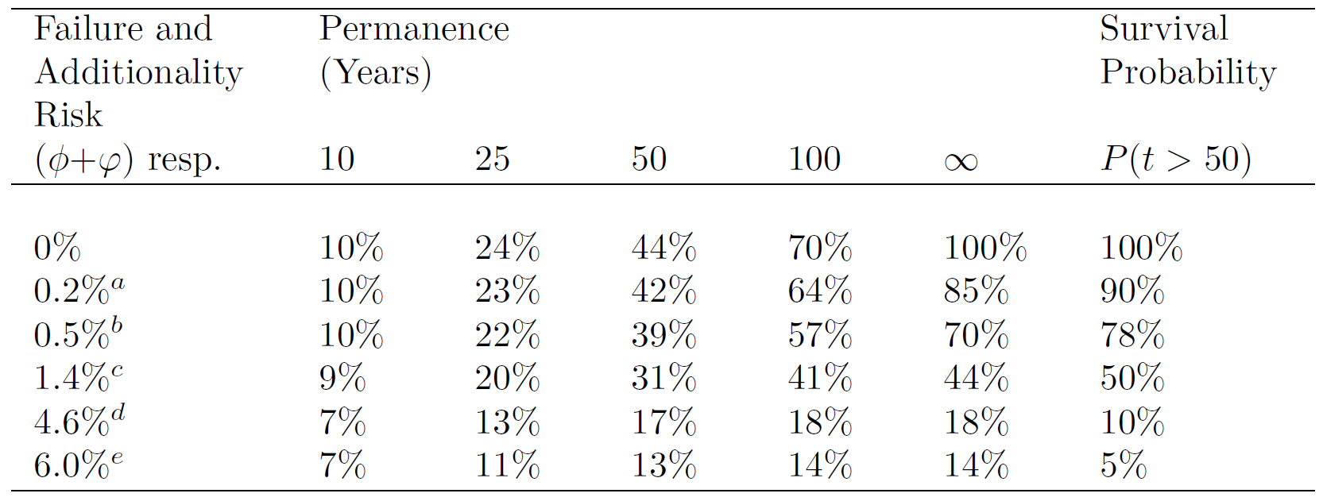
Jayachandran et al. (2017) in Uganda,
Guizar-Coutino et al. (2022) REDD+;
Badgely et al. (2022) in California and Acre study
West et al. (2023) tropical forests
sum of c) and d)

Slide 15
Applications

Slide 16
Applications
Offset hard-to-abate emissions using SVTR/SCC
Rank temporary and permanent projects according to SVTR/cost
Estimate the potential welfare gain of an removal market: SVTR-cost
Shorten the contract length of long term removals
Nature-based offsets should commit to store carbon for, say, 50 years
Store 2.5 tonnes of CO2 to compensate 1 tonne emitted
After 50 years, the same project can offset again emissions if additionality is proven.

Slide 17
Life cycle analysis: Pellets vs fossil fuels
Pellets : 8000$/ha
Methane: 12000$/ha
Oil: 16,000$/ha

Slide 18
Carbon debt
Negative emissions after 2050 are hard to finance.
Emitting companies could be made liable to remove CO2 in the future.
In this case their emissions are temporary.
The SVRT formula values these temporary emissions and could be charged upfront to limit problems with bankruptcy.

Slide 19
Potential shortcomings

Slide 20
Damages
Damages are unkown
SVTR/SCC is independent of the size of quadratic damages
The damages are positive, so SVTR>0
Damages depend not only on warming, but also on
warming speed (adaptation, species migration)
cumulative warming (ice melting, ocean warming)

Slide 21
After the end of the project, nothing has changed...
Temperature is indeed back to baseline
Some effects are permanent (species extinction, avoided tipping points, technological change)
A chain of temporary projects is identical to a permanent removal
Intertemporal transfers can lead to large welfare gains (SVTR>>cost)
If you dislike intertemporal transfers, offset methane with 20 year carbon removals

Slide 22
Discount rate
At zero discount rate the SVTR is larger
At zero discount rate the SCC is infinite
At zero discount rate there is no inequality aversion in the model
Opportunity costs of capital matter

Slide 23
Conclusion
The SVTR is always positive.
Avoid dogmatism on temporary vs permanent projects.
If a forest is expected to be additional over 50 years, 2.5 tonnes stored in the forest compensates the welfare effect of 1 tonne of fossil fuel emission.
The SVTR is also important for
project ranking,
life cycle analysis,
carbon debt.

