Slide 1
Endowment Spending Rules
Chris Avery, Cappy Hill, Doug Webber, and Ron Ehrenberg

Slide 2
Overview of the Paper
We collect data from yearly 990 tax returns required for non-profit organizations to track endowment returns and spending.
We attempt to reverse engineer the “spending rules” used by these organizations based on their reported expenses.
We assess the policy implications of the results.

Slide 3
Themes in the Past Literature
Motivation for endowments: Ehrenberg, Hoxby
How to spend endowments: Tobin, Merton, Dybvig
How to invest endowments: Campbell, Stein, Lo
What happens in practice?: J. Brown, Filosa

Slide 4
Insights from Ehrenberg’s Tuition Rising
Academic institutions use spending rules to “preserve the real value … of the spending that their endowments produce over time.”
Endowment per student is the best measure of institutional wealth.
A natural payout rate is the % difference between (1) returns and (2) higher education cost index plus administrative costs.
Investment returns and donations/gifts should be viewed differently.

Slide 5
Insights from J. Brown et al., (2014) “How University Endowments Respond to Financial Market Shocks”
The “actual payout rate” implemented by standard spending rules is typically less in rising markets and greater in falling markets than the specified “policy payout rate”.
The average yearly endowment shock is 9% of institution costs.
Institutions appear to deviate from their spending rules by further reducing endowment payouts in response to negative shocks.
Deviations from spending rules in response to negative shocks predict personnel reductions.

Slide 6
The Sample
We identified 250 colleges and universities with highest endowments in terms of Value per FTE student using IPEDS data.
Our sample includes data from 187 of the 190 private non-profit colleges in this group.
Our sample period is 2008-09 (“Fiscal Year 2009”) to the present.

Slide 7
Subgroups of Institutions
 | GROUP 1 | GROUP 2 | GROUP 3 | GROUP 4 | GROUP 5
 | Ivy League | Amherst | Bowdoin | American | Belmont
 | Chicago | Baylor | Brandeis | Babson | Bennington
 | Duke | Boston College | Carleton | Bates | Univ. of Dallas
 | Emory | Boston U | Davidson | Fordham | Elon
 | Johns Hopkins | Cal Tech | Haverford | Franklin Marshall | Emerson
 | MIT | Carnegie Mellon | Macalester | Gonzaga | Endicott
 | Northwestern | Case Western | Middlebury | Lewis and Clark | Evansville
 | Notre Dame | George Wash. | Northeastern | Loyola Marymt. | Hampshire
 | NYU | Smith | Oberlin | Marquette | Knox
 | Pittsburgh | Swarthmore | RPI | Providence | Lake Forest
 | Rice | TCU | Syracuse | Quinnipiac | Millsaps
 | Stanford | Tufts | Vanderbilt | Reed | Mt. St. Mary’s
 | USC | Tulane | Vassar | St. Lawrence | Sarah Lawrence
 | Vanderbilt | Wellesley | Wake Forest | Tulsa | Thomas Aquinas
 | Washington U | Williams | Wesleyan | Villanova | Westmont
 | 22 colleges | 24 colleges | 33 colleges | 78 colleges | 29 colleges

Slide 8
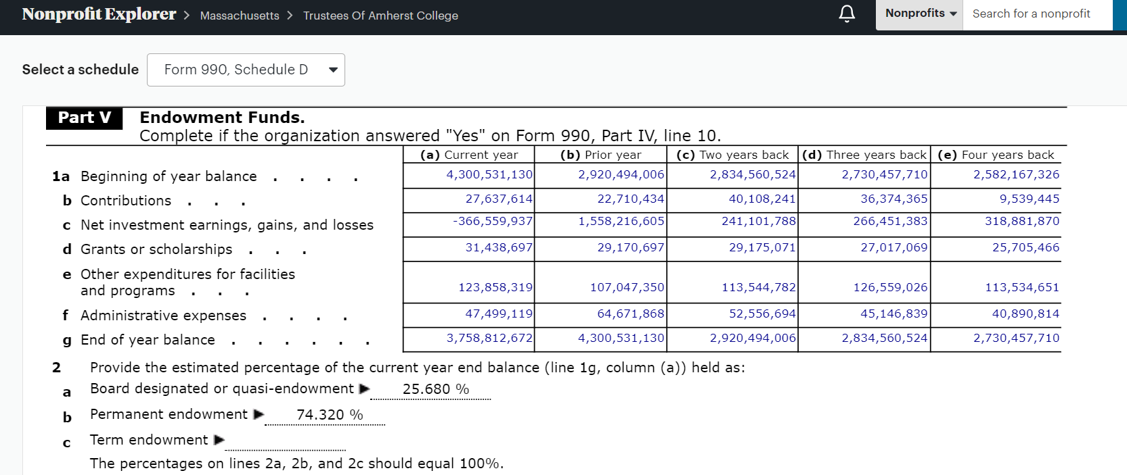
Data from Schedule D

Slide 9
Average Endowment Returns

Slide 10
Descriptive Statistics
 | All | Group 1 | Group 2 | Group 3 | Group 4 | Group 5
Invest Return | 7.28% | 8.70% | 7.77% | 7.43% | 7.14% | 6.23%
Contributions | 3.27% | 3.00% | 2.32% | 2.46% | 3.14% | 5.54%
Grants | 1.60% | 1.03% | 1.35% | 1.79% | 1.79% | 1.54%
Other Cost | 3.16% | 3.82% | 3.50% | 3.02% | 2.87% | 3.35%
Admin Cost | 0.30% | 0.27% | 0.35% | 0.32% | 0.35% | 0.15%
Revenues | 10.54% | 11.74% | 10.09% | 9.89% | 10.18% | 11.77%
Total Cost | 5.07% | 5.12% | 5.20% | 5.13% | 5.00% | 5.04%
Change in HEPI | 2.48% | 2.48% | 2.48% | 2.48% | 2.48% | 2.48%

Slide 11
Spending Rule 1: Moving Average
Yearly payout = target percentage of “endowment value”, usually 5%.
Endowment value is computed as an average of past values, usually quarterly values over 3, 5, or 7 years.
This rule is reportedly used by 70% of institutions.

Slide 12
Spending Rule 1: Moving Average

Slide 13
Spending Rule 1: Moving Average

Slide 14
Spending Rule 1: Moving Average

Slide 15
Spending Rule 2: Hybrid / Tobin
Yale’s Policy: “The payout under the Spending Policy is equal to 80% of the prior year’s spending plus 20% of the long-term spending rate applied to the previous year’s beginning endowment market value, with the sum adjusted for inflation.”
This rule is often used by institutions with highest endowment levels.
It is defined by weight on endowment and target spending rate.
Weight 60% on endowment and 5% long-term spending rate gives
Payout = 3% of endowment value + 40% of past spending level.

Slide 16
Spending of New Revenue with Hybrid Rule

Slide 17
Spending of New Revenue with Hybrid Rule

Slide 18
Spending of New Revenue with Hybrid Rule
Increasing the weight on the endowment shifts spending earlier.

Slide 19
Framework for Predictive Spending Rules
We run one lagged OLS regression for each combination of institution and spending rule to estimate the weights in the spending equations.
All regressions are run using nominal monetary values.
We use the coefficients as weights in the spending rules for separate simulations of past spending for each institution.
If the regression coefficients for an institution are not plausible weights, we revert to default weights for that institution.

Slide 20
Background Results for the Spending Simulations
OLS regressions yield valid weights for 80% (Hybrid) and 60% (Moving Average) of institutions. The example below is for Yale University.

Slide 21
Simulating the Hybrid Rule for Yale

Slide 22
Simulating the Moving Average Rule for Yale
OLS regressions yield valid weights for 80% (Hybrid) and 60% (Moving Average) of institutions. The example below is for Yale University.

Slide 23
Results with the Hybrid Rule
Our simulations yield 2022 endowments within 5% of the true value for 133 institutions (71%) and within 10% for 155 institutions (83%).
For these 155 institutions, the average weights are
.531 on lagged spending;
.025 on lagged endowment value.
These values correspond to weight 46.9% on endowment and target yearly spending level of 5.33% of lagged endowment level.

Slide 24
Actual vs. Simulated Hybrid Costs for 133 “Best Final Match” Institutions

Slide 25
Actual vs. Simulated Hybrid Costs for 133 “Best Final Match” Institutions

Slide 26
Projected Future Spending: Base Line
We can use the spending simulations to project future trajectories.

Slide 27
Projected Future Spending: Scenario 2
We can use the spending simulations to project future trajectories.

Slide 28
Projected Future Spending: Scenario 3
We can use the spending simulations to project future trajectories.

Slide 29
Projected Future Spending
We can use the spending simulations to project future trajectories.

Slide 30
Additional Analysis in the Paper
Changes in % Holdings by Endowment Category
Changes in IPEDS Spending
Descriptive Regressions to Predict Endowment Spending

Slide 31
Discussion
Hoxby (2013) says “a university should examine itself if its financial market portfolio's share of its total portfolio rises very persistently.”
Ehrenberg (2000) suggested that colleges and universities risk losing non-profit status if the perception is that their endowments are growing at fast rates (cf. Piketty (2014)).
Stock returns have outpaced inflation since the end of our sample.
Yet an abrupt downturn could cause a quick change of perspective.

Slide 32
Alternative Perspectives
We highlight two possible reasons that current rates of endowment payouts may be justifiable.
Dead Money: when funds with heavily restricted use accrue interest, they grow to larger percentages of the endowment (Baum, Hill, and Schwartz (2018))
Misdirected Contributions: Ehrenberg (2000) leaves out contributions in his suggested formula for the payout rate.

Slide 33
Opportunities for Further Research
It could be interesting to apply our method to a future downturn.
There might be some ways to convert responses on prior 990 tax submissions to variables like the current Schedule D responses.
There may be opportunities to combine NACUBO and tax data.

Slide 34
Projected Future Spending
We can use the spending simulations to project future trajectories.

Slide 35
Distribution of Endowment Funding

Slide 36
Changes in IPEDS Student Support Spending

