Slide 1
The Market for Healthcare in
Low Income Countries
NBER Summer Institute
Reshmaan Hussam (Harvard and NBER)
Joint with
Abhijit Banerjee, Abhijit Chowdhury, Jishnu Das, Jeffrey Hammer, and Aakash Mohpal
July 2023

Slide 2
Context
Most healthcare in OECD countries provided in highly regulated settings with (considerable) insurance
  When there is a market, it is highly regulated: insurance, subsidies, little fee for service that is not mediated through insurance
  Little information on how “markets” for healthcare work in the real world
In many low-income countries like India, however, healthcare markets have little de-facto regulation:
  Multiple providers in each “market”
  Private providers with varying qualifications
  Little insurance for primary care
  Prices, quality and quantity set in equilibrium

Slide 3
What we do in this paper
Provide a detailed description of these markets based on a unique database of standardized patients (SPs) akin to audit studies to measure quality and prices in India (mostly) with additional data from China and Kenya
Set up a puzzle in the market for healthcare in low income countries
Propose a conceptual framework for why the puzzle might exist
Employ a field experiment in West Bengal to test its theoretical predictions

Slide 4
Literature
Three broad categories of work on quality of care:
Provider induced patient demand and overtreatment
  Pauly and McGuire (1991), Dulleck and Kerschbamer (2006) provide theoretical explanations
  Large literature in low-income countries on quality of care, summarized in Das, Hammer and Leonard (2007) and Das and Hammer (2014); since then, increasing use of SPs to measure and describe quality of care
Low patient demand in low trust settings
  Lowes and Montero (2018), Aslan (2018), Martinez-Bravo and Stegmann (2019)
Provider behavioral biases and incorrect treatment
  Mullainathan and Obermeyer (2019), Lagarde (forthcoming)
Missing link: how does patient demand in low-trust settings affect
provision of health care by providers?

Slide 5
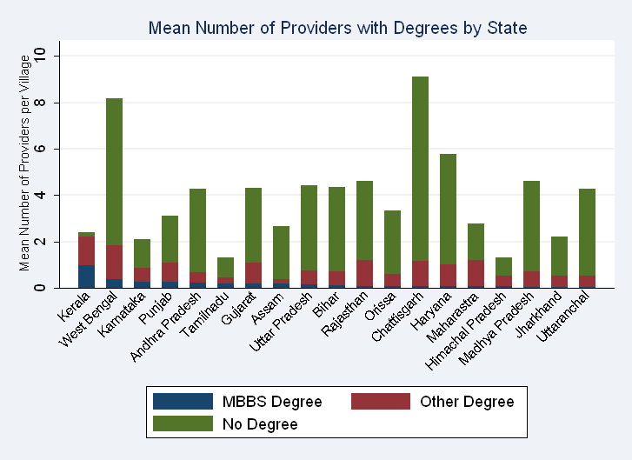
Markets for primary care: India
80% of first-contacts (primary care) in India are with fee-for-service private sector
77% of private providers in rural areas have no medical degree and 4% have an MBBS (MD)
Average village: 3.36 providers with no degree, 0.18 with MBBS
Public providers more qualified, and offer free services, but have ~20% market share (35% in villages with a public PHC)

Slide 6
Our data: quality of care and knowledge of care
Month 1: Standardized Patient (SP) visits healthcare provider and says (in one case): “Dr., I woke up this morning with crushing chest pain and I was feeling very anxious”
  Answers questions, completes basic exams and provider recommends a treatment
  Previous studies demonstrate low detection rates and show that provider behavior is consistent with their believing the SP
    That is, providers do not come to the conclusion that the SP is “faking it”—in fact, the more they do with the patient, the more they are convinced that the SP has the condition that they are presenting with
  Data capture all aspects of the interaction and the price charged at the end (validations with audio recordings confirm validity of data)
Months 3-6 (after completion of all SP cases): 2 surveyors visit the same provider and complete a test of knowledge using medical vignettes
  Surveyor 1: Surveyor 2 will act as a patient who has come to you. You should try and behave exactly as you would with a real patient.
  Surveyor 2: “Dr., I woke up this morning with crushing chest pain and I was feeling very anxious”
  Provider asks questions, completes basic exams and recommends a treatment. Answers given by the hypothetical patient are identical across SPs and medical vignettes
Compare performance in clinical interactions with performance in medical vignettes for the same case

Slide 7
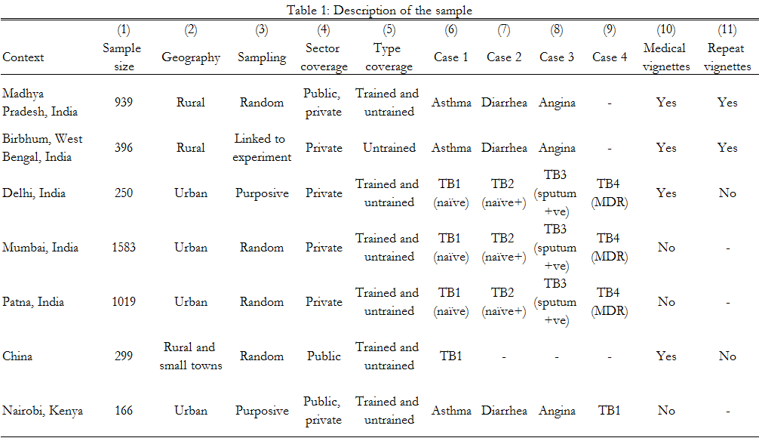
Study samples: conditions covered and types of studies
Notes:
The TB studies differ by the case presented.
TB1: SP has 3 weeks cough, went to the chemist but is not feeling better.
TB2: SP also has a Chest X-ray, whose findings are consistent with TB
TB3: SP has a positive sputum report, which has very few false positives as a test
TB4: SP has had TB previously, but then was cured. Now again has 3 weeks cough.
Asthma: Difficulty breathing
Angina: Crushing chest pain and anxiety
Diarrhea in a Child: Child is sleeping at home. Neighbor looking after child has called to say that child has had diarrhea.
Repeat vignettes are the two studies where we have done the same vignettes with the providers twice—important for measurement error corrections

Slide 8
Characterizing incorrect and over-treatment
Call the correct treatment vector A (example for angina, “take aspirin, get an ECG”)
Define:
  Correct Treatment: Patient receives (at least one element of) A and nothing else; example: “Get an ECG”
  Over treatment: Patient receives A and B; example: “Get an ECG and buy some antibiotics”
  Incorrect Treatment: Patient does not receive A; she could still receive B.
    Set that can range from: “You need a knee X-ray and here are some antibiotics” to “Buy some pain medication”

Slide 9
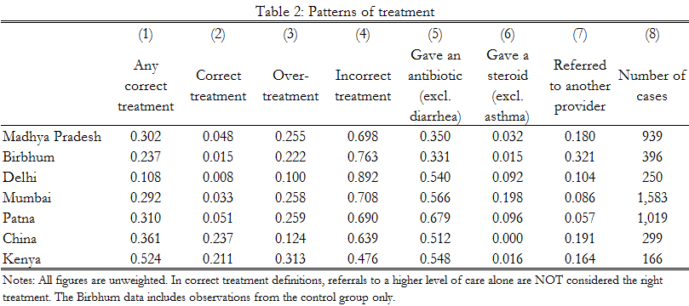
Characterizing incorrect and over-treatment: extent
Across all study sites, SPs incorrectly treated in majority of visits:
Notes:
Note: Including referral alone as correct increases any correct treatment in Birbhum to 52% and decreases incorrect treatment to 48%.

Slide 10
Financial implications
In example, where A is correct and B is not, assume:
  Only A is given: Full cost of visit is necessary
  A and B given: Marginal cost of B is avoidable
  No element of A is given: The full cost of the visit (including consultation costs) are avoidable—patient gets nothing out of being told that his/her heart attack is due to `the weather’
Caution: this an ex-post calculation and could be a lower or upper bound of overall costs
  Upper bound: Parent takes the child to doctor and is given cough syrup for strep throat; parent brings child back 2 days later and doctor correctly gives antibiotics. We treat all costs from first visit as avoidable, even though information from the first visit helped diagnosis in the second
  Lower bound: Factoring in health costs could substantially increase the cost of incorrect treatment
We are also cognizant of the fact that there is no policy counterfactual; these numbers help establish the magnitude of different problems in the sector
  For West Bengal experiment, we can provide the precise policy counterfactual

Slide 11
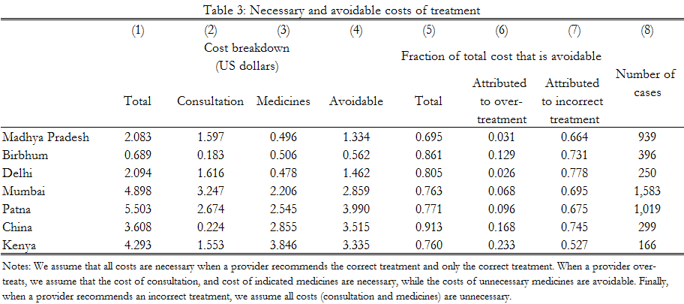
Characterizing incorrect and over-treatment: Financial implications
Financial implications

Slide 12
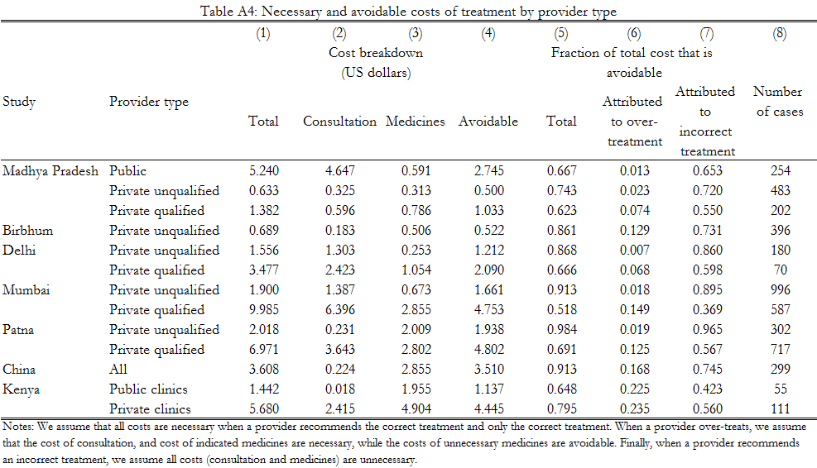
Characterizing incorrect and over-treatment: extent
Incorrect treatment also high for qualified private providers and in public sector

Slide 13
Incorrect treatment due to lack of knowledge?
High levels of incorrect treatment even among qualified providers suggest this is not just due to lack of knowledge
Directly measure knowledge using medical vignettes:
  First compare E(Performance with SPs) to E(Performance in Vignettes).
  Then assess E(Performance with SPs|Performance in Vignettes). This conditional expectation tells us how increases in knowledge alone translate into practice

Slide 14
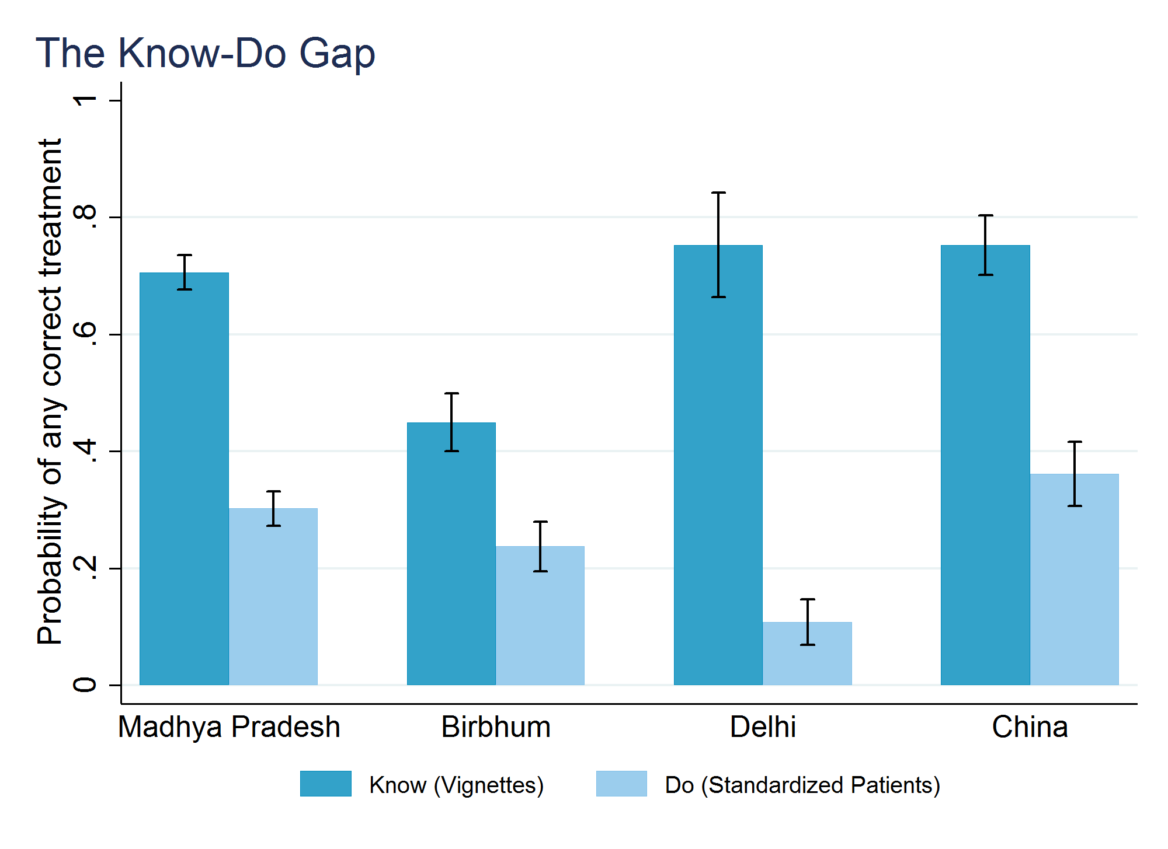
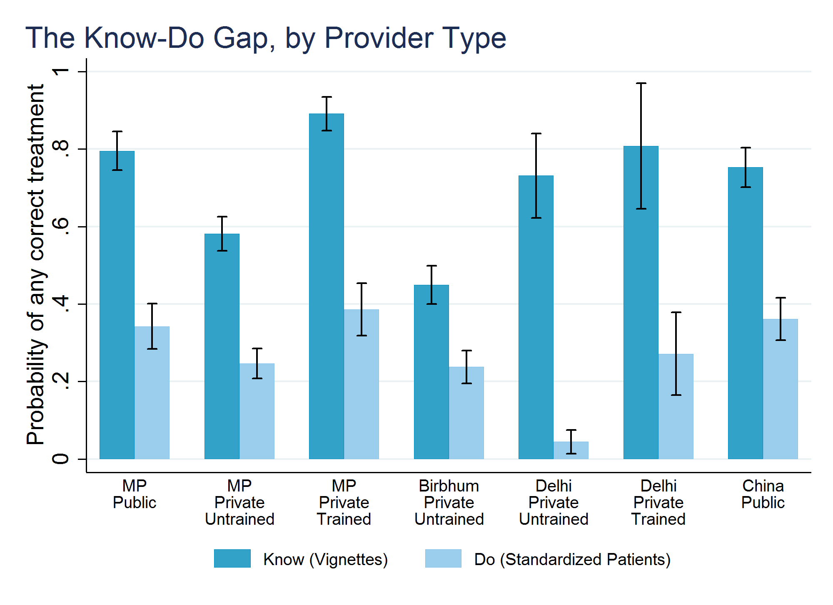
Absolute “know-do” gap
In all samples, providers perform better on vignettes than in SP audits.
Trained providers show larger gap than untrained: upskilling appears unlikely.

Slide 15
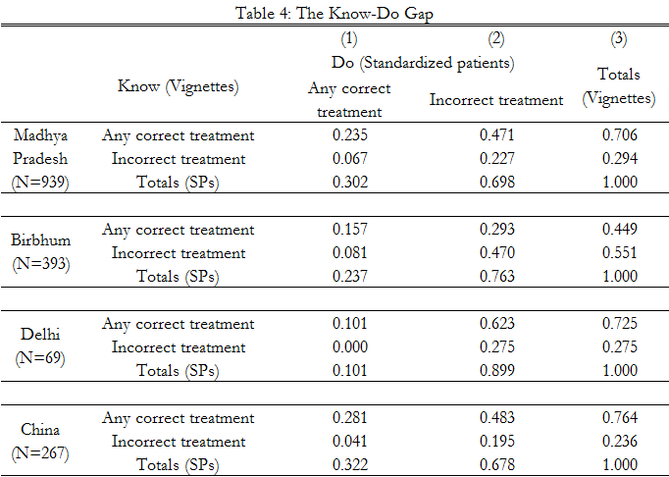
Conditional know-do gap
Conditional on “knowing” the correct treatment in MP (70.6%) only 23.5% “do” the correct action with SPs
But also possibility of measurement error as 0-8% of those who don’t “know” end up providing the correct treatment for SPs

Slide 16
Conditional know-do gap
First pass is the simple OLS:
Do_{j} = ⍺ + ⍬Know_{j} + ε_{j}
Here, ⍬ is attenuated due to measurement error in “Know.”
We use repeated surveys of “know” at 2 different points in time (Madhya Pradesh and Birbhum) to address measurement error:
  Instrument first measurement of “know” with the second measure; this IV is biased upwards for binary variables so that between the OLS and IV, we can estimate lower and upper bounds
  Another option is to use GMM estimates (consistent) with a second report as instrument

Slide 17
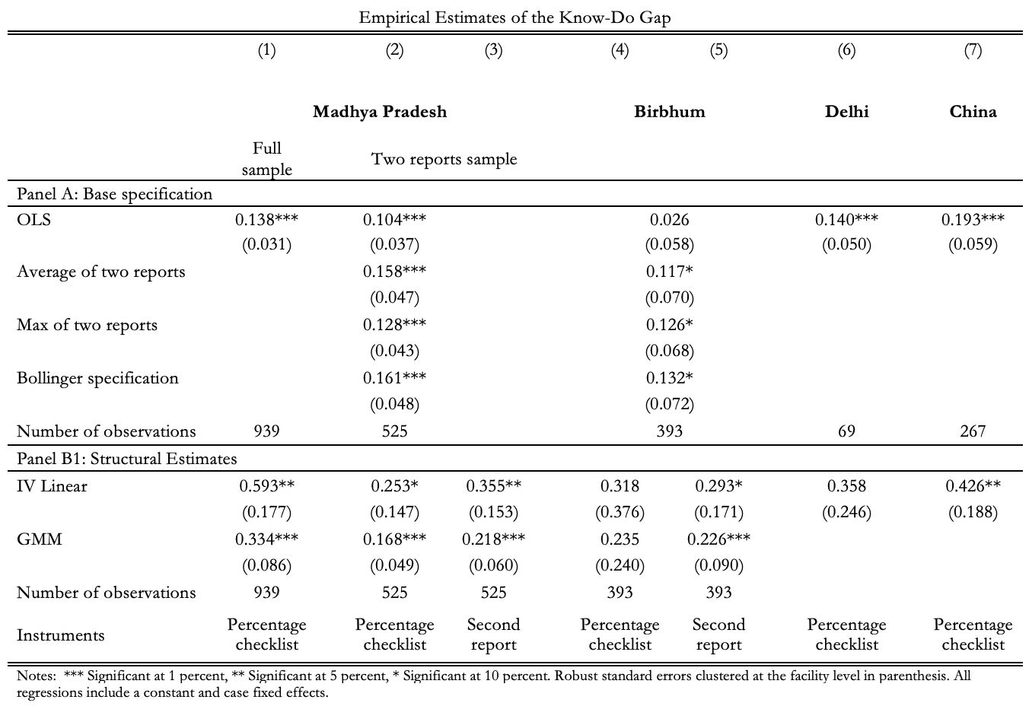
Conditional know-do gap: ME correction

Slide 18
Taking stock
Primary care markets characterized by significant incorrect treatment
  70% of all spending medically unnecessary, mostly because doctors treat them incorrectly
However, when we ask doctors how they would treat the same patients we send as SPs, correct treatment is much higher
One explanation: marginal cost of effort exceeds the marginal benefits. The (market) reward to doing more is insufficient to compensate provider for their additional effort
  Is there reward for extra effort?

Slide 19
Is effort rewarded in the market?
We define three aspects of provider performance:
  Time spent (physical effort)
  Checklist completion (cognitive effort): Fraction of important history questions and examinations that the provider undertook
  Correct treatment: Whether the provider gave a correct treatment to the SPs

Slide 20
The puzzle

Slide 21
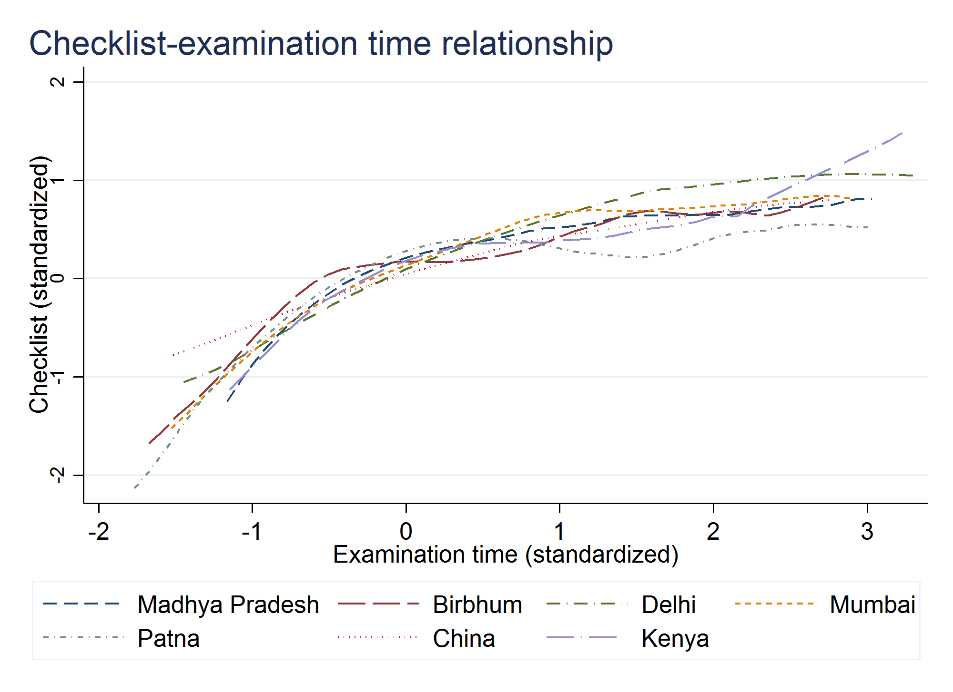
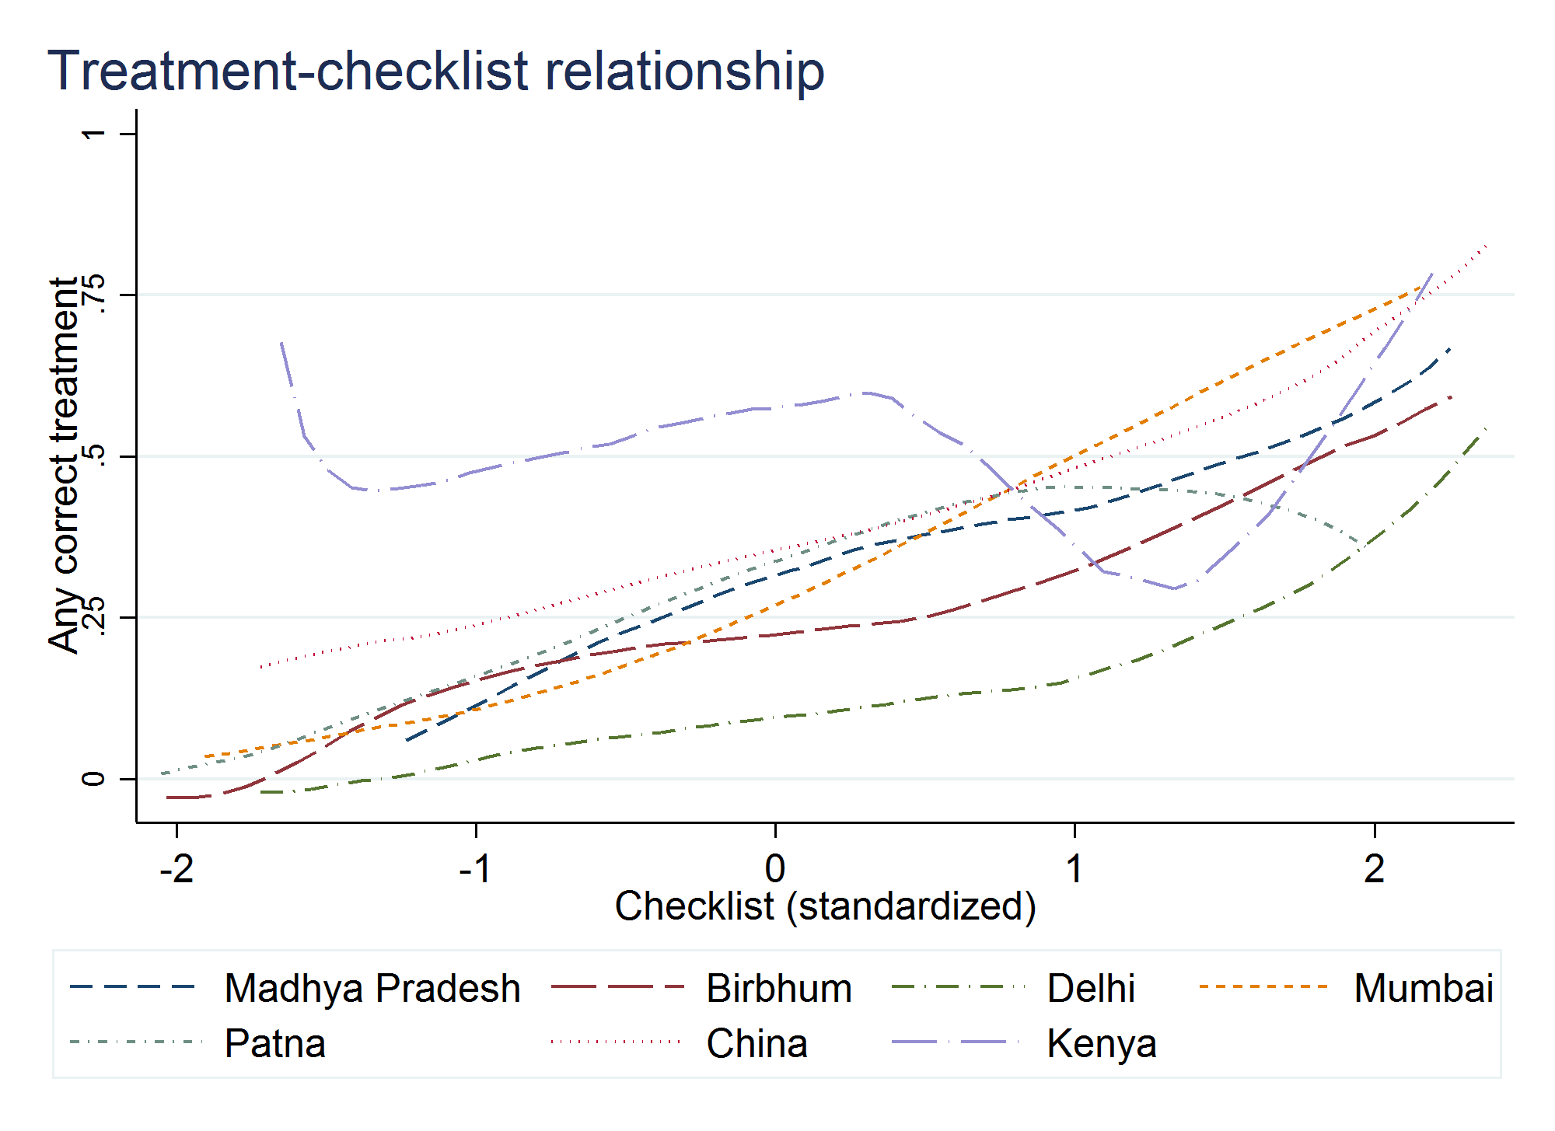
Fact #1: Providers who spend more time complete more checklist items.
Providers who complete more checklist items are more likely to treat correctly.
Notes:
In the Kenyan public facilities, they directly triage through people with a persistent cough to TB screening

Slide 22
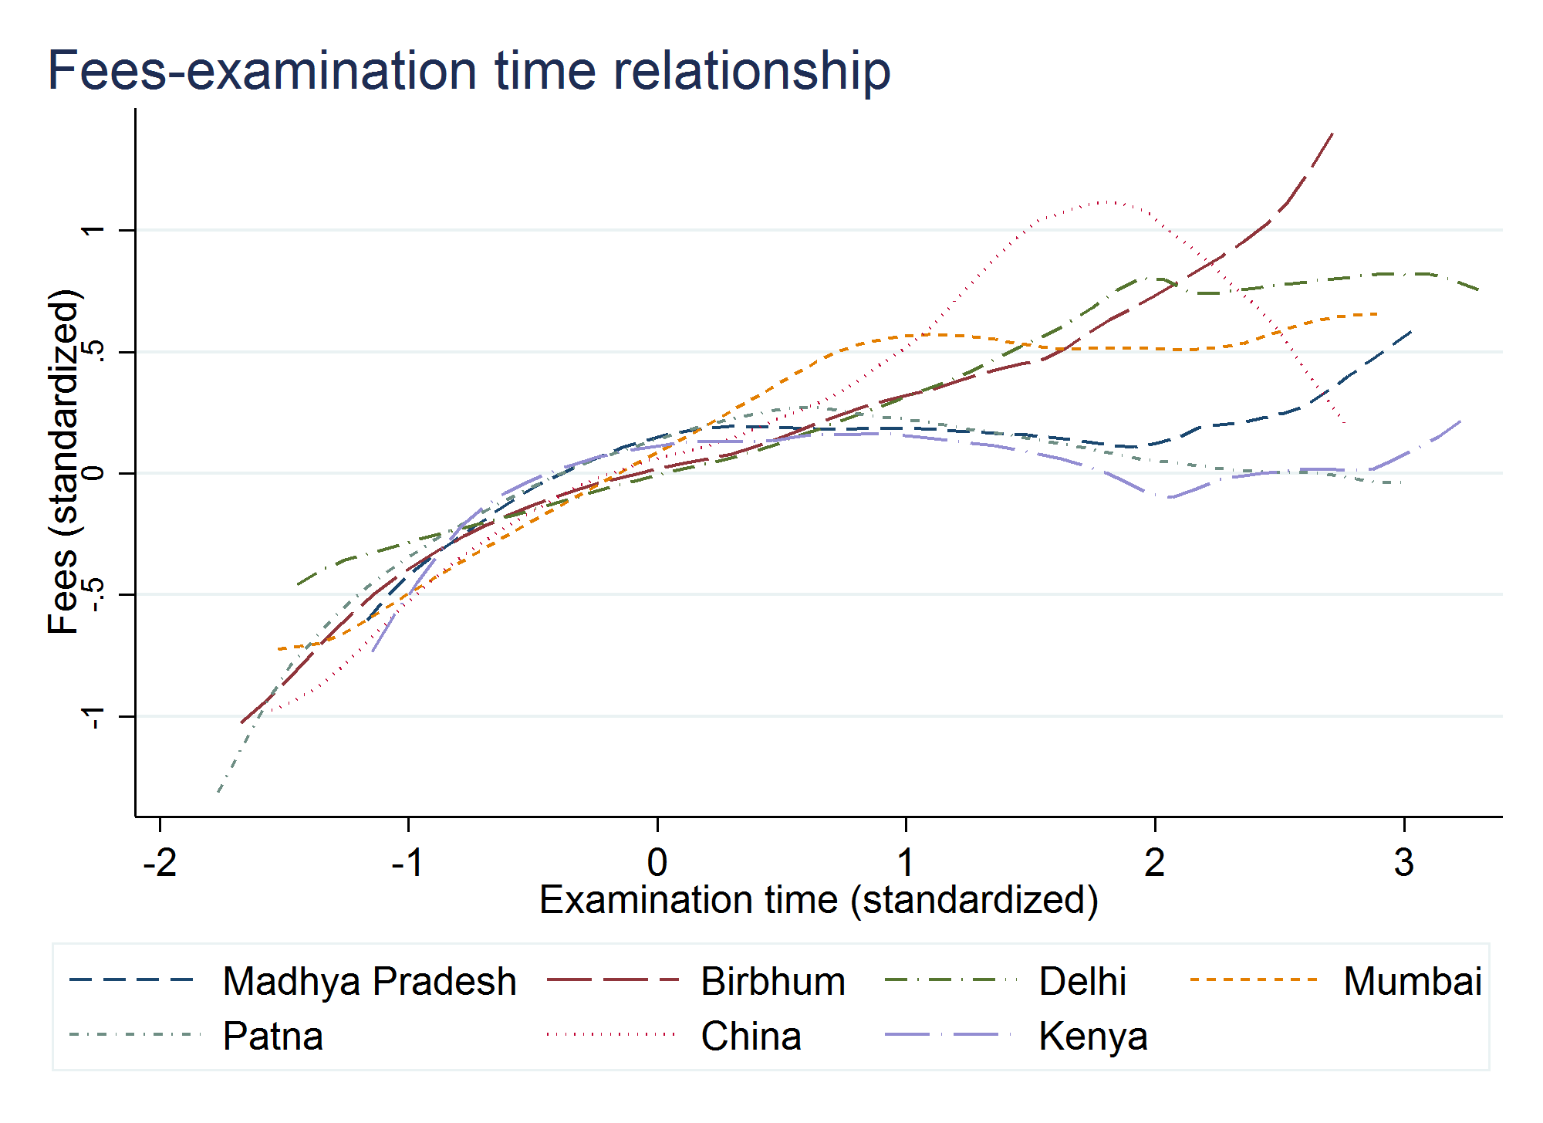
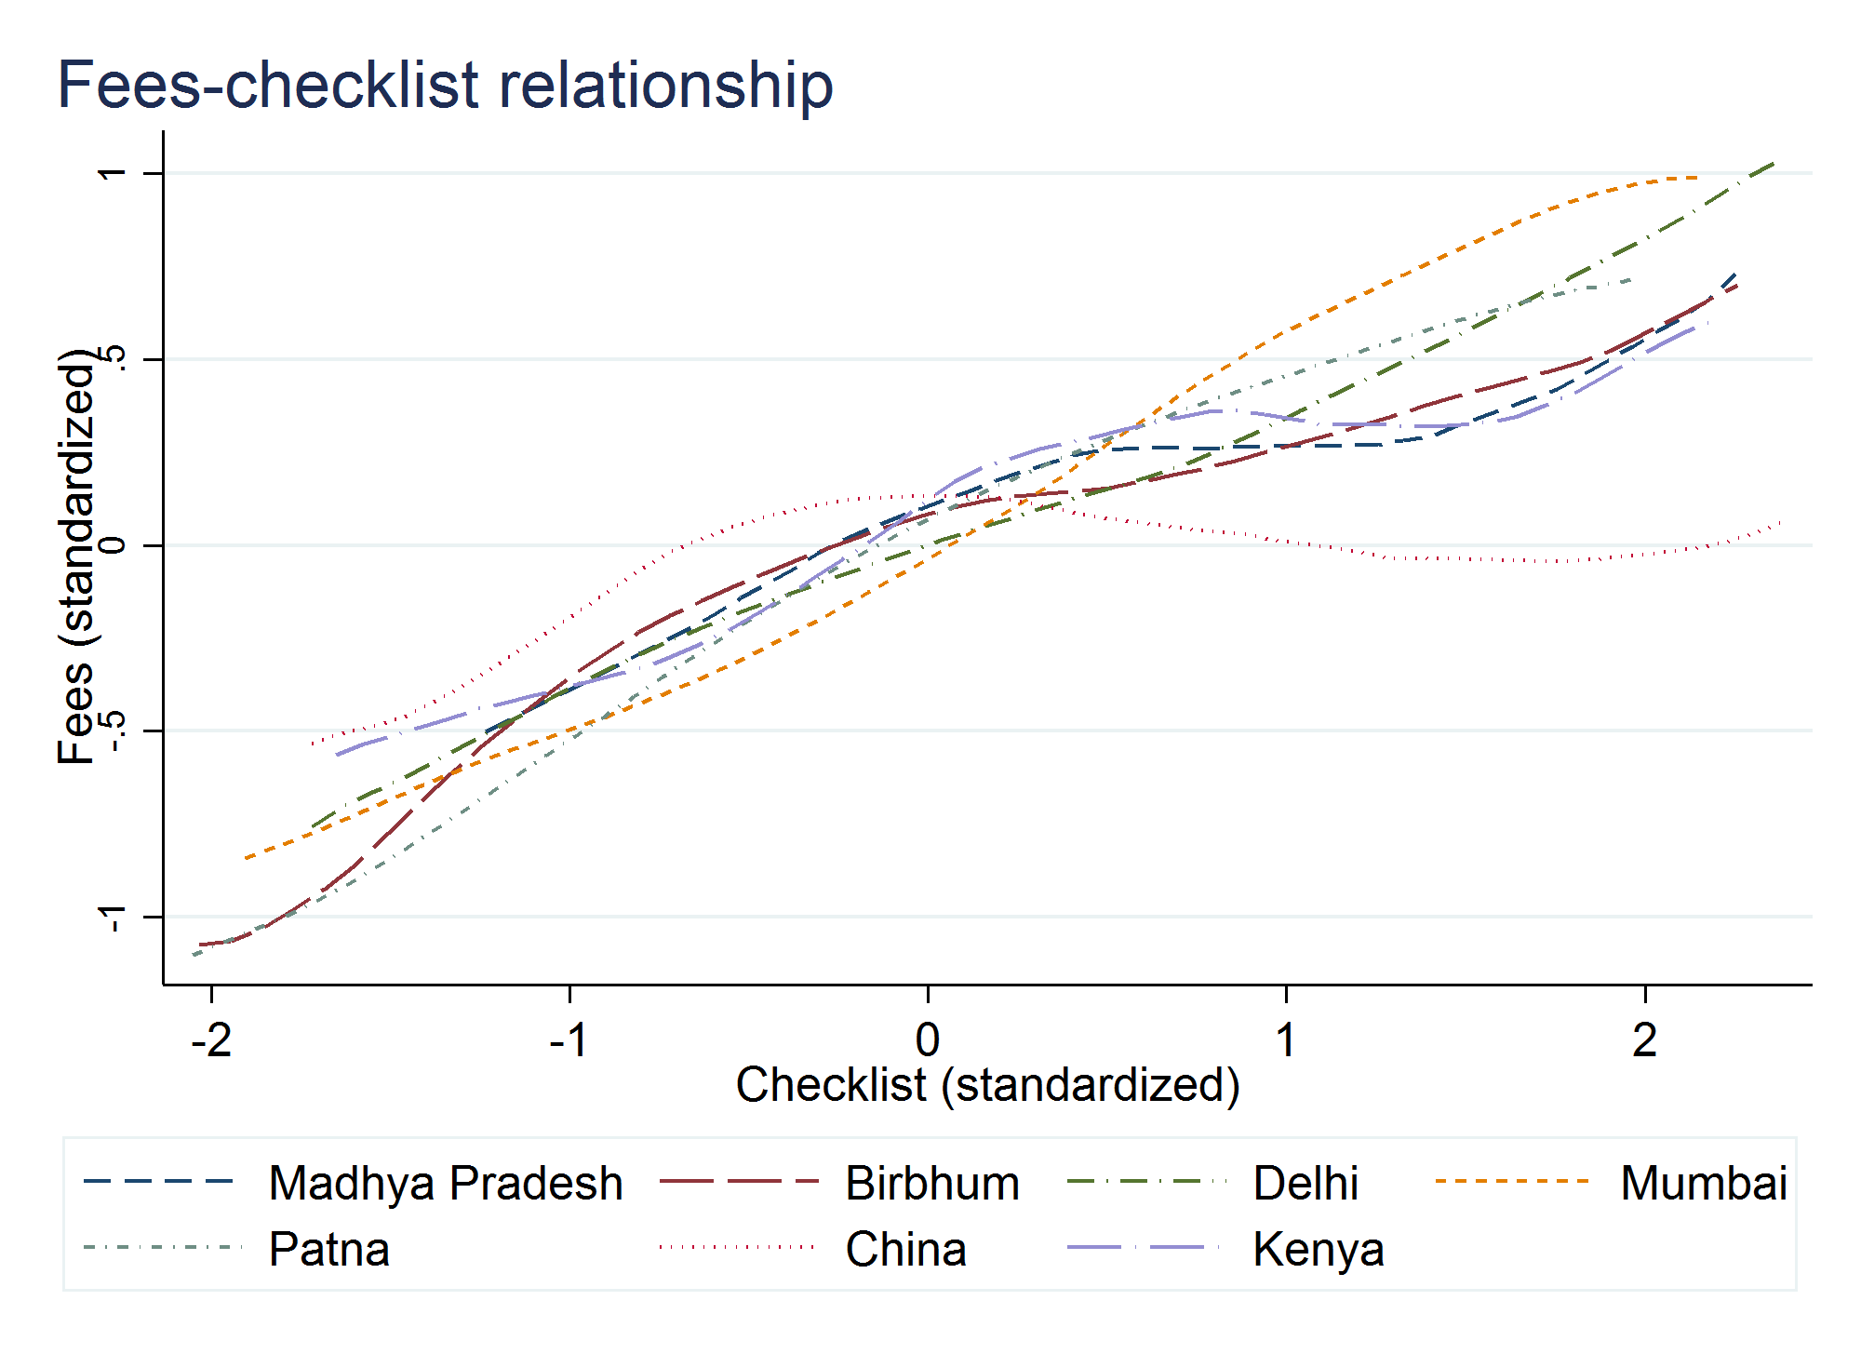
Fact #2: Providers who spend more time or complete more checklist items earn more money (positive return to effort).

Slide 23
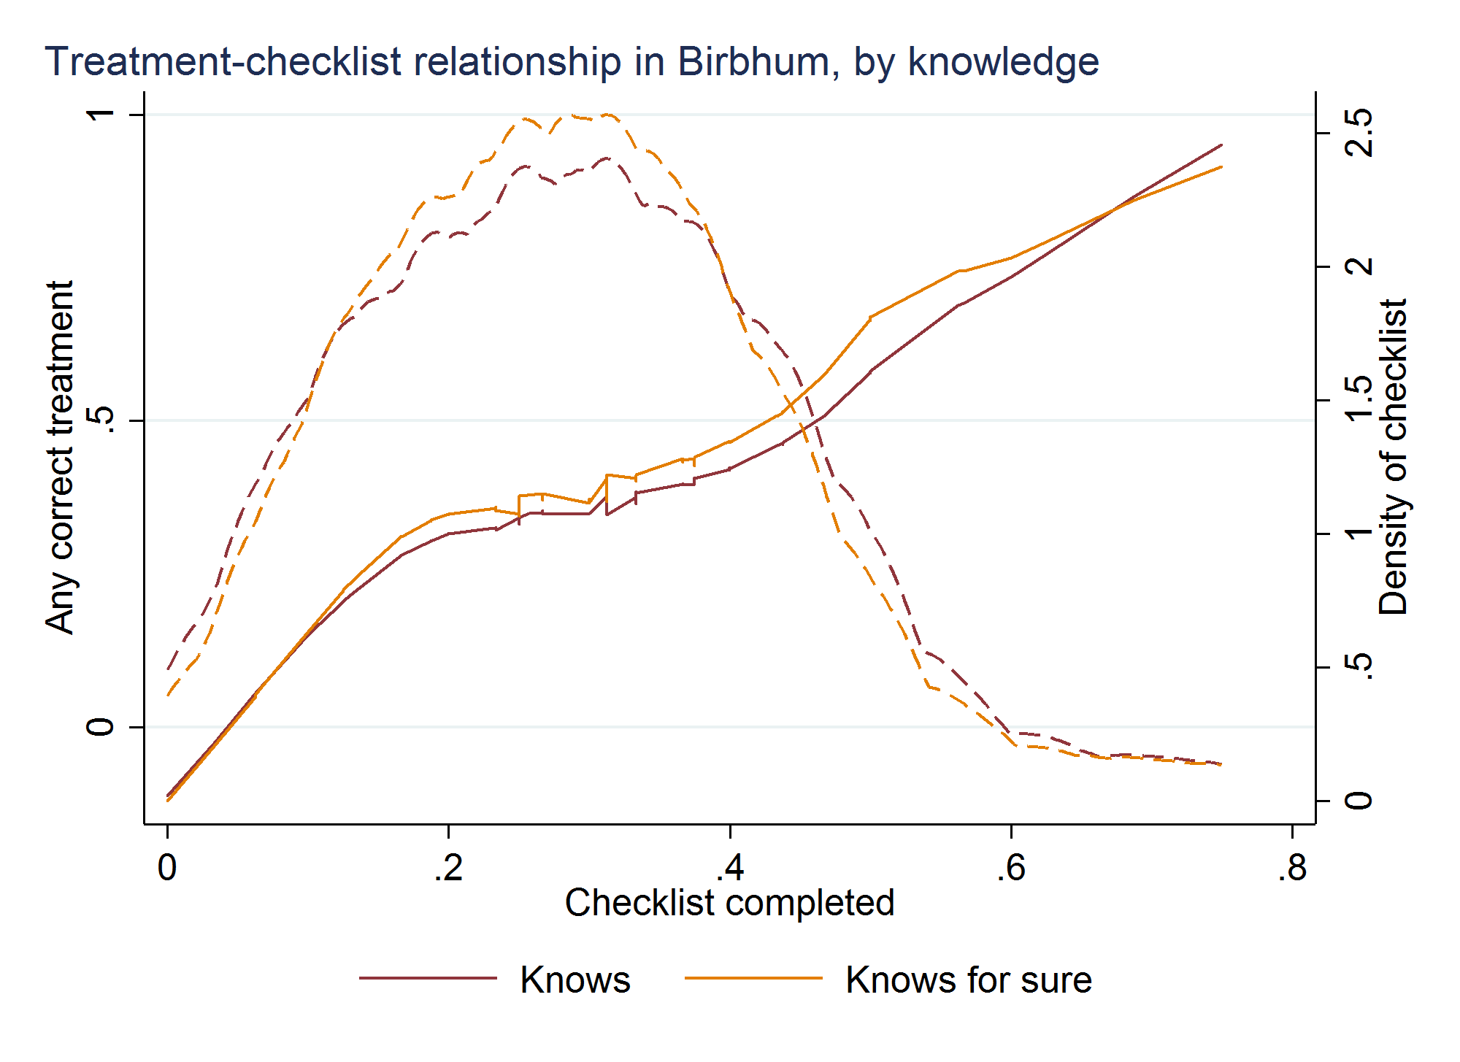
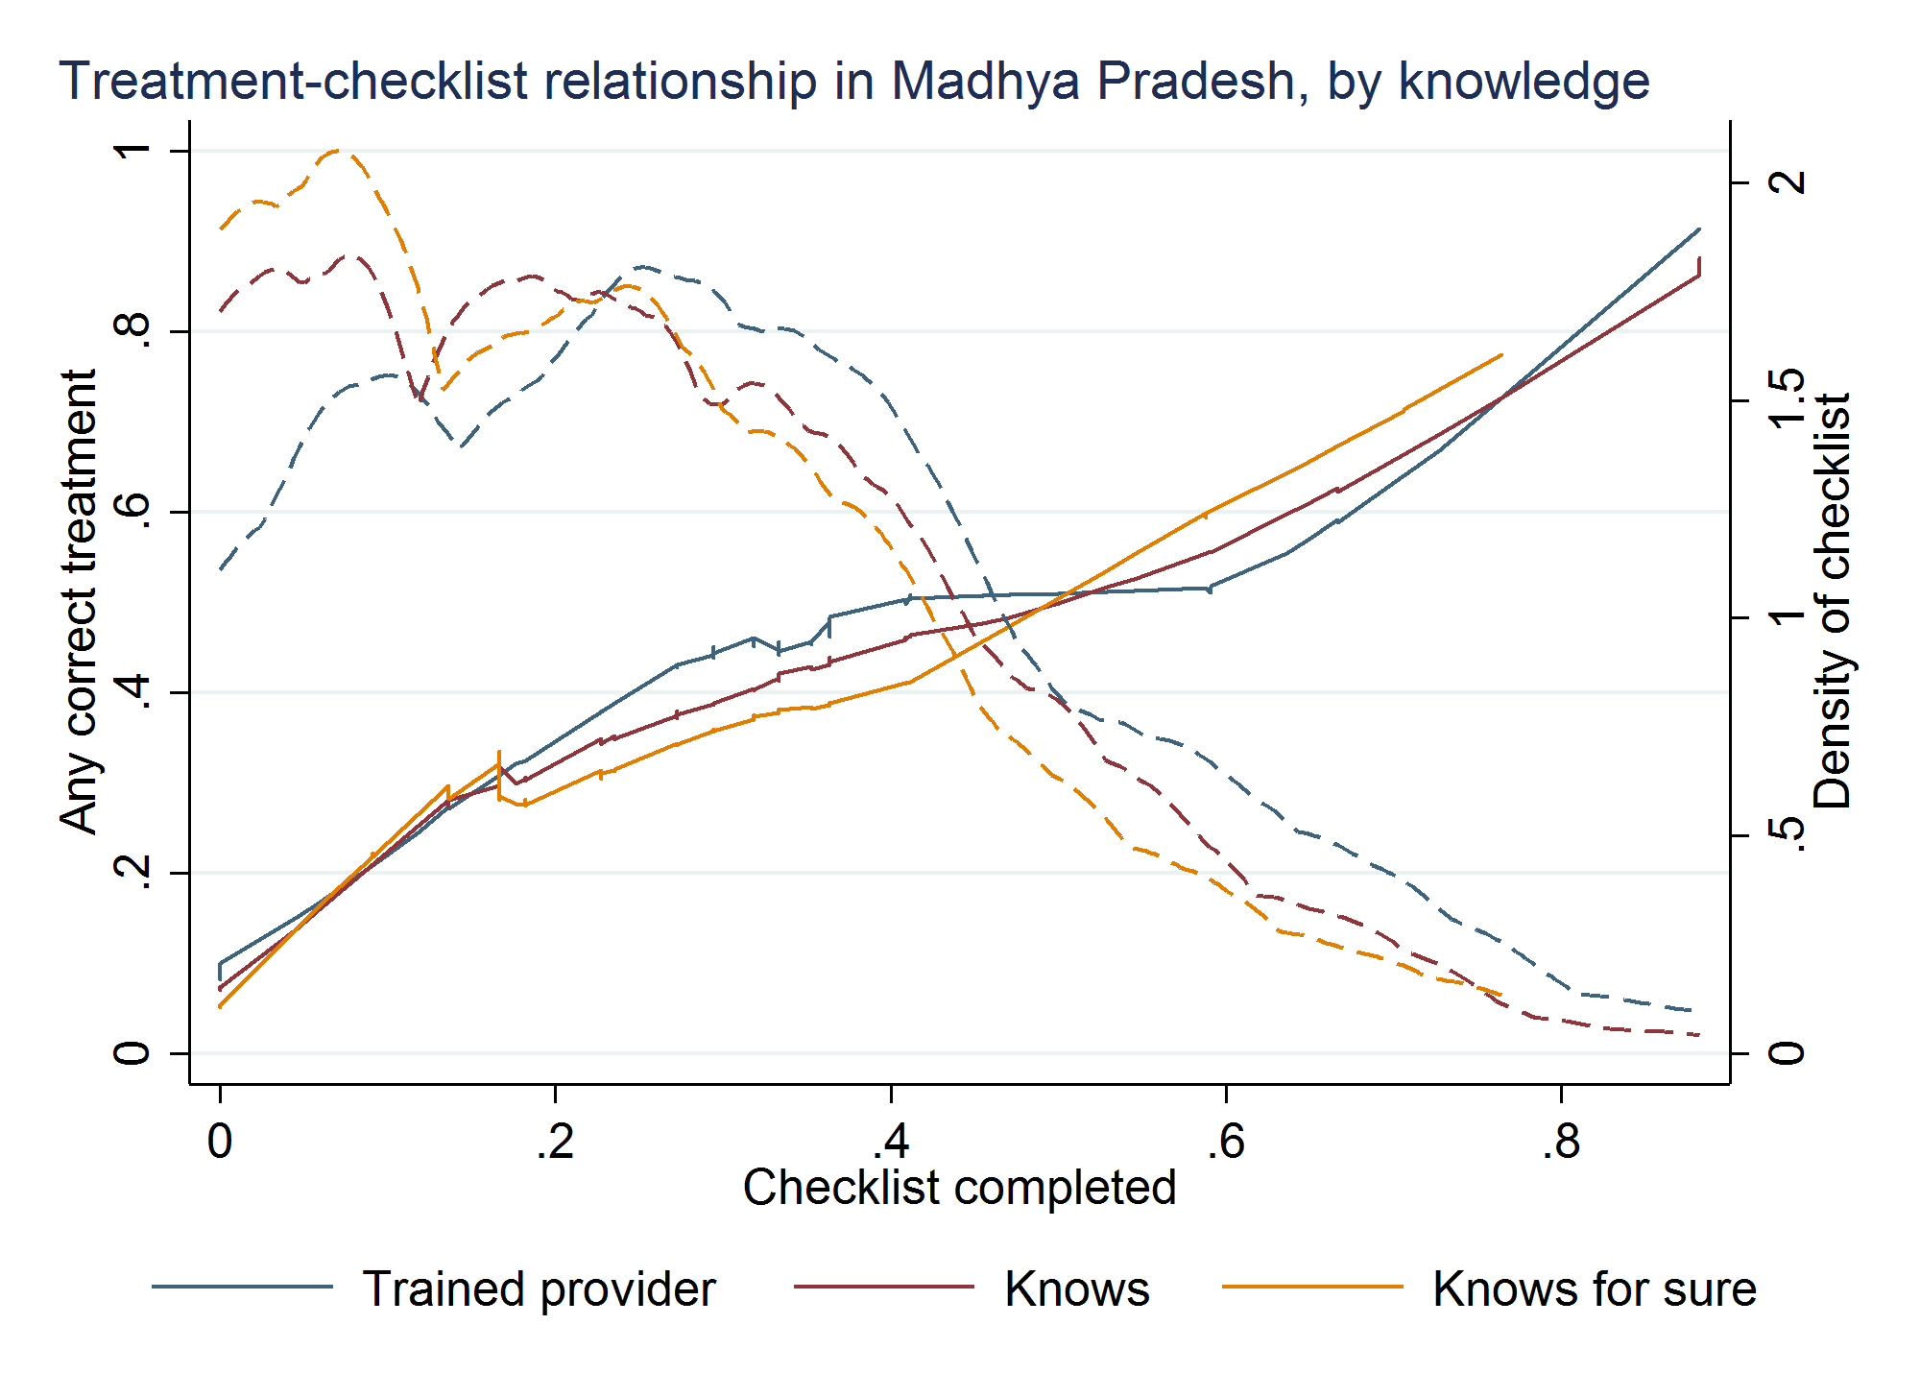
Fact #3: Among those who “know” the correct treatment, wide variation in “do.”
Among those who know, the more they “do”, the more likely they treat correctly.

Slide 24
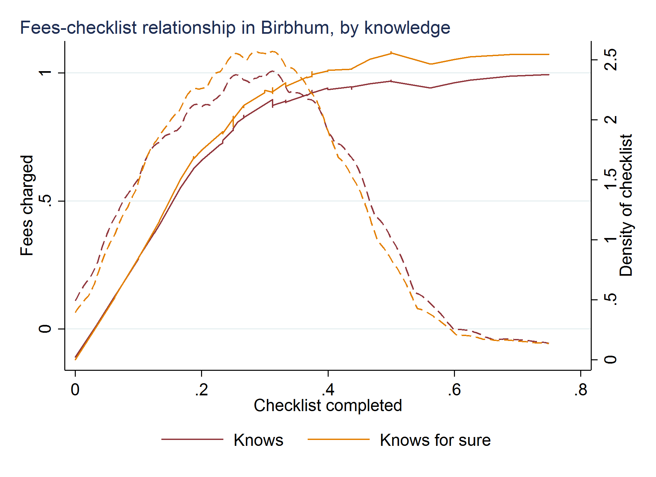
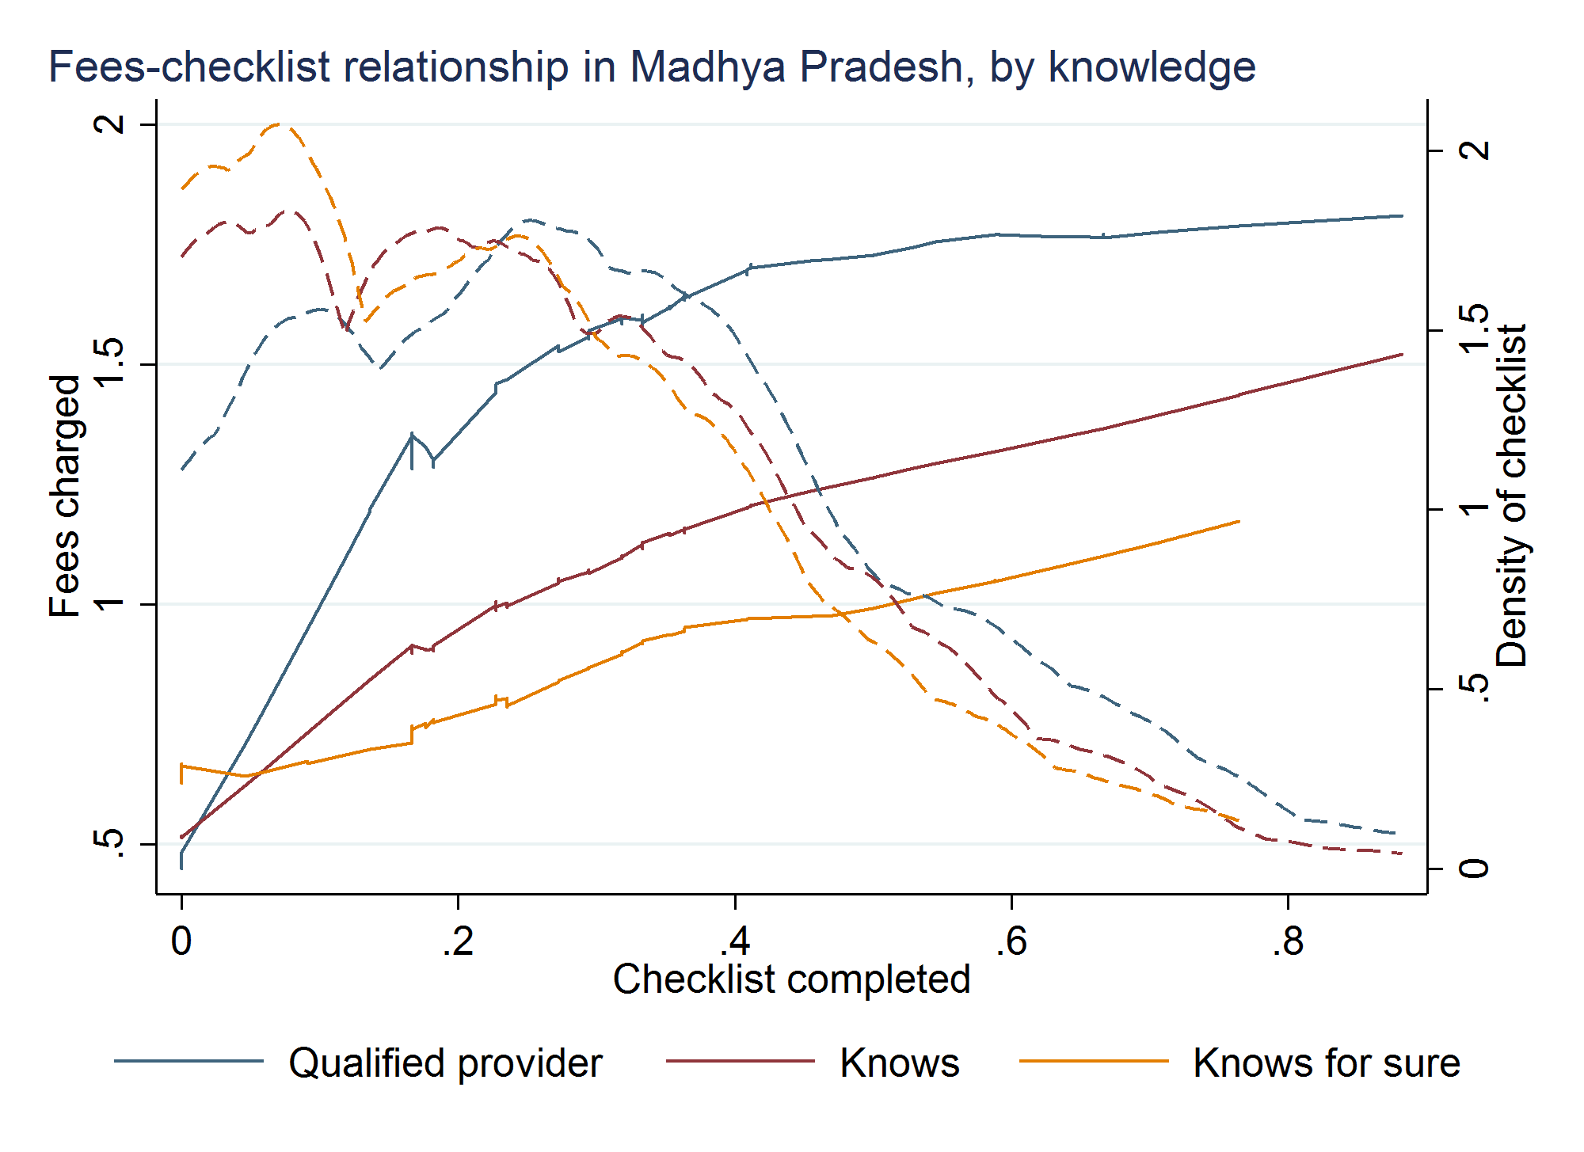
Fact #4: Those who do more charge patients more.

Slide 25
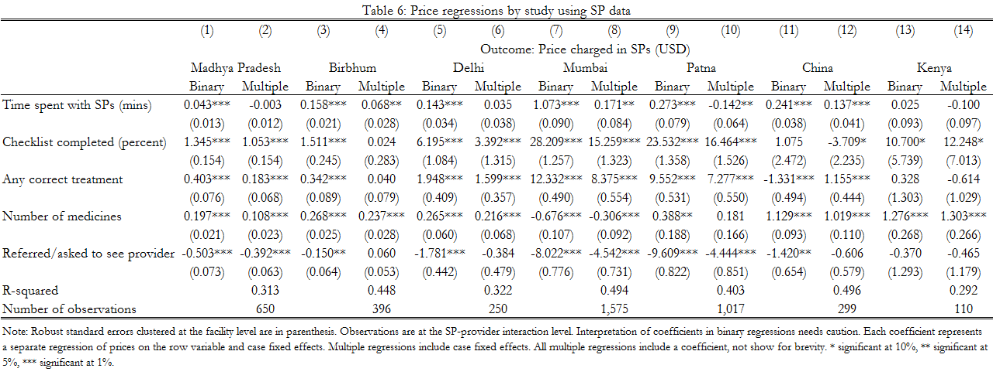
Hedonic price regression with SPs
Fees higher for providers who
spend more time, complete more checklist items, correctly treat more often

Slide 26
Hedonic price regressions with real patients
The cross-sectional estimate may be subject to identification issues:
  More knowledgeable practitioners “do” more (know-do gap is not zero)
  More knowledgeable providers also treat better and price higher
With real patients, we can also include provider fixed-effects as half the variation in time spent and actions completed is within provider, half is across

Slide 27
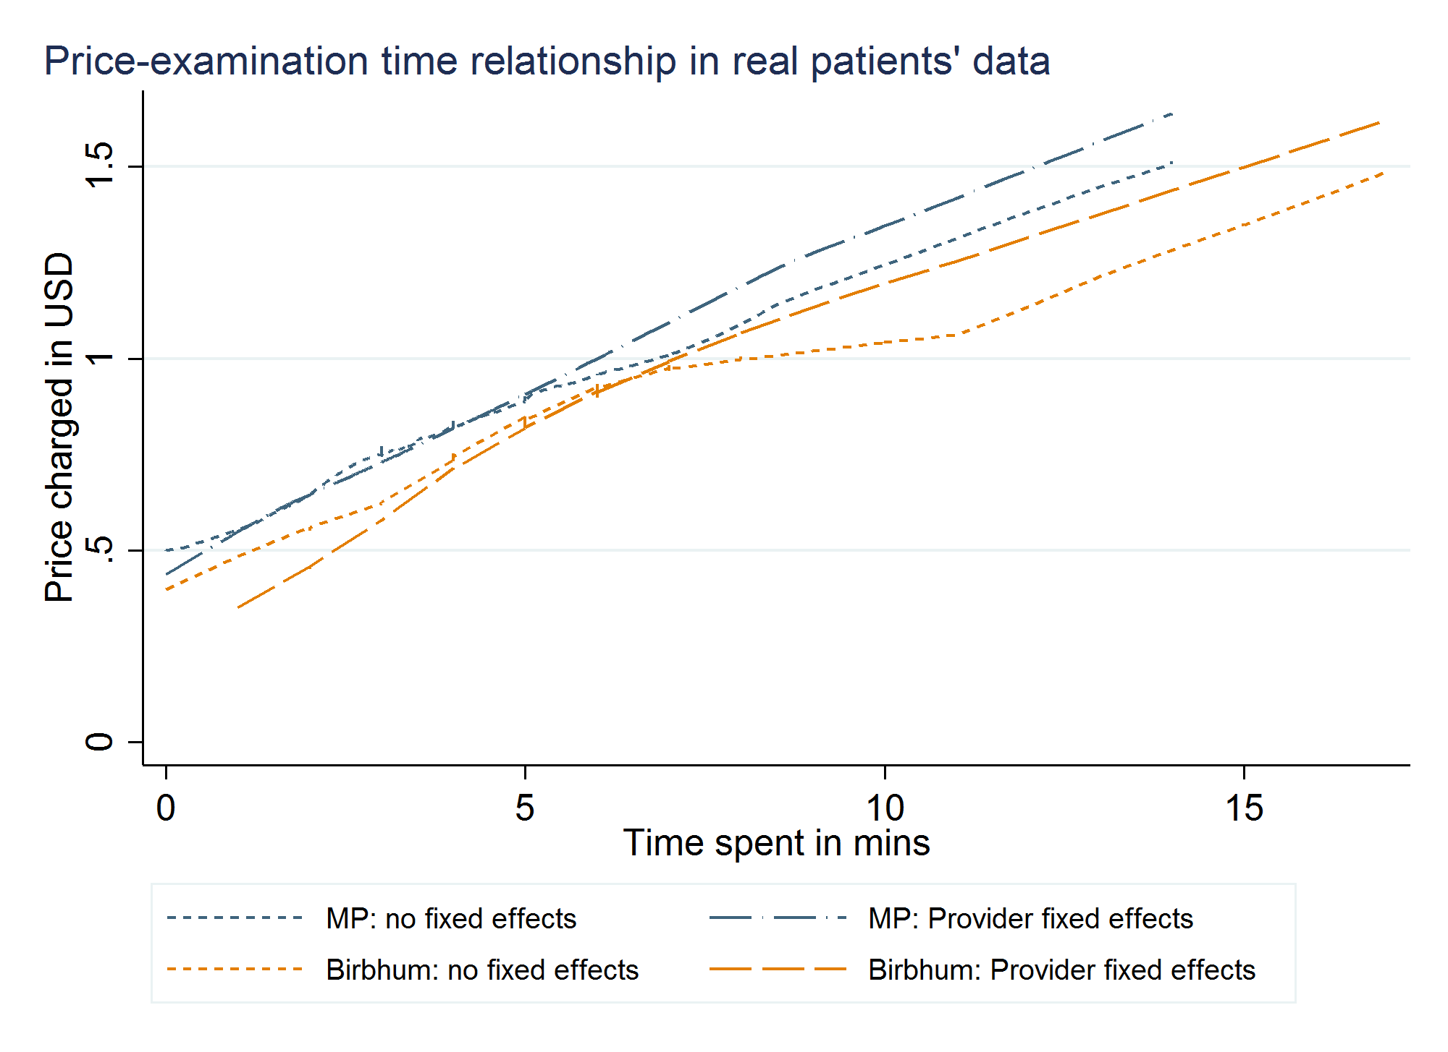
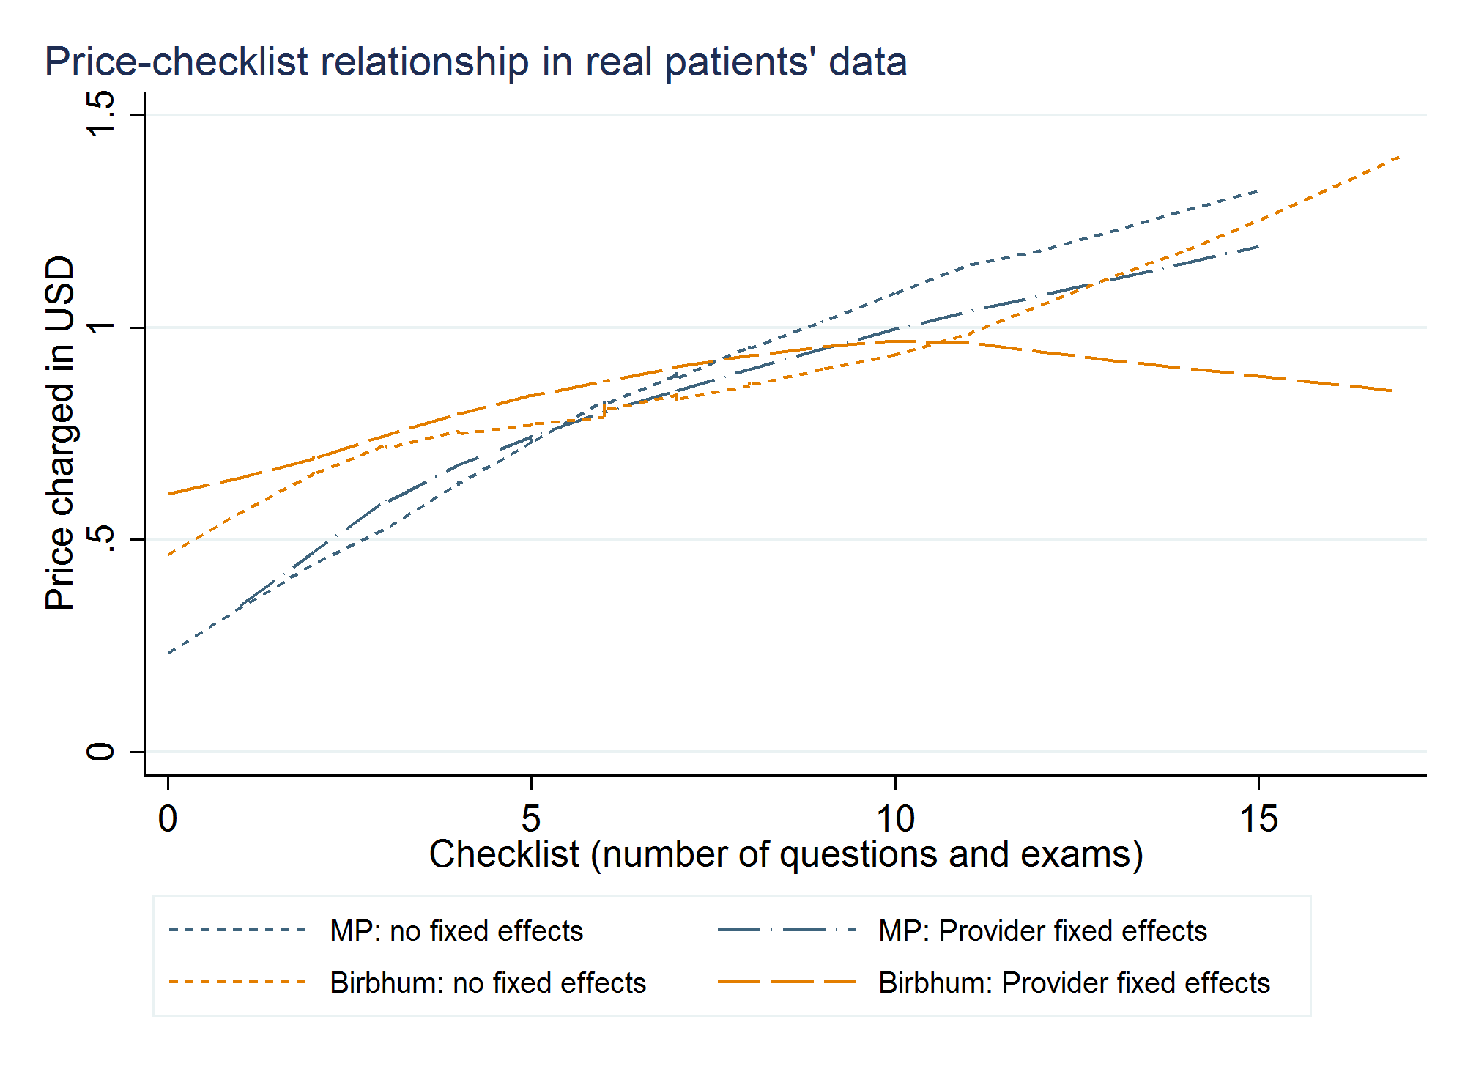
Hedonic price regression with real patients and provider fixed-effects

Slide 28
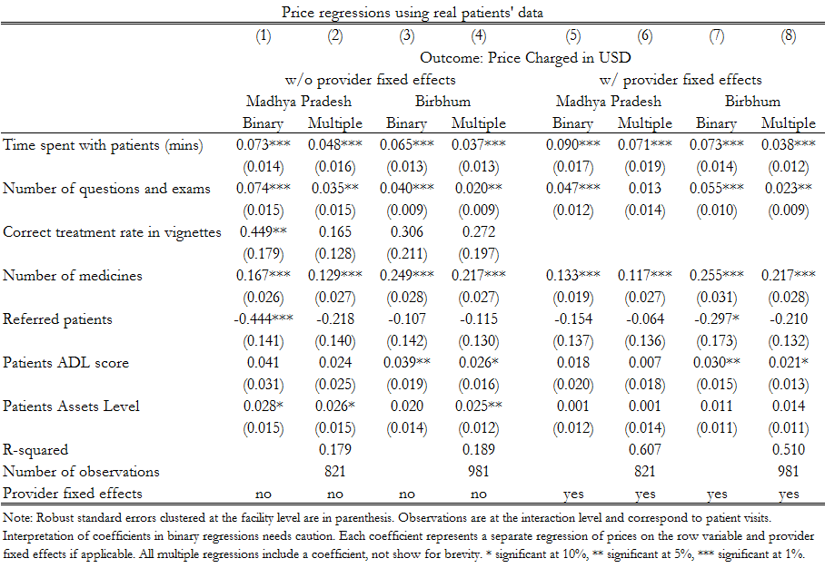
Hedonic price regression with real patients
Even with real patients, providers who spend more time and complete more actions (number of questions and exams) earn significantly more per patient
These coefficients remain very similar when we look within provider
(Columns 5-8)
Coefficients do not change when we include Patient’s ADL Score (a measure of health status) and assets

Slide 29
Perhaps providers are simply time constrained: they are too busy to ask more questions and reap the financial returns.

Slide 30
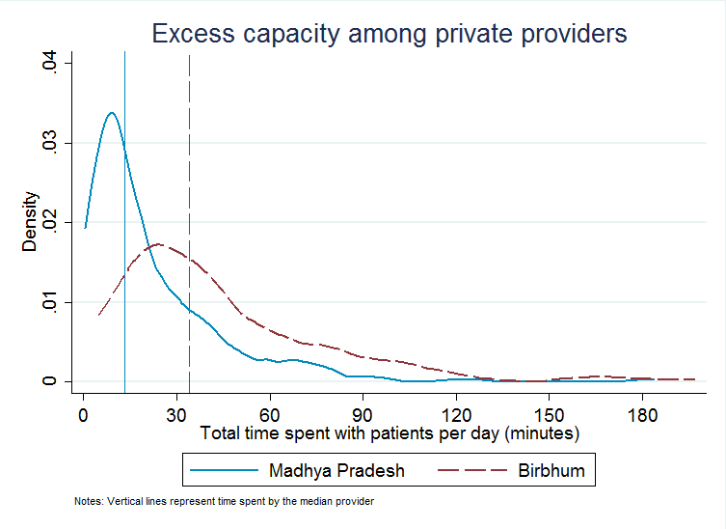
Fact #5: These patterns arise despite enormous excess capacity in providers’ clinics
Data based on spending a full day in the doctors clinic and noting down the time of entry and time of departure for each patient.

Slide 31
How to understand provider behavior
The providers are not time constrained.
For MP and Birbhum, we use regression estimates to calibrate additional revenue from additional time using the regression coefficients
  These calibrations suggest that the extra earnings per minute is 10 cents
  or $1 per 10 minutes
This implies an implicit wage rate of $6 per hour in 2011/2014, which compares to the maximum NREGA minimum wage of $3 per day in 2018 (less than 40 cents per hour)

Slide 32
Turning to the anthropologist

Slide 33
The Fallen Idol, Saria 2017
Corruption in the health sector in Patna was perceived by patients as the prescribing of diagnostic tests and medicines that resulted in “cuts” (commissions) for the doctors from the owners of the diagnostic centers and pharmaceutical companies (Jain, Nundy, and Abbasi 2014). To counter this charge, a lot of doctors like Dr. Anil send their patients for investigation only in the second visit if the complaints of the patient have remained persistent. …“If I tell the patient straightaway that they have to go get tests that cost 10,000 rupees, he will run away and not come back.”

Slide 34
The Fallen Idol, Saria 2017
The poor patients who came to the many clinics in the densely medical landscape of Patna with cough and fever were never tested for TB but were given medicines that would alleviate the symptoms associated with smoking and breathing the heavily polluted air. This was not because doctors did not understand the severity of the epidemic, which they knew about only too well. They hesitated in initiating investigation because immediate investigation and treatment would, as we have seen, raise suspicions in the minds of patients and make them vulnerable to defaulting on their medication or worse. It would prolong their suffering in their hunt for a doctor who they felt was not corrupt.

Slide 35
The Fallen Idol, Saria 2017
The clinical encounter was not just an exhibition of power on the part of the doctor and of resistance on the part of the patient; rather corruption made them both vulnerable in different ways. If perceptions of corruption made the patient became vulnerable to illness, disease, death and delayed treatment, then the doctors too were not immune.
Trust enabled patients to bear symptoms or side-effects within
a narrative of healing rather than a narrative of corruption.

Slide 36
The missing link: provider response to mistrust
The provider-patient relationship: healthcare provision is determined bilaterally
Positive shock to patient beliefs of provider quality should enable high quality providers to close their know-do gap.

Slide 37
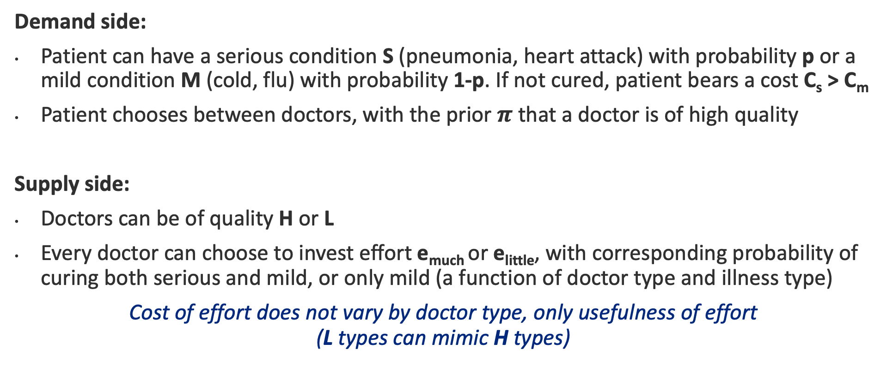
Conceptual framework
Demand side:
Patient can have a serious condition S (pneumonia, heart attack) with probability p or a mild condition M (cold, flu) with probability 1-p. If not cured, patient bears a cost C_{s} > C_{m}
Patient chooses between doctors, with the prior $π$ that a doctor is of high quality
Supply side:
Doctors can be of quality H or L
Every doctor can choose to invest effort e_{much} or e_{little}, with corresponding probability of curing both serious and mild, or only mild (a function of doctor type and illness type)
Cost of effort does not vary by doctor type, only usefulness of effort
(L types can mimic H types)

Slide 38
Conceptual framework
Contracting:
Doctor and patient contract over the amount of effort invested and the fee charged/paid.
Cannot contract over the outcome of the treatment (cure or not)
Incentives for quality:
The patient can decide not to come back if she is not cured.

Slide 39
Conceptual framework
Two period model:
Second period:
Because patients cannot contract on outcome, L types always have an incentive to pretend to be H types. No separating equilibrium.
First period:
Consider a separating equilibrium. If providers are truthful about type, then patients will no longer return based on cure, but directly on type.
Then L types always have an incentive to deviate, since outcome is irrelevant.
Pure separation is unstable: no way to impose a cost on L for deviating.

Slide 40
Implications
Because effort is contractible, fees and effort are positively correlated
A know-do gap will exist across the majority of provider-patient interactions, which fall into pooling or partially separating equilibria
Consider an intervention that positively shifts beliefs about the abilities of a provider.
  A new pooling equilibrium emerges, where both H and L put in high effort (tradeoff: potentially inefficient to the extent that L is putting in high effort and charging high fees)
  Greater separation emerges, with a greater fraction of H enabled to invest in high effort
A change in beliefs implies that the provider will move along their production function relating effort to quality, rather than a shift of the function itself

Slide 41
Case study from an experiment in West Bengal
Experiment from Birbhum district, West Bengal described in Das et al. 2016
Randomly chosen informal providers were given 9 months of training
  Training for 4 hours per session over 52 training sessions
  Average attendance of 54%
  Credible signal of quality: reputable program, costly in time, transport, and lost income

Slide 42
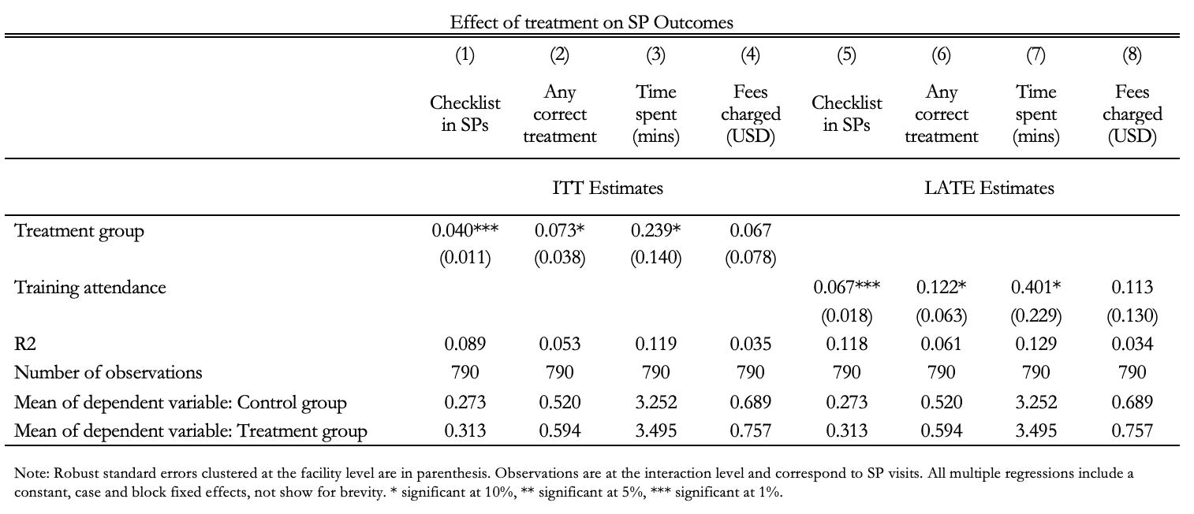
Significant impacts on performance with SPs
(Science - Das, Banerjee, Chowdhury, and Hussam 2016)

Slide 43
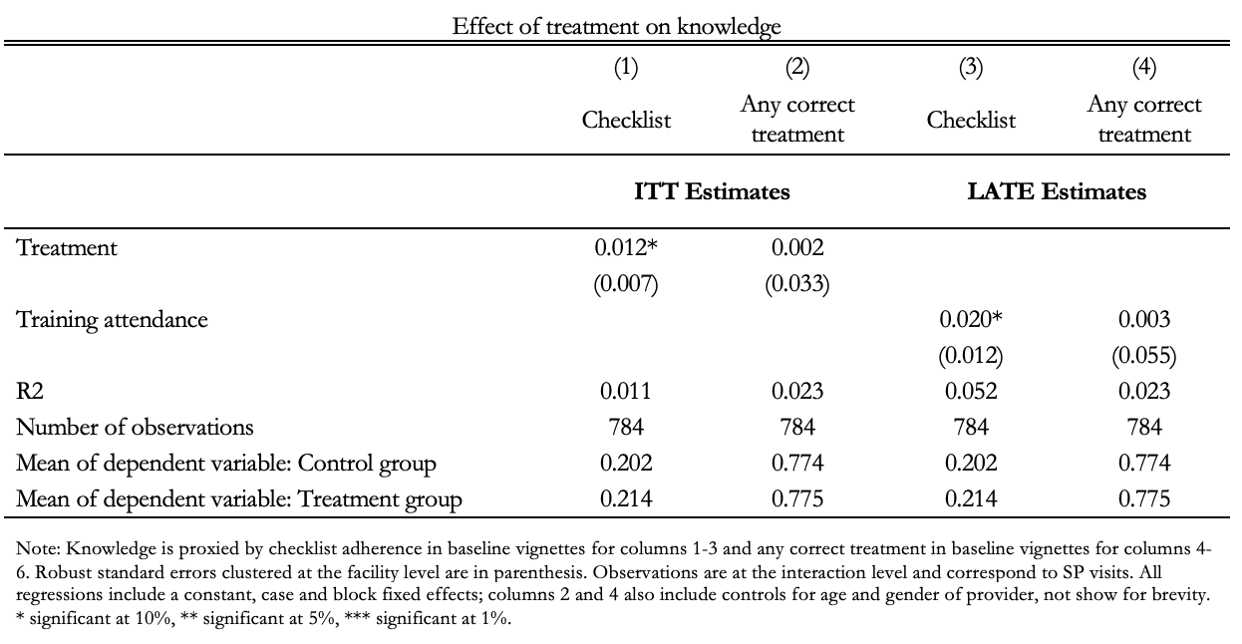
But training has no impact on knowledge
Small positive effects on checklist completion and
no impact on correct treatment in medical vignettes
Notes:
ADD CONTROL MEAN

Slide 44
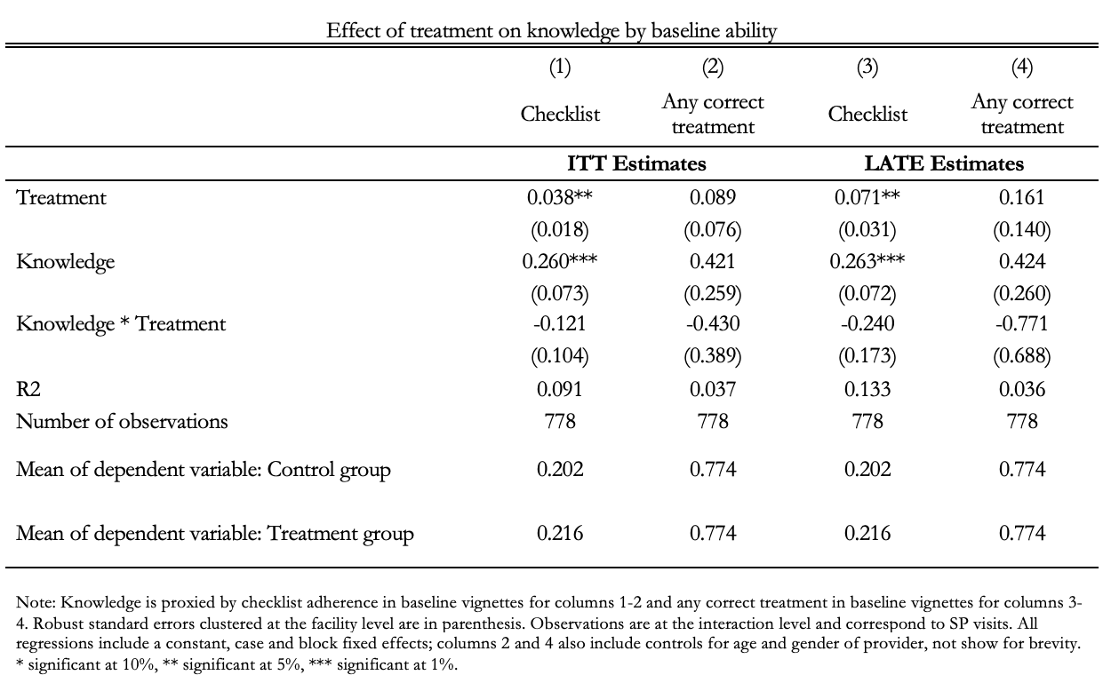
…nor differentially by baseline knowledge
Providers who are higher ability at baseline do not see
differentially greater improvements in knowledge due to the treatment.
Notes:
ADD CONTROL MEAN

Slide 45
Shift of curve or movement along the curve?
Higher treatment rates and prices could be due to:
  Shift onto new effort-price production function (training makes providers more productive in ways beyond direct effect on knowledge)
  Movement along the same effort-price production function (no change in productivity but a shift in demand)
This suggests a further test:
If the intervention only changed patient beliefs about quality (and not underlying quality), we should find that the production function (from effort to correct treatment to price) remain the same in control and treatment

Slide 46
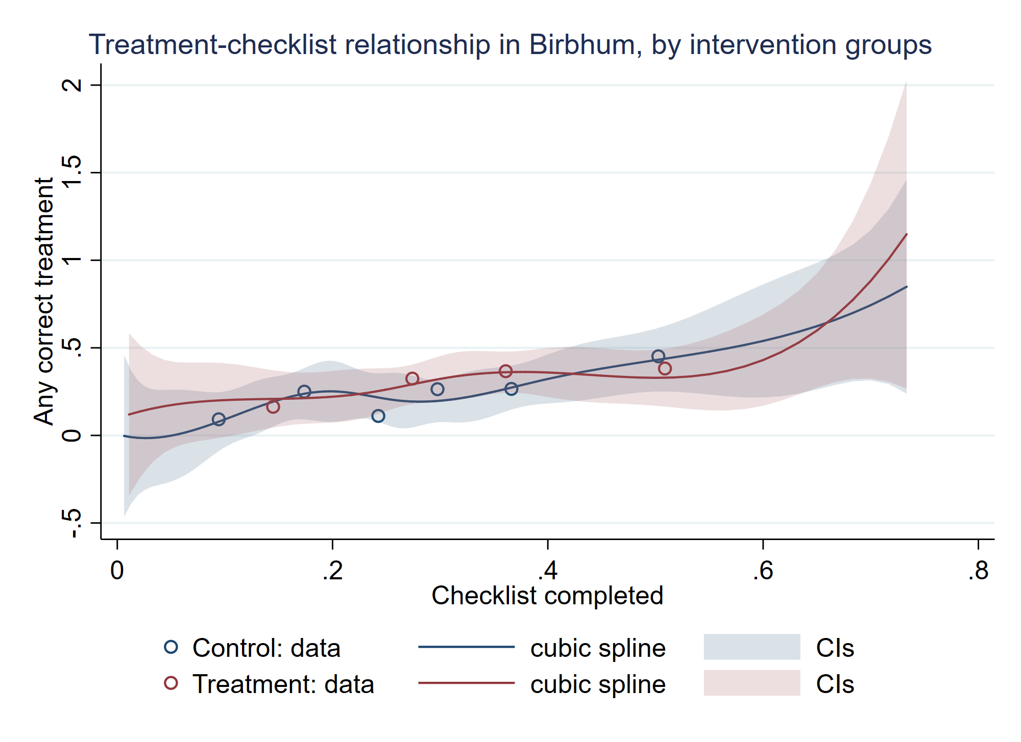
No shift in the curve

Slide 47
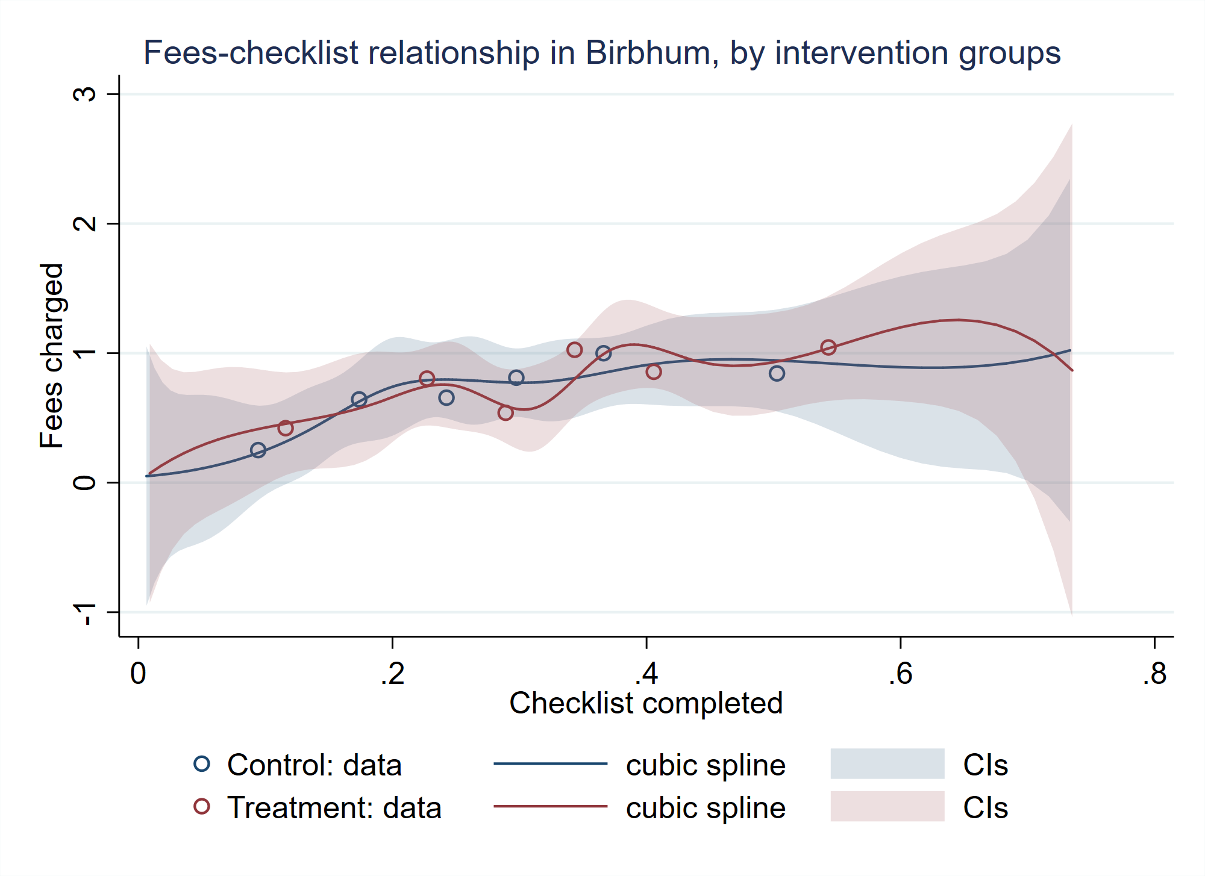
No shift in the curve

Slide 48
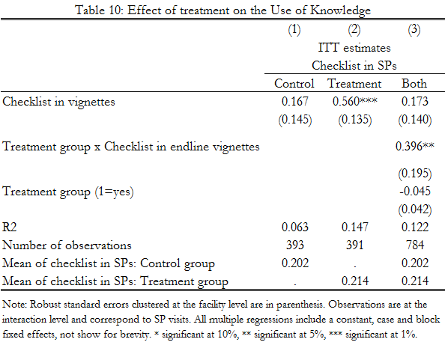
What did the intervention do?
Treatment enabled high ability providers to translate knowledge into action:
correlation between performance in vignettes and performance among SPs increases
Greater separation between H and L types.
Notes:
TABLE NEEDS TO BE REDONE: MEANS are for vignettes, not SPs!

Slide 49
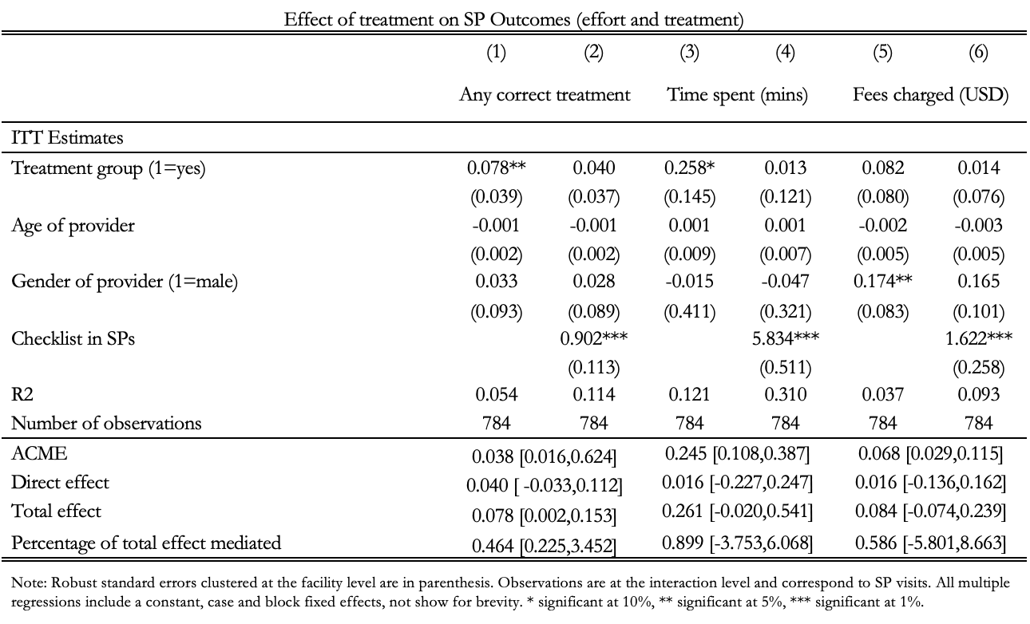
Movement along the curve: mediation analysis
With improvements in treatment mediated by higher effort invested.

Slide 50
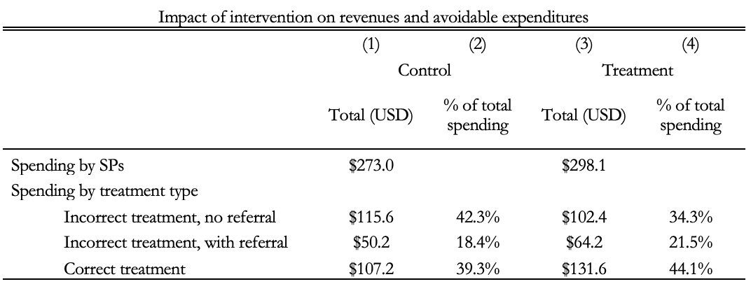
Impact on unnecessary medical expenditures
In control group, SPs spent a total of $273
In treatment group, SPs spent a total of $298
  This implies an ITT estimate of a 9 percent increase in revenue, or a LATE estimate of 18 percent increase in revenue
  Similar effects based on provider diaries of patients
In treatment group, the fraction of spending on the “worst case” scenario of incorrect treatment and no referral decreased by 8 percentage points (ITT) and spending on correct treatment increased by 5 percentage points with correspondingly higher IV effects

Slide 51
Key takeaways
Market for primary care characterized by significant incorrect treatment: 70-90% of out-of-pocket payments patients are “medically unnecessary”
  Incorrect treatment (rather than over-treatment) accounts for 50-78% of “medically unnecessary” expenditures
In clinical interactions, providers don’t do what they tell us they would do if a patient comes to them with the same condition (know-do gap)
  Effort costs would have to be extraordinarily high to explain this gap with low incentives
A theory that explains these patterns relies on the bilateral interaction between providers and patients:
  Without patient buy-in, providers can’t do much (even if they know) because patients will think they are trying to make more money
  An experimental case-study from West Bengal presents evidence consistent with this theory

Slide 52
Implications
The bilateral consequences of low trust highlighted by Arrow (1963) may be central to healthcare. In environments of `mistrust’, providers may distort how they care for their patients.
These distortions in the healthcare market appear to be large: the experimental results from Birbhum suggest a decline of 15 percentage points (LATE) in avoidable medical expenditures due to better treatment.

Slide 53
Thank you

Slide 54
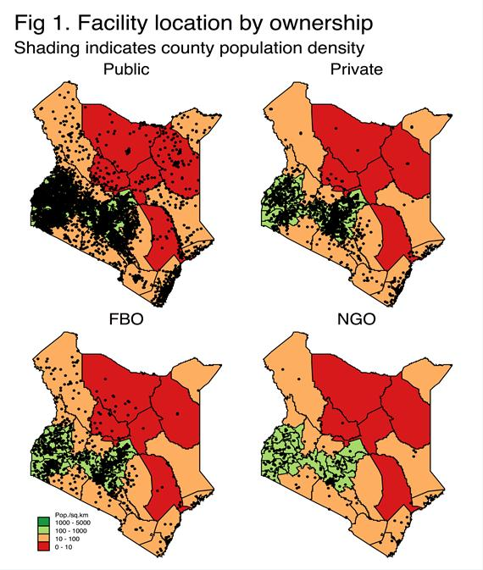
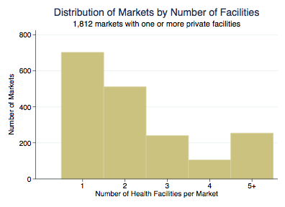
Markets for primary care: Kenya example
In 2013, 9,000 health facilities in the official registry (fairly accurate in field visits)
Just over 50% of these facilities private
Unlike India, few informal providers with most private facilities in rural areas operated by nurses
Of 1812 identifiable clusters in the country, 700 have a single provider—usually public providers in remote areas; the remainder have 2 or more, and the bulk of the population accesses providers in markets with multiple providers
Notes:
1. A cluster in Kenya is identified through the K-means clustering algorithm, so that a cluster includes all facilities that are within 4Km of the centroid of the cluster.

Slide 55
Table A4: Case Characteristics
 | (1) | (2) | (3) | (4) | (5) | (6) | (7) | (8)
Cases | Asthma | Diarrhea | Angina | TB1 (naïve) | TB2 (naïve+) SP brings a chest x-ray | TB3 (AFB +ve) SP brings sputum AFB results | TB4 (MDR) | TB
Study sites | Madhya Pradesh, Birbhum, Nairobi | Madhya Pradesh, Birbhum, Nairobi | Madhya Pradesh, Birbhum, Nairobi | Delhi, Mumbai, Patna, Nairobi | Delhi, Mumbai, Patna | Delhi, Mumbai, Patna | Delhi, Mumbai, Patna | China
Panel A: Checklist Items
History questions | current breathing, cough, expectoration, previous breathing problems, since when, shortness of breath, length of episode, what triggers, fever, chest pain, weight loss, smoking status, family history | age of child, qualities of stool, frequency, quantity of stool, urination, child active/playful, fever, abdominal pain, vomitting, source of water, what has child eaten, child taking fluids | where is the pain, when started, severity of pain, radiation, previous similar pain, since when, shortness of breath, sweating, smoking status, family history | cough duration, sputum, past TB, family history/TB, blood in sputum, patterns of cough, fever, fever type, family symptoms, chest, pain, appetite loss, weight loss, wheezing, difficulty breathing, smoking, alcohol, diabetes, HIV/AIDS, children exposure, age | cough duration, sputum, previous doctor type, if medicines, duration medicines, family history, examined x-ray, blood in sputum, patterns of cough, fever, fever type, previous typhoid diagnosis, past TB, family symptions, chest pain, appetite loss, weight loss, wheezing, difficulty breathing, smoking, alcohol, past medicines, diabetes, HIV/AIDS, children exposure, age | duration of cough, sputum, examined sputum results, past treatment for TB, blood in sputum, patterns of cough, fever, fever type, family history/TB, chest pain, loss of appetite, weight loss, wheezing, difficulty breathing, smoking, alcohol, past medicines, HIV/AIDS, children exposure, age | cough duration, sputum, examin sputum results, medication history, if visited govt. clinics, previous TB treatment, previous sputum tests or x-rays, previous diagnosis, previous treatment, previous treatment length, reason for stopping treatment, previous treatment records, blood in sputum, patterns of cough, fever, fever type, past history, family history/TB, chest pain, appetite loss, weight loss, wheezing, difficulty breathing, smoking, alcohol, diabetes, HIV/AIDS, children exposure, age | cough duration, sputum, past history, family history, fever, fever druation, chest pain, appetite, weight loss, breathing difficulty, wheezing, nigh sweats, family symptoms, HIV/AIDS, alcohol, smoking
Examination questions | pulse, bp, chest auscultation, temperature attempt | - | pulse, bp, auscultation, temperature attempt, ecg in/outside clinic | pulse, auscultation, temperature, throat exam, blood pressure, weight, abdomen palpitation | pulse, auscultation, temperature, throat exam, blood pressure, weight, abdomen palpitation | pulse, auscultation, temperature, throat exam, blood pressure, weight, abdomen palpitation | pulse, auscultation, temperature, throat exam, blood pressure, weight, abdomen palpitation | pulse, blood pressure, chest auscultation, chest radiograph, TST, sputum culture, sputum AFB, HIV, diabetes
Referred examinations |  |  |  | chest x-ray, ct scan, sputum AFB, Xpert MTB/RIF, sputum culture, ESR, HIV, diabetes test, TB Gold, TB Elisa, Mantoux text | chest x-ray, ct scan, sputum AFB, Xpert MTB/RIF, sputum culture, ESR, HIV, diabetes test, TB Gold, TB Elisa, Mantoux text | chest x-ray, ct scan, sputum AFB, Xpert MTB/RIF, sputum culture, ESR, HIV, diabetes test, TB Gold, TB Elisa, Mantoux text | chest x-ray, ct scan, sputum AFB, Xpert MTB/RIF, sputum culture, ESR, HIV, diabetes test, TB Gold, TB Elisa, Mantoux text
Panel B: Diagnosis
Correct | asthma, asthma attack | heart attack, angina, myocardial infarction, attack | diarrhea | tuberculosis, pulmonary Koch's disease | tuberculosis, pulmonary Koch's disease | tuberculosis, pulmonary Koch's disease | tuberculosis, pulmonary Koch's disease | tuberculosis, pulmonary Koch's disease
Incorrect (common outcomes) | blood pressure problem, gastrointestinal problem, heart problem, weather, cough in chest, weakness, lack of blood, allergies | blood pressure probblem, gastrointestinal problem, muscle problem, weather, injury, swelling in chest, bad blood, chest congestion | weather, heat in liver, acidity | viral fever, chest infection | viral fever, chest infection | viral fever, chest infection | viral fever, chest infection | allergies, chest infection, fever
Panel C: Treatment
Correct case management | bronchodilators, theophylline, inhaled or oral corticosteroids, leukotriene inhibitors, cromones, inhaled anticholinergincs | aspirin, clopidogrel, anti-platelet agents, ecg in/outside clinic, referral | ORS, rehydration | sputum testing, chest x-ray, referral to public DOTS center or aprivate provider or specialist | sputum testing, chest x-ray, referral to public DOTS center or aprivate provider or specialist | referral to public DOTS center, private provider or specialist, initiation of treatment with standard, 4-drug, first-line anti TB theray | DST (culture, line probe assay, or Xpert MTB/RIF) or referral to a public DOTS center or to a private provider or specialist | Test or recommendation for CXR, sputum test for AFB, test for DST
Incorrect case management (common outcomes) | anti-allergy medication, antibiotics, pain medication | antibiotics, steroids, ibuprofen | antibiotics, zinc, cetrizine | anti-TB medication alone, anti-allergy medication, antibiotics | anti-TB medication alone, anti-allergy medication, antibiotics | anti-allergy medication, steroids | anti-TB medication alone, anti-allergy medication, steroids | any other medication

Slide 56
Measurement (1)
Data rely on measurement of clinical interactions using standardized patients (do) and medical knowledge (know)
To compute “do” combine 7 different audit studies from India, China and Kenya
  Studies not directly comparable—but suggest common patterns in very different contexts
  Private sector: 4 Indian and 1 pilot study in Kenya
  Public Sector: 1 study each in India, Kenya and China
To compute “know” we test medical knowledge using “medical vignettes” for 2 studies in India
  Medical vignettes have been shown to produce variation that is closely linked to qualifications (as one would expect). Vignettes now been used in more than 40 countries in various studies as measures of knowledge
Finally, to examine patterns with `real’ patients, in 2 studies, we sit in the providers clinic for 1 day and record key metrics for each patient interaction

Slide 57
Preview of Results
Market for primary care characterized by significant incorrect treatment: We compute that between 70% and 90% of out-of-pocket payments patients can be characterized as “medically unnecessary”
  Incorrect treatment (rather than over-treatment) accounts for 50-78% of “medically unnecessary” expenditures
In clinical interactions, providers don’t do what they tell us they would do if a patient comes to them with the same condition (know-do gap)
  Gap increases with knowledge in medical tests, even after adjusting for measurement error
  We compute that effort costs would have to be extraordinarily high to explain this gap with low incentives as prices increase with correct treatment in clinical interactions
A theory that explains these patterns relies on reputation in the bilateral interaction between providers and patients
  Without reputation, providers can’t `do’ too much (even if they know) because patients will think they are trying to make more money
  An experimental case-study from West Bengal presents evidence consistent with this theory

Slide 58
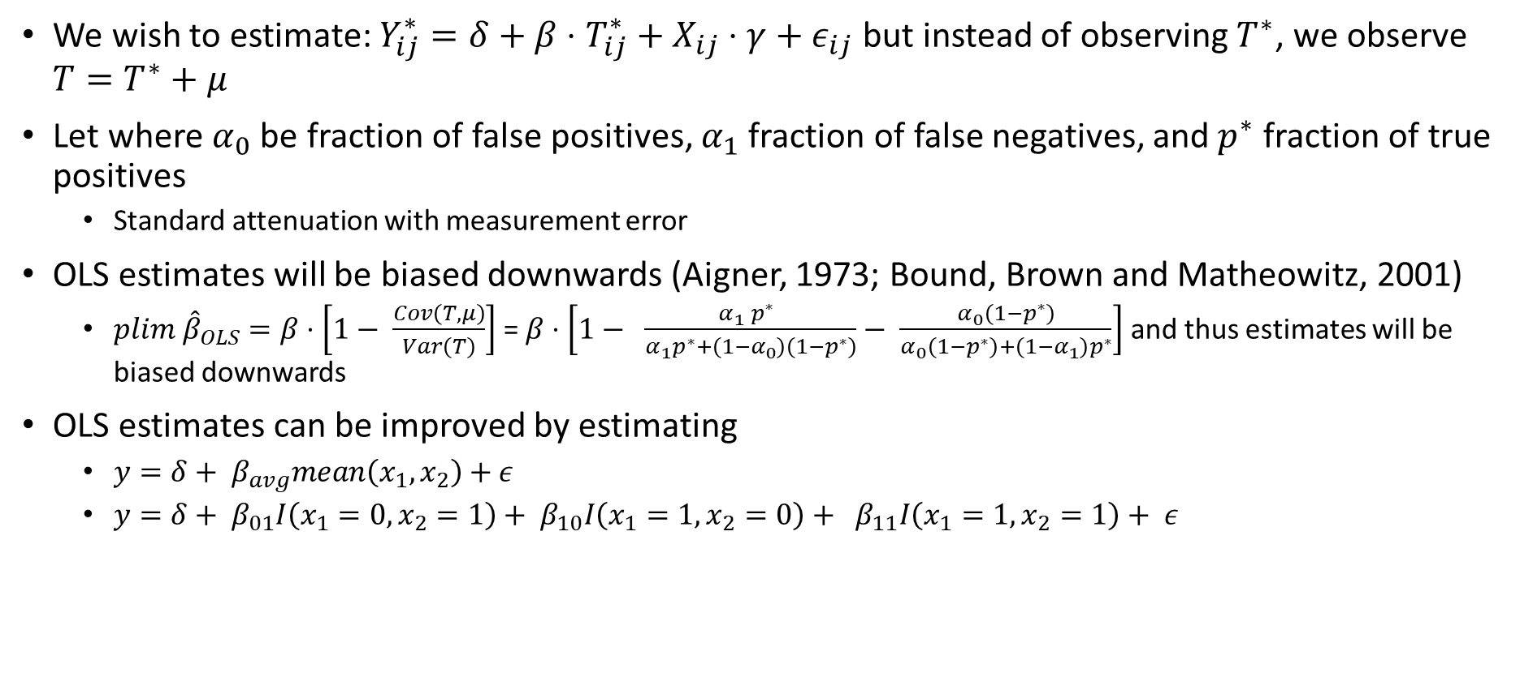
Addressing measurement error: Technical details
We wish to estimate: $Y_{ij}^{∗}=δ+β⋅T_{ij}^{∗}+X_{ij}⋅γ+ε_{ij}$ but instead of observing $T^{∗}$, we observe $T=T^{∗}+μ$
Let where $α_{0}$ be fraction of false positives, $α_{1}$ fraction of false negatives, and $p^{∗}$ fraction of true positives
  Standard attenuation with measurement error
OLS estimates will be biased downwards (Aigner, 1973; Bound, Brown and Matheowitz, 2001)
  ${plim \hat{β}}_{OLS}=β⋅\left[1− \frac{Cov\left(T,μ\right)}{Var\left(T\right)}\right]$ = $β⋅\left[1− \frac{α_{1} p^{∗} }{α_{1}p^{∗}+\left(1−α_{0}\right)\left(1−p^{∗}\right)}− \frac{α_{0}\left(1−p^{∗}\right)}{α_{0}\left(1−p^{∗}\right)+\left(1−α_{1}\right)p^{∗}}\right]$ and thus estimates will be biased downwards
OLS estimates can be improved by estimating
  $y=δ+ β_{avg}mean\left(x_{1}, x_{2}\right)+ε$
  $y=δ+ β_{01}I\left(x_{1}=0, x_{2}=1\right)+ β_{10}I\left(x_{1}=1, x_{2}=0\right)+ β_{11}I\left(x_{1}=1, x_{2}=1\right)+ ε$

Slide 59
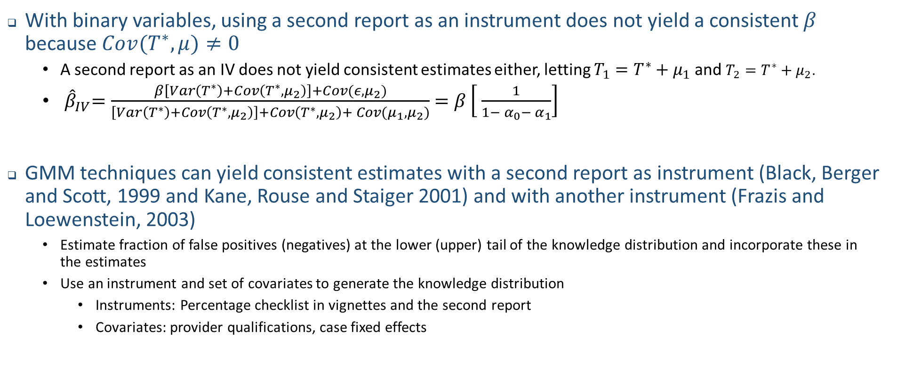
Addressing measurement error: Technical details
With binary variables, using a second report as an instrument does not yield a consistent $β$ because ${Cov(T}^{∗}, μ)≠0$
  A second report as an IV does not yield consistent estimates either, letting $T_{1}=T^{∗}+μ_{1}$ and $T_{2}=T^{∗}+μ_{2}$.
  ${ \hat{β}}_{IV}=\frac{β\left[Var\left(T^{∗}\right)+Cov\left(T^{∗}, μ_{2}\right)\right]+Cov(ε, μ_{2})}{\left[Var\left(T^{∗}\right)+Cov\left(T^{∗}, μ_{2}\right)\right]+Cov\left(T^{∗}, μ_{2}\right)+ Cov(μ_{1},μ_{2})}$ $=β\left[ \frac{1}{1− α_{0}− α_{1}}\right]$
GMM techniques can yield consistent estimates with a second report as instrument (Black, Berger and Scott, 1999 and Kane, Rouse and Staiger 2001) and with another instrument (Frazis and Loewenstein, 2003)
  Estimate fraction of false positives (negatives) at the lower (upper) tail of the knowledge distribution and incorporate these in the estimates
  Use an instrument and set of covariates to generate the knowledge distribution
    Instruments: Percentage checklist in vignettes and the second report
    Covariates: provider qualifications, case fixed effects

Slide 60
Part 1 - Characterizes market for primary care and poses a critical puzzle
  Quality of care given to SPs is low and highly variable although the knowledge of how to treat the same conditions is much higher
  There are large returns to better quality care and providers are not capacity constrained
Puzzle: If providers know how to treat a condition and would earn substantially more by doing so in a context of excess capacity, why do they choose not to do so?
Part 2 - Seeks to resolve this puzzle: Bilateral relationship between the patient and provider and the role of trust, not only in healthcare demand, but also supply
  Patients are not sure if the providers advice is self-serving. Providers know this and adjust their behavior accordingly

