Slide 1
Measuring Potential Effects of the Proposed Race and Ethnicity Question in the CPS
Mark Loewenstein
David Piccone
Anne Polivka
NBER-CRIW Conference
March 14, 2024

Slide 2
Disclaimer
Views expressed in this presentation are those of the presenter and do not necessarily reflect the views or policies of the Bureau of Labor Statistics

Slide 3
Background
OMB mandated 5 race groups in 1997
  White
  Black or African American
  American Indian or Alaskan Native
  Asian
  Native Hawaiian or Pacific Islander
Hispanic identified separately as an ethnicity not a race
Efforts to allow people to identify as Hispanic in response to questions about a person’s race since the late 1970’s

Slide 4
New Standard Partially motivated by ...
Increase in the proportion of the population identifying as Hispanic
Large proportion Hispanics who are selecting “Some Other Race” rather than one of the 5 OMB race categories
  In 2020 Decennial Census 8.4% of population was Some Other Race Alone
  Fourth largest race category behind White Alone, Black Alone, and More than One Race
  Vast majority of Some Other Race in Decennial Census were Hispanic

Slide 5
Proposed 2023 OMB Race and Ethnicity Standard
A combined race and ethnicity question with the following categories
White
Hispanic or Latino
Black or African America
Asian
American Indian or Alaskan Native
Middle Eastern or North African
Can select more than one categories (be multi-racial, ethnicity)

Slide 6
Effects on estimates
Race estimates currently include Hispanics and non-Hispanics (i.e., CPS monthly)
  Population in current race categories decreases since Hispanic Alone are removed from them
Race estimates disaggregated by Hispanic (i.e., ASEC)
  Current race categories by Non-Hispanic likely minimally impacted
  Will be Race Alone Categories
Current race categories by Hispanic substantially impacted
  Hispanic Alone has no race associated with it

Slide 7
Purpose of paper
How having a Hispanic or Latino Alone category may affect racial/ethnicity distributions
How having a Hispanic or Latino Alone category may affect key labor force estimates from the Current Population Survey (CPS) for various race and ethnicity groups. E.g.
  Unemployment rate
  Employment-to-population ratio
  Labor Force Participation rates
  Earnings

Slide 8
What currently happens in CPS…
Interviewer administered
Following current 1997 OMB two question standard:
  People are first asked if they are Hispanic
  People are then asked their race
    Can say they are more than one race

Slide 9
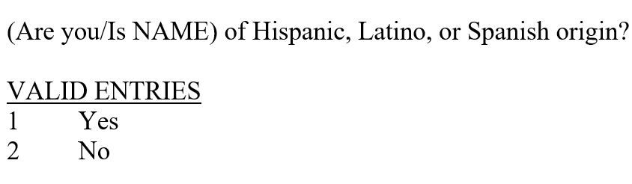
Current CPS Hispanic Ethnicity question

Slide 10
Current CPS Race question
Two variants of the question- one for in-person interviews, one for telephone interviews
People only asked Race and Ethnicity the first-time data is collected for them. Information verified thereafter
Telephone version of question on next slide

Slide 11
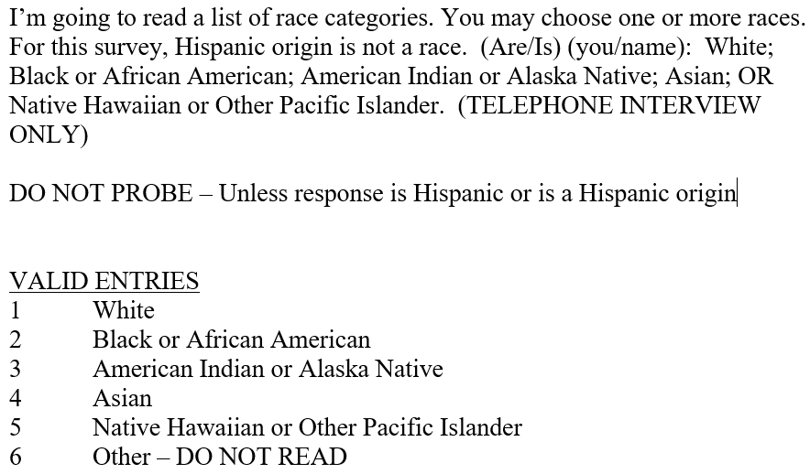
Current CPS Race question

Slide 12
Some Other Race Category (SOR)
Respondents not choosing one of the five race categories are put in the Some Other Race (SOR) category.
An imputation is made to place SOR respondents in one of the five allowable race categories for the published estimates.
  First, check for any previous race information provided by respondent
  Then, base imputed race on relative within the same household, putting preference on the respondent's mother's race
  Lastly, use a hot deck imputation
  If donor is multi-racial than the respondent will have a multi-racial imputation
Notes:
Keep this one

Slide 13
SOR (Continued)
In addition, those recorded as SOR are asked a follow up question
SOR follow-up question has 40 response categories. We have identified 8 of these as Hispanic:
1) Hispanic
2) Chicano
3) Cuban or Cuban American
4) Latin America
5) Latino
6) Mexican or Mexican American
7) Puerto Rican
8) Spanish

Slide 14
The percentage of respondents who are Hispanic has increased steadily from 13.5% in 2007 to 17.5% in 2022
The in SOR race category has increased somewhat between 2007 and 2022
  The trend has not been completely monotonic
  The increase in SOR has primarily been due to the increase in Hispanics

Slide 15
Our estimates of Hispanic Alone
Lower bound estimate: those identified as Hispanic whose race was only coded as “Some Other Race” and who then selected a Hispanic category as a proxy for people who will only choose Hispanic using the 2023 combined question OMB standard
  People who choose SOR and a Hispanic category in combination with one of the pre-specified race categories we assume would be classified as multi-racial/multi-ethnic
Upper bound estimate: those who identified as Hispanic using the current CPS direct questions as a proxy for people who will only choose Hispanic using the 2023 combined question OMB standard

Slide 16
Our Analysis
With this background, let’s dig into the CPS data.
All estimates are annual averages generated using the monthly CPS data
15 years of data from 2007 to 2022
A significant change to the Race and Ethnicity questions was implemented in the CPS in 2003
SOR estimates before and after 2007 do not appear to be comparable
Population and Labor Force estimates are generated using composite weights
Earning estimates use outgoing rotation weights

Slide 17
The proportion of Hispanics who are SOR has ranged between 26.3% and 35.7%
  Note in 2012 the language explicitly saying Hispanic was not a race was added. It seems to have had some effect
  Not shown on the graph, but proportion of Non-Hispanics who are SOR is quite small ranging between 0.8% and 1.0%.
The proportion of SOR that are a Hispanic subgroup has ranged between 84.9% and 87.9%

Slide 18
Turning to how the OMB Proposed Race and Ethnicity standard may affect CPS labor force estimates and earnings
How do labor force and earnings estimates vary across race and ethnicity?
Hispanic Whites have a higher unemployment rate (4%) than non-Hispanic Whites (3%). Hispanic Whites have a lower median hourly wage ($19.89) than non-Hispanic Whites ($25.77).
Hispanic Blacks have a higher unemployment rate (7.2%) than non-Hispanic Blacks (6.1%). However, there are only 3,045 Hispanic Blacks in the sample.
Year | Race Category | Hispanic | Sample Size | Unemploy-ment rate | Median Hourly Wage
2022 | White | No | 675,976 | 3.0% | $25.77
 |  | Yes | 90,075 | 4.0% | $19.89
 | Black | No | 96,346 | 6.1% | $20.06
 |  | Yes | 3,045 | 7.2% | $20.01
 | American Indian/Alaskian Native | No | 9,839 | 6.5% | $15.46
 |  | Yes | 1,588 | 6.9% | $15.00
 | Asian | No | 55,910 | 2.8% | $18.89
 |  | Yes | 561 | 2.8% | $19.71
 | Hawaiian Native/Pacific Islander | No | 4,586 | 4.3% | $16.22
 |  | Yes | 308 | 1.1% | $16.50
 | Some Other Race | No | 7,165 | 4.5% | $23.91
 |  | Yes | 39,963 | 4.6% | $18.97

Slide 19
Unemployment rate differences are generally greater in a year with higher overall unemployment.

Slide 20
How do the Not-SOR vs. SOR Hispanics/Non-Hispanics compare?
Hispanics Not SOR have a lower unemployment rate (4.1%) than Hispanics SOR (4.6%), and higher earnings ($19.91 vs. $18.97)
Non-Hispanics Not SOR have a lower unemployment rate (3.5%) than Non-Hispanics SOR (4.5%), and higher earnings ($25.00 vs. $23.91)

Slide 21
Year | Race Category | SOR Category | Sample Units | Population Estimate | Urate | EP Ratio | LFPR | Median Hourly Wage | Median Weekly Earnings
2010 | White Only | Not-SOR | 1,247,773 | 180,479,295 | 8.4% | 59.4 | 64.9 | $23.03 | $914.72
 |  | SOR | 74,524 | 11,595,689 | 12.8% | 59.9 | 68.8 | $16.41 | $648.09
 | Black Only | Not-SOR | 165,173 | 27,740,302 | 16.0% | 52.1 | 62.0 | $18.73 | $731.38
 |  | SOR | 5,864 | 967,972 | 14.2% | 57.6 | 67.2 | $17.09 | $655.79
 | Asian Only | Not-SOR | 69,877 | 10,871,337 | 7.5% | 59.9 | 64.7 | $26.04 | $1,039.01
 |  | SOR | 2,100 | 327,858 | 8.7% | 58.2 | 63.8 | $19.60 | $762.72
2022 | White Only | Not-SOR | 920,098 | 190,570,520 | 3.1% | 59.8 | 61.7 | $24.86 | $995.29
 |  | SOR | 51,104 | 12,643,622 | 4.5% | 63.5 | 66.5 | $18.97 | $737.93
 | Black Only | Not-SOR | 123,776 | 32,669,358 | 6.2% | 58.2 | 62.0 | $20.02 | $802.88
 |  | SOR | 4,679 | 1,462,009 | 5.4% | 63.0 | 66.6 | $19.49 | $778.93
 | Asian Only | Not-SOR | 67,580 | 16,267,941 | 2.8% | 62.8 | 64.6 | $31.25 | $1,257.51
 |  | SOR | 2,487 | 664,896 | 3.3% | 60.5 | 62.6 | $24.01 | $960.00

Slide 22
Population Percentages for 2022
How might the proposed standard affect Population estimates?
Most Hispanics who are reclassified are originally in the White racial group
  Most affected: Population estimate for Whites
  Non-trivial effects: Population estimates of other races
Hispanic populations could decrease with the new standard
  Depending on what categories Hispanics pick
 |  | Percent of Population
Year | Race/Ethnicity Category | Current Race/ Ethnicity Questions | New Race/ Ethnicity Question Lower Bound | New Race/ Ethnicity Question Upper Bound
2022 | White Only | 77.0% | 72.8% | 61.5%
 | Black Only | 12.9% | 12.6% | 12.1%
 | American Indian/Alaskan Native Only | 1.2% | 1.0% | 0.8%
 | Asian Only | 6.4% | 6.3% | 6.2%
 | Hawaiian/Pacific Islander Only | 0.4% | 0.4% | 0.4%
 | Hispanic Only | -- | 4.9% | 17.5%
 | Other/Multiple Race | 2.1% | 1.9% | 1.6%
Huge range between the lower and upper bounds. 2015 National Content Test of multiracial/multiethnicity question suggests upper bound more likely. Almost 70% of those identifying as Hispanic were Hispanic Alone

Slide 23
How might the proposed standard affect Labor Force estimates?
Most notable effect: a decline in the white unemployment rate (UR), especially when unemployment is higher.
2010
White UR falls from 8.7% to 8.5% (lower bound Hispanics estimate) or 8% (upper bound Hisp. Estimate).
  Reflects the fact that Hispanic Whites have a higher UR than non-Hispanic Whites.
Hispanic UR is 13.4% or 12.5%
  Reflects Hispanic SOR having a higher UR than Hispanic Non-SOR.
2022
White UR falls from 3.2% to 3.1% or 3%
Hispanic UR is 4.6% or 4.4%

Slide 24
Labor Force Statistics – Selected Years
 |  | E/P Ratio |  |  |  | LFPR
Year | Race/Ethnicity Category | Current Race/ Ethnicity Questions | New Race/ Ethnicity Question Lower Bound | New Race/ Ethnicity Question Upper Bound |  | Current Race/ Ethnicity Questions | New Race/ Ethnicity Question Lower Bound | New Race/ Ethnicity Question Upper Bound
2022 | White Only | 60.0 | 59.8 | 59.1 |  | 62.0 | 61.7 | 60.9
 | Black Only | 58.4 | 58.3 | 58.3 |  | 62.2 | 62.1 | 62.1
 | American Indian/Alaskan Native Only | 56.0 | 54.7 | 52.8 |  | 59.7 | 58.6 | 56.6
 | Asian Only | 62.7 | 62.6 | 62.7 |  | 64.5 | 64.4 | 64.4
 | Hawaiian/Pacific Islander Only | 63.9 | 63.6 | 62.5 |  | 66.6 | 66.2 | 65.3
 | Hispanic Only | -- | 63.8 | 63.5 |  | -- | 66.9 | 66.3
 | Other/Multiple Race | 61.7 | 61.5 | 61.3 |  | 65.3 | 65.2 | 65.0
2010 | White Only | 59.4 | 59.4 | 59.5 |  | 65.1 | 64.9 | 64.6
 | Black Only | 52.3 | 52.2 | 52.3 |  | 62.2 | 62.1 | 62.2
 | American Indian/Alaskan Native Only | 49.0 | 48.5 | 48.2 |  | 57.7 | 56.8 | 56.1
 | Asian Only | 59.9 | 59.9 | 59.9 |  | 64.7 | 64.7 | 64.7
 | Hawaiian/Pacific Islander Only | 60.1 | 59.7 | 59.8 |  | 68.4 | 68.0 | 67.8
 | Hispanic Only | -- | 59.7 | 59.0 |  | -- | 68.9 | 67.5
 | Other/Multiple Race | 56.5 | 55.9 | 55.3 |  | 65.4 | 64.7 | 63.9

Slide 25
Earnings Estimates – 2022
White median hourly earnings estimate increases from $24.22 to $24.86 or $25.84. Reflects the fact that Hispanic Whites have lower wages than non-Hispanic Whites.
Hispanic median hourly earnings are $18.89 or $19.58. Reflects the fact that SOR Hispanics earn less than non-SOR Hispanics.
White median weekly earnings estimate increases from $974.18 to $995.30 or $1,044.37. Hispanic median hourly earnings are $729.58 or $767.93.

Slide 26
Closer Look at Individuals Who Identify as Hispanic
 | Percent of Population
Country of Origin Category | 2010 | 2022
Born outside of the U.S. in a Hispanic Country | 7.6% | 8.1%
Born outside of the U.S. in a Non-Hispanic Country | 10.5% | 12.7%
Born in the U.S. with both parents born in a Hispanic Country | 2.0% | 3.0%
Born in the U.S. with only one parent born in a Hispanic Country | 1.1% | 1.3%
Born in the U.S. with no parent born in a Hispanic Country | 78.8% | 74.9%
How does the tendency to identify as Hispanic vary among these groups?

Slide 27
Probability of Identifying as Hispanic Ethnicity by Country of Own and Parents' Birth
 | Percent Hispanic Ethnicity
Country of Origin Category | 2010 | 2022
Born outside of the U.S. in a Hispanic Country | 97.2% | 97.5%
Born outside of the U.S. in a Non-Hispanic Country | 6.5% | 9.1%
Born in the U.S. with both parents born in a Hispanic Country | 96.4% | 97.5%
Born in the U.S. with only one parent born in a Hispanic Country | 84.8% | 87.8%
Born in the U.S. with no parent born in a Hispanic Country | 4.1% | 5.8%
The weaker an individual’s ties to a Hispanic country, the less likely they are to identify as being of Hispanic ethnicity and be included in our upper bound estimate.

Slide 28
Probability of Indicating Hispanic SOR by Country of Own and Parents' Birth
 |  | Percent in SOR-Hispanic Subgroup
Country of Origin Category | Hispanic Ethnicity | 2010 | 2022
Born outside of the U.S. in a Hispanic Country | Non-Hispanic | 18.5% | 14.7%
 | Hispanic | 37.8% | 32.7%
Born outside of the U.S. in a Non-Hispanic Country | Non-Hispanic | 0.3% | 0.3%
 | Hispanic | 34.9% | 31.5%
Born in the U.S. with both parents born in a Hispanic Country | Non-Hispanic | 18.2% | 14.9%
 | Hispanic | 38.6% | 33.6%
Born in the U.S. with only one parent born in a Hispanic Country | Non-Hispanic | 3.4% | 4.3%
 | Hispanic | 27.9% | 18.2%
Born in the U.S. with no parent born in a Hispanic Country | Non-Hispanic | 0.0% | 0.0%
 | Hispanic | 23.0% | 17.2%
The weaker an individual’s ties to a Hispanic country, the less likely they are to be identified as SOR-Hispanic and be included in our lower bound estimate.

Slide 29
Conclusion
We suggest when CPS adopts updated standard to ask everyone in the month of implementation the new questions
  Given the CPS rotation pattern if this is done ¾’s of respondents will have question asked new and current way.
    Asking everyone will assist in analysis of effects and generating bridge estimates
    Asking everyone will facilitate publication of estimates
Notes:
Use Julie’s –Add “We suggest….”

Slide 30
Contact Information
Mark Loewenstein
Senior Research Economist
Bureau of Labor Statistics
202-691-7385
loewenstein.mark@bls.gov

