Slide 1
Picking Winners or Propping Up Losers? The Challenges of Chinese Industrial Policy
Lee Branstetter, CMU, NBER, PIIE
Guangwei Li, ShanghaiTech University, School of Entrepreneurship and Management
NBER Entrepreneurship and Innovation Policy
and the Economy Conference
May 18, 2023
Washington, DC
Notes:
I’d like to thank the organizers for the opportunity to share this presentation

Slide 2
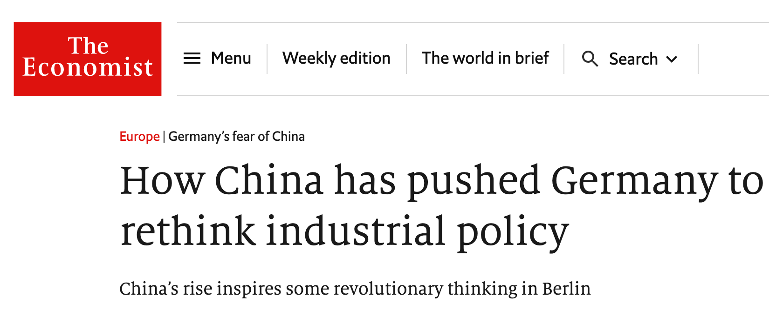
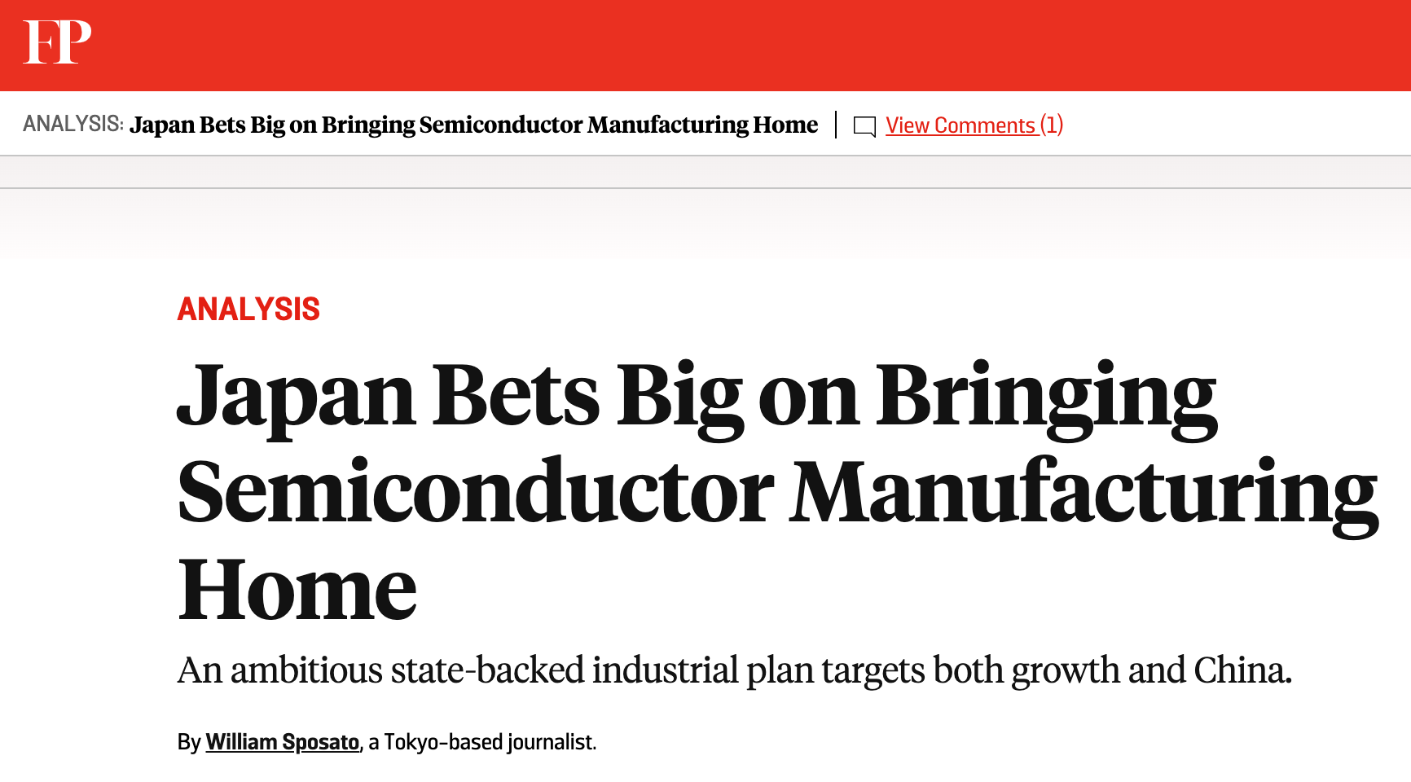
Chinese industrial policy has come to be regarded as a major political issue and policy challenge by China’s Western trading partners

Slide 3
The issues raised by Chinese industrial policy are not completely new
Remember the intense policy debate concerning the appropriate response to Japanese industrial policy?
The strategic trade literature of the 1980s and the growth-and-trade literature of the early 1990s were inspired, in part, by Japanese industrial policy.
That literature rigorously considered the circumstances under which industrial policy might work – and might not work. Some of those lessons turn out to be relevant for Chinese industrial policies apparent successes and failures.
An empirical literature has examined the long-run impact of industrial policy in Japan and other formerly fast-growing Asian nations; that literature can also provide useful lessons.
A careful review of the nascent literature on Chinese industrial policy unearths interesting similarities to these earlier lines of research.

Slide 4
Five major themes regarding the evolution of Chinese industrial policy
The Chinese government has consistently maintained the goal of guiding China’s industrial evolution at the industry level.
The Chinese government’s substantial power over the allocation of key resources gives it a greater ability to shape that industrial evolution than most rival nations.
But the usual principal-agent problems arise!
There is a growing gap between China’s industrial policy ambitions and its capabilities of realizing them.
China’s industrial policy is challenged by the “uneasy coexistence of multiple objectives.”

Slide 5
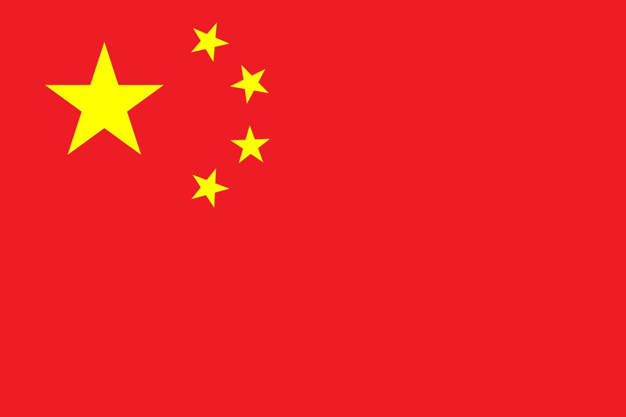
The origins of Chinese industrial policy
Soviet-style planned economy heritage
Japanese industrial policy inspiration
Chinese industrial policy
US prosperity aspiration

Slide 6
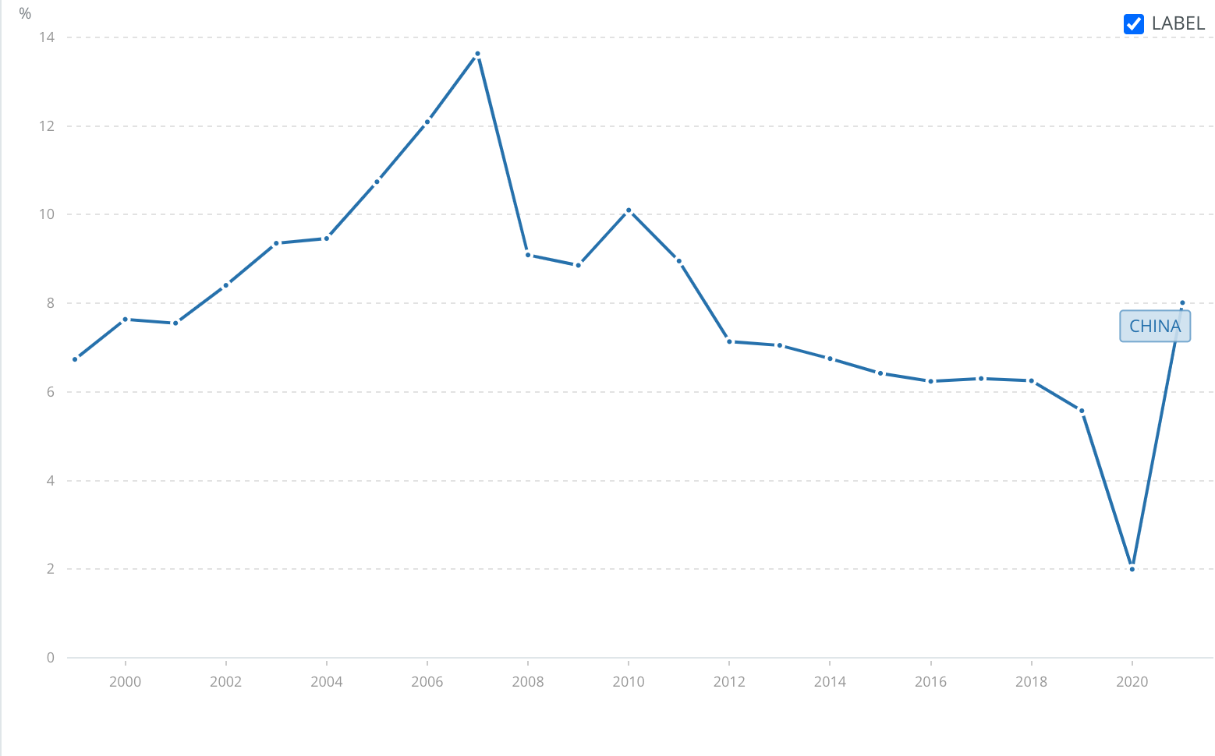
The overall evolution of Chinese industrial policy: two U-shapes
Degree of intervention
China’s GDP per capita growth (annual %)
Policy theme:
indigenous innovation & innovation driven growth
Policy theme: liberalization & catch-up
2007
1978
beginning of reform & opening-up
2001
entry into WTO
2006
MLP
Time
Source: the World Bank

Slide 7
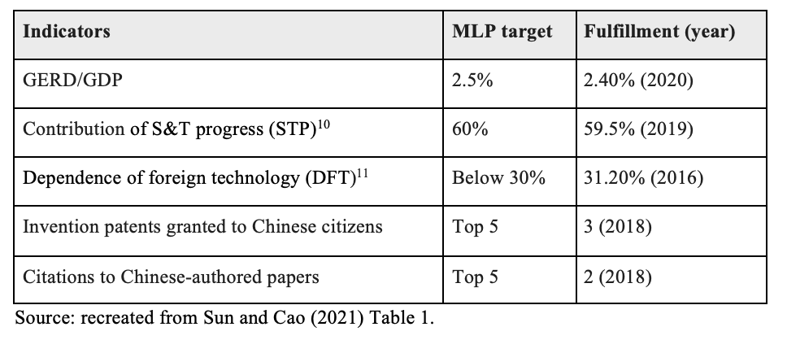
The Targets set in MLP and Their Fulfillment

Slide 8
The mid-2000s shift in Chinese industrial policy - promotion of indigenous innovation
Since 2006, major policy documents have articulated the centrality of productivity growth through indigenous innovation.
China’s labor market is shrinking, returns to capital investment are falling, and productivity growth has slowed substantially. To sustain growth, China needs to become more productive.
China’s industrial policy documents emphasize government support to supplant Western technology leaders with Chinese national champions.
”Western” trading partners increasingly see China’s subsidies as trade-distorting, and (expensive and risky) countermeasures are already being deployed to limit or reverse their impact.
But are China’s policies actually working?
2006, The “National Medium and Long-Term Plan for the Development of Science and Technology (2006–2020)” (MLP) (国家中长期科学规划)
2010, "Decision of the State Council on Accelerating the Cultivation and Development of Strategic Emerging Industries”
(国务院关于加快培育和发展战略新兴产业的决定).
2012, "12th Five-Year Plan for the Development of Strategic Emerging Industries"(“十二五”国家战略性新兴产业发展规划)
2015, “Made in China 2025 Initiative” (中国制造2025)
2016, "Outline of the National Strategy of Innovation-Driven Development" (IDDS) (国家创新驱动发展战略纲要)
2006, The “National Medium and Long-Term Plan for the Development of Science and Technology (2006–2020)” (MLP) (国家中长期科学规划)
2010, "Decision of the State Council on Accelerating the Cultivation and Development of Strategic Emerging Industries" (国务院关于加快培育和发展战略新兴产业的决定).
2012, "12th Five-Year Plan for the Development of Strategic Emerging Industries"(“十二五”国家战略性新兴产业发展规划)
2016, "Outline of the National Strategy of Innovation-Driven Development" (IDDS) (国家创新驱动发展战略纲要)
Notes:
A major point of emphasis in the paper, is that there was a major turning point

Slide 9
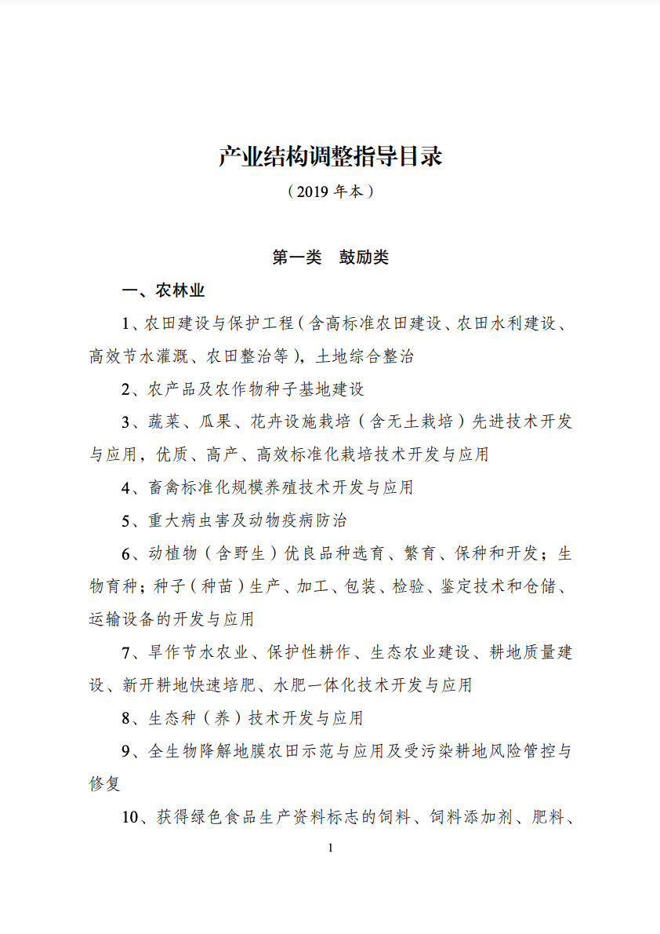
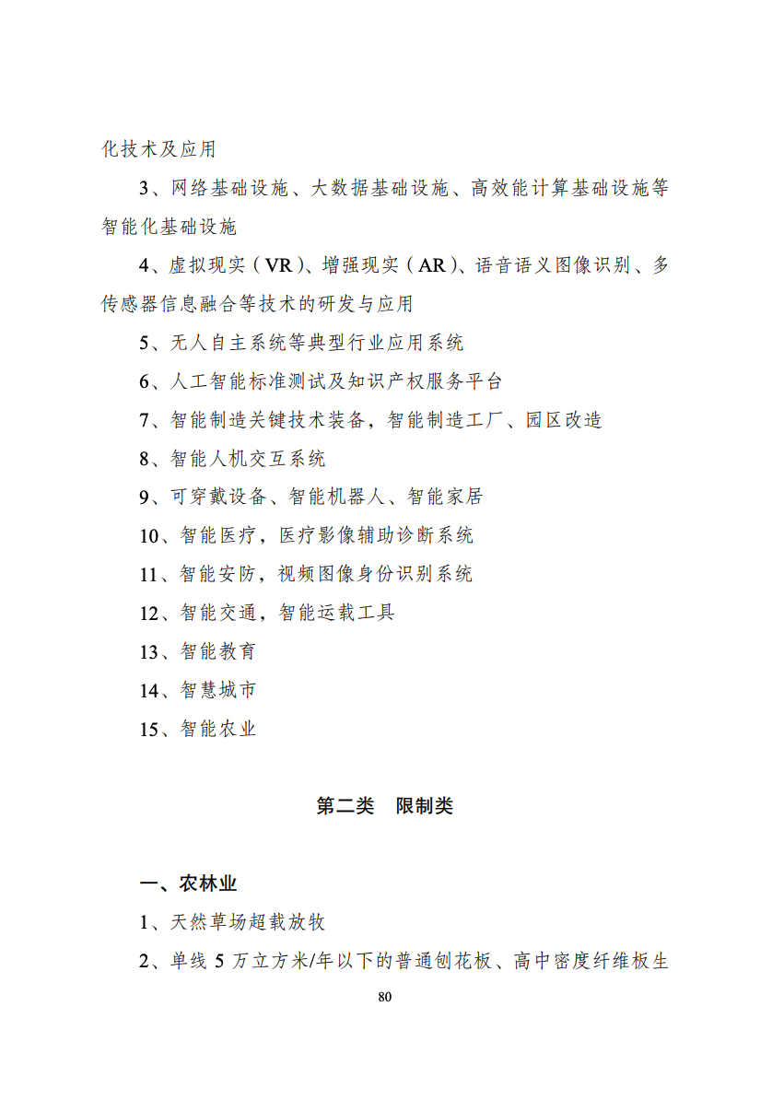
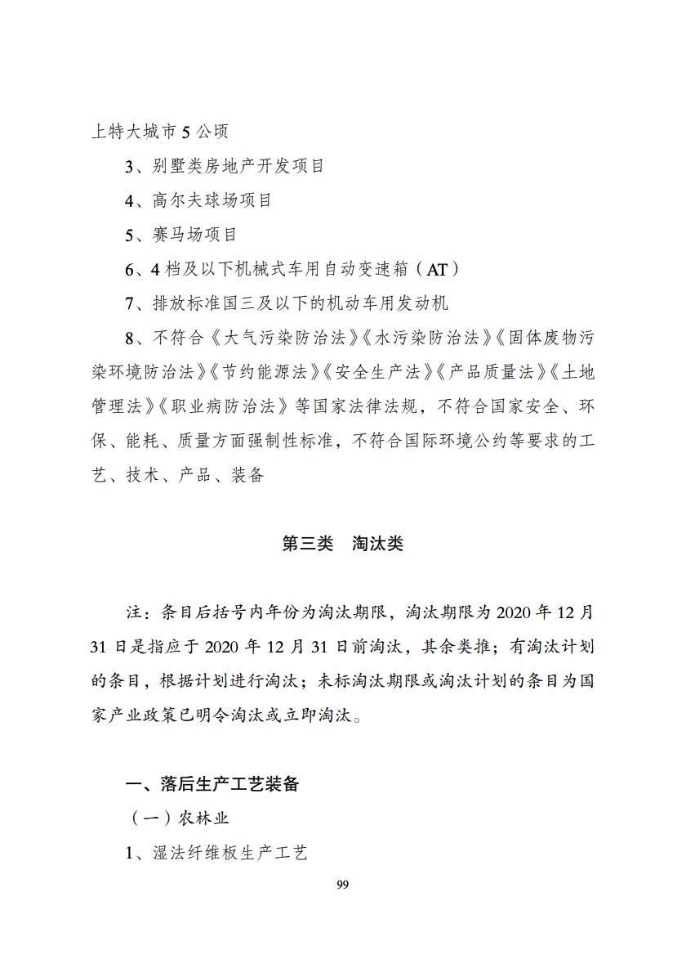
Policies Related to Guidance Catalogs
The catalogs are used as a reference book for project approval or confirmation, credit acquisition, tax incentives, and land use policies.
Explicitly designate industries into three categories: encouraged, restricted, and prohibited.
The current in force version of as “Catalogs for Guiding Industry Restructuring” convers 48 industrials, total 1477 items, with 821 encouraged, 215 restricted, and 441 prohibited.

Slide 10
The China’s complex industrial policy paradigm
State Council
Central Government Ministries
Provincial / Municipal Governments
Individual Firms

Slide 11
The Chinese industrial policy toolkit (1)
Guidance catalogs designating industries for expansion or contraction; control over commercial land allocations
Elimination of excess capacity (Horstman and Markusen, 1985; Eaton and Grossman, 1986)
Direct subsidies
Tax incentives
Policy loans

Slide 12
The Chinese industrial policy toolkit (2)
Government/SOE procurement
Talent policy
Government guidance funds

Slide 13
Does China’s new industrial policy work?
Creating winning industries through industrial policy seems to be challenging (Wu et al., 2019; Branstetter and Li, 2022; Barwick et al., 2019; Barwick et al., 2021; Bai et al., 2020).
The overall impact of industrial policy on firm productivity is limited (e.g., Branstetter et al. 2022; Howell, 2017; Cheng et al., 2019).
The literature also suggests the heterogeneity of policy effects. (e.g., Du et al. 2023).
Industrial policy has heterogeneous effects on innovation; corruption and firms’ gaming behaviors hamper the efficacy of industrial policy (e.g., Fang et al. 2022; Chen et al. 2021; Stuart and Wang 2016; Wei et al., 2021).
These results reflect the findings of research on industrial policy in other contexts, including Japan, South Korea, and the United States.
Notes:
Du et al. (2023) conduct a study using Chinese industrial enterprise data from 1998 to 2007 and find that government subsidies have a positive direct effect on subsidized firms' productivity but a negative indirect effect on non-subsidized firms operating within the same cluster, and the negative indirect effect tends to dominate. These findings indicate an uncomfortable result of industrial policy: what benefits one industry or firm may harm another, and while the government may be aware of who benefits, those who are harmed may go unnoticed.

Slide 14
Good intentions can lead to bad results
Cao et al. (2022) decomposes quantity-based subsidies’ aggregate impact into quantity and quality channels and calibrate the model to Chinese firm-level data in the early 2010s.
The quantitative analysis shows that the quality channel effects are negative and dominant, and quantity-based subsidies in that period reduce the TFP growth rate and welfare by 0.19 percentage points and 3.31%, respectively.

Slide 15
Shipbuilding industry: subsidies and distorted markets
Kalouptsidi’s (2018) theory-based approach points to a total subsidies of RMB 550 billion, or nearly $80 billion. These massive subsidies induced increases in investment and entry of 270% and 200%, respectively.
Barwick et al. (2019) show the extent to which the potential welfare benefits of this industrial expansion were dissipated, first by a vast wave of inefficient entry (needlessly exacerbated by extensive subsidies explicitly designed to encourage the entry of new shipyards) and then by a wave of government-led consolidation that forced shipyards out of business but favored relatively inefficient state-owned entities over the efficient ones.
The profits earned by the surviving incumbents were not sufficiently large to offset the enormous sums expended by the inefficient waves of entry and exit.

Slide 16
The “big fund” and the semiconductor industry: corruption and counter-measures
The National Integrated Circuit Industry Investment Fund (NICIF), known as the “Big Fund,” was established in September 2014.
During its first round of fundraising, the Big Fund raised RMB 138.72 billion (US$20.03 billion) from government agencies and SOEs and was managed by Sino IC Capital, a subsidiary of China Development Bank.
Rising global demand and a strong China-based customer base allowed invested firms to expand rapidly, leading to high returns and apparent success for the Big Fund.
But a series of corruption scandals have undermined the Big Fund’s reputation for savvy management…
And the technology restrictions imposed by the Biden Administration, among other factors, have led thousands of chip firms to close in recent months. Future progress seems especially difficult at/near the semiconductor technology frontier.
Notes:
These are the “LPs” of the fund.

Slide 17
A recent series of corruption scandals
The NICIF had been regarded as a success (Wei, Ang, and Jia 2022), but a recent series of corruption scandals has cast doubt on its ability to allocate resources.
In November 2021, Gao Songtao, the former vice president of Sino IC Capital was arrested for corruption.
In July of 2022, a new round of arrests began with the investigation into Lu Jun, the former president of Sino IC Capital.
In mid-July, Zhao Weiguo, the former chairperson of Tsinghua Unigroup, was taken away by police from his home in Beijing.
Then Ding Wenwu, the former president of the Big Fund, was also detained by police.
During the year of 2022, a dozen chip executives, fund managers and government officials related to the Big Fund were detained or arrested.
Although there hasn't been any official explanation for the link between the detentions of Gao, Lu, and Zhao, speculation has arisen due to the Big Fund's significant investments in Tsinghua Unigroup. In the first phase of the Big Fund, Tsinghua Unigroup was one of the biggest investees of the fund, receiving at least RMB 28.4 billion from the Big Fund. Tsinghua Unigroup, known as China’s "microchip aircraft carrier," has been in trouble since July 2021,

Slide 18
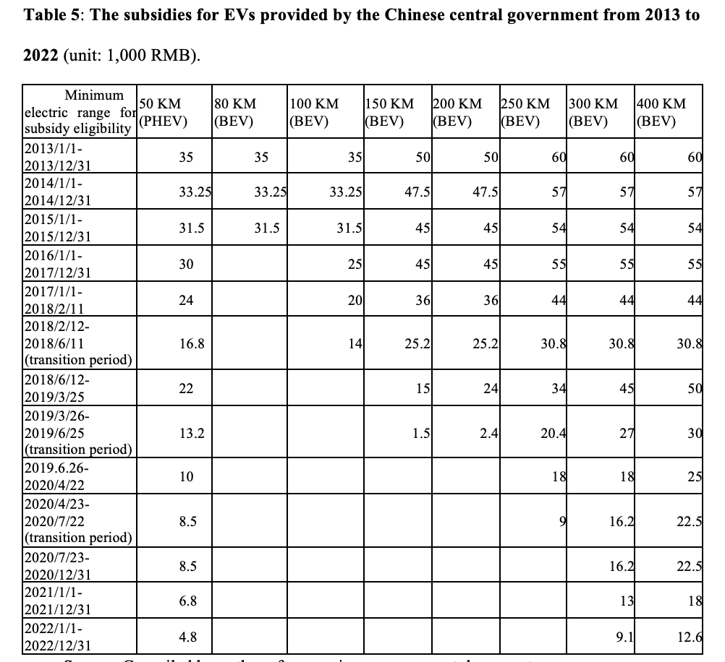
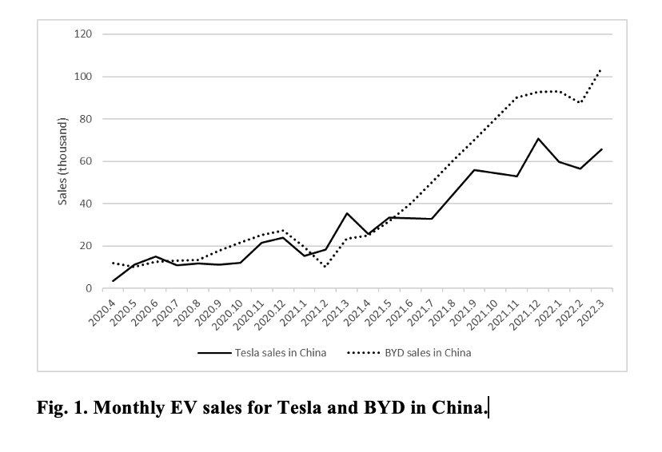
Chinese electric vehicle (EV) industry: Working better (so far) because consumers pick the winners, not bureaucrats

Slide 19
Conclusion
Sometimes, policymakers seem to get industrial policy “right.” Often, they get it wrong. This is not because Chinese policymakers are especially bad – it is because industrial policy is hard.
The evidentiary picture of China’s success that emerges from the extant empirical literature is, at best, mixed.
Our assessment is that industrial policy is going to get harder as China’s economy continues to mature and the long-lasting boost to economic growth generated by earlier waves of economic liberalization and demographic dividends continue to fade.
Finally, the opportunity cost of policy errors is likely to grow.

Slide 20
The NICIF’s chipmaking investments
Company | The Big Fund’s stake (%)
Semiconductor Manufacturing International North China (Beijing) Corp | 32
Hua Hong Semiconductor (Wuxi) Ltd | 29
Yangtze Memory Technology Holdings Co Ltd | 24.1
Unisoc (Shanghai) Technologies Co Ltd | 14
Empyrean Technology Co Ltd | 8.9
Beijing BDStar Navigation Co Ltd | 8.6
NAURA Technology Group Co Ltd | 7.5
Advanced Micro-Fabrication Equipment Inc China | 4
Goodix Technology Inc | 3.6
National Silicon Industry Group Co Ltd | 2.7
Source: Recreated from White and Liu (2022).

Slide 21
Compulsory elimination or shutdown of “excess production capacity”
To promote the structural adjustment of industries suffering from overcapacity, the Chinese government frequently mandates the elimination of excess capacity, often through designation of an industry as “restricted” and “prohibited” in the guidance catalogs.
In theory, this policy goal should be achieved through market mechanisms that eliminate the inefficient producers and leave the most productive in place. However, in reality, the government often forces a designated group of firms to reduce capacity or exit altogether, regardless of whether they are the high-cost producers.
In recent years, state-owned enterprises have been increasingly favored in these adjustment episodes, even though they are usually less productive than private sector competitors.

Slide 22
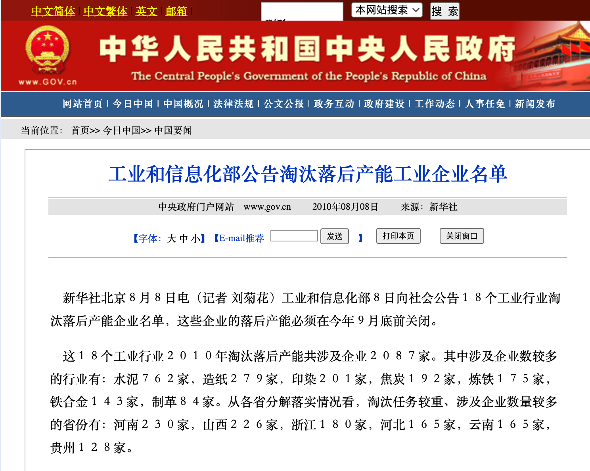
Notes:
For instance, in August 8, 2010, the Ministry of Industry and Information Technology released a list of 2,087 underperforming companies in 18 industrial sectors that must eliminate their outdated production capacity by the end of September that year.

Slide 23
Direct subsidies
Subsidies are widely used by the government to encourage specific behaviors of firms for a wide range of objectives including expanding business, increasing research and development investments, and supporting technology upgrades and environmental protection.
Supply-side subsidies provided to firms and demand-side subsidies provided to consumers are both widely used in China to encourage development of targeted industries.
Subsidies in China are provided by both the central government and local governments. Branstetter, Ren and Li (2022) finds that the subsidy providers involve all hierarchical levels of the Chinese governments, including central, provincial, prefecture, county, township and even village governments.

Slide 24
Tax incentives
Tax incentives for investment in encouraged industries;
Tax incentives for encouraging enterprise technology upgrading investment and adoption of advanced equipment;
Tax incentives for encouraging exports, such as export tax rebate policies for export enterprises;
Tax incentives for encouraging investment in environmental protection equipment and technology;
Tax incentives for encouraging R&D;
Tax incentives for small and micro enterprises.

Slide 25
Policy loans
Policy loans provide credit support for business operations in encouraged industries.
China has three official policy banks : the China Development Bank, the Export-Import Bank of China, and the Agricultural Development Bank of China.
n addition to policy banks, the four major state-owned commercial banks, the Industrial and Commercial Bank of China, the China Construction Bank, the Agricultural Bank of China, and the Bank of China, are also required to provide credit support for targeted industries and enterprises in accordance with industrial policies.

Slide 26
Government and SOE Procurement
China's decision to not accede to the Government Procurement Agreement (GPA) has allowed it to utilize government procurement as a significant tool for industrial policy.
Electric buses and passenger vehicles procured through public channels accounted for approximately 65% of total sales between 2012 and 2015, and around 50% of total EV sales in 2018
The extensive role of state-owned enterprises in critical sectors of the Chinese economy and the extensive control exercised over SOEs by the Chinese state and the CCP enable the effective use of SOE purchasing as an instrument of state policy.
Notes:
One notable example is the support for electronic vehicle (EV) development during the early years, when the Chinese government gave priority to EVs in public procurement to stimulate growth in the EV market.

Slide 27
Talent Policy
China’s talent drive received the backing of its most prominent leaders, including the Central Committee of CCP;
The 2016 “National Innovation-Driven Development Strategy” states that “the essence of being innovation-driven is being talent-driven.”
To build up its talent pool, China is pursuing a multi-pronged approach. In addition to enhancing domestic education, the Chinese government also seeks to attract overseas Chinese talent and draw in foreign talent in keeping with its industrial policy priorities

Slide 28
Government Guidance Funds
The Chinese government has employed government guidance funds to direct investments into strategic industries and accelerate the development of China's technological leadership on a global scale.
Since the turn of the 21st century, government guidance funds have emerged as a crucial mechanism for China to implement its industrial policies.
These funds are venture-capital-like public-private investment vehicles that operate according to the state's industrial policy objectives, aiming to generate financial returns while also supporting specific government priorities, such as promoting emerging technologies or attracting industry to particular regions.
Public and private sources contribute to these funds, with limited partners (LPs) investing capital and receiving returns while general partners (GPs) make investment decisions and oversee operations. While private investment is encouraged, these funds are predominantly financed by the government, state-owned enterprises, and state-influenced financial institutions.

Slide 29
Does China’s New Industrial Policy Work?
China's initial adoption of a Japanese-style industrial policy from Soviet-style economic management represents a positive step towards a more market-oriented economy during the early stages of reform and opening-up. However, as market mechanisms have become increasingly fundamental to the economy, the once-successful industrial policy is now experiencing diminishing returns.
Moreover, while government intervention may be effective during the catch-up phase, its effectiveness in driving innovation-based growth is often limited by the high degree of technology and market uncertainty surrounding the technology frontier.

