Slide 1
De-biasing peer review with voluntary anonymization
Inna Smirnova, Daniel Romero, Misha Teplitskiy
University of Michigan School of Information
Inna Daniel

Slide 2
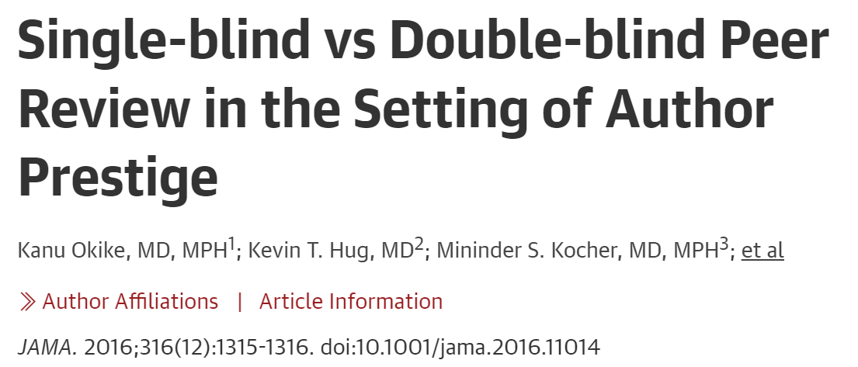
Bias in scientific evaluations is reduced by double-anonymization
Notes:
blinding vs anonymization
we will focus on prestige

Slide 3
Limited adoption of double-anonymous evaluation
90+% of physical sciences journals single-anon (Wiley 2022)
Why? Organizational inertia, single-anon helps spot conflicts of interest, …
Enforcing compliance
Institute of Physics Publishing: 1,878 hrs of editor labor / year
Voluntary anonymization?
Notes:
Wiley (2022, https://authorservices.wiley.com)
62% of 1600 journals single-anon.
90+% in physical sciences

Slide 4
Voluntary double-anonymization seems attractive but… theory
Strategic behavior
High-prestige people will not anonymize
“Full disclosure principle” (Frank 2008)
Most prestigious doesn’t anonymize… 2nd most prestigious doesn’t anonymize…
→ No one anonymizes!
Limits to strategic behavior
Information frictions: bias hard to predict
Other motivations: framing of the choice, culture
Unintended consequences
Harder to get reviewers? (Tomkins et al. 2017)
Harder to get prestigious authors?

Slide 5
Voluntary double-anonymization seems attractive but… practice
106,373 submissions
12% choose double-anon
Gender: no association
Country: India, China choose double-anon more
Prestige: less prestigious institutions choose double-anon a little more
Design, analysis non-causal
Notes:
voluntary disclosure… Ban the Box… complicated literature

Slide 6
Setting
Institute of Physics (UK + Ireland)
90+ journals, ~40k submissions/year
Notes:
2020

Slide 7
The anonymization nudge

Slide 8
Data & measures
57 journals, 156,015 submissions Jan 2018-Feb 2022
390k authors, 168k invited reviewers
“Policy” = double-anon option
Staggered roll out
Effect of policy, not anonymization
Intention to treat
Diff in diffs
Prestige = first author citations up to submission year
Low = 0
Medium = 1-100
High = 100+
Review positivity = {1=Accept or R/R, 0=Reject}
Controls: gender, country, team size, journal, month

Slide 9
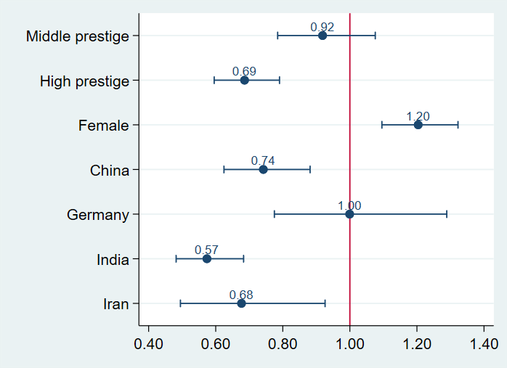
Who chooses to anonymize?
Odds ratios from a logistic regression
Reference category: Low prestige, USA-based, Male

Slide 10
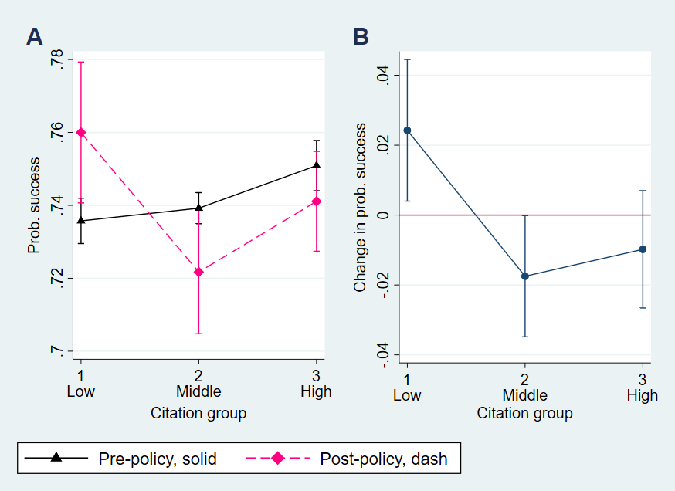
Policy improves reviews, acceptances of low-prestige authors, affects others less
Review positivity
Rates Change in rates

Slide 11
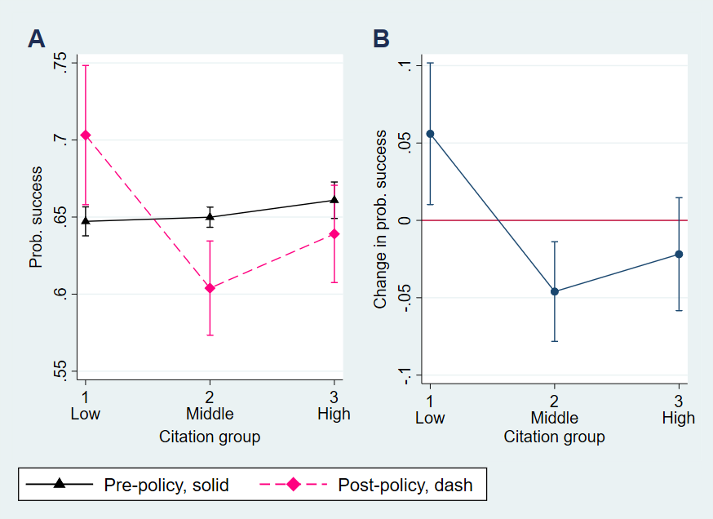
Policy improves reviews, acceptances of low-prestige authors, affects others less
Review positivity
Rates Change in rates
Acceptance
Rates Change in rates

Slide 12
Unintended consequences?
Non-significant effect on invitation acceptance rate
Non-significant effect on mean prestige (citations) of
Submitting authors
Reviewers

Slide 13
IV: effect of anonymization on compliers
Desk Peer review Final decision
Notes:
huge effect

Slide 14
Conclusion: voluntary anonymization works!
Double-anon option not used fully strategically
Information frictions not always bad!
⇑ success of low-cited authors
Review positivity up 2.4%, acceptance up 5.6%
IV: acceptance up 20%!!!
Medium & high cited authors less affected
Behavior changed less
No evidence of unintended consequences
Open questions: long-term? scope conditions?
Cheap way to reduce bias in science (and elsewhere?)
Notes:
Replications please

Slide 15
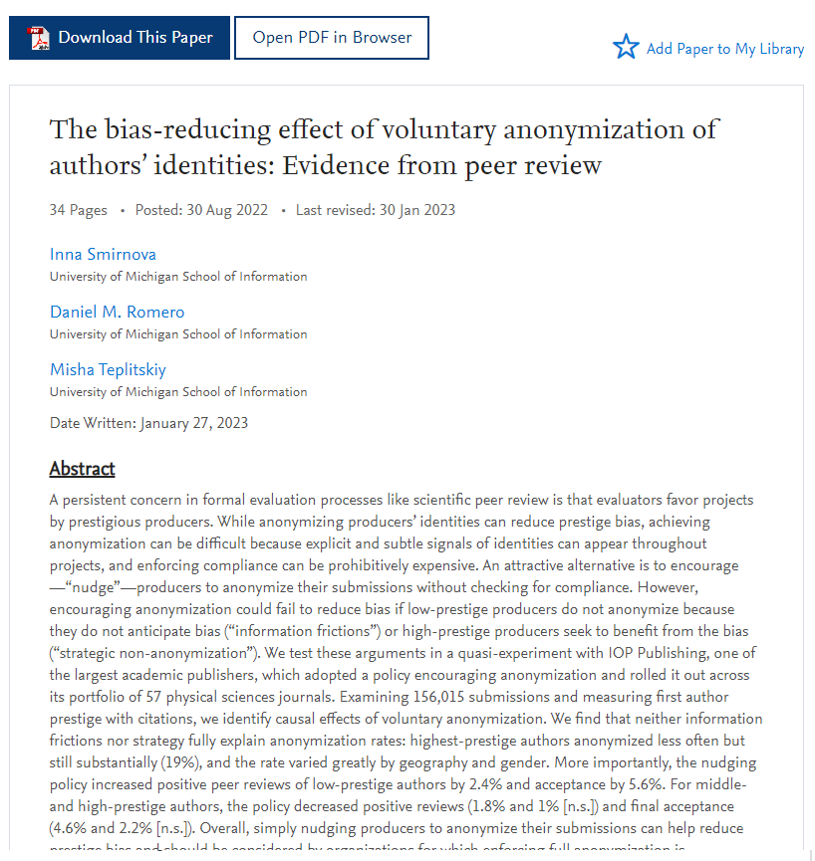
Thank you!
Questions?
Inna Smirnova, innas@umich.edu
Misha Teplitskiy, tepl@umich.edu
Preprint →

