Slide 1
Prior-itizing Privacy: A Bayesian Approach to Setting the Privacy Budget in Differential Privacy
Zeki Kazan and Jerome P. Reiter

Slide 2
Outline
Motivation and Prior Work
Our Method
Examples and Practical Considerations
Motivation and Prior Work
Our Method
Examples and Practical Considerations

Slide 3
Motivation
Differential Privacy for Government Agencies —Are We There Yet?
Jörg Drechsler
Don’t Look at the Data! How Differential Privacy Reconfigures the Practices of Data Science
Jayshree Sarathy, Sophia Song, Audrey Haque,
Tania Schlatter, Salil Vadhan
“Setting the value for the privacy parameter ε is arguably the most difficult decision in any deployment of DP in practice.”
“We conduct interviews with 19 data practitioners who are non-experts in DP as they use a DP data analysis prototype to release privacy-preserving statistics about sensitive data”
“A…participant emphasized that given his less technical background, he had trouble understanding the meaning and implications of the privacy-loss parameters.”
Differential Privacy and Federal Data Releases
Jerome P. Reiter
“Agency policy makers—who generally are not experts in differential privacy—need to comprehend privacy budgets and data quality in familiar terms”
“I’d want more information for people like me who are kind of familiar with technical concepts like this.”

Slide 4
Examples of Prior Work
Idea
Bound Bayesian disclosure risks
Assumptions
Population is public
Release consists of subset with a common trait
Adversary only interested in individual’s inclusion
How Much is Enough? Choosing ε for Differential Privacy
Jaewoo Lee and Chris Clifton
DP Mechanism
Laplace Mechanism
Idea
Two-party model with analyst and participant
Assumptions
Data not yet collected
Individuals participate if compensation from study outweighs risk to privacy
Fixed total monetary budget
Differential Privacy: An Economic Method for Choosing Epsilon
Justin Hsu, Marco Gaboardi, Andreas Haeberlen, Sanjeev Khanna, Arjun Narayan, Benjamin C. Pierce, Aaron Roth
DP Mechanism
Any DP Mechanisms
+ Dandekar et al. (2014), Fleischer and Lyu (2012), Li et al. (2014)

Slide 5
Bayesian Interpretation of DP
Name | Variable 1 | V2 | V3 | …
⁞ | ⁞ | ⁞ | ⁞ | …
Alice | * | * | * | …
Gertrude | * | * | * | …
Bob | * | * | * | …
⁞ | ⁞ | ⁞ | ⁞ | …
Name | Variable 1 | V2 | V3 | …
⁞ | ⁞ | ⁞ | ⁞ | …
Alice | * | * | * | …
Gertrude | * | * | * | …
Bob | * | * | * | …
⁞ | ⁞ | ⁞ | ⁞ | …
Prior belief about the probability Gertrude is in the data
Prior belief about the probability distribution of Gertrude’s values
Included in Data
Confidential Data
Gertrude
Update Prior Beliefs to Form Posterior
Examine Released Statistics
Inclusion:
Values:
Adversary
Released Statistics

Slide 6
Motivating Example
Name | Variable 1 | V2 | V3 | …
⁞ | ⁞ | ⁞ | ⁞ | …
Alice | * | * | * | …
Gertrude | * | * | * | …
Bob | * | * | * | …
⁞ | ⁞ | ⁞ | ⁞ | …
Name | Income | Age | Sex | …
⁞ | ⁞ | ⁞ | ⁞ | …
Alice | <$50,000 | 21 | F | …
Gertrude | >$100,000 | 30 | F | …
Bob | $50,000-$100,000 | 43 | M | …
⁞ | ⁞ | ⁞ | ⁞ | …
Prior belief about the probability Gertrude is in the data
Prior belief about the probability distribution of Gertrude’s values
Prior belief about the probability Gertrude is in each income bracket
Included in Data
Confidential Data
Gertrude
Update Prior Beliefs to Form Posterior
Income Brackets
<$50,000
$50,000 - $100,000
>$100,000
Income Brackets
<$50,000
$50,000 - $100,000
>$100,000
Examine Released Statistics
Adversary
Released Statistics

Slide 7
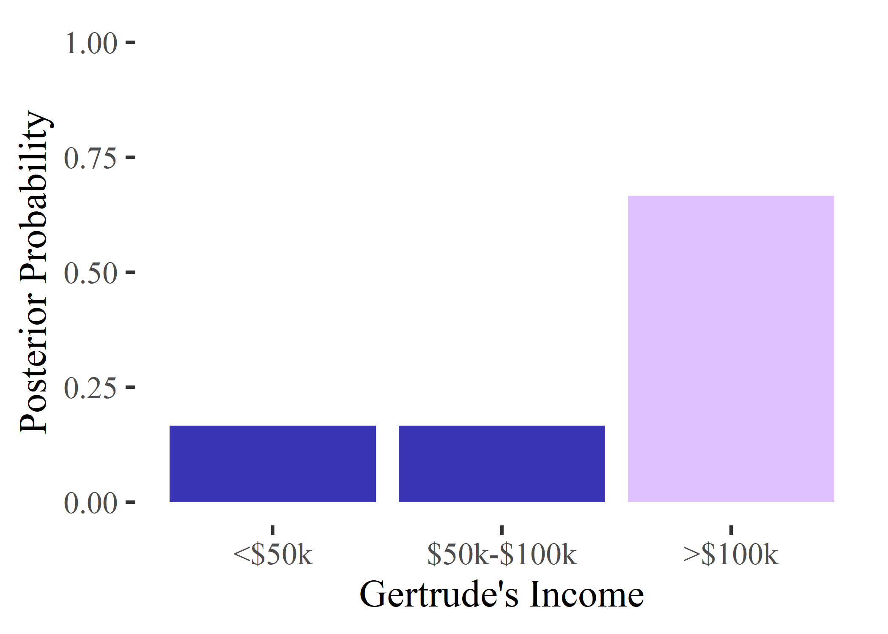
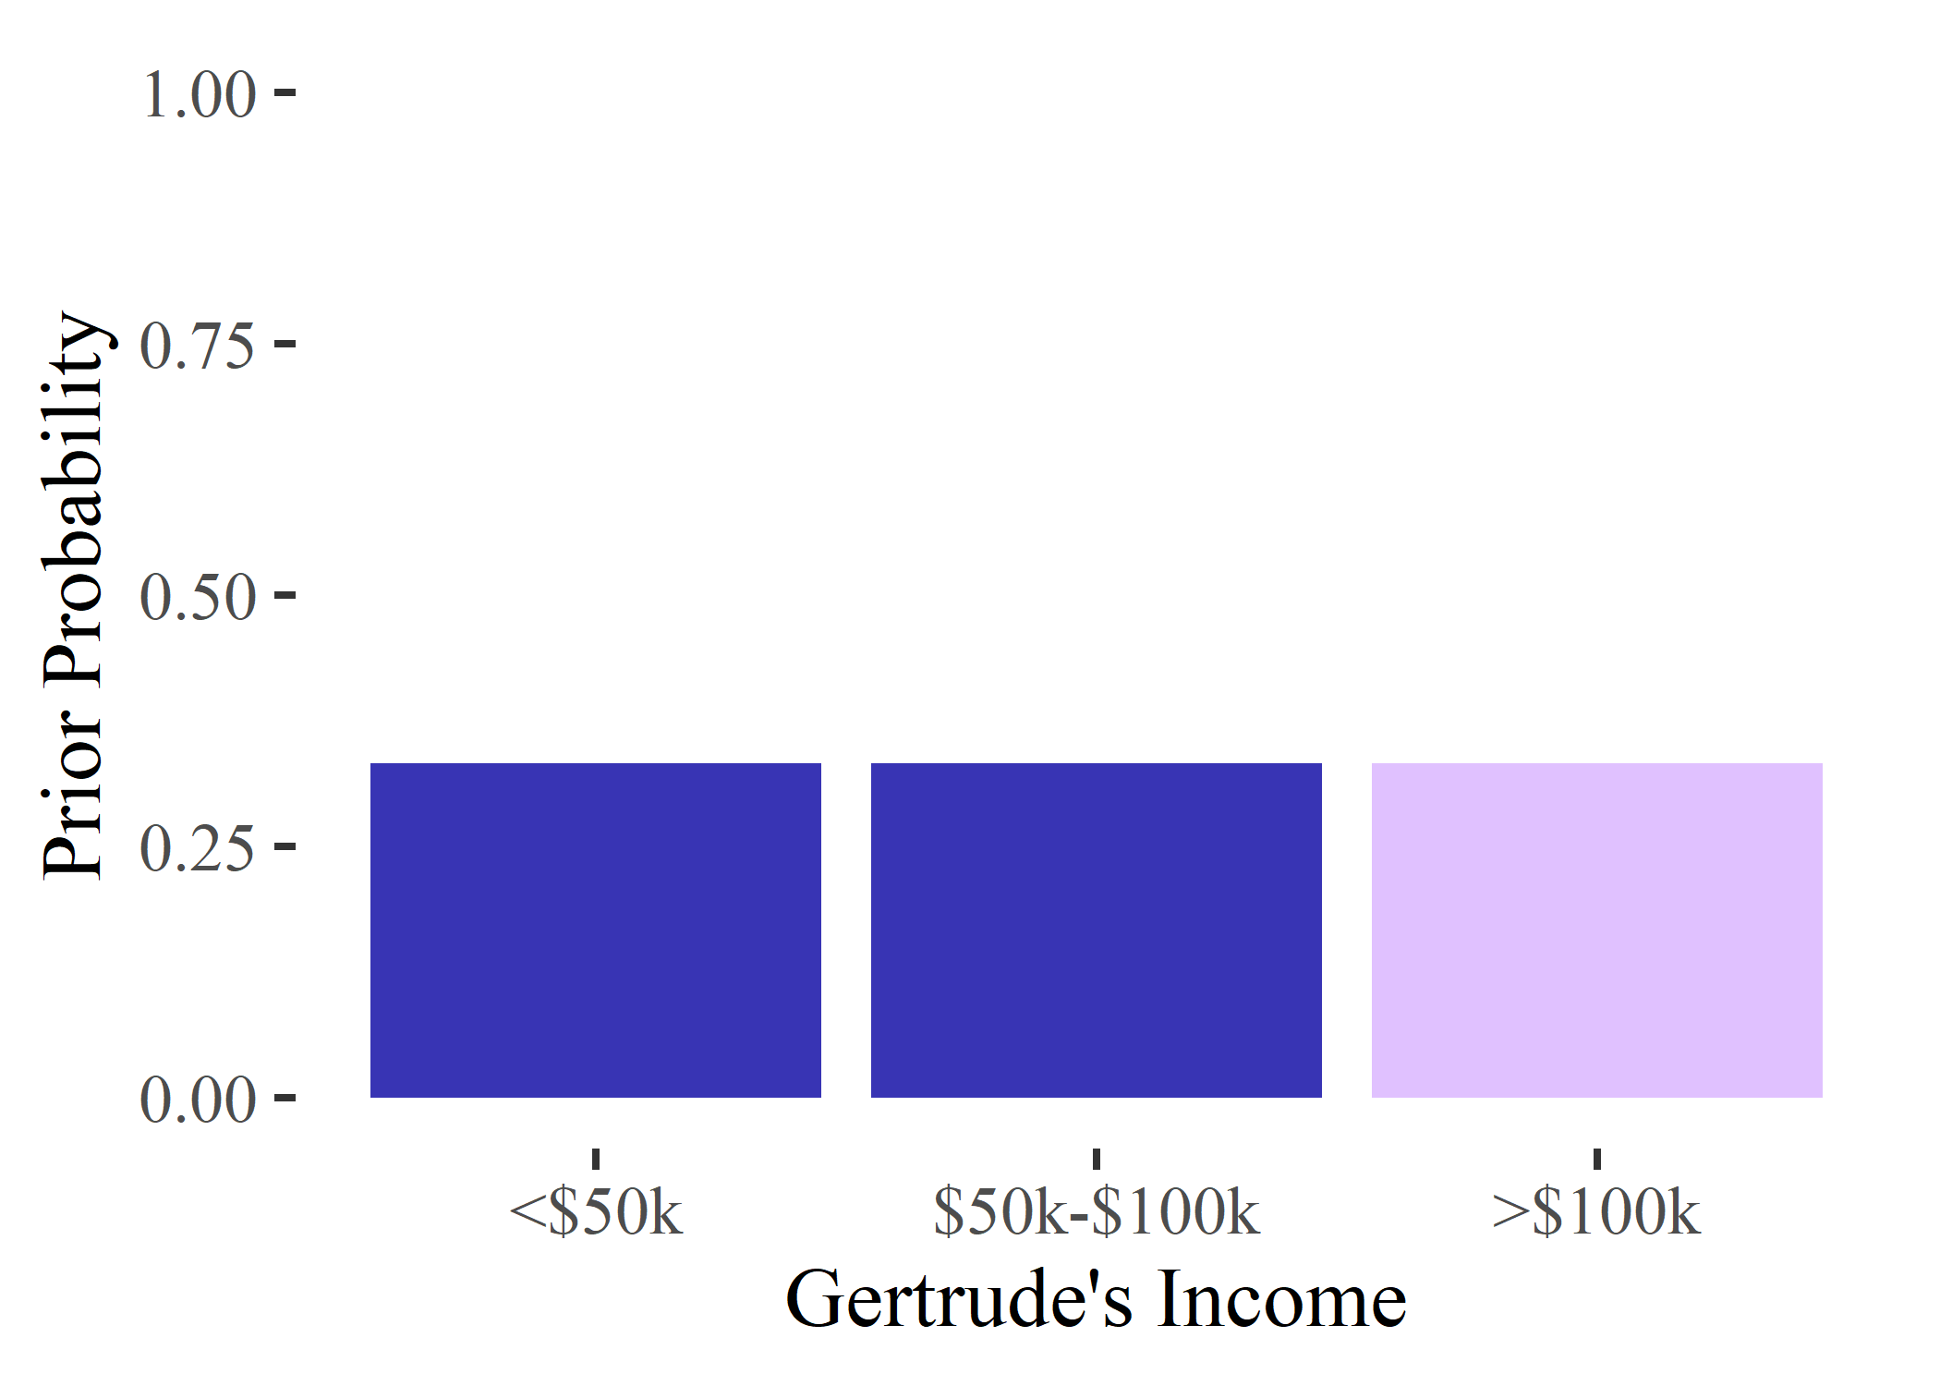
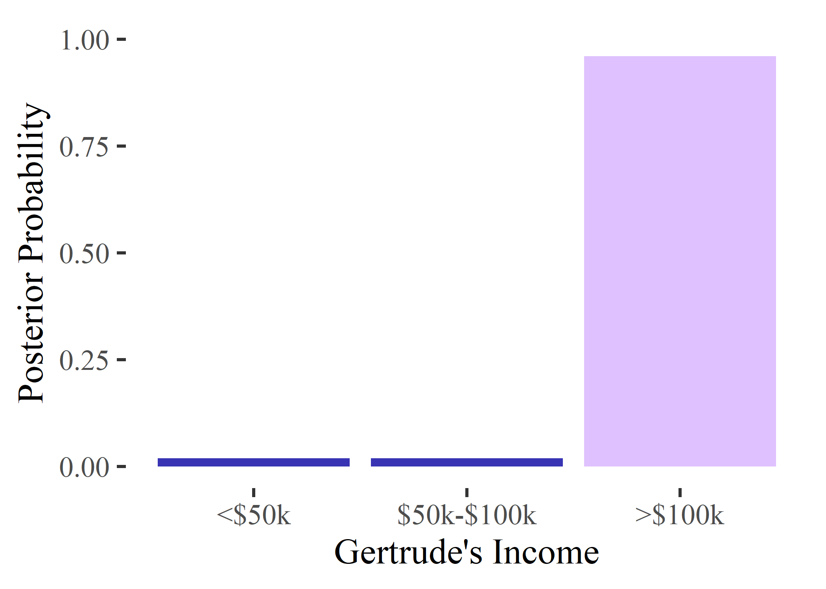
Motivating Example
Prior belief about the probability Gertrude is in each income bracket
Adversary
Released Statistics

Slide 8
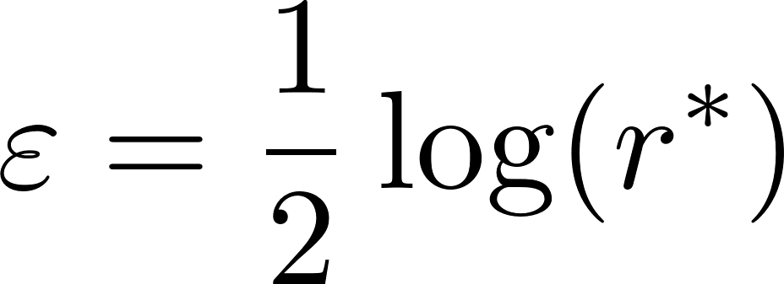
Motivating Example
Naïve Idea: Set $ε$ such that posterior-to-prior ratio is bounded by a desired fixed value, $r^{∗}$
Generally results in small recommended $ε$

Slide 9
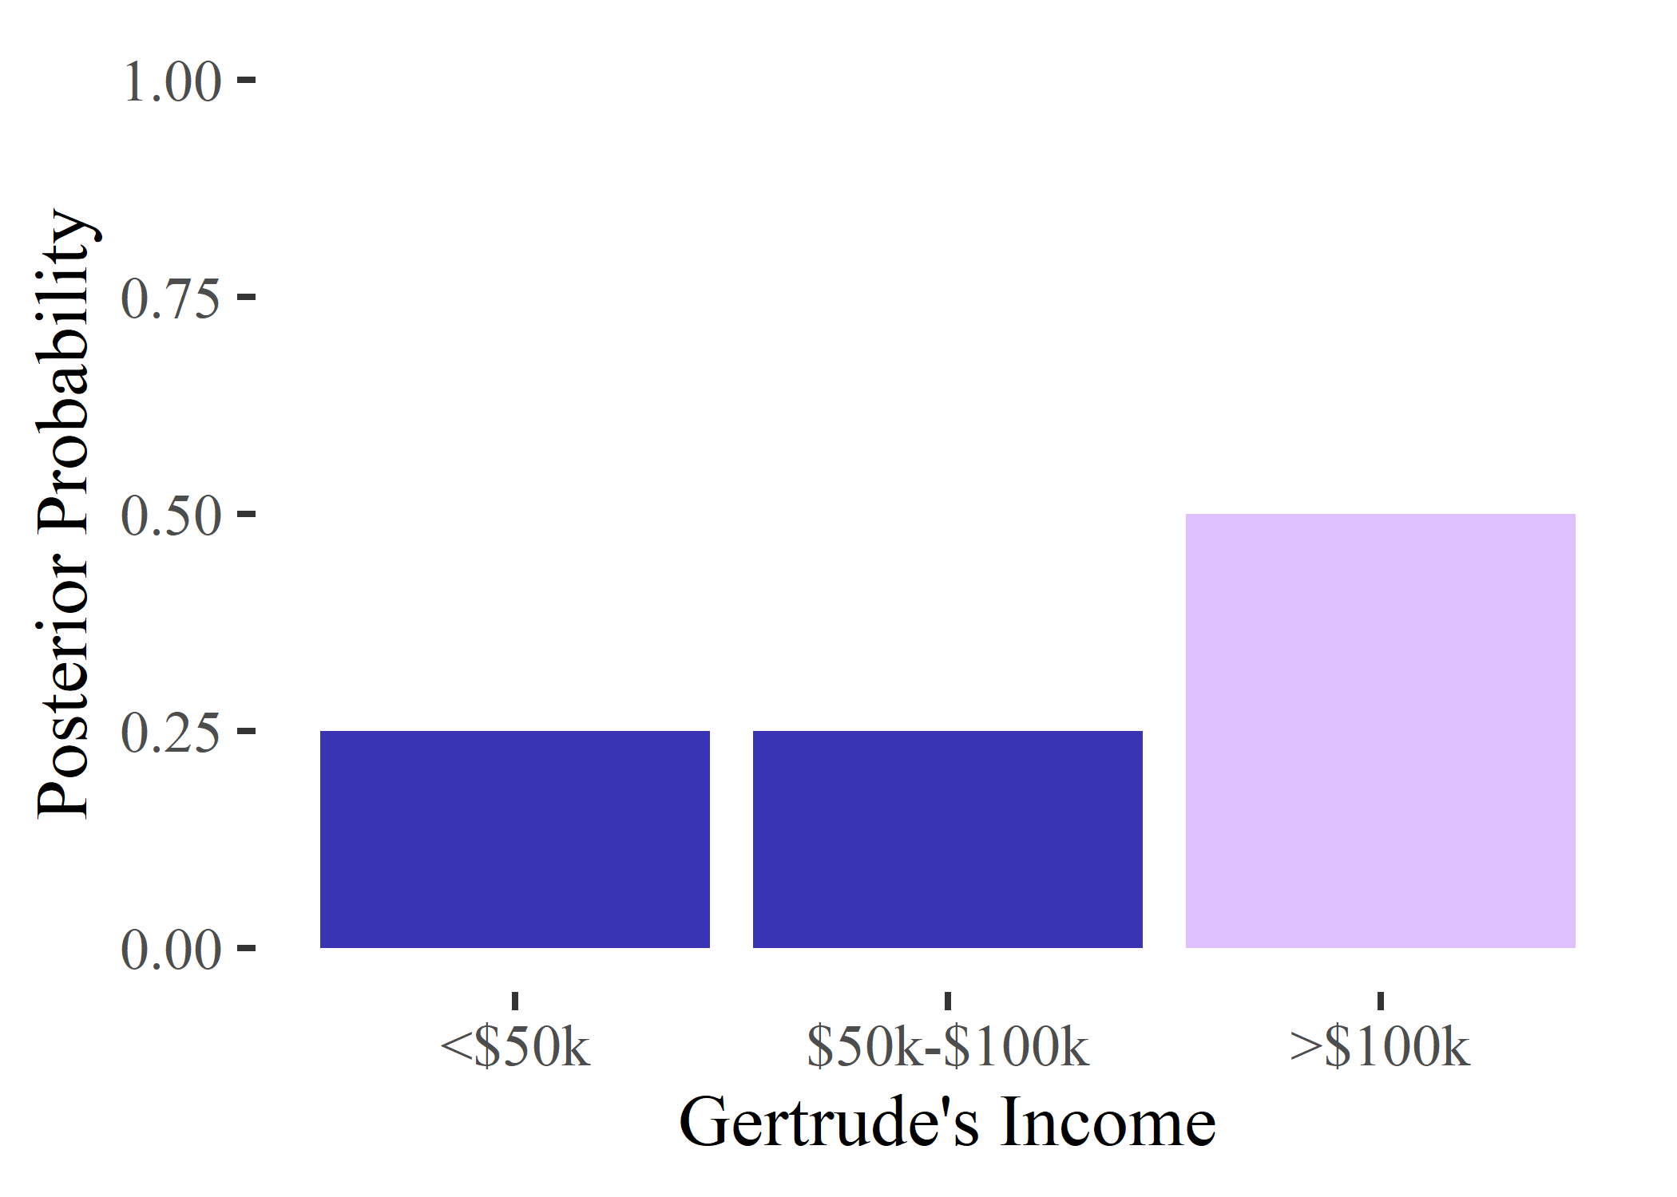
Motivating Example
Bound on posterior-to-prior ratio holds for all priors
May not be tight for particular prior
Can be quite loose in practice
Adversary
Released Statistics

Slide 10
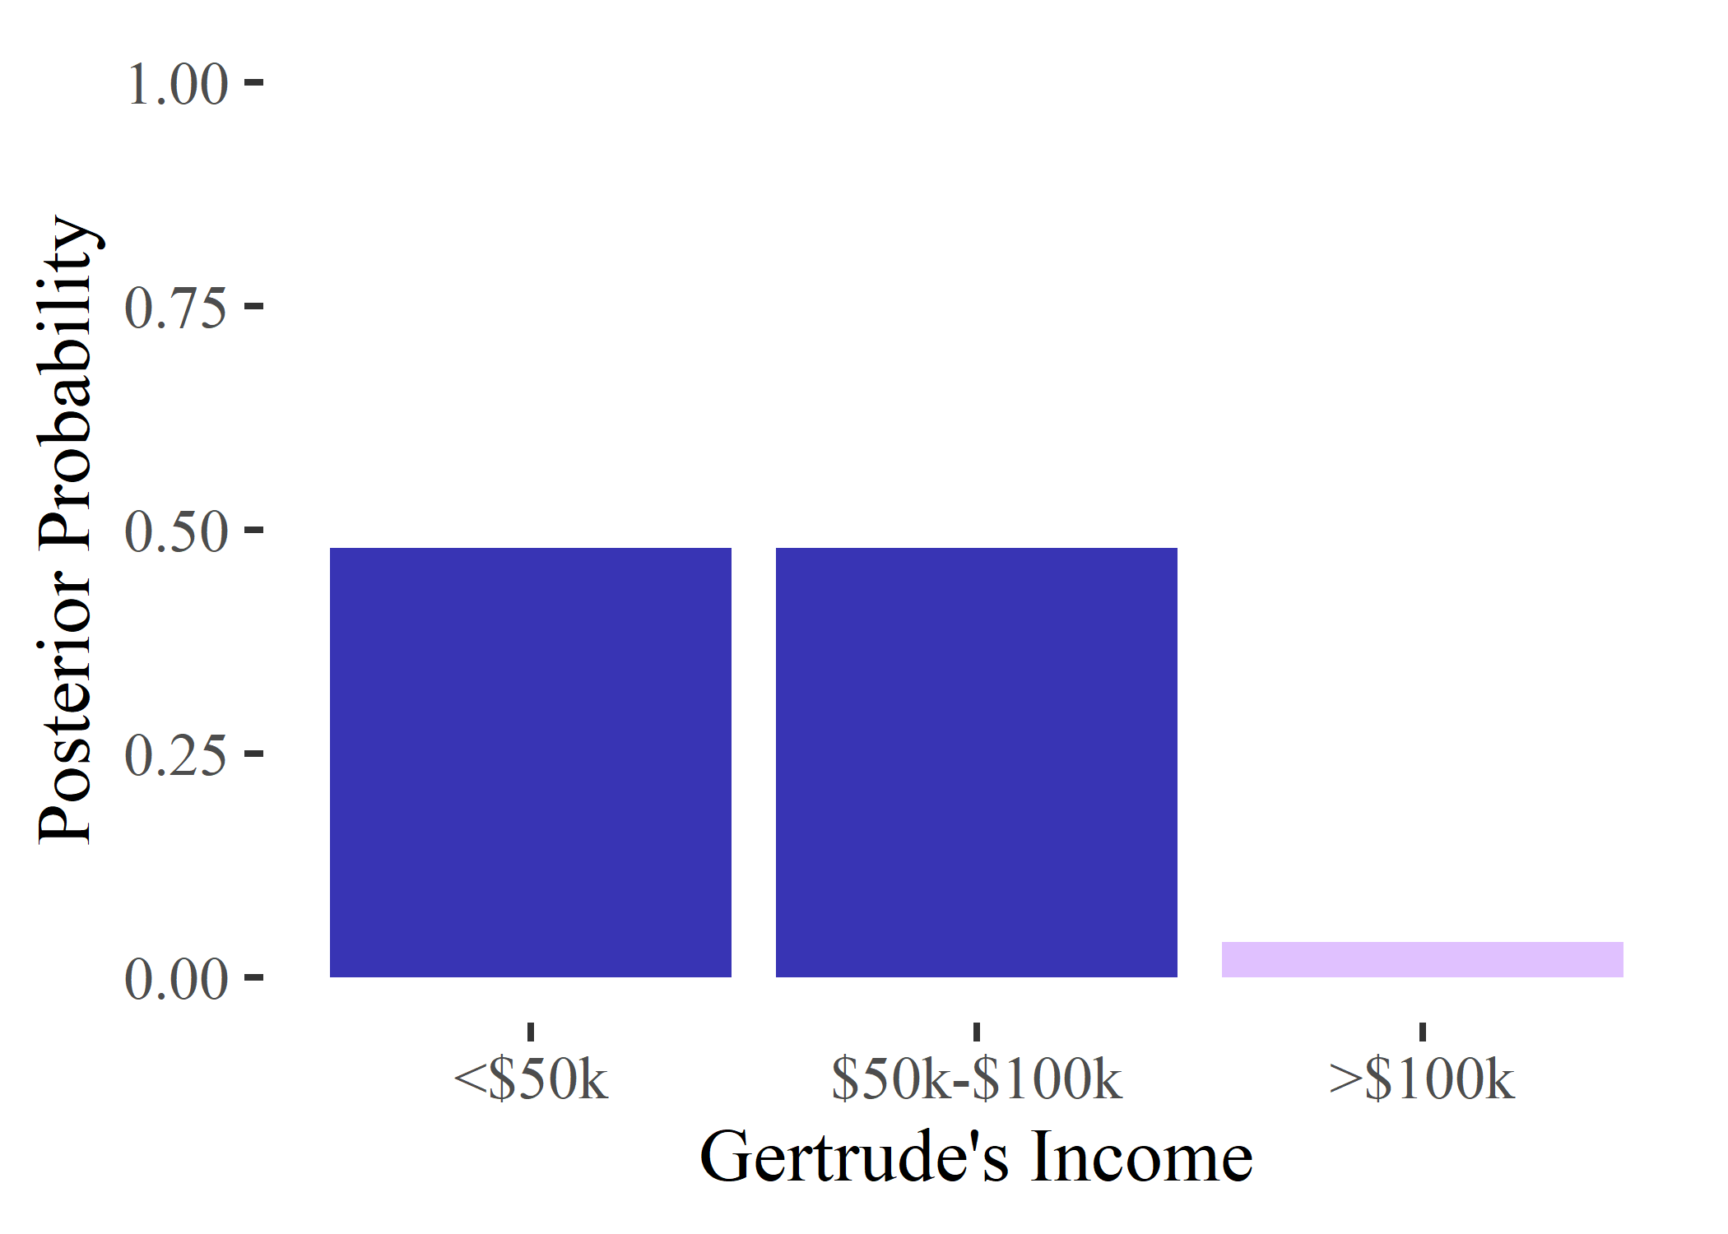
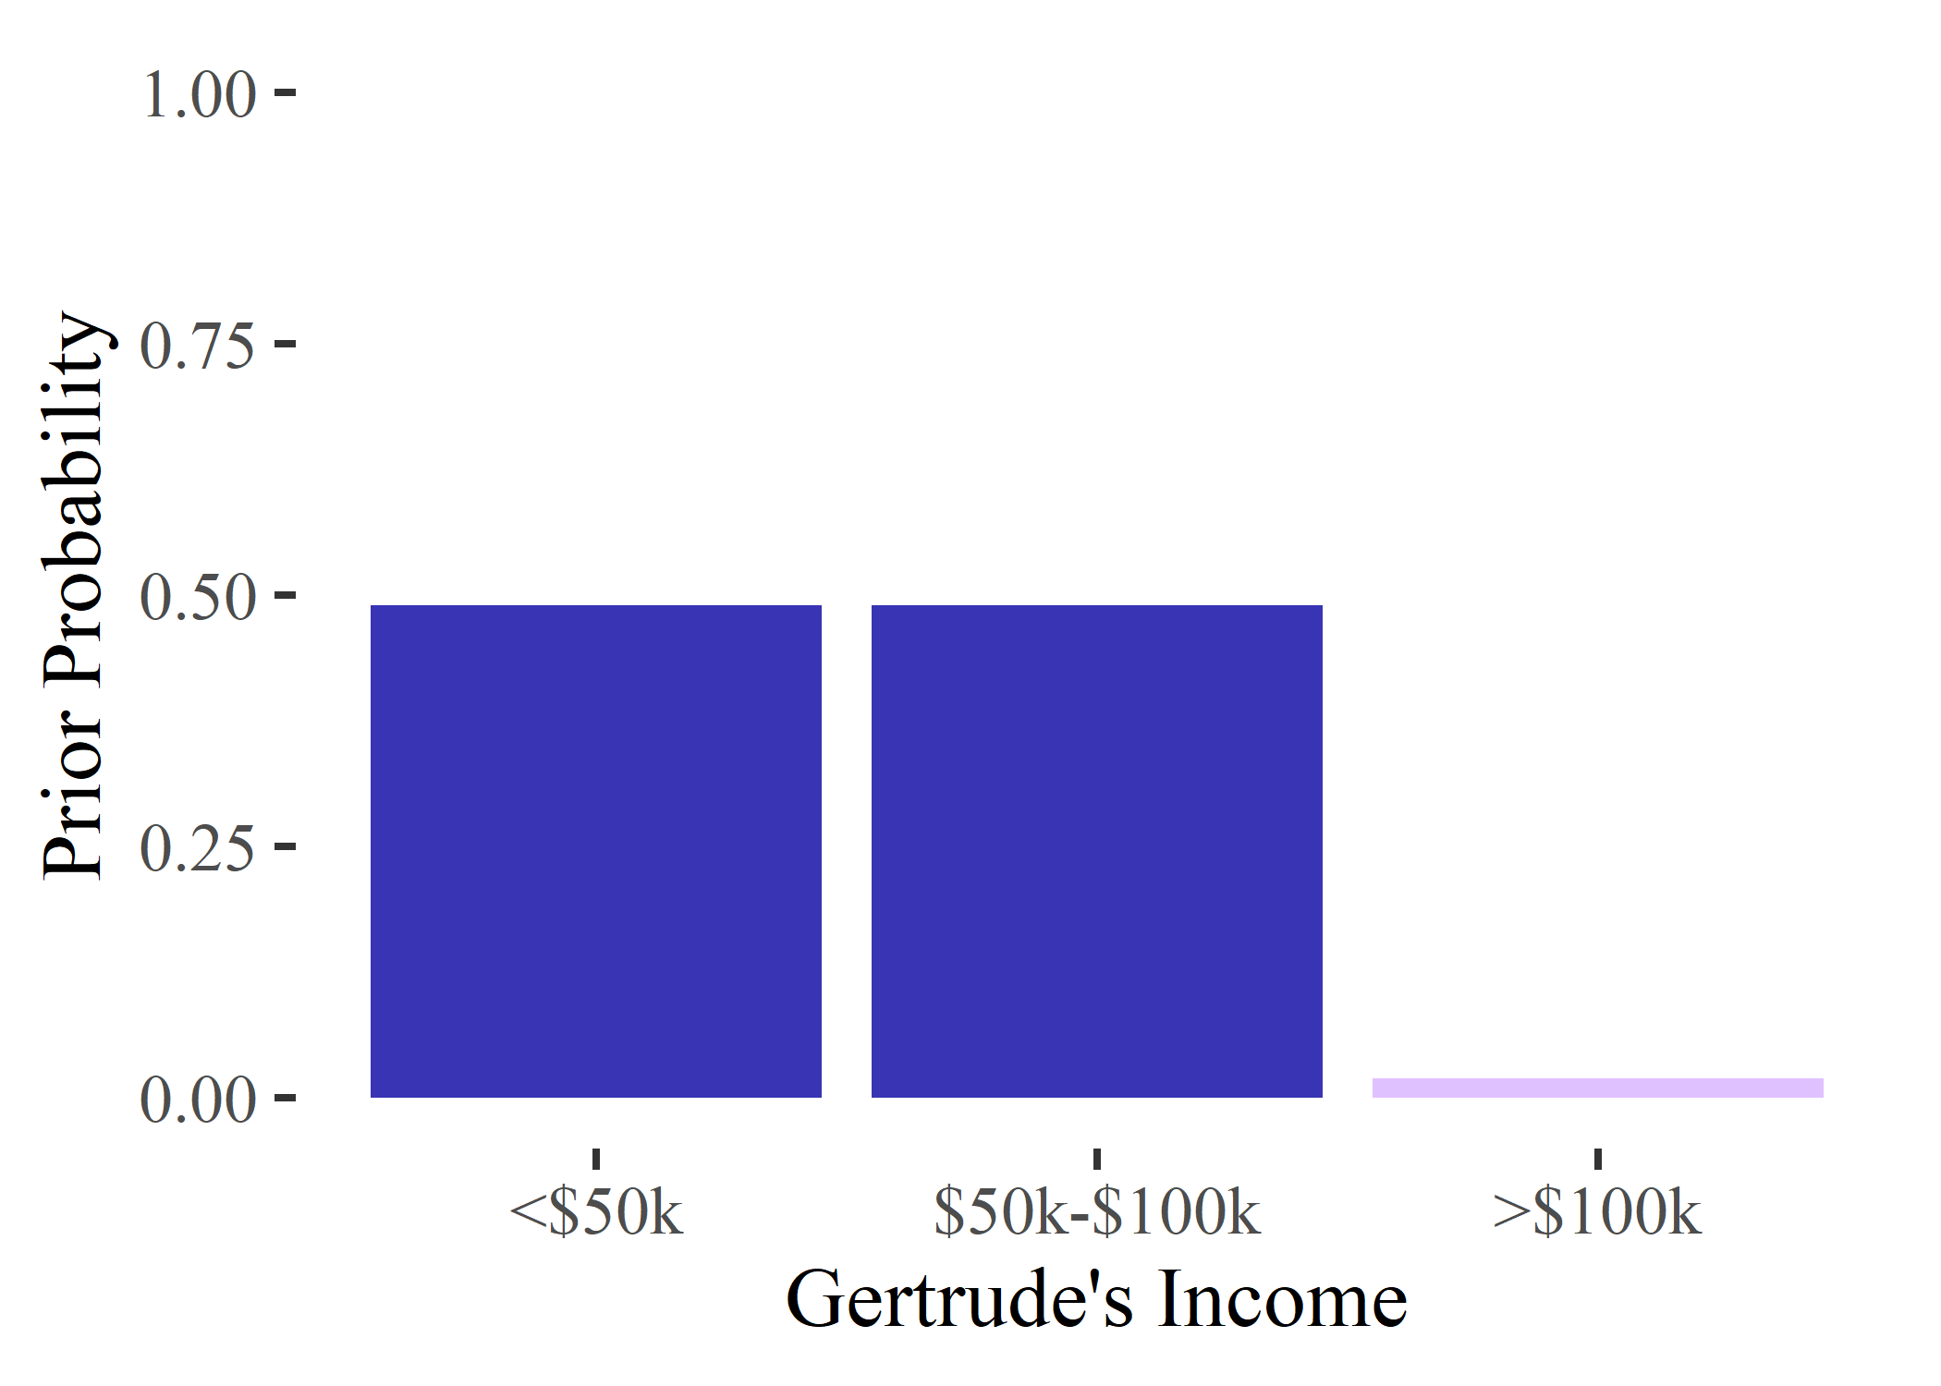
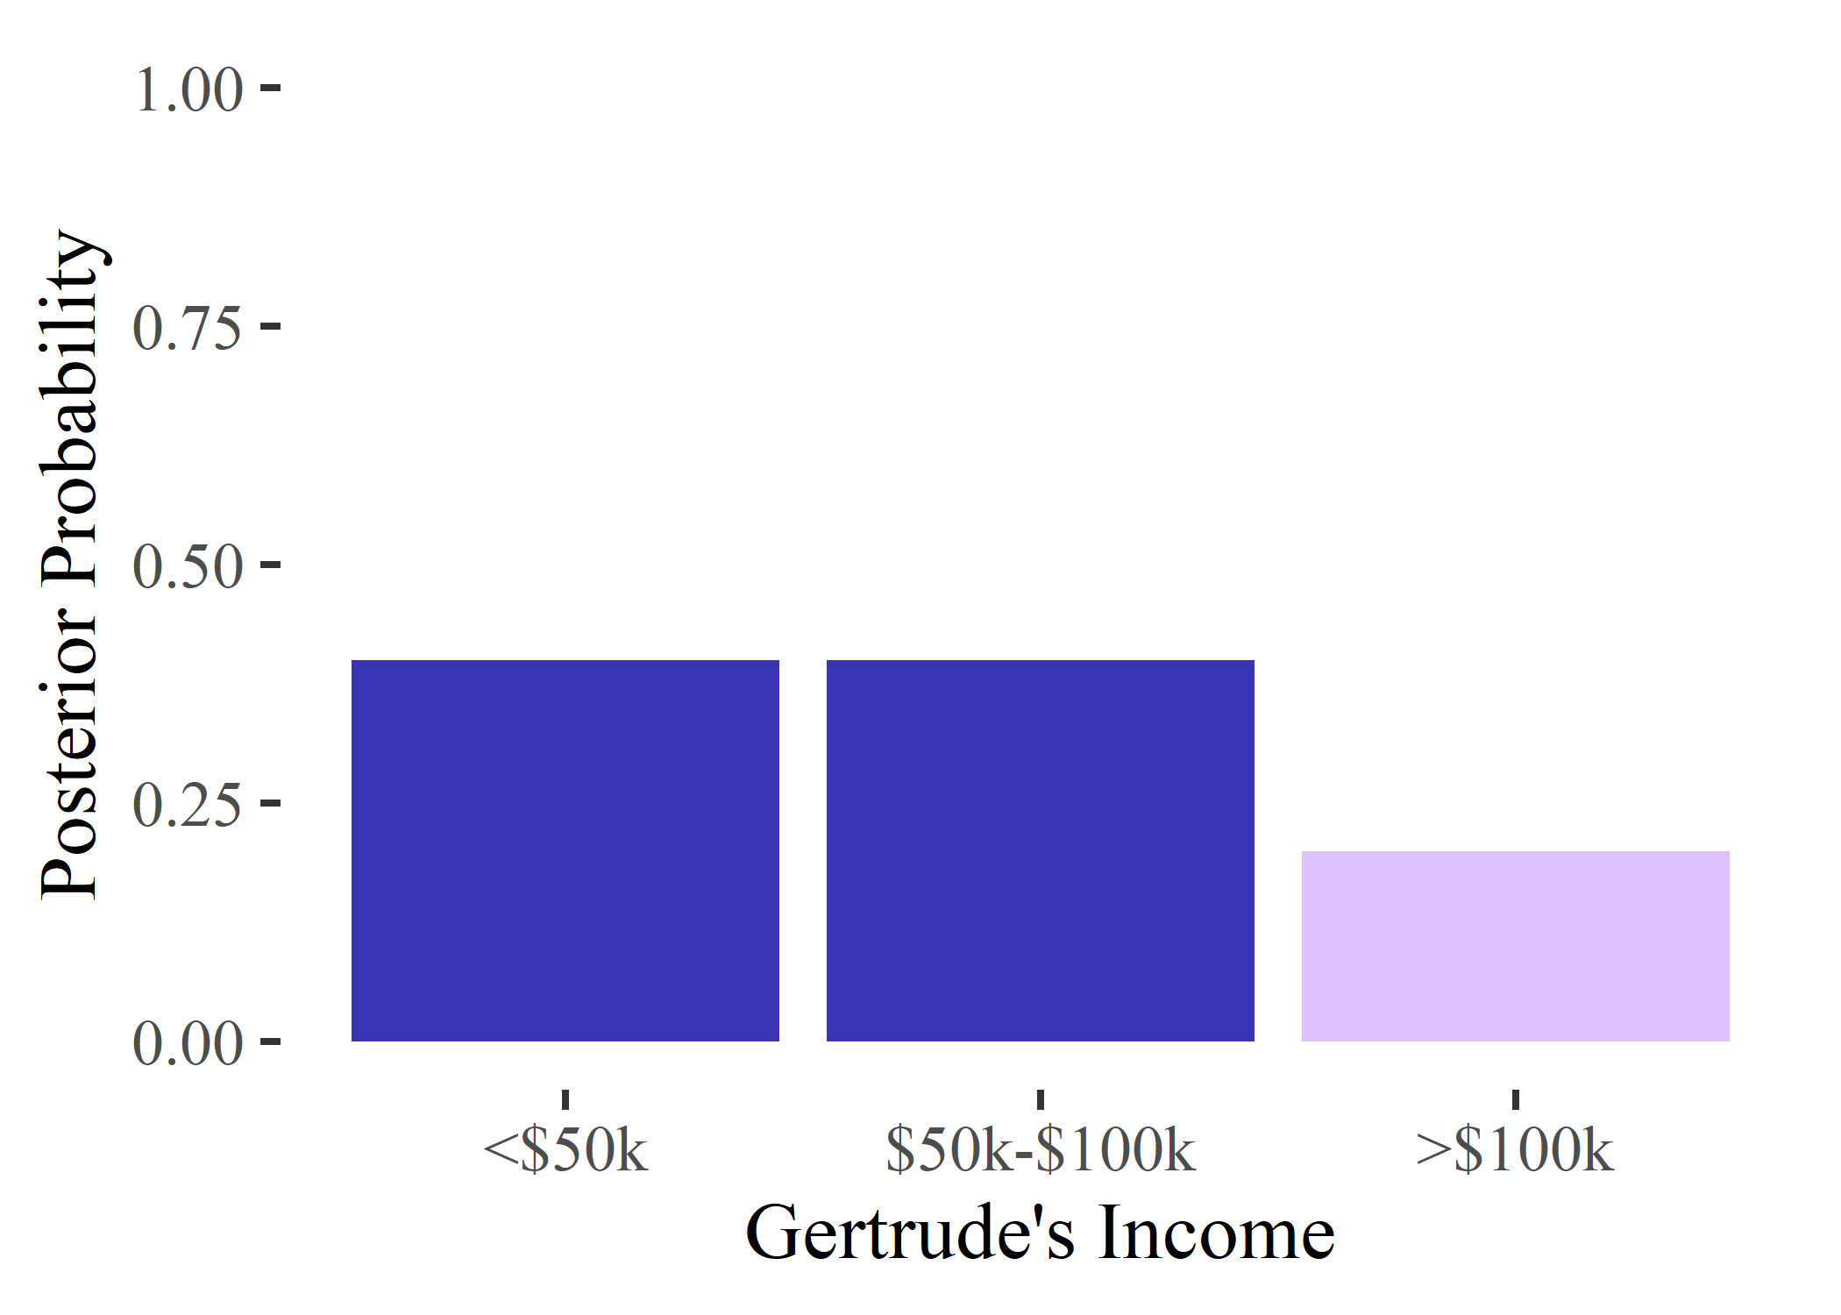
Motivating Example
Practically, bound may be tighter than necessary for some priors
Adversary
Released Statistics

Slide 11
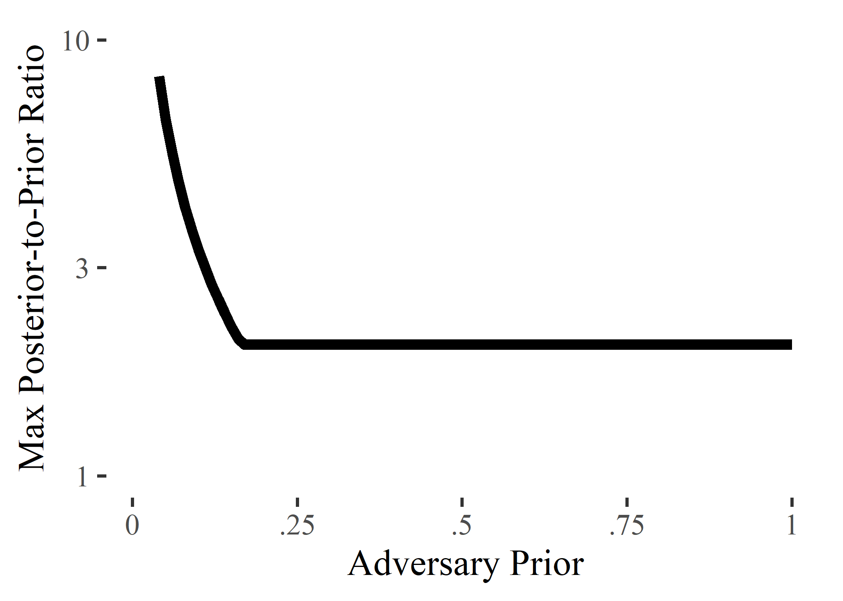
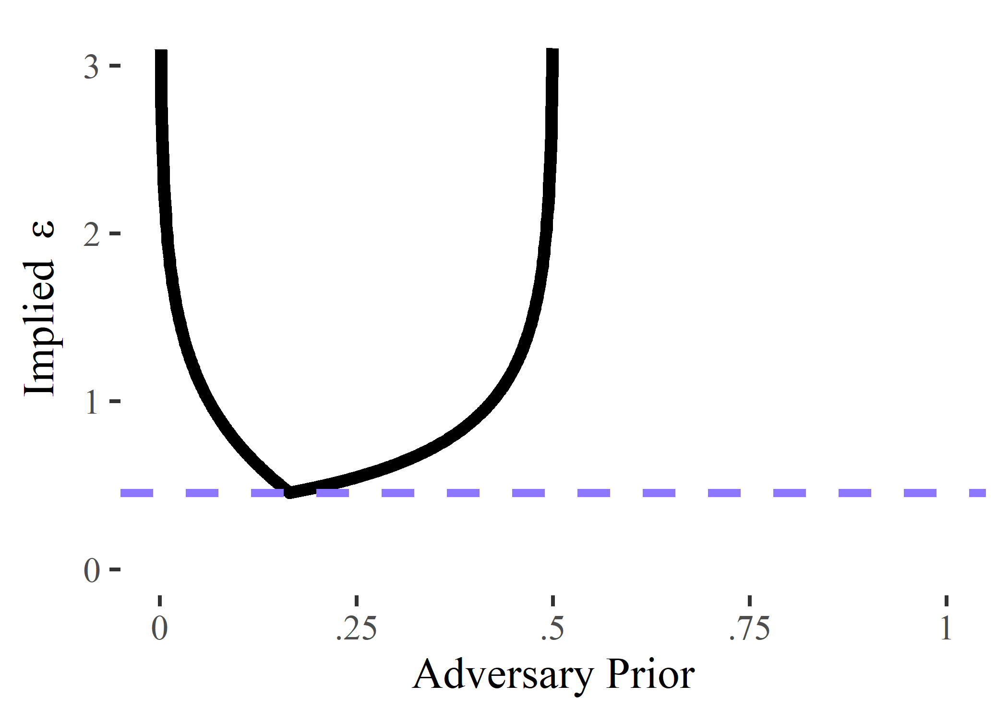
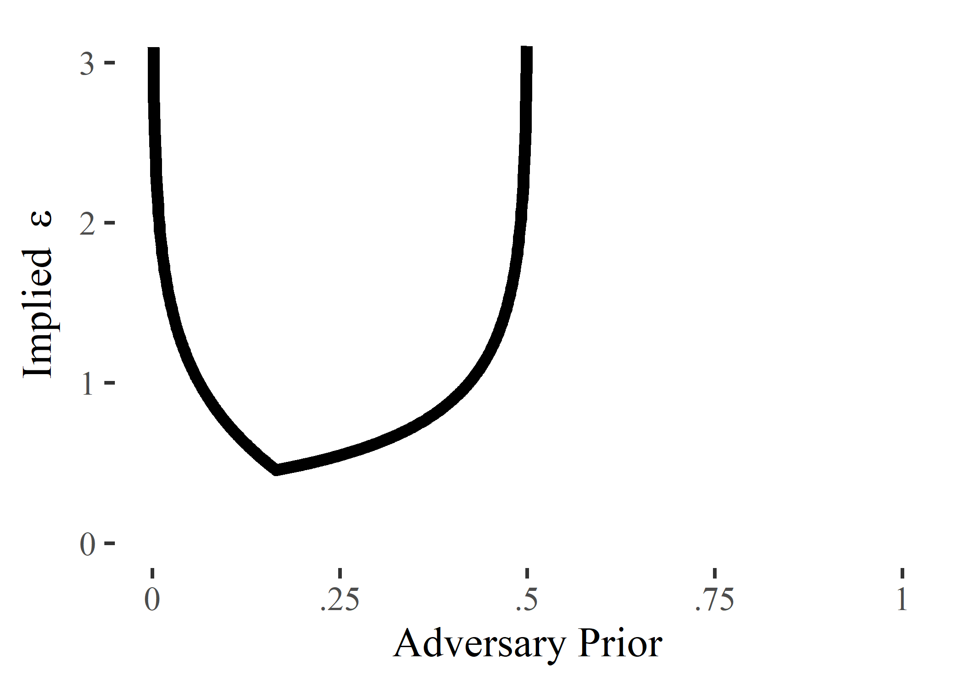
Motivating Example
Idea: For every possible adversary prior, data holder determines the maximum allowable posterior-to-prior ratio
For each prior, compute the maximal $ε$
Use the minimum $ε$ for the release
Advantages:
Allows for the use of a tighter bound
Allows ratio to be very different for very different priors

Slide 12
Outline
Motivation and Prior Work
Our Method
Examples and Practical Considerations

Slide 13
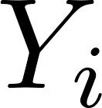
Formalization
Index | Variable 1 | V2 | V3 | …
⁞ | ⁞ | ⁞ | ⁞ | …
$$i−1$$ | * | * | * | …
$$i$$ | * | * | * | …
$$i+1$$ | * | * | * | …
⁞ | ⁞ | ⁞ | ⁞ | …
Index | Variable 1 | V2 | V3 | …
⁞ | ⁞ | ⁞ | ⁞ | …
$$i−1$$ | * | * | * | …
$$i$$ | * | * | * | …
$$i+1$$ | * | * | * | …
⁞ | ⁞ | ⁞ | ⁞ | …
Confidential Data, $Y$
represents region in which privacy violation occurs
Example: Privacy violation if exact match with true value
Example: For income data in $5,000 buckets, privacy violation if within $10,000 of true value
Index | Variable 1 | V2 | V3 | …
⁞ | ⁞ | ⁞ | ⁞ | …
$$i−1$$ | * | * | * | …
$$i+1$$ | * | * | * | …
⁞ | ⁞ | ⁞ | ⁞ | …
Adversary

Slide 14
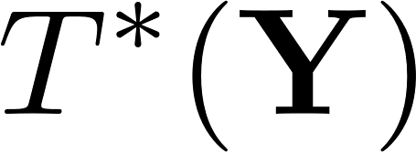
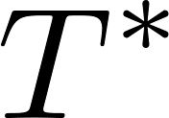
Formalization
Exact Statistic
DP Statistic
Absolute Risk: The adversary’s posterior probability
Relative Risk: The adversary’s posterior-to-prior ratio

Slide 15
Formalization
Data holder’s risk profile: For all
Assumptions
The release mechanism for $T^{∗}$ is public information
The adversary is principled
The $Y_{i}$ are independent

Slide 16
Results
Fix a specific adversary with priors $p_{i}$ and $q_{i}$
Under DP, the relative risk satisfies the bound:
The desired risk bound $r^{∗}(p_{i}, q_{i})$ is achieved for $ε$:

Slide 17
Our Recommendation
Set $ε$ to be the solution to the following minimization problem:

Slide 18
Outline
Motivation and Prior Work
Our Method
Examples and Practical Considerations

Slide 19
Example 1
Dataset consisting of individuals diagnosed with COVID-19 in a particular community
Concern: Release could reveal which individuals had COVID-19
ID | Age | Sex | Race | Blood Type | …
⁞ | ⁞ | ⁞ | ⁞ | ⁞ | …
137 | 21-30 | F | Asian | A- | …
138 | 21-30 | F | White | B+ | …
139 | 41-50 | M | Black | O- | …
⁞ | ⁞ | ⁞ | ⁞ | ⁞ | …
Geometric Mechanism
Released DP Counts

Slide 20
Example 1
Inclusion is of primary concern
Key quantity:
Less important:
Focus on adversaries such that
Suppose data holder willing to accept absolute disclosure risk of 0.25 for adversaries with low priors
A reasonable risk profile might be, for some $\tilde{r}>1$:

Slide 21
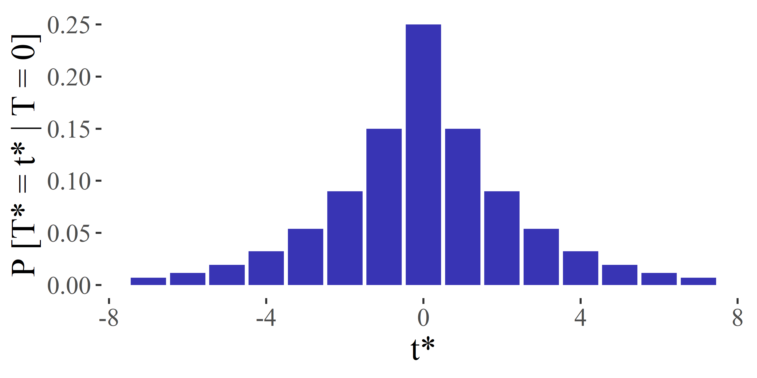
Example 1
Agency 1: $\tilde{r}=1.5$
Recommendation: $ε≈0.51$
Standard Deviation: $σ≈2.74$

Slide 22
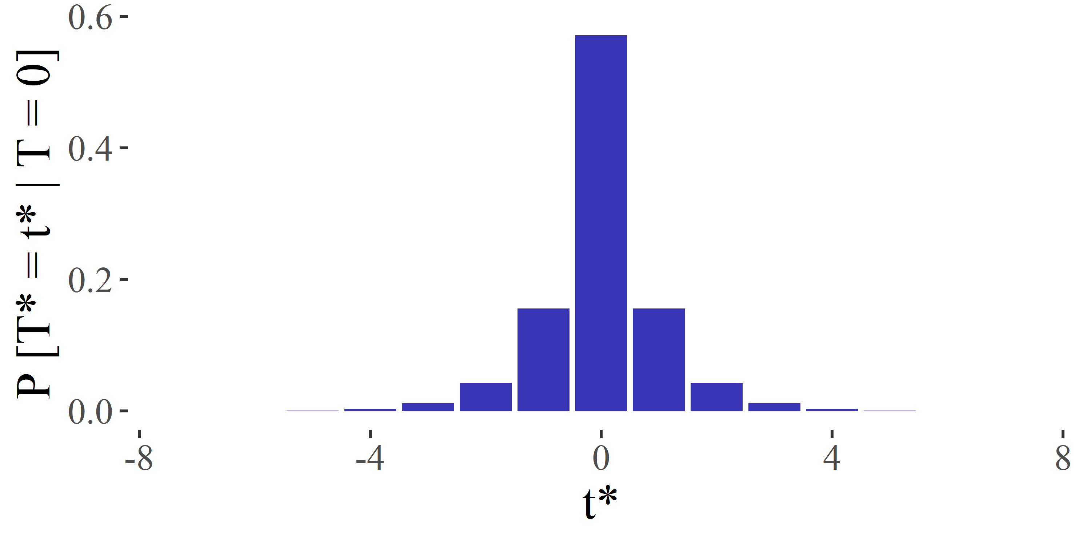
Example 1
Agency 2: $\tilde{r}=3$
Recommendation: $ε≈1.30$
Standard Deviation: $σ≈1.02$

Slide 23
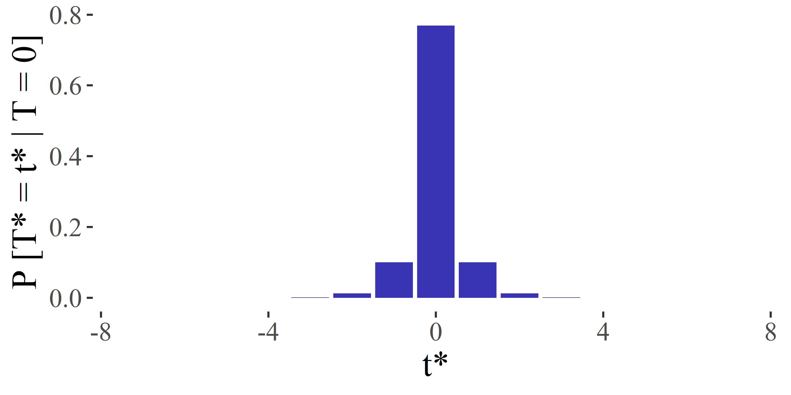
Example 1
Agency 3: $\tilde{r}=6$
Recommendation: $ε≈2.04$
Standard Deviation: $σ≈0.59$

Slide 24
Example 1
Substantial gain over naïve risk profile,
For $\tilde{r}=3$, naïve risk profile recommends $ε=\log{(3)}/2≈0.55$, while tailored risk profile recommends $ε≈1.17$
Specific case of a general risk profile

Slide 25
Example 2
Survey of individuals in a particular community
Asked whether they have had COVID-19
Concern: Release could reveal which individuals had COVID-19
ID | COVID-19 | Age | Sex | Race | Blood Type | …
⁞ | ⁞ | ⁞ | ⁞ | ⁞ | ⁞ | …
137 | 1 | 21-30 | F | Asian | A- | …
138 | 0 | 21-30 | F | White | B+ | …
139 | 0 | 41-50 | M | Black | O- | …
⁞ | ⁞ | ⁞ | ⁞ | ⁞ | ⁞ | …
Geometric Mechanism
Released DP Counts

Slide 26
Example 2
Values in data of primary concern
Key quantity:
Not important:
Suppose 5% of community surveyed
Focus on adversaries such that
Suppose data holder willing to accept relative disclosure risk of 3 for adversaries with high priors
A reasonable risk profile might be, for some $\tilde{a}<1$:
Set of individuals who have had COVID-19

Slide 27
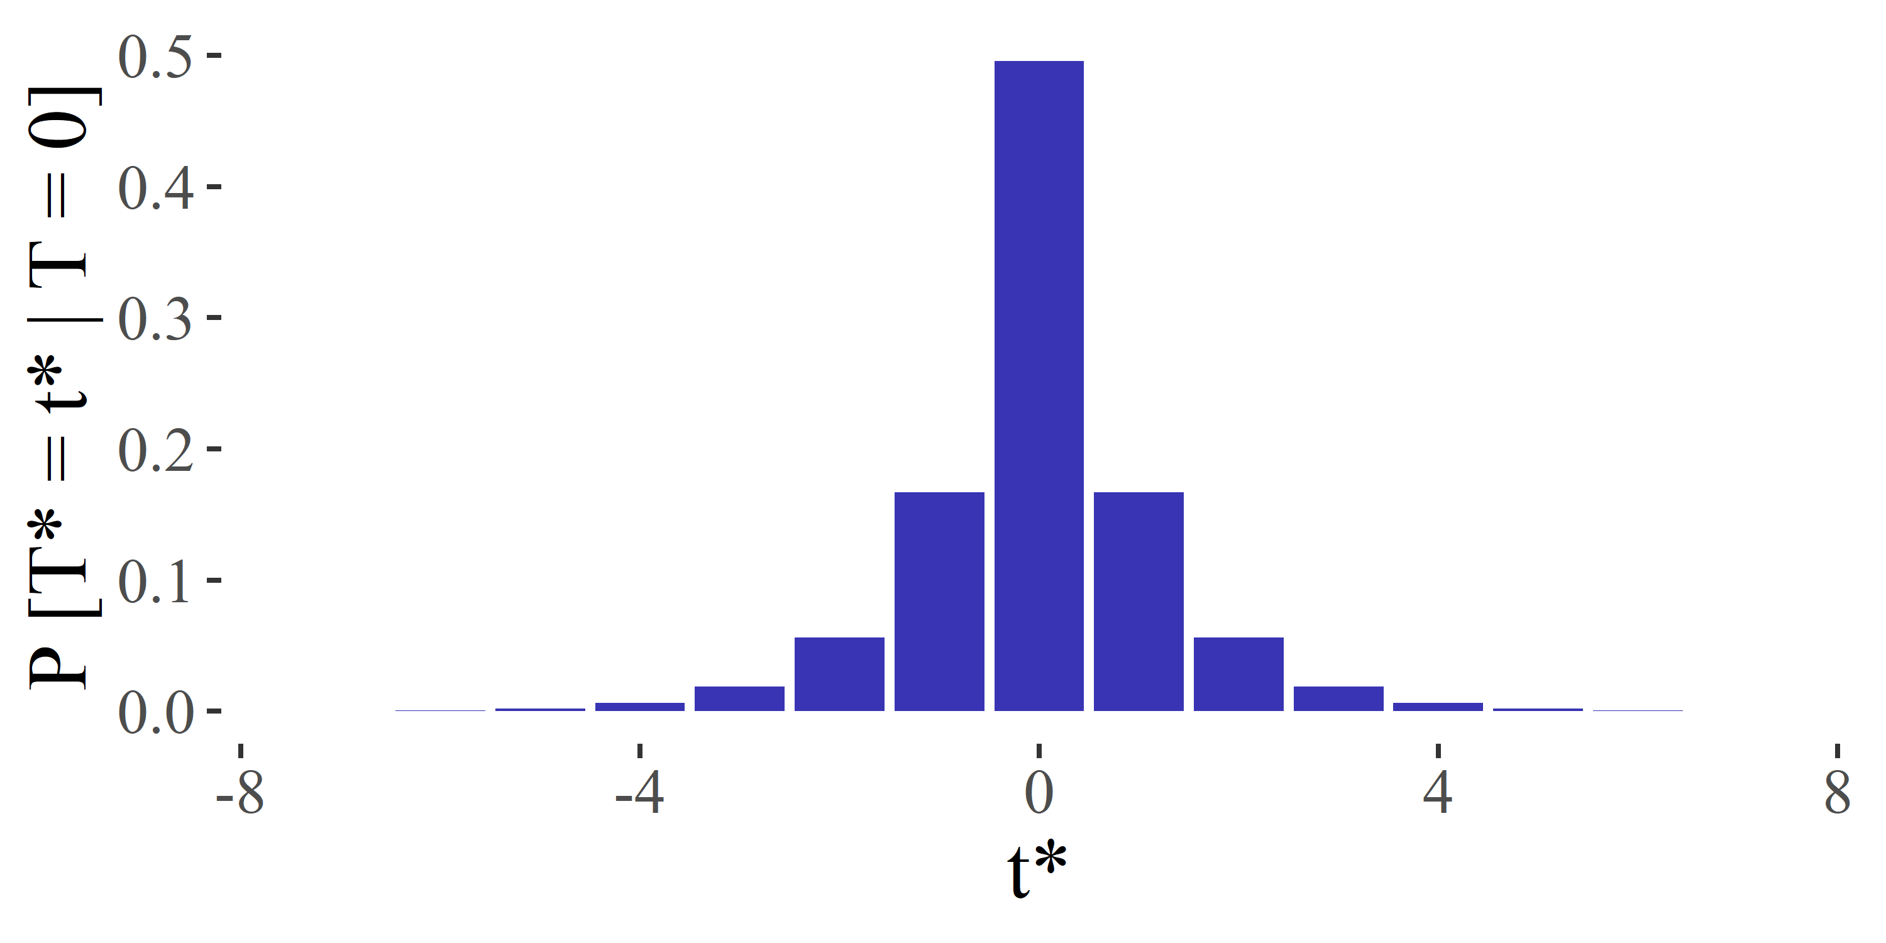
Example 2
Agency 1: $\tilde{a}=0.025$
Recommendation: $ε≈1.09$
Standard Deviation: $σ≈1.24$

Slide 28
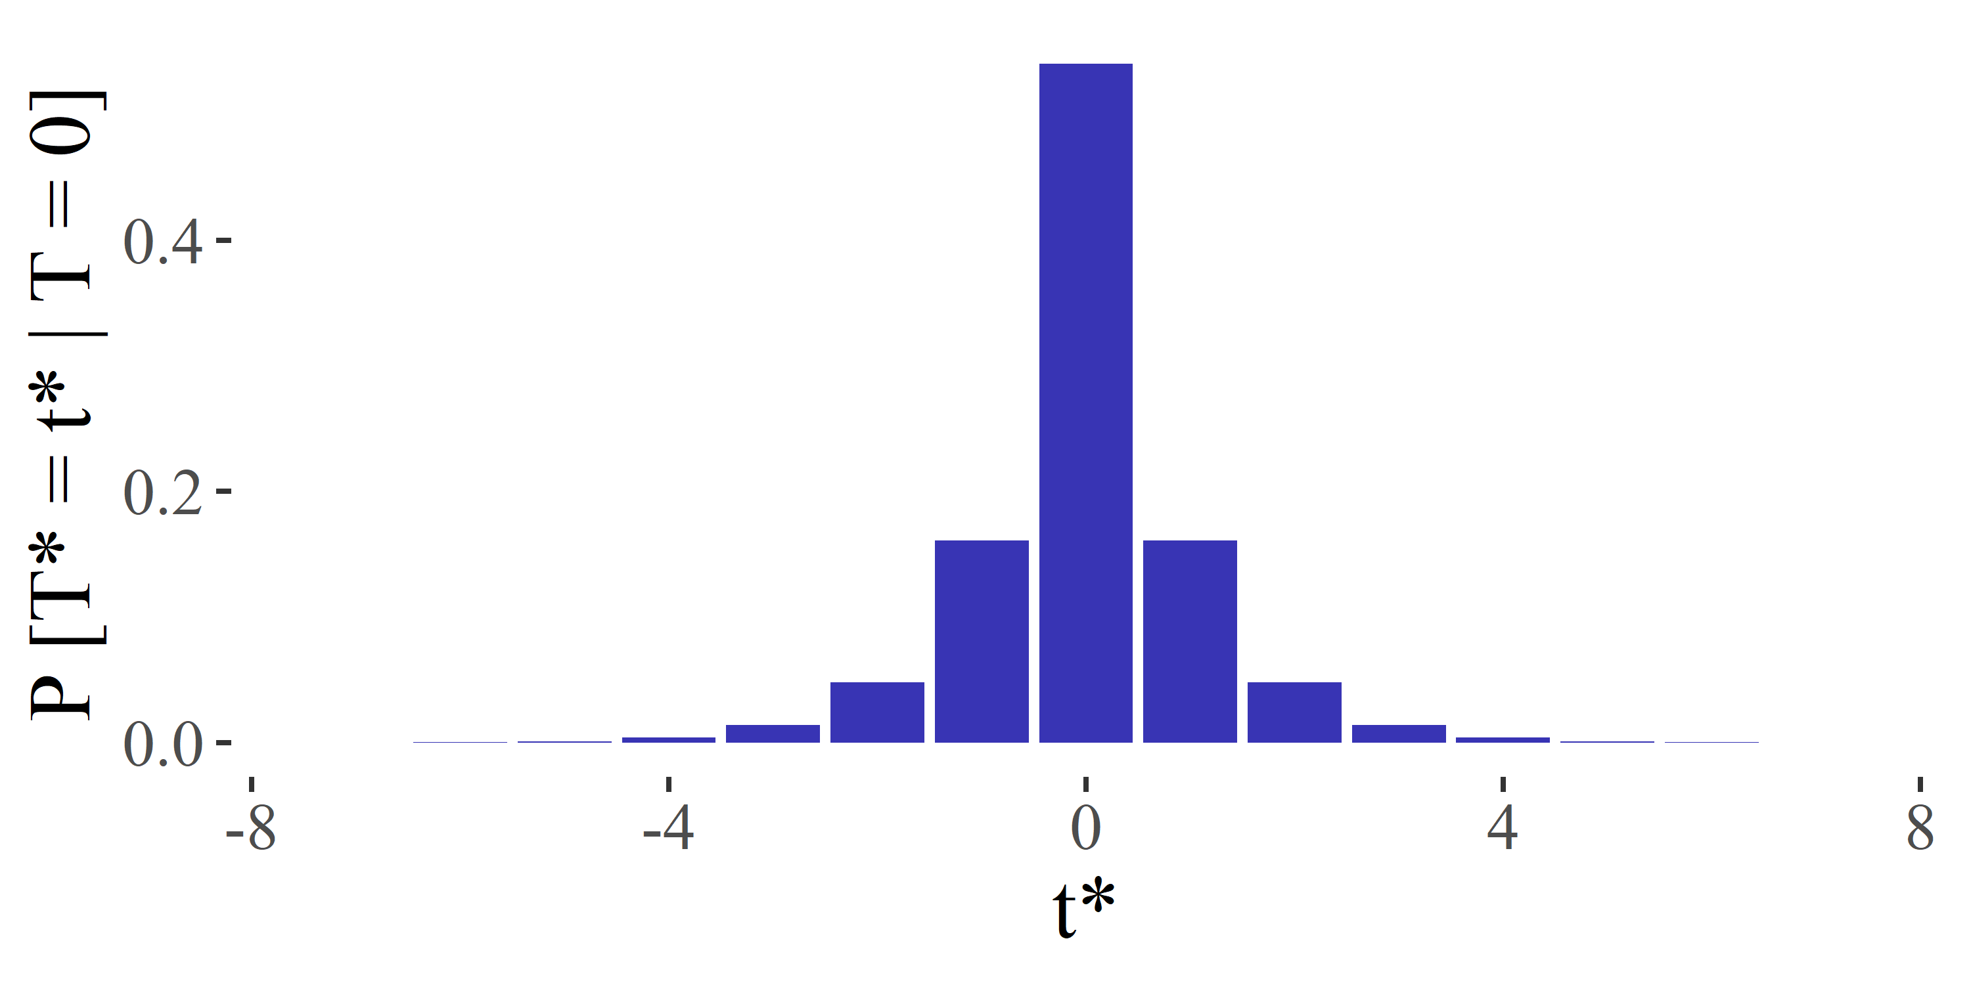
Example 2
Agency 2: $\tilde{a}=0.15$
Recommendation: $ε≈1.21$
Standard Deviation: $σ≈1.10$

Slide 29
Example 2
Agency 3: $\tilde{a}=0.3$
Recommendation: $ε≈2.10$
Standard Deviation: $σ≈0.56$

Slide 30
Example 2
Substantial gain over naïve risk profile,
Gain due to incorporating uncertainty from the sampling mechanism
Specific case of a general risk profile

Slide 31
Summary
Propose framework for setting privacy budget in DP
Relate the choice of $ε$ to more interpretable quantities
Use data holder’s disclosure risk profile
Focus on a particular class of adversaries
Prove a tighter bound on the relative risk under DP
Derive closed form for $ε$ under realistic risk profiles
Provide code implementing this framework: https://github.com/zekicankazan/choosing_dp_epsilon

Slide 32
References
Pranav Dandekar, Nadia Fawaz, and Stratis Ioannidis. Privacy auctions for recommender systems. ACM Transactions on Economics and Computation (TEAC), 2(3):1–22, 2014
Jörg Drechsler. Differential privacy for government agencies—are we there yet? Journal of the American Statistical Association, 118(541):761–773, 2023
Cynthia Dwork, Frank McSherry, Kobbi Nissim, and Adam Smith. Calibrating noise to sensitivity in private data analysis. In Theory of cryptography conference, pages 265–284. Springer, 2006.
Lisa K Fleischer and Yu-Han Lyu. Approximately optimal auctions for selling privacy when costs are correlated with data. In Proceedings of the 13th ACM conference on electronic commerce, pages 568–585, 2012
Ruobin Gong and Xiao-Li Meng. Congenial differential privacy under mandated disclosure. In Proceedings of the 2020 ACM-IMS on foundations of data science conference, pages 59–70, 2020.
Justin Hsu, Marco Gaboardi, Andreas Haeberlen, Sanjeev Khanna, Arjun Narayan, Benjamin C Pierce, and Aaron Roth. Differential privacy: An economic method for choosing epsilon. In 2014 IEEE 27th Computer Security Foundations Symposium, pages 398–410. IEEE, 2014.
Jaewoo Lee and Chris Clifton. How much is enough? choosing ε for differential privacy. In International Conference on Information Security, pages 325–340. Springer, 2011.

Slide 33
References (cont.)
Chao Li, Daniel Yang Li, Gerome Miklau, and Dan Suciu. A theory of pricing private data. ACM Transactions on Database Systems (TODS), 39(4):1–28, 2014.
Jerome P Reiter. Differential privacy and federal data releases. Annual review of statistics and its application, 6:85–101, 2019.
Jayshree Sarathy, Sophia Song, Audrey Haque, Tania Schlatter, and Salil Vadhan. Don’t look at the data! how differential privacy reconfigures the practices of data science. arXiv preprint arXiv:2302.11775, 2023.
Sources for Images
Adversary: https://www. pngitem.com/middle/JRxwJ_hacker-clipart-hd-png-download/
Person: https://www.silhouette.pics/73284/person-icon-clipart-silhouette.php
Released Data: https://www.istockphoto.com/illustrations/data-table
Thought Bubble: https://www.elearningdesigner.co.uk/freebies

