Slide 1
Wage Inequality in US Manufacturing, 1820 – 1940: New Evidence
Jeremy Atack, Robert Margo, and Paul Rhode
Conference on “Historical Inequality and Labor Markets”
National Bureau of Economic Research
April 1, 2023

Slide 2
Overview
Topic: pre-WW2 evolution of wage inequality in US manufacturing
transition from artisan shop to steam-powered factory, and from the latter to electrification
We provide new evidence showing:
(a) wage inequality across establishments follows an inverted-U from early 19th to early 20th century
(b) ↑ wage inequality within establishments through late 19th C.
(c) ↓ wage inequality across workers from ca. 1890 - 1940
(d) Mechanization plays a role in generating the inverted-U

Slide 3
Caveats
Wage inequality within manufacturing is a component of, but is NOT the same as, overall inequality. In particular …
We do NOT assess the causal impact of the American industrial revolution on overall inequality. Important but difficult general equilibrium problem – We’ll “think about that – tomorrow!”
Key new evidence pertains to production workers. In our opinion, incorporating non-production workers would reinforce the main findings.
So far, empirical analysis is OLS w/fixed effects.

Slide 4
New Evidence
Establishment wages and rise of big(ger) business
Additional analysis of sample data from 1820, 1850-80 censuses of manufacturing
Mechanization through transition to steam power
1899 Department of Labor Report, Hand and Machine Labor Study. Regression analysis at the “unit” level.
Impact of Electrification
state-level reports from Massachusetts (Annual Survey of Manufacturers), ca. 1890-1938 with annual/bi-annual data on “classified” wages, time series and industry panel linked to electricity use.
Fills gaps in the previous literature
Atack, Bateman and Margo, 2004; Goldin and Katz, 1999, 2008.

Slide 5
American Manufacturing Ascendancy and Wage Inequality, 1820 - 1900
American manufacturing “ascends” from ca. 1820 to 1900
transition from the artisan shop to the mechanized factory
Artisan shop: small, not much K, “hand labor”, limited division of labor (DOL)
Mechanized factory: bigger (much higher L), much higher K/L, use of steam power, substantial division of labor (DOL)
Hypothesis at issue here: shift from artisan shop to factory → wage inequality within manufacturing ↑
Why?
(a) mechanization + increase in establishment size → “hollowing out”
(b) DOL

Slide 6
American Manufacturing and Wage Inequality, 1820 – 1900, continued
Skill differentials in the 19th century
Williamson & Lindert (1980), Margo & Villaflor (1987), Margo (2000), Katz & Margo (2013), Autor, Goldin & Katz (2020). Current state of the art: artisan-common wage ratio is stable BUT rise in white-collar/common ratio.
Atack, Bateman, Margo (ABM), JEH (2004
Uses establishment level data from 1850 and 1880 COM. Distribution of the “establishment wage” = average wage in the establishment. Focus on 1850 and Regression analysis & decomposition of 50-10, 90-50 differentials
Key Finding in ABM: rise in establishment wage inequality comparing 1880 to 1850
Mostly due to an increase in employment of workers in below-average wage establishments, which were larger.
We extend time series back to 1920 and forward to 1919.
No direct evidence on causal factors (for example, DOL) or on wage inequality within establishments.

Slide 7
American Manufacturing and Wage Inequality, 1890 - 1940
Goldin and Katz (1998, 1999, 2009): emergence of capital-technology complementarity (electrification) & the high school movement
Wages compress within manufacturing
electrification reduces demand for low skill labor, compressing lower tail
growth in relative supply of educated labor compresses the upper tail, offsetting increased demand
Evidence: skill differentials and wage distributions for ten matched industries for two years, 1890 (COM) and mid-1930s (BLS)
Timing of change in wage distributions within period not known
No direct evidence on the impact of electrification on wage distribution

Slide 8
Our evidence and contribution, part one …
I. Census of Manufactures, 1820-1919

Slide 9
Monthly Establishment Wage Inequality: 1850-1880
Sample Screens | Full Sample | Full Sample | Full Sample | Urban & Brissenden Industries | Urban
Type | Ln (50/10) | Ln (90/50) | COEFFICIENT OF VARIATION | COEFFICIENT OF VARIATION | COEFFICIENT OF VARIATION
1850 | 0.62 | 0.50 | 0.467 {0.45} | 0.506 | 0.498
N, establishments | 5,214 | 5,214 | 5,214 | 941 | 1,291
N, workers | 43,093 | 43,093 | 43,093 | 16,145 | 19,105
1860 | 0.72 | 0.41 | 0.481 {0.46} | 0.487 | 0.468
N, establishments | 5,172 | 5,172 | 5,172 | 1,265 | 1,671
N, workers | 47,994 | 47,994 | 47,994 | 21,222 | 26,377
1870 | 0.70 | 0.58 | 0.507 {0.53} | 0.451 | 0.474
N, establishments | 3,641 | 3,641 | 3,641 | 600 | 863
N, workers | 43,467 | 43,467 | 43,467 | 13,930 | 20,518
1880 | 0.94 | 0.56 | 0.571 {0.60} | 0.544 | 0.542
N, establishments | 6,904 | 6,904 | 6,904 | 2,075 | 3,397
N, workers | 83,613 | 83,613 | 83,613 | 44,177 | 60.585
Notes:
Table 1: updates sample statistics from ABM, extends backward to 1820 and forward to 1920 (Brissenden). Rising establishment wage inequality across the nineteenth century, falls at some point after the turn of the twentieth century.
Monthly wages in 1850 and 1860 are total monthly wages divided by total labor; monthly wages in 1870 = (Annual wage bill/months of operation)/number of workers; monthly wages in 1880 = (Annual wage bill/fulltime equivalent months)/number of workers. COV: coefficient of variation of average monthly wage. {}: standard deviation of ln (average monthly wage).

Slide 10
Annual Establishment Wage in Manufacturing, 1820, 1870-1880, and 1919: Coefficient of Variation
Sample Screens | Full Sample | Northeast, 10 percent trim | Urban & Brissenden Industries | Urban
1820 |  | 0.403
N, establishments |  | 801
N, workers |  | 8,620
1870 | 0.521 | 0.406 | 0.435 | 0.470
N, establishments |  | 1,451
N, workers |  | 25,966
1880 | 0.596 | 0.516 | 0.570 | 0.563
N, establishments |  | 2,767
N, workers |  | 43,819
1919 (Brissenden) |  |  | 0.335
Notes:
Northeast, 10 percent trim: restricted to establishments in the Northeast, observations with annual establishments wages between 10th and 90th percentiles in the full distribution, among establishments reporting positive annual wage bill.

Slide 11
Takeaway
Rising establishment wage inequality across the nineteenth century based on 1820-1880 Census of Manufacturing data and
Inequality lower by 1919 when Brissenden has access to COM data so …
Inequality in establishment wage follows an inverted U but …
What about within establishments?

Slide 12
Our evidence and contribution…
II. Hand and Machine Labor Study (1899)

Slide 13
Hand and Machine Labor Study: Within-Establishment Wage Inequality
Wage inequality ACROSS establishments increased (above) with the transition to the mechanized factory BUT …
NOT the same as wage inequality across workers. We need to know what happened to WITHIN-establishment wage inequality.
Not possible with the COM.
We turn to a different source: the US Department of Labor’s 1899 Hand and Machine Labor study
Detailed data at the TASK/OPERATION level. Allows us to calculate a proxy for within establishment wage inequality.

Slide 14
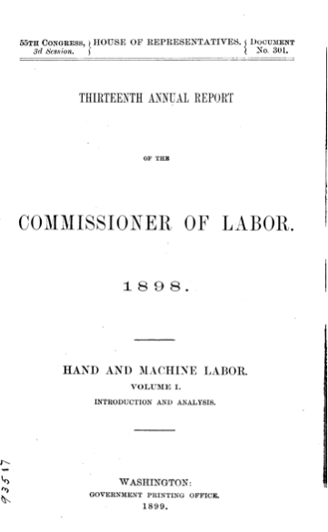
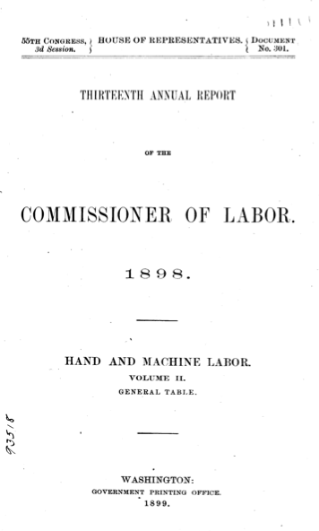
Focus of much of our current work
“The Division of Labor and Economies of Scale in Late Nineteenth Century American Manufacturing: New Evidence” (2017, unpublished)
“’Automation’ of Manufacturing in the Late Nineteenth Century: The Hand and Machine Labor Study” (Journal of Economic Perspectives, 2019)
’Mechanization Takes Command’: Powered Machinery and Production Times in Late Nineteenth-Century American Manufacturing” (Journal of Economic History, 2022)
“Digitizing Carrol D. Wright’s Hand and Machine Labor Study” (Jahrbuch für Wirtschaftsgeschichte (Economic History Yearbook), 2023)
“De-Skilling: Evidence from Late Nineteenth Century US Manufacturing” (in progress)
“The Historical Evolution of Wage Inequality in US Manufacturing: New Evidence” (for NBER-DAE conference, THIS PRESENTATION)
“Tasks, Tools, and Time Use: Evidence from Late Nineteenth Century Manufacturing (in progress)
A yet-to-be-titled monograph

Slide 15
Hand and Machine Labor Study: Structure of report
In HML study, “unit” refers to a set quantity of a very specific good. Overall, there are 626 manufactured goods, our analysis here uses approximately 500. Broad industry coverage, but not a representative sample.
For each unit, there are two full descriptions of production operations, one using “hand labor” and the other “machine labor”. Based on written records, interviews, and direct observation. Proxy for establishment.
Operations listed from start to finish. Some intermediate inputs (primarily in machine production) tracked down and data inserted.
We use operations and unit level data in this paper. Our measure of wage inequality is (time-weighted) standard deviation of ln labor cost (wage per unit of time) at the unit level.
Notes:
all manufactures, no use of inanimate power in hand production (all used inanimate power in machine production).

Slide 16
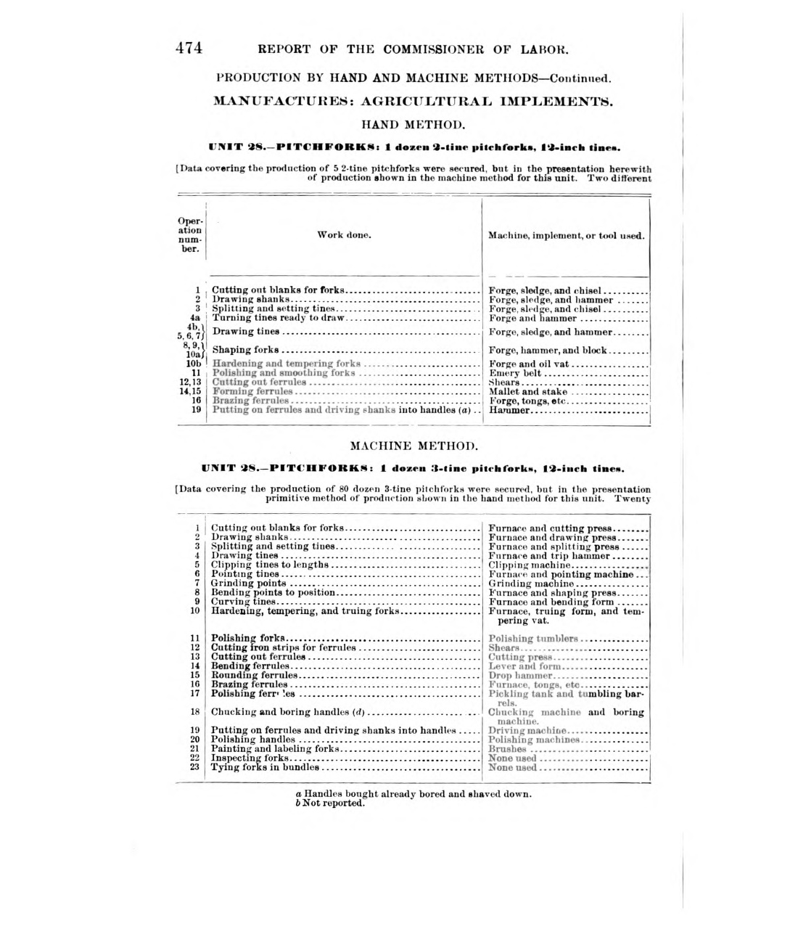
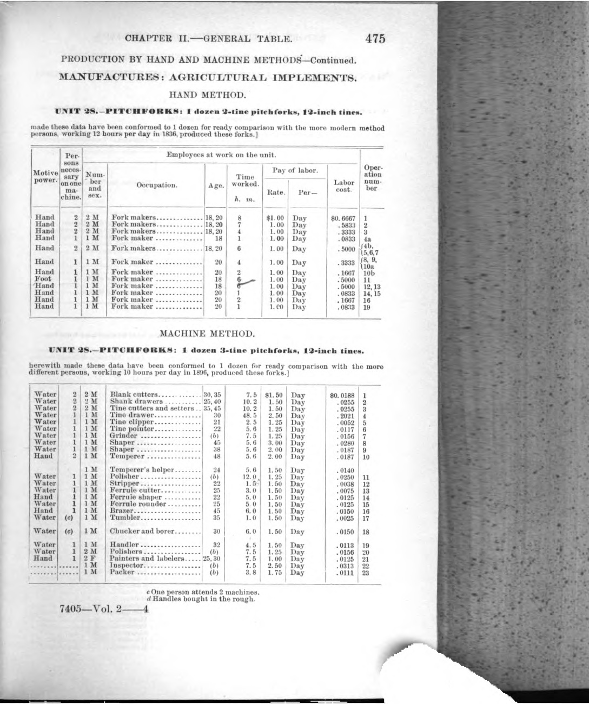
What we mean by full description…
Notes:
Note animation…

Slide 17
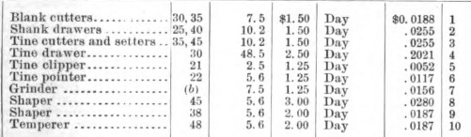
What we mean by full description…
Notes:
Note animation…

Slide 18
Hand & Machine Labor Sample Statistics
Type | Standard deviation of ln (labor cost) | Fraction of time devoted to mechanized operations | Ln (# of different workers) | Ln (# of different operations) | One Worker Unit
Hand Labor | 0.142 | 0 | 1.202 | 1.853 | 0.270
Machine Labor | 0.282 | 0.553 | 2.806 | 2.495 | 0.010
Difference, Machine – Hand | 0.140 | 0.553 | 1.604 | 0.642 | -0.260
On average, wage inequality is significantly higher under machine labor.
On average, in machine labor units relative to hand labor:
(1) more time is devoted to tasks that are mechanized
(2) there are more workers
(3) there are more tasks
(4) fewer one-worker units
Notes:
Sample here is N = 496, We restrict attention to those units in which no inanimate power was used at any point in hand labor and where inanimate power was used in machine labor (i.a. effectively the same criteria as MTC).

Slide 19
Regression & Decomposition: Std. Deviation of ln(Labor Cost)
Variable | Coefficient | Coefficient | Percent Explained | Coefficient | Percent Explained
Machine Labor = 1 | 0.140 (0.013) | -0.0400 (0.029) |  | -0.030 (0.028)
Fraction of time devoted to mechanized operations |  | 0.107 (0.043) | 42.3 | 0.086 (0.042) | 34.3
Ln (# of different workers) |  | 0.061 (0.009) | 69.8 | 0.046 (0.009) | 52.7
Ln (# of different operations) |  | 0.035 (0.020) | 16.1 | 0.036 (0.020) | 16.1
One worker unit |  |  |  | -0.100 (0.025) | 18.3
Adjusted R-2 | 0.296 | 0.448 |  | 0.474
Notes:
Mention that we will be returning to Atack, Margo, Rhode (2017) which has a protocol for exactly measuring the share of operations performed by the average worker, need the operation level data to compute this. For now, I will show a robustness check, which is basically the –ln of # of operations per worker, rounded up to the nearest integer. This is measured with error, so the coefficient will be biased towards zero, understating the importance of the DOL. Even so, DOL is still more important than mechanization.

Slide 20
Robustness Check: alternative specification
Variable | Sample Mean, Machine Labor | Sample Mean, Hand Labor | Difference | Coefficient | Percent Explained
Machine_Unit = 1 |  |  |  | 0.005 (0.028) | 3.6
Fraction of time devoted to mechanized operations | 0.553 | 0 | 0.553 | 0.116 (0.040) | 45.7
Ln (DOL) | -0.194 | -0.962 | 0.768 | 0.092 (0.011) | 50.7
Notes:
Ln (DOL) is computed as follows. For each unit we calculate the average number of operations per worker, rounding up to the nearest integer, then take the natural log of the inverse. Higher values of ln (DOL) indicate a higher degree of division of labor (on average, fewer operations per worker), and vice versa. Dependent variable is the standard deviation of ln labor cost across operations; difference in mean value between machine and hand labor = 0.140. N = 496 units.

Slide 21
Takeaway from HML study…
Greater mechanization ➔ ↑ wage inequality
Greater division of labor (more workers or a more refined task structure) ➔ ↑ wage inequality
DOL quantitatively more important than mechanization.
Substantive results are unchanged if we also control separately for one-worker units.

Slide 22
Our evidence and contribution…
III. Classified Wages in Massachusetts Manufacturing, 1890 - 1938

Slide 23
Classified Wages in Massachusetts Manufacturing, 1890 - 1938
Newly digitized tables from the Annual Survey of Manufacturing (ASM) reports by the State of Massachusetts, 1890 – 1938. Covers majority of production workers in the state.
“Classified” wages.
These are “binned” distributions of wages of individual production workers in manufacturing.
Focus here on distributions for all workers (cf. Goldin-Katz on adult males)
For two years (1905 & 1920), we have industry distributions for a balanced panel of 41 3-digit SIC level industries, matched to data on horsepower by type of energy (electric vs. non-electric).

Slide 24
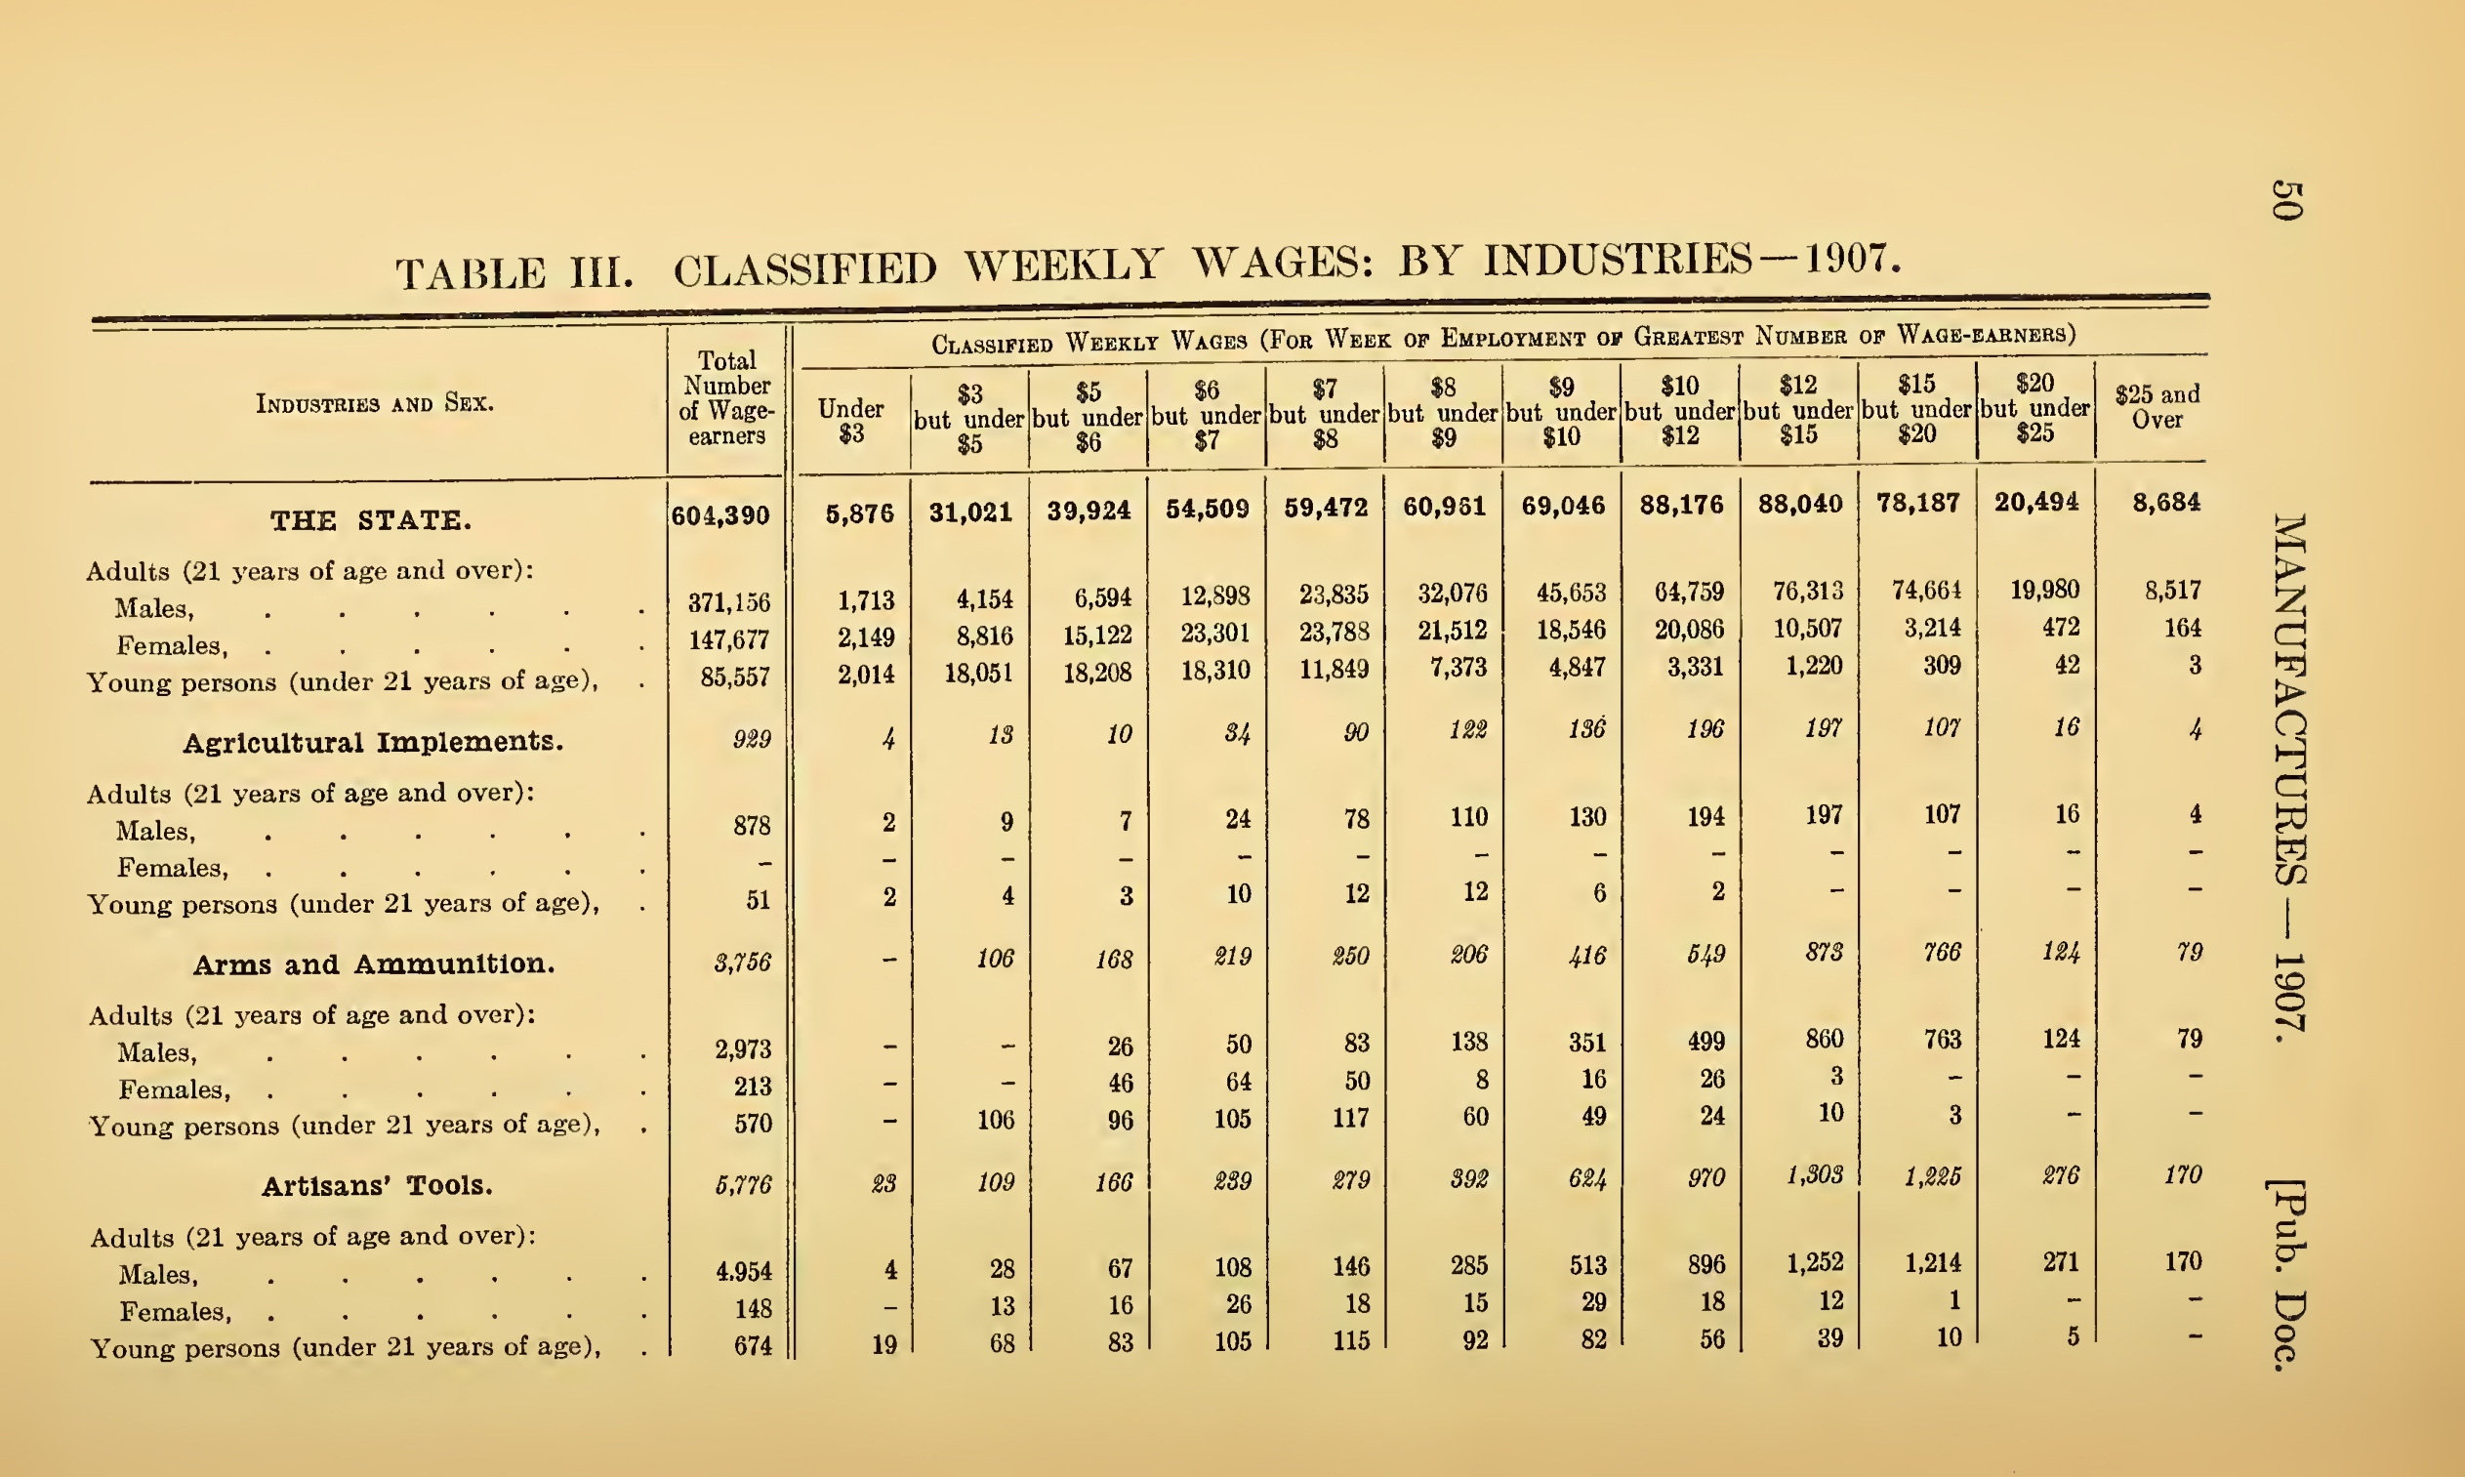
Raw data from Massachusetts ASM
Note:
Industry detail (not used here)
Two open-ended bins
Lower bounded at zero
Upper unbounded
Middle bins all closed intervals

Slide 25
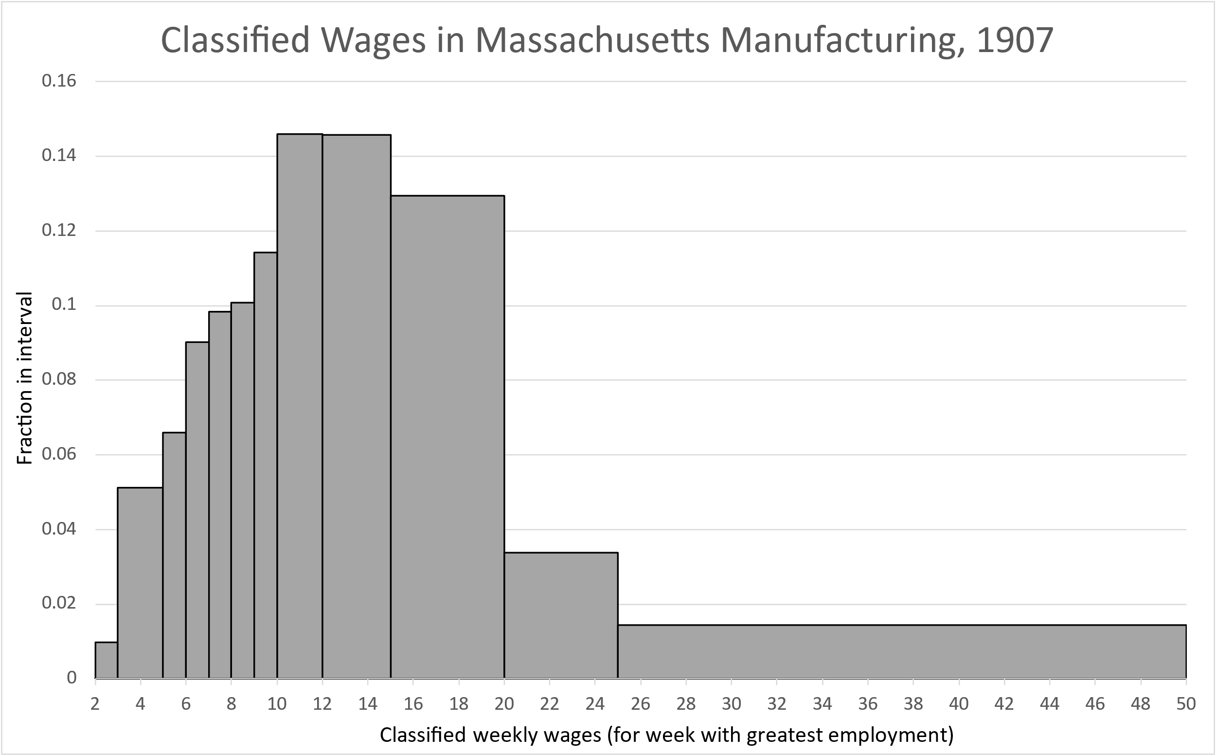
Histogram assumes the support is [$2- $50]. Bounds do not affect quantile estimates for 1907.

Slide 26
Binning and Inequality Measures
Classic problem in statistics inferring moments and quantiles from binned data.
For comparability, we follow Goldin & Katz who used a modified version of Blalock (1960).
Blalock: uniform distribution within bins, linear interpolation to estimate quantiles.
Modification: impose a support on the distribution (upper and lower bound).
Like G & K, we are conservative in imposing these bounds, probably understate inequality early in the period.
We graph the inequality statistics for 50-10 ratio, 90-50 ratio (note ordering for interpretative ease) and 75-25 ratio along with confidence intervals from non-parametric regression.

Slide 27
Figure 2: 10-50 ratio.
Steady decline after 1900, significantly lower by 1940 than ca. 1890. Total change from 1890-40 (20 index points) very similar to G&K.
Some impacts of WWI and Great Depression throughout the distribution.

Slide 28
Figure 3, 50-90 ratio.
Largely the same pattern as 10-50 ratio, although overall long-run change is smaller. Again, total change from 1890 to 1940 (around 8 index points) very similar to G &K.

Slide 29
Figure 4: 75-25 ratio.
Largely the same pattern as 90-50 ratio but with more noise beginning in 1920s. Total change (8 index points) identical to G &K.

Slide 30
Electrification in Massachusetts, 1885-1938
Notes:
steady electrification after turn of century, picks up pace in mid-1910s, starts to level off in the 1930s.

Slide 31
Panel Analysis
Time series of inequality statistics fill in gaps in Goldin & Katz (1999)
Their analysis based on 10 industries, and two data points (1890 and ca. 1940, varies by industry) but …
Insufficient observations in our electricity time series for reliable regression ➔ SO, panel approach (N = 41, two years, 3-digit SIC industries)
Dependent variable: ∆ ln (50-10 ratio)
the lower tail of the distribution compressed by electrification, according to Goldin & Katz.
Same as a) two-way fixed effects, with year = 1920 + industry, b)electric and non-electric horsepower per worker, and c) the percent male among workers.

Slide 32
Regression Analysis of Massachusetts Industry Panel, 1895 and 1920
Significant negative effect of electrification on 50-10 ratio (= explains about 80 percent of ↓) Consistent with Goldin & Katz.
Explanation: electrification eliminated many low wage jobs that were present under steam power (e.g. stoking furnace).
Variable | Sample Means | Coefficients | Coefficients | Coefficients
Elec | 1.204 | -0.127* (0.034) | -0.132* (0.036) | -0.128* (0.038)
Non-elec | -0.486 |  | -0.019 (0.032) | -0.017 (0.033)
Pctmale | -0.028 |  |  | -0.070 (0.240)
Adjusted R-2 |  | 0.242 | 0.229 | 0.210

Slide 33
Conclusion
Conventional wisdom: wage inequality in US manufacturing followed an inverted-U from the early C19 to ca. WW2 correct but significant gaps in the evidence underpinning the conventional wisdom.
We fill in two of the gaps:
Gap #1: inequality within establishments declined with the shift from hand labor to steam-powered factories. Wage inequality much higher in the mechanized factory, partly due to mechanization but also because of greater division of labor.
Gap #2: wage inequality across production workers declined steadily after the turn of the twentieth century, more at the bottom (50-10 ratio) than at the top (90-50 ratio) of the distribution.
Electrification can explain most of the decline in the 50-10 ratio.

Slide 34
Conclusion
Conventional wisdom: wage inequality in US manufacturing followed an inverted-U from the early C19 to ca. WW2 correct but significant gaps in the evidence underpinning the conventional wisdom.
We fill in two of the gaps:
Gap #1: inequality within establishments declined with the shift from hand labor to steam-powered factories. Wage inequality higher in the mechanized factory, partly due to mechanization but also because of greater division of labor.
Gap #2: wage inequality across production workers declined steadily after the turn of the twentieth century, more at the bottom (50-10 ratio) than at the top (90-50 ratio) of the distribution.
Electrification can explain most of the decline in the 50-10 ratio.

Slide 35
Conclusion
Conventional wisdom: wage inequality in US manufacturing followed an inverted-U from the early C19 to ca. WW2 correct but significant gaps in the evidence underpinning the conventional wisdom.
We fill in two of the gaps:
Gap #1: inequality within establishments declined with the shift from hand labor to steam-powered factories. Wage inequality much higher in the mechanized factory, partly due to mechanization but also because of greater division of labor.
Gap #2: wage inequality across production workers declined steadily after the turn of the twentieth century, more at the bottom (50-10 ratio) than at the top (90-50 ratio) of the distribution.
Electrification can explain most of the decline in the 50-10 ratio.

Slide 36
Conclusion
Confirm the convention wisdom: wage inequality in manufacturing followed an inverted-U from 1820 to 1940
We fill in two main gaps in the literature:
Gap #1: inequality within establishments declined with the shift from hand labor to steam-powered factories. Wage inequality much higher in the mechanized factory, partly due to mechanization but also because of greater division of labor.
Gap #2: annual/biannual data for Massachusetts manufacturing shows that wage inequality across production workers declined steadily after 1900, more at the bottom (50-10 ratio) than at the top (90-50 ratio) AND …
Electrification can explain most of the decline in the 50-10 ratio.

Slide 37
To Do:
Additional robustness checks on quantile estimates using alternative estimators for binned data.
Incorporate classified wage distributions for other states (not as extensive as Massachusetts but useful for robustness)

