Slide 1
Using Couples’ Data to Calculate the Longevity of Older Couples and Surviving Spouses
Janice Compton, University of Manitoba
Robert A. Pollak, Washington University in St. Louis, NBER, and IZA
Seth Sanders, Cornell University
January 15, 2023

Slide 2
Introduction
Part of a larger project.
Joint work with Janice Compton and Seth Sanders.
I’ll begin with an extended example to illustrate the questions we address.

Slide 3
Consider an Older Couple Approaching Retirement Age
For definiteness, suppose the wife is 60 and the husband is 62, and that both spouses are non-Hispanic whites.
The National Health Interview Survey (NHIS) reports responses from married couples and unmarried individuals and is linked to death records. We use information about each individual’s birth month and death quarter.
Using the NHIS, we estimate
Her Life Expectancy is 24.8 years -- call it 25 years
His Life Expectancy is 19.9 years – call it 20 years
Almost all estimates we report are our calculations based on the NHIS, but a few rely on CDC Life Tables. There are no CDC life tables by marital status.
Notes:
Calculations are on men and women (actual couples), Life expectancy – using Gompertz

Slide 4
Older Couples Make Decisions About
Savings
Labor supply
Retirement
Claiming social security benefits
Investments, including
annuities and
insurance (for example, long-term care insurance)

Slide 5
To Make these Decisions, Older Couples may be Concerned with
Joint Life Expectancy: the expected number of years both spouses will be alive
Survivor Life Expectancy: who will be the surviving spouse and the expected number of years she (he) will be alive as a widow (widower).

Slide 6
Intuitions - 1
Janice Compton and I first encountered these questions in a Sloan Foundation-NBER project on the retirement behavior of older women. Our initial focus was on retirement behavior, not on demography. For demography, we relied on our intuition, which was a mistake.
Recall:
Her Life Expectancy is 25 years
His Life Expectancy is 20 years
Our initial intuitions were that these individual life expectancies imply that
1. The couple’s joint life expectancy would be about 20 years.
2. The wife would be the surviving spouse.
3. After becoming a widow, she would live about 5 years.

Slide 7
Intuitions - 2
It took us a long time
* to understand why these three intuitions are wrong and
* to figure out how to calculate
joint life expectancy and
survivor life expectancy
* to realize that these calculations require couples’ data
* to understand that couple decision making and public policy often require more complex indicators of longevity than life expectancies.

Slide 8
Two General Points
This is a descriptive paper. We do not have an identification strategy for sorting out selection into marriage, assortative marriage, and the protective effects of marriage.
This paper is about cohort life expectancy, not period life expectancy. We focus on couples that, in 1986-1990 reported to the NHIS they were married, that the wife was about 60 and that the husband about 62.

Slide 9
Road Map
We first explain why these three intuitions are wrong.
We then provide estimates of joint longevity and survivor longevity based on the NHIS data.
Evidence that married people live longer.
Limitations of NHIS data:
small sample sizes
censoring.
Using “longevity matrices” to investigate the dispersion of longevity is around its mean and median.

Slide 10
Who Should Care about Joint and Survivor Longevity?
Couples making saving decisions, retirement decisions, etc.
Financial planners advising such couples.
Policy makers interested in the adequacy of retirement savings, old-age financial security, social security, and long-term care.
Economists using the standard “individual life cycle model” to study anything. The threshold question should be: “Whose life cycle?”
Demographers studying longevity. Thus far demographers haven’t shown much interest in the longevity of couples (see next two slides)

Slide 11
The Literature - 1
Neither demographers nor economists have thought much about joint and survivor life expectancy.
IRS publishes race-gender-neutral tables from which taxpayers can calculate the tax on joint life annuities
Actuaries know about this. Insurance companies need this information to price joint-life annuities. Bowers, et al. (1997), Actuarial Mathematics, published by the Society of Actuaries, explains how to make these calculation. Also see Brown and Poterba (2000 JofRisk&Ins).
Lotka, one of the great names in mathematical biology, has a 1931 article on “orphanhood,” a problem isomorphic to the joint life expectancy. Also see Noymer (2010).

Slide 12
The Literature - 2
Goldman and Lord (1983 Demography) have a very nice paper in which they estimated joint and survivor life expectancy at the time of marriage using life table data on individuals. Their paper has received much less attention than it deserves (fewer than 60 Google cites).
Compton and Pollak (2021 PLOS One) reinvented the Goldman and Lord individual life table procedure and applied it to older couples.
The Compton and Pollak estimates were based on the CDC life tables which report age-specific mortality rates for individuals, not couples.
The estimates we present today are based on the NHIS which provides data on married couples

Slide 13
Ending the Suspense: Joint Life Expectancy
Recall our focal couple (she is 60; he is 62), recall
her life expectancy is 25 years
and
his life expectancy 20 years.
We estimate that their joint life expectancy is 15.6 years – call it 15.5 years
If you thought that their joint life expectancy was about 20 years, you would be off by more than 4 years.

Slide 14
Ending the Suspense: Who Will be the Surviving Spouse?
If you thought that the wife would be the surviving spouse, you would probably be right. But the probability is not as high as you might have guessed. We estimate that
The probability that the wife will be the surviving
spouse is 64.1
This implies that
the probability that the husband will be the surviving
spouse is 35.9

Slide 15
Ending the Suspense: Survivor Life Expectancies
If you thought that the wife would live about 5 years as a widow,
you would be dramatically wrong.
If the wife is the surviving spouse,
her survivor LE lies between 12.6 and 14.5
- call it 13.5 years.
If the husband is the surviving spouse,
his survivor LE lies between 10.1 and 11.6
call it 11 years.
These longevities are much greater than our intuition suggested.
Notes:
Fraction Women Censored= .2805051
Fraction Men Censored= .12383332
These are median widow and widower survivor LE LB and UP

Slide 16
What is Driving these Results? - 0
Few people die at their life expectancies. Mortality distributions are spread out.
This does not matter to insurance companies because they care mostly about averages, but it should matter a lot to couples.
By mortality distributions, we mean the distributions of age-specific mortalities – for example, the probability that our 60 year old woman will die between her 70th and her 71st birthday.
The age-specific mortality distributions of 60 year old women and
62 year old men overlap a lot.

Slide 17

Overlapping Distributions of Age-Specific Mortality

Slide 18
What is Driving these Results? - 1
When mortality distributions of husbands and wives overlap, you cannot calculate joint or survivor life expectancies from individual life expectancies.
If you are going to base your calculations on individual (i.e., life table) data – and you shouldn’t -- you need age-specific mortality distributions (as in Goldman-Lord and Compton-Pollak).

Slide 19
What is Driving our Results? - 2
If the mortality distributions did not overlap, joint life expectancy would be the minimum of the spouses’ life expectancies.
Our results are driven almost entirely by the overlapping of the mortality distributions and the randomness of mortality.
To counteract your mistaken intuition, think about the longevity of a same sex couple in which the spouses are the same age. I call them Gertrude and Alice.

Slide 20
What is Driving our Results? - 3
Suppose Gertrude and Alice are both 60 years old.
Their mortality distributions are, of course, identical.
Hence, they have the same life expectancy (from the CDC): 25.72 years. Say 26 years
What is your intuition about their joint life expectancy? Do you expect them both to die in 26 years?
And what is your intuition about survivor life expectancy? Is it 0?
Their joint life expectancy is 19.77 years – call it 20 years
Survivor life expectancy is 12.25 years – call it 12 years.
Notes:
These numbers are from CDC. Don’t have couples in the NHIS that are same-sex (at least not enough) to calculate for couples.
May do synthetic couples for this – life tables for married women with NHIS – for the final version.

Slide 21
What is Driving our Results? - 4
Instead of being distracted by age and sex differences,
think about the first spouse to die.
(That is the point of Gertrude and Alice.)

Slide 22
Mortality Distribution for Gertrude and Alice

Slide 23
Random Longevity Matrix Showing Joint and Survivor Life Expectancies
Consider a 4 x 4 matrix, where the rows are Gertrude’s age at death in decades and the columns are Alice’s age at death in decades.
Gertrude and Alice are a ”synthetic couple” – a statistical construct. We simulate their lives according to the CDC age-specific mortality schedule.
We could produce a 40 x 40 random longevity matrix showing the probability the Gertrude and Alice would die in a particular pair of years (e.g., Gertrude age 68, Alice age 97), but the 40 x 40 matrix has too many bins to be useful.

Slide 24
Longevity Matrix Showing the Probability that Gertrude (row) and Alice (column) will Die in the i,j bin
(We used CDC age-specific mortalities to construct this Longevity Matrix.)

Slide 25
Interpretation of the Random Longevity Matrix
The interpretation of the random longevity matrix based on age-specific mortality schedules is straightforward: it shows the probability that the couple will die in various “age bins” – for example, that the Gertrude will die between 81 and 90 and that Alice will die between 71 and 80. Or, to take another example, that both Gertrude and Alice will die in their 90s – this has a probability of about .1
The generalization of the random longevity matrix to opposite sex couples where the ages of the spouses differ is straightforward.
In terms of joint and survivor life expectancy, age and sex differences are of second order importance and, hence, mostly a distraction.

Slide 27
The Data: National Health Interview Survey (NHIS)
The NHIS is an annual cross section survey of a representative sample of about 35,000 US households; one adult and one child interviewed per household.
It provides data on both married couples and unmarried individuals.
We used non-Hispanic white couples and individuals. We focused on couples in which the wife was 60 and the husband 62 (more or less), and on unmarried woman age 60 and unmarried men age 62 (more or less)
The 1986-2011 NHIS have been matched to the National Death Index (NDI) as of December 31, 2015, so that we have death dates for everyone in the survey who died by that date.

Slide 28
Definition of Marriage and Marital Status - 1
We define marriage as the marital status of 60 year of old women and
62 year old men report to NHIS.
NHIS tells us an individual’s “marital status” at the time the survey was completed: each adult falls into one of four categories:
Currently married (i.e., in 1986-1990 at ages 60/62)
Widowed (i.e., in 1986-1990 at ages 60 or 62)
Separated or divorced (i.e., in 1986-1990 at ages 60 or62)
Never married (i.e., in 1986-1990 at ages 60 or 62)
We know nothing about cohabitation.
If we had marital history, we would know her marital status before age 60 and after age 60… But we don’t.

Slide 29
Definition of Marriage and Marital Status - 2
What’s wrong with using the CDC life table?
CDC life tables pool married and unmarried individuals
On average, married men live longer than unmarried men;
On average, married women live longer than unmarried women.
The CDC life tables are period life tables; we are trying to measure cohort life expectancy.

Slide 31
The Sample Size Problem - 1
Each year the NHIS sample is about 35,000 households which is not large enough for us because we classify married couples by the age of the wife (60) AND the age of the husband (62).
We mitigate the small sample problem by expanding the age range that we consider but we maintain the 2 year age gap between spouses.
We look at woman age 59 married to men 61;
women age 60 married to men 62; and
women age 61 married to men 63.

Slide 32
The Sample Size Problem - 2
To increase sample size, we included in our working sample couples who responded to the NHIS in any of the 5 years 1986-1990. We would have preferred to restrict our attention to couples that responded in 1986.
By including couples who responded in the years 1986-1990 gives us a working sample of 493 non-Hispanic white opposite sex couples of ages 59/61, 60/62, and 61/63.

Slide 33
The Right Censoring Problem - 1
Not everyone in our working sample of 493 couples died before December 31, 2018. So we have a problem right censoring.
How incomplete is our mortality data?
Percentage of women censored: 28%
Percentage of men censored: 12%
Predicted percentage of couples censored: 3.47%
Percentage of couples censored: 3.65%

Slide 34
Three Ways to Calculate Means and Medians with Censored Data
The Gompertz Distribution
2a. Medians for Joint Longevity
2b. Bounds on Medians for Survivor Longevity
3. The 4 x 4 Longevity Matrix

Slide 35
The Gompertz Distribution - 1
Demographers have found that, for individuals over 30, age-specific mortalities follow a Gompertz Distribution.
If we assume that the age-specific mortalities follow a Gompertz Distribution, then we can extrapolate from the death data we have to individuals who were still alive (or not reported as dead) on December 31, 2018.
This is how we calculated the joint and survivor life expectancies with which I began this talk.

Slide 36
The Gompertz Distribution - 2
The Gompertz Distribution is basic demography -- see Wikipedia article on the Gompertz-Makeham model
The classic paper is: Benjamin Gompertz “On the Nature of the Function Expressive of the Law of Human Mortality and on a New Model of Determining Life Contingencies,” Phil Trans of the Royal Soc of London (1825).
If you’re wondering about “life contingencies,” Gompertz was an actuary.
In the Gompertz model, age-specific mortalities increase at a constant rate after age 30 or so. For the US population, this rate is about 9% or 10% per year. A rate of 10% implies that, for those over age 30, age specific mortality rates double about every 7.2 years.

Slide 37
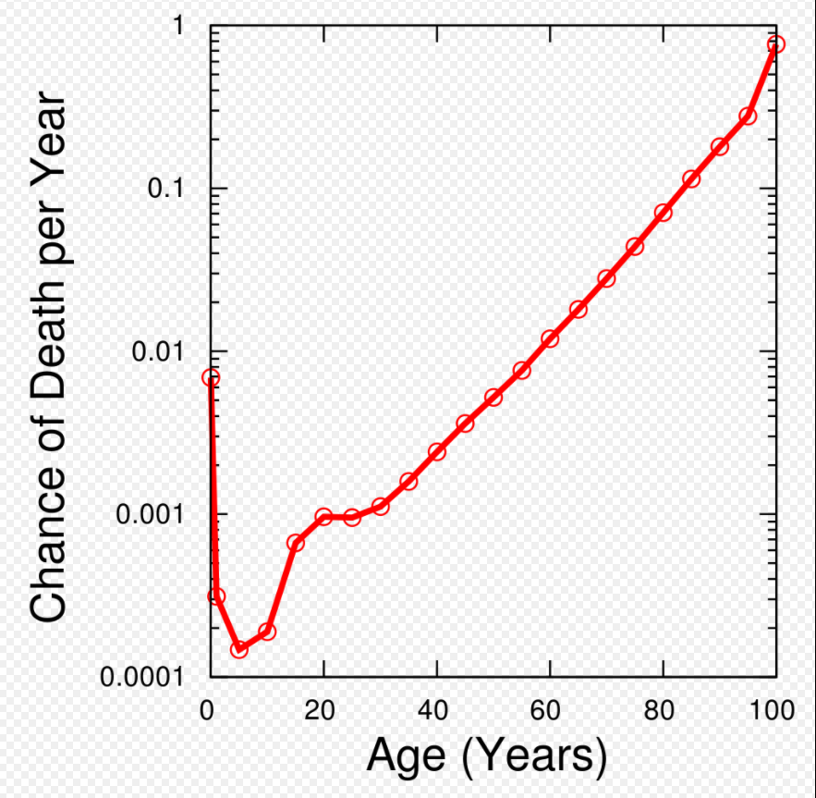
$$h\left(x\right)= ∝e^{βx}$$
$$\log{h(x)}=log∝+βx$$
Estimated probability of a person dying at each age, for the U.S. in 2003. Mortality rates increase exponentially with age after age 30.
https://en.wikipedia.org/wiki/Gompertz%E2%80%93Makeham_law_of_mortality

Slide 38
Median Longevity of Couples and Individuals
I’ll focus on the easy case and let you figure out the rest.
Suppose we had a working sample of 500 couples in which all the wives were 60 and all the husbands were 62 in 1986.
Each year we observes the some deaths and the first spouse in a couple to die determines the joint lifespan of the couple.
Under these assumptions, couple deaths arrive in ascending order – the shortest life span reports first, then the second shortest…
When we reach 250 couple deaths, we have median couple longevity.
We can calculate median longevity of men (women) this way.

Slide 39
Bounds on Median Survivor Longevity
Survivor longevity for couples in which the first spouse died in a particular year (e.g., 2010), arrive in ascending order.
Some widows who die after December 31, 2018 became widows in 1986 while others became widows in 2019.
But we want median survivor longevity over all couples – some whose spouses’ died in 1988, some in 1998, some in 2008, some in 2018…
Deaths widows whose husbands died in different years do NOT arrive in ascending order of longevity.
Although we can’t calculate medians directly from censored survivor data, we can calculate bounds on survivor longevity if we make assumptions about individual and couple mortality.

Slide 40
Random Longevity Matrices Again
The random longevity matrix for Gertrude and Alice provides information about the distribution of mortality outcomes implied by the age-specific mortality schedules used to construct them.
Specifically, it provides information about the dispersion of the distribution. For example, it shows the implied percentage of couples in which both spouses die in the first decade and the percentage of couples in which both spouses live into the last decade.
Information about the tails of the distribution is crucial for couples retirement planning and for policy makers thinking about the adequacy of retirement saving, etc.

Slide 41
Actual Longevity Matrices - 1
Because we have actual couples, we don’t need to construct a random matrix from CDC age-specific mortality schedules. We can construct a random matrix from the mortality schedules we constructed from the NHIS using the Gompertz Distribution when necessary.
We follow a different strategy. We construct an actual longevity matrix directly from the NHIS data on actual couples.
The problem is that some of the NHIS respondents were not dead by December 31, 2018, the most recent date the NHIS was linked to the NDI.
To solve this problem we defined the size of our final ”bin” so that it includes all NHIS respondents who were not dead at the time of linking.
We use three bins of 10 years and a fourth bin consisting of those who live 30 years or more from the starting date.

Slide 42
Longevity Matrix, Actual Couples
 | Husband
 |  | 0-9 | 10-19 | 21-30 | 30 or more | All
Wife | 0-9 | 0.035 | 0.030 | 0.018 | 0.016 | 0.099
 | 10-19 | 0.055 | 0.061 | 0.059 | 0.014 | 0.189
 | 21-30 | 0.059 | 0.103 | 0.134 | 0.053 | 0.349
 | 30 or more | 0.051 | 0.097 | 0.146 | 0.069 | 0.363
 | All | 0.199 | 0.292 | 0.357 | 0.152
Notes:
Actual couples
Independence assumption – can break down either because of assortative mating on longevity characteristics OR because of interaction/influence.
Difference

Slide 43
Fat Tails - 1
Fat tails is a comparative notion.
But what is the appropriate comparison?

Slide 44
Fat Tails - 2
When I put the Longevity Matrix for the Actual Couples on the same slide as the Quasi-Random Longevity Matrix, look at the (1,1) and the (4,4) elements of the matrices – the upper left hand corner and the lower right hand corner (both highlighted).
The (1,1) element (upper left) is the tail of the distribution in which both spouses die early (within the first 8 years).
The (4,4) element (lower right) is the tail of the distribution in which both spouses die late (both live 25 or more years).
Both tails are larger for actual couples than for synthetic couples, consistent with the hypothesis that healthier people marry healthier people, and less healthy people marry less healthy people.

Slide 45
Longevity Matrix, Actual Couples under Independence
 | Husband
 |  | 0-9 | 10-19 | 21-30 | 30 or more | All
Wife | 0-9 | 0.020 | 0.029 | 0.035 | 0.015 | 0.099
 | 10-19 | 0.037 | 0.055 | 0.067 | 0.029 | 0.189
 | 21-30 | 0.069 | 0.102 | 0.125 | 0.053 | 0.349
 | 30 or more | 0.072 | 0.106 | 0.130 | 0.055 | 0.363
 | All | 0.199 | 0.292 | 0.357 | 0.152
Notes:
Actual couples
Independence assumption – can break down either because of assortative mating on longevity characteristics OR because of interaction/influence.
Difference

Slide 46
Difference
 | Husband
 |  | 0-9 | 10-19 | 21-30 | 30 or more
Wife | 0-9 | 0.015 | 0.001 | -0.017 | 0.001
 | 10-19 | 0.017 | 0.006 | -0.009 | -0.014
 | 21-30 | -0.011 | 0.001 | 0.009 | 0.000
 | 30 or more | -0.021 | -0.009 | 0.016 | 0.014
Notes:
Compared to independence, actual couples are overrepresented on the diagonal, especially SAME extremes.
They are underrepresented at OPPOSITE extremes.

Slide 48
Conclusions - 1
This is a descriptive paper, not a causal paper.
This paper is about cohort longevity, not period longevity.
Few people die at their life expectancy
Why is joint longevity shorter and survivor longevity dramatically longer than intuition based on individuals’ life expectancies suggests?
Because joint (i.e., couple) longevity is about the first spouse to die and survivor longevity is about the second spouse to die.
This is the lesson of the Gertrude and Alice example.

Slide 49
Conclusions - 2
Couples’ longevity is complicated – more complicated than refocusing the discussion from individuals’ life expectancies to joint life expectancies and the life expectancies of surviving spouses.
Hence, life expectancy is not enough information for couples making retirement plans.
Age-specific mortality rates contain all the required information but are too cumbersome to work with.
No single number can capture everything relevant, but the condensed (4 x 4) longevity matrix is a useful starting point.

Slide 50
Conclusions - 3
Government should provide more accessible
information about these risks.
Formal insurance arrangements are crucial, including
Government annuities and insurance such as social security, Medicare, and Medicaid.
Private annuities and long-term care insurance.
Informal insurance arrangements – care provided by family members – are also crucial.

Slide 51
Conclusions - 4
For Demography:
Instead of focusing almost exclusively on individuals, do pairs (or triples) of individuals related by blood or marriage (sibling pairs, parents and children, grandparents and grandchildren, married couples) deserve more attention.

Slide 52
Conclusions - 5
For economics:
The standard individual life cycle model solves all problems related to couples by assuming away both the problems and the couples.
We need to ask: “Is there a version of the life cycle model that works for couples?”

Slide 53
Thank You For Your Attention

