Slide 1
IPOs and Corporate Tax Planning
Christine Dobridge | Becky Lester | Andrew Whitten
Board of Governors of the Federal Reserve | Stanford Graduate School of Business | U.S. Department of the Treasury
October 2022
The analysis and conclusions set forth are those of the authors and do not indicate concurrence by other members of the research staff or the Board of Governors of the Federal Reserve System. The findings, interpretations, and conclusions expressed in this paper are entirely those of the authors and do not necessarily reflect the views or the official positions of the U.S. Department of the Treasury. Any taxpayer data used in this research was kept in a secured Treasury or IRS data repository, and all results have been reviewed to ensure that no
confidential information is disclosed.

Slide 2
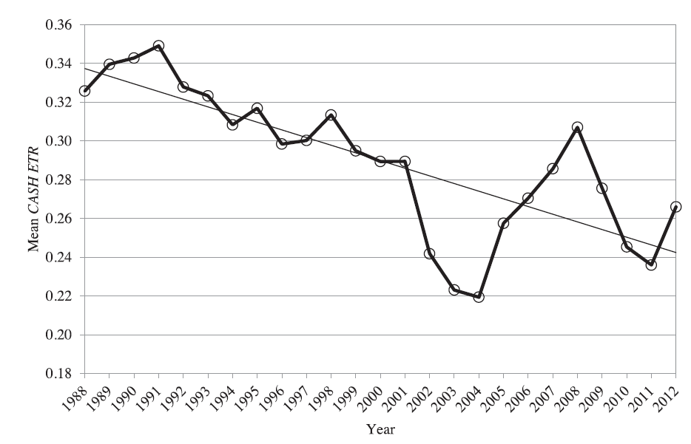
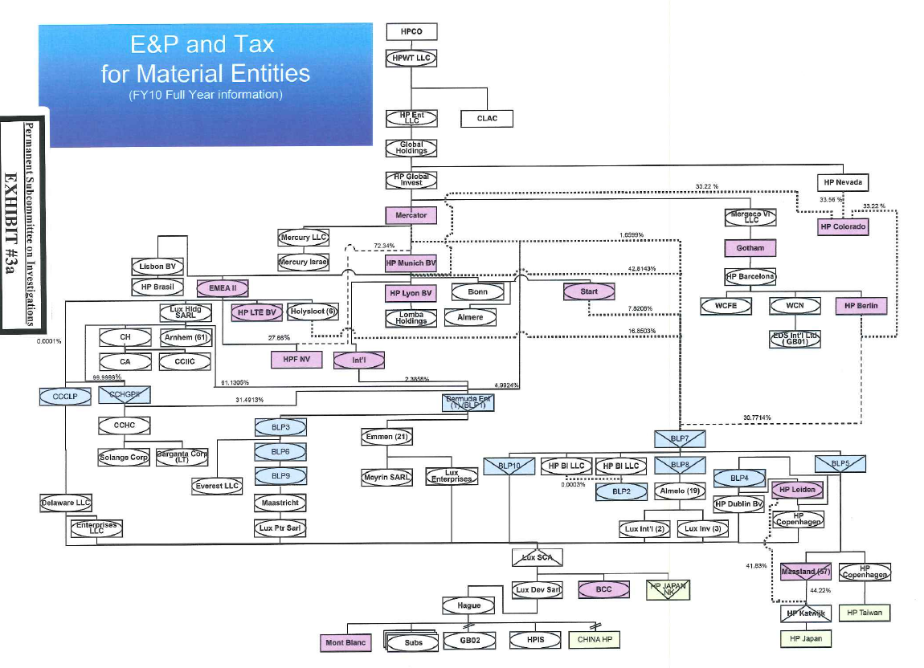
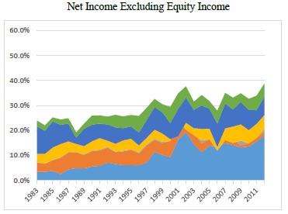
Motivation #1: Observed Tax Planning Effects
Observed Decline in Corporate Tax Payments
Complicated Foreign Tax Planning Structures
(Example of HP’s 2010 Structure)
Increased Income Reported in Tax Havens

Slide 3

Motivation #2: Minimal Evidence in Prior Literature
Tax Planning by Private Firms
(Substantial Tax Losses)
Tax Planning by Established
Public Firms
Cooper and Knittel 2006 and 2010
Cash ETRs
ETRs
Mills and Newberry 2001
MNC
Guenther & Willenborg 1999
Lin, Lin, and Robinson 2016
Firm Size
Badertscher, Katz, and Rego 2013
Industry
Repat. Costs
Financial Reporting Incentives
Allen, Allen, Raghavan, and Solomon 2018
IPO
Political Costs
UTBs
Firm Risk
Hoopes, Langetieg, Maydew, and Mullaney 2020
Pricing and Performance of Supercharged IPOs (Edwards, Hutchens, and Rego 2019)
Badertscher, Katz, Rego, and Wilson 2019
Book/Tax Trade-off
Tax Risk
Share-holder Taxes
Leverage
R&D, Capex
Cohn, Towery, and Mills 2014
Taxes and IPO Pricing: Evidence from U.S. Tax Reform
(Edwards and Hutchens 2020)
Olbert and Severin 2022
Book/Tax Conformity
FIN 48
IRS Enforce-ment

Slide 4
Overview
Research Question: What is the effect of an IPO transaction on corporate tax planning?
Empirical Approach:
  U.S. corporate tax data to study ~ 900 companies that file for IPO between 1996-2016 (n=5,683 firm-years)
  Study foreign and domestic tax planning strategies
  Compare IPO-completing firms to three control groups of companies to isolate the effect of the IPO (withdrawn IPOs, private firms, public firms)
Findings:
  Very large changes in foreign tax planning
    50% increase in incidence of tax haven subsidiary
    Likelihood of income shifting agreement doubles
    Large increases in income shifting payments
  Effects occur in firms that switch to more sophisticated tax advisor pre-IPO
  Little change in domestic tax planning

Slide 5
Why would we expect to see effects?
Capital market scrutiny
  Private firms have aligned financial reporting and tax incentives, affecting their tax strategies (Badertscher et al., 2019; Hoopes et al., 2020)
  The divergence of these incentives at the time of the IPO affects tax choices (Graham et al., 2014)
  Peer effects should motivate firms to converge to higher levels of avoidance as exhibited by public peers (Bird et al., 2018)
Valuation implications
  Discrete opportunities to implement tax-specific planning (Edwards et al., 2019)
  Certain foreign planning strategies is based on valuation of assets → Incentive to establish in anticipation of IPO, when lower/wide valuation is plausible
However, firms have substantial losses (Cooper and Knittel 2006, 2010), so possibly insensitive to tax planning.

Slide 6
IPO Completers vs. Withdrawn IPOs
  Frequency of Firms in Sample
  Equity Financing

Slide 7
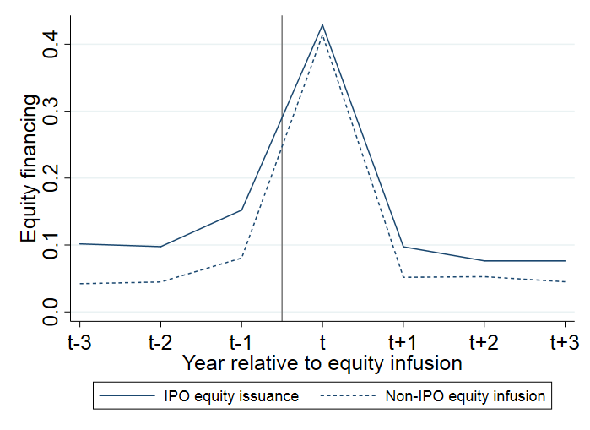
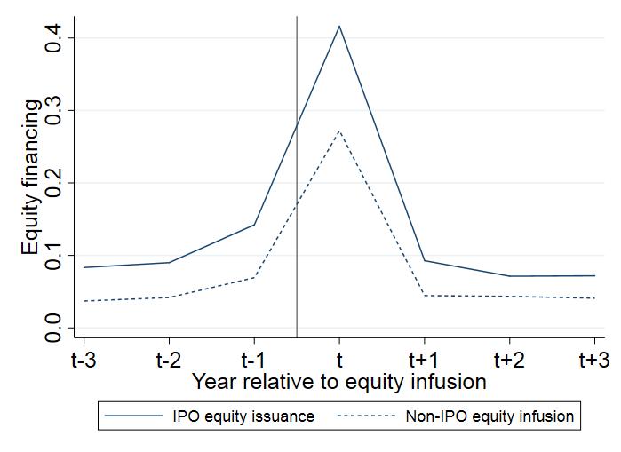
Private and Public Control Samples
  Require firms to be of similar size and also issue equity
  Completed IPOs vs. Private Firms
  (n=2,905)
  Completed IPOs vs. Public Firms
  (n=1,691)

Slide 8
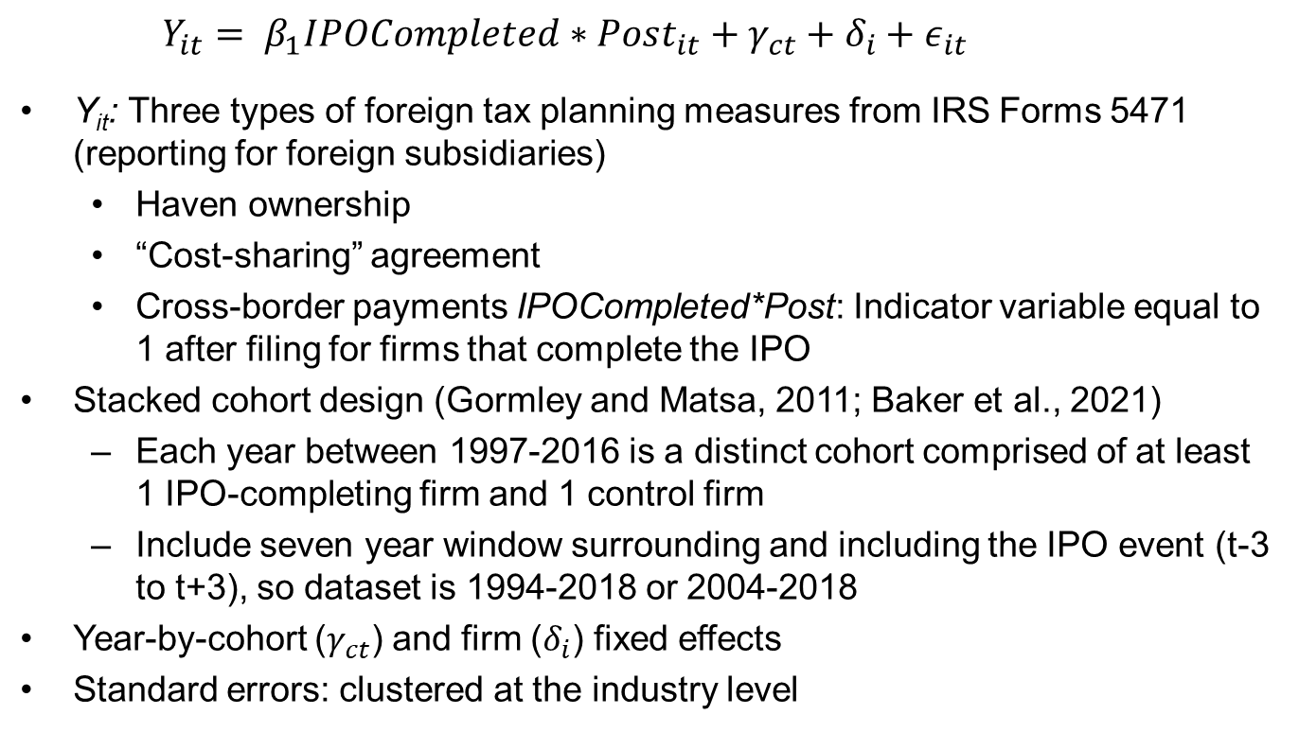
Specification
$Y_{it}= β_{1}IPOCompleted∗Post_{it}+γ_{ct}+δ_{i}+ε_{it}$
Y_{it}: Three types of foreign tax planning measures from IRS Forms 5471 (reporting for foreign subsidiaries)
  Haven ownership
  “Cost-sharing” agreement
  Cross-border payments IPOCompleted*Post: Indicator variable equal to 1 after filing for firms that complete the IPO
Stacked cohort design (Gormley and Matsa, 2011; Baker et al., 2021)
  Each year between 1997-2016 is a distinct cohort comprised of at least 1 IPO-completing firm and 1 control firm
  Include seven year window surrounding and including the IPO event (t-3 to t+3), so dataset is 1994-2018 or 2004-2018
Year-by-cohort ($γ_{ct}$) and firm ($δ_{i}$) fixed effects
Standard errors: clustered at the industry level

Slide 9
Figure 4: Tax Haven Trends (vs. Public + Private Samples)
  Pr(Owning Haven Subsidary)

Slide 10
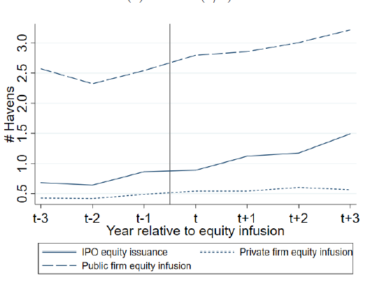
Figure 4: Tax Haven Trends (vs. Public + Private Samples)
  # Tax Haven Subsidiaries

Slide 11
Figure 5: Tax Haven Trends (vs. Withdrawn Firms)
  Pr(Owning Haven Subsidary)
  # Haven Subsidiaries

Slide 12
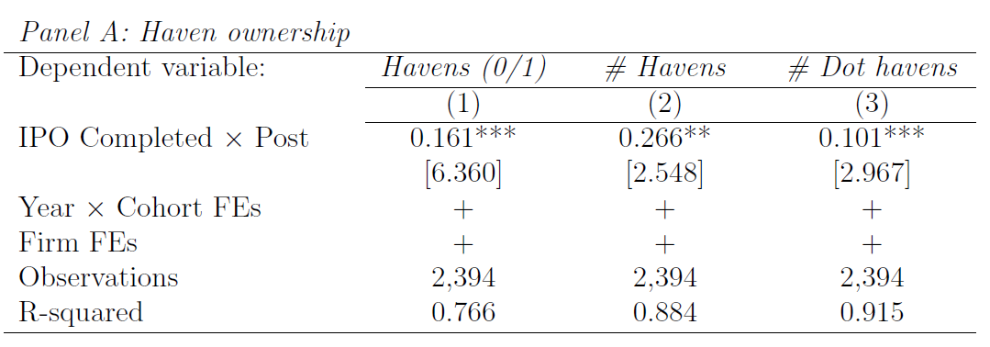
Table 5: Foreign Haven Ownership
  16.1 percentage point increase in having a foreign haven subsidiary (54% change)
  Also increase in # of havens and “small as a dot” haven subsidiary

Slide 13
Cost-sharing Agreements
  Specific income-shifting strategy
  U.S. develops IP (and deducts costs and/or claims R&D credit)
  Once viable (but before too valuable), foreign subsidiaries agree to “share in the cost” of IP
  Entitles revenue earned on IP to be sourced to (lower taxed) foreign subsidiaries
  IPO timing important because U.S. exit tax assessed at fair market value
  Example from Cisco (Drucker, 2011):
  “Beginning in 1995, the Netherlands subsidiary began paying for part of Cisco’s ongoing research in the U.S. under cost sharing agreement, according to company records. Like other U.S. technology companies, Cisco qualifies for U.S. tax benefits by doing most of its research and development domestically. By paying for some of it, the overseas unit can remove a chunk of any subsequent profits from the U.S. and claim them offshore.”

Slide 14
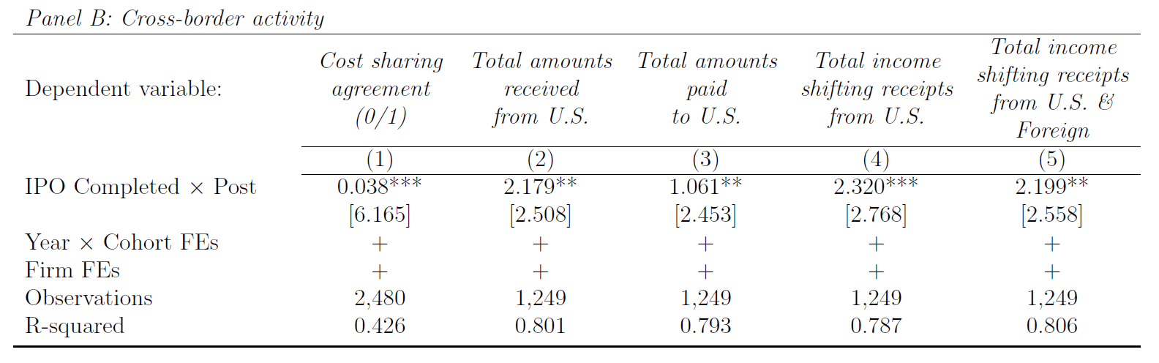
Table 5: Intercompany Payments
  3.8 percentage point increase in likelihood of being in a cost sharing agreement
  Substantial increase in payments out of U.S. (higher taxed)
  Not just firm growth
    Compare to payments into U.S.
    Increase in specific “income shifting receipts” (royalties, management fees, related party interest, license fees)

Slide 15
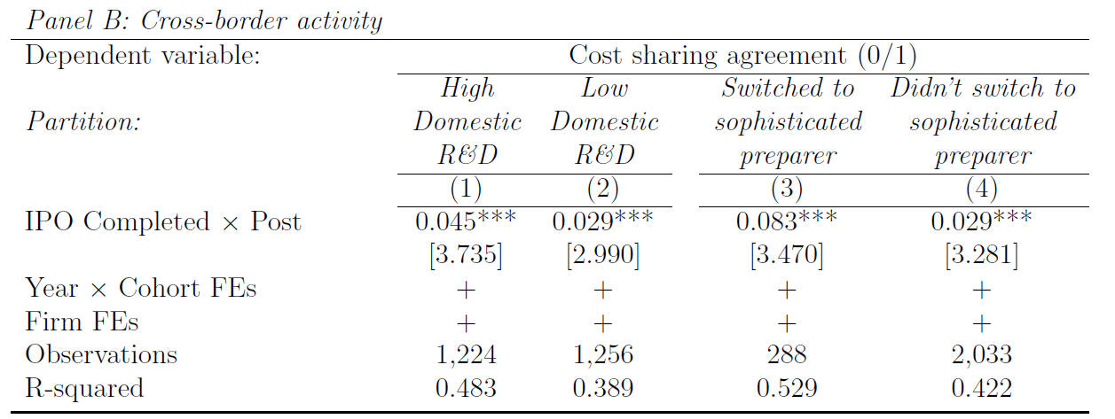
Table 6: Heterogeneity based on R&D Spending
  Effects (weakly) larger in high R&D firms
  Implication
    Firms invest domestically and obtain R&D tax credit
    Right before value of IP is known (right before IPO), shift IP offshore to facilitate future income shifting

Slide 16
Use of Sophisticated Tax Preparers
  Relative to Private and Public Firms

Slide 17
Use of Sophisticated Tax Preparers
  Relative to Withdrawn Firms

Slide 18
Table 6: Heterogeneity based on Tax Preparer
  Foreign effects greater in firms that switched advisors
  Effects also hold when examining haven use

Slide 19
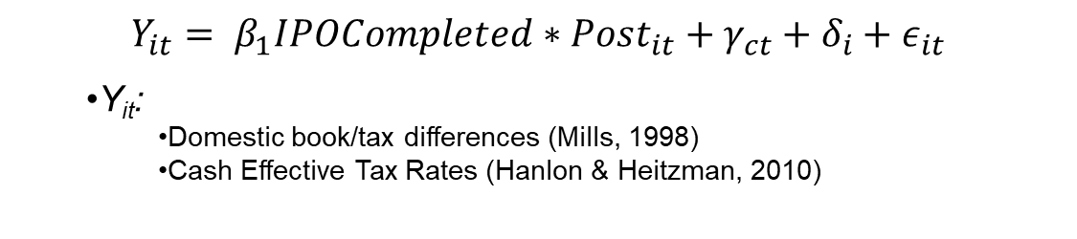
What is the effect of IPOs on domestic tax planning?
$$Y_{it}= β_{1}IPOCompleted∗Post_{it}+γ_{ct}+δ_{i}+ε_{it}$$
  Y_{it}:
    Domestic book/tax differences (Mills, 1998)
    Cash Effective Tax Rates (Hanlon & Heitzman, 2010)
  Relative to Withdrawn IPO Firms
  Relative to Private Firms
  Relative to Public Firms
    However, we then use the underlying tax data to decompose measure
    Effects driven by
      Increased stock option deductions (natural consequence of IPO)
      Higher book income from capital market scrutiny
    Conclusion: little domestic planning because stock options sufficiently shield domestic taxable income

Slide 20
Alternative Explanations
Results driven by post-IPO limitation on tax loss utilization
  Domestic measures calculated before tax losses
  Additional tests show propensity of limit to bind does not change in short window after IPO
  Should not affect foreign planning
Differences between withdrawn, private, and public samples could be correlated with tax planning and thus drive effects
  Minimize differences with inverse probability weighting for each sample
  Conduct additional analyses using instrumental variables following Bernstein (2015)
  IV: 2-month NASDAQ composite return
  For overlapping sample period, confirm valid instrument (F-stat of 18.5) and consistent (but slightly weaker second stage results (t=1.613)
  But for more recent period, instrument is weak (F-stat of 4.6)

Slide 21
Contribution
Tax literature:
  Provide new evidence about the origins of foreign tax structures
IPO literature:
  Despite large literature on IPOs, extremely little evidence on tax implications
  Improve identification strategy by comparing to other groups beyond withdrawn firms
  The literature that does exist is often based on tiny samples to study IPO pricing and compensation planning
  We examine a range of foreign outcomes and provide evidence on the factors motivating changes (i.e., advisors)
Policy-relevant evidence:
  Current major proposals target a relatively small set of very sophisticated multinationals
  We show that sophisticated foreign planning begins relatively early in a public firms’ lifecycle
  To mitigate future profit shifting (address the root cause), need targeted incentives that motivate firms to retain developed IP in the first place

Slide 22
Thank you!
rlester@stanford.edu

