Slide 2
Traditional Healthcare Value Chain
Pt. presents Treatment Treatment and
with illness Diagnosis Rec’d Resolution
(MD) (MD) (MD)

Slide 3
The “Captain of the Team”
Fuchs (1974): MD is “Captain of the Team”
Commands resources along the value chain
Captures large share of the value
Arrow (1963): MD is agent for patient
Well-informed, controls resources, suppresses self-interest
“The social obligation for best practice is part of the commodity that the physician sells”
Value chain in which physicians control medical decision making (MDM) maximizes social welfare

Slide 4
Rose-colored glasses?
Research evidence
Misaligned incentives
FFS Payments
Supplier induced demand
Medical practice variations
Substandard quality
Implication: Imperfect MDM in MD-dominated value chain

Slide 5
Value Chain with Oversight 1975-2020 (ish)
Pt. presents Treatment Treatment and
with illness Diagnosis Rec’d Resolution
(MD) (MD?) (MD)
UR
PORTS
CDS

Slide 6
History of Third-Party Interventions
Hospital peer review (1950s+)
PSROs, PROs, and Second Surgical Opinion Programs (1970s-80s)
Federal programs
Expert panels
Mandates and information
Few teeth; little impact
Utilization Review (1990s)
Private sector
Expert panels
Mandates with formal algorithms
Limited success, unlimited backlash
Transition to purely informative

Slide 7
Patient Outcome Research Teams
Federal program
Informative
Treatment Protocols
Decision trees
From initial testing to treatment decisions
Clinical Decision Support
Incorporated into Electronic Health Records
Largely informative
Pay for performance
Bonuses for following treatment protocols

Slide 8
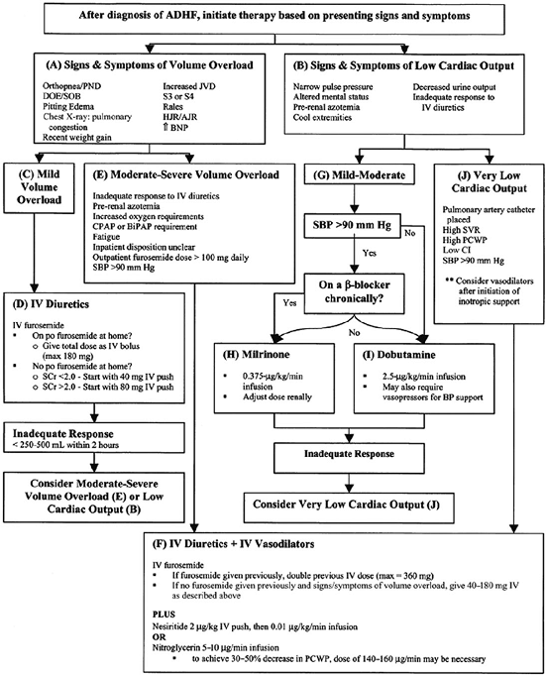
Notes:
Acute Decompensated Heart Failure

Slide 9
Inevitable Tension: Norms vs. Idiosyncrasies

Slide 10
Research identifies best practice for average patient with given observable characteristics (“norms”)
Physicians may deviate from best practice
Incentives, biases, information
But…
Physician may have private information not incorporated into decision algorithm (“idiosyncrasies”)
Do benefits of incorporating private information into medical decision making outweigh costs of misaligned incentives, etc.?

Slide 12
Economics of AI
Autor et al. (2003): Labor economics view of technology
Production requires labor and technology inputs
Mix varies by occupation and task
New technology has two effects
Displacement effect – replace labor with technology
Productivity effect – increase value of labor inputs (not necessarily the same labor inputs)
Relative importance of each effect depends on task
Routine tasks – technology can substitute for labor
Non-routine – requires tacit human knowledge – technology complements labor
AI shifts the frontier of jobs that can be automated – redefines “routine”

Slide 13
Value Chain with AI
Pt. presents Treatment Treatment and
with illness Diagnosis Rec’d Resolution
(MD?) (MD?) (MD?)
AI AI (Robots)

Slide 14
AI Influences Two Types of Medical Tasks
Diagnosis
Radiology
Pathology
Lower false negatives
AI alone may outperform AI + MD judgment
Determine what clinical data to collect
Clinical decision support
Translate diagnostic information into treatment recommendations
“Personalize” treatment recommendations – “idiosyncrasies” become “norms”

Slide 15
Most common billed tasks differ by specialty
Internal Medicine
Radiology
Service | Medicare Payment (in $M)
CT Scan | 1130
MRI Scan | 526
Mammography | 405
Ultrasound Examination | 322
X-Ray Scan | 284
Nuclear Medicine Study | 184
Digital Tomography | 176
Removal of Plaque in Arteries | 149
Bone Density Measurement | 32.3
Biopsy | 29.9
Service | Medicare Payment (in $M)
Established Patient Office\Outpatient Service | 1760
Subsequent Hospital Inpatient Care | 1300
Initial Hospital Inpatient Care | 511
Annual Wellness Visit | 458
Subsequent Nursing Facility Visit | 328
Hospital Discharge Day Management | 237
Injection of Drug | 226
Vaccine | 221
Critical Care Delivery | 135
Physician Telephone Patient Service | 107

Slide 16
Tasks don’t exactly matched billing codes
O*Net Tasks for Radiologists
Obtain patients' histories from electronic records, patient interviews, dictated reports, or by communicating with referring clinicians.
Prepare comprehensive interpretive reports of findings.
Perform or interpret the outcomes of diagnostic imaging procedures including magnetic resonance imaging (MRI), computer tomography (CT), positron emission tomography (PET), nuclear cardiology treadmill studies, mammography, or ultrasound.
Review or transmit images and information using picture archiving or communications systems.
Communicate examination results or diagnostic information to referring physicians, patients, or families.
Provide counseling to radiologic patients to explain the processes, risks, benefits, or alternative treatments.
Instruct radiologic staff in desired techniques, positions, or projections.
Confer with medical professionals regarding image-based diagnoses.
Coordinate radiological services with other medical activities.
Document the performance, interpretation, or outcomes of all procedures performed.
Establish or enforce standards for protection of patients or personnel.
Develop or monitor procedures to ensure adequate quality control of images.

Slide 17
Substitution to allied medical personnel
AI may allow allied medical personnel to perform tasks currently performed by physicians
Take patient histories
Make diagnoses
Recommend treatments
Accelerate trend towards “retail” medicine
Infrastructure is growing
CVS, Walmart

Slide 18
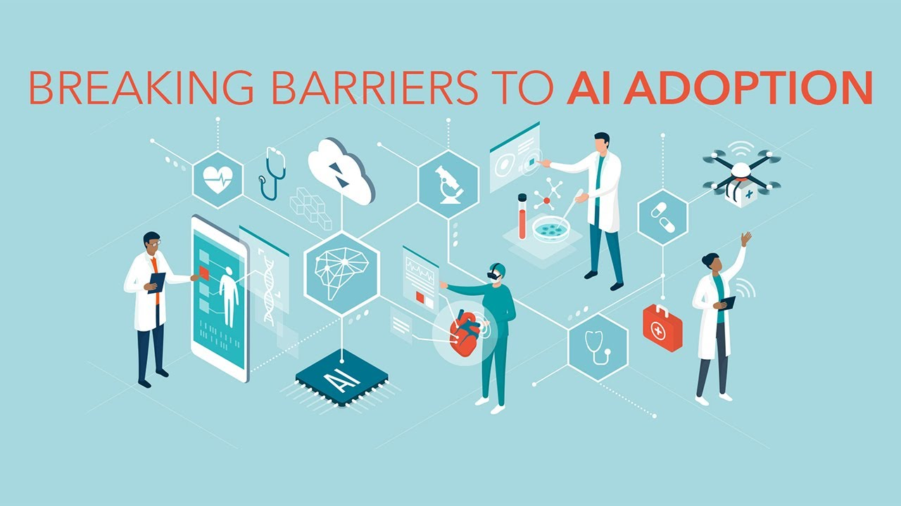

Slide 19
Three Barriers: Costs, Rules, and Resistance
Data
Largely reside in EHRs
No central repository in US
Imperfect interoperability
HIPAA constraints on sharing
Most US-centric studies use “in house” data
Implementation – administration and communication
Sticky prices
Fees paid by schedule
Procedures assigned “relative values” based on input costs
Fee per procedure = RV * multiplier
Absent “carve outs,” system will accelerate shift away from MDs

Slide 20
Resistance from organized medicine
MDs historically fight against challenges to autonomy
Physician “ethicists” insist that AI must be input into medical decision making (complement)
Resistance from patients
Managed care backlash fueled by third party limits on access to care
Suspicion that UR algorithms rigged to reduce cost, not to improve outcomes
Will automated restrictions on utilization (substitutes) lead to another backlash?
Will patient resistance weaken if AI recommends “more” treatment?
Ambiguous malpractice environment
Currently, insurers share responsibility with providers
Unclear if a purely machine-dictated system would also share responsibility
Will AI development anticipate this resistance?

Slide 21
Payment Reform and AI
Moral hazard and misaligned incentives plague medical decision making
“Solutions” include
Cost-sharing (limited effectiveness)
Rationing (politically unacceptable)
Third party oversight
Solutions create tensions between insurers and providers/patients
Payment reform may realign incentives -- providers may share in the value created by AI
Questions remain:
If AI reduces total spending, someone has to lose
What is the locus of payment reform (MD versus hospital/health system)?
Will shifting locus to hospital reduce tensions and increase political viability of AI?

Slide 22
Impact on Physicians
We are not doctors but…
Impact likely to vary by specialty and specific service
Impact will depend on other ongoing changes
Vary by specialty/service
Most published AI papers demonstrate superior diagnostic accuracy
Radiologists do not have strong relationships with patients (but may have with other MDs)
Some clinical conditions will lend themselves to straightforward clinical decision making
Ongoing changes
Payment reform could limit biases in clinical decision making
Payment reform could even encourage physician adoption (more later)
CDS as suggestions or rules?

Slide 23
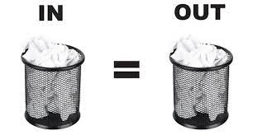

Slide 24
GIGO
Research evidence betrays Faultline in system
Nearly all studies come from individual organizations
“Personalized medicine” requires lots of personalized data on lots of persons
Will AI systems capture sufficient data?
What about idiosyncrasies?
How do we elicit from the patients the complex information needed to diagnose illness and make appropriate recommendations?
Medical profession staunchly argues that AI can never be more than a complementary input

Slide 25
Value Capture
AI development market is fragmented
Should be scale economies
EHR market is moderately concentrated
But…big names (IBM and Google) had limited success
Several dozen smaller firms
AI developers partner with provider organizations
Providers can choose their AI partner
Many health systems have large local market shares
Systems can translate AI gains into additional profits

Slide 26
Conclusion
New technologies may complement or substitute for labor inputs
Applies to AI in medical care
Prior interventions attempt to enhance (disrupt?) the value chain
Met with resistance
Mixed results
AI is the latest and most promising intervention
Many obstacles to widespread adoption
“Unique” institutional features
Siloed data, rate regulations, scope of practice regulations, etc.
Unclear who will capture the value created by AI

