Slide 1
Racial differences in access to capital for innovative firms
Robert W. Fairlie
University of California, Santa Cruz and NBER
David T. Robinson
Duke University and NBER
May 3, 2022

Slide 2
Racial Differences in Startup Financing are Important for Understanding Inequality
Racial inequality in access to financing contributes to broader inequality in business success, growth and job creation.
Large body of research points to the importance in self-employment/business ownership as a channel for wealth accumulation.
Our previous research finds large disparities between white and Black startups in the use of financial capital in the first year and follow-up years (Fairlie, Robb and Robinson 2021).
  Black-owned businesses start smaller
  They do not converge to levels of white-owned businesses
  Differential access to bank financing is a major driver of this difference
  Anticipated discrimination creates “self-screening”
    Black entrepreneurs are more likely to report fear of denial as reason they did not seek out a loan
  Areas with stronger local banks support greater small business lending, but not for black borrowers
    Reliance on “soft information” exacerbates racial differences

Slide 4
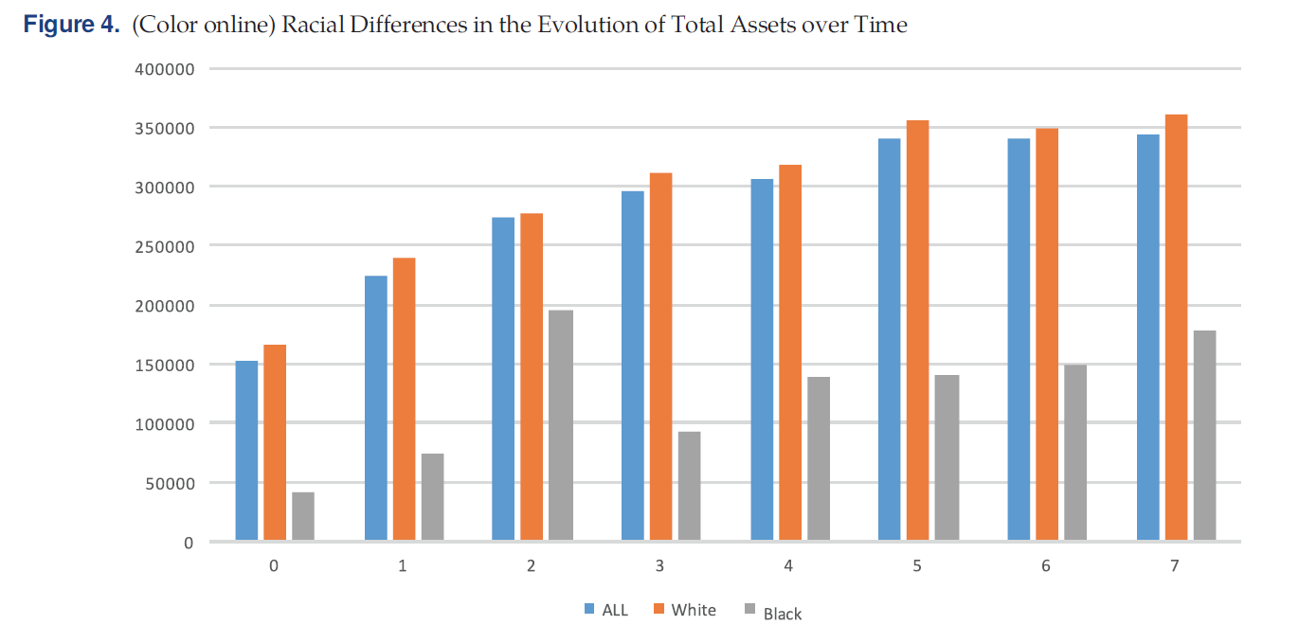

Slide 5
Do These Differences Exist for Innovative Startups?
Hypothesis 1
Hypothesis 2
Racial disparities in average financing reflects sorting into low capital-intensive, low-growth businesses
The Black/White funding gap will disappear when we look at innovative firms.
Does not imply equal representation in innovative industries, only equal treatment conditional on representation
Racial disparities in average financing reflects systemic differences:
  Perceived treatment
  Actual experience
The Black/White funding gap will persist when we focus on innovative firms.
Does not imply that simple, supply-side policy “fixes” will fix anything

Slide 6
Step 1: broader trends in innovative startups
…data from the Current Population Survey allow us to examine the extensive margin of participation in innovative startup activity by black and white founders…

Slide 14
Step 2: access to startup capital
...data from the Kauffman Firm Survey allow us to see a detailed picture of startup financing for black and white founders…we can zero in on innovative firms and industries to see if racial differences persist.

Slide 15
Empirical Strategy
The Kauffman Firm Survey (KFS) follows a sample of startups from 2004 to 2011, contains detailed information on financing amounts and sources.
  4,928 businesses founded in 2004, detailed info on demographics, business characteristics, capital access, survival.
  Restricted access version contains detailed information on credit scores, detailed location information
Robb and Robinson (2013) and Fairlie, Robb, and Robinson (2021) focused on full-sample.
Instead, let’s zero in on innovative firms:
  Innovative Industries:
    Firms operating in Manufacturing or Arts, Entertainment and Recreation.
    Larger average capital, higher rates of incorporation.
  High-growth firms:
    Incorporated businesses with intellectual property and employees
This is about ¼ of the original KFS sample

Slide 16
These Firms are Different
By focusing on high-growth firms we are focusing on firms with much larger amounts of starting capital and firms which grow dramatically over time relative to their low-growth counterparts.

Slide 17
Business Bank Debt at Founding
The difference between black and white initial bank debt is about three times larger when we focus on either innovation flag.

Slide 18
Later Borrowing Does Not Compensate
If we look at average new borrowing from 2008-2011, when surviving firms are between 4 and 7 years old, there is no evidence that black firms “catch up”

Slide 19
Black businesses stay smaller
Controlling for demographics, business characteristics, we find larger, not smaller, differences in firm size by the end of the sample period.

Slide 20
Perceived and actual differences in borrowing outcomes
Did Not Apply For Fear of Denial
Applied but Denied or Received Less than Requested
Strong and statistically significant difference
for black founders in innovative industries
Difference is statistically insignificant; outcomes vary
wildly
Black | 0.830*** | 0.986*** | 0.794***
 | (0.059) | (0.198) | (0.228)
Controls | Yes | Yes | Yes
Sample | Full | Firm | Industry
Observations | 12,979 | 1,045 | 2,239
Standard errors in parentheses
*** p<0.01, ** p<0.05, * p<0.1
Black | 0.438*** | 0.586 | 0.345
 | (0.101) | (0.366) | (0.367)
Controls | Yes | Yes | Yes
Sample | Full | Firm | Industry
Observations | 11,547 | 844 | 1,934
Standard errors in parentheses
*** p<0.01, ** p<0.05, * p<0.1

Slide 21
Conclusions
We see many fewer black-founded businesses in high innovation settings.
The black/white funding gap documented in previous work is at least as large, if not larger, in these settings.
  Differences cannot be attributed simply to selection into low capital-requirement industries or work settings
A simple, supply-side policy intervention might not fix the problem unless it changes perceptions on the demand side.
  Short-run changes in policy vs. long-run changes in beliefs

