Slide 1
Accounting for Environmental Activity: Measuring Public Environmental Expenditures and the Environmental Goods and Services Sector in the U.S.
Dennis Fixler, Julie L. Hass, Tina Highfill, Kelly Wentland, & Scott Wentland
2023 NBER-CRIW Conference
March 16, 2023
Disclaimer: The opinions are those of the authors and do not necessarily reflect the official position of the Bureau of Economics Analysis, Department of Commerce, or United States Government.

Slide 2

SEEA Central Framework and Environmental Activity
What do we do?
First SEEA-based pilot estimates of environmental activity in the U.S. economy
Comparability – internationally & domestically (consistent with the SNA)
SEEA Central Framework:
Physical flow accounts (Ch. 3)
Environmental Activity Accounts (Ch. 4)
1. Environmental protection expenditures accounts
2. Environmental goods and services sector (EGSS) accounts
3. Tax and subsidy accounts
Environmental Asset Accounts (Ch. 5)
“economic activities whose primary purpose is to reduce or eliminate pressures on the environment or to make more efficient use of natural resources” (SEEA-CF, §1.30)

Slide 3
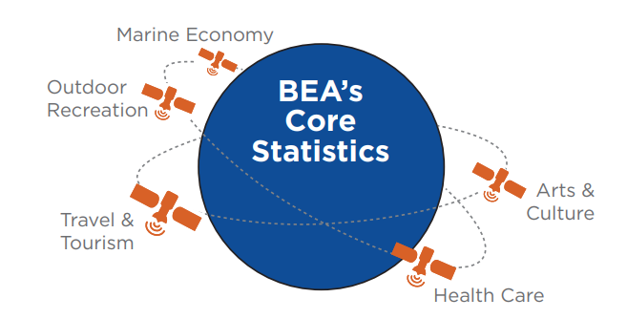
Data
BEA’s satellite account approach
Primary data source: BEA’s internal supply-use table (SUT) data
Drawn chiefly from the Economic Census and other sources
Very detailed product-level categories (5,300+ product categories)
Supplementary data sources to fill in gaps
Official sources: USDA, DOE, DOI
Private: Refinitiv firm-level ESG data

Slide 4
Classification Methodology
Determine relevant categories based on SEEA Ch. 4 definitions
Start with European Statistical System categories
Converting CPA/NACE to NAPCS/NAICS → mapping is imperfect
Use U.S. sources and prior work for clarifications on NAPCS/NAICS definition, including DOC/ESA’s “Measuring the Green Economy” appendix
Fully aligned category (100% environmental)
Partially relevant (<100%)
Out of boundary/scope
1 & 2 were then sorted into CEPA and CReMA classifications
CEPA – Classification of Environmental Protection Activities
CReMA – Classification for Resource Management Activities

Slide 5
Methodological challenges – partial categories
How relevant are partial categories?
Scenario 1: exclude them entirely
Conservative estimate of the EGSS
Scenario 2: assign a small percentage of the partial category (10%) where supplemental data is currently insufficient
Slightly less conservative, but still fairly conservative overall
If the gap between these two estimates is large, it would be evidence that partial categories are overwhelmingly important
A large gap would indicate that Scenario 1 is not really in the ballpark

Slide 6
U.S. Environmental Goods & Services Sector
Table 1a. Estimates of gross output for environmental goods and services (EGSS) (in millions $)
 |  | 2015 |  |  | 2019
CEPA/CReMA | CEPA/CReMA category | Producer Value | Margins | Purchaser Value | Producer Value | Margins | Purchaser Value
10 | Protection of ambient air and climate | $2,976 | $2,686 | $5,662 | $2,611 | $4,513 | $7,124
20 | Wastewater management | $84,384 | $1,370 | $85,754 | $95,508 | $2,192 | $97,700
30 | Waste management | $126,204 | $27,298 | $153,502 | $152,873 | $33,605 | $186,478
40 | Protection and remediation of soil, groundwater and surface water | $7,581 | $3,626 | $11,207 | $12,379 | $7,810 | $20,189
60 | Protection of biodiversity and landscapes | $79,665 | $0 | $79,665 | $93,494 | $0 | $93,494
70 | Protection against radiation | $1,765 | $484 | $2,249 | $2,950 | $981 | $3,931
90 | Other environmental protection | $6,160 | $0 | $6,160 | $6,798 | $0 | $6,798
100 | Management of water | $103,391 | $1,802 | $105,193 | $122,391 | $2,228 | $124,618
110 | Management of forest resources | $2,185 | $0 | $2,185 | $4,357 | $0 | $4,357
111 | Management of forest areas | $3,537 | $0 | $3,537 | $3,578 | $0 | $3,578
112 | Minimisation of the intake of forest resources | $339 | $0 | $339 | $368 | $0 | $368
120 | Management of wild flora and fauna | $4,072 | $0 | $4,072 | $3,378 | $0 | $3,378
131 | Production of energy from renewable sources | $53,131 | $2,323 | $55,454 | $56,824 | $3,097 | $59,920
132 | Heat/Energy saving and management | $27,077 | $41,878 | $68,955 | $30,119 | $40,190 | $70,309
Mixed | Mixed | $31,101 | $709 | $31,810 | $35,941 | $702 | $36,644
Unclassified | Unclassified | $3,910 | $898 | $4,808 | $4,711 | $928 | $5,639
 |  | $537,479 | $83,074 | $620,553 | $628,280 | $96,246 | $724,526
Note: Scenario 1 - Excluding EGS where we do not have source data to estimate the “environmental” portion of the commodity.

Slide 7
U.S. EGSS including partial categories
Table 1b. Estimates of gross output for environmental goods and services (EGSS) (in millions $)
 |  | 2015 |  |  | 2019
CEPA/CReMA | CEPA/CReMA category | Producer Value | Margins | Purchaser Value | Producer Value | Margins | Purchaser Value
10 | Protection of ambient air and climate | $2,976 | $2,686 | $5,662 | $2,611 | $4,513 | $7,124
20 | Wastewater management | $84,384 | $1,370 | $85,754 | $95,508 | $2,192 | $97,700
30 | Waste management | $126,494 | $27,390 | $153,884 | $153,281 | $33,744 | $187,025
40 | Protection and remediation of soil, groundwater and surface water | $9,771 | $3,626 | $13,397 | $14,592 | $7,810 | $22,402
60 | Protection of biodiversity and landscapes | $79,665 | $0 | $79,665 | $93,494 | $0 | $93,494
70 | Protection against radiation | $1,765 | $484 | $2,249 | $2,950 | $981 | $3,931
90 | Other environmental protection | $6,160 | $0 | $6,160 | $6,798 | $0 | $6,798
100 | Management of water | $103,391 | $1,802 | $105,193 | $122,391 | $2,228 | $124,618
110 | Management of forest resources | $4,873 | $835 | $5,708 | $6,686 | $845 | $7,531
111 | Management of forest areas | $3,537 | $0 | $3,537 | $3,578 | $0 | $3,578
112 | Minimisation of the intake of forest resources | $566 | $55 | $622 | $565 | $59 | $624
120 | Management of wild flora and fauna | $4,422 | $9 | $4,431 | $3,877 | $11 | $3,889
131 | Production of energy from renewable sources | $55,617 | $2,571 | $58,188 | $59,190 | $3,239 | $62,429
132 | Heat/Energy saving and management | $27,208 | $41,915 | $69,123 | $30,233 | $40,223 | $70,456
Mixed | Mixed | $34,411 | $1,076 | $35,487 | $39,539 | $1,044 | $40,583
Unclassified | Unclassified | $4,544 | $960 | $5,504 | $5,113 | $994 | $6,107
 |  | $549,784 | $84,779 | $634,563 | $640,407 | $97,882 | $738,288
Note: Scenario 2 - For a sensitivity analysis we use a placeholder of 10% for EGS for partial categories without source data to estimate the “environmental” portion of the commodity.

Slide 8
2019 EGSS Breakdown
From Table 1a - Scenario 1

Slide 9
2019 EGSS Breakdown
From Table 1a - Scenario 1

Slide 10
U.S. EGSS – Public vs. Private (2015)
Table 2. 2015 Environmental goods and services sector (EGSS) output by type – public sector vs. private sector output
 |  | 2015
CEPA/CReMA | CEPA/CReMA category | Government Portion of EGSS Gross Output (Producer Value) (1) | Government Portion of Margins (2) | Government Portion of EGSS Gross Output (Purchaser Value) (3) | Public Sector % of Total EGSS Gross Output (Purchaser Value) (4) | Private Sector EGSS (Purchaser Value) (5) | Private Sector % of Total EGSS Gross Output (Purchaser Value) (6)
10 | Protection of ambient air and climate | $2,098 | $267 | $2,366 | 41.8 | $3,296 | 58.2
20 | Wastewater management | $41,629 | $0 | $41,629 | 48.5 | $44,125 | 51.5
30 | Waste management | $16,834 | $0 | $16,834 | 11.0 | $136,668 | 89.0
40 | Protection and remediation of soil, groundwater and surface water | $1,607 | $0 | $1,607 | 14.3 | $9,600 | 85.7
60 | Protection of biodiversity and landscapes | $79,665 | $0 | $79,665 | 100.0 | $0 | 0.0
70 | Protection against radiation | $128 | $24 | $152 | 6.8 | $2,097 | 93.2
90 | Other environmental protection | $1,235 | $0 | $1,235 | 20.0 | $4,925 | 80.0
100 | Management of water | $18,632 | $3 | $18,635 | 17.7 | $86,558 | 82.3
110 | Management of forest resources | $2,185 | $0 | $2,185 | 100.0 | $0 | 0.0
111 | Management of forest areas | $3,537 | $0 | $3,537 | 100.0 | $0 | 0.0
112 | Minimisation of the intake of forest resources | $339 | $0 | $339 | 100.0 | $0 | 0.0
120 | Management of wild flora and fauna | $3,031 | $0 | $3,031 | 74.4 | $1,041 | 25.6
131 | Production of energy from renewable sources | $23 | $0 | $23 | 0.0 | $55,431 | 100.0
132 | Heat/Energy saving and management | $1,123 | $378 | $1,501 | 2.2 | $67,454 | 97.8
Mixed | Mixed | $2,823 | $0 | $2,823 | 8.9 | $28,987 | 91.1
Unclassified | Unclassified | $20 | $1 | $22 | 0.4 | $5,518 | 99.6
 |  | $174,908 | $674 | $175,582 | 28.3 | $445,702 | 71.7
Note: This table divides the portion of the EGSS estimates from Table 1a into public and private sector output for 2015.

Slide 11
U.S. EGSS – Public vs. Private (2019)
Table 3. 2019 Environmental goods and services sector (EGSS) output by type – public sector vs. private sector output
 |  | 2019
CEPA/CReMA | CEPA/CReMA category | Government Portion of EGSS Gross Output (Producer Value) (1) | Government Portion of Margins (2) | Government Portion of EGSS Gross Output (Purchaser Value) (3) | Public Sector % of Total EGSS Gross Output (Purchaser Value) (4) | Private Sector EGSS (Purchaser Value) (5) | Private Sector % of Total EGSS Gross Output (Purchaser Value) (6)
10 | Protection of ambient air and climate | $2,611 | $809 | $3,420 | 48.0 | $3,704 | 52.0
20 | Wastewater management | $43,790 | $0 | $43,790 | 44.8 | $53,910 | 55.2
30 | Waste management | $15,642 | $0 | $15,642 | 8.4 | $170,836 | 91.6
40 | Protection and remediation of soil, groundwater and surface water | $2,351 | $0 | $2,351 | 11.6 | $17,838 | 88.4
60 | Protection of biodiversity and landscapes | $93,494 | $0 | $93,494 | 100.0 | $0 | 0.0
70 | Protection against radiation | $65 | $14 | $79 | 2.0 | $3,852 | 98.0
90 | Other environmental protection | $788 | $0 | $788 | 11.6 | $6,010 | 88.4
100 | Management of water | $22,480 | $2 | $22,482 | 18.0 | $102,136 | 82.0
110 | Management of forest resources | $4,357 | $0 | $4,357 | 100.0 | $0 | 0.0
111 | Management of forest areas | $3,578 | $0 | $3,578 | 100.0 | $0 | 0.0
112 | Minimisation of the intake of forest resources | $368 | $0 | $368 | 100.0 | $0 | 0.0
120 | Management of wild flora and fauna | $3,177 | $0 | $3,177 | 94.0 | $201 | 6.0
131 | Production of energy from renewable sources | $21 | $0 | $21 | 0.0 | $59,899 | 100.0
132 | Heat/Energy saving and management | $469 | $139 | $608 | 0.9 | $69,701 | 99.1
Mixed | Mixed | $2,763 | $0 | $2,763 | 7.5 | $33,881 | 92.5
Unclassified | Unclassified | $104 | $11 | $115 | 1.8 | $6,366 | 98.2
 |  | $196,056 | $976 | $197,032 | 27.2 | $528,336 | 72.8
Note: This table divides the portion of the EGSS estimates from Table 1a into public and private sector output for 2019.

Slide 12
EGSS – Private vs. Public Sector Output
From Table 2
From Table 3

Slide 13
Public vs. Private Sector (from Table 3 – 2019)

Slide 14
Takeaways
EGSS gross output was $725 billion in 2019
About 1.9% of the total gross output of the US economy
Public/Government sector is about 27-28% of the EGSS
$738 billion when a portion of the partial categories are included
Not a particularly large gap between scenarios
What’s quantitatively most important in the U.S.?
Waste management, wastewater management, water management

Slide 15
Some Lessons and Data Gaps
Imperfect mapping of NAPCS/NAICS to “environmental” definition in SEEA
Revision cycle to NAPCS/NAICS could incorporate better alignment with SEEA environmental product/industry categories
Imperfect alignment with NAPCS/NAICS and CPA/NACE
European CReMA excludes marine and mineral resource management even though they are part of the SEEA-CF Classification of Environmental Activities
Better data & methods required for estimating proportion of partial categories considered to be “environmental”

Slide 16
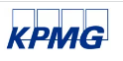
Can firm-level ESG data fill some of the data gaps?
Recently, agencies like the BEA and US Census Bureau are incorporating “Big Data” and other administrative data already collected as supplements to traditional surveys (Abraham, Jarmin, Moyer, and Shapiro 2019).
e.g., retailer point-of-sale data vs. Monthly and Annual Retail Trade Surveys (Hutchinson 2019); health care insurance claims (Dunn et al. 2019)
A 2020 KPMG reports that 96 (80) of the largest (large and mid-cap) firms report publicly on sustainability (e.g., ESG reports, which may include environmental R&D, environmental costs & revenues, environmental fines/taxes)
Consistent with findings in Boffo and Patalono (2020)
Is there information on relevant monetized environmental expenditures, costs, or revenues in ESG data that could prevent (or moderate) the need for additional survey data for NSOs?

Slide 17
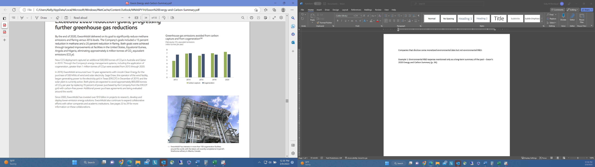
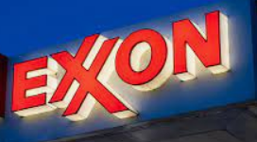
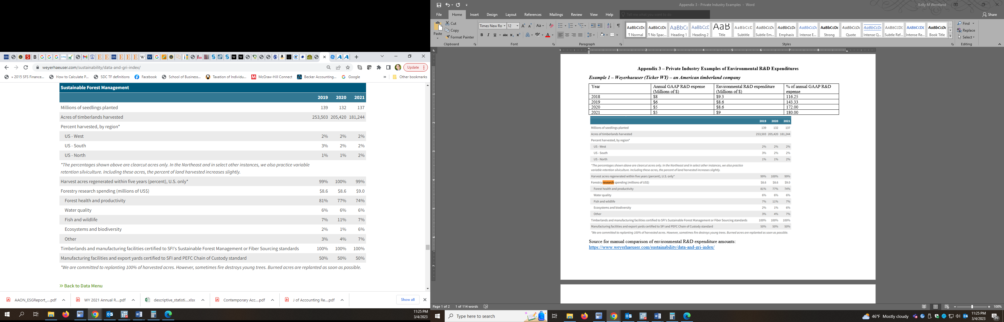
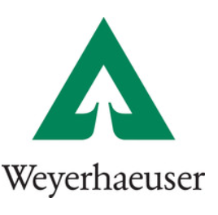
Firm ESG and climate-related disclosures
Roughly 31% of US public firms (benchmarked with US firms in Compustat North America) report publicly on environmental activity and have activity captured by Refinitiv
Coverage of annual, monetized values is infrequent
Of the 31%, only 0.3% of those US firms in Refinitiv report environmental R&D
other monetized values are also infrequent
3.5% for environmental fines
4.5% for environmental expenditures

Slide 18

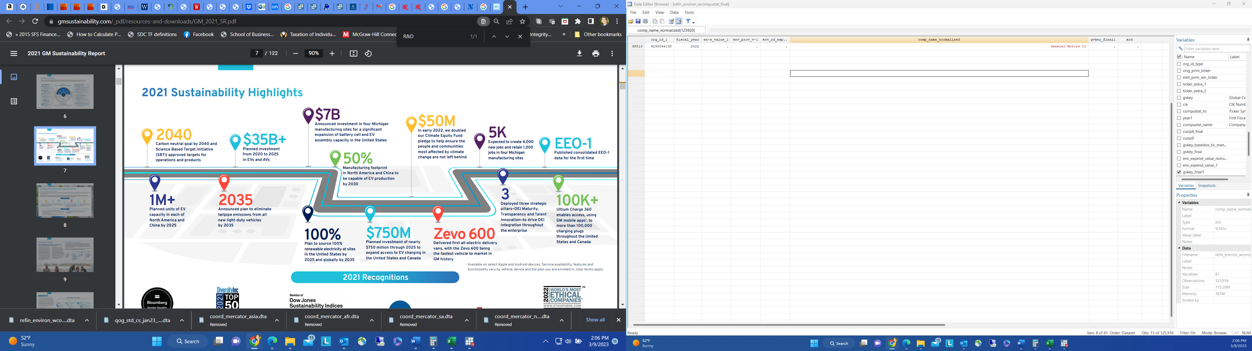
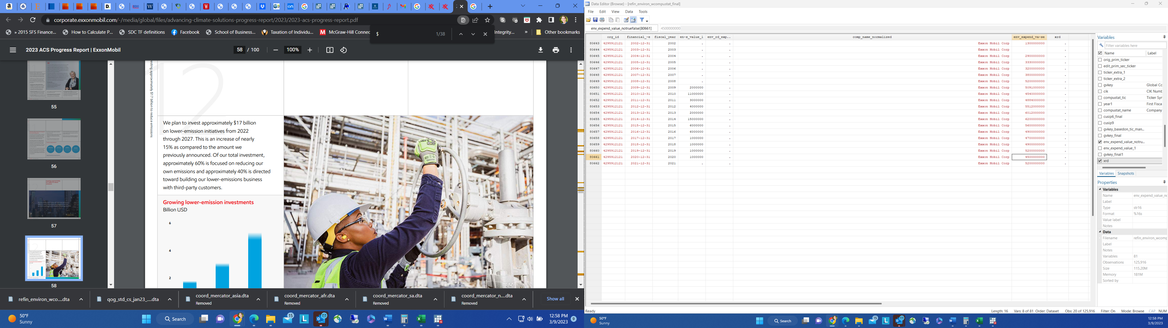
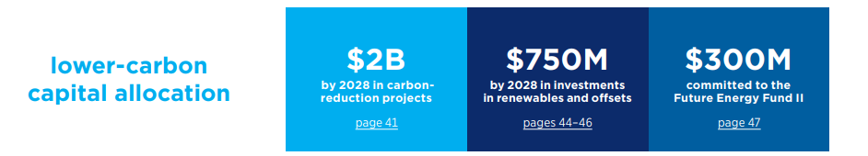
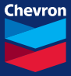
Firm ESG and climate-related disclosures
One reason coverage of monetized values may be low is that reports sometimes use long-horizons or projected future expenditures (not current, annual values)

Slide 19
Thank You!
Additional questions/comments?
Dennis Fixler
Dennis.Fixler@bea.gov
Julie L. Hass
JLHASS@gmail.com
Tina Highfill
Tina.Highfill@bea.gov
Kelly Wentland
kwentlan@gmu.edu
Scott Wentland
Scott.Wentland@bea.gov

Slide 20
What do we find with Refinitiv global data?
US coverage (in blue) represent a relatively large portion of the data relative to the 106 countries globally as well as other OECD countries (Appendix 2 – Panel C)

Slide 21
What do we find with Refinitiv global data?
For those US firms with data – what is environmental R&D as a % of annual GAAP R&D expense?
 | N | 1% | 5% | 10% | 25% | 50% | 75% | 90% | 95% | 99% | Mean
All | 105 | 0.04 | 0.50 | 13.62 | 23.51 | 50.39 | 100.00 | 109.25 | 172.00 | 250.00 | 64.94
If >100% | 13 (12%) | 100.03 | 100.03 | 101.38 | 116.25 | 157.50 | 191.30 | 250.00 | 283.95 | 283.95 | 165.48
if =100% | 14 (13%) | 100.00 | 100.00 | 100.00 | 100.00 | 100.00 | 100.00 | 100.00 | 100.00 | 100.00 | 100.00
if <100% | 78 (74%) | 0.03 | 0.49 | 0.50 | 19.37 | 37.99 | 66.67 | 85.82 | 99.38 | 99.99 | 41.90
Caveat:
Voluntary reporting with very limited coverage

Slide 22
Future opportunities with US firm public reporting
US accounting standard setters and regulators have been discussing mandatory environmental reporting
FASB Staff Educational Paper “Intersection of Environmental, Social, and Governance Matters With Financial Accounting Standards” issued 3/19/21
The SEC actually proposed rules on 3/21/22 “The Enhancement and Standardization of Climate-Related Disclosures for Investors” with a targeted effective date for December of 2022.
Requires reporting on climate costs that are >=1% of each line of a company’s financial statements (could correspond with R&D, p. 138-139)
Received >5,000 regarding its:
Legality (as it corresponds to the Supreme Court’s decision in West Virginia v. Environmental Protection Agency in June of 2022)
The 1% reporting threshold
Requirements for scope 3 emissions in addition to scope 1 and 2 emissions
The timeline for final rules has been pushed back and the commission is still evaluating whether to make requirements less “onerous” (Wall Street Journal, Feb. 3, 2023)

Slide 23
Examples of firms in the environmental R&D reporting sample
General Electric Co – Aircraft engine and engine parts manufacturing
Xerox Holdings Corp – Computing infrastructure, data processing, and related services
Weyerhaeuser Co – Timberland company
Air Products and Chemicals Inc – Industrial gas manufacturing
Texas Instruments Inc – Semiconductor and related device manufacturing
FMC Corp – Pesticide and other agricultural chemical manufacturing
Danaher Corp – Manufacturing
Aaon Inc. – Air conditioning and HVAC
Marathon Oil Corp – Crude petroleum extraction
Raytheon Technologies Corp – Aircraft engine and engine parts manufacturing
Archer-Daniels-Midland Co – Other miscellaneous food manufacturing
Caterpillar Inc (2012) – Construction machinery manufacturing
Kimberly-Clark Corp – Sanitary paper product manufacturing
Eli Lilly and Co – Pharmaceutical preparation manufacturing
Back to % breakout findings slide

