Slide 1



Does Occupational Licensing Reduce the Effectiveness of Customer Search on Digital Platforms?
NBER Labor Studies
March 11, 2022
Dr. Peter Q. Blair
Mischa Fisher
Harvard University & NBER
https://www.peterqblair.com/
Angi Inc. & Northwestern University
https://www.angi.com/research/

Slide 2
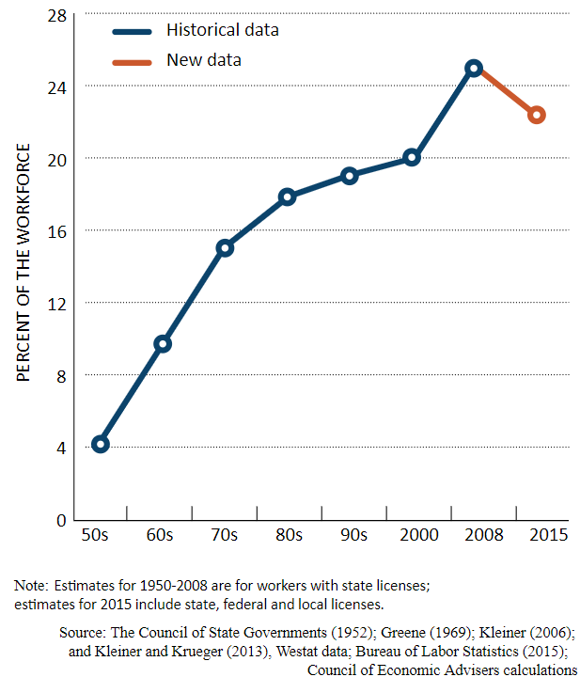
What is Occupational Licensing? How Pervasive is it?
According to Bureau of Labor Statistics an occupational license is:
a labor market credential issued by a government agency that allows an individual to lawfully practice for payment.
1 in 5 workers in US and Europe require a license (Gittleman et. al. 2018, Koumenta & Pagliero 2019).
Tradeoff: better service quality versus lower labor supply and higher prices (Friedman and Kuznets 1945)
Notes:
Don’t touch design, or background.
Our research question is X. Let me define it by Y.

Slide 3
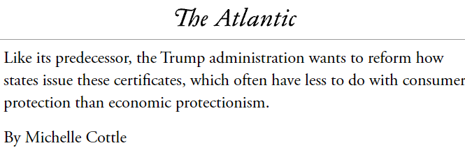
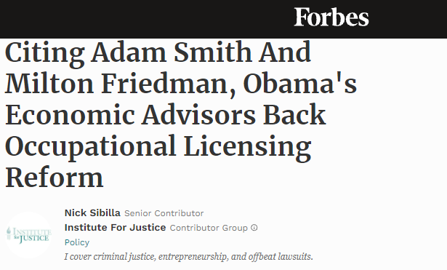


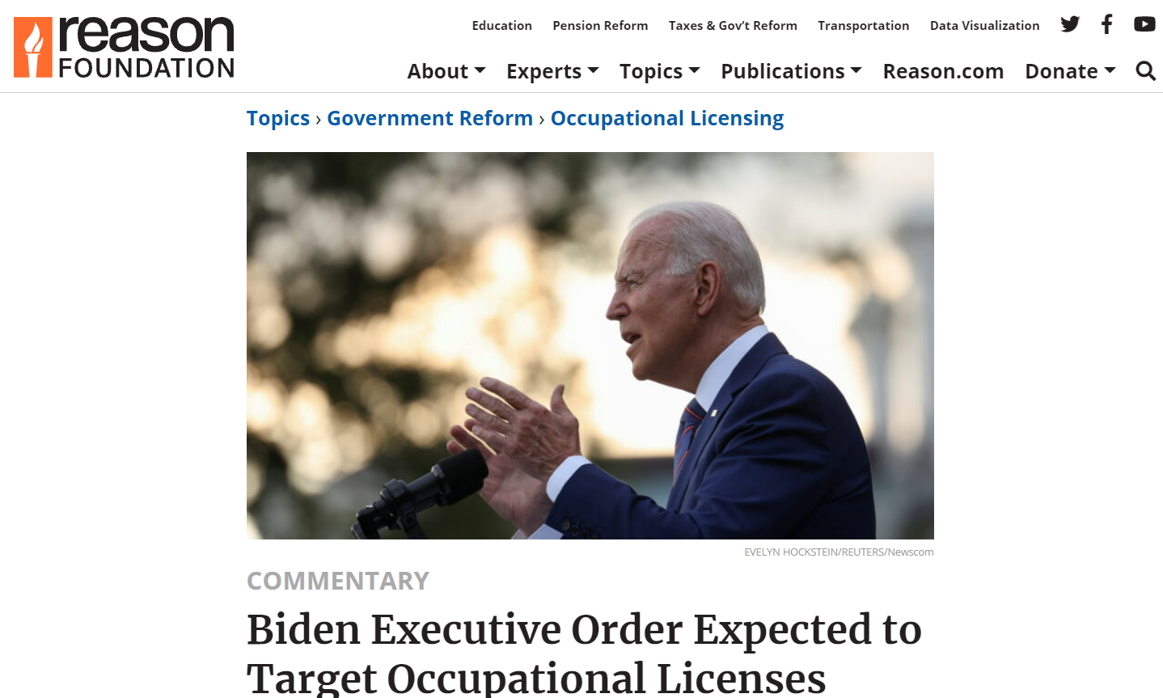
Licensing Reform is coming and we need best evidence to inform policy
Notes:
RL: Time stamp by years: Also beef up title perhaps decades 2000s-2020. Is there evidence move to after plumber’s license and before literature background. Mention that you worked on it at the state level in Chicago!

Slide 4
Motivation for Research at Intersection of Licensing and Digital Labor Platforms
Digital labor market platforms increase productivity by reducing search and matching frictions
Occupational Licensing regulations push in the opposite direction:
In offline-economy: licensing reduces employment share in occupation by 17-27% (Blair & Chung 2019, Kleiner & Soltas 2021)
On digital labor market platforms: licensing reduces competition, increases price but doesn’t improve service quality or likelihood of hiring service professional (Hall et. al. 2017, Farronato et. al. 2020)

Slide 5
Research Questions
What is the impact of occupational licensing on the likelihood that a customer engaged in search on a digital platform finds at least one worker who is legally permitted to do the work (“accept rate”)?
Are these impacts persistent?
Are they due to licensing increasing customer search on the platform, or reducing labor supply of producers, leading to a labor shortage?

Slide 6
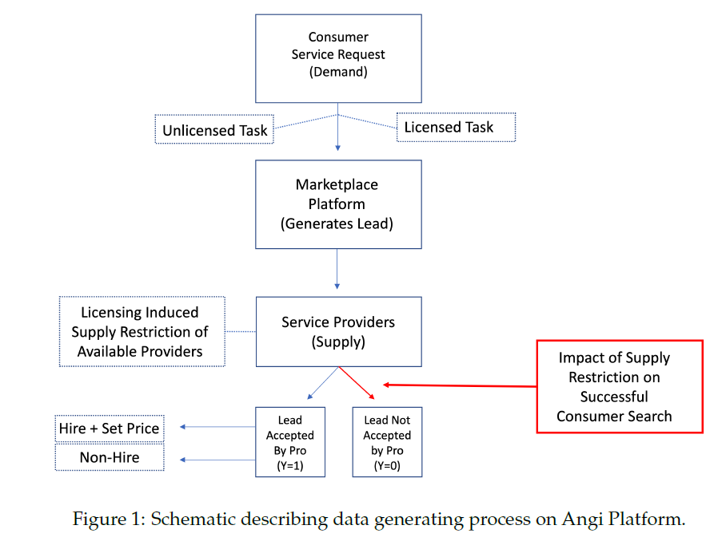
Customer search generates demand, which is fulfilled if service providers purchase the lead
Outcome of Interest: probability that a customer searching for a service provider can find at least one service provider who satisfies state requirements for working (“accept rate” or “success rate for customer search”)

Slide 7
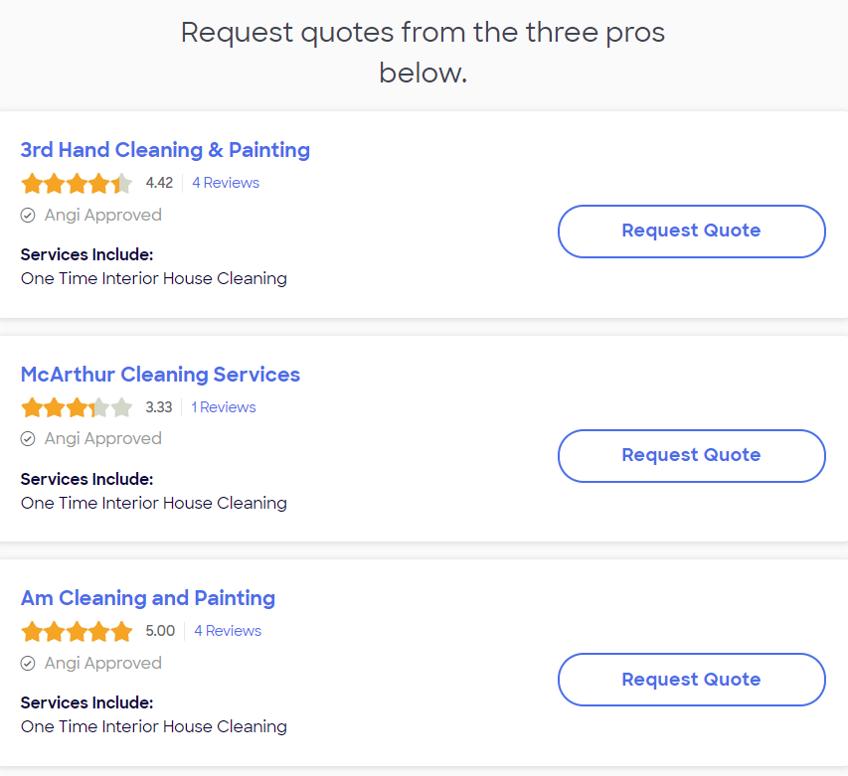

Example of an Accept (Y=1)
Example of a non-Accept (Y=0)

Slide 8
Our Approach and Key Findings
Novel proprietary data from online platform with verified task level measures of licensing
Two research designs
Event-study: NJ reform pool contractors licenses
Border discontinuity design all tasks
We find convergent evidence that
Licensing reduces the accept rate
Reduction is persistent (2 years out)
The reduction in the accept rate is driven by a reduction in labor supply and not an increase in volume of customer search

Slide 9
Contributions
Identify successful search as a new margin along which occupational licensing impacts labor markets
One of first studies to show the impact of licensing exploiting task-level variation in licensing
Demonstrate that licensing produces persistent labor shortages

Slide 10
Related literature: licensing is a barrier to entry that has minimal impact on customer satisfaction
Quantity Restriction: Occupational licensing creates barriers to entry, restricting supply and increasing prices [Smith, 1937; Friedman, 1962, Kleiner & Kruger 2013, Gittleman Klee and Kleiner 2018, Koumenta & Pagliero 2018].
Occupational licensing imposing minimum quality standards, resulting in higher average prices to reflect higher average quality of workers. [Leland 1979, Anderson et. al. 2016, Chung 2020]
Licensing restricts entry into occupations within state and restricts mobility in same occupations across states [Johnson & Kleiner 2020]
These frictions have differential impacts for workers with felony records, returning veterans and trailing spouses [Law & Marks 2007, Blair & Chung 2018]
Negative impacts of licensing on labor supply in survey data (offline labor markets) n[Blair and Chung 2019, Kleiner and Soltas 2019]
Licensing has minimal impacts on customer satisfaction on digital platforms [Hall et. al. 2017, Deyo 2018, Farronato et. al 2020]
Notes:
FarraNOTo

Slide 11
Research Setting & Data
Privileged & Confidential
Notes:
RL: Consider 44 or 48 pt font.
With this deep and wide data, we can handle multiple empirical designs, including cross sectional LPMS, causal boundary discontinuities, and category specific case studies.
Hand to Dr. Blair to walk through the empirical designs and results.

Slide 12
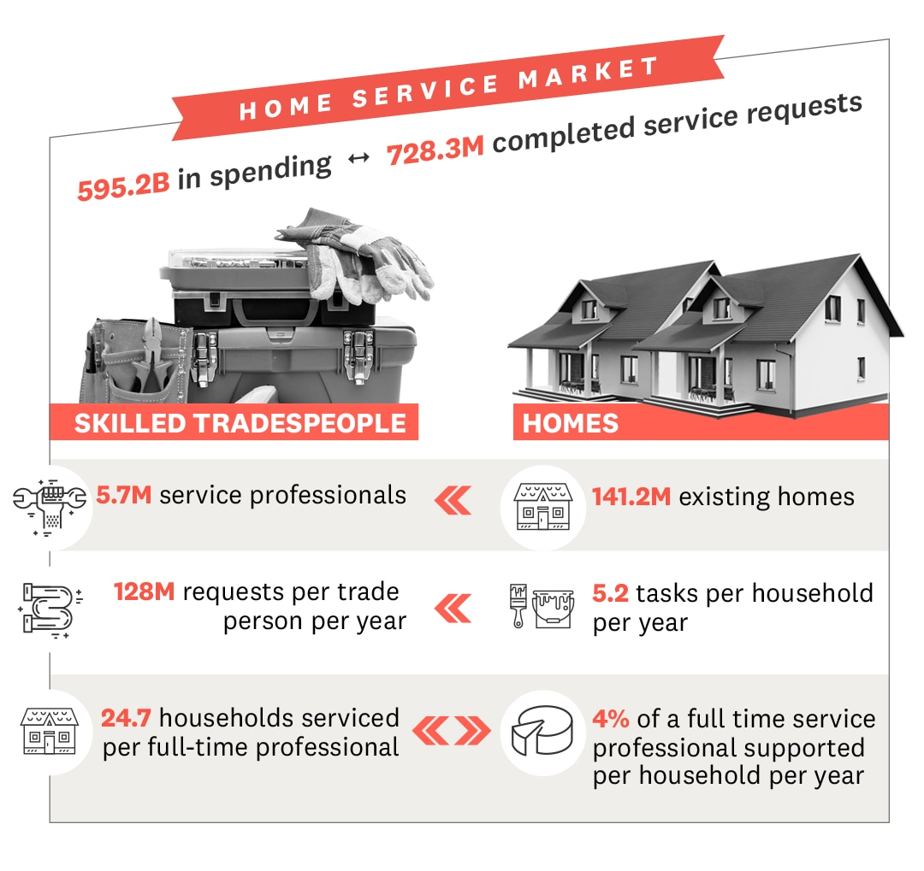
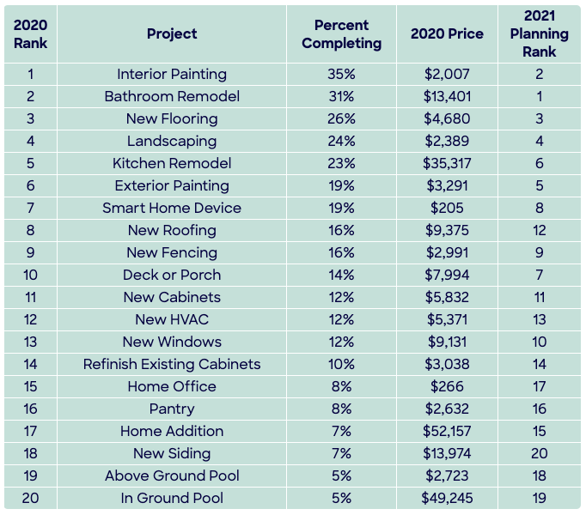
Data & Research Strategy
Proprietary data from Angi’s HomeAdvisor digital marketplace in home services industry (20M observations.)

Slide 13
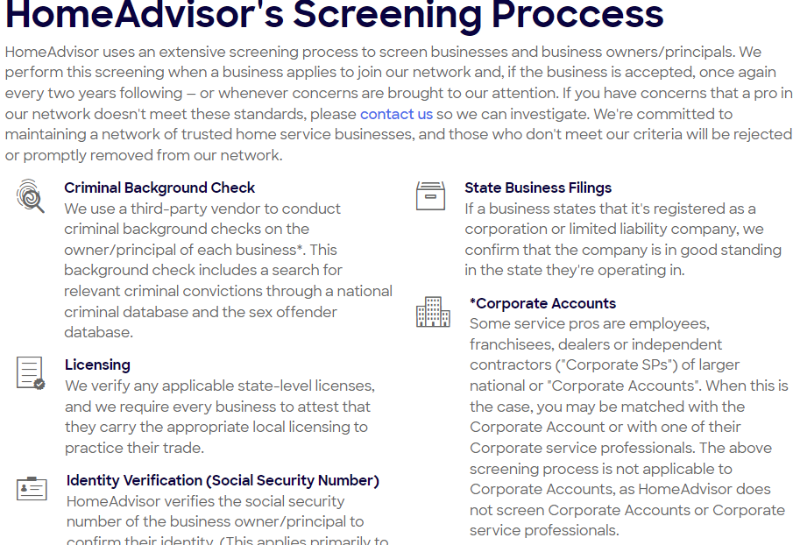
State and Local Licensing Requirements Verified by Platform for each service professional

Slide 14
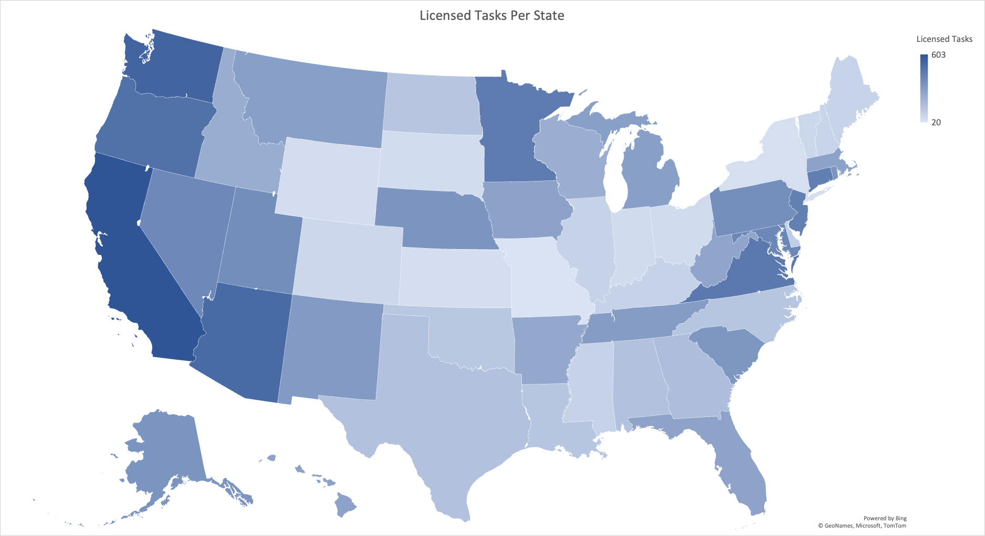
We observe licensing at the state-by-task level
Task | Primary Work Cat. | License
Installing a Water Heater | Plumbing | Yes
Clearing a Clogged Drain | Plumbing | No

Slide 15
Empirical Designs & Data
Privileged & Confidential
Notes:
RL: Consider 44 or 48 pt font.
With this deep and wide data, we can handle multiple empirical designs, including cross sectional LPMS, causal boundary discontinuities, and category specific case studies.
Hand to Dr. Blair to walk through the empirical designs and results.

Slide 16
The source of variation in licensing (individual vs. state) impacts the interpretation of the estimates
Variation | Example | Interpretation of Estimates
Quasi-random assignment of licenses to people within the same state | Idiosyncratic variation in when customer becomes aware that a service provider is licensed | Signaling value of having a license on outcomes (Farronato et. al. 2020)
Quasi-random assignment of license across states that apply equally to everyone in same state | Differences in licensing laws across state borders Change in licensing laws over time | Impact of licensing laws on outcomes (Hall et. al. 2017, Blair & Fisher 2022)
Notes:
We are going to focus on the second source of variation because we have rich data on variation in licensing laws across state at the task level and because this variation links to the policy debate on the causal impact o flicensing laws on labor market outcomes.

Slide 17
Event Study Results
New Jersey Pool Law
Privileged & Confidential
Notes:
RL: Consider 44 or 48 pt font.
With this deep and wide data, we can handle multiple empirical designs, including cross sectional LPMS, causal boundary discontinuities, and category specific case studies.
Hand to Dr. Blair to walk through the empirical designs and results.

Slide 18
Empirical Models using State Variation in Licensing Laws
Event Study: New Jersey enacts Pool Contractor Licensing Law 2019
Covers: 17 of the 18 task in pool category
Examples: install pool, repair pool heater
Exception: “clean or maintain swimming pool”
Data: task in pool primary work category, all states, all requests Jan 1, 2016-December 31st 2021.
Method
2-step event study procedure in Gardner (2020)
Notes:
Data is at the micro-second!

Slide 19
Empirical Design: Event Study
Notes:
For our event study design we map out differences between New Jersey and all other states in the accept rate for the tasks covered by the pool licensing law in New Jersey in the four years prior to the law and the three years post law. We take the year immediately before the law tau=-1 to be the reference year for all of our event study estimates. To estimate our event study we regress a dummy for weather a service request r in state s, month m calendar year y and relative year tau on event year dummies and controls for state month and calendar year fixed effects. We use the procedure in Gardner 2020 which estimates the unit and time fixed effects off of the never treated states. With this event study we are looking for evidence of no pretrends in the differences in accept rates before the law passes and a change once the law is effects in tau=0 and beyond.

Slide 20
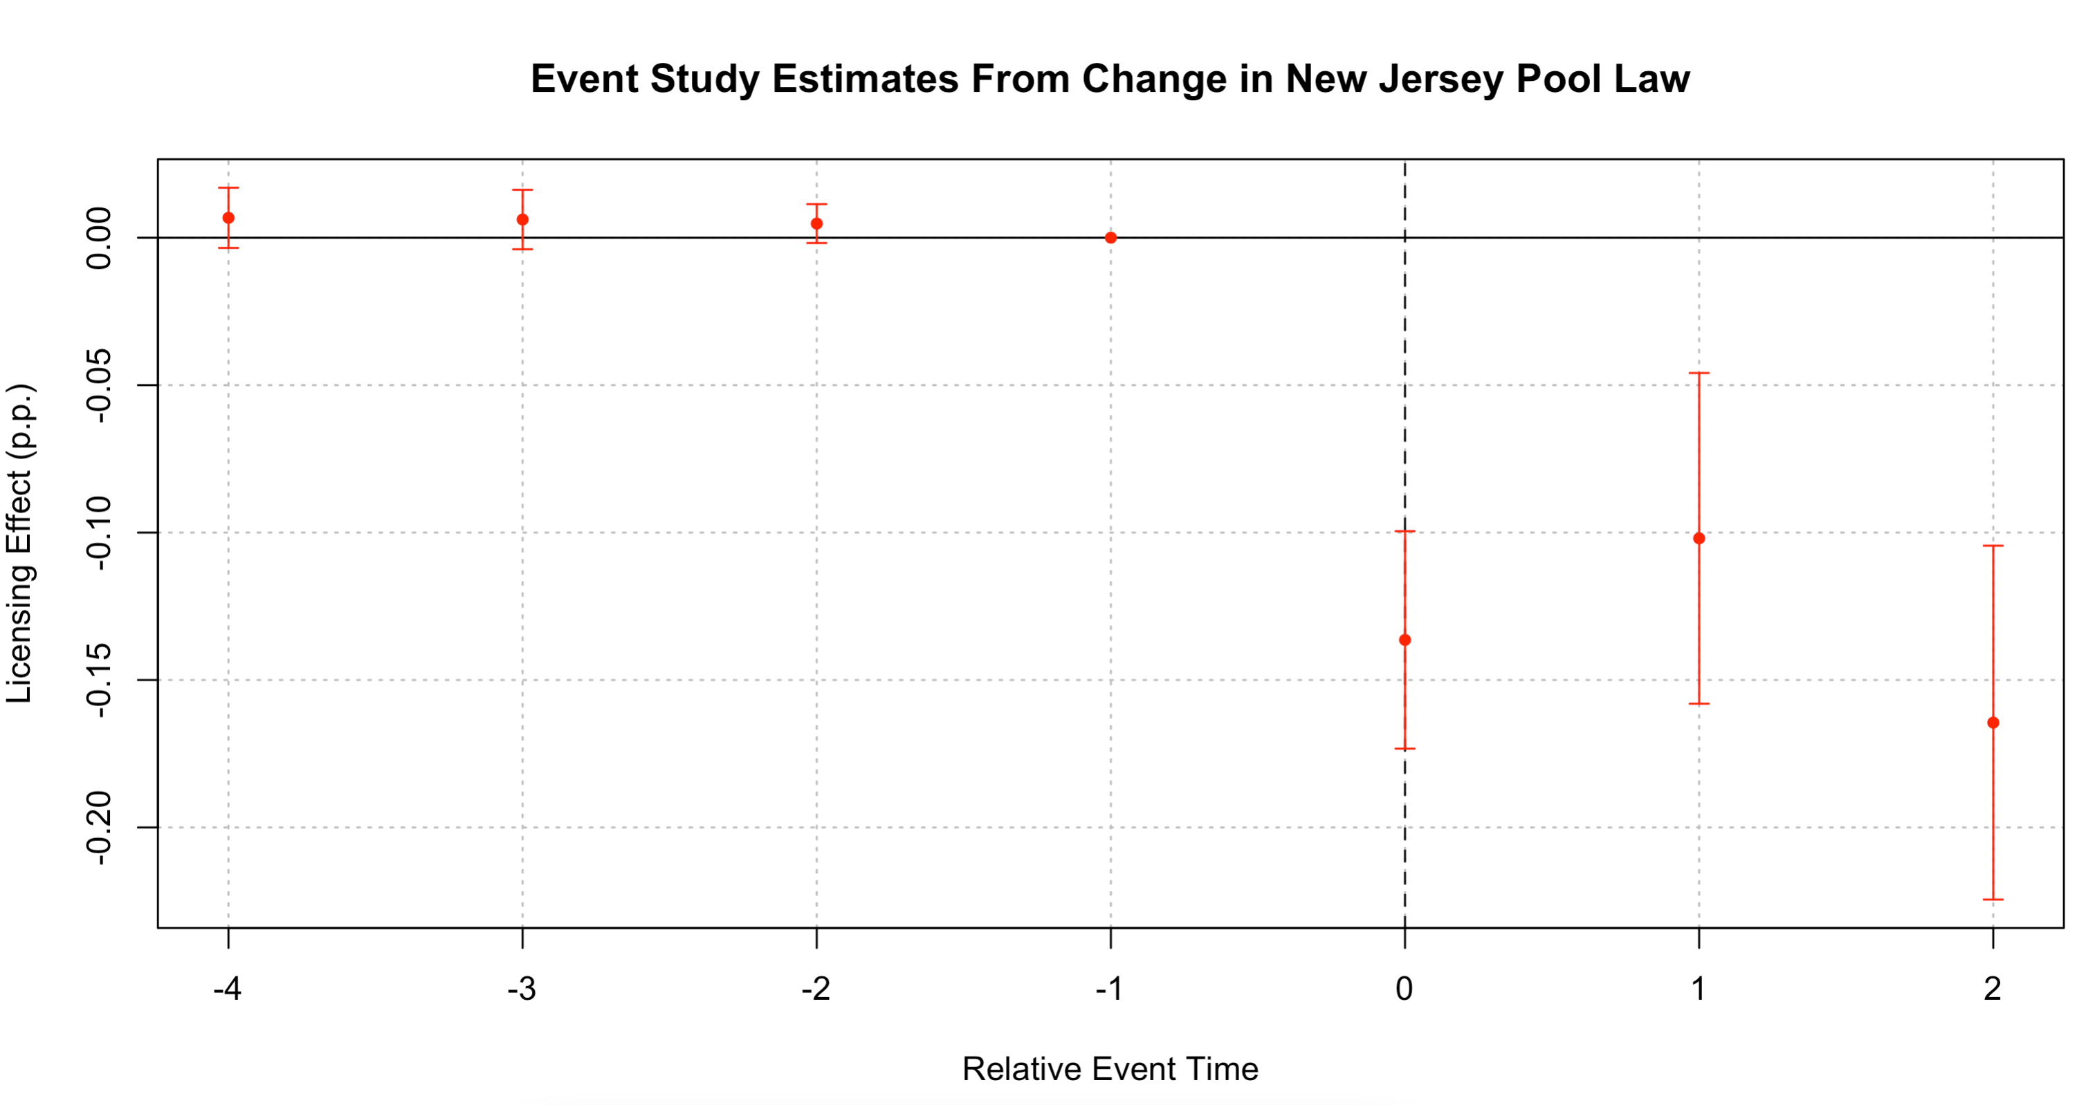
NJ Pool Licensing Law reduces accept rate by 13p.p.
13 pp drop
Notes:
Our result produce a striking pattern of no difference in accept rate between New Jersey and other states in the 4 pre-treatment years followed by a large reduction of 13 percentage points in the New Jersey’s accept rate after the law passes tau =0. In the relative decline of accepts in New Jersey following the licensing law persists for three years

Slide 21
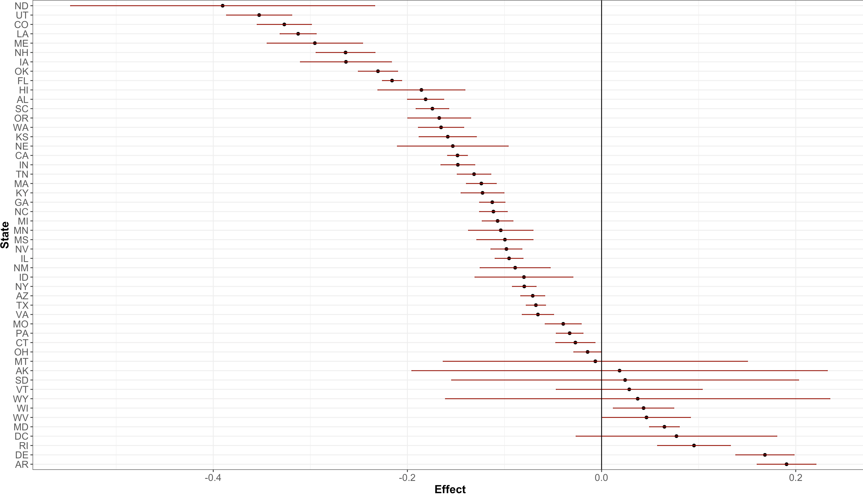
39 of 50 state-by-state comparisons yield negative impact of licensing on match rate (p-value: 0.00001)
Notes:
The estimated impact of the New Jersey pool law in reducing the accept rate is not driven by just one state. In fact, running a traditional diff-in-diff estimation in which we use each of the other 49 states and DC as a control group, we find that the pool law in New Jersey results in a reduction in the accept rate in 39 of the 50 pairwise cases. The probability of this occurring due to random chance is low.

Slide 22
Placebo Test: NJ Licensing Law has no impact in exempt pool task (cleaning and maintain swimming pool)
Notes:
As a placebo test, we find that the new Jersey pool law has no impact on the exempt task – cleanings and maintaining swimming pool). In a difference in differences model we find that the pool law has an economically small and statistically insignificant impact on the accept.

Slide 23
Results from Linear Probability Model
Privileged & Confidential
Notes:
RL: Consider 44 or 48 pt font.
With this deep and wide data, we can handle multiple empirical designs, including cross sectional LPMS, causal boundary discontinuities, and category specific case studies.
Hand to Dr. Blair to walk through the empirical designs and results.

Slide 24
Empirical Models using State Variation in Licensing Laws
Linear Probability Model
Data: universe of tasks (10% random sample), all states, Jan 1, 2019-Dec 31st 2019.
Estimate: cross sectional differences in accept rate in model with state, month and task fixed effects
Notes:
Data is at the micro-second!

Slide 25

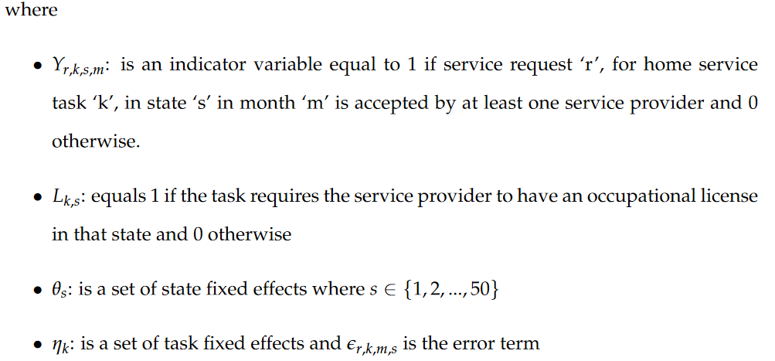
Linear Probability Model

Slide 26
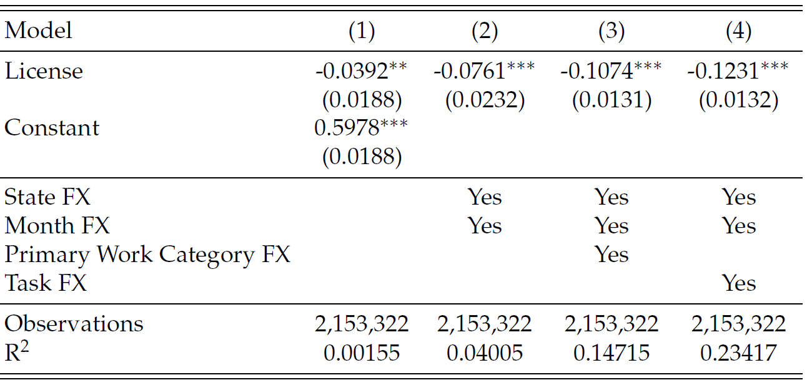
Licensing Reduces Accept Rate by 12pp or 21%
Notes:
Licensing reduces the likelihood that the market clears for 12.3 ppt

Slide 27
Mechanism: Reduction in Supply not Demand

Slide 28
Results from Border Discontinuity Design
Privileged & Confidential
Notes:
RL: Consider 44 or 48 pt font.
With this deep and wide data, we can handle multiple empirical designs, including cross sectional LPMS, causal boundary discontinuities, and category specific case studies.
Hand to Dr. Blair to walk through the empirical designs and results.

Slide 29
Empirical Models using State Variation in Licensing Laws
Boundary Discontinuity
Data: universe of tasks (10% random sample), all states, Jan 1, 2019-Dec 31st 2019.
Include only service request from border counties
Linear probability model with boundary fixed effects, estimated on only border counties.
Notes:
Data is at the micro-second!

Slide 30
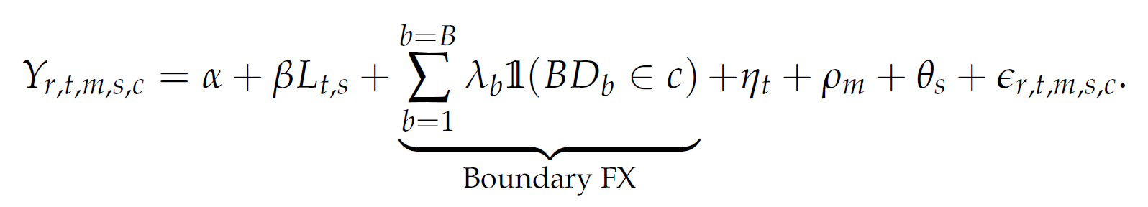
Empirical Design: Boundary Discontinuity
Notes:
Two things we do, restrict the sample to all border counties. Then run OLS and then run boundary fixed effects. Allows us to exploit licensing variation in local labor market that is plausibly exogeonous. Kitchen remodelling licensed in MA but not NH

Slide 31
Boundary Design: Licensing reduces accept rate by 13pp (24%)
Notes:
First point estimate are larger than the OLS estimates, suggest that an endogeneity in the OLS was biasing our estimates downwards toward zero. More over

Slide 32
Mechanism: licensing reduces number of accepts but has no impact on volume of search

Slide 33
National Survey of Service Providers in Skilled Trades
Date: August 4-18, 2021.
N=1,200 respondents
Privileged & Confidential
Notes:
RL: Consider 44 or 48 pt font.
With this deep and wide data, we can handle multiple empirical designs, including cross sectional LPMS, causal boundary discontinuities, and category specific case studies.
Hand to Dr. Blair to walk through the empirical designs and results.

Slide 34
Pros predict that licensing would increase accept rate by 26% (opposite of what we find)

Slide 35
Summary of Results
What is the impact of occupational licensing on the likelihood that a customer engaged in search on a digital platform finds at least one worker who is legally permitted to do the work? Reduces 11-16ppt (16%-27%)
Are these impacts persistent? Yes. Licensing results in persistent reduction in accept rate 3 years out.
Are they due to licensing increasing customer search on the platform, or reducing labor supply of producers, leading to a shortage? Licensing reduces labor supply but has no impact on customer search. Evidence that reduction in service providers in offline market due to licensing not compensated for by licensed providers taking on more work. Customers don’t value licensing.
Bottom line: licensing reduces the effectiveness of search and causes persistent shortage. Moreover, moving labor to digital platforms we observe a similarly large reduction in labor supply → licensing mitigates some of the efficiency gains of platforms

Slide 36
Appendix

Slide 40
HomeAdvisor Captures Large Volume of Search in Industry

Slide 41
Licensing Reduces Accept Rate by 12pp or 21% in population reweighted sample

Slide 43
Heterogeneity by Demographics & Housing Attributes
Demographic characteristics
population density, family income, rental prices, the share of minorities, and the fraction of college education
House Supply Characteristics
Fraction of new houses (<10 years old), the fraction of the housing stock that is single detached units, the average number of rooms per unit, and the fraction of units without kitchens
Notes:
Next measure distributional impacts of licensing on market clearing by interacting our licensing term with standardized z score county level characteristics of demographics and the housing stock.

Slide 44
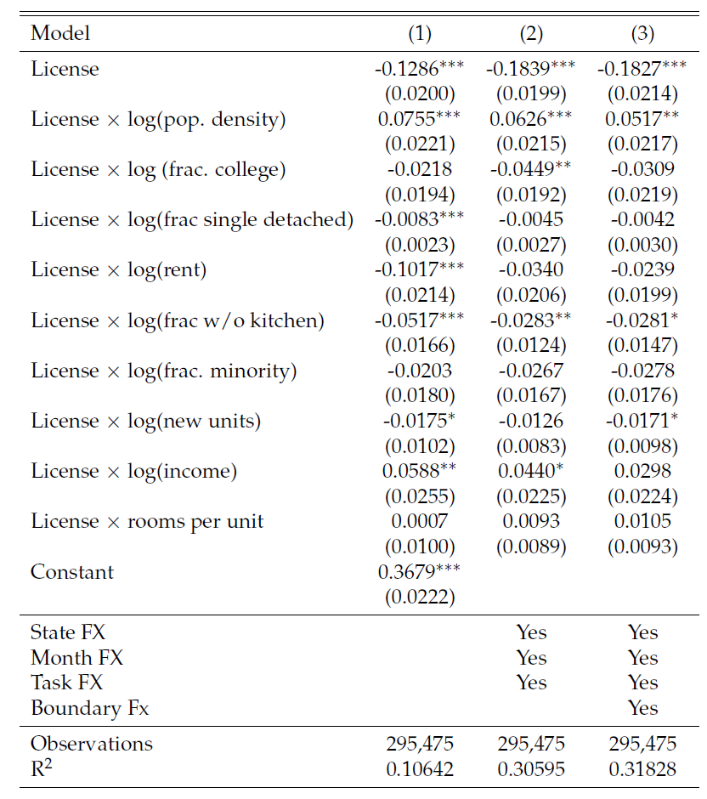
Negative impact of licensing on accept rate declines w/ population density
Notes:
For a county at an average of these attributes, the effect is most pronounced in sparsely populated areas.

Slide 45
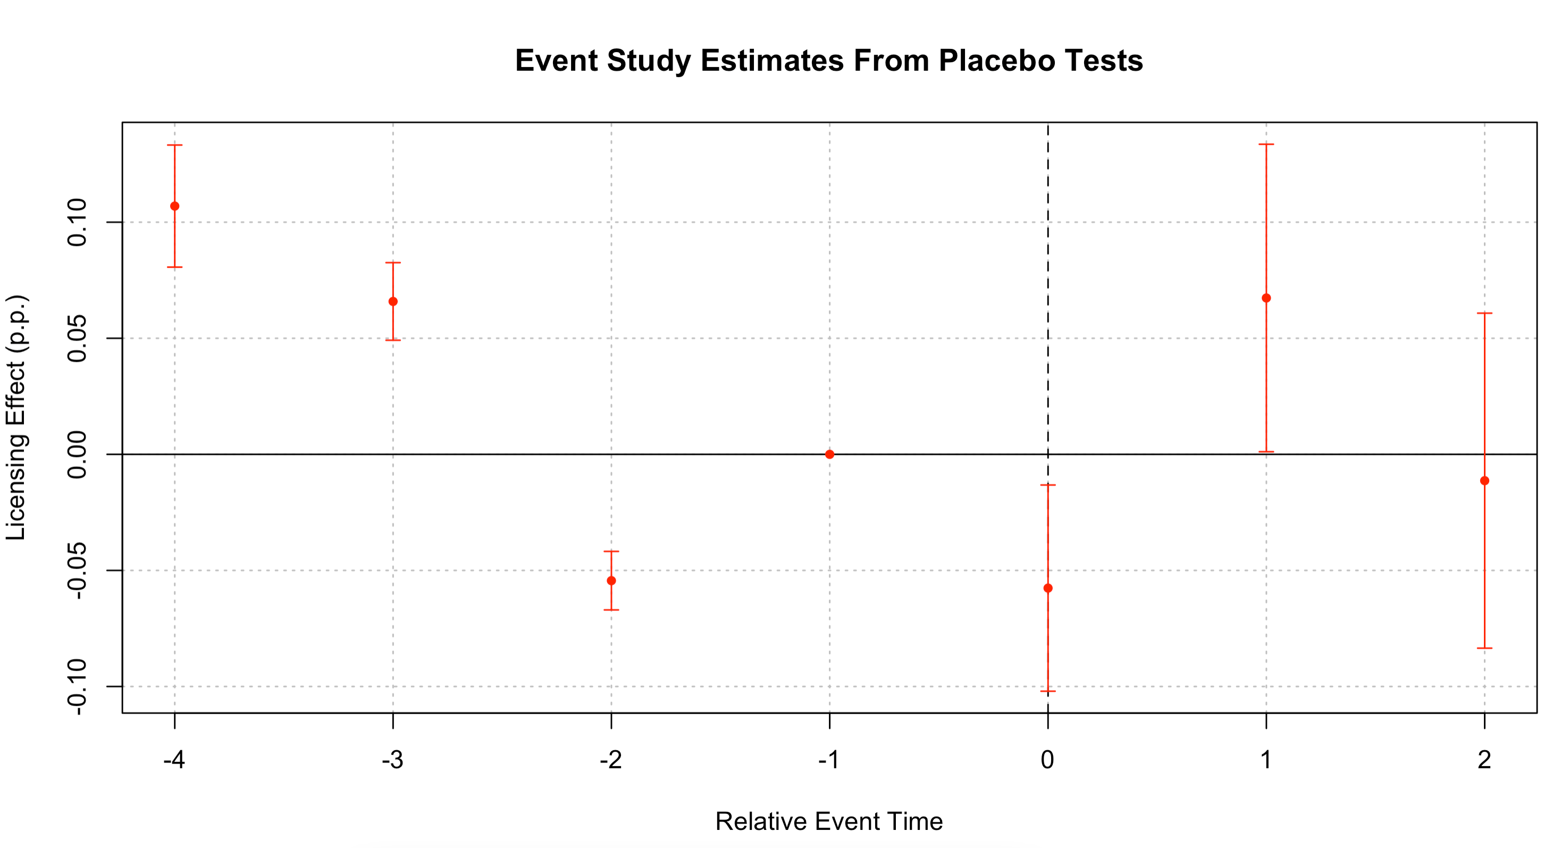

Slide 46
Licensing Reduces accept rate by 11p.p. (16%) overall

Slide 47
Summary Statistics

Slide 48
Empirical Design: Event Study

