Slide 1
The Impact of the GDPR on Content Providers: A Longitudinal Analysis
V. Lefrere¹, L. Warberg², C. Cheyre³,
V. Marotta⁴ & A. Acquisti²
1 Institut Mines Telecom-Business School, 2 Carnegie Mellon University, 3 Cornell University, 4 University of Minnesota
Notes:
Opening the cession on the effect of privacy regulation
With the paper
Co-author are in the room

Slide 2
GDPR Effects and Downstream Outcomes
Numerous claims of expected negative effects of data regulation in general, and GDPR in particular
“[Data regulation] may limit digital advertising’s ability to continue to deliver a wide range of online content to users at little or no cost at the point of consumption” Townsend Feehan, CEO of IAB Europe, 2015
Significant academic interest in GDPR (Jia, Jin, Wagman 2018; Goldberg, Johnson, Shriver 2020; Godinho de Matos and Adjerid, 2019; Peukert et al 2021; Jenssen et al 2021;Lukic 2022 et al …)
But limited evidence on GDPR effects on downstream outcomes
In particular: unknown impact on profitability of ad-supported content providers and their ability to produce free, high-quality online content
Notes:
Negative claims especially from the industry
Since The GDPR have been enacted numerous Academic works have documented the impact of GDPR on number of tracker and market concentration for example
But we find limited evidence on downstream economics outcomes
In particular on this direct link made by the industry on accessible high quality content

Slide 3
The Potential Impact of GDPR on Ad-Supported Online Content
We study the impact of GDPR on websites’ ability to provide online content
Whether and how websites in the EU and in the US reacted to GDPR (technical variables)
Whether and how GDPR and websites’ responses affected content quantity and quality (downstream outcomes)
GDPR Opt-In Impacts Ability to Collect Personal Data
Fewer Targeted Ads Make Online Advertising Less Profitable¹
Revenues of Online Content Providers May Be Affected²
Reduction in Quantity and Quality of Free Online Content³
1 Goldfarb and Tucker (2011), 2 Lambrecht et al. (2014), 3 Downes (2018)
Notes:
Impact of GDPR on content providert
respond to the GDPR using technical variable
Quantity and quality on of content - Downstream
We rely on this framework GDPR with the “almsot” mandatory opt-in

Slide 4
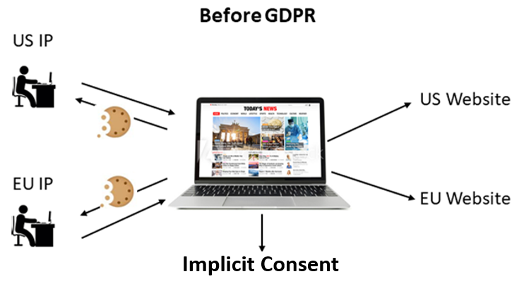
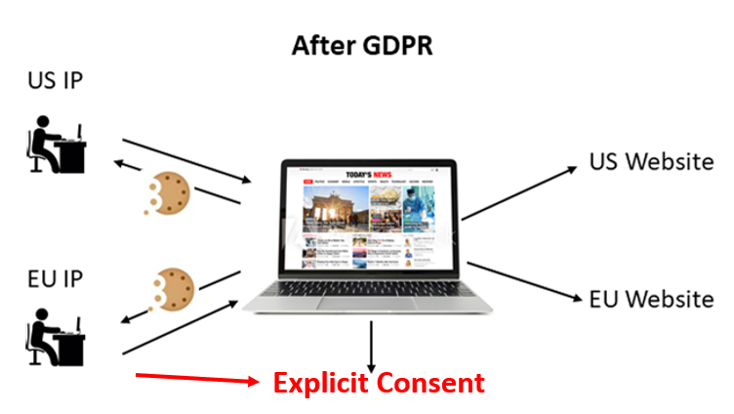
Study Design
Panel of 909 news and media websites
US and EU websites (50%/50% split EU/US))
Top-ranked and ‘long tail’ websites (Alexa)
Periodically collected technical variables using OpenWPM
Visited websites from US and EU IP addresses
16 waves of data collection between April 2018 and November 2019
Notes:
We focus on News and Media websites which are more likely to be “content” providers and to be ad-supported - about 1k websites, 50%/50% split EU/US)
Mined via scripts regularly visiting websites from different (EU vs US) IP addresses (with OpenWPM):

Slide 5
Websites’ Responses to GDPR (Technical Variables)
Number of Cookies (1st and 3rd party)
Length of Advertising Content (KB)
Blocking EU visitors
Consent Mechanisms
Cookie Banners
Cookie Walls
Privacy Policies (Legitimate Interest)

Slide 6
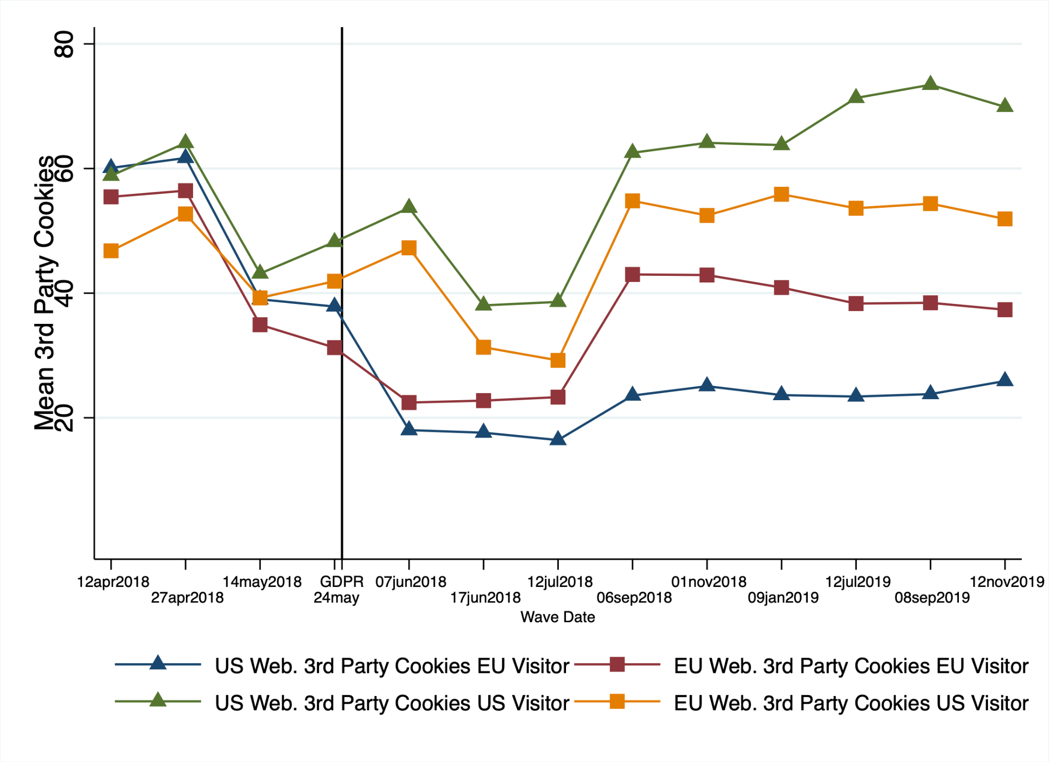
3rd Party Cookies
Notes:
THis graph depicts the average number of 3rd Party Cookies Set by EU/US Websites for EU/US Visitors
Triangle is US websites, square is EU websites.
We can underline tow mains point from this grah:
There is an initial drop of 3rd parties cookies for all websites and a rebounced, that give this U shape trends
Except may be for the Blue line that represent how many 3rd parties cookies US websites set on EU visitor, this is the strongest response. So US websites seem’s to responde to GDPR in stricter mane that EU websitss

Slide 7
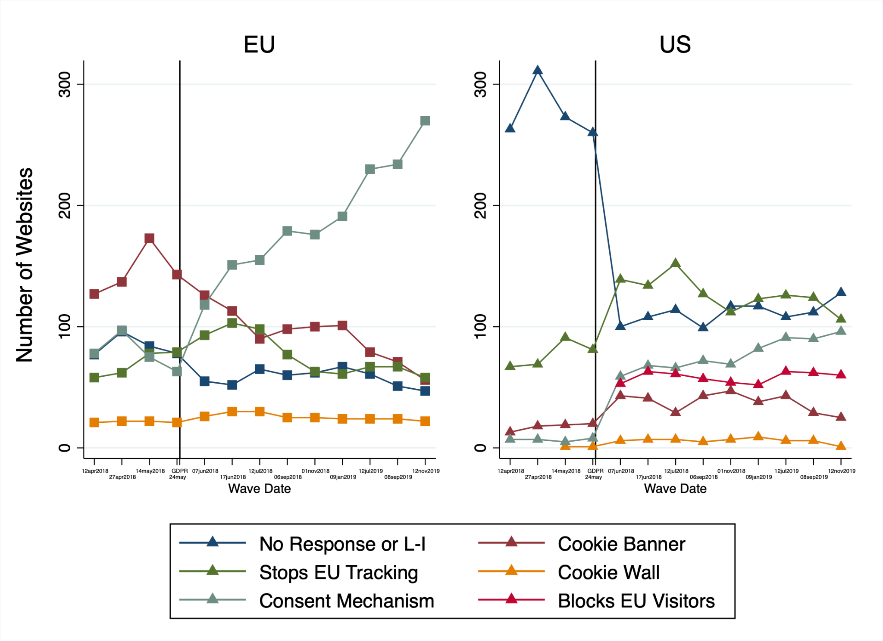
Website-Level Responses to GDPR
Notes:
Now let focus how websites respond to GDPR in general:
This pale Green line show that EU websites took sometimes to react to GDPR by using CM instead of Cookies banner (dark red) but in November 2019 almost 60% used a CM
Whereas in this US the response is more stable, with even somewebsites that exit the EU mark (the light red line) because the cost of compliance was to high

Slide 8
Downstream Outcomes
Content quantity
Amount of new content URLs posted (GDELT)
Content quality (we use, as proxy, various measures of user engagement)
Page Views Per User (Alexa)
Reach Per Million (Alexa)
Rank (Alexa)
Page Views Per Million (Alexa)
FB Reactions (FB Graph API)
Notes:
External databases used to gather‘ downstream variable”

Slide 9
Diff-in-Diff: EU Websites Experience Small Drop in Page Views Per User, No Other Change in Content Quantity/Engagement
Notes:
To measure the effect of GDPR we use a classic Diff-in-diff approach. And this results is robust across specifications

Slide 10
Why No Effect Other Than Page Views Per User?
Ecosystem effect:
Not easy for visitors to opt-out (dark patterns)
Reduction in 3rd parties cookies was followed by significant rebound in tracking
Market concentration
Website-level Effect
LATE
Type of response:
Look Ahead Matching
No evidence of increased advertising intensity or changes in business models
Consent mechanisms fatigue?
Notes:
We found very limited ecosystem or website level effects of the GDPR.
We then try to see if the effect come from a websites level effect using LATE approach our Look ahead Matching
The results are more nuance, we still only find an effect for page views but that probably no capture the complet effect
This reduction in page views might be driven by consent Mechanisms fatigue

Slide 11
Conclusions
Websites’ responses
Robust evidence of dynamic responses by websites to the GDPR in both the US and the EU (identified 5 common responses to GDPR; responses change over time)
In particular, initial reduction in third-party cookies and intensity of visitor tracking among EU websites
Initial reduction is followed by trend reversal and uptick in tracking
Downstream outcomes
Small reduction in average page views in EU websites relative to US websites, appearing near the end of the period of observation
No impact on EU websites' provision of new content, ranking, or social media engagement

Slide 12
Extra Slides

Slide 13
Has GDPR limited the ability of ad-tech companies to collect data on users?
Adoption of new consent dialogs is still low
Tracking cookies on popular websites are still being placed (Dutch DPA Report, December 10, 2019 - https://autoriteitpersoonsgegevens.nl/nl/nieuws/ap-veel-websites-vragen-op-onjuiste-wijze-toestemming-voor-plaatsen-tracking-cookies)
Existing consent dialogs can make it difficult for users to reject tracking cookies (Utz et al. 2019, https://dl.acm.org/citation.cfm?id=3354212)
Many websites claim ‘legitimate interest’ as a basis for continuing to collect data on users (UK ICO Report, https://ico.org.uk/media/about-the-ico/documents/2615156/adtech-real-time-bidding-report-201906.pdf)
While the exact level of GDPR compliance (and what it exactly means to be compliant) is unknown, we have still observed a slight decrease in advertising cookies for EU users

Slide 14
Do fewer targeted ads make online advertising less profitable?
Revenues for some websites may have decreased slightly following GDPR for traffic from EU users (Goldberg et al. 2019, https://www.ssrn.com/abstract=3421731)
Behaviorally targeted ads may only generate a small boost in revenue for publishers (Marotta et al. 2019 https://weis2019.econinfosec.org/wp-content/uploads/websites/6/2019/05/WEIS_2019_paper_38.pdf)

Slide 15
Sampling
Methods
2018 Alexa data
Top 500 websites in a geographical region
Top 500 websites in 5 content categories (News, Sports, Society, Health, & Games)
Top 500 websites globally
Also, to balance the sample:
500 random websites ranked 200k-300k, …, 900k-1M
500 from 19 additional SimilarWeb categories
Cleaning
Remove websites with only a small # of EU or US visitors
Removed websites with adult content - for RAs’ sakes
Notes:
Over 11,000, cleaned to just 5,474

Slide 16
Many (mostly negative) claims about the economic impact of data regulation in general, and GDPR in particular

Slide 17
“If this reduction in the use of OBA were to occur businesses would need to reallocate a large amount of marketing expenditure from OBA to other online channels. The Deloitte Business Survey suggests that, on average, the ROI that businesses would expect to receive from other channels would decrease by 27%” – Deloitte 2013
Forecast: 2.8 millions jobs lost and 1.34% EU GDP reduction following GDPR – Deloitte 2013
“The evidence clearly suggests that the tradeoffs of stronger privacy laws result in less free and low-cost content and more spam (i.e. unwanted ads) which is not in the interests of consumers” - ITIF 2010
“The data protection text currently on the table would essentially impose a one-size-fits-all framework to an almost infinitely broad range of data that may be considered “personal”, without adequately matching regulatory scrutiny and the onerousness of the obligations on data controllers, to the real risks arising for consumers from a particular act of processing. This may limit digital advertising’s ability to continue to deliver a wide range of online content to users at little or no cost at the point of consumption” - Townsend Feehan, CEO of IAB Europe, IHS Technology Report, November 2015

Slide 18
Approach
Exploit natural field experiment associated with the implementation of the GDPR
Diff in diff approach: before vs after GDPR, EU websites vs US websites
Caveat: both “diffs” are problematic. More on this later
We focus on website categories (such as News and Media) which are more likely to be “content” providers and to be ad-supported - and therefore theoretically more likely to be affected (about 1k websites, 50%/50% split EU/US)
Started collecting data months before GDPR implementation. Data collection continues to this day
Periodically visit each website in the sample (multiple “waves”)
12 “waves” from April 2018 to October 2019 (19 months)
Mine data from both EU and US locations (i.e., IP addresses), complemented with external sources (GDELT, Alexa, Facebook)
We collect both “technical” variables (our controls) and “downstream” economic variables (our DVs)

Slide 19
Approach
Exploit natural field experiment associated with the implementation of the GDPR
Diff in diff approach: before vs after GDPR, EU websites vs US websites
Caveat: both “diffs” are problematic. More on this later
We analyze a sample of 5,000+ websites based in the EU and the US from multiple categories
In this presentation, we focus on website categories (such as News and Media) which are more likely to be “content” providers and to be ad-supported - and therefore theoretically more likely to be affected (about 1k websites, 50%/50% split EU/US)
Started collecting data months before GDPR implementation. Data collection continues to this day
Periodically visit each website in the sample (multiple “waves”)
12 “waves” from April 2018 to October 2019 (19 months)
Mine data from both EU and US locations (i.e., IP addresses), complemented with external sources (GDELT, Alexa, Facebook)
Collect both “technical” variables (websites responses) and “downstream” economic variables (content quantity/quality)

Slide 20
Sankey Diagram: Flow of EU Websites Level Response

Slide 21
Sankey Diagram: Flow of US Websites Level Response

Slide 22
1. GDPR Responses
No decrease (in fact, very slight increase) in 1st party cookies for EU websites
Decrease in 1st party cookies on US websites for visitors with EU IP visitors
Significant increase over time of “consent” mechanisms (especially in EU websites)
Sharp initial reduction in the number of ads/tracking cookies (as well as http requests) right around GDPR
Around 12% of US websites in our sample Block EU user
However, reduction is followed by significant recovery after some months. Furthermore:
Reduction is more pronounced when visiting websites using EU IP visitors
Even an increase for US IP visitors
Decrease is more persistent when US websites are visited from EU IP visitors
Notes:
« but may be two point need to be highlits: The drop of 1st party cookies in the US for EU IP (First graph, green light) and the small amount of Consent Mechanisms for EU IP in US (Second graph green light) underline a different behavior of US website: Blocking EU or stop tracking at all EU citizien”

Slide 23
“Naïve” Difference-in-Differences
Wave & site
fixed effects
Effect of GDPR on Y
1 if EU website
& after GDPR
0 else
Variable of interest
(e.g. amount of new content, engagement)
Notes:
Perhaps use this version of the slide instead?

Slide 24
"Naïve" Diff-in-Diff Estimations, Content DVs (1/3)
Notes:
Stress that we are not using here controls we do have – consent mech, trackers, etc – because they are endogenous

Slide 25
"Naïve" Diff-in-Diff Estimations, Content DVs (2/3)

Slide 26
"Naïve" Diff-in-Diff Estimations, Content DVs (3/3)

Slide 27
Analysis
Page views per user have decreased for EU websites
Quantity of content posted by EU sites does not seem to have decreased, relative to US sites
Nor has user engagement (conditional on visiting the website)
Notes:
EU sites shooting themselves on the foot?

Slide 28
Ongoing work
Still collecting longitudinal data
Are websites complying? And if so, how? Consider, again, Model (1):
Problems with naive diff-in-diff approach:
What is the treated group (i.e., who is complying/not complying)?
When does GDPR compliance?
Luckily, we can use our “GDPR response” data to discern a more granular view of websites’ responses to GDPR: including trackers, privacy policies, and consent mechanisms

Slide 29
Local Average Treatment Effect (LATE)

Slide 30
Lookingahead matching (1/2)

Slide 31
Lookingahead matching (2/2)

Slide 32
Heterogeneous Effect: Advertising

Slide 33
Heterogeneous Effect: Ranking

Slide 34
Heterogeneous Effect: Long run

Slide 35
GDELT New URLs on EU and US websites

Slide 36
1st party Cookies on EU and US Websites
Notes:
Blue US US
Green US EU (IP)
Orange; EU EU
Red, EU US

Slide 37
*
Notes:
Stress the 2x2x2 moving parts: before after, EU US IP, EU US websites
Explicit consent: not forced – just one of 6 possible justifications data controllers can have before collecting data

