Slide 1
Data, Digitization, and Productivity
Carol Corrado
Jonathan Haskel
Massimiliano Iommi
Cecilia Jona-Lasinio
Filippo Bontadini
NBER/CRIW Conference on Technology, Productivity, and Economic Growth
Washington, D.C. March 17-18, 2022

Slide 2
Data and digital-based business platforms
Digital transformation is affecting whole societies, and is a topic of interest in many disciplines
In a digitizing economy, many economic activities are potentially driven by data.
Data are becoming a key corporate asset, complemented with analytics, and organizations are
Investing heavily in digital platforms and the accumulation of proprietary data and its analysis
Demanding a workforce with skills in data science
Many claims in business and
technology literature:
Volume is growing > 50% per year
“Data is the new oil”
Digital transformation of business and societies:
“You ain’t seen nothing yet”

Slide 3
Data value creation: What do technologists and business strategists say?
Data value chain
Data stores are raw records not yet cleaned, formatted, or transformed for analysis
Databases consist of transformed raw data suitable for some form of data analytics or visualization
Data intelligence reflects the further integration of data with advanced analytic tools
Most valuable stage of the value chain
Data intelligence takes on many forms, e.g., scientific, engineering design, marketing, business strategy (business models and logistics)
Notes:
Spending to create knowledge that expands productive capacity in the future is investment.
This is the central underpinning of the, a framework that can be used to consider “data” as an asset.

Slide 4
Data as an intangible asset
Included in GDP
No one-to-one correspondence between components of intangibles and components of data stack
Intangible investment includes most forms of data intelligence
Also, data tools/apps and databases
Research strategy:
Develop independent measures of investments in data assets
Compare with intangible investment
Investigate impacts of proprietary nature of intangible capital (via overlap with data assets) on productivity growth
Data
Digitized information
Software
Databases
Innovative property
R&D
Artistic, entertainment, and literary originals
Economic competencies
Market research and branding
Operating models, platforms, supply chains, and distribution networks
Attributed designs (industrial)
Financial product development
Employer-provided training
Mineral exploration
Likely most data intensive
Notes:
Spending to create knowledge that expands productive capacity in the future is investment.
This is the central underpinning of the, a framework that can be used to consider “data” as an asset.

Slide 5
The rise of proprietary data: Implications for the intangible assets - macro productivity nexus
Data as a trade secret
Commercially valuable knowledge becomes more difficult to replicate as, e.g., training data used to develop new intelligence remains closely held
Data and data tools as an “innovation in the method of innovation”
Efficiency of innovation-producing activities (intangible investments) improves due to AI adoption and availability of open-source software
Notes:
Relative asset price an indicator of relative productivity
Potential depends on the degree of substitutability between data/AI and human efforts,

Slide 6
The rise of proprietary data: Data as trade secrets
Commercially valuable knowledge becomes more difficult to replicate
This implies fewer knowledge spillovers/less knowledge diffusion, increased revenue-generating capacity of data asset producers/owners
…with potential consequential effects:
Fewer spillovers => weaker total factor productivity growth
Less knowledge diffusion => increased productivity dispersion, less competition, concentration of market power
Longer service life of intangible assets => higher value of (appropriable) intangible capital, lower ex post calculated RORs, Tobin’s average q closer to 1
Notes:
Relative asset price an indicator of relative productivity
Potential depends on the degree of substitutability between data/AI and human efforts,

Slide 7
The rise of proprietary data: Data/AI as an innovation in the method of innovation
Efficiency of innovation-producing activities (intangible investments) improves
….a development that should manifest as declines in relative asset prices
Long-term growth of OPH is boosted as cost shares rise (or, as volumes rise more rapidly than relative prices fall)
Calibration in table 3 of paper suggest this boost is potentially large – and underscores importance of getting intangible asset prices right
Source: Corrado, Carol (2021). “Measuring Intangible Capital and Productivity: Implications for Growth and Productivity” The Brookings Hutchins Center Productivity Initiative working paper.
Notes:
Relative asset price an indicator of relative productivity
Potential depends on the degree of substitutability between data/AI and human efforts,

Slide 8
Evidence: Data capital and intangible capital
Data assets nearly 40 percent of intangible investment
Data assets + data tools (software) more than 50 percent
Note: Data and software are sum-of-cost estimates for market sector industries, percent of market sector GVA; intangibles are authors’ estimates from INTANInvest
Notes:
Averages 40 percent of intangibles (domestic)

Slide 9
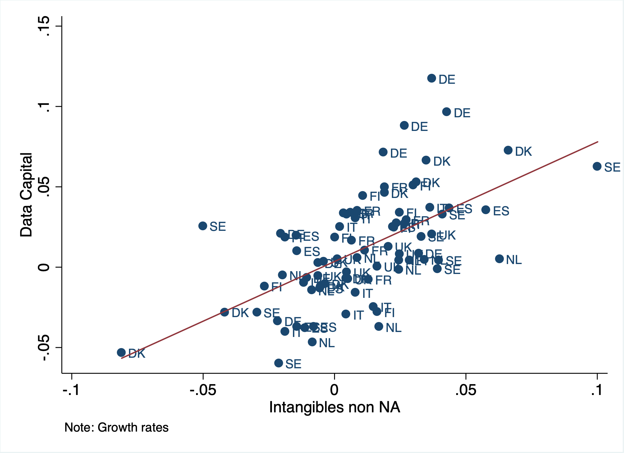
Data capital growth strongly correlated with components of intangibles hypothesized as the most data intensive Data capital vs intangibles (components not included in GDP, left), and vs those included, right) growth of investment rates, 2010 to 2018

Slide 10
Total factor productivity estimates
Intangible investment estimates now available via EUKLEMS & INTANProd project
Estimates cover EU countries, UK, US, and Japan
EU estimates Include full coverage of own-account components for the first time. For further information, see Bontadini et al. (2022) on project portal: https://euklems-intanprod-llee.luiss.it
Using these estimates, productivity decompositions were calculated for the US and a European aggregate covering the 9 countries with data production estimates shown on slides 8 and 9.
Real intangible capital estimates exploit deflators for marketing assets harmonized to use prices for advertising media costs shown in figure 6b in the paper (and incorporated in the chart on slide 7)

Slide 11
Productivity since 2007: OPH, tangible capital deepening, TFP down …. intangible capital deepening well maintained with a step up in data intensive components Decompositions of growth in labor productivity in market sector industries

Slide 12
Implications
TFP drops .9 percentage point (annual rate) in Europe and .7 percentage point in the United States
Price mismeasurement of paid-for consumer digital services plays a role
Up to .3 percentage points this drop can be attributed to its increasing disinflationary impact*
The diffusion of commercially valuable knowledge is the primary determinant of TFP in the intangible capital framework.
Exploiting: past studies of spillover effects*, estimates of intangible capital growth, and our findings on how much data capital overlaps with intangibles (i.e., 40 to 50 percent)
…then to the extent proprietary data has no productivity spillovers, the diminishment shaves another .2 to .3 percentage points off the growth of TFP
* See text of paper for references.
Notes:
Past studies* suggest that something like $\hat{da }≈ .2 dr$describes this spillover process
$dr$ has been growing about 2-3/4 percent per year in Europe and 3-1/2 percent in the United States

Slide 13
Summary
The paper uses an intangible assets approach and a new version of a widely used productivity dataset to address how the increased use of data affects productivity
We introduced a value chain framework for measuring data assets and implemented it, finding that
Production of data assets covers nearly 40 percent of intangible investment
The most data intensive components of intangibles are not capitalized in GDP
Theory predicts that nonrival capital goods create increasing returns in the macroeconomy because they can be copied and replicated at low cost.
Though data is fundamentally nonrival, many assets derived from “bigdata” tend be held as trade secrets and restrain the diffusion of data intelligence across firms and industries.
Many models and studies describe how this breakdown may lead to “winner take all” impacts
The contribution of this paper is to empirically frame these mechanisms in terms of their macroeconomic impact on productivity.

Slide 14
Thank you.
Back ups follow.

Slide 15
Approach to the analysis of data in this paper
Data refers to “big data”
Data and the knowledge gained from data are intangible assets
Like other intangible assets, data assets are nonrival (though excludable) goods
Many ”modern” AI applications use data as a proprietary asset
The impact of data needs to be analyzed with reference to its nonrivalry and excludability
Put differently, the analysis of intangible capital needs to be analyzed with reference to
its overlap with data assets
….and increased proprietary character
Notes:
and consumer data privacy laws => total excludability
The term “data” implicitly refers to "bigdata" as used in the business literature, or even "massive data," a term frequently used in scientific applications. Bigdata has been defined in a technical sense by, e.g., the SAS Institute, as data that is so large, fast, or complex that it is difficult or impossible to process using traditional methods.
A nonrival good is not exhausted in an instance of use, i.e., an orange is a rival good, a blueprint for a machine is nonrival—it can be copied and used repeatedly. The optimal supply of nonrival goods can create policy challenges (is the good under- or over-supplied?), and thus the uses of data, the functioning of markets for data, and data ownership and consumer privacy rights are examined in this report.

Slide 16
Contribution of data capital to labor productivity growth
Long-term growth promoting potential of data capital depends on the extent to which their volume rises more rapidly than their relative price falls (i.e., that the input shares continue to rise)
Ultimately this is an empirical question about the degree of substitutability between data/AI and human efforts.
Apart from spillovers, the impacts of data capital on labor productivity growth can be calibrated using estimates of two effects determined by input cost shares and relative prices:
Use effect (capital deepening)
Production effect (tfp)
This approach has been a mainstay of productivity analysis with IT capital.
Scenarios in next slide.

Slide 17
Data capital and labor productivity
Table 3. Long-term Scenarios: Contribution of data capital to annual labor productivity growth (percentage points)
 | Productivity advantage
 | (relative asset price growth differential)
Adoption (digital capability) | Narrow edge 1 percentage point |  | Large edge 5 percentage points
Broad use
(and net exporter of data services) | 0.25 |  |  | 1.26
10 percent capital income share
11 percent production share
Limited use
(and net importer of data services) | 0.12 |  |  | 0.58
5 percent capital income share
4.5 percent production share
Note: Contributions include the sum of the use and production effects of data capital.
Table reports scenarios for the contribution of data capital to labor productivity growth
Potential contribution of data capital to labor productivity exhibits a wide range
Synergies among data capital efficiency and an economy’s breadth of use and capability for digital transformation
Data capital tends to be domestically produced (much production occurs within firms and international trade in data assets remains limited), so impact on labor productivity is “doubly” important.
Underscores importance of getting asset prices right.
The calculations are based on the steady-state solution to a two-sector model that consists of a data capital producing sector and all other goods and services. In this simple model, the contribution of the data sector to labor productivity equals the sum of the use effect, ${{\overline{v}}^{D}}/{{\overline{v}}^{L}} \left(−\dot{p}\right)$ plus the production effect, ${\overline{ω}}^{D}(−\dot{p})$, where ${\overline{v}}^{D}$ and ${\overline{v}}^{L}$ are the income shares of data capital and labor, ${\overline{ω}}^{D}$ is the production share of data investments, and $(−\dot{p})$ is the relative productivity of data measured as the rate of decline in the relative price of data assets (sign reversed). The calculations in the table assume labor’s share of total income, ${\overline{v}}^{L}$, equals .7. For a derivation, see Oulton (2012) or Byrne and Corrado (2017).
Notes:
The lower bound for the productivity advantage is drawn from recent evidence on the relative price differential implied by an intangible investment price index designed to capture the impacts of digitization on investments in brand and the IT consulting and marketing subcomponents of organizational capital, about 1 percentage point per year (Corrado 2021). This deflator takes national accounts asset prices for R&D and software as given, however, and thus is a lower bound in that these deflators do not incorporate efficiency gains due to increased application of AI methods or use of open-source content. The upper bound is guided by the long-term relative price decline of conventionally defined IT capital of about 15 percent per year (based on the estimates reported in Byrne and Corrado, 2017). It is conservatively set at one third of that, i.e., 5 percentage points per year.

Slide 18
Intangible investment a factor behind growth in productivity dispersion at the firm level
Evolution of firm-level productivity dispersion by intangible
intensity of industry in a regression framework, after controls*
* Classification of industries according to intangibles intensity based on INTAN-Invest data.
Source: Preliminary results from Corrado, Criscuolo, Haskel, Himbert, and Jona-Lasino (2021)
Notes:
Premininary
Intangible intensity is the ratio of intangible investment to total investment.

Slide 19
Ex post rate of return for market sector industries not consistent with significant increase in market power after accounting for intangibles

