Slide 1




Slide 2
Assignment Probabilities and Centralized Application and Assignment Platforms
Widespread use of centralized platforms to assign students to schools.
These platforms collects ranked ordered lists i.e. applications during a period of time.
An algorithm assigns options to applicants by encoding priorities, applications and capacities.
Depending on the algorithm used - there could be strategic incentives when applying.
Information on the probability of assignment for each option/portfolio is a key input to determine application strategy.
We show that if parents must engage in costly search prior to applying
Information on the probability of assignment for each option/portfolio is always required for optimal school search/choice
Problem:
Virtually no school choice systems provide information on assignment probabilities.
Learning admissions chances is difficult if not impossible for an individual family.
Beliefs are biased (optimistic) and this leads to 1) under-search, 2) short applications and 3) more families unassigned.

Slide 3
Solution: Smart Platforms Can Help Families Avoid Strategic Mistakes
Conceptual Solution – Platform Can Predict Assignment Probabilities Better Than People
Figuring out the assignment probabilities for each individual is a prediction problem (predicting equilibrium cutoffs).
The matching platform aggregates all the information on demand and supply + algorithm + past experience.
The platform can predict the final assignment probability for each families application portfolio.
Providing families this personalized information can help them adjust their search and/or application strategy.
Practical Implementation and Evaluation – Provide Live Feedback
Evidence suggests costly search is meaningful part of school choice process and biased beliefs distort this process.
Work with ConsiliumBots (EdTech NGO) to design and evaluate live feedback intervention in multiple cities in Chile and then in New Haven, CT.
We find this intervention to be an eﬀective and generalizable approach to get more families into schools they want.
Results replicate across settings and over time (20 cities in Chile over four years, then in New Haven, CT)
Recently implemented by ConsiliumBots in cities in Peru, Ecuador, and Brazil (no results yet)

Slide 4
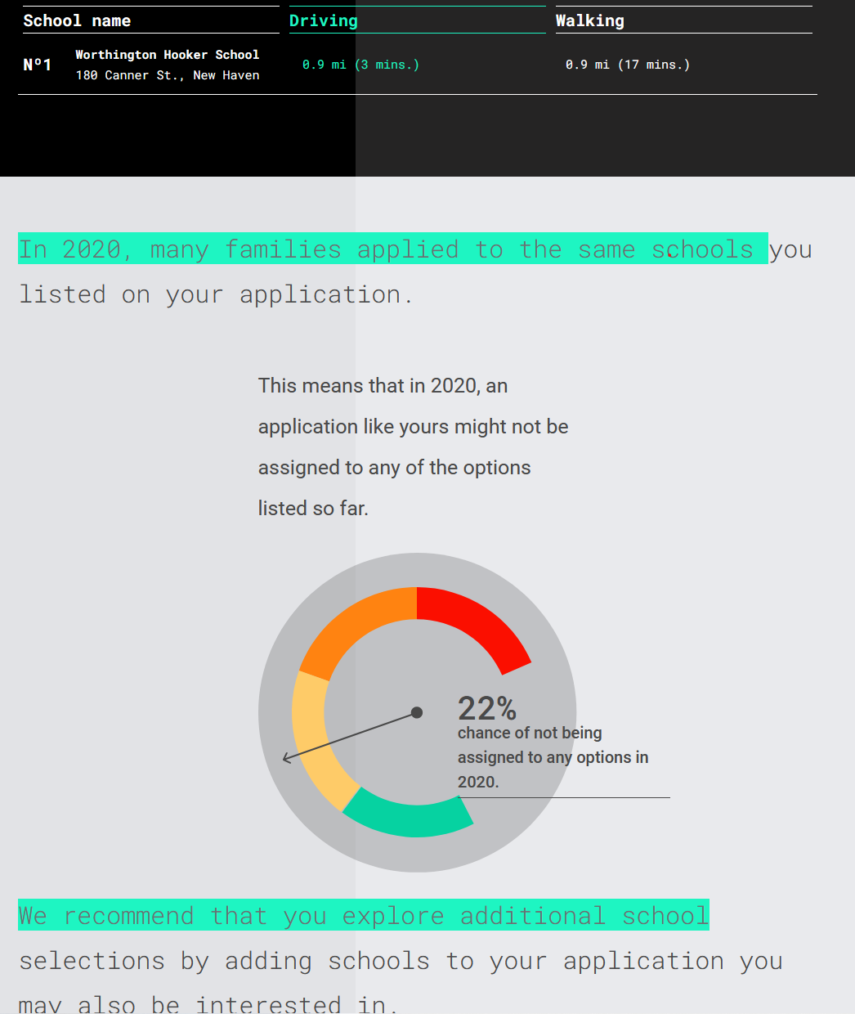
Platform Reaches out to Provides Personalized Information
Platform reacts with live feedback when applications have high risk of non-placement.
Reaches out to participants later with updates as more data comes in. (via SMS, Whatsapp Chatbot)
Note this intervention does not provide information about option attributes or other alternatives.

Slide 5
Regression Discontinuity and RCT Results Indicate Robust Positive Effects
Summary of the results :
22% of ``risky'' applicants to extend rank lists, reducing non-placement risk by 58%
Encouragement design RCT shows these results are not just relevant at the cutoff.
Replication across many settings and over time suggest these findings have been generalizable.
Overall the reaction is largely consistent with the model of search described in the paper.

