Slide 1
From Laborer to Founder
The effects of filtering on search and matching
Moshe Barach
NBER Lightning Talk
Notes:
Digitization is fudementally altering markets.

Slide 2
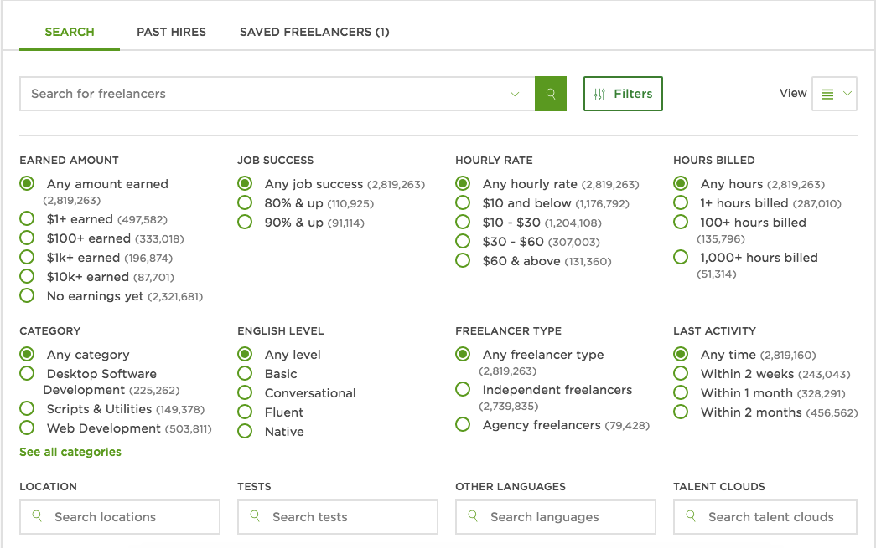
Experimental design
Control Recruitment Interface
Treatment Recruitment Interface

Slide 3
Filters reduce search effort but still increase observable match quality
$y_{ij}=β_{1}{TRT}_{j}+β_{2}{Bid}_{ij}+γ_{j}+θ_{i}+ε_{ij}$; where $γ_{j}$ is a job category FE, and $θ_{i}$ is a contractor FE. SE clustered at employer level.

Slide 4
Less variation in match opportunities
Cox Hazard Ratio .931 (.03)
Notes: The sample is limited to applicants who submitted their first on platform bids during the experiment. Treatment applicants are limited to those applicants who submitted only bids to treatment jobs during the experimental period. Control applicants are limited to those applicants who submitted only bids to control jobs during the experimental period. Workers who submitted bids to both types of jobs are removed from the sample.

Slide 5
Recap
Findings
Employers reduce screening effort directed at non-invited workers.
Higher “quality” observable pool & hires.
Less variance in matches.
Harder for new “products” to break in.
Implications
Filters generate value by sorting applicants and reducing screening costs.
This sorting generates disparities in opportunity for different groups especially novice workers or new products.
The disparities in opportunities stem from buyers having similar preferences.

