Slide 1
Age and the labor market for Hispanics in the United States
By
Joanna Lahey
Texas A&M University and NBER
and
Roberto Mosquera
Universidad de las Américas Ecuador

Slide 2
Thank you to Sloan for funding!

Slide 3
Motivation
The Hispanic population in the US has been steadily growing
  Both foreign-born and native-born
Age of Hispanics in the US has been steadily increasing over time
May be doing better
  Less-educated white Hispanics have higher employment and LFP than less-educated white non-Hispanics
May be doing worse
  Hispanic men have lower earnings trajectories than non-Hispanic men
  Hispanic people are more likely than other groups to live in poverty in old age
  Hispanic people have lower Social Security receipt
  Hispanic people have a higher risk of being work-disabled at younger ages
Tracing employment patterns and discrimination by age is important

Slide 4
Focus: High School Graduates (in Orange/Grey)

Slide 5
Three parts
We look at the Census/ACS by age and Hispanic status over time
  Problem: “Hispanic” not necessarily consistent over time
    Affected by citizenship status, xenophobia, etc.
    Affected by questionnaire/coding changes 1980, 2000, 2008
We re-analyze two previous experiments using students and HR manager samples
  Compare resume ratings for hs educated clerical applicants with Hispanic vs. non-Hispanic last names
  Only non-Hispanic first names
We use mTurk to have people rate resumes for hs educated clerical applicants

Slide 6
Census/ACS Cohort Charts

Slide 7
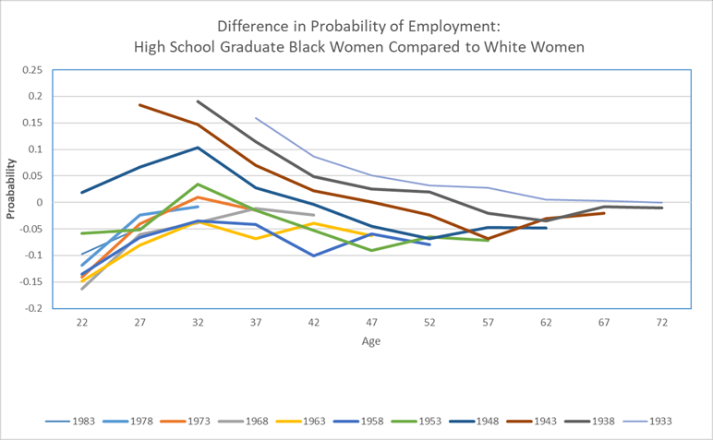
By way of comparison:
Black women compared to White women

Slide 8
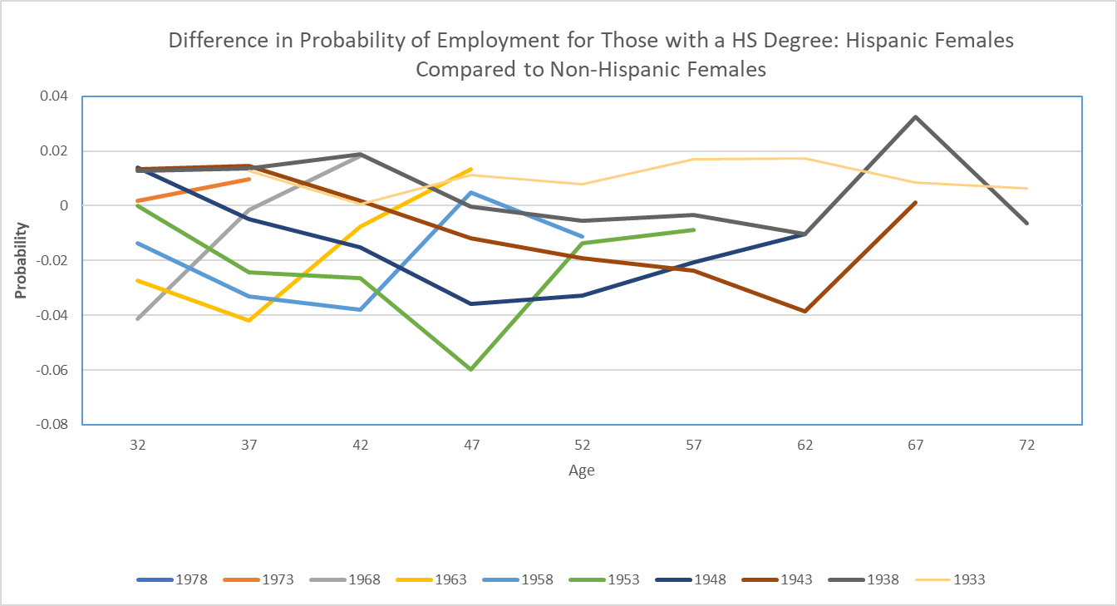

Slide 9
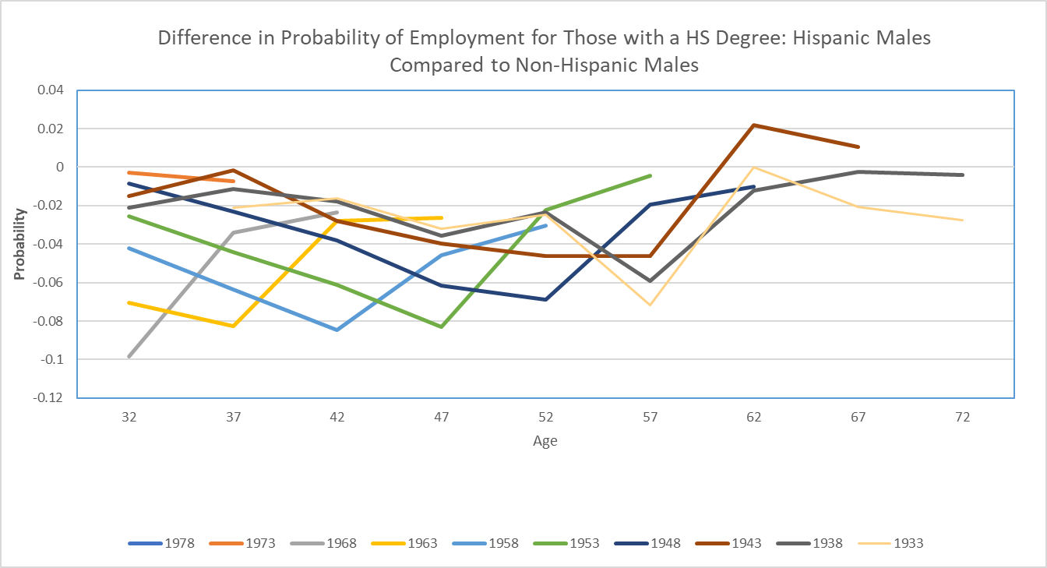
Notes:
Double check 2000 chart to make sure it’s correct (there was a problem with the wage chart)

Slide 10
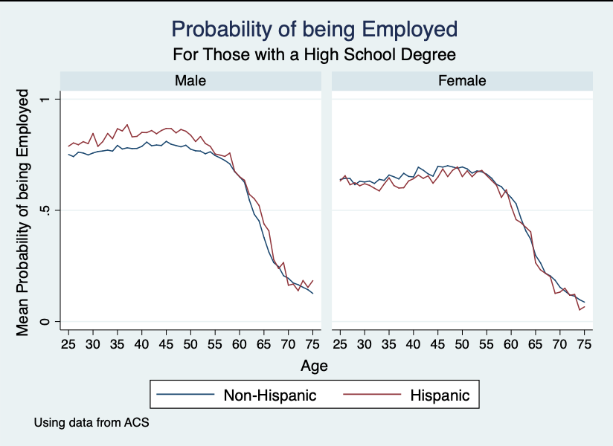
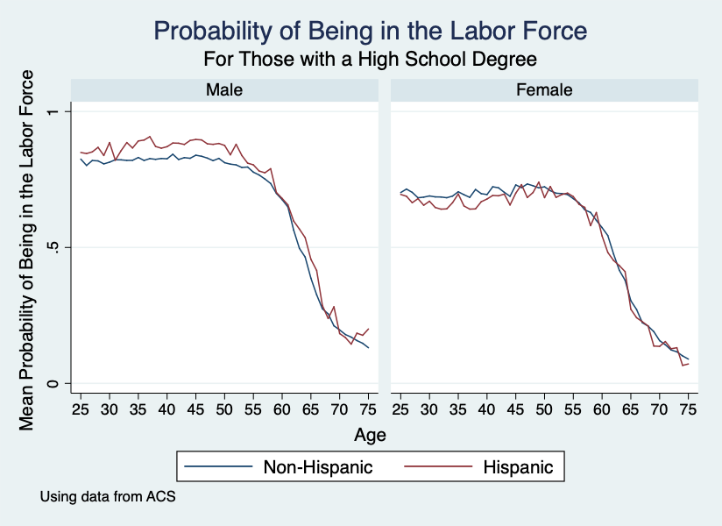
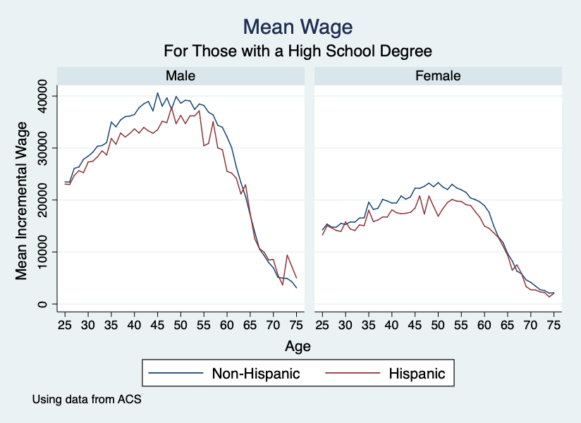
Labor Market Outcomes

Slide 11
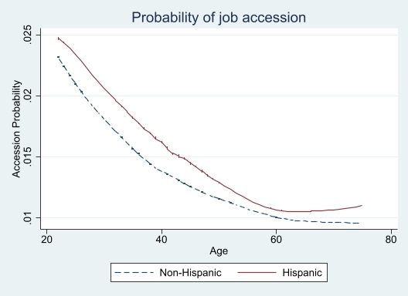
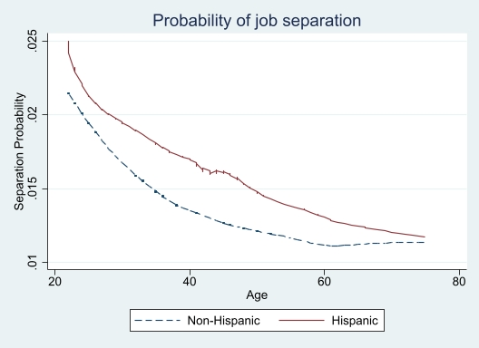
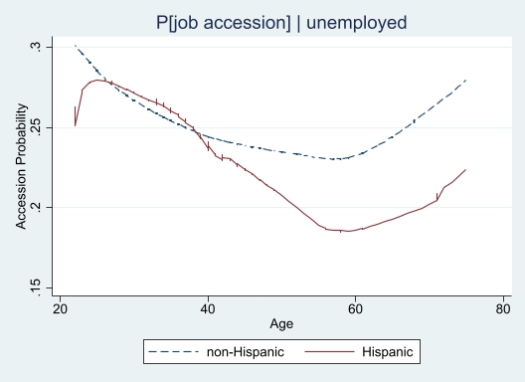
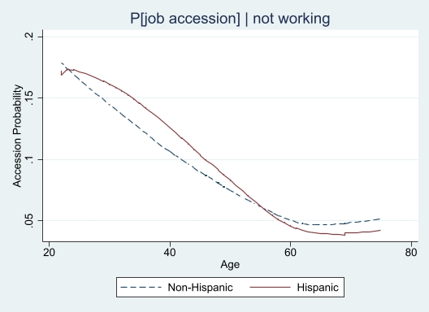
Job Flows
Notes:
Hispanics more likely to have an accession at all ages and more likely to be separated at all ages -> more rotation (churn), some potential difference in age for accessions conditional on unemployment

Slide 12
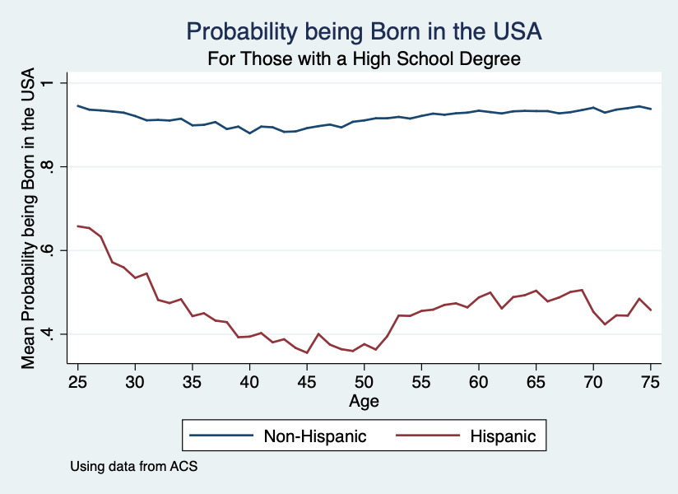
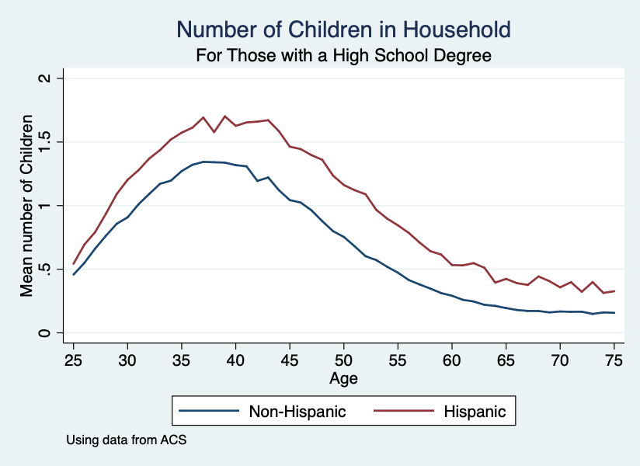
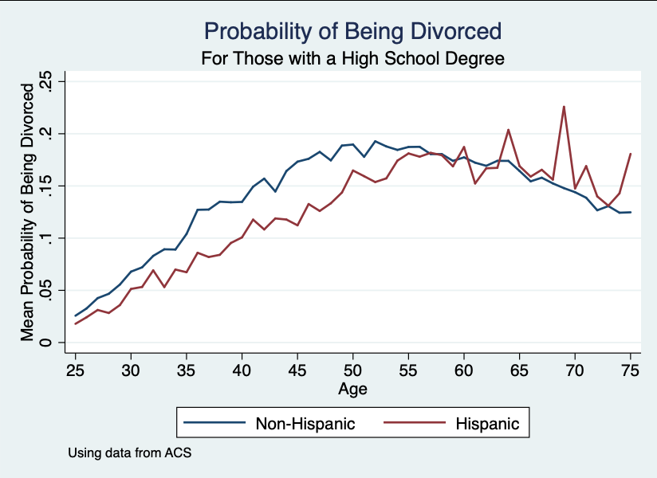
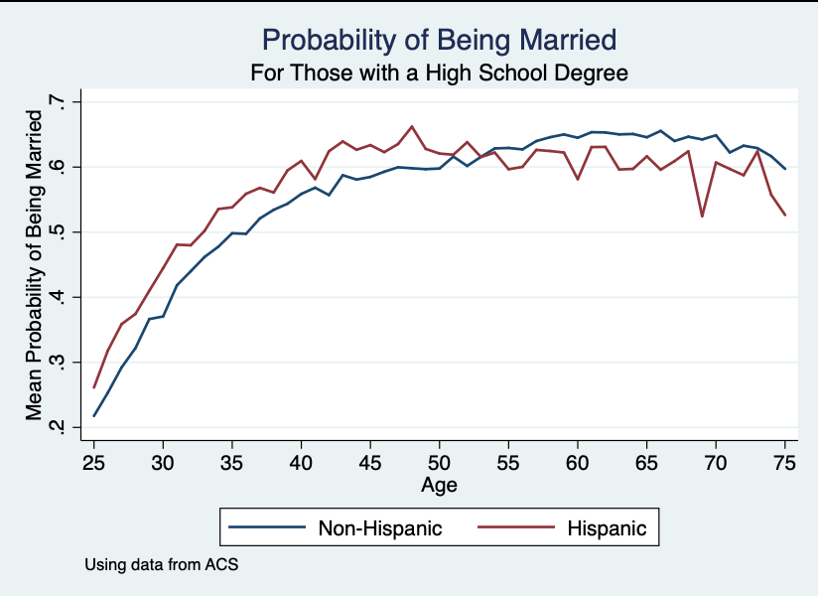
Demographics

Slide 13
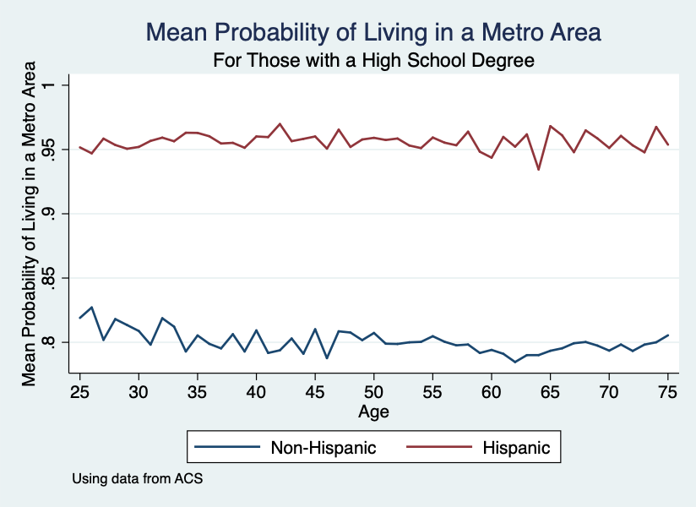
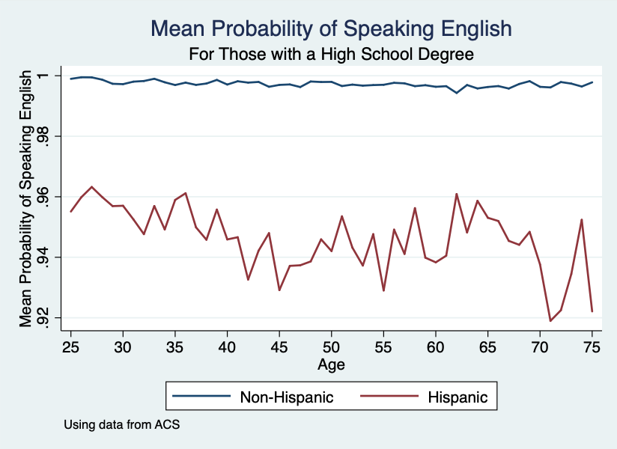
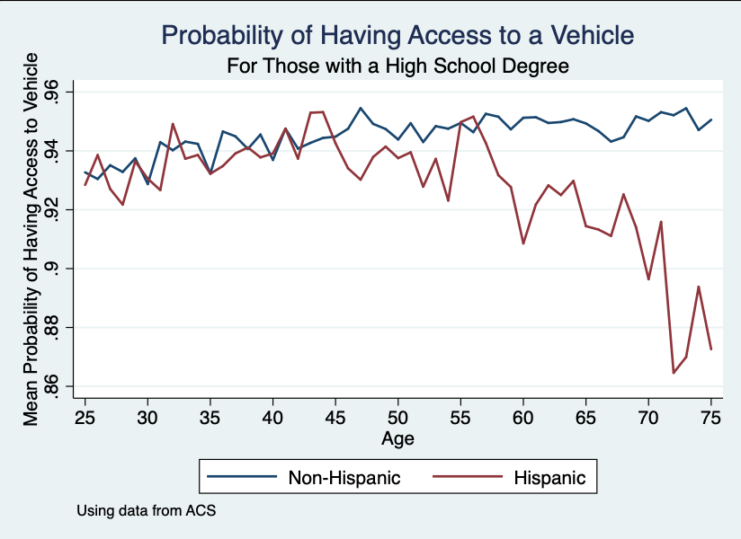
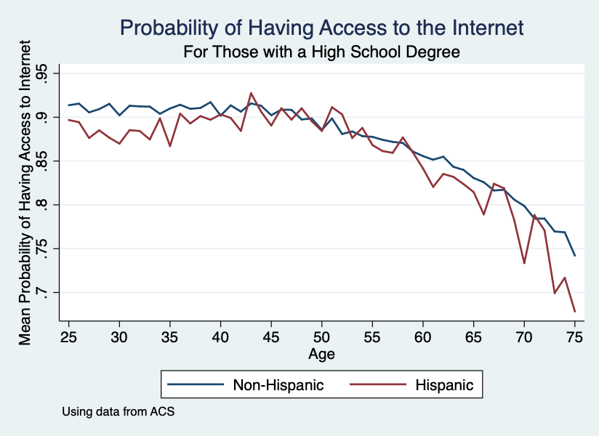
Characteristics related to employability

Slide 14
Summary of Census/ACS data
No clear patterns by Hispanic status and Age among the High School graduate population

Slide 15
Previous experiments
Two laboratory experiments in which we showed 40 randomized resumes for a clerical position to
  149 Students
  68 HR managers
Asked them to rate resumes on a 1-7 Likert Scale
Tracked eyes
Age indicated by high school graduation date, ranged from 36-76
Hispanic status indicated by last name
  There are no Hispanic first names in these resumes
Other resume items came from real resumes, following standard procedure for audit studies

Slide 18
Student Sample

Slide 23
HR Manager Sample

Slide 26
Bottom-Line
Student and HR samples treat Hispanic and non-Hispanic resumes very similarly across ages 36-76
This is in striking contrast to earlier results by Black/non-Black first names
It may be that Hispanic last names don’t signal Hispanic in the same way that Hispanic first names do
Experiments are not set up to test stereotypes about Hispanics

Slide 27
The mTurk Experiment

Slide 28
Experimental Design
We recruited participants in Amazon’s MTurk
  1,068 participants contacted in 5 waves
  Participants were asked to rate 30 resumes hosted in a Qualtrics survey
    More than 30,000 resumes were rated
  Paid participants $4 for completing the survey
  Survey designed to take 30 minutes to complete
Experiment ran from September 2019 to July 2020
Participants did not know they were part of an experiment until they completed the survey

Slide 29
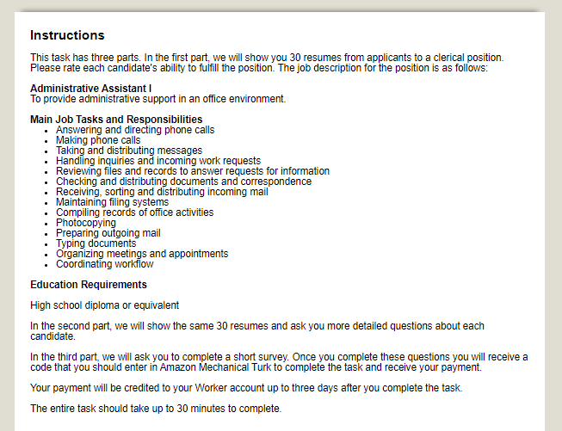
Experimental Design

Slide 30
Experimental Design
The survey had three parts:
  Resume rating
    Participants were asked to rate the ability to fulfill a clerical position for 30 fictitious candidates using a 7-point Likert Scale
    Attention check question
    We brought back the resumes and evaluated if the candidate had the necessary skills for the position, how much supervision they need, and their communication skills
  Participant demographic information
    A second attention check question
  Trust and altruism questions (unincentivized)
Question 1
Question 2

Slide 31
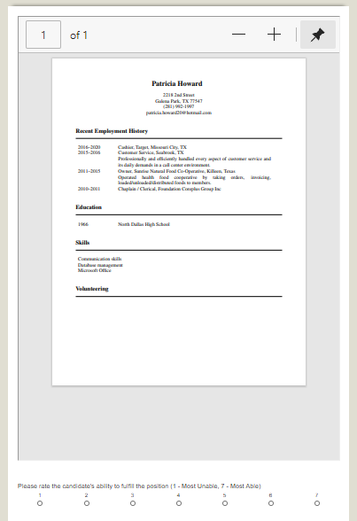
Resumes
Resumes constructed combining all its components randomly using Lahey and Beasley’s (2009) resume randomizer
We draw the components from a pool of
  216 different jobs
  24 skills
  80 first names and 40 last names (male and female)
  82 addresses
  72 phone numbers
  77 high schools
  41 high school graduation years (1962-2002)

Slide 32
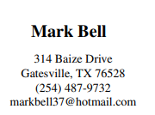
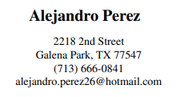
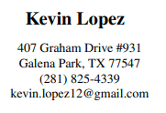
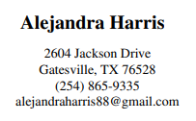
Signaling Age and Ethnicity
We use high school graduation year to signal age
We use the candidate’s name on the resume to signal if the candidate is Hispanic
  The distribution of names matches the proportion of Hispanics in Texas
    80 percent of the resumes have non-Hispanic first and last name
    10 percent have Hispanic first and last name
    5 percent have a non-Hispanic first name and Hispanic last name
    5 percent have a Hispanic first name and non-Hispanic last name

Slide 33
Ensuring Data Quality
We took the following steps to ensure the best possible data quality:
  Participants did not know they were part of an experiment
    We debriefed participants at the end of the survey
  Two attention check questions that required specific answers
  Exclude participants who took less than 20 minutes to complete the survey
  Exclude participants with duplicated IP addresses
  Exclude participants with IP addresses outside of the US
353 participants did not pass at least one of the quality checks

Slide 34
Participant Summary Statistics

Slide 35
Do Resume Characteristics Predict Ratings?
Three machine learning models, Linear regression:
  Both Lassos predict 22% of rating
  OLS predicts 20%
  Random Forest predicts 79%
LASSO predictor gives a high weight to
  Job histories related to clerical experience
  Job histories with details
  Skills related to clerical work
LASSO predictor gives a low weight to
  Job histories not related to clerical work (examples: waiter, babysitting)
  High school name
  Email provider
We conclude resume characteristics have a good predictive power suggesting that participants read the resumes before rating them

Slide 36
Participants Distinguish Age and Ethnicity from Resumes
Notes:
Similar to EEO questions, including if they are veterans or not

Slide 37
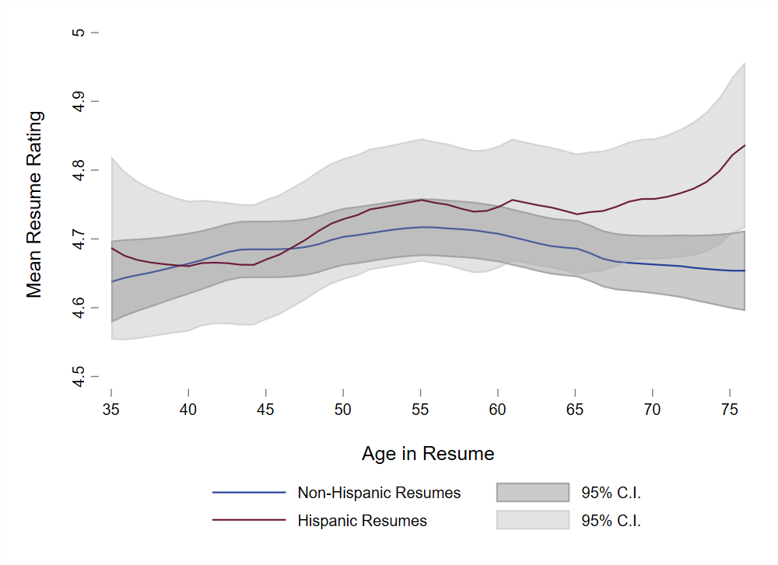
Resume Ratings by Ethnicity and Age
No significant difference between Hispanic and non-Hispanic resumes
Hispanics experience an increasing trend in ratings as they age
Slight decrease in ratings for older non-Hispanics

Slide 38
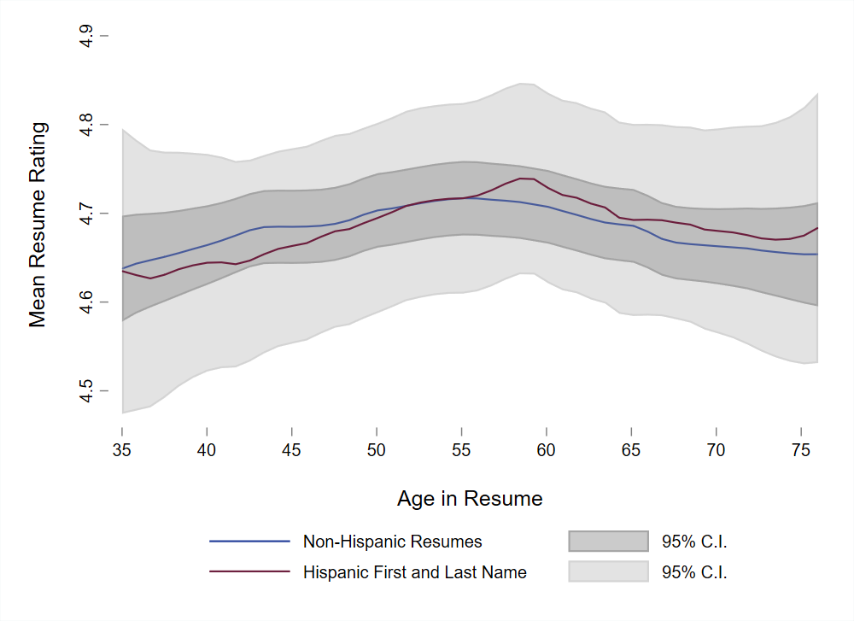
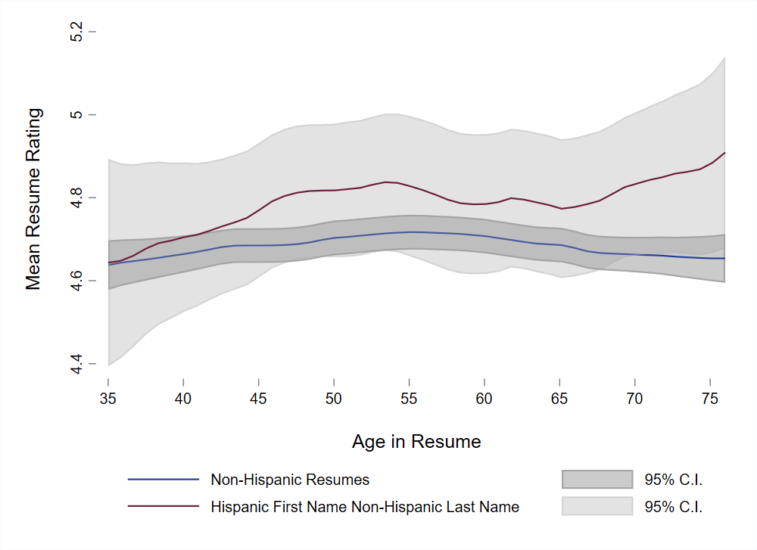
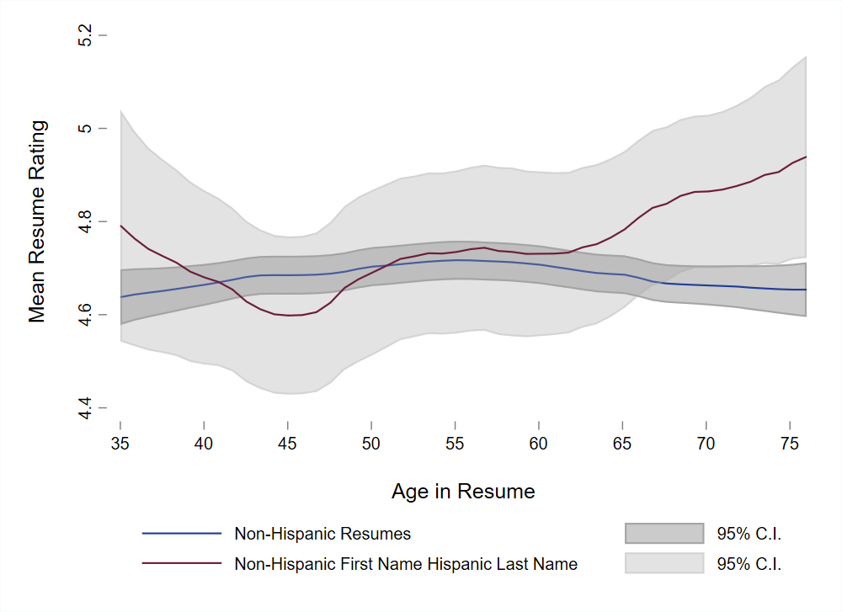
Resume Ratings by Type of Hispanic Signal and Age
Hispanic first and last name
Hispanic first name, non-Hispanic last name
Non-Hispanic first name, Hispanic last name
No significant difference compared to non-Hispanic resumes
Increasing trend in ratings for Hispanics as they age driven by mixed-signal groups

Slide 39
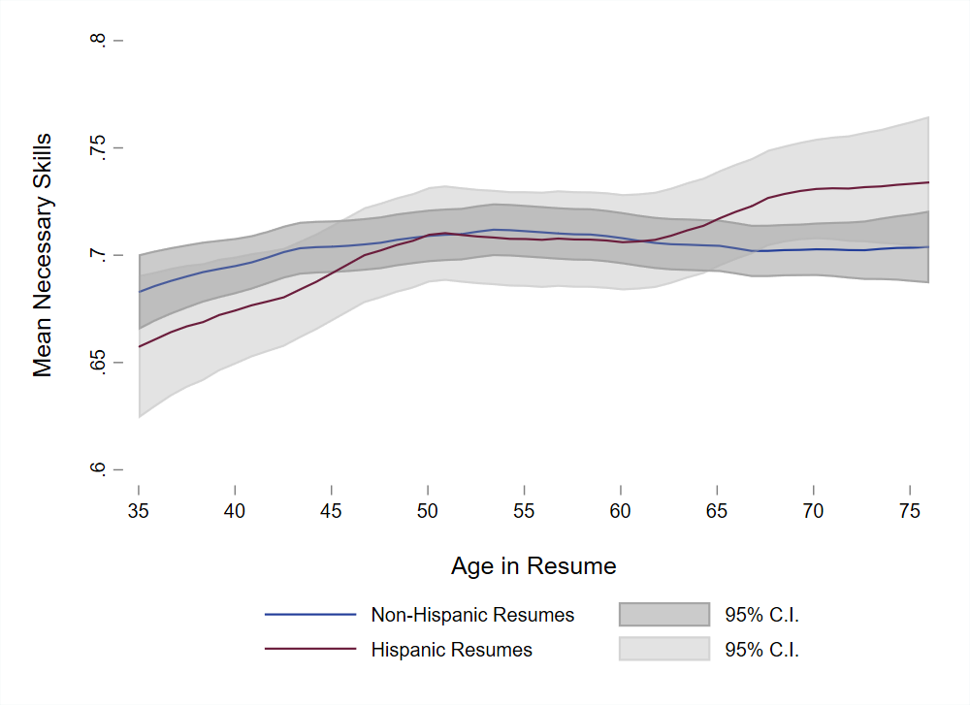
Having Necessary Skills Ratings by Ethnicity and Age
No significant differences between ethnicities
Pattern is consistent with the one in overall resume ratings

Slide 40
Estimation results: Differences between Ethnicities
On average we cannot find a significant difference between Hispanics and non-Hispanics
We have power to detect anything but small effect sizes

Slide 41
Estimation results: Differences between Ethnicities

Slide 42
Estimation results: Differences between Ethnicities and Age
Non-Hispanic ratings follow a linear pattern across age
Hispanics ratings follow a U-shaped pattern across age

Slide 43
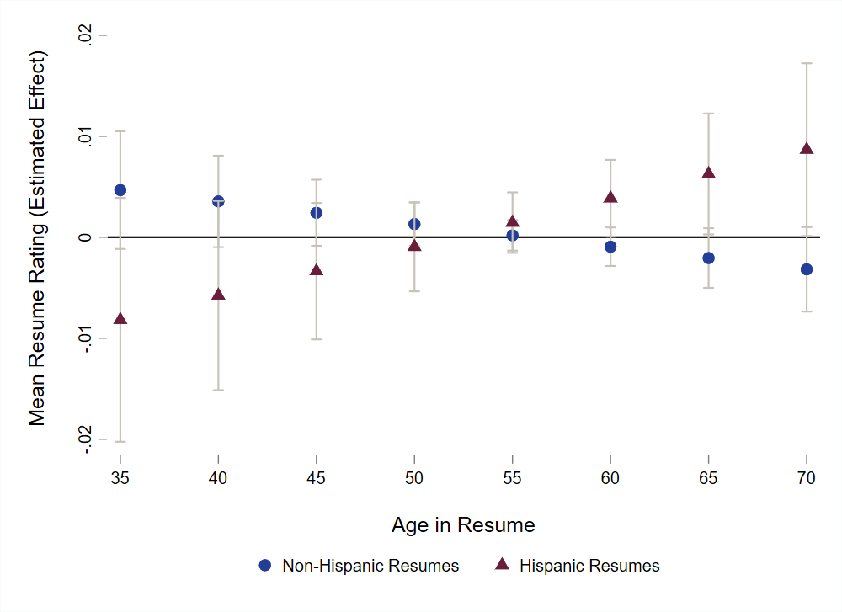
Marginal Effect of Age for Hispanics and non-Hispanics
Age has an increasing effect for Hispanics

Slide 44
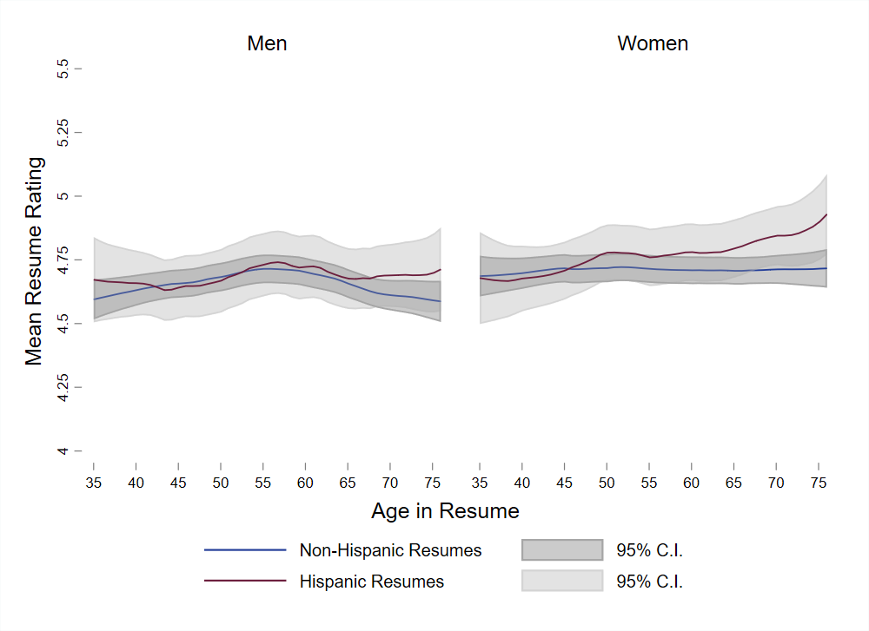
Heterogeneity by Gender
Increasing trend in age for Hispanics driven by women
Ratings for men are very similar between Hispanics and non-Hispanics

Slide 45
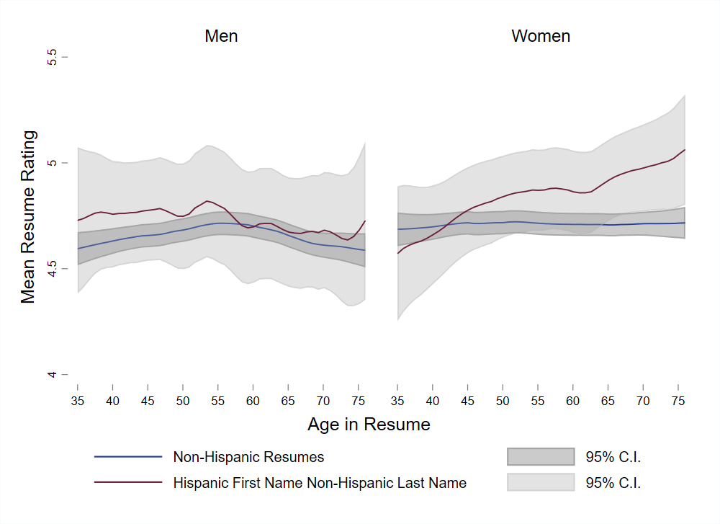
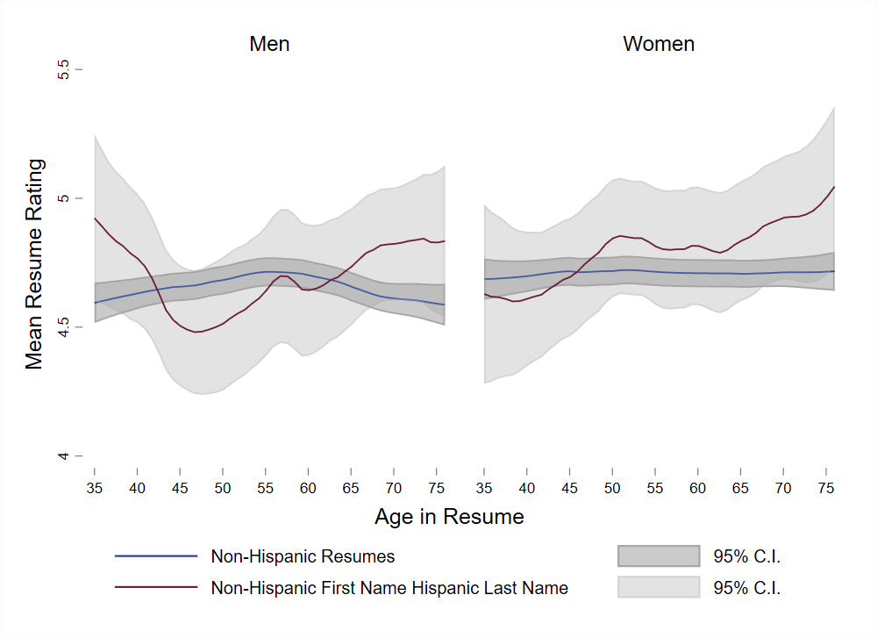
Heterogeneity by Gender
Hispanic first and last name
Hispanic first name, non-Hispanic last name
Non-Hispanic first name, Hispanic last name
Increasing trend in age for Hispanics with mixed signal

Slide 46
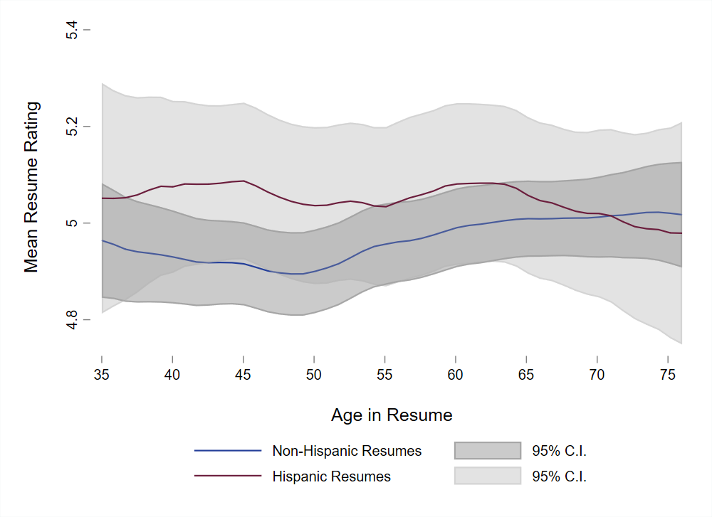
Match with HR Sample in Second Experiment
Matched mTurk sample on HR and Hiring Experince
HR Sample from Experiment 2

Slide 47
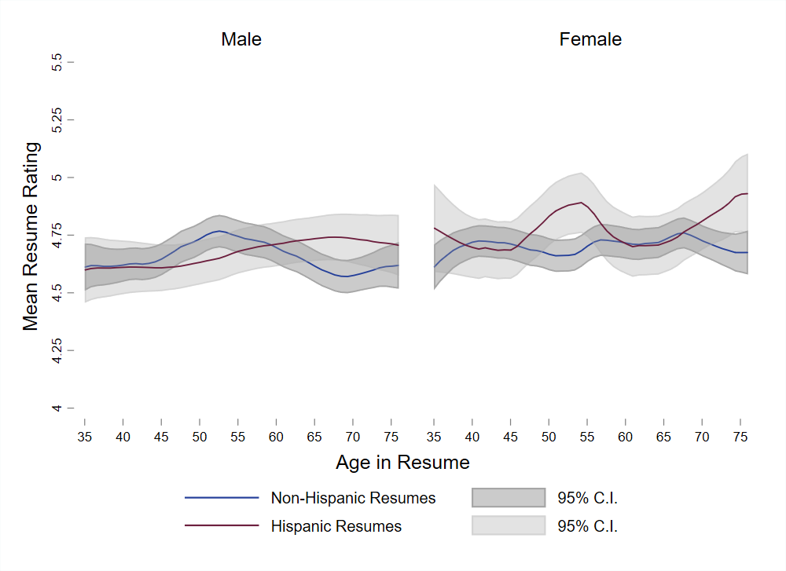
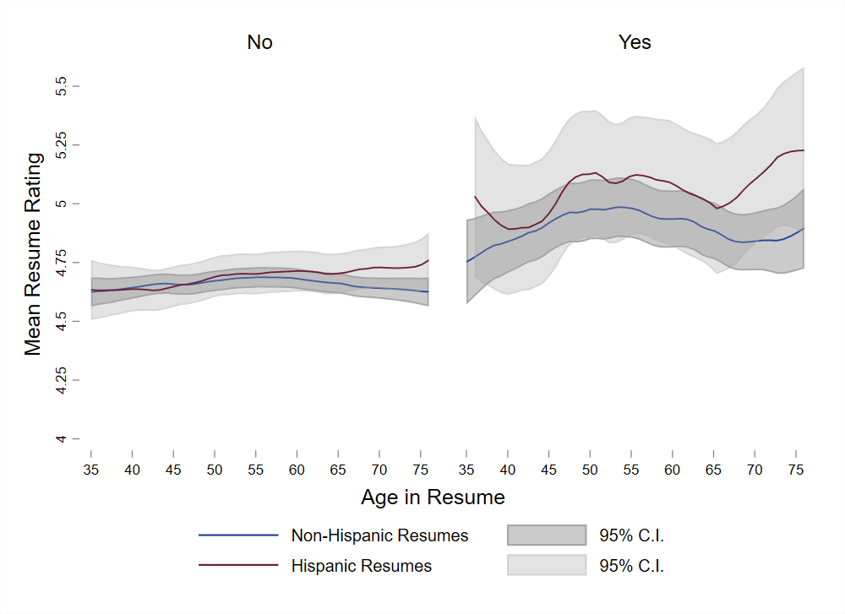
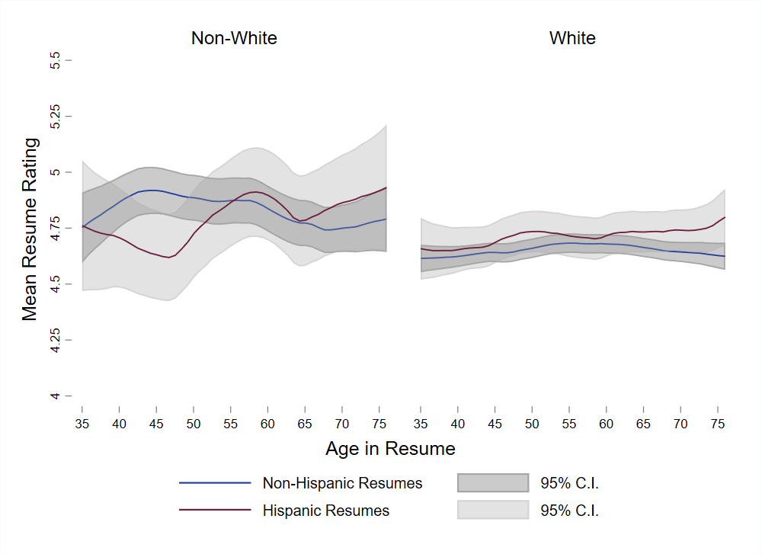
Heterogeneity by Participant Characteristics
Gender
Identifies as Hispanic
Race
Patterns similar to main results
No differences for men or women
Hispanic participants give higher ratings overall, and slightly higher for Hispanic resumes
White participants give lower ratings, no difference between Hispanic and non-Hispanic resumes

Slide 48
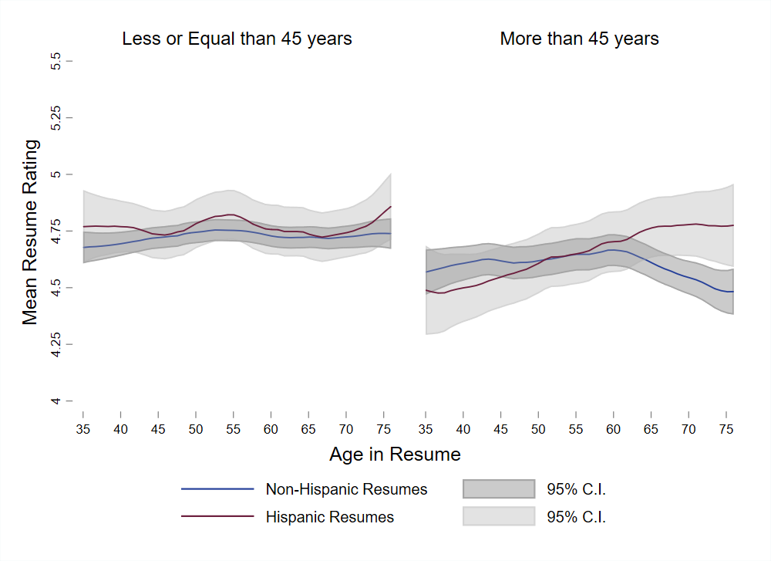
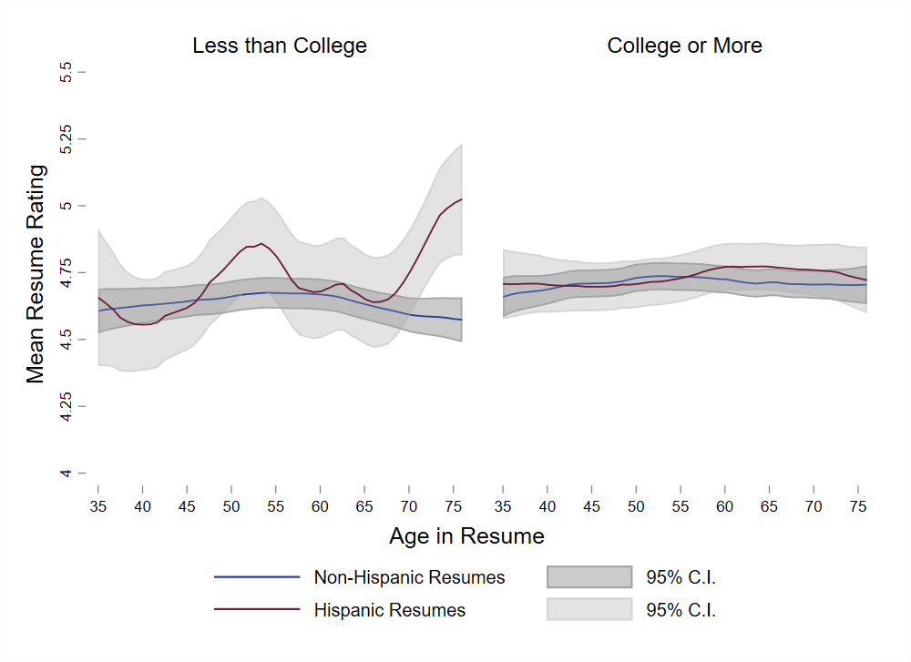
Heterogeneity by Participant Characteristics
Age
Education
Patterns similar to main results
Ratings flatter by age for younger participants, no difference between Hispanic and non-Hispanic resumes
Older participants prefer older Hispanic applicants to older non-Hispanic applicants
Less educated give higher ratings for older Hispanics

Slide 49
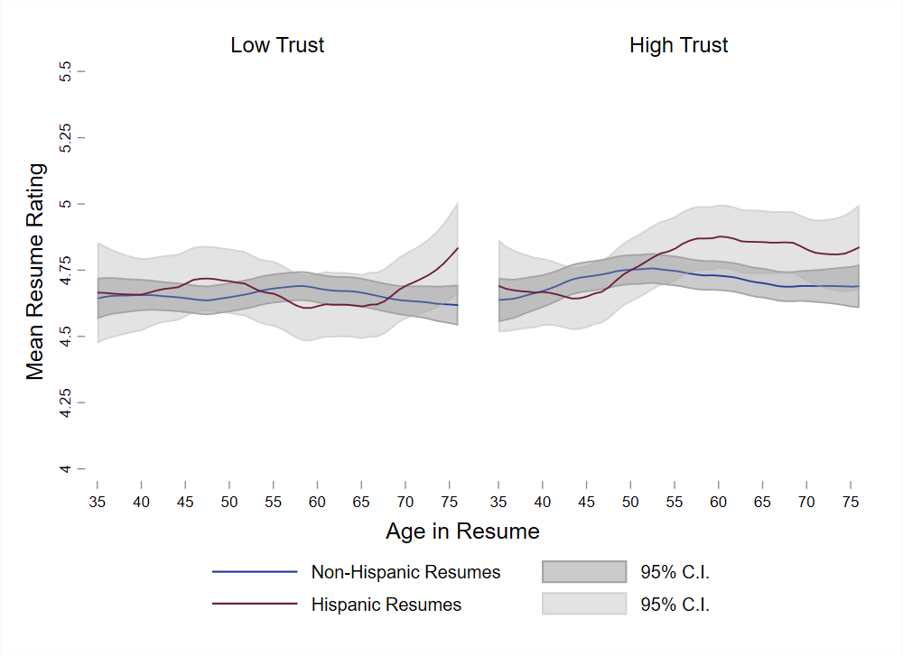
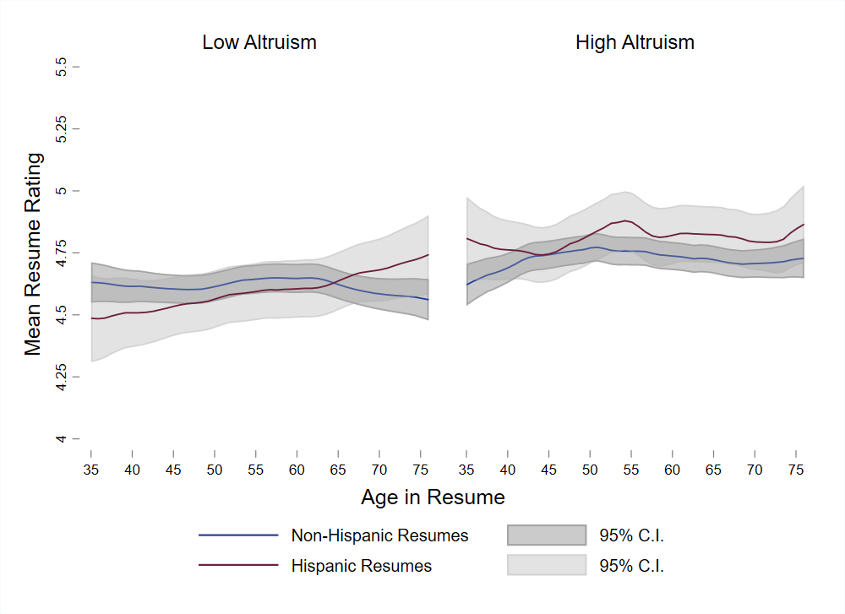
Heterogeneity by Participant Characteristics
Trust
Altruism
Patterns similar to main results for low-trust participants
High-trust participants give Hispanics higher ratings but the difference is not significant
High-altruism participants give Hispanics higher ratings and the difference respect to low-altruism participants is significant
Regression results

Slide 50
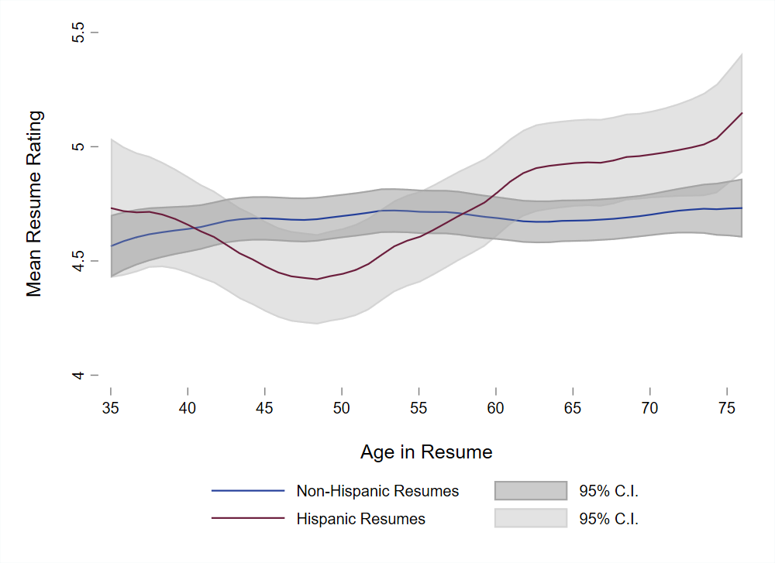
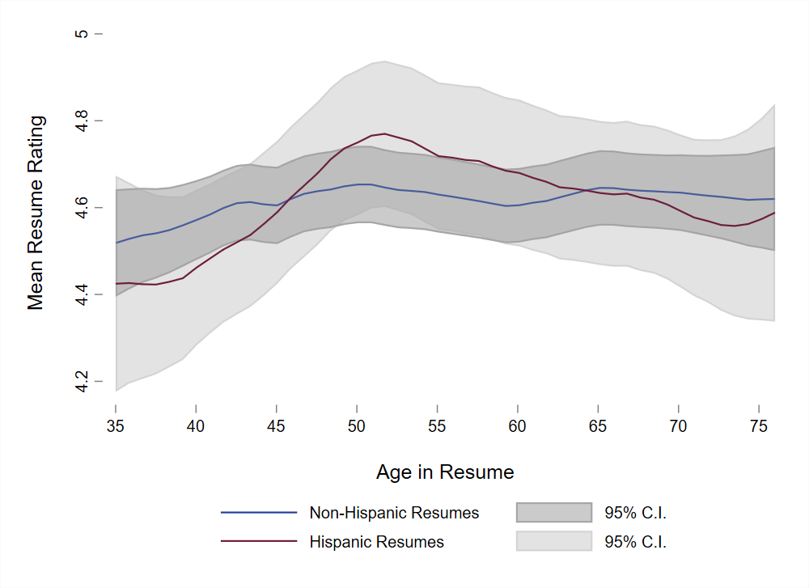
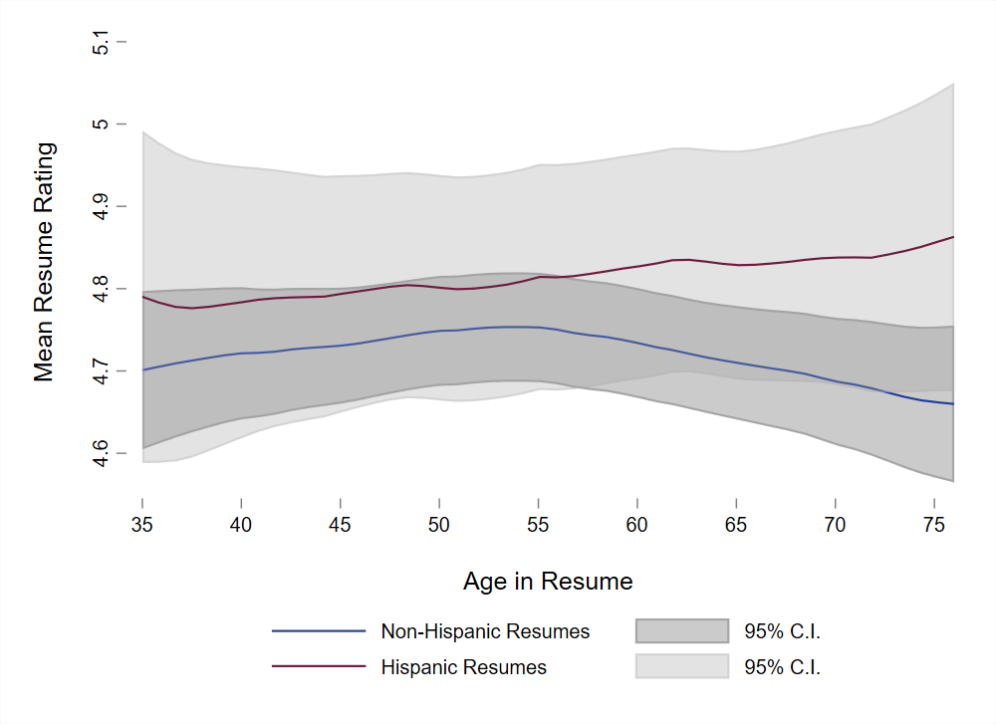
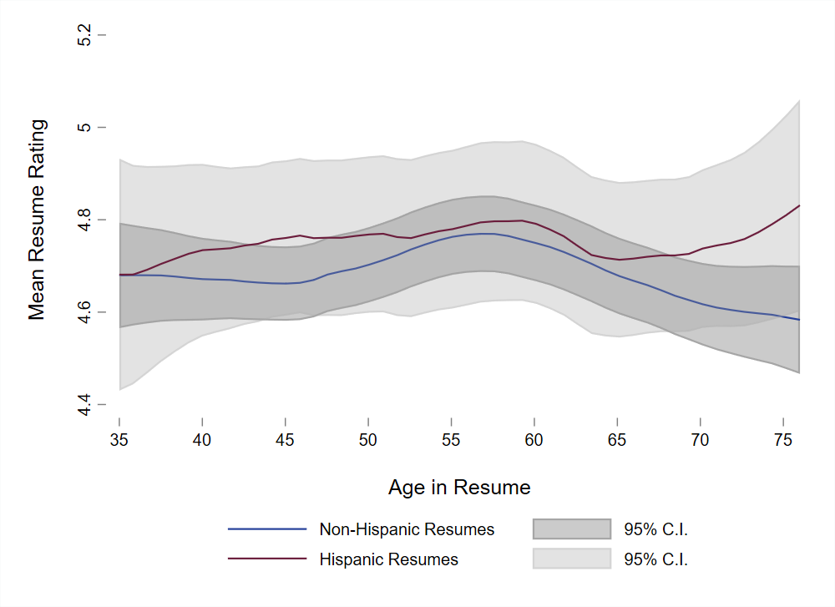
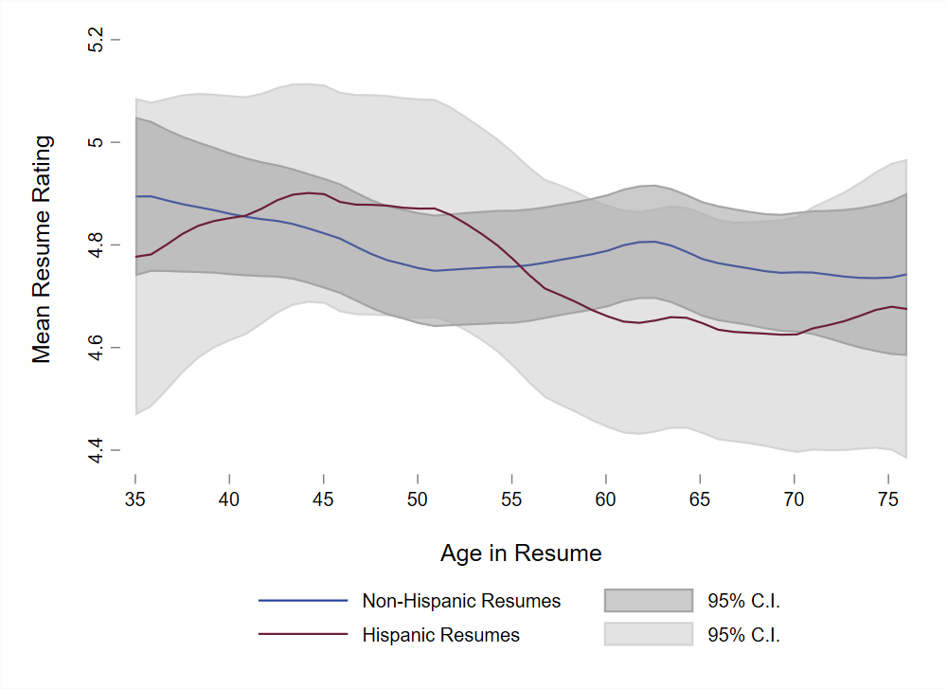
Regional Heterogeneity
Northeast
Southeast
Southwest*
Midwest
Northwest*
Midwest and Southwest that have large Hispanic populations have higher ratings
The West displays a marked decreasing trend in ratings with age
  * California is in the Southwest in this analysis

Slide 51
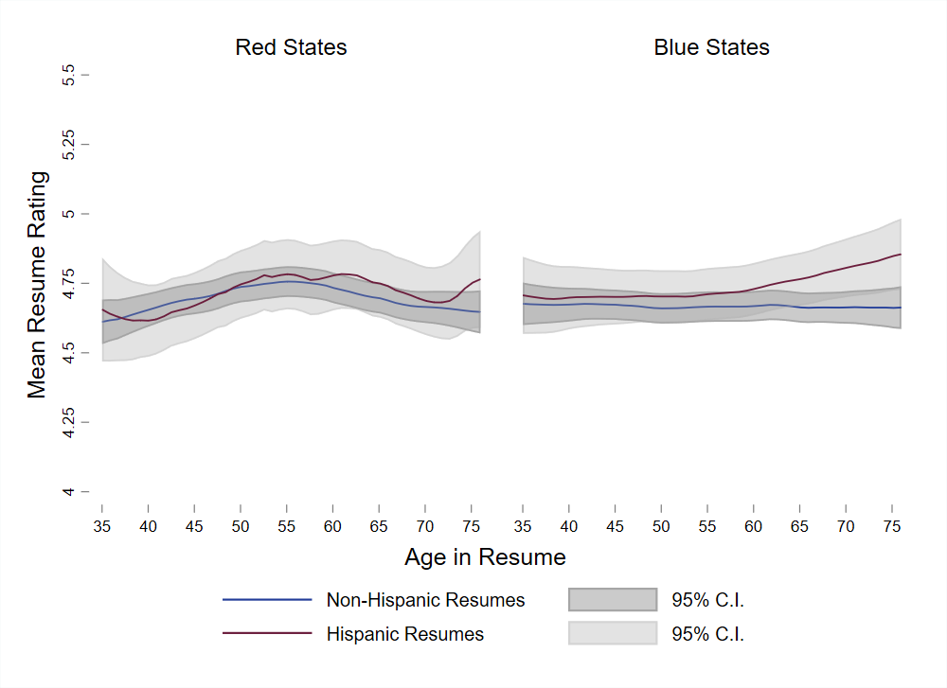
Red vs Blue States Heterogeneity
States ordered by 2016 election results
No significant difference
Patterns similar to main results
Upward trends by age in Hispanic ratings driven by participants in blue states

Slide 52
Checking the Effect of Hispanic Stereotypes
We have two approaches to analyze the potential effect of Hispanic stereotypes
  When we brought back the resumes after the first attention check, we asked participants questions to asses potential stereotypes as outcome variables
    Need for supervision
    Communication skills

Slide 53
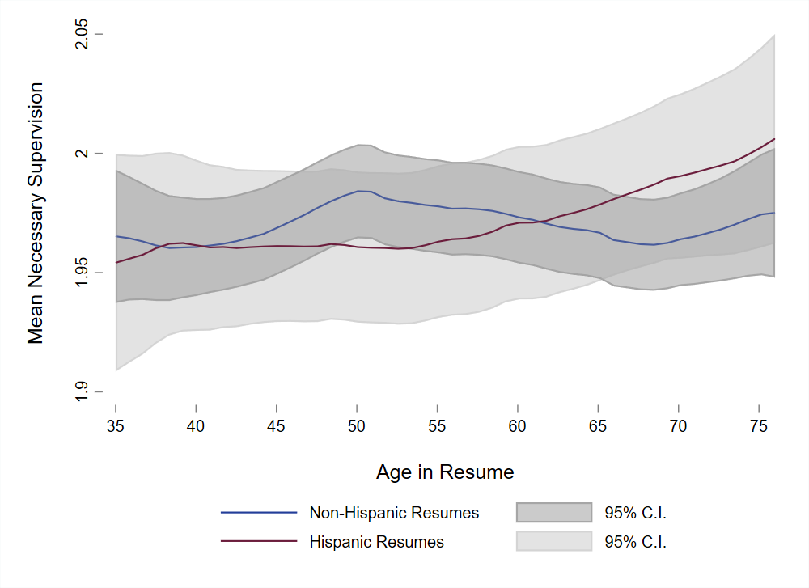
Stereotype 1: Hispanics are lazy and need more supervision
Y-axis is inverted: higher number, less need for supervision
No significant differences between ethnicities
  Slightly lower rating for younger Hispanics
Pattern is consistent with the one in overall resume ratings

Slide 54
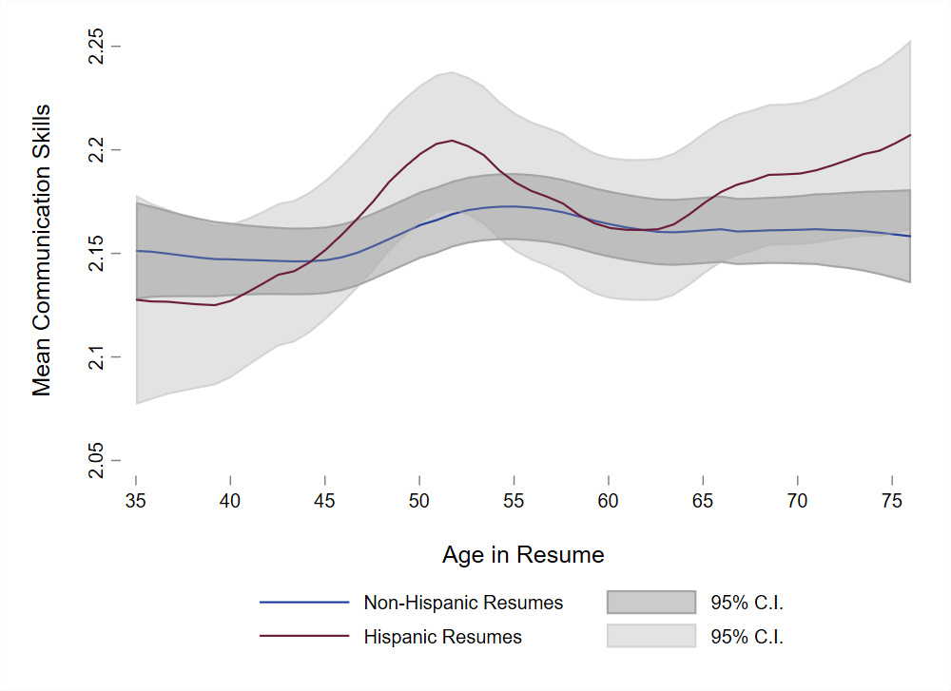
Stereotype 2: Hispanics have poor communication skills
No significant differences between ethnicities
  If anything, communication skills for Hispanics increase with age
Pattern is consistent with the one in overall resume ratings

Slide 55
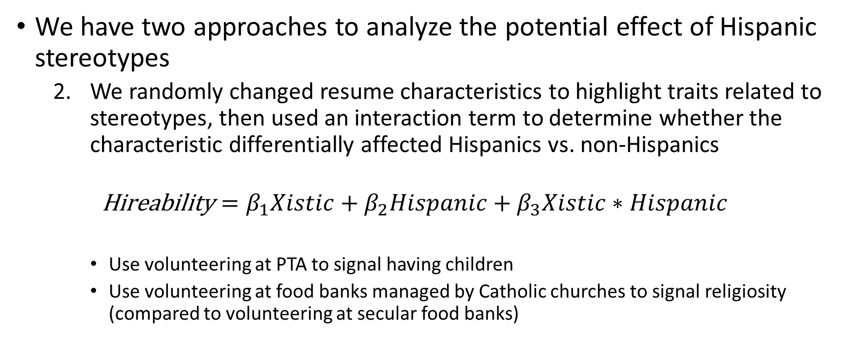
Checking the Effect of Hispanic Stereotypes
We have two approaches to analyze the potential effect of Hispanic stereotypes
  We randomly changed resume characteristics to highlight traits related to stereotypes, then used an interaction term to determine whether the characteristic differentially affected Hispanics vs. non-Hispanics
  $$\text{Hireability}=β_{1}Xistic+β_{2}Hispanic+β_{3}Xistic∗Hispanic$$
    Use volunteering at PTA to signal having children
    Use volunteering at food banks managed by Catholic churches to signal religiosity (compared to volunteering at secular food banks)

Slide 56
Stereotype 3: Hispanics have many children and require time off work
Effect across age
Effect across age
Notes:
Do estimates for women

Slide 57
Bottom Line
National survey data and three experiments suggest that for high school graduates (w/o college degrees)
  There is no discernable pattern to labor market outcomes differences by Hispanic vs. non-Hispanic status by cohort and age over time
  There is no discernable pattern to labor market outcomes by Hispanic vs. non-Hispanic status by age in a recent cross-section
  Hypothetical Hispanic and non-Hispanic job applicants for a clerical position are treated similarly by age in three different experiments
  Caveat: not externally valid to other education levels!

Slide 58
Thank you!!

Slide 59
Extra Slides

Slide 60

Attention Check Question1
Return

Slide 61

Attention Check Question2
Return

Slide 62
Do Resume Characteristics Predict Ratings?
To check if resume characteristics predict ratings we train three machine learning models including every resume characteristic except ethnicity and age:
  Causal Forest
  Linear LASSO
  Adaptive LASSO
We also estimate a linear regression including the same controls
We check:
  Fit of each model
  The weight the LASSO predictor give to each resume characteristic
  The correlation between the predictions of these models
We conclude resume characteristics have a good predictive power suggesting that participants read the resumes before rating them

Slide 63
Do Resume Characteristics Predict Ratings?
To check if resume characteristics predict ratings we train three machine learning models including every resume characteristic except name and age:
  Causal Forest
  Linear LASSO
  Adaptive LASSO
We also estimate a linear regression including the same controls
LASSO predictor gives a high weight to
  Job histories related to clerical experience
  Job histories with details
  Skills related to clerical work
LASSO predictor gives a low weight to
  Job histories not related to clerical work (examples: waiter, babysitting)
  High school name
  Email provider
We conclude resume characteristics have a good predictive power suggesting that participants read the resumes before rating them

Slide 64
Model Fit and Correlations
Full sample
Applying Quality Checks
Correlations
Both specifications have a good predictive power for a cross-section

Slide 65
Relative Weights in LASSO
LASSO predictor gives a high weight to
  Job histories related to clerical experience
  Job histories with details
  Skills related to clerical work
LASSO predictor gives a low weight to
  Job histories not related to clerical work (examples: waiter, babysitting)
  High school name
  Email provider

Slide 66

XMarginal Effect of Ethnicity Across Age
No significant difference across ethnicities except for the eldest

Slide 67
Heterogeneity by Participant Characteristics: Trust and Altruism
Return
Notes:
Do estimates for women

Slide 68

Stereotype 3: Hispanics have many children and require time off work
No significant differences between ethnicities
No evidence that children signal leads to smaller ratings
Sample with children signal is smaller so results are suggestive
  Focus on general Hispanic indicator
Return

Slide 69

Stereotype 3: Hispanics have many children and require time off work
No significant differences between ethnicities
No evidence that Catholic indicator has an effect on Ratings
Sample with Catholic signal is smaller so results are suggestive
  Focus on general Hispanic indicator
Return

Slide 70
Stereotype 3: Hispanics have many children and require time off work – Results for Women
Return
Notes:
Do estimates for women

Slide 71


Holiday Destination Questions

Slide 72
Potential Heterogeneity Checks across Participants
Trust/Reciprocity
Altruism
Geography
Before/during COVID

Slide 73

Robustness check 1: Restrict sample to participants with a college education
Similar pattern for both Hispanics and non-Hispanics
No significant difference between Hispanics and non-Hispanics

Slide 74

Robustness check 2: Match with HR Sample in Second Experiment
Propensity Score Match
Match on HR and Hiring Experience
Patterns change a little but there is no significant difference between Hispanics and non-Hispanics

Slide 75



Slide 76



