Slide 1

Enforcing Payment for Water & Sanitation Services in Nairobi’s Slums
Aidan Corville, World Bank
Sebastian Galiani, U of Maryland & NBER
Paul Gertler, UC Berkeley & NBER
Susumo Yoshida, World Bank
NBER SI
August 23, 2020
Cambridge MA

Slide 2
Motivation
Slums growing worldwide
Kenya, ½ urban population live in slums
Poor access to public services, e.g. electricity, water & sanitation
40% lack sanitation in urban Africa, 1 toilet/ 500 in Nairobi slums
Subsidies/credit for connection costs successful, but few pay usage bills
e.g. Devoto et al, 2012 AEJ:Applied; Guiteras et al, 2015 Science; Lee et al., 2020 JPE
Despite investment, last mile connections low e.g. Lee et al., 2018 Dev. Engineering; Cameron & Shah, 2019 JDE
Creates financial distress: Utilities lose $39 billion of billable water & $96 billion in electricity annually from non-payment e.g. Liemberger et al, 2019; Northeast Group, 2017

Slide 3
Culture of nonpayment creates financial crisis for utilities
Nonpayment lowers effective price below MC, making new customers financial liabilities
Lack of resources for operation and investment, possibly making utilities ration services (Burgess et al, 2020)
Water and sanitation rationing has negative health consequences (Galiani et al., 2005; Ashraf et al., 2018)
Enforcement especially difficult in countries with weak institutions and corruption (Ashraf et al., 2016)
Politicians reluctant to cut services for nonpayment for fear of loosing public support

Slide 4
Two enforcement interventions
Engagement invention
  Provide information on payment areas to tenants
  Explain value to them & consequences to utility
  suggest that they encourage landlords to pay
Credible threat of disconnection if do not pay
Field Experiment with
  Nairobi City Water and Sewerage Company
  8 slums with about 9000 compounds in and around Nairobi

Slide 5
Preview of results
Engagement intervention has no effect
Large effect of disconnection
  Increases payment 30 percentage points (300%)
  One-time effect: Intervention may need to be sustained
  No spillover effects
No political costs of disconnections
  Landlord/tenant perceptions of Utility fairness & quality of service
  Relationships of tenants with their landlords
  Tenant community activism
  Child health
Housing Market
  Landlords rent out more units
  marginally increase rents
  No effect on tenants moving out

Slide 6
Contribution to Enforcement Literature
High Income settings
  Tax evasion literature (e.g. Slemrod et al., 2001; Kleven et al., 2011)
  Environmental protection (e.g. Telle, 2013)
  OHSA (Levine 2015)
LMIC Settings
  India – Environmental inspections of large manufacturing plants (Duflo et al., 2018)
  Brazil - Inspections and fines if firms are found to be operating without a business license (Bruhn and McKenzie 2013)
  Costa Rica -- Credible enforcement emails for tax compliance (Brockmeyer et al. 2019)
  Kenya – Patient safety inspections of health clinics and closure if non-compliant with patient safety rules (Bedoya et al. 2020)

Slide 7
Overview
Institutional Setting
Interventions
Experimental Design
Results
Next steps

Slide 8
Institutional Setting
IN 2014 Nairobi Water and Sewerage Company (NCWSC) invested in water and sanitation infrastructure in 8 slums with over 9000 compounds
NCWSC used subsidies and credit to finance connections from compounds to the water/sewage systems
  Raised coverage from 47% in 2014 to near universal in 2018
Customer non-payment has been a problem
  57% of costumers have yet to make a single payment
Caused deterioration in service quality
  % did not have water “last week” increased from 5% in 2014 to 60% in 2018

Slide 9
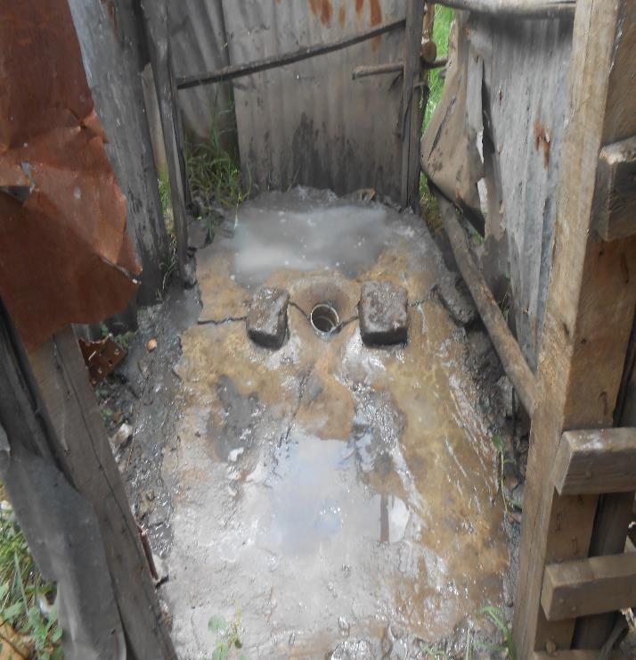
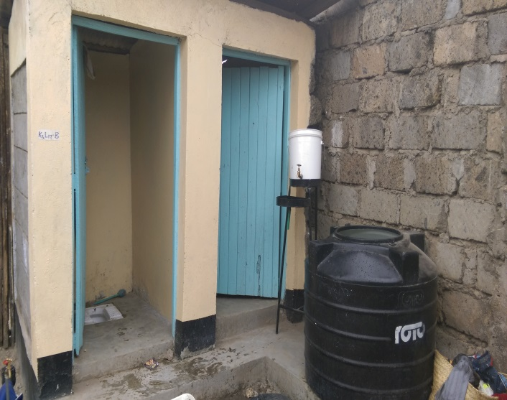
Before and after upgrading

Slide 10

NCWSC billing data collected in “Jisomee Mita”
Phone (mobile money) system to collect consumption, receive bills and make payments
Billing data captures each transaction
Includes all NCWSC accounts spanning 4.5 years of transactions
  Monthly and ad hoc invoices
  Payment dates and amounts
  Water usage
  Basic demographics
  Contact information

Slide 11
Non-payment is the norm
 | Mean
Years NCWSC customer | 1.98
Ever made a payment | 0.52
Proportion of invoices paid | 0.14
Months until first payment | 8.19

Slide 12
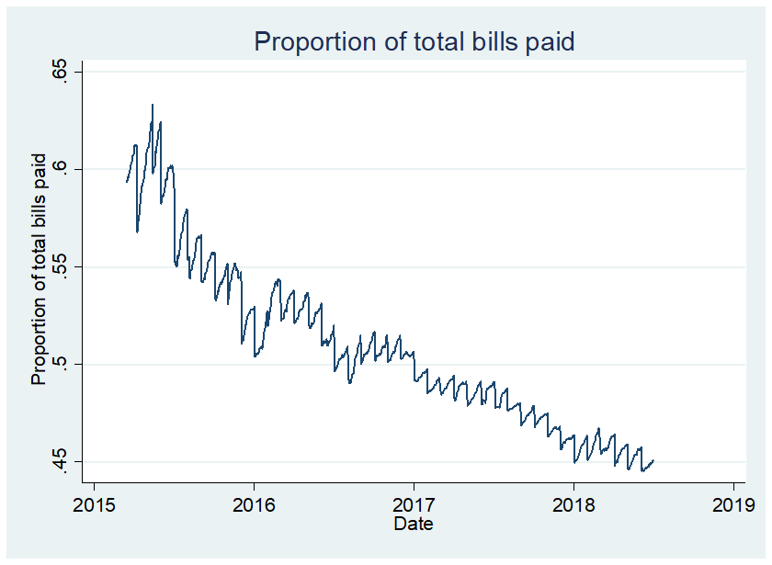
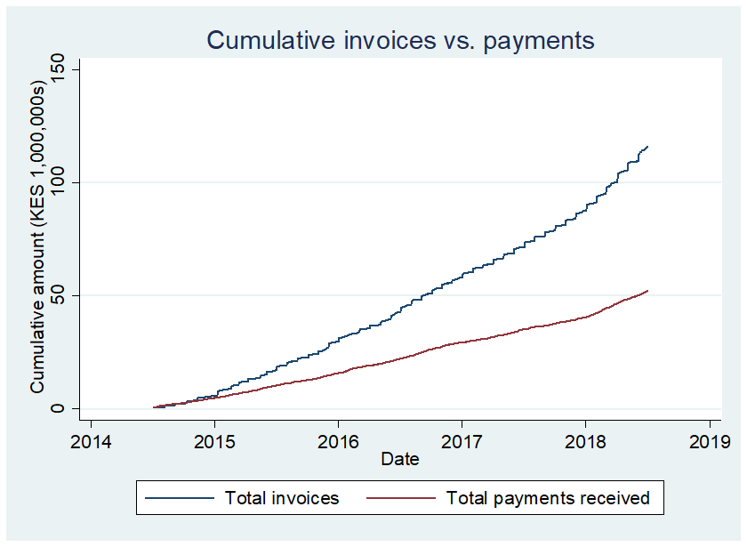
While connections grew, share of bills paid fell btw 2014-18

Slide 13
Why don’t people pay? (self-reported)

Slide 14
Correlates of payment
VARIABLES | Proportion of invoices paid
Landlord is resident | 0.024***
Received water in last 7 days | 0.068***
Knows how to pay the bill | 0.105***
Compound has tenants | 0.010
Owner/Landlord is the bill payer | 0.013
Years with connection | 0.039***
Constant | 0.063***
Observations | 4,329
R-squared | 0.219
Notes:
Note: Left hand side variable is the proportion of total invoices paid by customer as of Aug 2019. Coefficients are generated from a simple OLS regression *** p<0.01, ** p<0.05, * p<0.1
**I would like to include income as a covariate but that is only in the kayole survey which will take more time to merge and only be for a small group.
I take from this slide that lots of stuff seems to matter in different ways, but r squared is still only 0.22, which means lots of unexplained variation too.

Slide 15
Overview
Institutional Setting
Interventions
Experimental Design
Results
Next steps

Slide 16
Interventions
All compounds received :
  call to owner to confirm contact details
  explain how to use Jisomee Mita
  on-site meter reading
  SMS to LL/owner with outstanding balance based on latest reading
Then rolled out 2 approaches to promote repayment:
  Strengthen accountability through face-to-face engagement with tenants
  Threat of disconnection for nonpayment

Slide 17
Engagement intervention
NCWSC visits compound to speak with tenants
“… make you aware of the importance of paying for water/sewer service charges and help you take the necessary steps to avoid being disconnected.”
“You may not be responsible for making water payments, but you can still make a difference by helping your landlord remember when and how to take action.”
“… explain to you how you can help ensure payments are made and how to avoid being disconnected.”

Slide 18
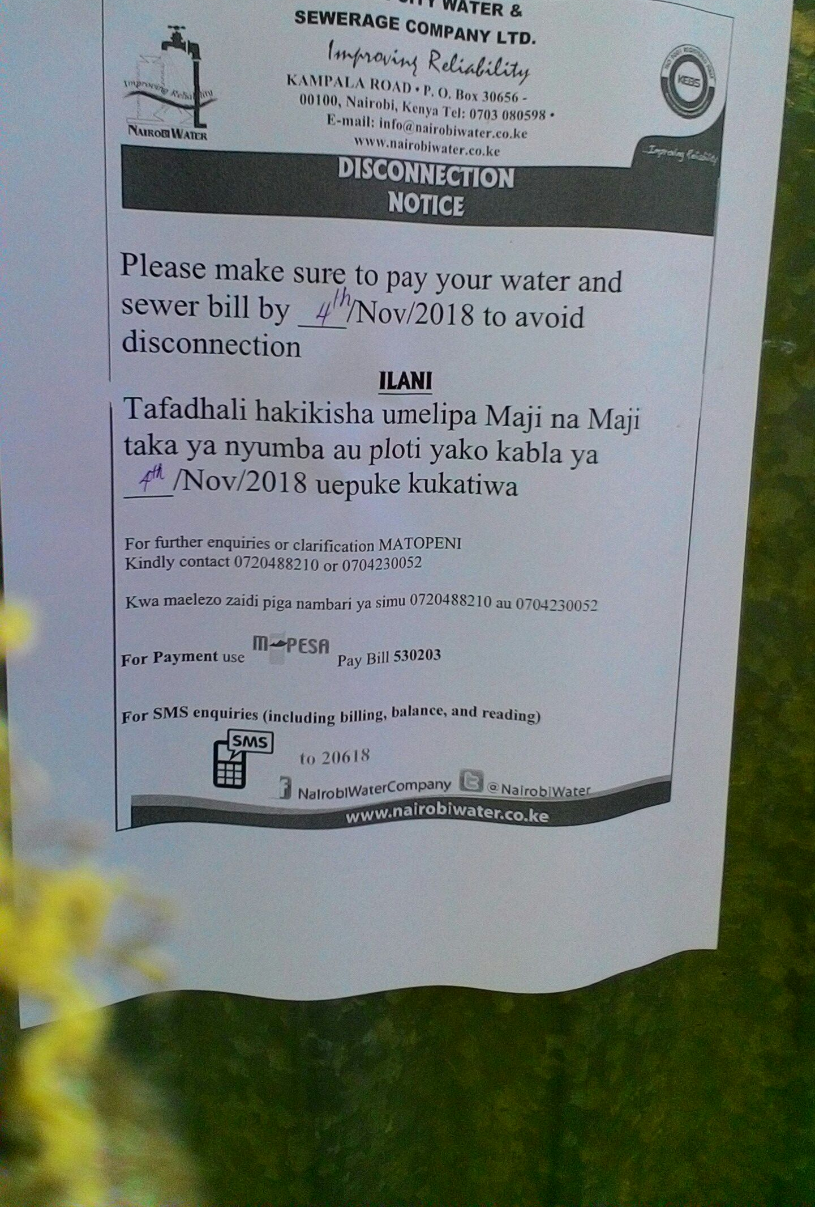
Enforcement intervention
Disconnection-eligible compounds visited by NCSWC staff.
Official notice placed on front door and next to water point including deadline for payment (15 days)
SMS to landlord provide second warning
Phone call Two further reminders before deadline
Disconnection if not paid by deadline.
Notes:
In practice, people didn’t have to pay the full amount. They had to pay something and then verbally agree to repay the remainder over time.

Slide 19
Timeline
 | LL info & phone survey |  | Engagement Intervention |  |  |  |  |  |  |  |  | Landlord and Tenant follow up survey
2018 |  |  |  |  |  | 2019
J | A | S | O | N | D | J | F | M | A | M | J | J | A | S
 |  | Meter readings |  | Enforcement intervention

Slide 20
Overview
Institutional Setting
Interventions
Experimental Design
Results
Take aways

Slide 21
Eligible Sample
Of 9147 compounds, 5091 eligible for study
  Payments in arrears
  Landlord had single not multiple accounts
  Drop business only compounds
Engagement intervention
  2,584 had tenants
Disconnection intervention
  2 slums dropped where disconnection technically difficult because of high-rise buildings
  3,253 included in study

Slide 22
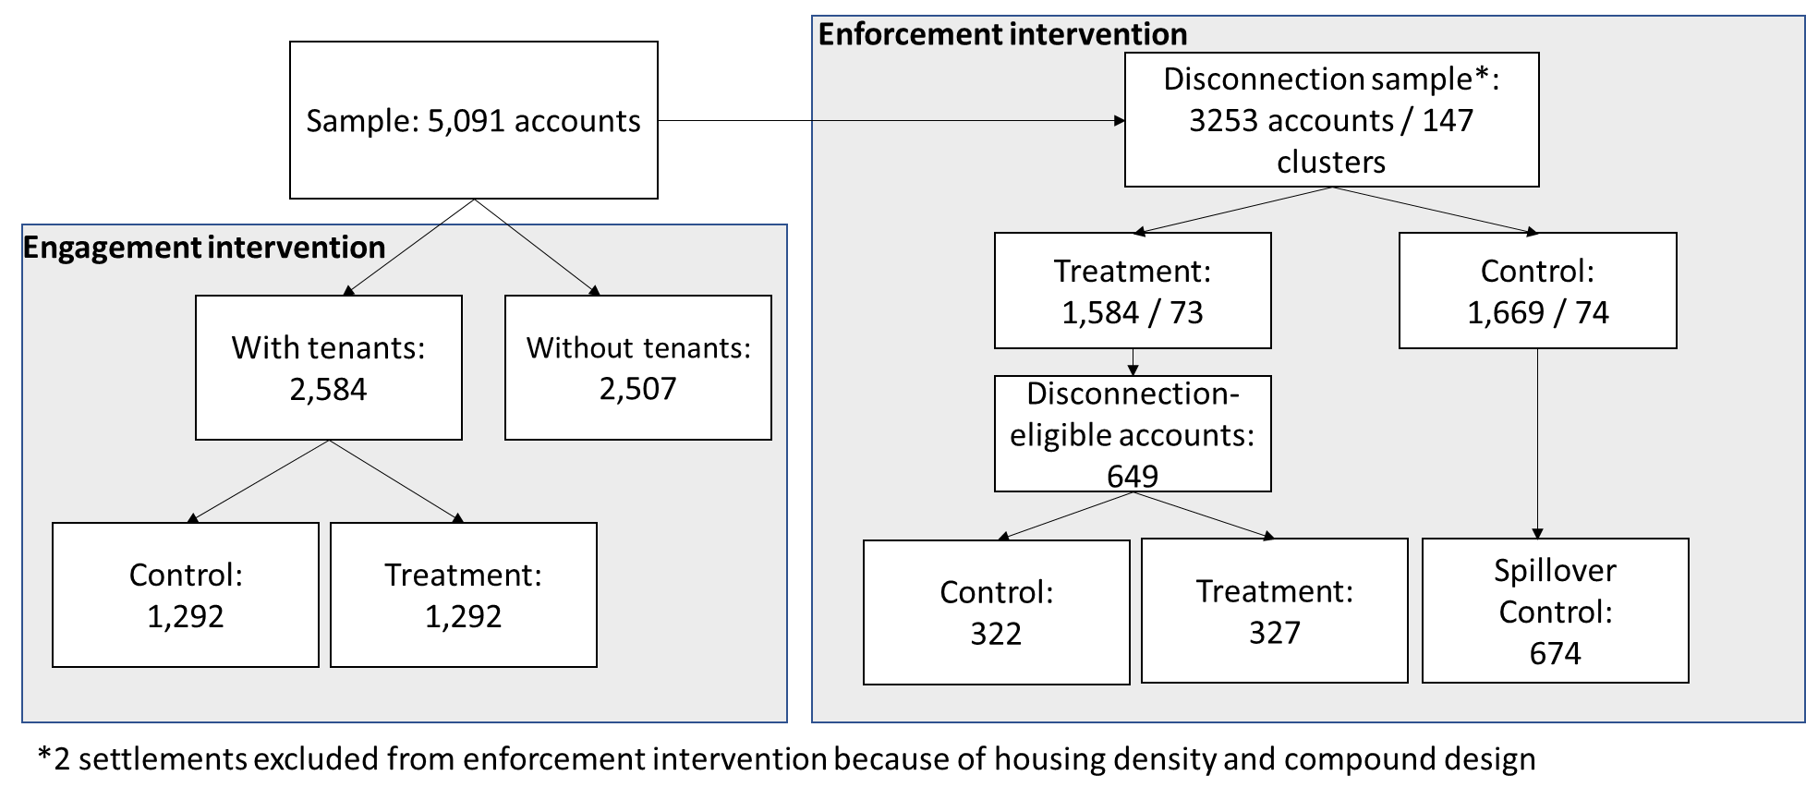
Experimental Design:

Slide 23
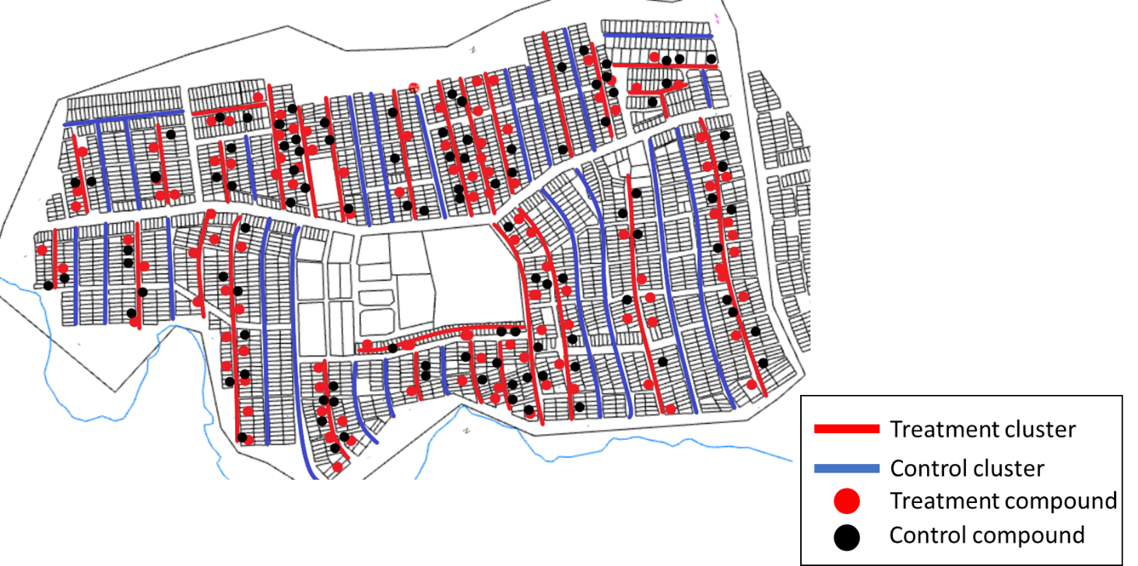
2-Stage Randomization for Disconnection Intervention

Slide 24
Intervention compliance
Engagement
Assigned to treatment | 1,292
Successful visit | 885 (69%)
Enforcement
Assigned to treatment | 327
Disconnection notice delivered | 299 (91%)
Disconnected | 97 (32%)
Notes:
Note that actual disconnections don’t reflect compliance, since the intervention is the notice. Disconnections only occurred if customers did not make payment after notice and 2 additional reminders. Some compounds that are recorded as having not paid but also not disconnected because of either (i) they were disconnected prior to the intervention or (ii) there was a particular engineering issue that didn’t allow a disconnection to happen – e.g. type of piping.

Slide 25
Overview
Institutional Setting
Interventions
Experimental Design
Results
Take Aways

Slide 26
Likelihood of payment over time
Notes:
This considers whether people make at least 1 payment from the time of the intervention

Slide 30
Survey of Landlords/Tenants
Political/Cost Outcomes (Anderson 2008 Indices)
Quality of Tenant-Landlord relationship Index:
  Landlord perceptions on whether tenants complain about water/ sewage facilities or about general compound conditions, and whether tenants keep compound in good condition.
  Tenants rating of their relationship with the landlord from 1 (very poor) to 10 (excellent).
Perceptions of NCWSC service quality Index:
  Extent satisfied with NCWSC services,
  Believe that NCWSC services improve people’s lives
  NCWSC provides clear communication,
  Believes NCWSC is not interested in helping community (reverse coded)
Perception of service fairness Index:
  believe that NCWSC enforcement mechanisms are fair and that bills are accurate and fair.
Activism:
  Whether tenants reached out to community leaders, participated in community meetings, or are members of community committees
Child health: Oldest child under 5 has had diarrhea or a fever in the past 2 weeks.

Slide 33
Take Aways
Culture of nonpayment of utility bills in slums leads to
  financial crisis for utility
  cuts in service quality that may have negative health effects
Credible threats of disconnection for nonpayment
  effective intervention to increase payment,
  but probably need to be continual and not one-time
Disconnection policy does not seem to have political costs
Affects rental market by
  making more rental units available,
  albeit at slightly higher costs but not high enough to cause tenants to leave

