Slide 1
Have Income-Based Achievement Gaps Widened or Narrowed?
Shirin Hashim, Thomas J. Kane, Thomas Kelley-Kemple, Mary Laski
and Douglas O. Staiger
NBER Summer Institute
July 22, 2020

Slide 2
For 30+ years, education policy has tried to preserve the equalizing role of public schools in the face of rising income inequality.
Rising income inequality,
income-based residential segregation
Higher standards, school accountability, school finance reform
VS.
Yet a consensus has emerged that income-based achievement gaps are widening:
“The Education Gap Between Rich and Poor is Wider than Ever”
-Eduardo Porter, New York Times, 2015.
“The gap in test scores between poor kids and wealthy kids is now nearly twice what it is between white kids and black kids.” -President Barack Obama, December 2013.
“Indeed, achievement gaps on standardized tests between high- and low-income students in the United States have grown by 40 percent in a generation…”
-National Academies of Sciences, Engineering, and Medicine 2019, Consensus report, Monitoring Educational Equity.

Slide 3
Why is this a difficult question?
We have no national assessment with student-level data on parental income over time.

Slide 4
Prior research
Reardon (2011) | Combined 12 surveys with family income linked to achievement for individual students. Measured change in student level relationship over time.
The measures of achievement differed. Achievement was measured at different ages (e.g. age 1-6 vs. age 18) Some income measures student-reported, some parent-reported. Income categories ranged from 5 to 15.
Hanushek, Peterson, Talpey and Woessmann (2019) | Used a factor analysis to create an SES-index using parental education and household possessions.
Found SES-based achievement gaps to be stable. The weights and components of the SES index varied from year to year. Not inconsistent with Reardon (2011), who also found gaps by parental education to be stable.
Lafortune, Rothstein and Schanzenbach (2018) | Used NAEP to study the impact of school finance reforms on student achievement and district spending.
Found that school finance reforms reduced gaps in spending and reduced gaps in achievement between high and low-income districts. District-level equalization could mask between-school or within-school widening.

Slide 5
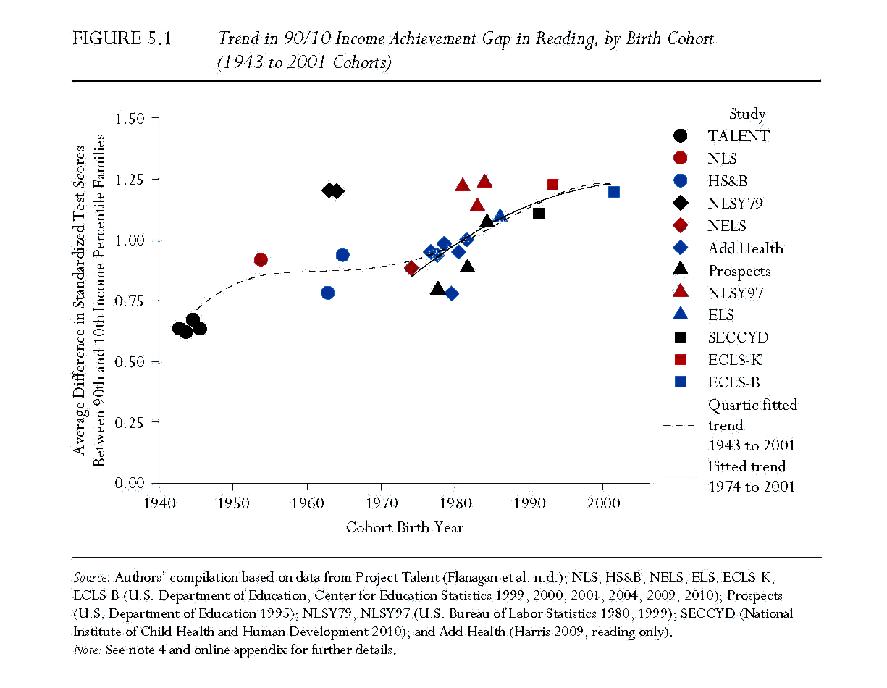
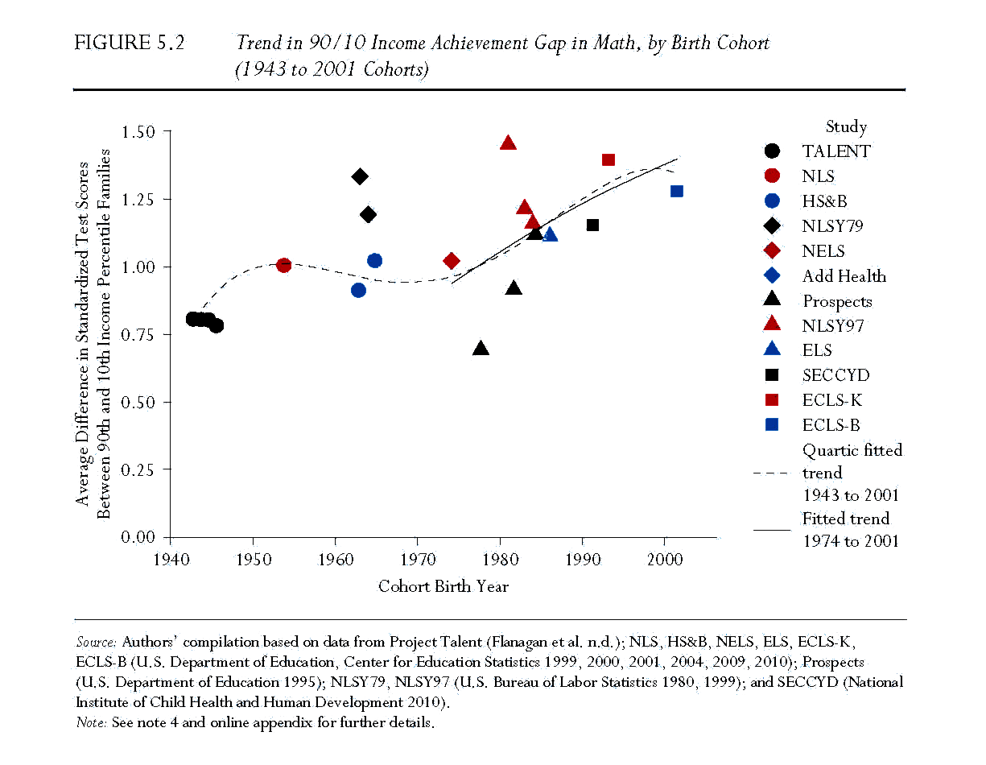
Reardon: Sharp rise in income-based gaps for 1975-2001 birth cohorts
40% rise in gap in reading
45% rise in gap in math
NAEP allows us to study birth cohorts of 1977-2001.

Slide 6
NAEP State Assessment: 4th and 8th grade 1990-2015
We included all states that missed at most one year between 1990 and 2015. (41-46 states, depending on grade/subject)
~125 public schools per state in 4th grade,
~100 public schools per state in 8th grade.
Random sample of 30 students per school (all students if fewer than 30.)
Matched each school to Census block groups using geographic locations.
Final sample:
4800 schools and 128,000 students in average grade/subject/year.

Slide 7
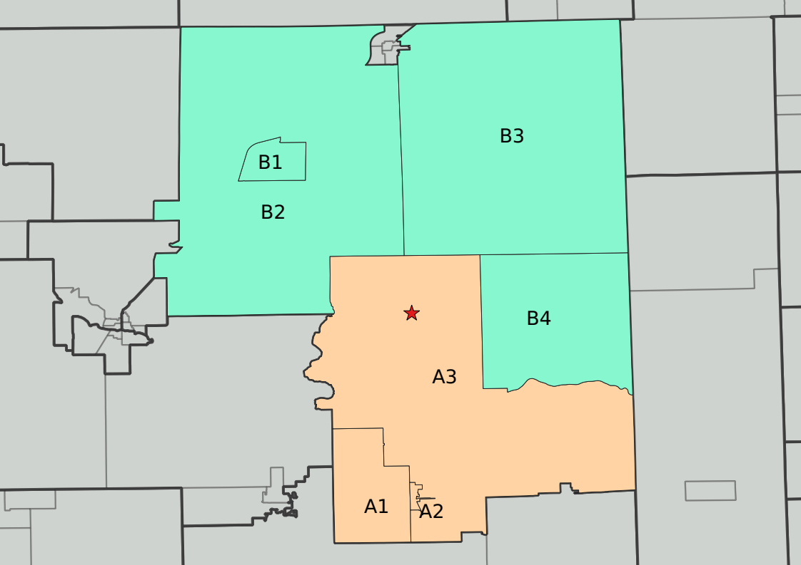
Adding Family Income Data to the NAEP
Block Group | Children in Block Group Grades 1-4 | Children in Block Group Grades 5-8 | Estimated number of students in Grades K-5 | Tract (for income distribution)
A1 | 63 | 58 | 93 | A
A2 | 69 | 46 | 98 | A
A3 | 43 | 49 | 66 | A
B1 | 44 | 37 | 64 | B
B2 | 68 | 49 | 97 | B
B3 | 25 | 35 | 40 | B
B4 | 54 | 56 | 82 | B
School
The school has 110 students in grades K-5. The closest Block Group centroid is A3, which only has 66 students in that grade range. The next closest Block Group is B4, which has 82 students in the grade range. These two Block Groups and the income distributions for families with children in the associated Census Tracts will provide our school level estimates of the mean and variance of income.

Slide 8
What we do:
Method 1: Estimate Student-Level Regression with School Level Aggregates
Method 2: Impute parental income by student-level characteristics in NAEP

Slide 9

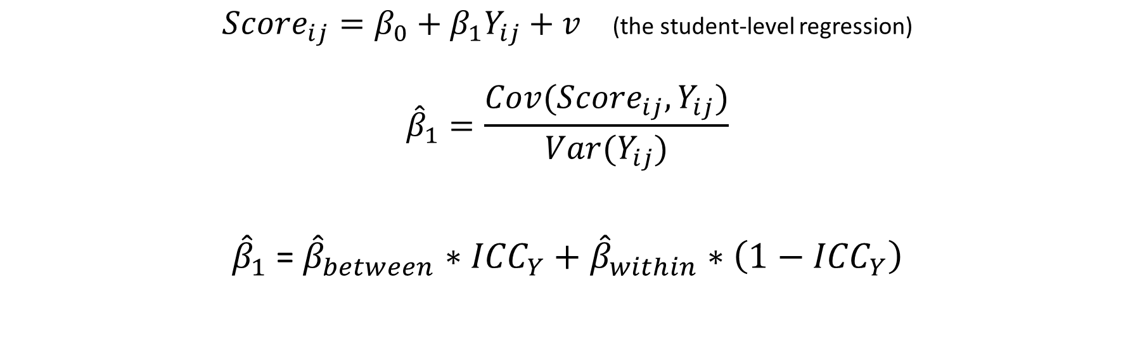
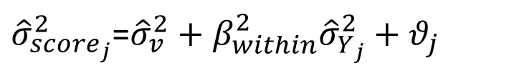
Method 1: Estimate Student-Level Regression with School-Level Aggregates
${Score}_{ij}=β_{0}+β_{1}Y_{ij}+v$ (the student-level regression)
$${\hat{β}}_{1}=\frac{Cov({Score}_{ij},Y_{ij})}{Var(Y_{ij})}$$
${\hat{β}}_{1}$= ${\hat{β}}_{between}∗{ICC}_{Y}+{\hat{β}}_{within}∗\left(1−{ICC}_{Y}\right)$
We don’t observe student-level covariance.
$${\overline{Score}}_{j}=β_{0}+β_{between}{\overline{Y}}_{j}+ε_{j}$$
${\hat{σ}}_{{score}_{j}}^{2}$=${\hat{σ}}_{v}^{2}+β_{within}^{2}{\hat{σ}}_{Y_{j}}^{2}+θ_{j}$
School Mean Score on School Mean Income
School Variance in Score on School Variance in Income

Slide 10
Analytic Sample from NAEP Restricted Use Data

Slide 11
How well does the imputation reproduce the Common Core of Data?
Measurement error stable over time

Slide 12
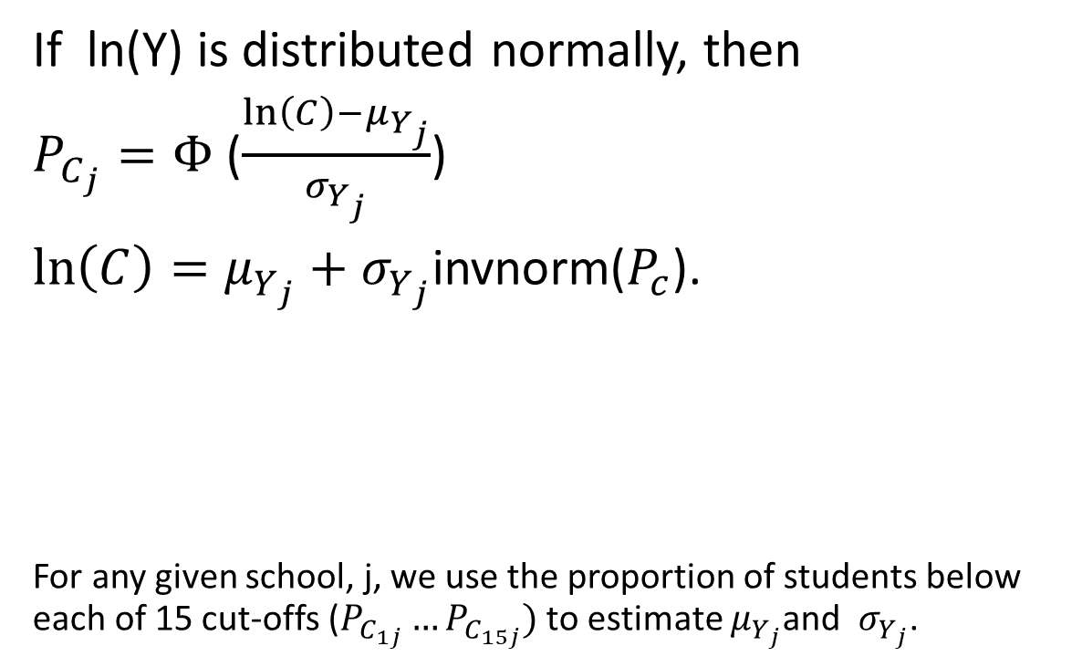


Using the Income Bins to Estimate the Mean and Variance in Income by School
If ln(Y) is distributed normally, then
$P_{C_{j}}=Φ$ ($\frac{\ln\left(C\right)−μ_{Y_{j}}}{σ_{Y_{j}}}$)
$\ln\left(C\right)=μ_{Y_{j}}+σ_{Y_{j}}$invnorm($P_{c}$).
For any given school, j, we use the proportion of students below each of 15 cut-offs ($P_{C_{1j}}…P_{C_{15j}})$ to estimate $μ_{Y_{j}}$and ${ σ}_{Y_{j}}$.
$$μ_{Y_{j}}$$
$$σ_{Y_{j}}$$

Slide 13
School mean achievement and mean income (Locally weighted polynomial)

Slide 14
School mean achievement and mean income (Locally weighted polynomial)

Slide 15
School mean achievement and mean income (Locally weighted polynomial)

Slide 16
School mean achievement and mean income (Locally weighted polynomial)

Slide 17
School mean achievement and mean income (Locally weighted polynomial)

Slide 18
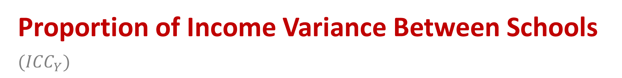
Proportion of Income Variance Between Schools $({ICC}_{Y})$
Growing income segregation implies increasing weight on the between-school slope.
Increasing segregation is not an artifact of the change in shape of income distribution.

Slide 19
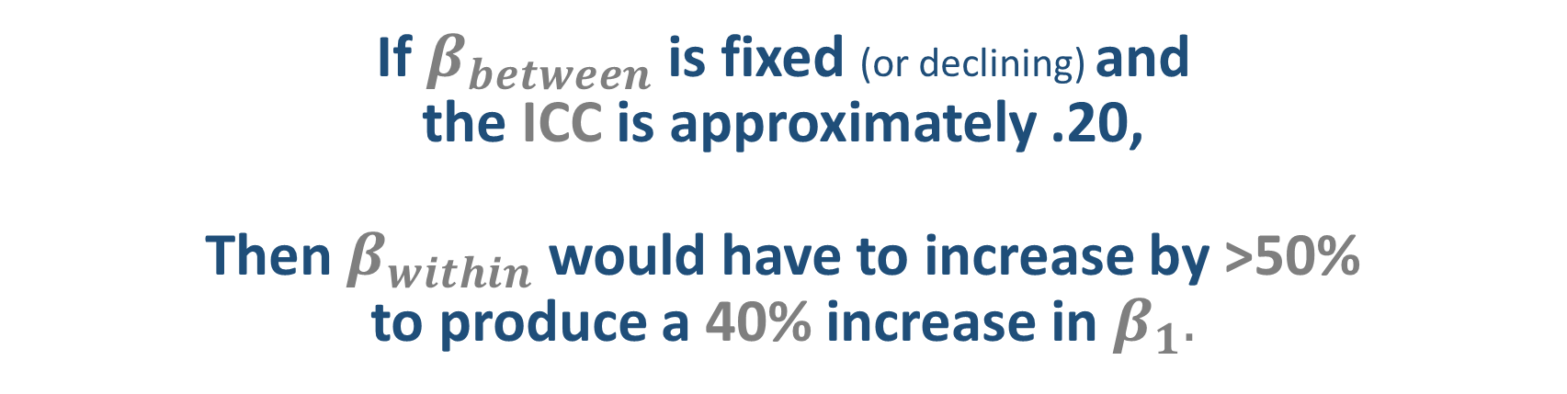

If $β_{between}$ is fixed (or declining) and the ICC is approximately .20, Then $β_{within}$ would have to increase by >50% to produce a 40% increase in $β_{1}.$
How much would $β_{within}$ have to increase?
$$β_{1}=β_{between}∗{ICC}_{Y}+β_{within}∗\left(1−{ICC}_{Y}\right)$$

Slide 20
School variance in achievement and variance in income (Binned scatter)

Slide 21
School variance in achievement by variance in income (Binned scatter)

Slide 22
Estimating the Student-Level Slope: Gr 4, Math
-25%
-51%
+20%
-40%
-.4 s.d.

Slide 23
Estimating the Student-Level Slope: Gr 8, Math
-11%
-28%
+18%
-21%
-.15 s.d.

Slide 24
Estimating the Student-Level Slope: Gr 4, Read
-7%
-100%
+20%
-72%
-.82 s.d.

Slide 25
Estimating the Student-Level Slope: Gr 8, Read
-9%
-54%
+17%
-37%
-.34 s.d.

Slide 26
Racial gaps were also closing.

Slide 27
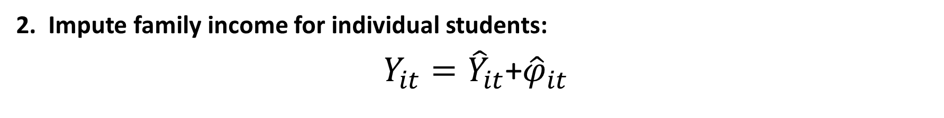
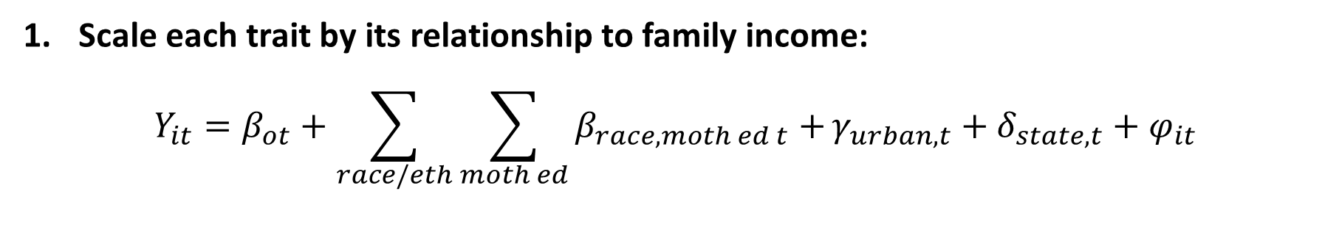
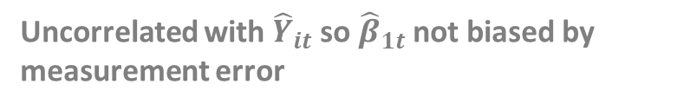
Method 2: Impute parental income by student-level characteristics in NAEP
Scale each trait by its relationship to family income:
$$Y_{it}=β_{ot}+\sum_{race/eth}{\sum_{moth ed}{β_{race,moth ed t}}+}γ_{urban, t}+δ_{state,t}+φ_{it}$$
2. Impute family income for individual students:
$Y_{it}={\hat{Y}}_{it}$+${\hat{φ}}_{it}$
3. Estimate student-level relationships:
$${Score}_{it}=β_{0t}+β_{1t}{\hat{Y}}_{it}+{(β_{1t}{\hat{φ}}_{it}+v}_{it})$$
Uncorrelated with ${\hat{Y}}_{it}$ so ${\hat{β}}_{1t}$ not biased by measurement error

Slide 28
The Student-Level Slope on Imputed Income Grade 8, Math
-22%
-18%
-43%
-15%

Slide 29
Plotting Mean Scores and Ln Income by Race, Mother’s Education, Urbanicity and State

Slide 30
Comparing Methods 1 and 2: Gr 8 Math

Slide 31
Comparing Methods 1 and 2: Gr 8 Reading

Slide 32
What about Private Schools? Gaps narrowing in math

Slide 33
Conclusion
There’s been a large increase in 4th and 8th grade math scores since 1990-- .87 and .53 s.d. in 4th and 8th grade math respectively.
The increases in achievement have been larger for low-income families, leading to a narrowing of the income-based achievement gaps.
Both the between- and within-school coefficients on income have been declining. The rise in ICC has not been large enough to offset.
Although we focus on public schools, there’s no evidence that the gap with private schools is widening.
The changes we see are consistent with the trends in the racial gaps.
Next step is to evaluate causes: state accountability, NCLBA, SFR
(impacts on intercepts as well as income-based gaps)

