Slide 1

Merger Analysis in the App Economy: An Empirical Model of Ad-Sponsored Media
Kohei Kawaguchi Hong Kong University of Science and Technology
Toshifumi Kuroda Tokyo Keizai University
Susumu Sato Hitotsubashi University
NBER SI 2020 IT and Digitization

Slide 2
Developed a novel empirical model of ad-sponsored media applicable to merger analysis in the mobile app market.
Considering both download price and ad hosting revenues and allowing endogenous business model choice by app developers.
Generating product characteristics by applying word2vec to app descriptions and integrating as high-dimensional attributes into demand estimation.
Estimating the model using detailed app download and usage data from Japanese mobile app market.
Conducting several ssnip & relevant market definition, merger simulations, and platform regulation exercises.

Slide 3
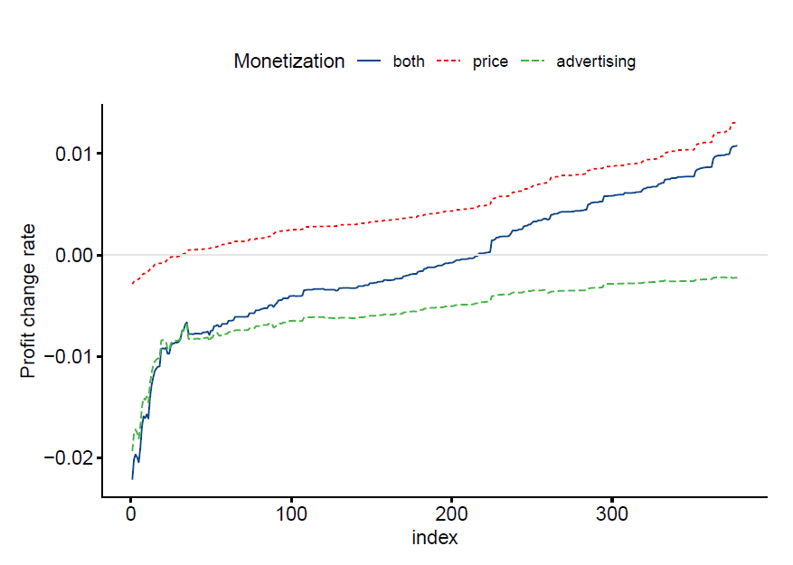
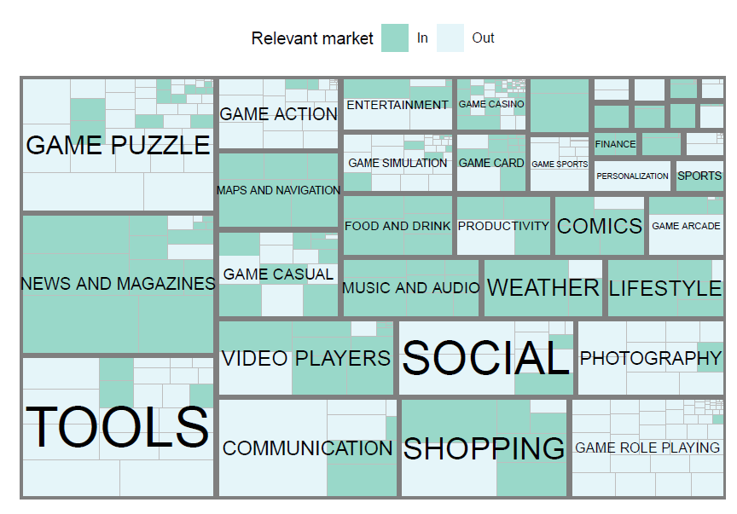
SSNIP & Relevant Market Definition

Slide 4
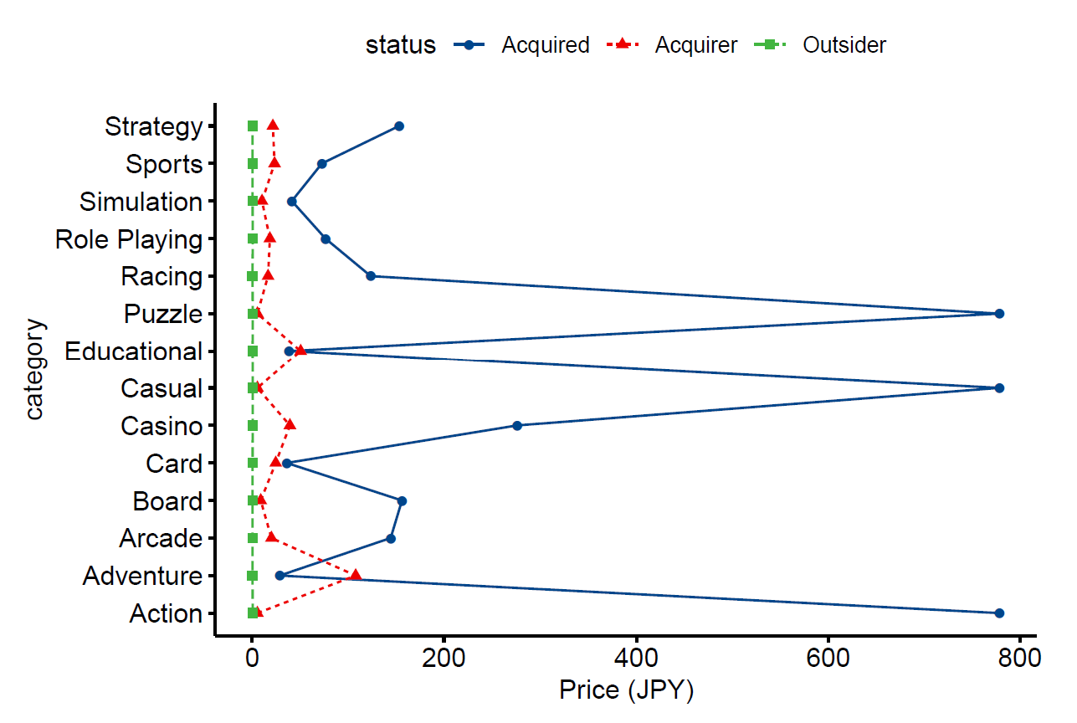
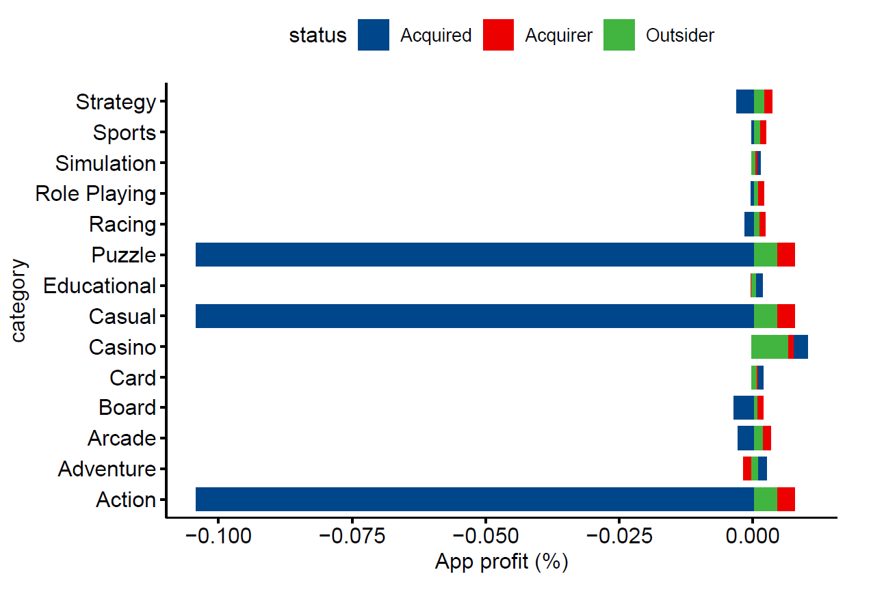
Merger Simulations

Slide 5
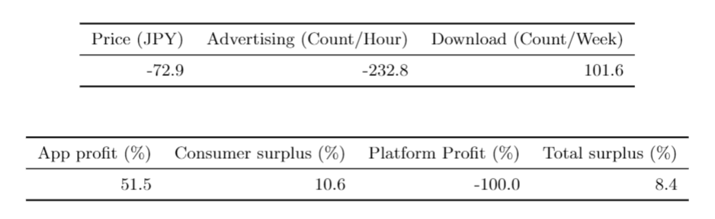
Platform Fee Reduction

