Slide 1

Comments on
“Does Homeownership Reduce Crime? A Radical Housing Reform in Britain.”
Ingrid Gould Ellen
NYU Wagner
NYU Furman Center
1

Slide 2
Summary
Studies effect of UK Right-to-Buy (RTB) program, which sold public housing units at discounted prices to incumbent residents in 1980s/90s on crime.
Uses diff-in-diff and IV specifications based on initial eligibility for sales in local area (average length of tenure at time of program launch and size of initial public housing stock).
Finds RTB led to significant short-run reductions in burglaries and robberies in Police Force Areas and longer-term reductions in both property and violent crime.

Slide 3
Framing: What is the Key Research Question?
What is the effect of the Right to Buy policy on local crime rates?
What the effect of homeownership on crime?
What is the effect of gentrification on crime?
Notes:
Clarify the research question.
Good answer to the first question.
Less persuasive answer to the second, because the results of the induced increase in homeownership among public housing residents on crime might not generalize to the full population.
Downplay discussion of gentrification in the paper. I don’t think the paper really addresses gentrification. Gentrification is about population changes resulting from in-movement of higher income or higher status residents; the RTB policy by contrast led to behavioral changes within the existing population – that’s what makes these results all the more compelling.

Slide 4
Identification Strategy (Short-run estimates)
Rely on average tenure in public housing in the PFA at onset of program.
  Baseline tenure can’t be gamed, but it may capture other relevant community features. (Resident SES? Popn size/density? Social capital?)
  Other controls for SES*post (baseline crime/population/%immigrant)?
  Why not specify initial tenure as thresholds to match eligibility rules?
  Interact length of tenure with # baseline public housing units to capture intensity of treatment?
Directly test correlation btw tenure length in 1980 and sales in 1980-1992.
Explore shorter-run impacts, which are more exogenous.
Notes:
Nice identification strategy – relying on pre-determined eligibility.
Is baseline length of tenure a proxy for other factors?
PFAs are very large areas.
Treat as one-time effect- but treatment unfolded over time.

Slide 5
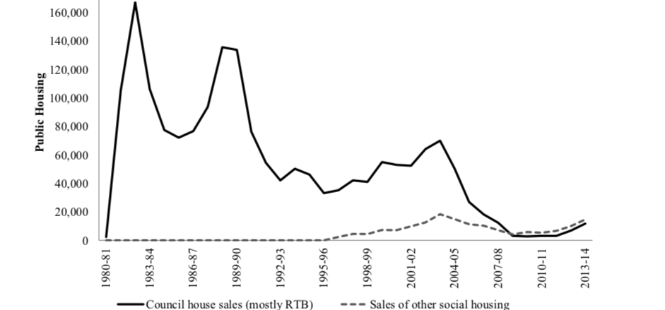
Figure 2. Right to-Buy and Other Sales of Public Housing in England, 1980-81 to 2013-14

Slide 6
Identification Strategy (Long-run estimates)
Different unit of analysis and different empirical approach
Why use variation in public housing stock as instrument for long-run estimates vs ITT estimate of length of tenure in short-run estimates?
  Is long-run question about impact of change in homeownership?
  If so, instrument for homeownership change.
Exclusion restriction:
  Size of PH stock in 1980 may be correlated with other unmeasured attributes of the Local Authority.

Slide 7
Magnitude of Effects
Clarify magnitude of estimates in terms of crime reduction.
Estimates show impacts on % change in crime rate rather than change in crime.
  Magnitude = 10 percent increase in eligibility reduces number of property crimes by .01 percent

Slide 8
Mechanisms?
Behavioral change from boost in homeownership rate
  Yet no community effects?
Change from transferring from public to private ownership
Composition shifts: selective retention (program meant retention of higher-income households who would have left development)
  Test for changes in resident characteristics? More income mixing?
Did changes in management of rental units accompany sales?
Did purchases invite other community investments?
Notes:
Homeowners have greater incentive to invest in private security measures and to demand more police coverage.
They may also make more physical improvements.
They also stay in their homes for longer.

Slide 9
Generalizability
Incomes of public housing residents higher in UK than in US
  In other countries, public housing residents may not have savings/incomes to maintain properties
Would general increases in homeownership generate the same crime reductions?
Notes:
Authors claim that their results have implications for other countries.

Slide 10
Ingrid Gould Ellen
NYU Wagner
NYU Furman Center
Ingrid.ellen@nyu.edu
This research has been prepared by a Center affiliated with New York University School of Law and Wagner Graduate School of Public Service, but does not purport to present the schools’ institutional views, if any.

