Slide 1
Quality Competition at the Competitive Margin in US Residential Broadband Markets
Kenneth Flamm and Pablo Varas
University of Texas at Austin
July 2020

Slide 2
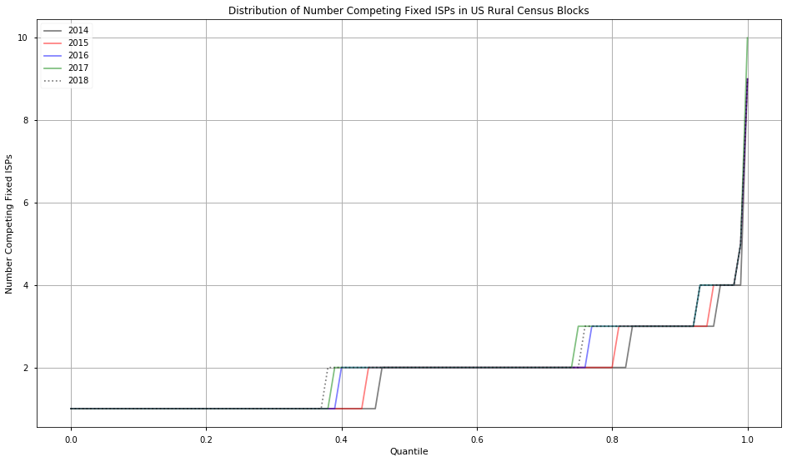
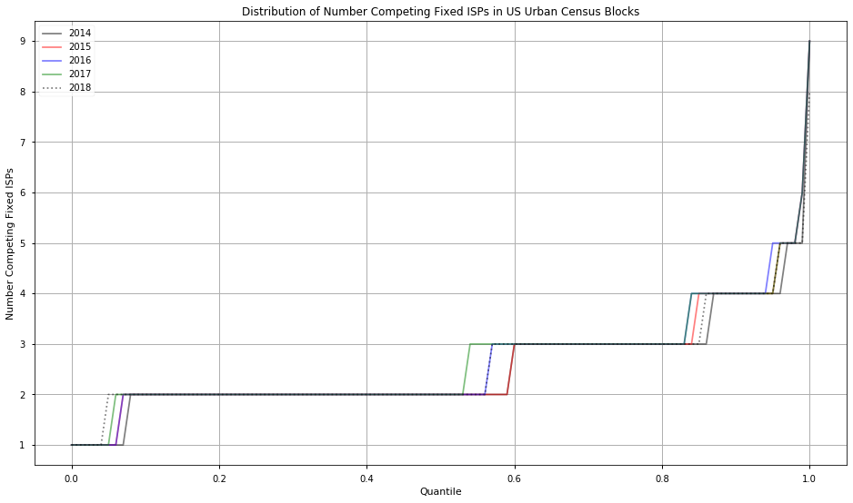
A glass half empty? limited competition in US residential broadband…
FCC recently published major revisions to historical data collected on US residential broadband providers
Warning: if you used the FCC’s Form 477 data for research, your results WILL change
In urban areas, >50% of census blocks have 2 or fewer fixed ISPs*; 85% 3 or fewer
In rural areas, ~75% 2 or fewer, ~90+% 3 or fewer, ~40% with single ISP
Not much change overall since 2014, and average competitors per census block actually fell from 2017 to 2018
* Satellite excluded for reasons discussed in paper

Slide 3
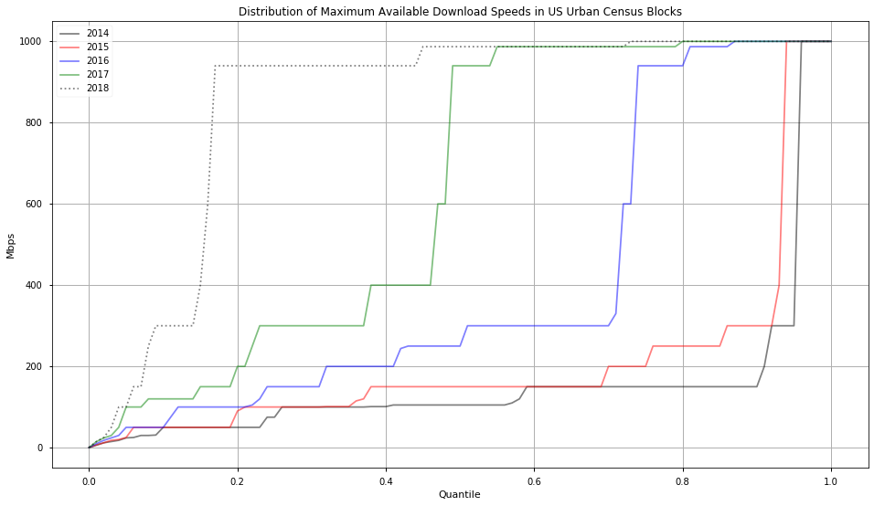
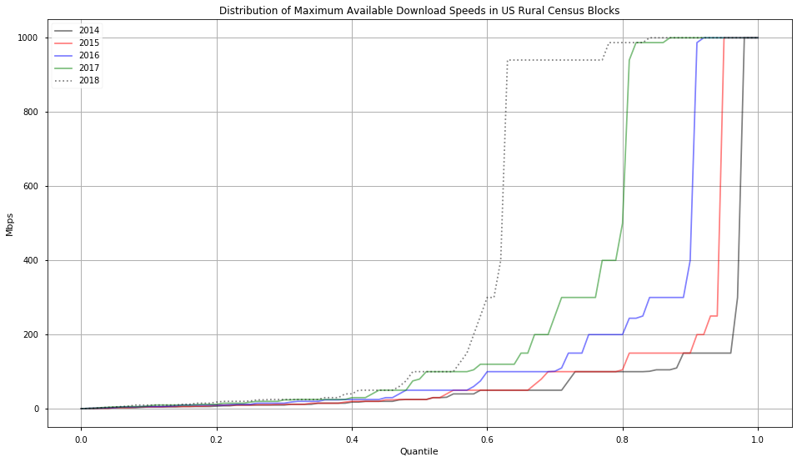
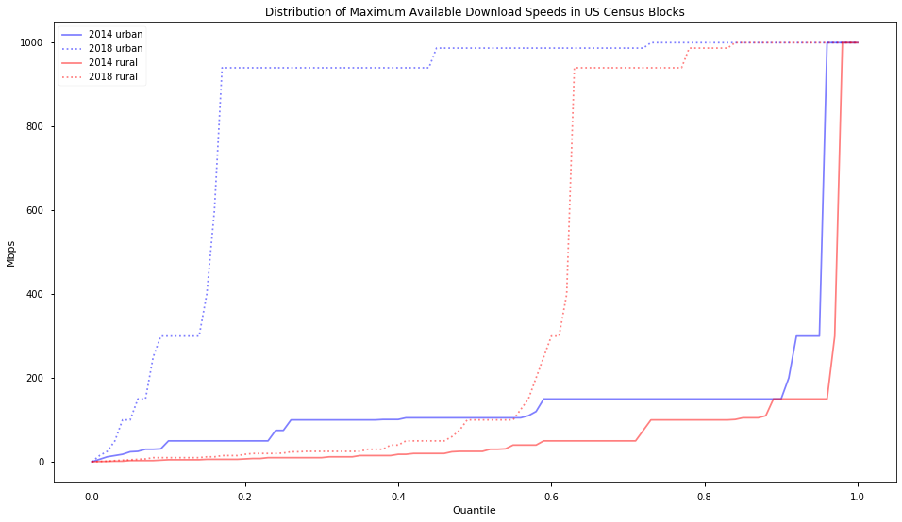
Nonetheless best available service quality improved…a lot
85% urban blocks approaching gigabit speeds in 2018, <5% under 50mbps
Not so much in rural areas: half of blocks with maximum download speeds under 100mbps, ~40% under 50mbps
Urban-rural contrast:

Slide 4
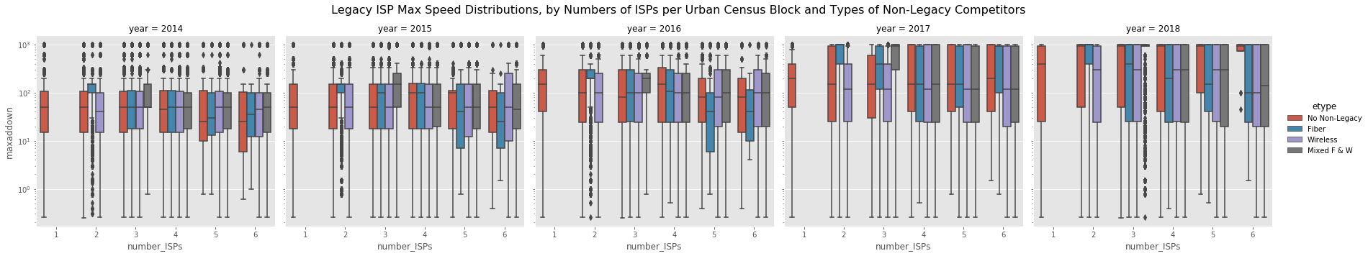
What relationship between competition and quality improvement?
A policy-relevant question: government broadband subsidy programs experimenting with subsidizing entry in “high cost” areas with limited service options, using auction system
Q: Did disruption of decades-old duopoly by recent fiber/wireless tech entrants trigger greater quality improvement?
Anecdotes + box plot distributions on maximum advertised speed for “legacy” ISP’s:
Four census block groups:
Census blocks with only “legacy” providers
Census blocks with non-legacy fiber entrants
Census blocks with non-legacy wireless entrants
Census blocks with mixed non-legacy fiber and wireless entrants
Urban box plots
conditioning on year and market structure (number ISPs/ census block group types):

Slide 5
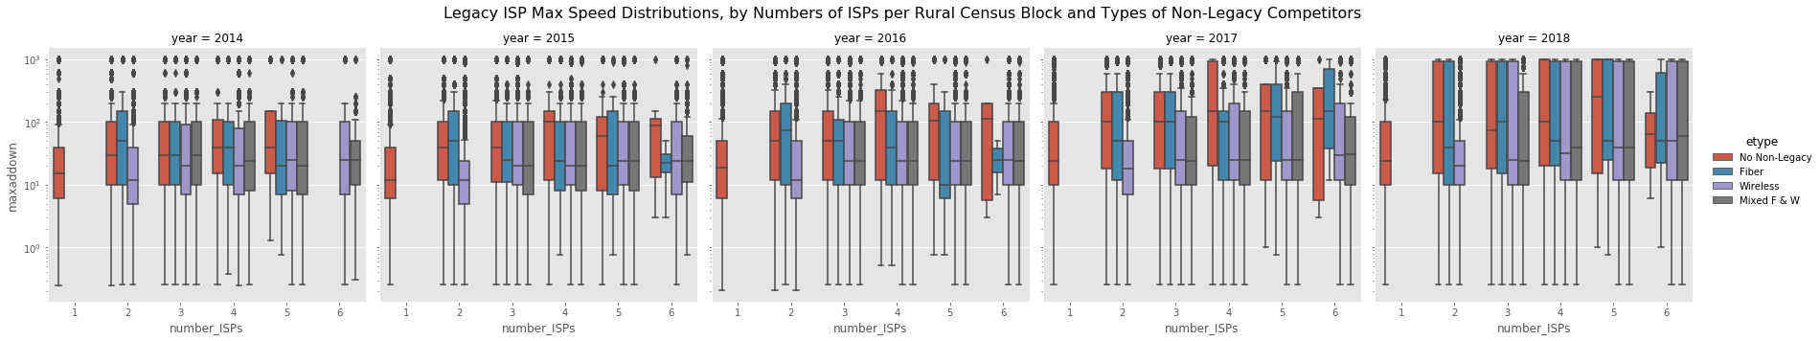
Results in next version of paper. Thanks for your time!
Rural box plots:
Census blocks with fiber entrants and small numbers of ISP competitors (<4), on average, seem to have upward shifts when compared to speed distribution in blocks with same number of “legacy only” competitors.
Doesn’t seem to hold, on average, in census blocks with large numbers of competitors
Modeling strategy in paper:
Control for differences across census blocks with reasonably complete set of time-varying demand and cost shifters, govt. subsidies to ISPs, etc.
Use every census block as its own control: Fixed effects, identify “within” effect of change in number competitors
Account for selection and other endogeneity in entry “treatment”: use geospatial instruments affecting entry cost but not legacy network speed

