Slide 1
FIFTY-FOUR YEARS AT THE NBER AND STILL HANGING IN THERE
Old Discredited Economist
NBER, CUNY Graduate Center, and IZA

Slide 2


Slide 3
Main Themes
Involvement in NBER during past 54 years
Emphasis on history of health economics as area of investigation at the Bureau
Formalization of field by establishment of Health Economics Program
My role in development of program

Slide 4

Mike at the NBER: The Beginning, 261 Madison Ave., NY, NY

Slide 5
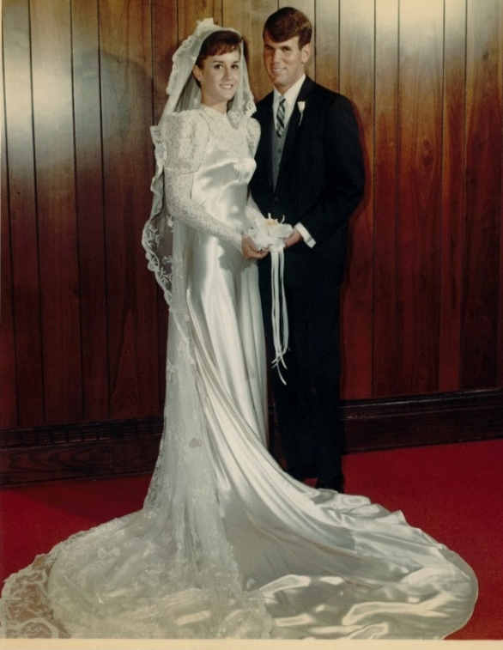
Second 50th Anniversary,
September 11, 1966

Slide 6
The Service Economy, 1968

Slide 7
Acknowledgment by Vic in Preface
“Irving F. Leveson was my chief assistant until the project was almost finished; his dedication and perseverance more than justify his inclusion on the title page of the book. Michael Grossman joined the project at a late stage but made many contributions, particularly in connection with the chapter on cyclical fluctuations.”
Led to my short-lived career as a macroeconomist

Slide 8
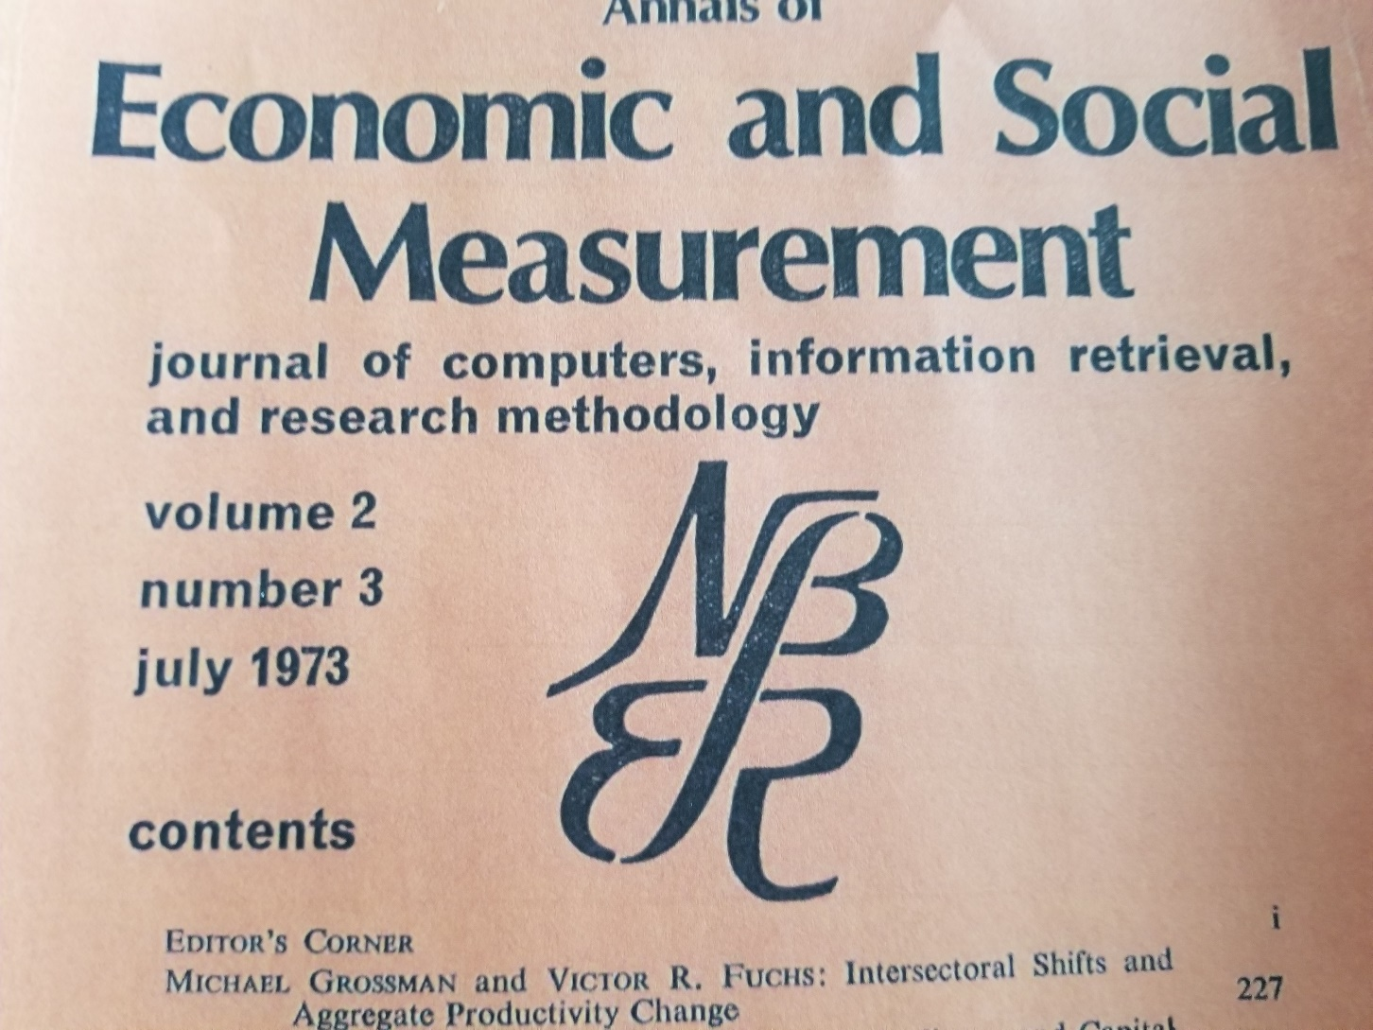
Annals of Economic and Social Measurement

Slide 9
Quote from Paper and Outcome
Mike: “‘What goes down must come up’ is the rule of the business cycle”
Reactions
Ground-breaking contribution because many commentators agreed:
“New ground should be broken to bury the paper and its lead author”

Slide 10
Mike at NBER, September 1966-June 1969
Late August 1966: Vic makes me an offer I could not refuse
In retrospect, in 1966 an investment in health economics paid me the best interest
October 1966: Gary Becker suggests topic for my dissertation
View health as demanded because it is an item in utility function and, as a component of stock of human capital, a determinant of earnings

Slide 11
Health Economics at the NBER: The Beginning
First NBER publication with significant health economics component co-authored by?
Milton Friedman and Simon Kuznets, Income from Independent Professional Practice, 1954
Vic Fuchs: first NBER research associate to focus on health beginning in early 1960s

Slide 12
Key Early Contributions
Vic Fuchs, “Some Economic Aspects of Mortality in the United States,” 1965
Richard Auster, Irving Leveson, and Deborah Sarachek, “The Production of Health: An Exploratory Study.” Journal of Human Resources, 1969
Mike Grossman, The Demand for Health: A Theoretical and Empirical Investigation.” Ph.D Dissertation, 1970 and NBER Occasional Paper 119, 1972.

Slide 13
NBER Center for Economic Analysis of Human Behavior and Social Institutions
Founded by Vic in 1972, with him as director, with Gary Becker as research policy advisor, and with five programs:
Education and Information
Income Distribution
Law and Economics
Population and Family Economics
Health

Slide 14
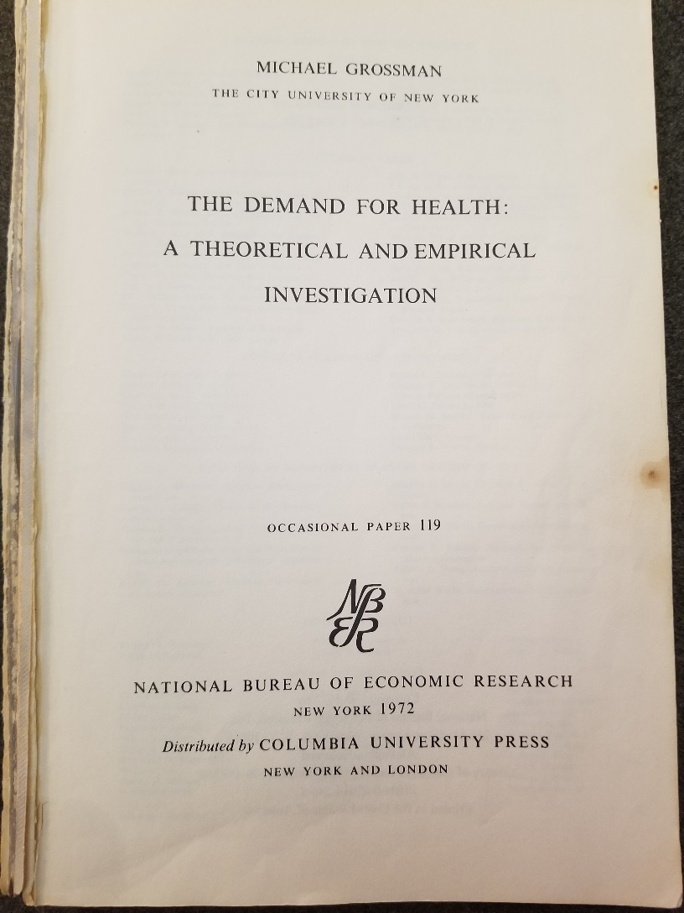
1972: My NBER Occasional Paper Published

Slide 15
1972: Mike Grossman Is In Trouble Why?
Financial World: America’s Investment and Business Weekly, December 13, 1972: “Trifle obscure to talk about people choosing ‘their level of health’.”

Slide 16
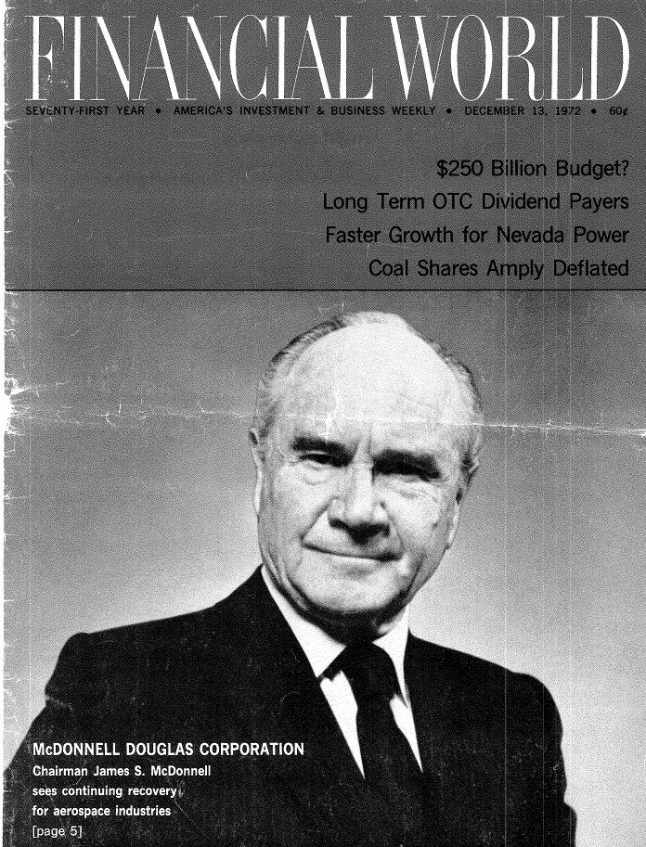

Slide 17
More Trouble in 1972
“The original ‘occasional paper series’ appears to have ended with #119 in 1972.” Claudia Goldin and Lawrence Katz, “The Incubator of Human Capital: The NBER and the Rise of the Human Capital Paradigm, NBER Working Paper 26909, March 2020, note 16, p. 10, Presented at 2020 AEA Meetings.
They were nice enough not to mention my name as the author of OP 119
Ironic that a paper on health marked the death of the series

Slide 18
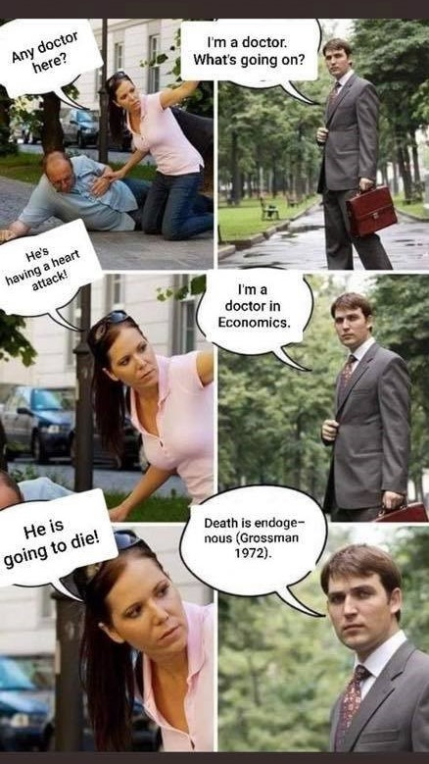
More Recently: Better Publicity for OP 119

Slide 19
Research in 1970s
Does More Schooling Really Cause Better Health?
“1976 paper in NBER volume
More recent paper in American Economic
Journal: Applied Economics, 2010
Determinants of Children’s Health
Effects of parents’ schooling
Effects of early health on later health and school achievement
Race differences

Slide 20
Mike Grossman Still is In Trouble
Papers on whether schooling causes health published every year
In a good year 50% say yes
Like my batting average of 500 in New York State Veterans of Foreign Wars Leagues playoff competition in 1957 (small sample, 2 at bats)
Much smaller percentage in other years
More like my BA of 154 during the regular season (larger sample, 39 at bats)
Third rule of research: Better to be the first or one of the first even if you’re wrong

Slide 21

1978, Office Moves to 269 Mercer Street on Campus of New York University

Slide 22
New Research in 1980s: Infant Health Outcomes
Focus on public policies and programs
Abortion reform
Maternal and infant care projects
Community health centers
Medicaid
Federally subsidized family planning clinics
Special Supplemental Food Program for Women Infants, and Children (WIC Program)

Slide 23
New Research Begun in 1980s: Economics of Unhealthy Behaviors
Cigarette Smoking
Excessive Alcohol Use
Illegal Drug Use
Overeating/Lack of Exercise
E-Cigarette Vaping
Opioid Epidemic

Slide 24
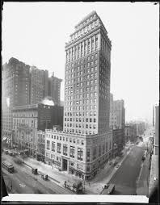
1995-1999, 50 East 42nd Street

Slide 25

1999-2013: Altman Building at 365 Fifth Avenue on Campus of City University of New York Graduate Center

Slide 26
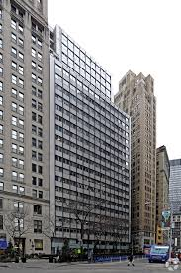
2013-Present: 5 Hanover Square

Slide 27
Vic Fuchs Quote
When I told Vic Fuchs that the office had moved again in 2013, he said, with apologies to Guys and Dolls:
“The New York NBER Office is the oldest established floating economics research organization in New York.”

Slide 28
Initial Involvement in Economics of Unhealthy Behaviors
1978: Doug Coate, Gene Lewit, and I decide to submit an NIH proposal on teenage smoking and alcohol use
US anti-smoking campaign 14 years old and much newer anti-drinking campaign
But real prices of cigarettes, beer, wine, and distilled spirits had been falling for a long time, mainly because federal excise taxes on these goods had been fixed in nominal terms since 1951
Does law of downward sloping demand function apply?

Slide 30
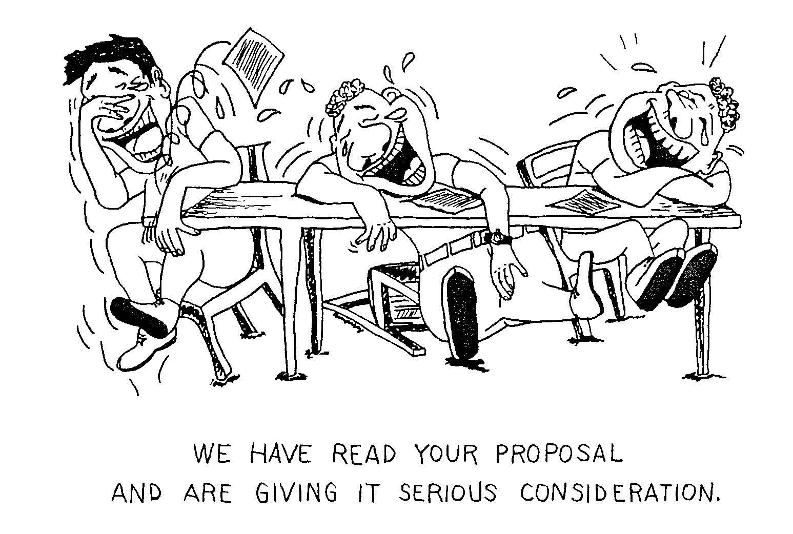
Notes:
Field work

Slide 31
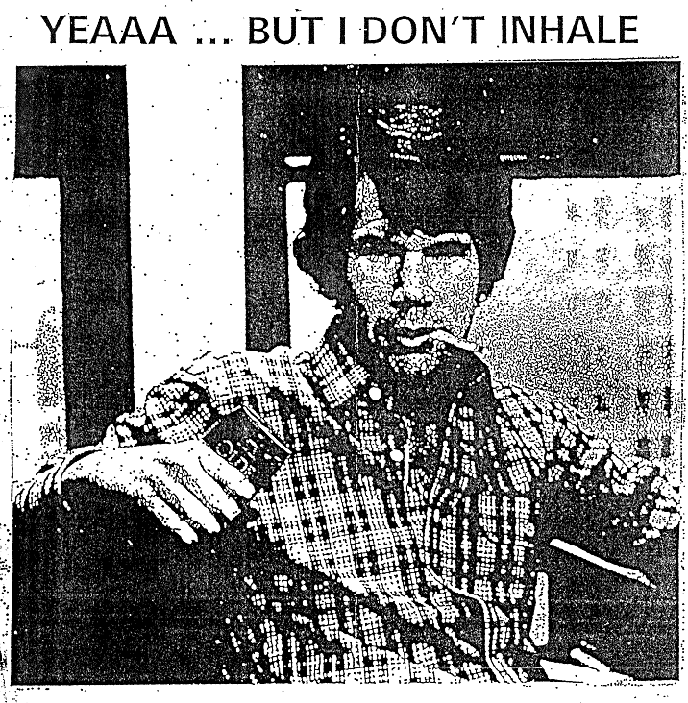

Slide 32
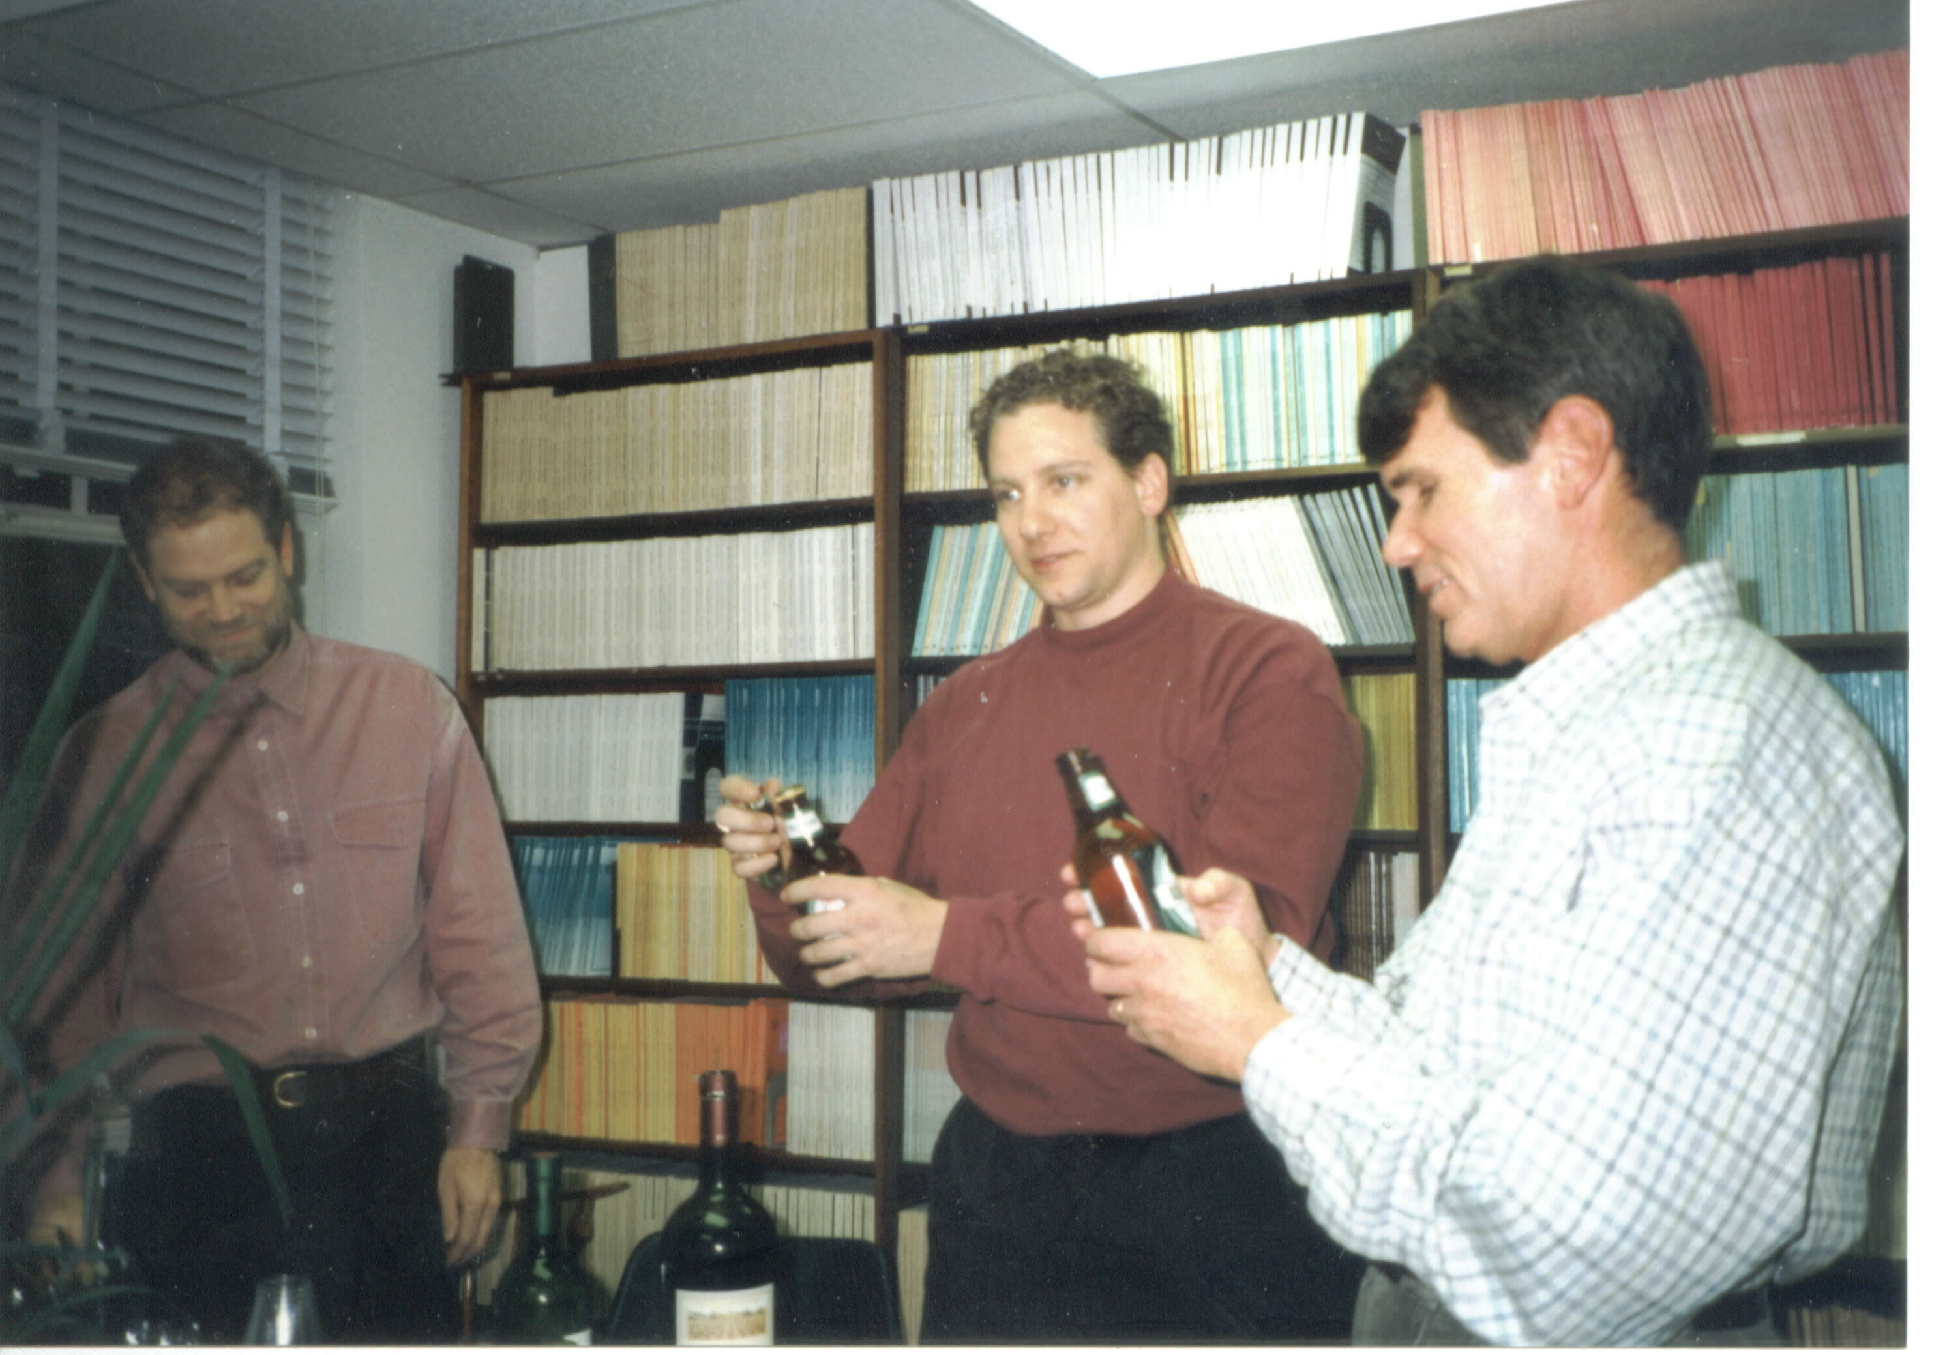

Slide 33
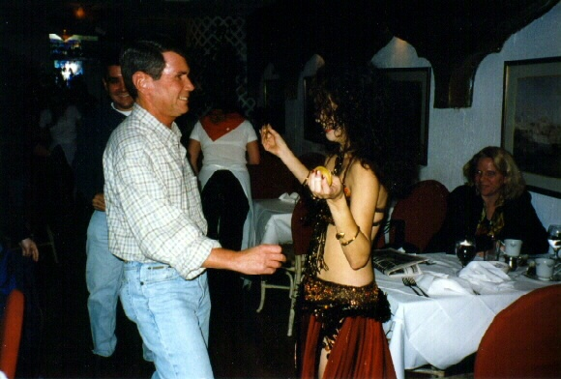

Slide 34
Ultimate Success
Funded, conducted, and continue to conduct research on unhealthy behaviors
Collaborators: Doug Coate, Gene Lewit, Gary Becker, Kevin Murphy, Henry Saffer, Bob Kaestner, Sara Markowitz, Frank Chaloupka, Ted Joyce, Dhaval Dave, Erdal Tekin, Naci Mocan, Dan Dench, Don Kenkel, Shin-Yi Chou, Inas Rashad Kelly, Rosalie Liccardo Pacula, Jenny Williams, Jan van Ours, Roy Wada, Ismail Sirtalan, Bjorn Lindgren, Ben Yarnoff, Ryan Conrad, Alison Cuellar, John Tauras, Freddy Siahaan, Greg Colman, Adit Laixuthai, Beau Kilmer

Slide 35
Results in Brief
Behaviors at issue sensitive to price
Teenage cigarette smoking price elasticity of -1.20, Coate, Lewit, and Grossman, Journal of Law and Economics, 1981
Much smaller elasticities reported since then BUT
NBER HE RA Dan Rees reports an elasticity of about -1.20 in his May 2020 NBER WP 27204 with Andrew Friedson
For many more of my results and those of others, including some that do not agree with mine, see

Slide 36
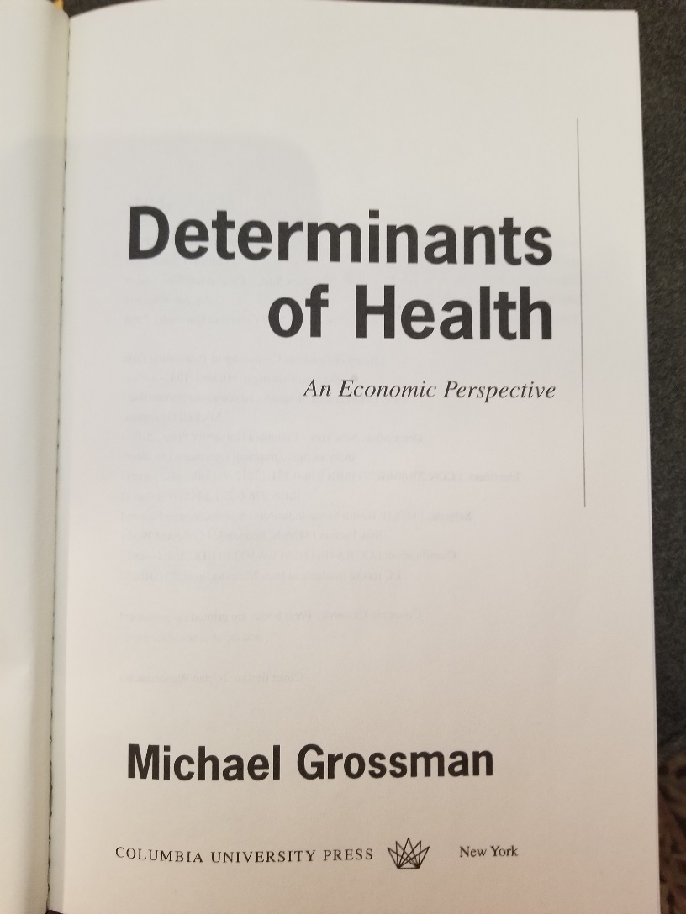
2017 Book

Slide 37
In Conclusion
After 54 years of marriage
I still love my two wives
Ilene
And
The NBER

