Slide 1
The Effect of Online Shopping on the Healthfulness of Grocery Purchases
Katherine Harris-Lagoudakis
Iowa State University
July 2020

Slide 2
Motivation & Research Question
Adult rate of obesity 33% over past 16 years
Obesity is associated with bad health outcomes
Growing public health concern
What role do purchasing environments play in consumer choice?
In-store vs. Online
Theoretical prediction: online purchases will be healthier
Time inconsistent preferences: make better decisions for future self
Visceral influences: noise, congestion, children
Consumption cues: end of aisle displays, checkout lanes, hunger
Sensory distance: representation of products with pictures

Slide 3
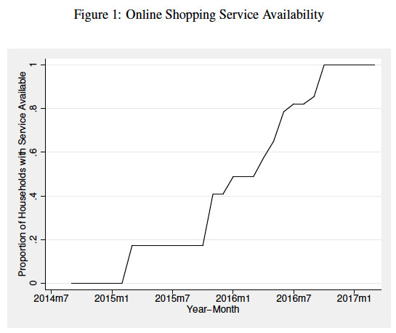



Data & Research Design
Supermarket Panel Data
25K Households
300 million hh-day-store-channel-UPC purchases
March 2014-September 2017
Click and collect online shopping service
Introduced by store locations over time
Event Study Research Design
Household ( ) and time ( ) fixed effects
Time of availability is independent of any other factors:
Influencing demand (Non and Semi Parametric)
That produce a deviation from the modeled time trend (Parametric)
$$γ_{i}$$
$$γ_{t}$$

Slide 4
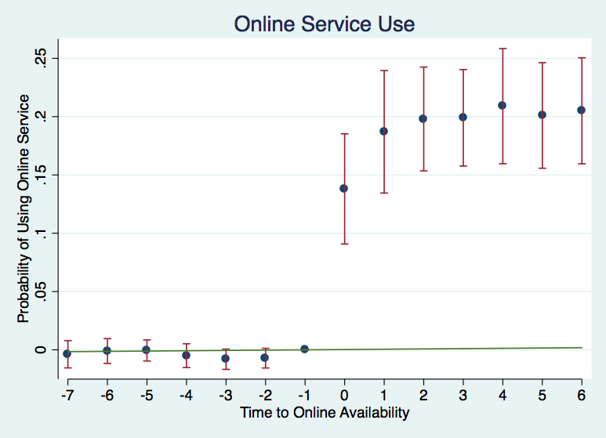
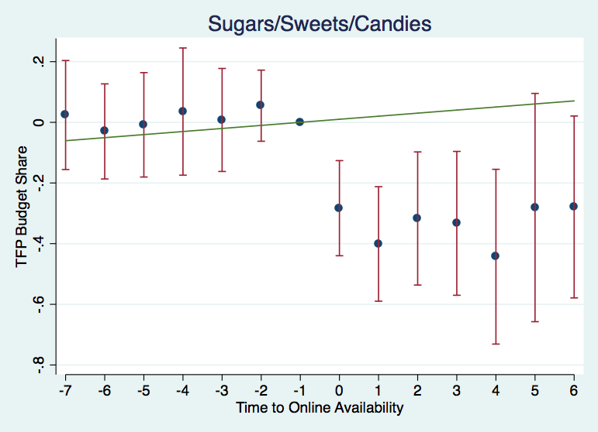
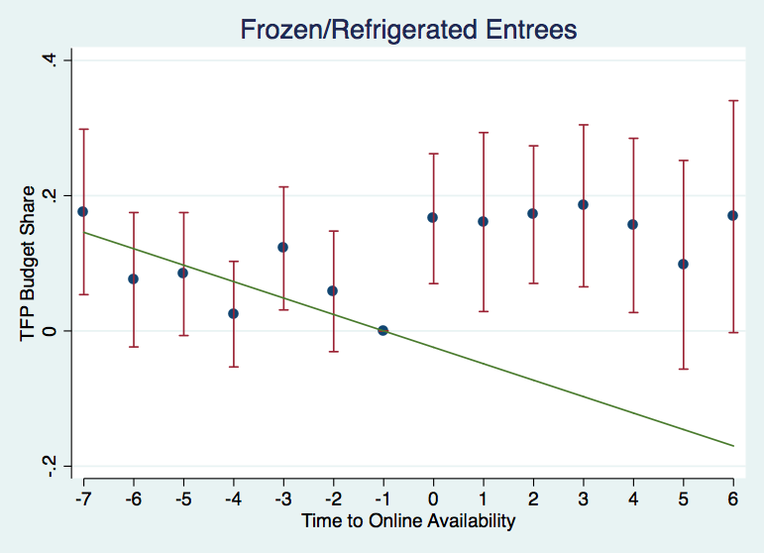
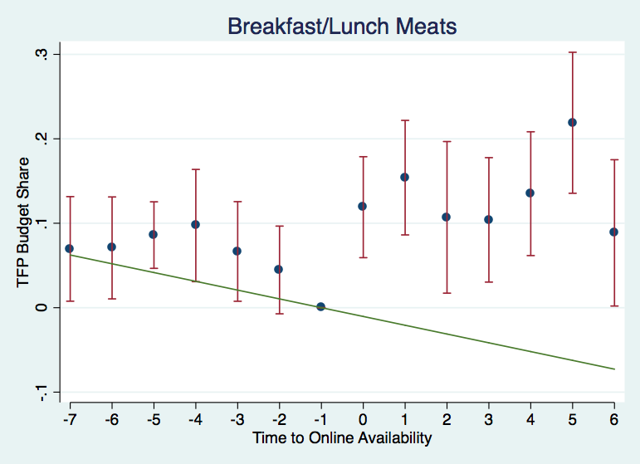
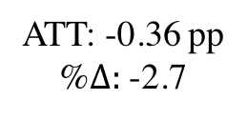
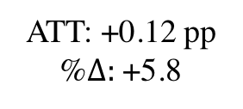
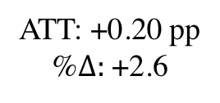
Event Study Results
ATT: +18.2 pp
ATT: -0.36 pp
%$Δ:$ -2.7
ATT: +0.12 pp
%$Δ:$ +5.8
ATT: +0.20 pp
%$Δ:$ +2.6

Slide 5
Conclusion & Discussion
Summary of Findings
Evidence for changes in basket composition
Little evidence of improved healthfulness
No change in TFP healthy budget/calorie shares or nutrient density
Improvements in calorie density
Psychological factors may lead to impulse purchases of a few things
“Few things” play a small role in healthfulness measures
Policy recommendation: some purchasing cues are cheap to incorporate - unlikely to hurt but also unlikely to lead to drastic changes

