Slide 1
Product Innovation, Product Diversification, and Firm Growth: Evidence from Japan’s Early Industrialization Serguey Braguinsky, U. of Maryland Smith School of Business Atsushi Ohyama, Hitotsubashi University Tetsuji Okazaki, U. of Tokyo Chad Syverson, U. of Chicago Booth School of Business
Presented at the NBER Summer Institute
Productivity, Development, and Entrepreneurship Workshop
July 15, 2020

Slide 2
Firm Growth and Product Line Expansion
Lots of evidence that firms usually grow by adding product varieties
Extant frameworks assume a certain degree of symmetry among products
In expectation, all potential product introductions are equally effective channels for growth
Supply- and demand-side effects may be different
Consumers’ willingness to substitute and firms’ economies of scope are driven by very different primitives
Does the nature of the varieties matter?

Slide 3
Two Types of Product Line Expansion
Pushing the frontier: Adding new varieties that are outside of the current technology level
Expanding product varieties (and scaling up) inside the already achieved technology frontier
Pushing the frontier
need for non-trivial experimentation (risky big investment looms, need to understand the new technology, develop new markets, etc.)
Innovative products may create spillovers that me-too products do not
Bottom line: It might not just be the number, but type, of products that matters for growth

Slide 4
Main Findings
Pushing the frontier & experimentation with innovative products more robustly associated with growth, etc. than me-too products
A twist: firms that push the frontier also do more diversification within the frontier ending up with more of BOTH types of varieties
Ultimately, scale and scope do go together
We open the “Black Box” of HOW this happens:
Innovation and experimentation come first
Then knowledge gained thereby applied to diversification and translates into growth – examine the “transmission” channels

Slide 5
Setting and Data
Historical data on Japan’s cotton spinning industry: the first modern manufacturing industry in Asia
Can look at long-term growth and other outcomes for 1893-1914
Supply chain:
Raw Cotton → Cotton Spinning → Textile Weaving → Textile products
Output is “yarn” (read: thread)
Product varieties differentiated by count (fineness) and finish
Count: units of yarn length that have a given weight
Higher counts mean finer (higher quality) yarn
Finish: the way threads are spun
Doubled and gassed yarns are higher quality

Slide 6
Setting and Data
(1) Product Variety
Production of yarn by type (count-by-finish)
Census of firms, panel data, from 1893 to 1914
Lower counts (≤ 20-count) vs. higher counts (> 20-count) and higher-quality finishes (doubled and gassed)
(2) Machines and Engineers
Machine types, orders, and installations
New machines had to be ordered from the UK
Number of educated engineers
New machines had to handled by educated engineers to push the frontier
(3) Exogenous variation (for IV estimations):
Industry-mandated output restrictions
Introduced by consensus, strictly enforced, applied mostly to lower counts

Slide 7
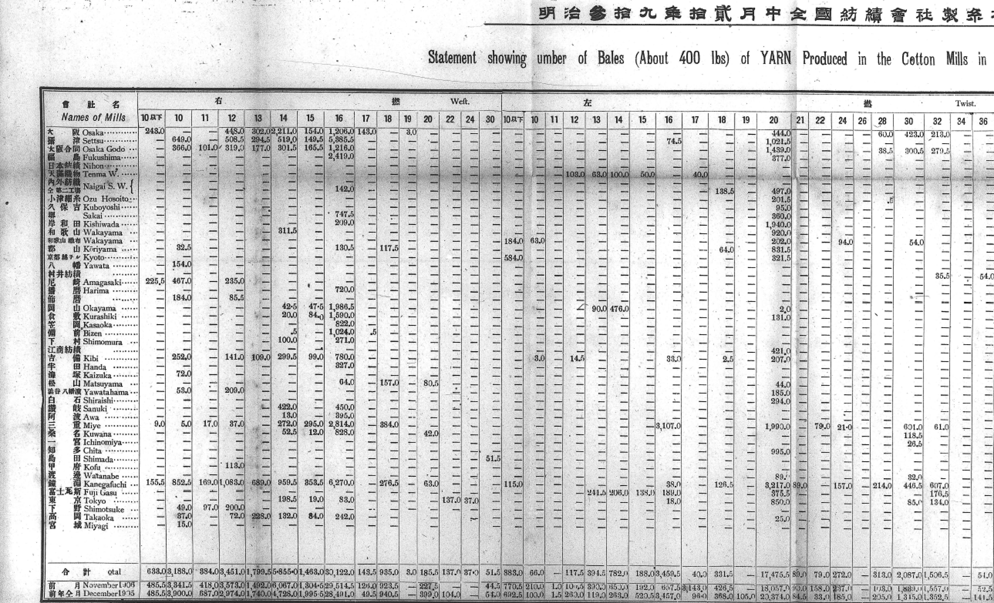
Setting and Data

Slide 8

Setting and Data

Slide 9
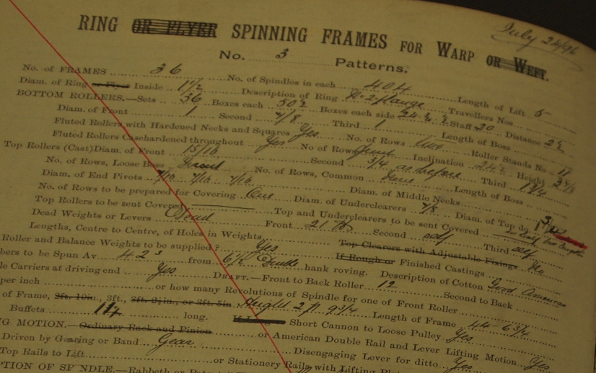
Setting and Data

Slide 10
Firm Growth and Product Expansion

Slide 11
Firm Growth and Product Expansion
Within-between decomposition indicates:
Before 1907, increase in products per firm driven roughly equally by increase in product varieties within existing firms and entry of higher-variety firms
After 1907, as overall variety growth speeds up, magnitude of between effect remains about the same as before but within-growth becomes much bigger

Slide 12
Firm Growth and Product Expansion

Slide 13
Key definitions
Product upgrade/vertical expansion: making new yarn type that is a) high-end and b) has a higher count than any of similar type that the firm previously made “at scale”
At scale: accounting for at least 3% of firm’s output
Product diversification: making a new yarn at scale at a count lower than or equal to any count the firm previously made
Experiments: making a yarn in period t that a) the firm did not make in t – 1 (semiannual periods), b) is not made at scale in t, and c) had never been made at scale by the firm before t
Experiments can succeed—grow to reach production at scale
Experiments can fail but be retried later

Slide 14
Experiments
Experiments usually fail, two-thirds to three-fourths of the time
Given that experiments are small by definition and often fail, it cannot be that experimentation per se is a source of growth
However, product UPGRADE experiments are related, probably causally, to firm growth through product expansion

Slide 15
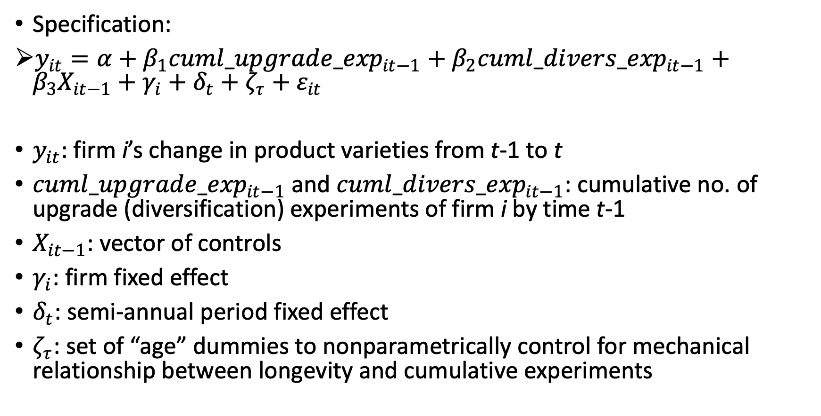
Upgrade Experiments and Product Expansion
Specification:
$y_{it}=α+β_{1}{cuml_upgrade_exp}_{it−1}+β_{2}{cuml_divers_exp}_{it−1}+β_{3}X_{it−1}+γ_{i}+δ_{t}+ζ_{τ}+ε_{it}$
$y_{it}$: firm i’s change in product varieties from t-1 to t
${cuml_upgrade_exp}_{it−1}$ and ${cuml_divers_exp}_{it−1}$: cumulative no. of upgrade (diversification) experiments of firm i by time t-1
$X_{it−1}$: vector of controls
$γ_{i}$: firm fixed effect
$δ_{t}$: semi-annual period fixed effect
$ζ_{τ}$: set of “age” dummies to nonparametrically control for mechanical relationship between longevity and cumulative experiments

Slide 16
Upgrade Experiments and Product Expansion
 | Change in number of products, t to t-1 | Change in number of high-end varieties, t to t-1 | Change in number of low-end varieties, t to t-1
Cumulative upgrade experiments | 0.384*** | 0.239*** | 0.174**
 | (0.090) | (0.058) | (0.073)
Cumulative diversification experiments | 0.022 | 0.003 | 0.017
 | (0.036) | (0.008) | (0.032)
I[adds high-end machine in t] | 0.659*** | 0.269** | 0.389**
 | (0.214) | (0.128) | (0.149)
I[adds low-end machine in t] | 0.216 | 0.002 | 0.213*
 | (0.137) | (0.046) | (0.113)
I[employs univ.-educated engineer in t] | 0.370* | 0.272* | 0.121
 | (0.190) | (0.138) | (0.142)
I[has exchange merchant on board in t] | 0.193 | 0.041 | 0.148
 | (0.151) | (0.064) | (0.114)
Constant | 2.740*** | 0.686*** | 2.007***
 | (0.609) | (0.226) | (0.470)
Period, firm, and “age” dummies | Included | Included | Included
N | 1,618 | 1,618 | 1,618
Number of firms | 99 | 99 | 99
Cumulative upgrade experiments 25th %ile = 1, 75th %ile = 5; IQR tied to about 1.7 (0.43x4) add’l new varieties

Slide 17
What Drives Experimentation?
An instrument for upgrade experimentation: interaction of a) installing high-end machinery in t and b) imposition and magnitude of mandated output cuts in t
Relevance condition
Having high-end machinery correlated with making high-end products; output cuts imposed on low-end product types only, freeing up firm resources to try new things
Exclusion condition
Delivery time lags of high-end machine orders are 1-2 years (sometimes longer) and uncertain
Unlikely firm can anticipate imposition or size of mandated output cuts that far in the future
Mandated cuts driven by aggregate demand fluctuations unlikely to be associated with shifts in firms’ unobservable innovative capabilities

Slide 18
What Drives Experimentation?
Number of upgrade experiments in t:
 | All Firms |  |  | Firms with high-end machines
I[had high-end machine in t] | 1.066***
 | (0.378)
I[installed high-end machinery in t] |  | 1.493*** | 0.823** | 1.098*** | 0.464
 |  | (0.305) | (0.366) | (0.314) | (0.352)
I[installed high-end machinery in t] x I[mandated output cuts in effect in t] |  |  | 1.012* |  | 1.703***
 |  |  | (0.580) |  | (0.609)
I[installed low-end machinery in t] |  | -0.266 | -0.386 | -0.474 | -0.458
 |  | (0.359) | (0.405) | (0.459) | (0.456)
I[employs univ.-educated engineer in t] |  |  | 0.568 |  | 0.509
 |  |  | (0.426) |  | (0.497)
I[has exchange merchant on board in t] |  |  | 1.455*** |  | 1.623***
 |  |  | (0.414) |  | (0.567)
Controls: period FEs, “age” dummies | Yes | Yes | Yes | Yes | Yes
N | 1,618 | 1,618 | 1,618 | 701 | 701

Slide 19
Experimentation and Growth
 | DV: number of upgrade experiments started at t |  | DV: Δln(output)
 | First stage | Placebo test | Second stage
Cumulative upgrade experiments |  |  | 0.012 | -0.014
 |  |  | (0.010) | (0.013)
Fraction of products that are low-end | -2.365*** | -2.355*** | -0.028 | -0.079**
 | (0.463) | (0.461) | (0.035) | (0.039)
(Cumulative upgrade experiments) x fraction low-end products |  |  |  | 0.080***
 |  |  |  | (0.023)
(Fraction output subject to cuts) x Δln(installed high-end spindles) | 2.542***
 | (0.645)
(Fraction output subject to cuts) x Δln(installed low-end spindles) |  | -0.089
 |  | (0.568)
Controls: Δln(installed spindles), engineer and merchant board member dummies, logged output, period FEs, “age” dummies | Yes | Yes | Yes | Yes
N | 1,608 | 1,608 | 1,608 | 1,608
Estimation | Poisson | Poisson | IV | IV

Slide 20
Experimentation and Growth
Complementarity over time between vertical upgrading and horizontal expansion
Upgrade experiments translate into higher growth after the firm also expands product varieties horizontally
An additional upgrade experiment for firm at mean fraction of low-end products raises growth rate by about 5.5% (one-third of IQR)

Slide 21
Mechanisms: Production Flexibility
Measure in monthly data how often a firm rebalances its product portfolio
Changes in “lead direction” of twists (within lower counts)
E.g., firm had been producing 80% left-twist and 20% right-twist 16-count and then in next month shifts to 30% left-twist and 70% right-twist
Changes in “lead count” (within lower counts finishes)
E.g., firm had been producing 80% 16-count and 20% 20-count and then in next month shifts to 30% 16-count and 70% 20-count

Slide 22
Mechanisms: Production Flexibility
 | Number of changes in lead direction | Number of changes in lead count | Δln(output) | Δln(output)
Cumulative upgrade experiments | 0.244*** | 0.156*
 | (0.082) | (0.086)
Cumulative diversification experiments | 0.021 | 0.011
 | (0.016) | (0.024)
Number of changes in lead direction |  |  | 0.010**
 |  |  | (0.004)
Number of changes in lead count |  |  |  | 0.012***
 |  |  |  | (0.004)
I[employs univ.-educated engineer in t] | 0.186 | -0.093 | 0.103** | 0.103**
 | (0.152) | (0.292) | (0.041) | (0.041)
I[has exchange merchant on board in t] | 0.086 | 0.156 | 0.011 | 0.008
 | (0.098) | (0.171) | (0.026) | (0.025)
I[installed high-end machinery in t] | 0.142 | 0.208* | 0.014* | 0.014*
 | (0.155) | (0.122) | (0.007) | (0.007)
I[installed low-end machinery in t] | 0.192 | -0.004 | -0.002 | -0.002
 | (0.139) | (0.101) | (0.015) | (0.015)
Total output | -0.034 | -0.138*** | -0.298*** | -0.296***
 | (0.035) | (0.038) | (0.048) | (0.047)
N | 1,605 | 1,605 | 1,608 | 1,608
Period and firm FEs | Yes | Yes | Yes | Yes
Upgrade experiments more frequent ”product switching” in low counts

Slide 23
Mechanisms: Demand Appeal
Measure quality of low-end products
Quality metric: Khandelwal (2010)-style demand estimation
Essentially, product’s market share after controlling for price differences
We don’t have price data for every product, but we do for a key 20-count yarn that accounted for around ¼ of industry output
IV for price: lead-count changes production flexibility measure from above, interacted with output controls (imposed on yarns up to 20-count)
Intuition: flexible firms could more easily substitute to counts above 20 when output controls were in place, and as such did not need to reduce 20-count prices as much
But not lead-twist (finish)—shouldn’t have effect on pricing

Slide 24
Mechanisms: Demand Appeal
Demand Estimation
 | DV: ln(20-count price) |  | DV: ln(share)
 | First stage | Placebo test | Second stage
ln(20-count price) |  |  | -5.407
 |  |  | (6.136)
Lead-count changes | -0.002**
 | (0.001)
(Lead-count changes) x (mandated output cuts) | 0.032***
 | (0.007)
Lead-twist changes |  | -0.001 (0.001)
(Lead-twist changes) x (mandated output cuts) |  | 0.005
 |  | (0.006)
Controls: Period and firm FEs | Yes | Yes | Yes
N | 743 | 743 | 743

Slide 25
Mechanisms: Demand Appeal
 | DV: Quality
 | OLS | OLS | IV | IV
Cumulative upgrade experiments | 0.067** | -0.037 | 0.503*** | -0.102
 | (0.026) | (0.081) | (0.062) | (0.217)
(Cumulative upgrade experiments) x (fraction of low-end products) |  | 0.158 |  | 0.926***
 |  | (0.114) |  | (0.320)
Fraction of low-end products | 0.883*** | 0.801** | 1.531*** | 1.027**
 | (0.289) | (0.294) | (0.289) | (0.364)
I[employs univ.-educated engineer in t] | 0.990*** | 1.002*** | 0.764*** | 0.763***
 | (0.118) | (0.118) | (0.116) | (0.117)
I[has exchange merchant on board in t] | 0.189* | 0.168 | 0.027 | -0.056
 | (0.112) | (0.112) | (0.107) | (0.110)
Controls: Δln(installed spindles), period FEs, “age” dummies | Yes | Yes | Yes | Yes
N | 721 | 721 | 721 | 721

Slide 26
Conclusions and Discussion
Product expansion and firm growth go together in our sample, as the literature has found in other settings
However, all product-line expansions are not the same
Clear asymmetry in product expansion and growth patterns in our sample
High-growth firms went outside their existing technological frontiers and experimentally introduced innovative products
This led to growth not just in high-end products, but low-end as well
Low-end/diversification experiments are not related to long-run growth
Mechanisms behind high-end-driven growth seemingly related to knowledge gains in manufacturing flexibility and improvements in some notion of demand-side appeal

