Slide 1
Estimating Social Preferences and
Gift Exchange with a Piece-Rate Design
Stefano DellaVigna, John List, Ulrike Malmendier, Gautam Rao
NBER Labor Studies, Fall Meeting
Chicago, 11/8/2019

Slide 2
Motivation
Incentives often limited in the workplace, e.g., due to multi-tasking problem (Holmstrom and Milgrom, 1991)
Worker social preferences towards employer can play motivating role (Akerlof and Kranton, 2005 and Besley and Ghatak, 2005)
Our goal: Understand workers’ social prefs towards employers
  What is nature of social preferences? Do workers respond to return to employer (altruism) or not (warm glow/norms)?
  Magnitude and economic importance?
  Does employer kindness / meanness matter? (gift exchange)
Notes:
2

Slide 3
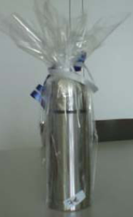
Gift Exchange Experiments
Gift exchange in the field design a la Gneezy and List (2006)
  Hire workers for one-time task at a promised wage, no piece rate
  Shut off repeated-game incentives
  Surprise treatment group with gift at beginning of work
  Does treatment group work harder due to reciprocity?
Example: Kube, Marechal and Puppe (2012)
  Treatment groups receives in-kind gift (mug), or money
Notes:
3

Slide 4
Let’s consider these experiments through the lens of a simple model.

Slide 5
Simple Model
Notes:
5

Slide 6
Simple Model
Notes:
6

Slide 7
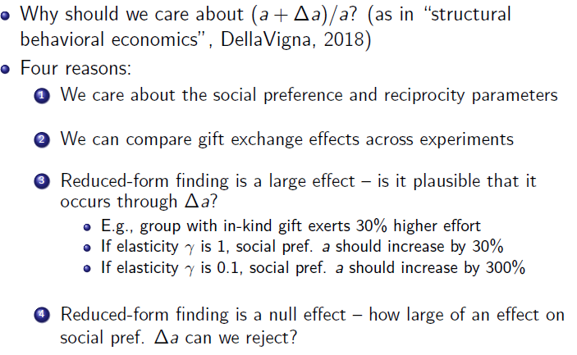
Simple Model
Notes:
7

Slide 8
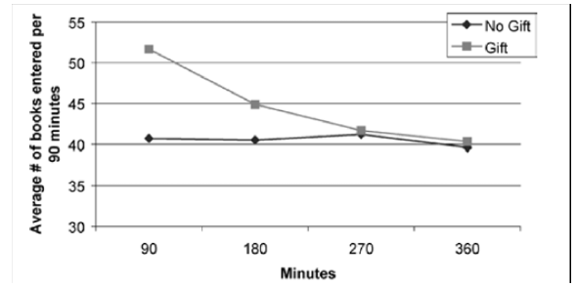
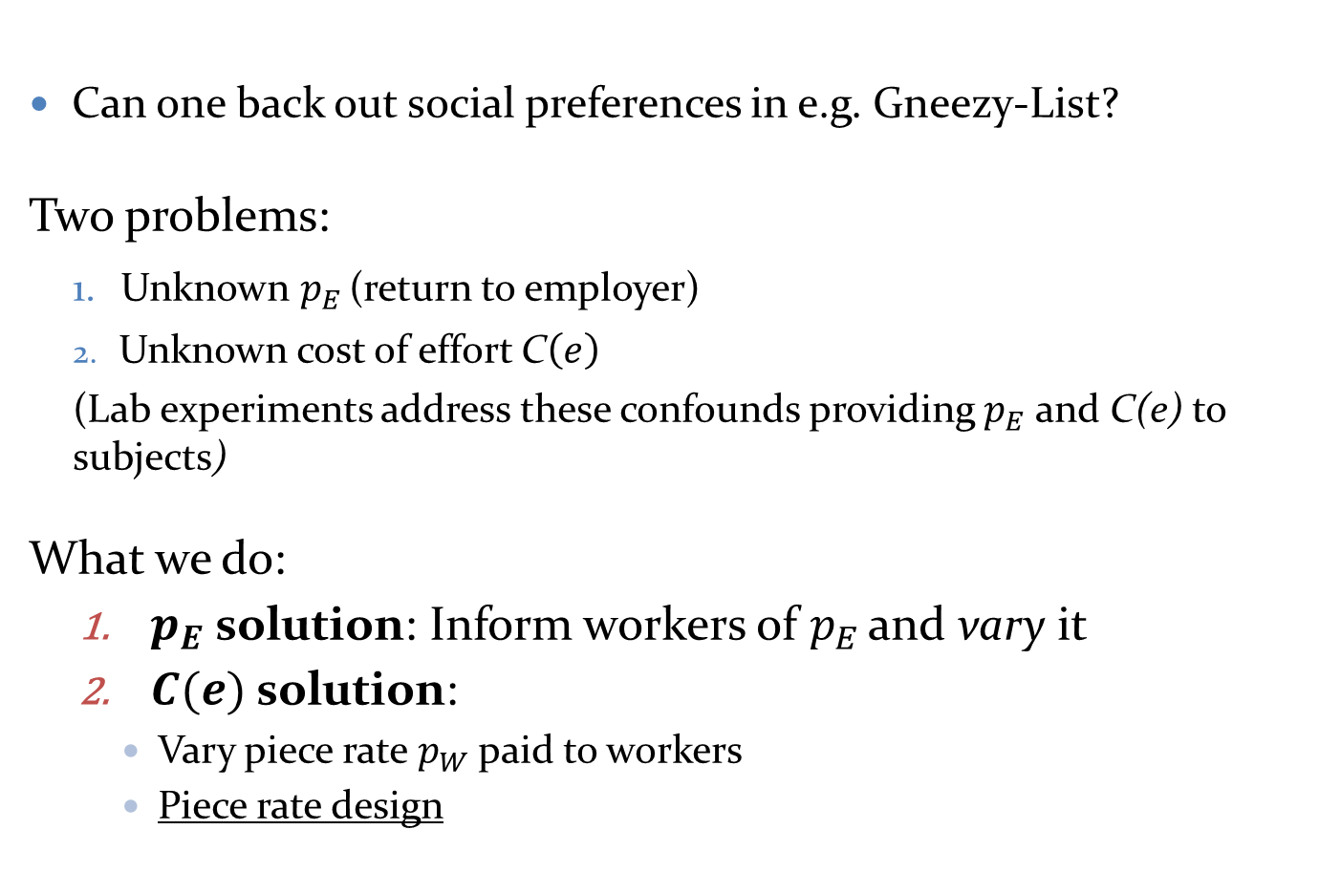
Challenges to Estimating Social Preferences
Can one back out social preferences in e.g. Gneezy-List?
Two problems:
Unknown $p_{E}$ (return to employer)
Unknown cost of effort C$\left(e\right)$
(Lab experiments address these confounds providing $p_{E}$ and C(e) to subjects)
  What we do:
  $p_{E}$ solution: Inform workers of $p_{E}$ and vary it
  $C(e)$ solution:
    Vary piece rate $p_{W}$ paid to workers
    Piece rate design

Slide 9
Design of Experiment 1
Subjects recruited from Craigslist for one-time 6-hour employment in ‘13-’15
N=446 workers (largest gift-exchange experiment in the field so far)
Fold and stuff envelopes for three charities matching different materials
Within subject: Ten 20-minute rounds of work with 10-minute breaks
Vary piece rate p_{W}
    Fixed pay $7, no piece rate
    Fixed pay $3.5, 10 cent piece rate per envelope
    No fixed pay, 20 cent piece rate per envelope
    Equivalent for average-productivity worker (35 envelopes in 20 minutes -pilot)
Announce, and vary return to employer p_{E} with donor match
Example : “Thanks to an anonymous donor, [NAME] has received a matching grant that will match every dollar raised by these letters 1 to 1 up to $2,000 total. This means that the first $2,000 in total donations to [NAME] will become $4,000. A number of such matching grant campaigns have been run by charities similar to [NAME], and historically, charities like [NAME] have yielded roughly $___0.60____ per mailer with such campaigns, including the match.”
  Between subjects: Gift Exchange Treatments in last 2 rounds
  Control ($7), Negative ($3), Positive ($14), In-Kind ($7 + thermos)
Notes:
Dates of experiment?
9

Slide 10
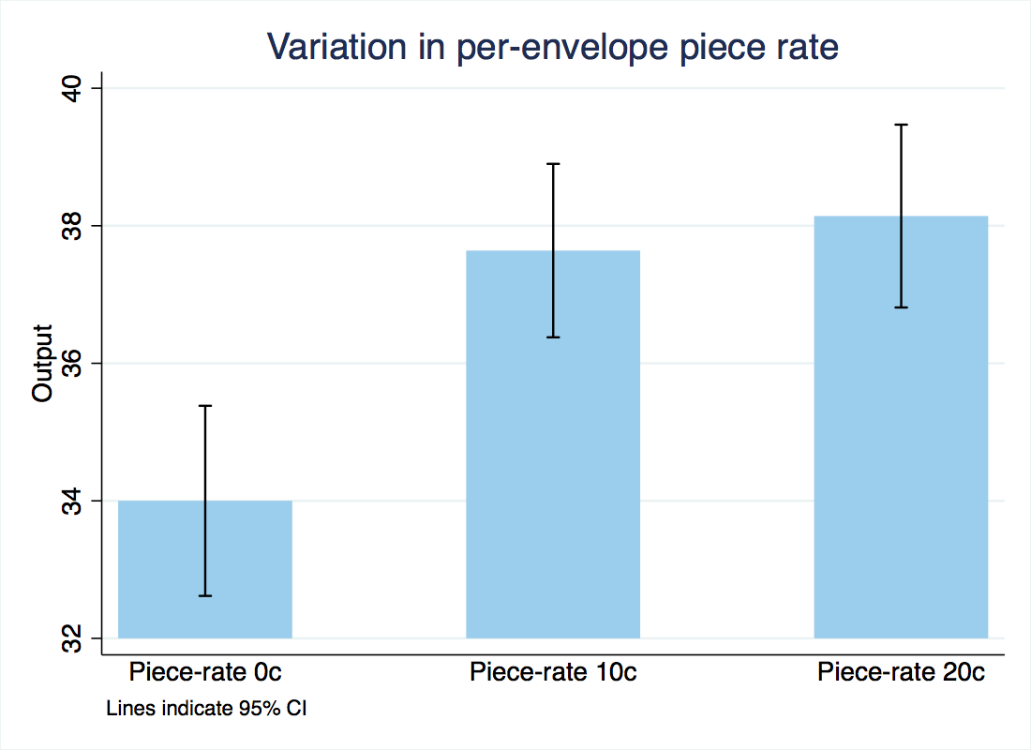

Effect of Piece Rate
Finding 1. Significant (though small) response to piece rate
  20 cent/envelope increase in $p_{W}$→ 4 envelope (12%) increase
  Identifies curvature of cost of effort function
“Charity X will be paying for your work. The pay is $7 with no per-envelope payment, as noted on your
schedule.”
“…The pay is $3.50 plus $ __0.10_per envelope completed…”
“…The pay is $ 0.20 per envelope completed…”
Notes:
10

Slide 11
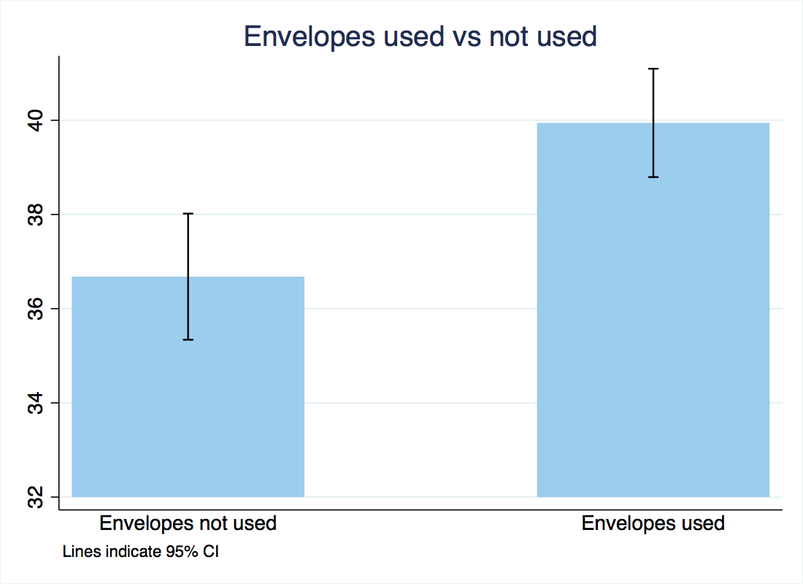
Training vs “Real” Session
Finding 2. Significant increase when letters are used
  Envelope used →3.5 envelopes (10%) increase
  Consistent with positive altruism/warm glow
Training round: “As part of our agreement with the organizations mentioned before, the Becker Center will provide two paid training sessions….The training is paid for by the Becker Center. We will be discarding all of the envelopes prepared in this training session.”
Notes:
* Flag that always biased in reduced form
11

Slide 12
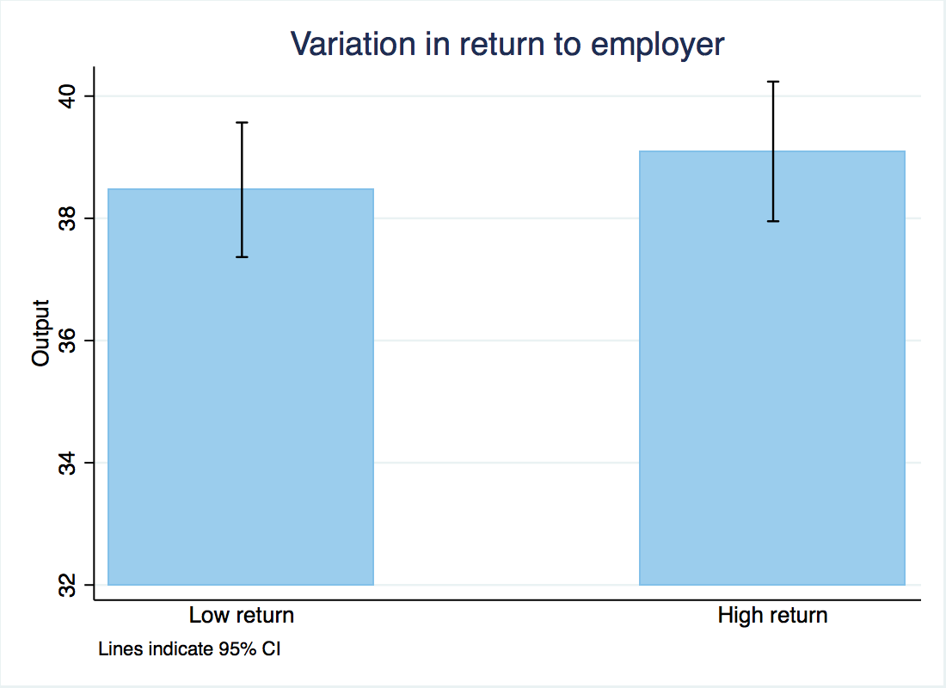

Varying the Return to Employer
Finding 2. Very small impact of increasing return to employer
  30 cent/envelope increase in $p_{E}$→ 0.6 envelope (1.6%, not sig.) increase
  Inconsistent with pure altruism
“Thanks to an anonymous donor, Charity 1 has received a matching grant that will match every dollar raised by these letters 1 to 1 up to $2,000 total.”
“A number of such matching grant campaigns have been run by charities similar to Charity 1, and historically have yielded roughly $___0.60____ per mailer with such campaigns, including the match.”
Notes:
12

Slide 13
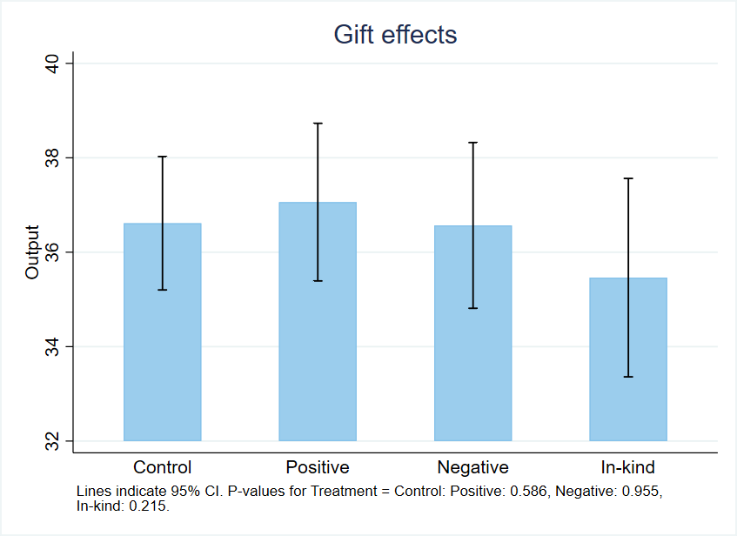
Positive In-Kind Gift
Last 2 rounds: Between-subject gift treatments
Finding 3: Small, non-significant effects of gifts
Notes:
13

Slide 14
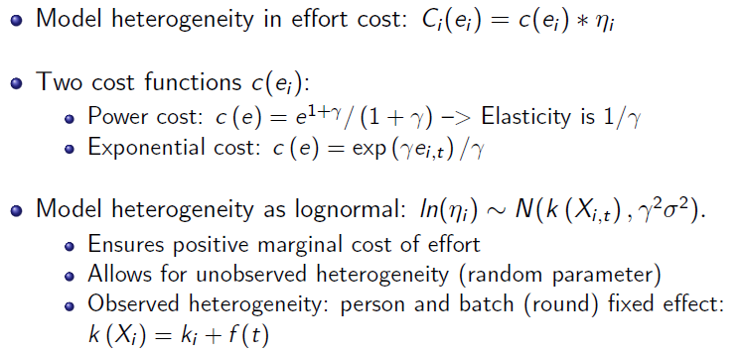
Estimates of Social Preferences in Exp 1
Notes:
Maybe skip this?
Insert MB=MC graphs? YES! (SDV)
14

Slide 15
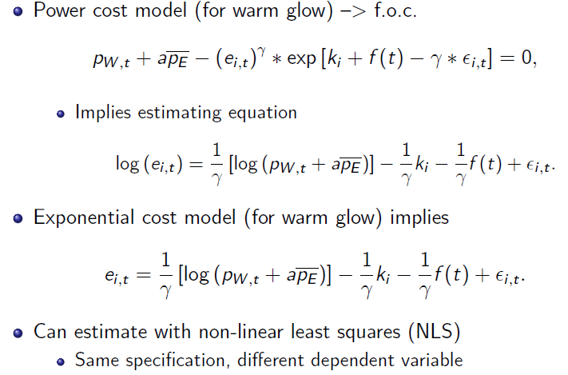
Estimates of Social Preferences in Exp 1
Notes:
Maybe skip this?
Insert MB=MC graphs? YES! (SDV)
15

Slide 16
Social Preferences NLS Estimation
Notes:
INSERT 8 period model here
→ Uses date from first 8 rounds
16

Slide 17
Summary of Results, Exp. 1
Aim to measure social preferences in field experiment
  Issue 1. (Value of Work) Inform and vary employer return
  Issue 2. (Cost of Effort) Use piece-rate design and vary worker return to effort (piece rate)
Piece-rate design:
  Control group, no piece rate
  Treatment group (gift/delay/comparison), no piece rate
  Control group with low piece rate
  Control group with high piece rate
  Issue 3. (Inelastic Task) Task inelastic → Social pref. estimates relatively imprecise despite large sample and within design
Were we unlucky to have inelastic productivity task?
  Few real-effort papers use piece rate design (none on gift exch)
Notes:
17

Slide 18
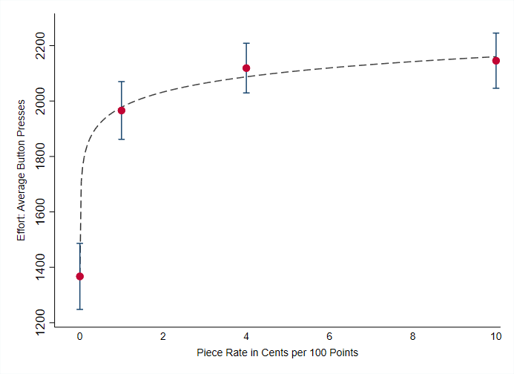
Productivity Experiments
Two more papers we are aware of for productivity task:
  Araujo et al. (2016) for slider task (Gill and Prowse, 2012), N=148
    Piece rates: 0.5c, 2c, 8c, output: 26.1, 26.6, 27.3 → Elast. of 0.025
  DellaVigna and Pope (2018) for 10-min typing task, N=10,000
    Piece rate (per 100 presses): 0c, 1c, 4c, 10c → Elast. Of 0.04
Three productivity experiments → elasticity <= 0.1
  Makes sense, ex post: Hard to work harder in fixed time
Can we find a design with larger elasticity?
Notes:
18

Slide 19
Labor Supply Design (Exp. 2)
Second experiment: extra work design
  Idea from Abeler et al. (2015)
  We hire workers for a one-time 2-hour RA coding job for $60
  After 2 hours, randomization takes place: “Thank you for your work today. You have completed the work we hired you for, so here is the $60, as advertised. [Monetary Gift/Non Monetary Gift: In addition, as a token of appreciation, the Becker Center is giving you (Monetary Gift: an additional $15 for helping today. Therefore, we are paying you a total of $75./ Non Monetary Gift: this thermos with a retail value of $15 for helping today.)]”
  After a short break, we ask: “If you happen to have some time available, even a few minutes, and are willing to do some extra work, that would be appreciated. Would you be willing to help us enter some more of the data for up to one hour? [Control/Monetary Gift/Non-Monetary Gift/Early Gift: Unfortunately, we cannot compensate you for this extra time.] [M-H Piece Rate: We will pay you [¢25/ ¢50] for every minute of work that you do, up to one hour. For example, if you do an extra 20 minutes of work, we will pay you $5 [$10] extra.]”
  Outcome: number of minutes worked (pre-registered)
  Sample size: 300 workers (pre-registered)
Notes:
19

Slide 20
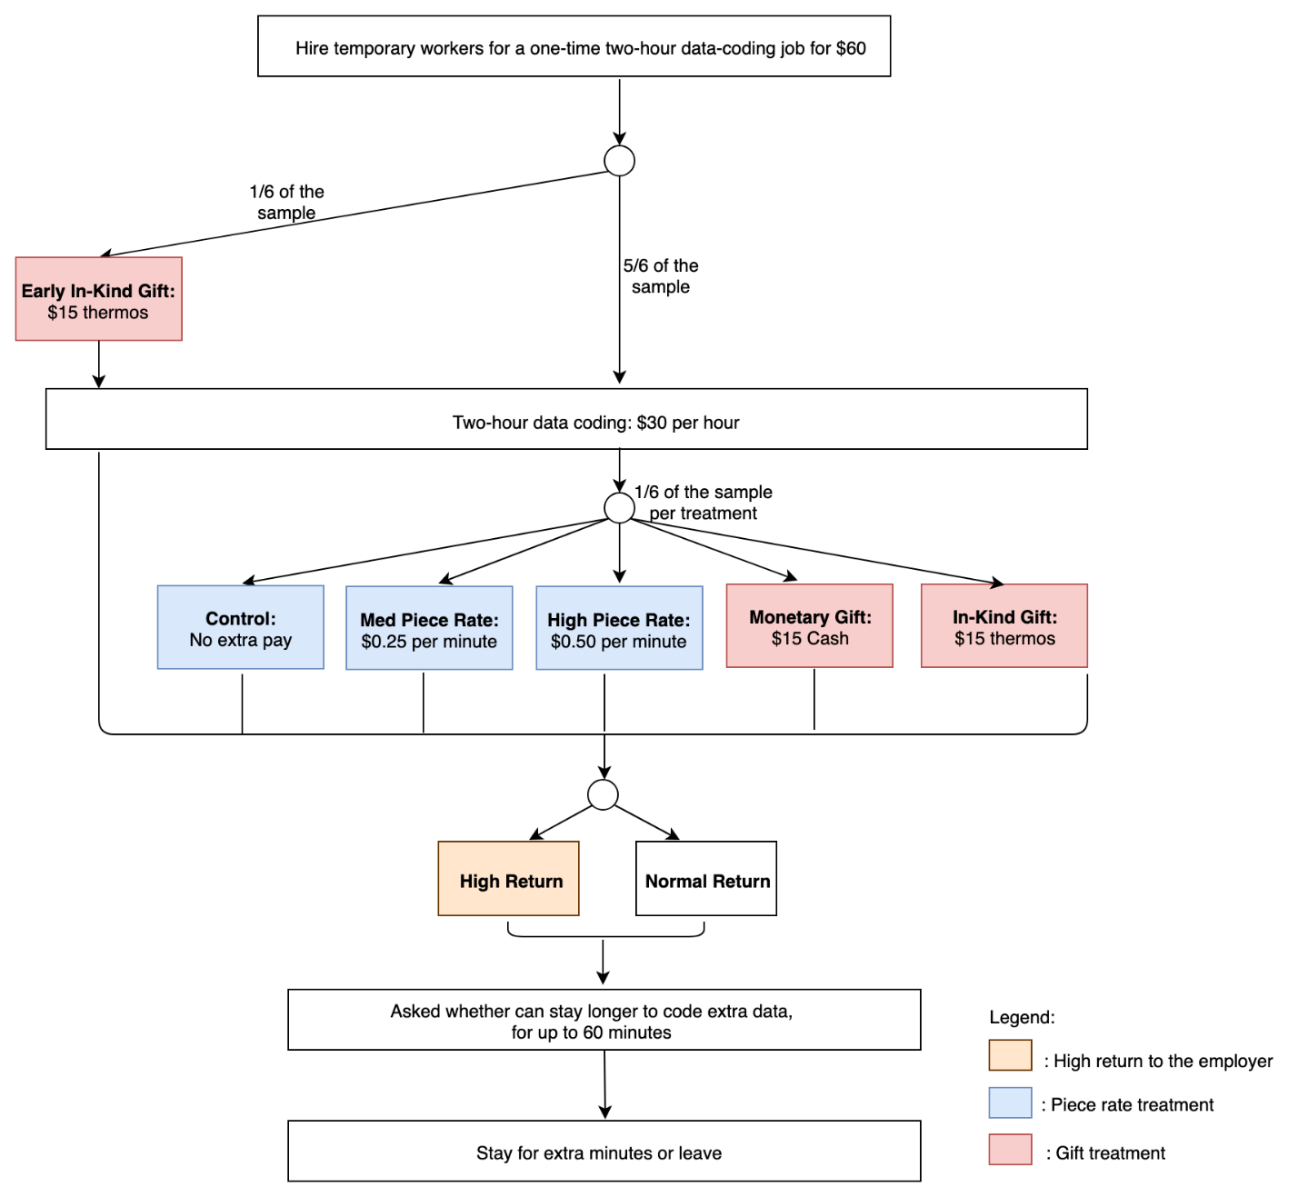
Labor Supply Design (Exp. 2)
Notes:
20

Slide 21
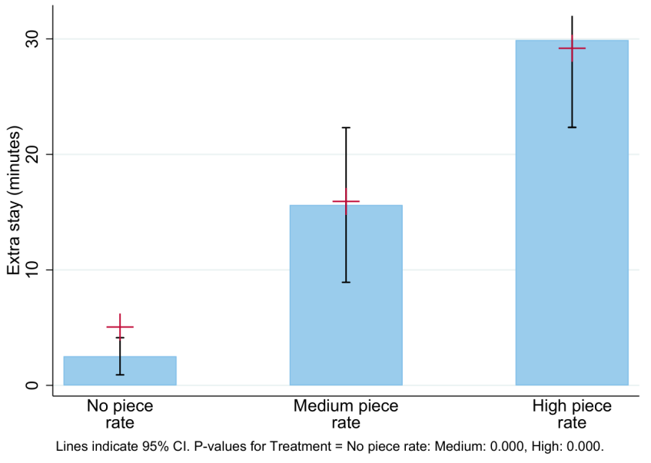
Labor Supply Experiment
Very strong response to incentives: elasticity above 1
Margin of extra work done is very sensitive
What happens with social preference treatments then?
Notes:
21

Slide 22
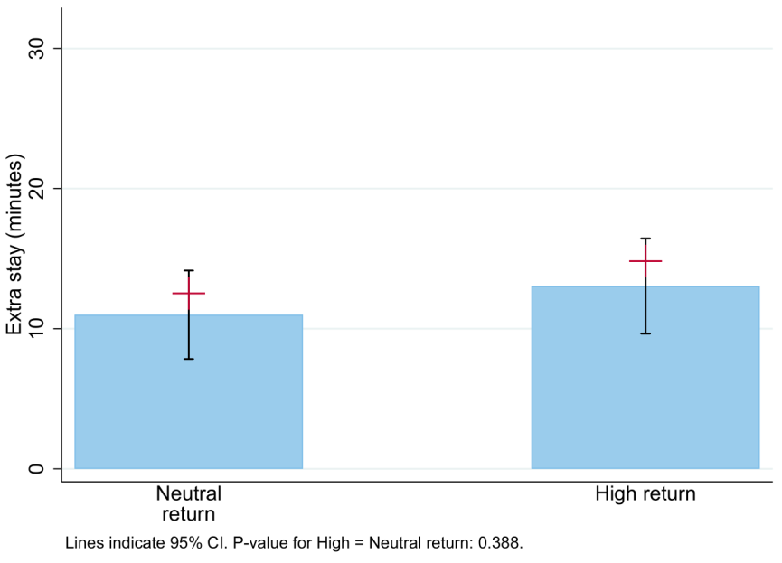
Labor Supply Experiment
Treatment on value of work to the employer: “Getting the extra data entered today is really valuable to us.”
No significant response → Consistent with results of productivity experiment and with “warm glow” model
Notes:
22

Slide 23
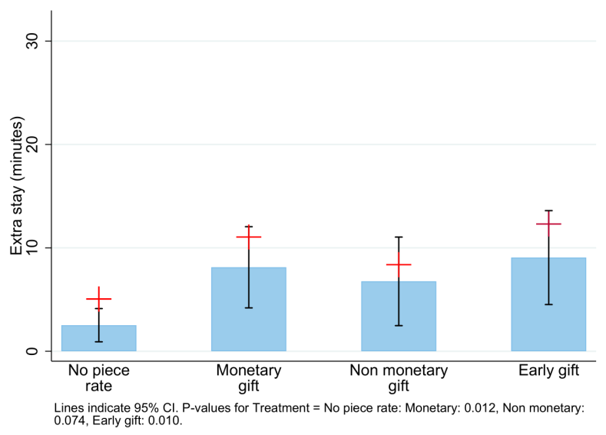
Labor Supply Experiment
Significant response to gifts → Evidence on reciprocity, even for “early gift” and monetary gift
Notes:
23

Slide 24
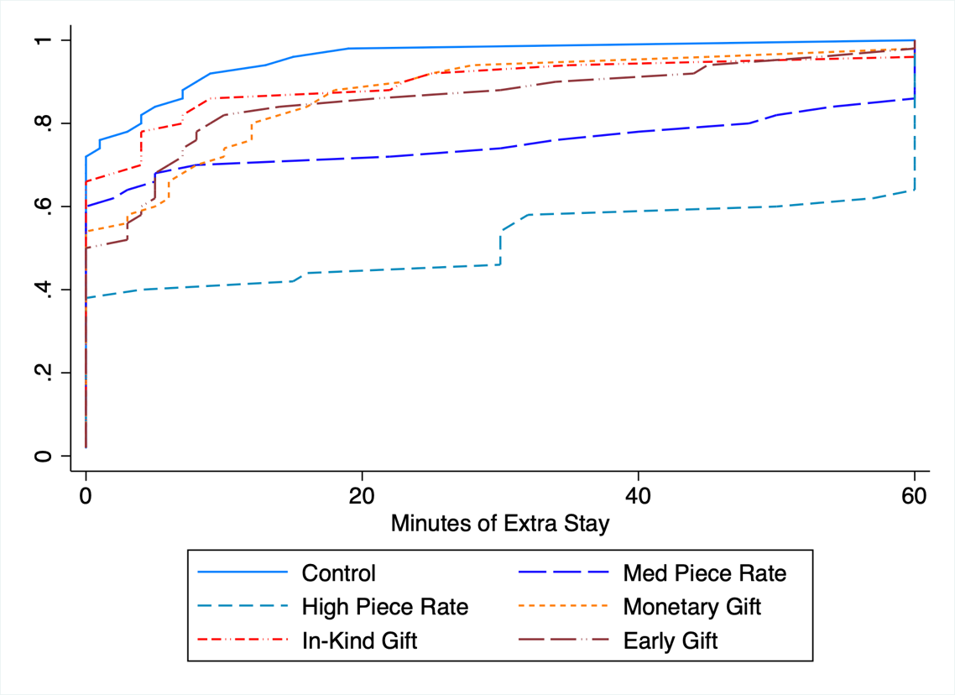
Labor Supply Experiment
Results in detail
Notes:
24

Slide 25
Social Preference Estimates in Exp 2
Notes:
INSERT 8 period model here
→ Uses date from first 8 rounds
25

Slide 26
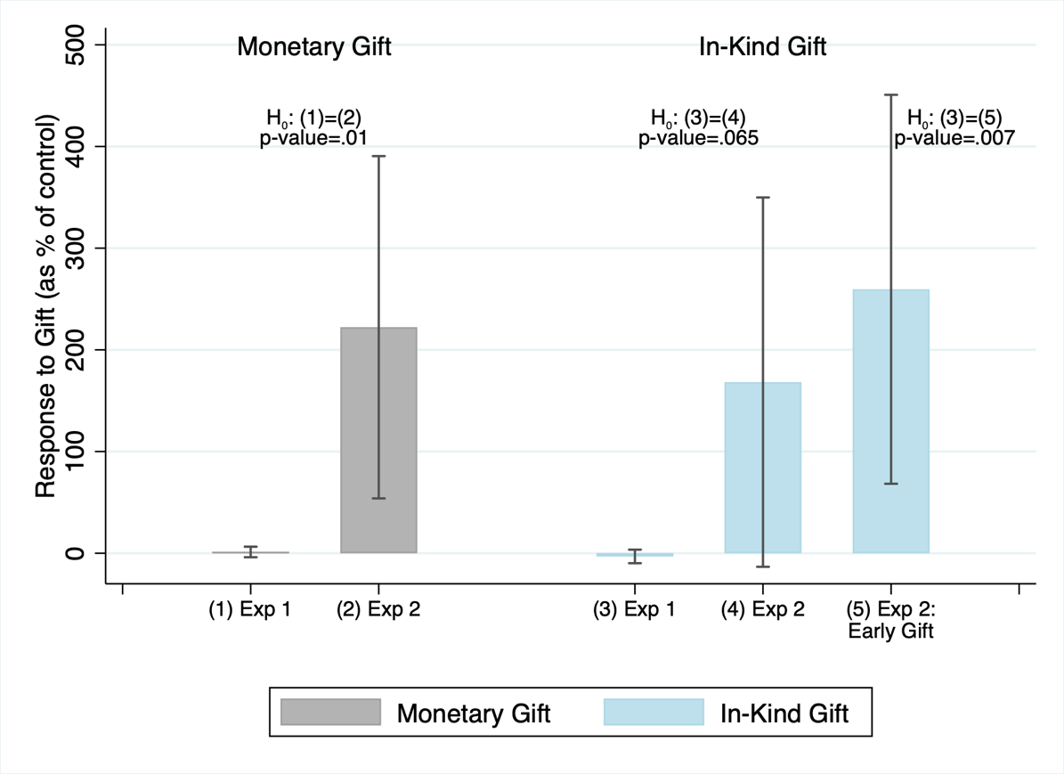
Gift Treatments: Value of Estimates
Puzzle: Reduced-form effect of gifts very different in 2 experiments
Contradictory evidence? Translate to structural estimates
Notes:
26

Slide 27
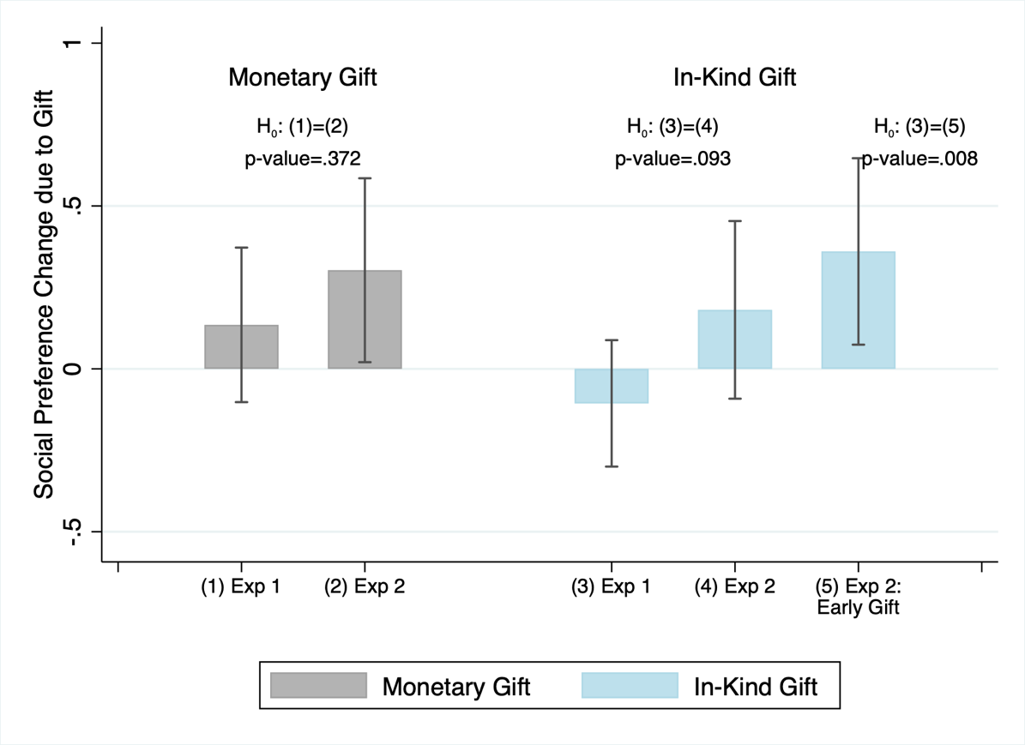
Gift Treatments: Value of Estimates
Estimates of reciprocity preferences much more in line
Solves most of the puzzle (and supports role of reciprocity)
Notes:
27

Slide 28
Conclusion
Real-effort tasks are important part of arsenal for behavioral and experiment economists
A piece-rate-metric design complements existing designs:
Allows for structural estimation of parameters
Provides a check if behavioral effect sizes are plausible
Allows comparison of results across experiments
Helps identify real-effort designs that are more responsive to motivation
Using piece-rate design, we identify labor-supply design that is more elastic, and thus more powered
The two experiments lead us to find evidence of
  warm glow (Exp 1 and 2) and
  reciprocal gift exchange (Exp 2)
Notes:
28

Slide 29
Notes:
29

Slide 30
Gift Exchange, I vs. II
Can we reconcile the two findings?
  The two experiments have statistically different effort increases due to treatment
  BUT they could have the same underlying increase in motivation if different elasticities
  If Marechal et al. task is more elastic to motivation
So, how do we get gamma, and thus the elasticity?
Piece-rate design:
  Control group, no piece rate
  Treatment group (gift/delay/comparison), no piece rate
  Control group with low piece rate
  Control group with high piece rate
Two piece rates identify elasticity and baseline motivation
Notes:
30

Slide 31
Simple Model
Notes:
31

Slide 32
Piece-Rate Design
How common is the piece rate design?
Example 1 above (Marechal et al., 2013): no piece rate
Survey of published papers in QJE-AER-JPE-EMA-RES
23 studies with real-effort tasks or workplace effort manipulated (e.g, Gneezy et al., 2003; Abeler et al., 2011; Kaur et al., 2015)
How many have piece rate variation? Only 6 out of 23 studies
In how many studies piece rate variation can be used to identify a behavioral effect? 3 papers only
  Gill and Prowse (2012) – reference dependence
  Augenblick, Niederle, and Sprenger (2015) – identify time preferences
  DellaVigna and Pope (2018a,b) – behavioral parameters
Notes:
32

