Slide 1

Difei Ouyang
University of Geneva
Capital Scarcity and Industrial Decline:
Evidence from 172 Real Estate Booms in China
Real Estate Boom
Capital
cost
实体经济
房地产繁荣
Industry
hollowing
Harald Hau
University of Geneva
Swiss Finance Institute
http://www.haraldhau.com
1
Notes:
1

Slide 2
What is this paper about?
This paper quantifies the negative effect of real estate booms on industrial competitiveness though biased capital allocation in China
  US evidence: Chakraborty, Goldstein, and MacKinlay, RFS 2018: 1 SD in housing price increase reduces firm investment by 21%
  China: Growth mostly about capital deployment, hence crowding-out of firm finance can have large real effects on many firm variables: investment, output, real wages, exports, ROA, TFP 1 SD in housing price increase reduces firm investment by 40%
  Emerging markets: Real estate booms often precede current account crisis, but no causal evidence for its adverse effect on firms
Develop an modified Balassa-Samuelson framework to explain the effect of real estate boom on factor prices and firm variables

Slide 3
Local Wage versus Capital Cost Externality
 | Classical Balassa-Samulson Effect | Modified Balassa-Samulson Effect
Assumptions | Integrated capital market Local labor market | Both capital and labor market are local markets
Initial shock | Productivity growth in tradables increases real wage | Real estate boom increases cost of capital
Mechanism | Interest rate global and constant; High real wages increase costs of non-tradables: Wage Externality | Interest rates for export sector increases, investment decreases and real wages decrease: Capital Cost Externality
Consequence | Non-tradeable sector survives in spite of high prices because it competes only locally | Higher capital costs reduce the competitiveness of the tradeable sector
Evidence | Plenty | This paper, CGM RFS 2018

Slide 4
What is special about China?
Large housing prices variation
  -13% to 467% change in city-level housing prices (2003-10) within same country!
Segmented capital market
  Lending barriers across administrative regions
  Large investment needs
Monopolistic land markets by government
  Large intertemporal variation

Slide 5
Key Findings
Real estate booms cause quantitatively large
  city-level capital scarcity for local private manufacturing firms
  and competitive decline
Ceteris paribus effect of a 1 SD higher housing price index:
  Corporate credit costs become 107 bps higher
  (+18% relative to a 6.1% average)
  Corporate net investment rate 8.7 percentage point lower
  (-40% relative to sample mean of 21.5%)
  Real manufacturing wage is 19% lower
  Value-added output 42.6% lower
  ROA is 7 percentage points lower
  Total Factor Productivity (TFP) 14.5% lower

Slide 6
Data
Firm data:
  Annual Survey of Industrial Firms
  Sample 2002-2007
  Focus on manufacturing firms (around 900,000 obs.)
Housing prices data:
  Regional Economic Statistical Yearbook
  (log) Average housing prices deflated by regional CPI
Land supply data:
  Province Statistical Yearbook and Land Transaction Data
  Annual land supply for housing construction

Slide 7
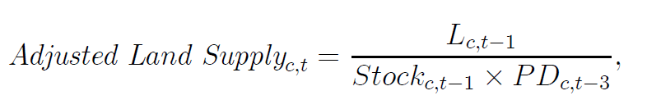
Adjusted Land Supply over Time
Instrument:
  Supply of new constructible land in t-1
  Adjusted for housing stock and population density in t-3
Erratic Land Supply:
  Ineffective intragovernmental coordination
  Property rights conflicts
  Policy conflicts with central government

Slide 8
Is Land Supply Exogenous?
Adjusted land supply is unrelated to contemporaneous city characteristics:
  City GDP
  Population
  Fiscal conditions
  Infrastructure
  Exception: Park area.

Slide 9
Is Land Supply Exogenous?
Adjusted land supply is unrelated to recent city development trends:
  City GDP growth
  Population growth
  Educational growth
  Change in industry structure
  Etc.

Slide 10
Is Land Supply Exogenous?
Adjusted land supply is unrelated to future city development plans:
  City Gov. Expenditure growth
  Road construction
  Transport infrastructure
  Etc.

Slide 11

Determinants of Housing Inflation
Instrument: Adjusted Land Supply interacted with local elasticity
Chinese housing price like commodity market price (=highly dependent on yearly supply)
Identification is based on city-level intertemporal variation in the adjusted land supply because of city/firm fixed effects in the second stage

Slide 12
Is Land Supply Exogenous?
Political economy variable do not explain housing supply:
  Local party leader age irrelevant
  Local Party leader tenure irrelevant
Could there be an unobserved endogenous response to high local housing prices?
Answer: Yes, but high housing prices should trigger more local supply, which (if ignored) bias our results downwards against finding strong real effects

Slide 13
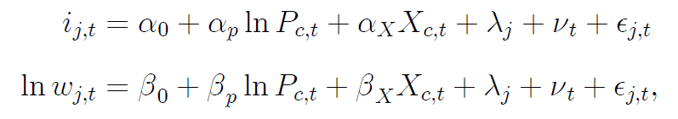
Factor Prices Responses for 1SD real estate price increase: SD[ln P ]= 0.486
107 bps higher credit costs: 18% higher relative to average of 6.1%
(additional extensive margin effect)
19% lower real manufacturing wage

Slide 14
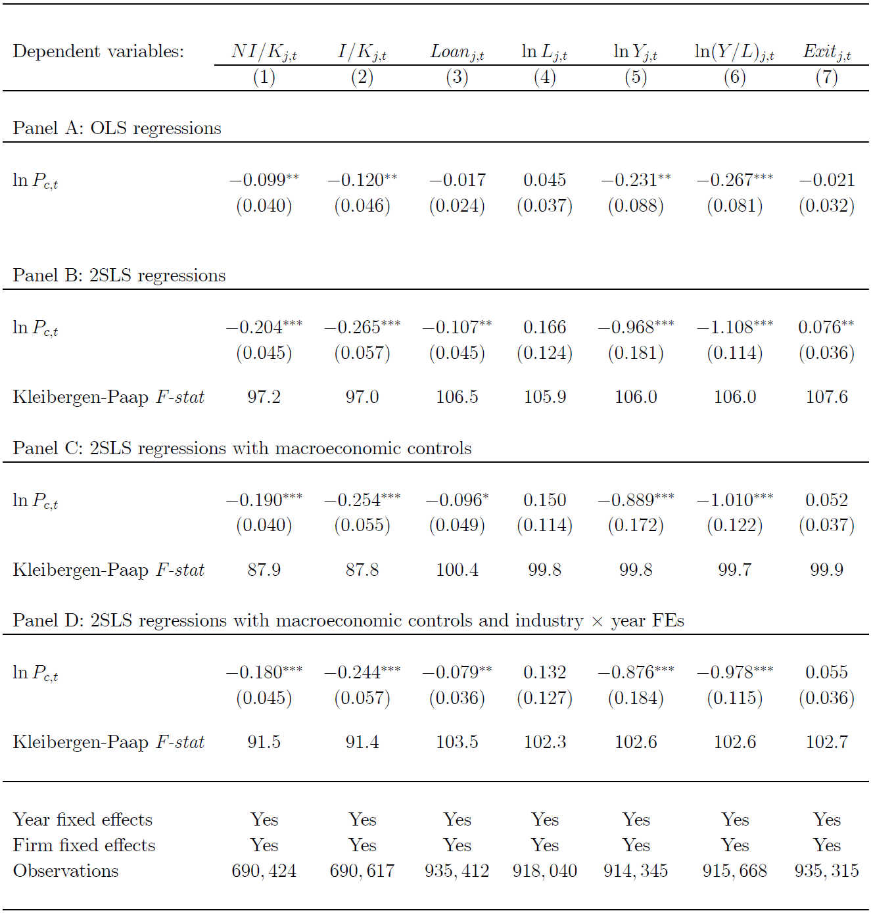
Manufacturing Firm Responses for 1 SD real estate price increase: SD[ln P ] = 0.486
Net investment rate: 8.7 percentage points lower
(mean = 21.5)
Firms with loans:
3.8 percentage point lower
(mean = 33.7)
Output:
42.6% lower
Firm exit rate: 2.7 percentage point higher

Slide 15
2002-2007 Growth Differences by Firm Type

Slide 16
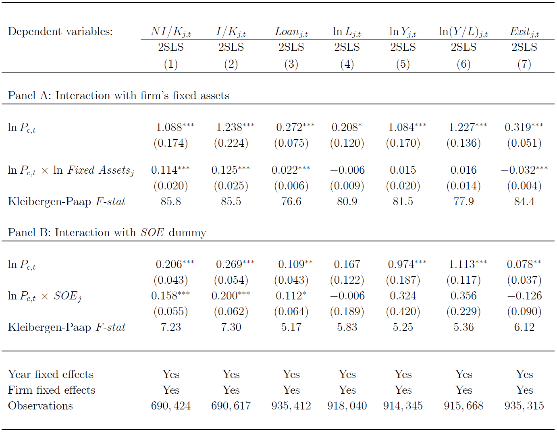
Heterogeneity: Small Private Firms Suffer Most
1 SD real estate price increase: SD[ln P ] = 0.486
Private Firms:
10 percentage point investment decline
SOEs:
2.3 percentage
points investment decline

Slide 17
Additional Firm Performance for 1 SD real estate price increase: SD[ln P ] = 0.486
7 percentage points lower
(mean = 7.2)
4.6 percentage points lower
(mean = 57.6)
14.5% lower productivity
(mean=1.14)

Slide 18
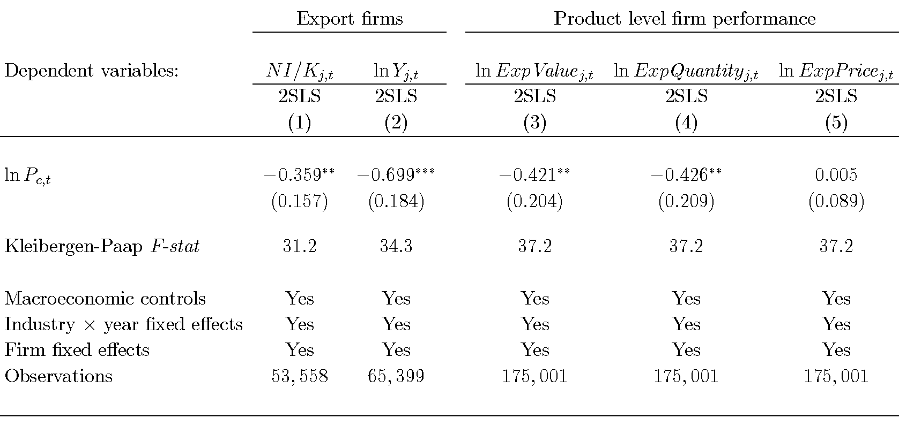
Firm Performance at Product Level
Advantages:
Eliminate local demand effects: higher real estate saving can reduce local product demand
Industry price deflator might miss-measure local real output
Independent data collection
Export volume elasticity is 61% of output elasticity:
local demand plays at best a partial role
No pass-through to industrial export price:
Industry price deflator appropriate

Slide 19
Robustness Issues
Alternative instrument for housing prices:
Housing supply elasticity (Wang et al. 2012) for major 35 cities
Using 02-07 growth specification we find similar 40% decrease in real investment

Slide 20
Robustness Issues
Alternative instrument for housing prices
  Housing supply elasticity (Wang et al. 2012) for major 35 cities
  Using 02-07 growth specification and find similar results
Initial condition of capital matters?
  Cross-sectional differences in initial financial development
  Loan/GDP, corporate loan/GDP, deposit/GDP, household deposit/GDP, does not matter for firm investment dynamics

Slide 21
Conclusions
Exogenous variation in local land supply policies provides an instrument which can partially account for the large variation of real estate prices across Chinese cities
Real estate booms push up the capital cost for the local manufacturing sector and cause strong underinvestment
Underinvestment implies the demise of the manufacturing sector in cities with the strongest real estate booms
Motivation for macro-prudential policies on real estate investment booms
Suggestive of large benefits to capital market integration

Slide 22

Motivation I
  What is the effect of real estate investment booms on industrial competitiveness?
  Collateral Channel
    More valuable collateral?
    Investment expansion?
  Capital diversion channel
    High capital cost?
    Investment decline?
    Industry hollowing?
  Real estate booms are more harmful than assumed

Slide 23
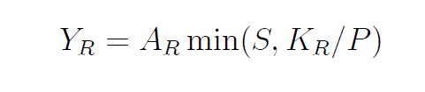



Two-Sector Balassa-Samuelson Model
Assumption 1: Real estate and tradeable sectors
  Real estate sector:
  Tradeable sector:
Assumption 2: Factor supplies
  Capital supply:
  Labor supply:

Slide 24

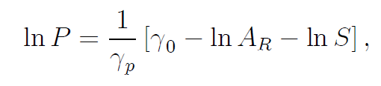

A Two-Sector Model
Assumption 3: Housing Demand
  Price elastic:
Real estate price:
Value of housing supply:
Empirics: is low

Slide 25


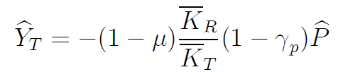
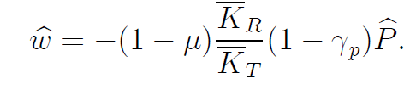
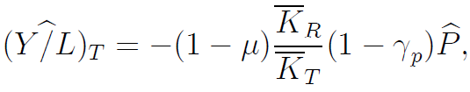
Model Implications
Proposition 1: Wage and interest rate channel
  Interest rate:
  Real wages:
Proposition 2: Manufacturing under a real estate boom
  Investment rate:
  Output:
  Labor Productivity:

Slide 26
Model Implication
Proposition 3:
Heterogeneous capital access
  Firms with large fixed asset face less credit scarcity and do better
  SOEs have privileged credit access and do better
Proposition 4:
Financial performance and TFP under capital scarcity:
  Lower Profitability
  Higher Leverage
  Lower total factor productivity

Slide 27
Determinants of Housing Inflation

Slide 28
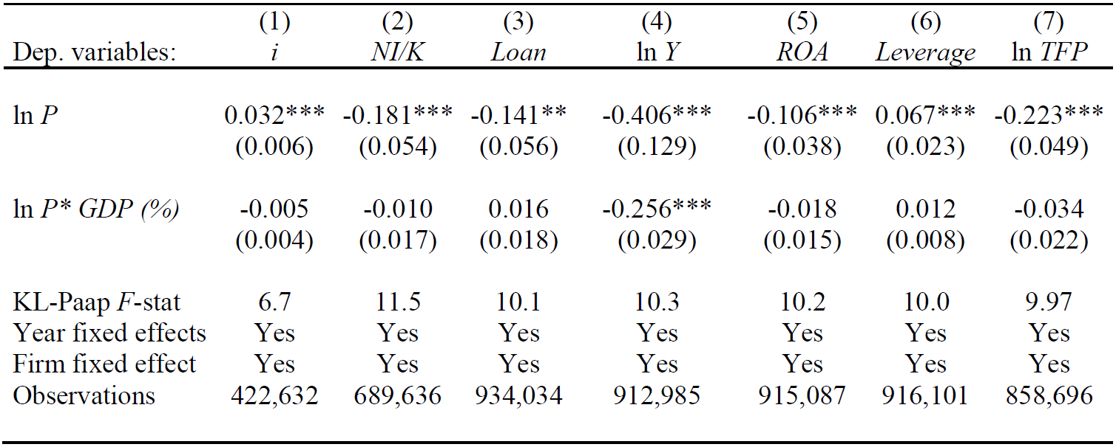
Real Effects by Relative City Size
See no differential effect on financial policy
However output effect contingent on relative city size

