Slide 1
In Search of the Roots of American Inequality Exceptionalism:
An Analysis Based on
Luxembourg Income Study (LIS) Data
Janet Gornick, Branko Milanovic, Nathaniel Johnson
Graduate Center, City University of New York
February 2020

Slide 2
Outline of the talk
Background
Objective of this study
Analytic approach
Data, measure, methods
Main results
Robustness (two analyses)
Conclusions, with brief remarks about future research

Slide 3
Background

Slide 4
Does the US have high inequality of market income, across households?
A large literature – much of it based on the LIS data – has established that the US has exceptionally high inequality of disposable household income (i.e., post-tax-post-transfer income). Much of the literature has concluded that this is due more to weak redistribution (via taxes and transfers) than to an unusually high level of inequality of market income (i.e., pre-tax-pre-transfer income).
In our own earlier work (Gornick and Milanovic 2015), we revisited this question. We found that, among working-age households, US market income inequality is high in cross-national terms. Redistribution is moderate.

Slide 5
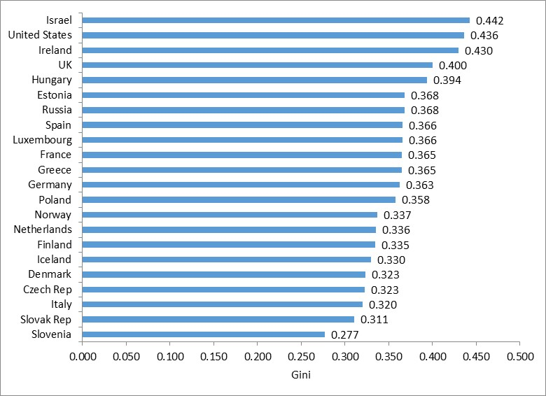
Inequality of labor income in 24 OECD countries, across working-age households, (countries ranked by labor income inequality, 2010)

Slide 6
Objective of this study

Slide 7
What underlies that high level of market income inequality?
We look more deeply at household-level market income inequality, focusing on its main component – labor income – across a group of 24 OECD countries. We ask: Is the comparatively high level of market income inequality driven upwards by inequality within some demographic subgroups or it is a “universal” result?
We disaggregate the working-age population into household types, defined by the number and gender of the household’s earners, and by the partnership and parenting status of its members.
Our main objective is to establish whether the greater underlying market income inequality in the US is the result of:
large gaps in mean earnings between subgroups;
high inequality within subgroups; and/or
an unusual composition (e.g., a high prevalence of highly unequal subgroups).

Slide 8
Analytic approach

Slide 9
Disaggregate households into subgroups, motivated by factors known to influence household- and person-level earnings
1: Six groups, based on number and gender of earners
2. Fifteen groups, based on partnership and parenting status
Assess US rank, compared to other OECD countries, with respect to between-group versus within-group inequality, using:
Visual inspection
Inequality decomposition into
between and within (within component includes overlap term)
Multivariate analysis (N = 15 x 24 = 360 country-groups)

Slide 10
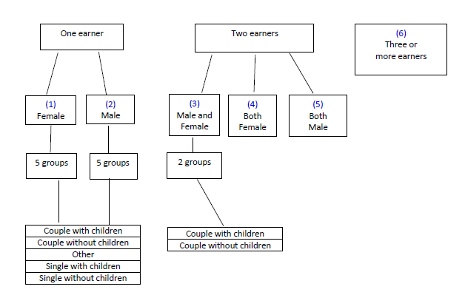
Typology of household types based on number and gender of earners, further disaggregated by demographic groups based on partnership and parenting status

Slide 11
Data, measures, methods

Slide 12
Data are from Luxembourg Income Study (LIS) Database.
We chose 24 OECD* countries: Australia, Canada, Czech Republic, Denmark, Estonia, Finland, France, Greece, Hungary, Iceland, Ireland, Israel, Italy, Luxembourg, Netherlands, Norway, Poland, Russia*, Slovakia, Slovenia, Spain, the UK, and the US.
The data from LIS Wave VIII (income year is 2010), except Hungary, which corresponds to 2009. We add one robustness check at 1995-1997 (Wave IV).

Slide 13
Unit of observation is not an individual worker (earner) but the household. We include households whose members are all below age 60 and which have at least one member reporting labor income.
To assess labor income, we use LIS’ harmonized variable “household income from labor”(HIL). We exclude capital income, which constitutes 3-7% of market income. (Thus, here, “market income” = “labor income”.)
We adjust HIL for household size, using square-root scale. Thus, we arrive at a variable that measures potential individual welfare derived from labor income.
To measure inequality, we mainly use the Gini coefficient – which allows us to remain in dialogue with the large literature on disposable income inequality. In one part of our analysis, we use two Theil indices.

Slide 14
Main results

Slide 15
six household types

Slide 16
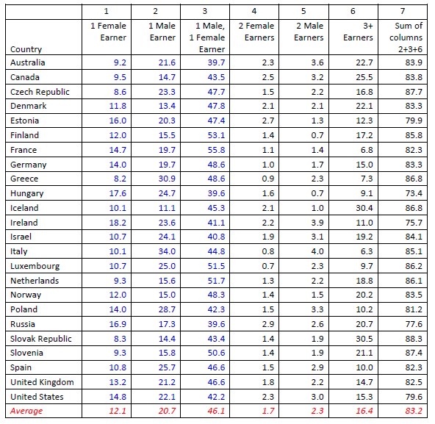
Composition of working-age population, across 6 household types (where household types are based on the number and gender of earners)

Slide 17
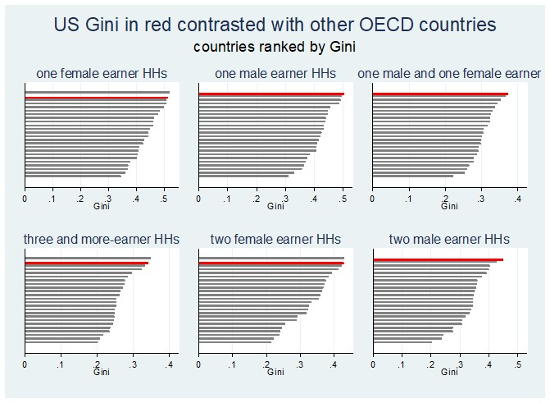
Inequality in six main household types, (where household types are based on the number and gender of earners)

Slide 18
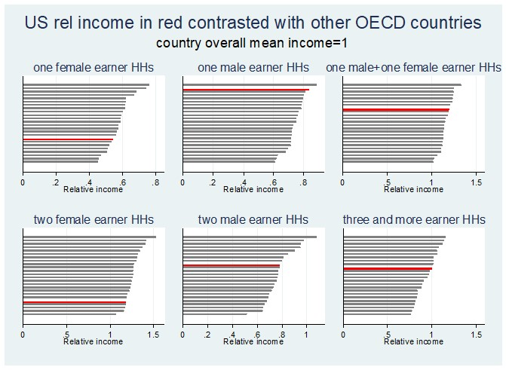
Relative income of six main household types (where household types are based on the number and gender of earners)

Slide 19
Decomposition: between-group and within-group components (for six household types)

Slide 20
15 household types

Slide 21
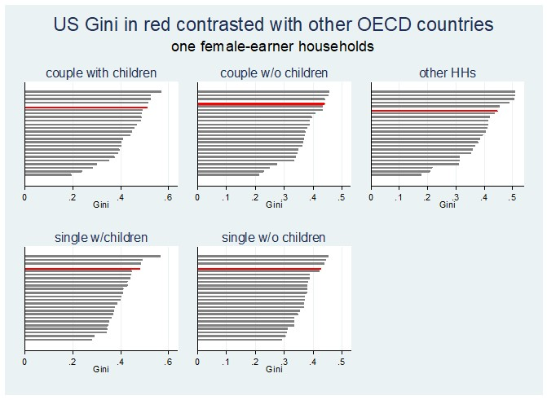
ONE EXAMPLE: one-female-earner households, disaggregated by partnership and parenting status - inequality

Slide 22
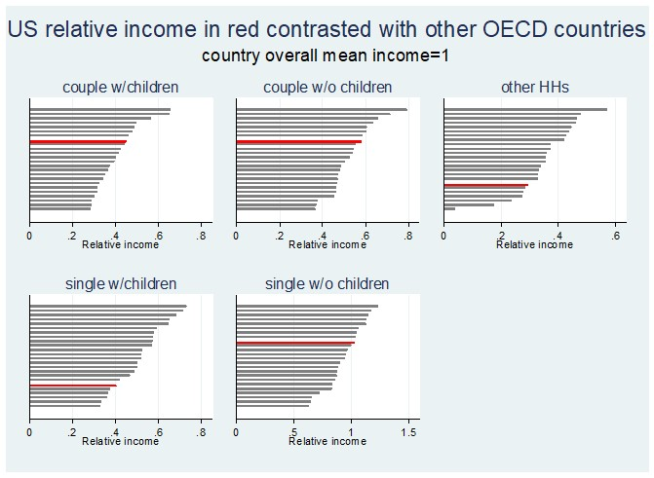
ONE EXAMPLE: one-female-earner households, disaggregated by partnership and parenting status - relative income

Slide 23
Variable |  | Unweighted regression | Population-share weighted regression
Relative group mean income |  | n.s. | n.s.
3 or more earners |  | n.s. | -0.034**
2 earners | Female | n.s. | 0.035*
 | Male | 0.034* | 0.033*
1 female earner | Couple w/ children | 0.099** | 0.136**
 | Couple w/o children | 0.048* | 0.065**
 | Single w/ children | 0.082** | 0.098**
 | Single w/o children | 0.066** | 0.078**
1 male earner | Couple w/ children | 0.089** | 0.097**
 | Couple w/o children | 0.054** | 0.067**
 | Single w/ children | 0.086** | 0.117**
 | Single w/o children | 0.087** | 0.094**
1 male, 1 female earner | Without children | 0.104* | n.s.
US dummy |  | 0.069** | 0.101**
R² |  | 0.59 | 0.82
N |  | 360 | 360

Slide 24
Robustness

Slide 25
Population shares of 15 household types

Slide 26
US inequality rankings among 24 OECD countries
(1 = highest; 24 = lowest)

Slide 27
Conclusions,
with brief remarks about future research on policies and institutions

Slide 28
Main findings
We conclude that within-group inequality of labor incomes in the US is, in almost all household groups, high by OECD standards.
The roots of US inequality exceptionalism are not to be found in an unusual demographic composition, nor in unusually high or low mean incomes of some demographic groups, but in pervasive high inequality within each of these groups.

Slide 29
Policies and institutions
1) Public policies and institutions that shape earnings distributions – e.g., minimum wages, structures of collective bargaining, and other mechanisms for wage-setting, including on the high end – are understood to affect the distribution of individuals’ earnings.
Our work focuses on households’ earnings; those are clearly shaped by the employment behavior and earnings of individual household members but also by the ways in which households are formed, vis-à-vis combinations of earners.
Little if any research assesses the extent to which earnings-related policies and institutions shape households’ earnings – either directly or indirectly (by influencing household-level employment behavior or household formation).

Slide 30
We are certainly not the first to note this lacuna in the inequality literature.
Salverda and Checchi’s (2015:1537) review of labor market institutions and wage dispersion (Handbook of Income Distribution) begins by observing that there are two massive literatures – one on wage dispersion and one on household-level income inequality – and that “the two strands of study are . . . miles apart”.
Salverda and Checchi lament that split because income from labor is the largest component of working-age households’ income. They attribute the lack of integration of the two literatures to the complexity of their interaction.

Slide 31
2) The extensive cross-national literature on the major tools of “predistribution” has not, thus far, focused on their varied effects across subgroups of workers, differentiated by “bundles” of characteristics – much less subgroups of households.
Little if any research assesses whether (or how or why) earnings-related policies differentially affect households, when those households are distinguished by their earners’ gender, partnership, and/or parenting status.

Slide 32
A rich and growing supply of institutional databases in combination with high-quality microdata (such as the LIS data) – both available across countries and over time – offers the basis for future studies that might tackle these questions.

Slide 33
Thank You
Janet Gornick, Branko Milanovic, Nathaniel Johnson

