Slide 1

Inequality and mobility over the past half century using income, consumption, and wealth
David S. Johnson
University of Michigan
Jonathan D. Fisher
Stanford University
The authors thank the Russell Sage Foundation for their support.

Slide 2
Outline
1. Using income, consumption, and wealth, have subsequent cohorts fared better than previous ones at the same age?
Levels (mean, 10th, 50th, and 90th)
Little or no improvement at the 10th percentile; Great Recession led to lower means at younger cohorts; improvements seen elsewhere.
Inequality (Gini coefficient)
Inequality increased across cohorts.
Intra-generational mobility (rank-rank correlation using vingtiles)
Mobility is no higher for younger cohorts and may be lower.
2. What is the relationship between within cohort inequality and within-cohort intra-generational mobility?

Slide 3
Outline
1. Using income, consumption, and wealth, have subsequent cohorts fared better than previous ones at the same age?
Levels (mean, 10th, 50th, and 90th)
Little or no improvement at the 10th percentile; Great Recession led to lower means at younger cohorts; improvements seen elsewhere.
Inequality (Gini coefficient)
Inequality increased across cohorts.
Intra-generational mobility (rank-rank correlation using vingtiles)
Mobility is no higher for younger cohorts and may be lower.
2. What is the relationship between within cohort inequality and within-cohort intra-generational mobility?

Slide 4
Outline
1. Using income, consumption, and wealth, have subsequent cohorts fared better than previous ones at the same age?
Levels (mean, 10th, 50th, and 90th)
Little or no improvement at the 10th percentile; Great Recession led to lower means at younger cohorts; improvements seen elsewhere.
Inequality (Gini coefficient)
Inequality increased across cohorts.
Intra-generational mobility (rank-rank correlation using vingtiles)
Mobility is no higher for younger cohorts and may be lower.
2. What is the relationship between within cohort inequality and within-cohort intra-generational mobility?

Slide 5
Background
Levels
Chetty, Grusky, Hell, Hendren, Manduca, and Narang (2017) find that 92% of children in the 1940 birth cohort had higher before-tax income than their parents, but it fell to 50% of children in the 1984 birth cohort
Inequality
Increasing earnings inequality across cohorts (Guvenen, Kaplan, Song, and Weidner, 2018)
No comparable evidence for consumption and wealth across cohorts; but both are increasing economy-wide over time (Fisher, Johnson, and Smeeding, 2014; Saez and Zucman, 2016)
Intra-generational mobility
Nothing comparable by cohorts
Income volatility (Gottschalk and Moffitt, 1994)
Consumption mobility (Fisher & Johnson, 2006) and wealth mobility (Meschede et al., 2016)
Relationship between inequality and mobility
Countries with higher inequality experience less intergenerational mobility (Corak, 2013)

Slide 6

Panel Study of Income Dynamics (PSID)
1968-2017
Follows 1968 respondents and their descendants
Measures and frequency
Before-tax income every wave
Consumption every wave since 1999 (food and housing before 1999)
Net wealth 1984, 1989, 1994, and every wave since 1999
We supplement the PSID
By imputing total consumption for all waves
Imputed consumption matches level, Gini, and trends from Consumer Expenditure Survey
Mobility using reported consumption matches mobility using imputed consumption
By imputing net wealth for all waves (in progress)

Slide 7
Details
For income and consumption, we average t-2, t, and t+2
Equivalence scale: square root of family size
Use those 25-years and older
Mobility is measured over 10-year periods within a cohort (e.g., mobility between 1987 and 1997)
Create 10-year birth cohorts

Slide 8
Details
For income and consumption, we average t-2, t, and t+2
Equivalence scale: square root of family size
Use those 25-years and older
Mobility is measured over 10-year periods within a cohort (e.g., mobility between 1987 and 1997)
Create 10-year birth cohorts
Birth years | Age range first observed | Sample size
1916-1925 | 45-54 | 423
1926-1935 | 35-44 | 525
1936-1945 | 25-34 | 818
1946-1955 | 25-34 | 2,244
1956-1965 | 25-34 | 2,927
1966-1975 | 26-35 | 2,732
1976-1985 | 26-35 | 3,836

Slide 9
Outline
1. Using income, consumption, and wealth, have subsequent cohorts fared better than previous ones at the same age?
Levels (mean, 10th, 50th, and 90th)
Little or no improvement at the 10th percentile; Great Recession led to lower means at younger cohorts; improvements seen elsewhere.
Inequality (Gini coefficient)
Inequality increased across cohorts.
Intra-generational mobility (rank-rank correlation using vingtiles)
Mobility is no higher for younger cohorts and may be lower.
2. What is the relationship between within cohort inequality and within-cohort intra-generational mobility?

Slide 10
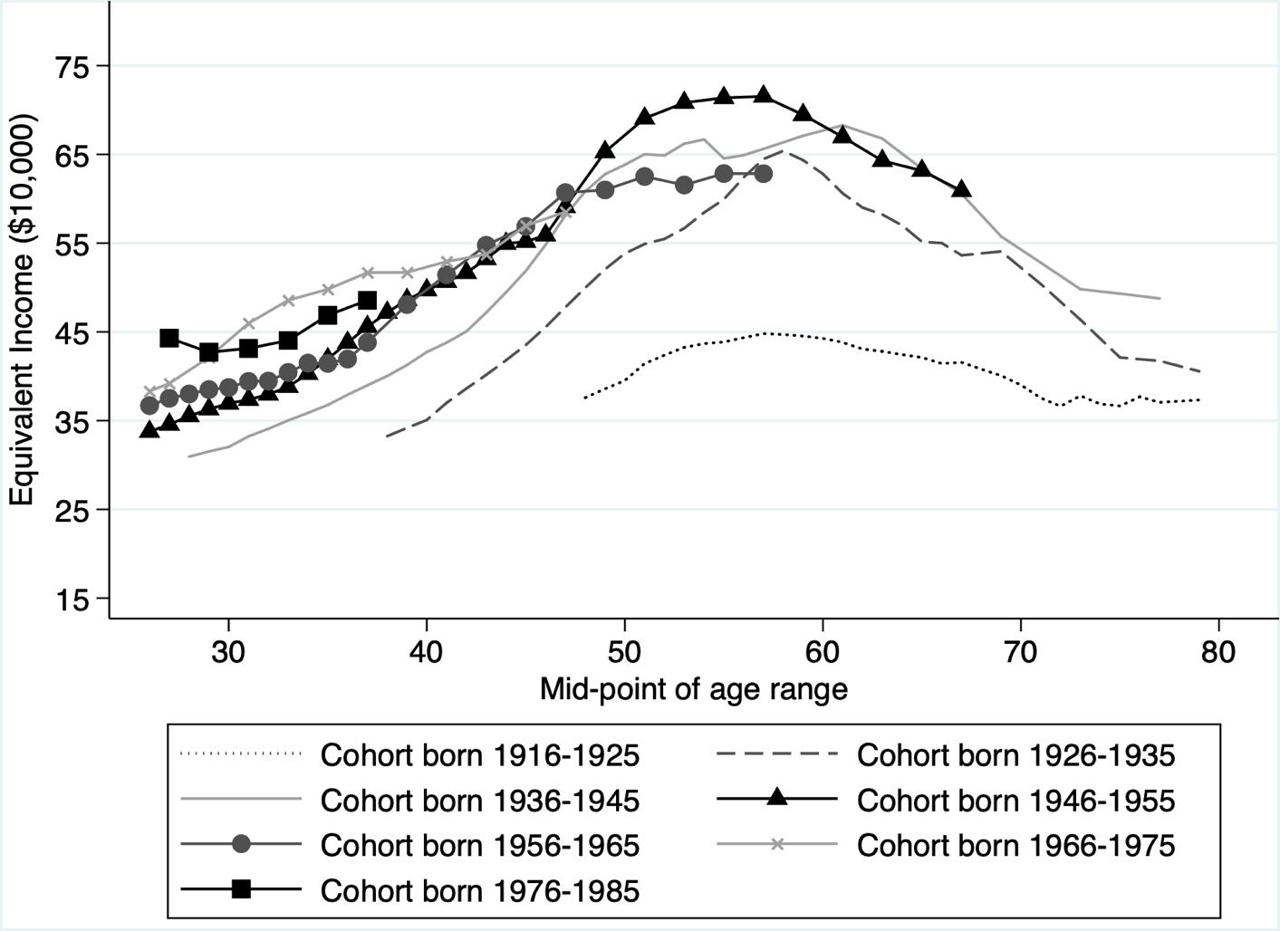
Age-income profile by cohort (mean)

Slide 11
Age-income profile by cohort (mean)

Slide 12
Age-income profile by cohort (mean)
Great Recession
for cohort born 1946-1955

Slide 13
Age-income profile by cohort (mean)
Great Recession for cohort born 1956-1965

Slide 14
Age-income profile by cohort (mean)
Great Recession for cohort born 1976-1985

Slide 15
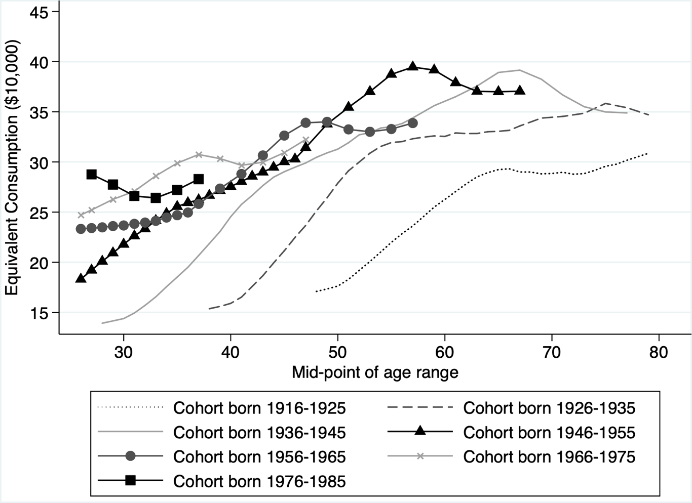
Age-consumption profile by cohort (mean)

Slide 16
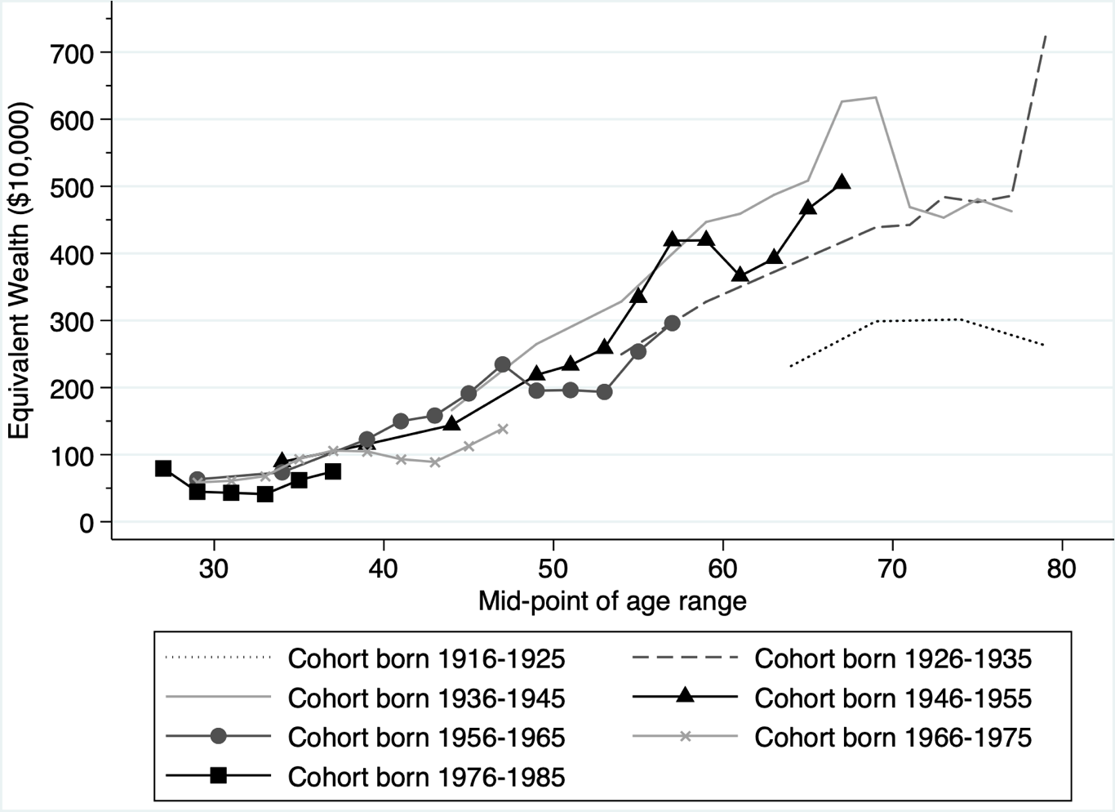
Age- wealth profile by cohort (mean)

Slide 17
Outline
1. Using income, consumption, and wealth, have subsequent cohorts fared better than previous ones at the same age?
Levels (mean, 10th, 50th, and 90th)
Little or no improvement at the 10th percentile; Great Recession led to lower means at younger cohorts; improvements seen elsewhere.
Inequality (Gini coefficient)
Inequality increased across cohorts.
Intra-generational mobility (rank-rank correlation using vingtiles)
Mobility is no higher for younger cohorts and may be lower.
2. What is the relationship between within cohort inequality and within-cohort intra-generational mobility?

Slide 18
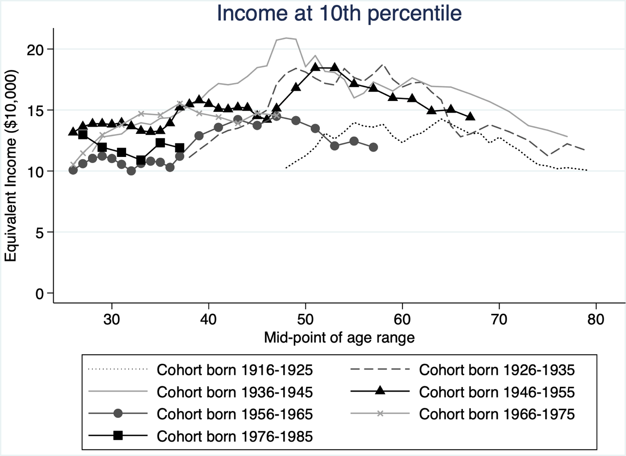
Age- income profile by cohort (10th percentile)

Slide 19
Age- income profile by cohort (10th percentile)
At the 10th percentile, 1956-1965 birth cohort worse off than previous cohorts

Slide 20
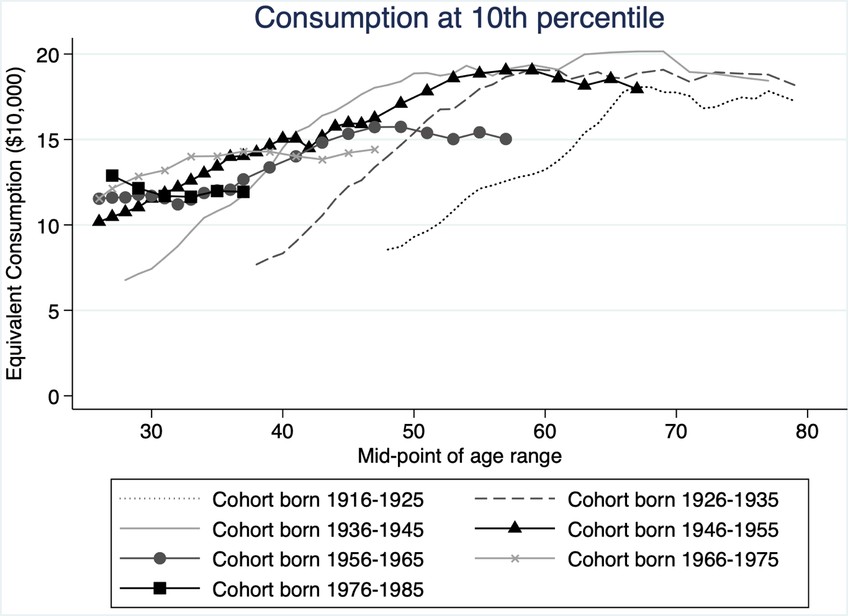
Age- consumption profile by cohort (10th percentile)

Slide 21
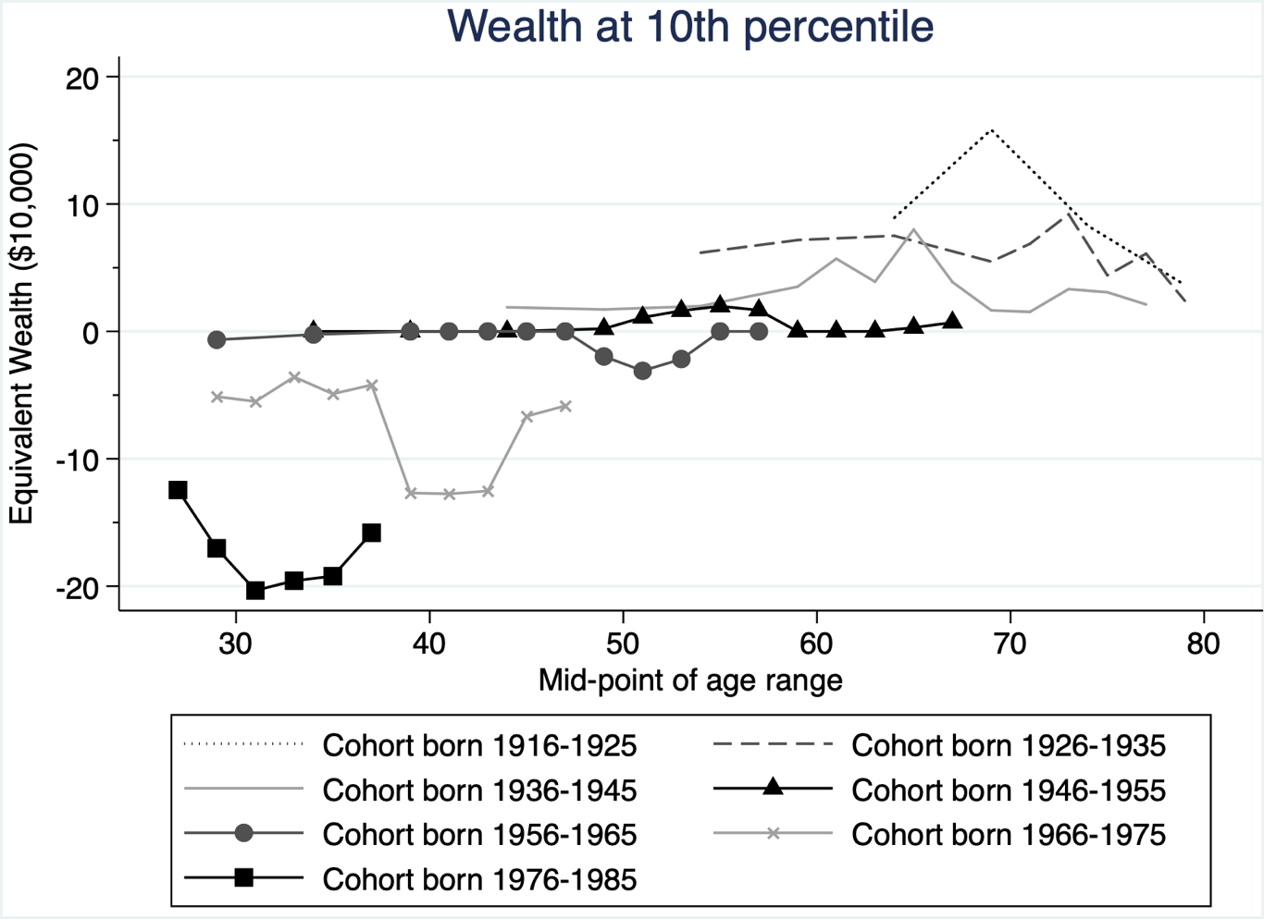
Age- wealth profile by cohort (10th percentile)

Slide 22
Outline
1. Using income, consumption, and wealth, have subsequent cohorts fared better than previous ones at the same age?
Levels (mean, 10th, 50th, and 90th)
Little or no improvement at the 10th percentile; Great Recession led to lower means at younger cohorts; improvements seen elsewhere.
Inequality (Gini coefficient)
Inequality increased across cohorts.
Intra-generational mobility (rank-rank correlation using vingtiles)
Mobility is no higher for younger cohorts and may be lower.
2. What is the relationship between within cohort inequality and within-cohort intra-generational mobility?

Slide 23
Outline
1. Using income, consumption, and wealth, have subsequent cohorts fared better than previous ones at the same age?
Levels (mean, 10th, 50th, and 90th)
Little or no improvement at the 10th percentile; Great Recession led to lower means at younger cohorts; improvements seen elsewhere.
Inequality (Gini coefficient)
Inequality increased across cohorts.
Intra-generational mobility (rank-rank correlation using vingtiles)
Mobility is no higher for younger cohorts and may be lower.
2. What is the relationship between within cohort inequality and within-cohort intra-generational mobility?

Slide 24
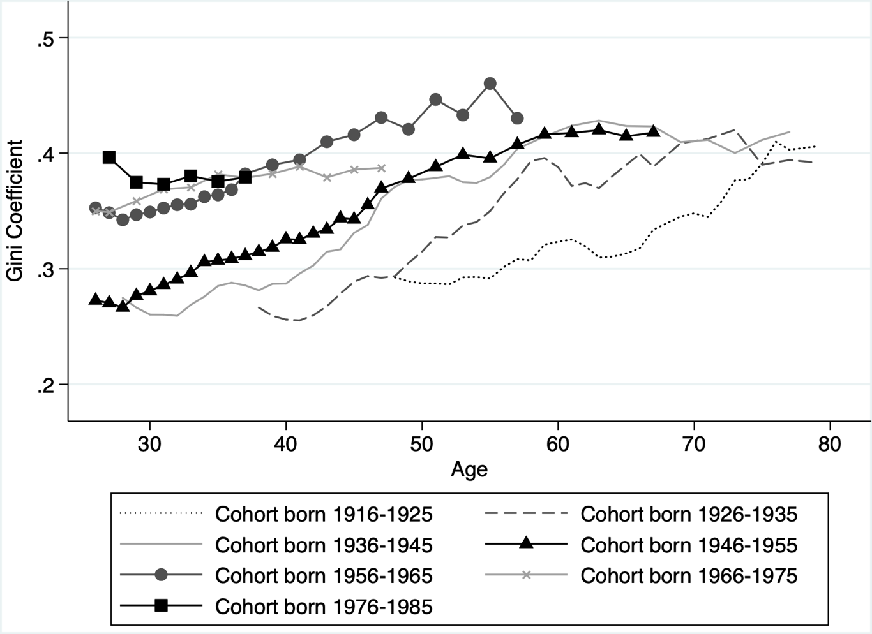
Age- income profile by cohort (Gini coefficient)

Slide 25
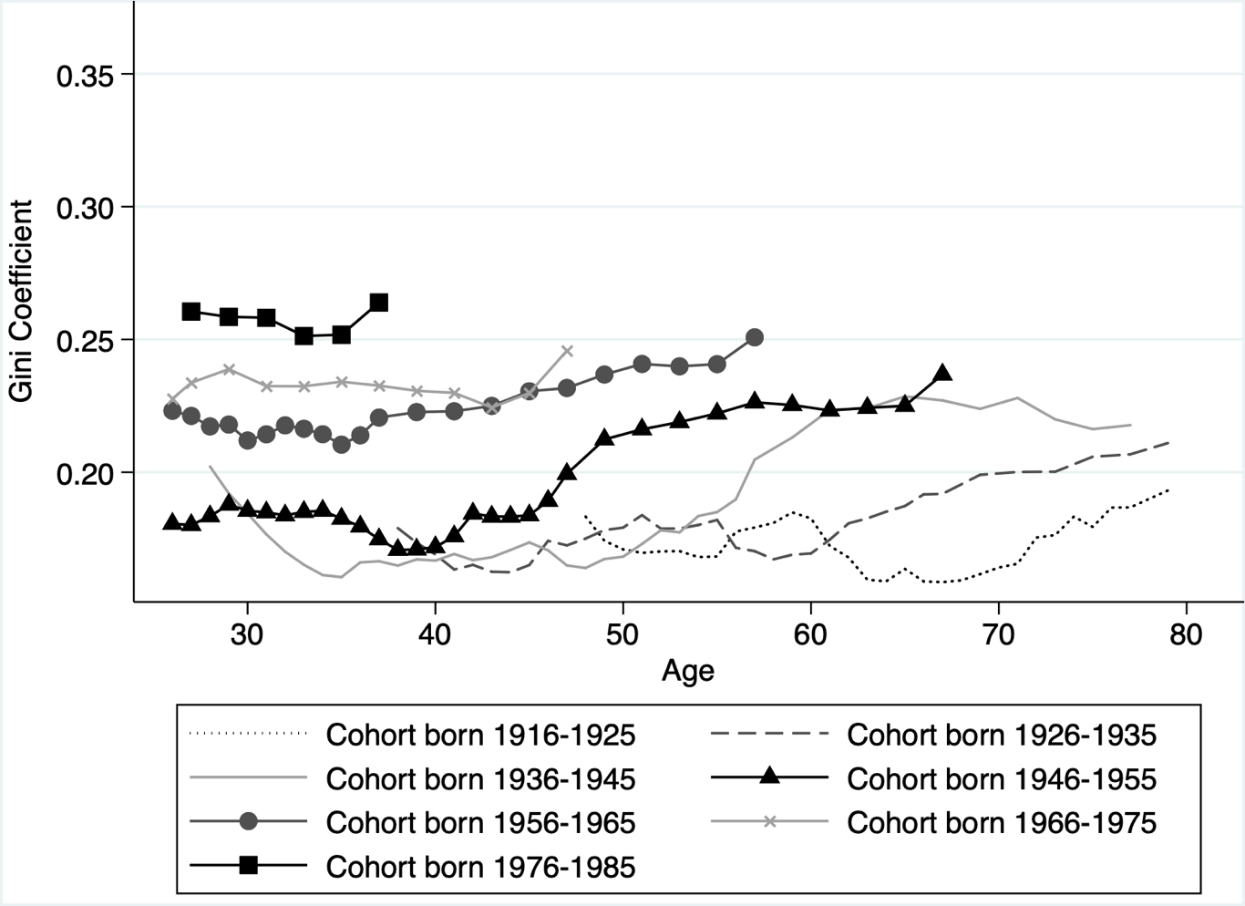
Age- consumption profile by cohort (Gini coefficient)

Slide 26
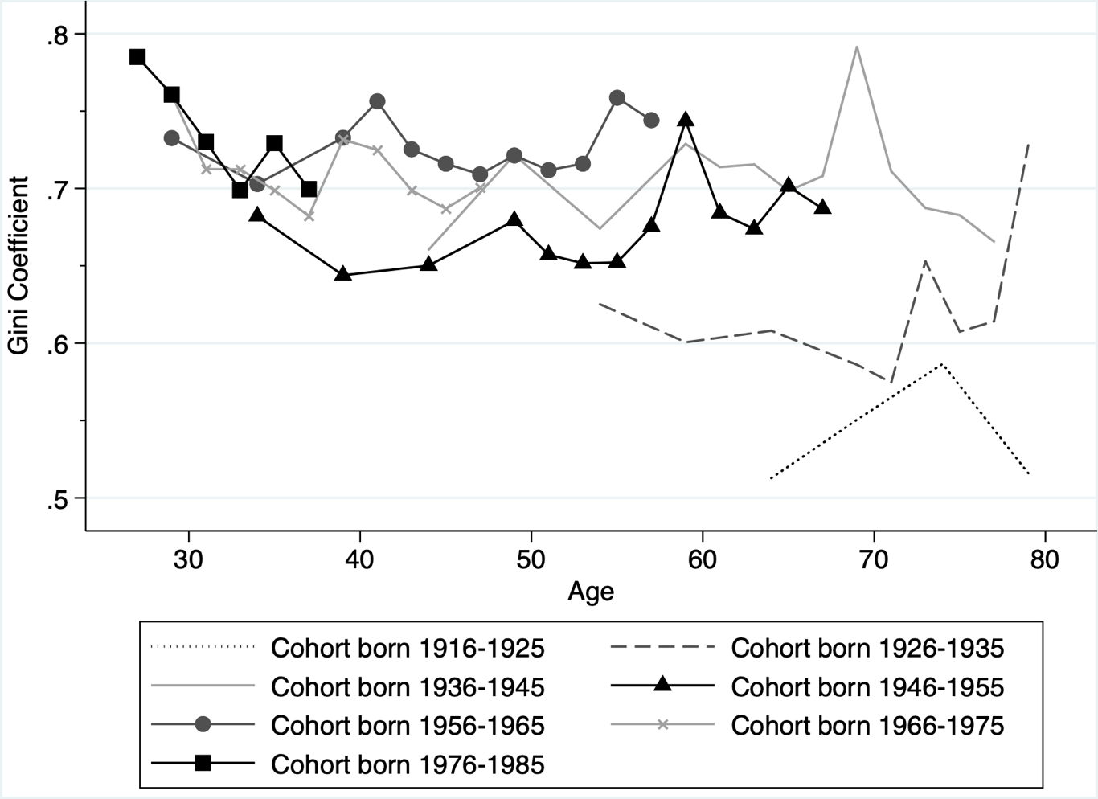
Age- wealth profile by cohort (Gini coefficient)

Slide 27
Outline
1. Using income, consumption, and wealth, have subsequent cohorts fared better than previous ones at the same age?
Levels (mean, 10th, 50th, and 90th)
Little or no improvement at the 10th percentile; Great Recession led to lower means at younger cohorts; improvements seen elsewhere.
Inequality (Gini coefficient)
Inequality increased across cohorts.
Intra-generational mobility (rank-rank correlation using vingtiles)
Mobility is no higher for younger cohorts and may be lower.
2. What is the relationship between within cohort inequality and within-cohort intra-generational mobility?

Slide 28
Outline
1. Using income, consumption, and wealth, have subsequents cohort fared better than previous ones at the same age?
Levels (mean, 10th, 50th, and 90th)
Little or no improvement at the 10th percentile; Great Recession led to lower means at younger cohorts; improvements seen elsewhere.
Inequality (Gini coefficient)
Inequality increased across cohorts.
Intra-generational mobility (rank-rank correlation using vingtiles)
Mobility is no higher for younger cohorts and may be lower.
2. What is the relationship between within cohort inequality and within-cohort intra-generational mobility?

Slide 29
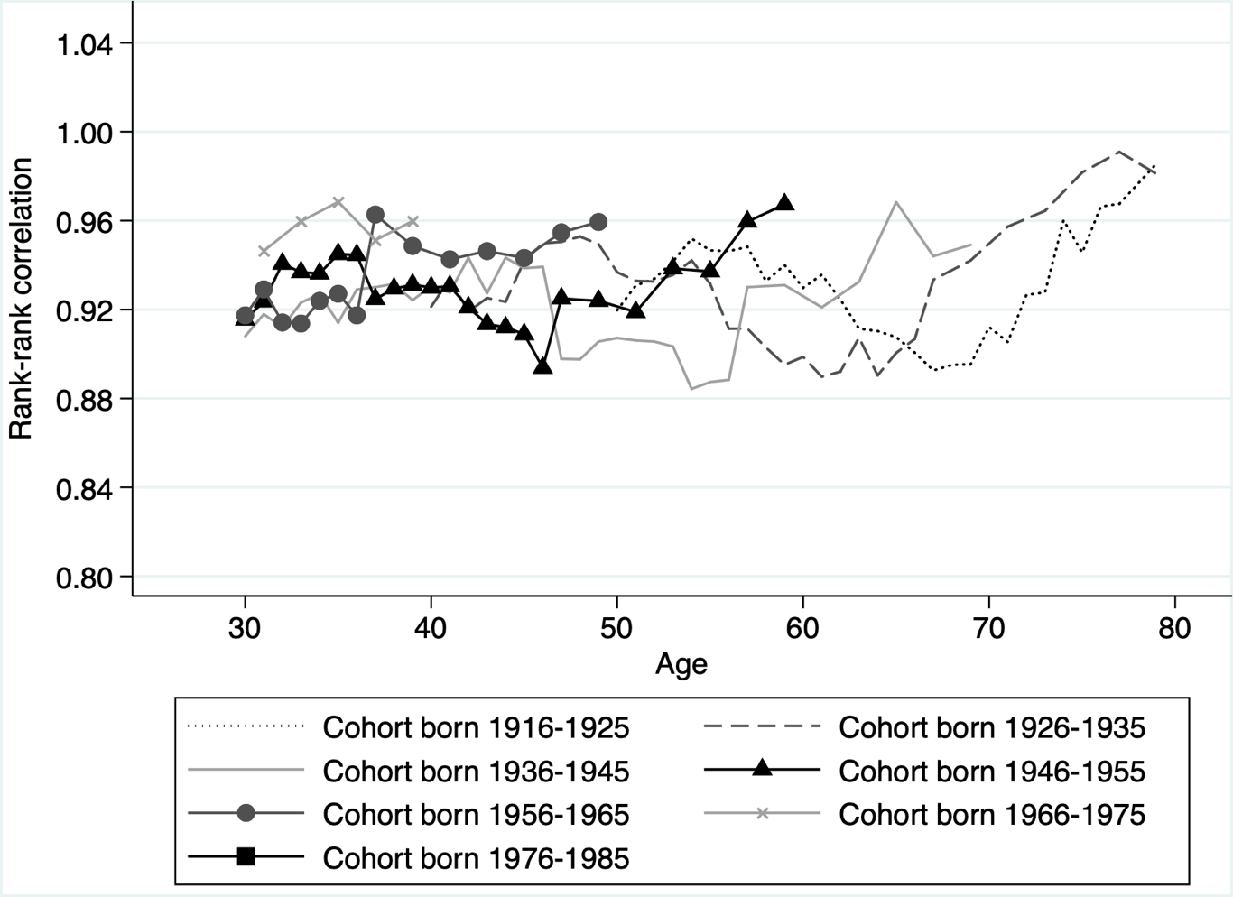
Age- income profile by cohort (Rank-rank correlation)
Rank-rank correlation between income at age 31 and income at age 41 for the 1966-1975 birth cohort

Slide 30
Age- income profile by cohort (Rank-rank correlation)
Higher rank-rank correlation for 1966-1975 birth cohort means less mobility for that cohort.

Slide 31
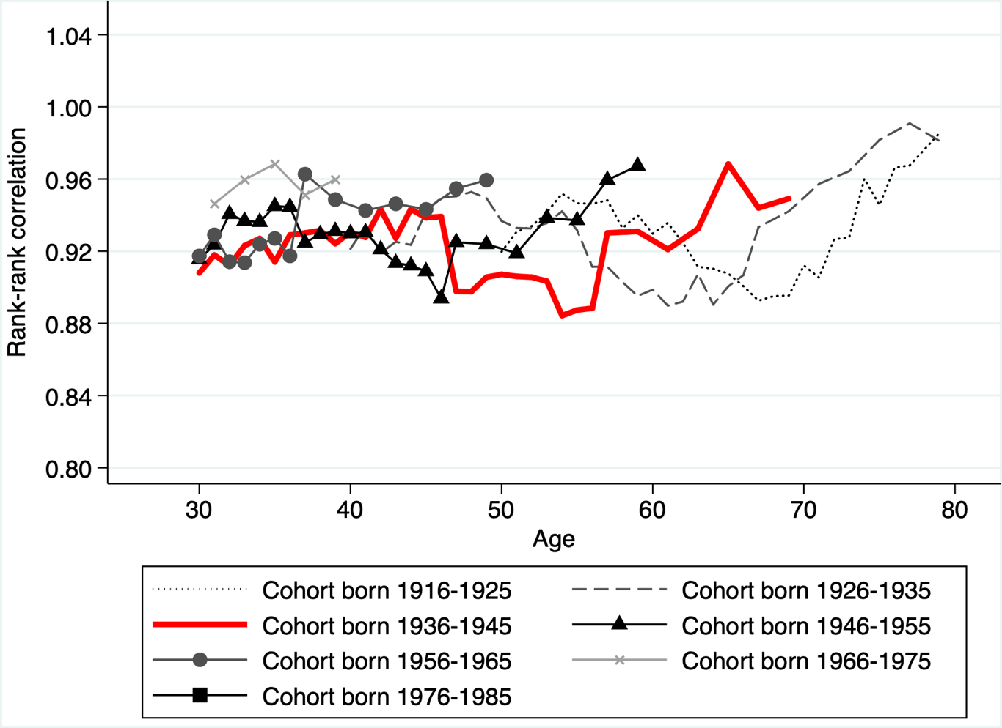
Age- income profile by cohort (Rank-rank correlation)

Slide 32
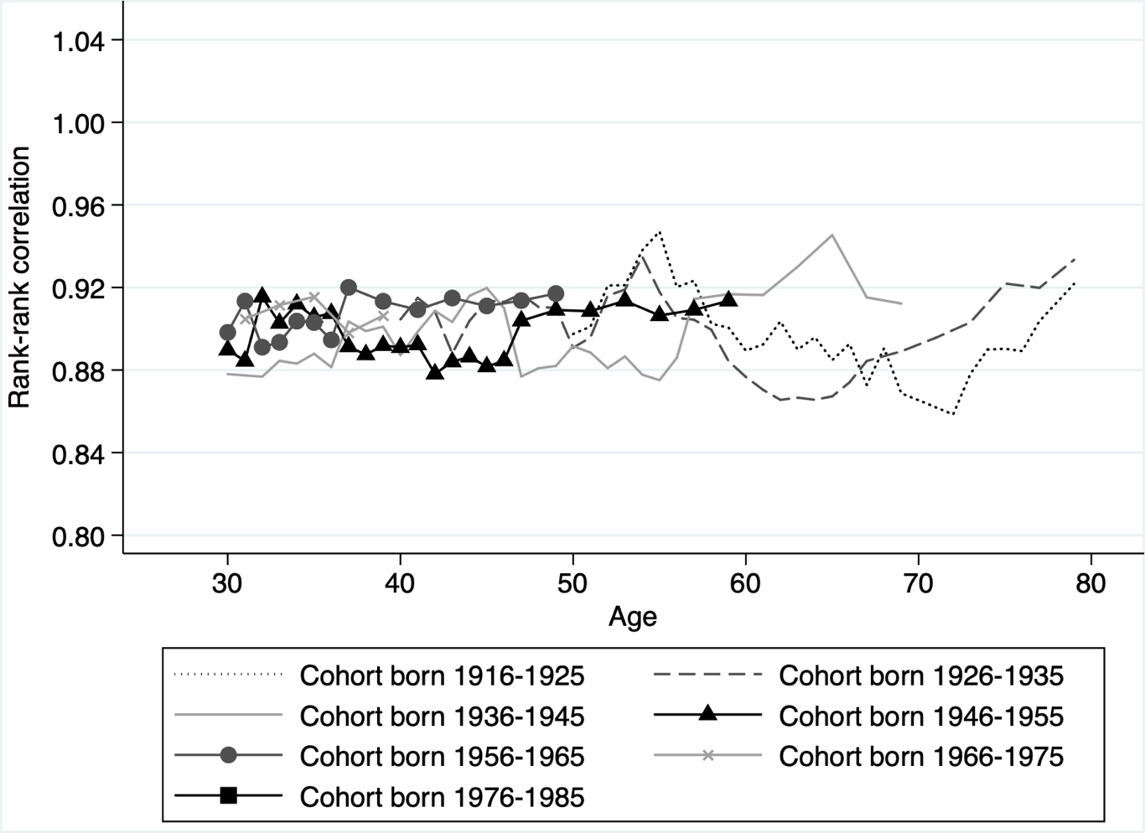
Age- consumption profile by cohort (Rank-rank correlation)

Slide 33
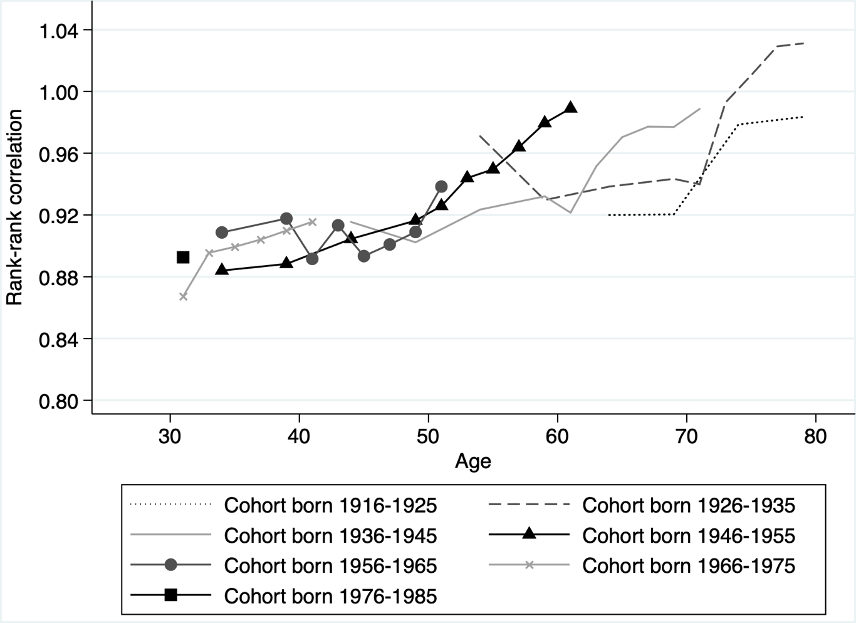
Age- wealth profile by cohort (Rank-rank correlation)

Slide 34
Outline
1. Using income, consumption, and wealth, have subsequents cohort fared better than previous ones at the same age?
Levels (mean, 10th, 50th, and 90th)
Little or no improvement at the 10th percentile; Great Recession led to lower means at younger cohorts; improvements seen elsewhere.
Inequality (Gini coefficient)
Inequality increased across cohorts.
Intra-generational mobility (rank-rank correlation using vingtiles)
Mobility is no higher for younger cohorts and may be lower.
2. What is the relationship between within cohort inequality and within-cohort intra-generational mobility?

Slide 35
Outline
1. Using income, consumption, and wealth, have subsequents cohort fared better than previous ones at the same age?
Levels (mean, 10th, 50th, and 90th)
Little or no improvement at the 10th percentile; Great Recession led to lower means at younger cohorts; improvements seen elsewhere.
Inequality (Gini coefficient)
Inequality increased across cohorts.
Intra-generational mobility (rank-rank correlation using vingtiles)
Mobility is no higher for younger cohorts and may be lower.
2. What is the relationship between within cohort inequality and within-cohort intra-generational mobility?

Slide 36
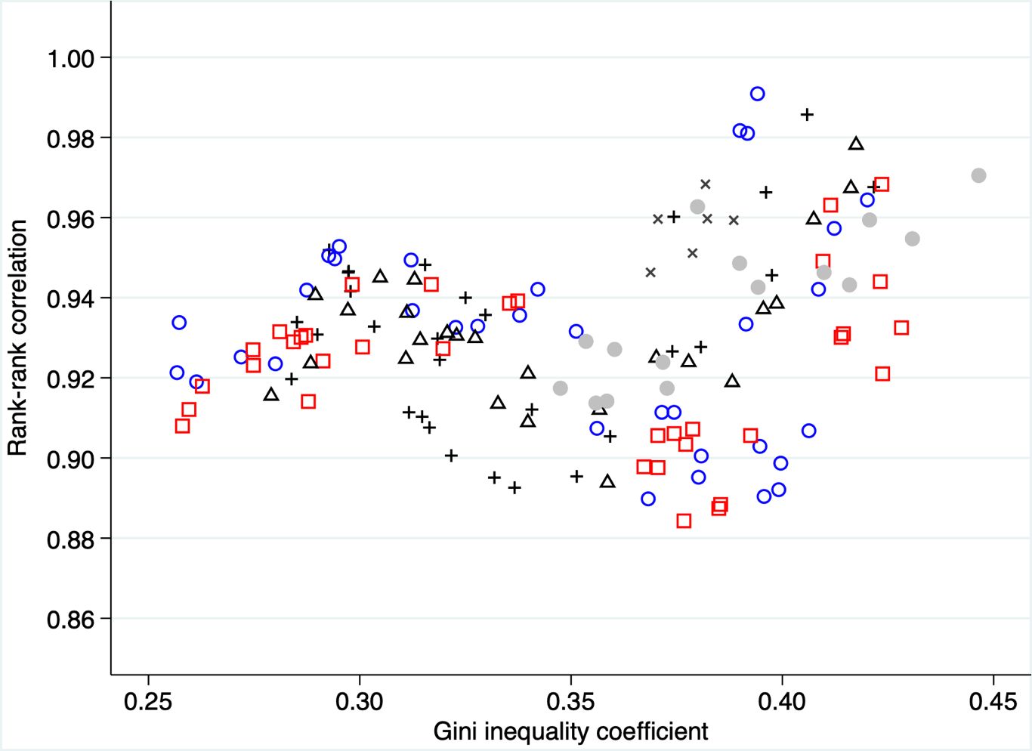
Relationship between inequality and intra- generational mobility by cohort Income

Slide 37
Relationship between inequality and intra- generational mobility by cohort Income

Slide 38
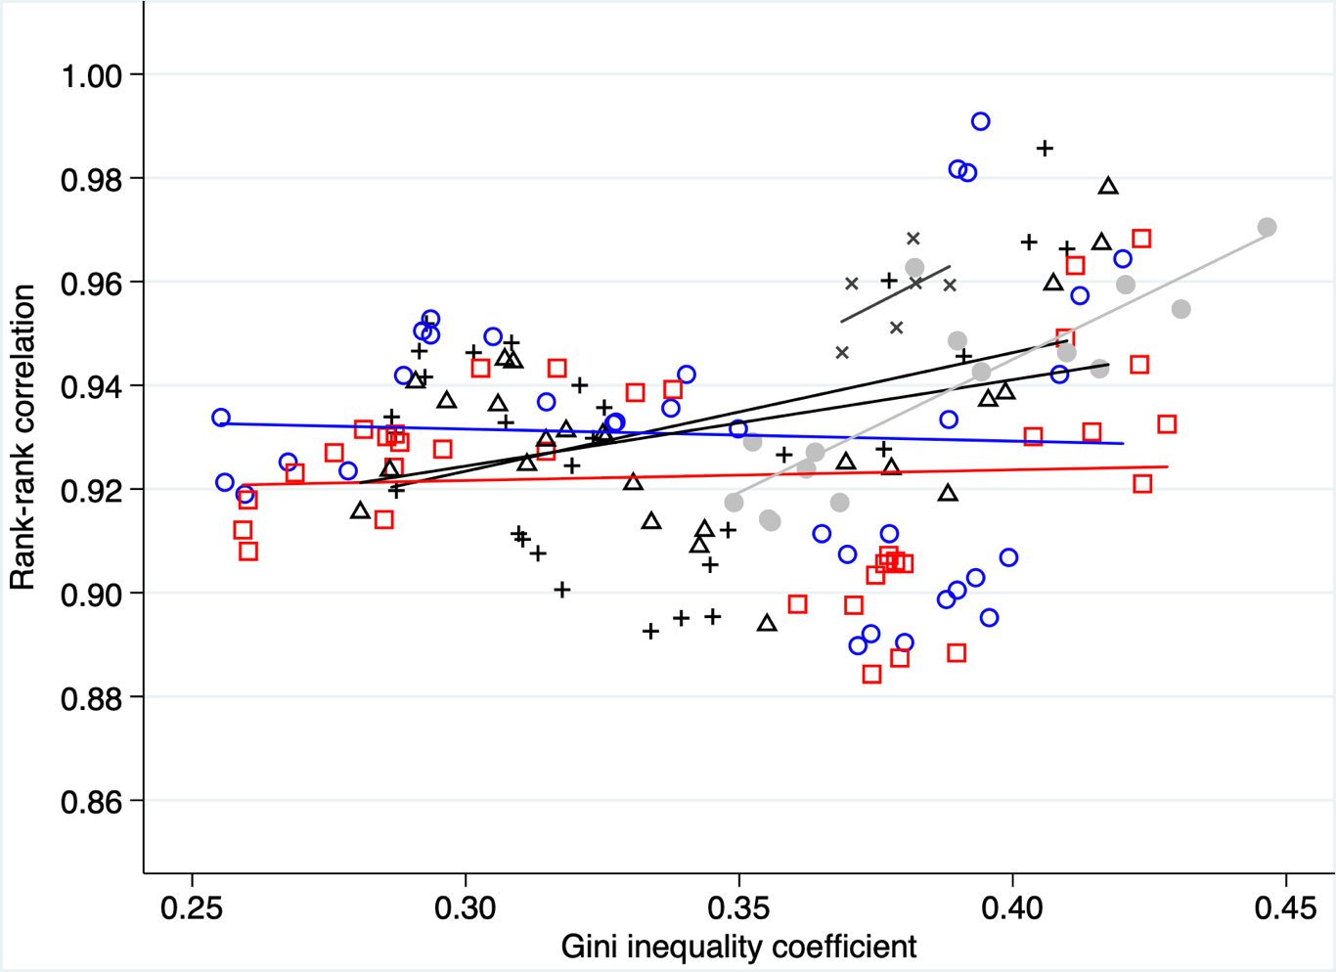
Relationship between inequality and intra- generational mobility by cohort Income

Slide 39
Relationship between inequality and intra- generational mobility by cohort Income

Slide 40
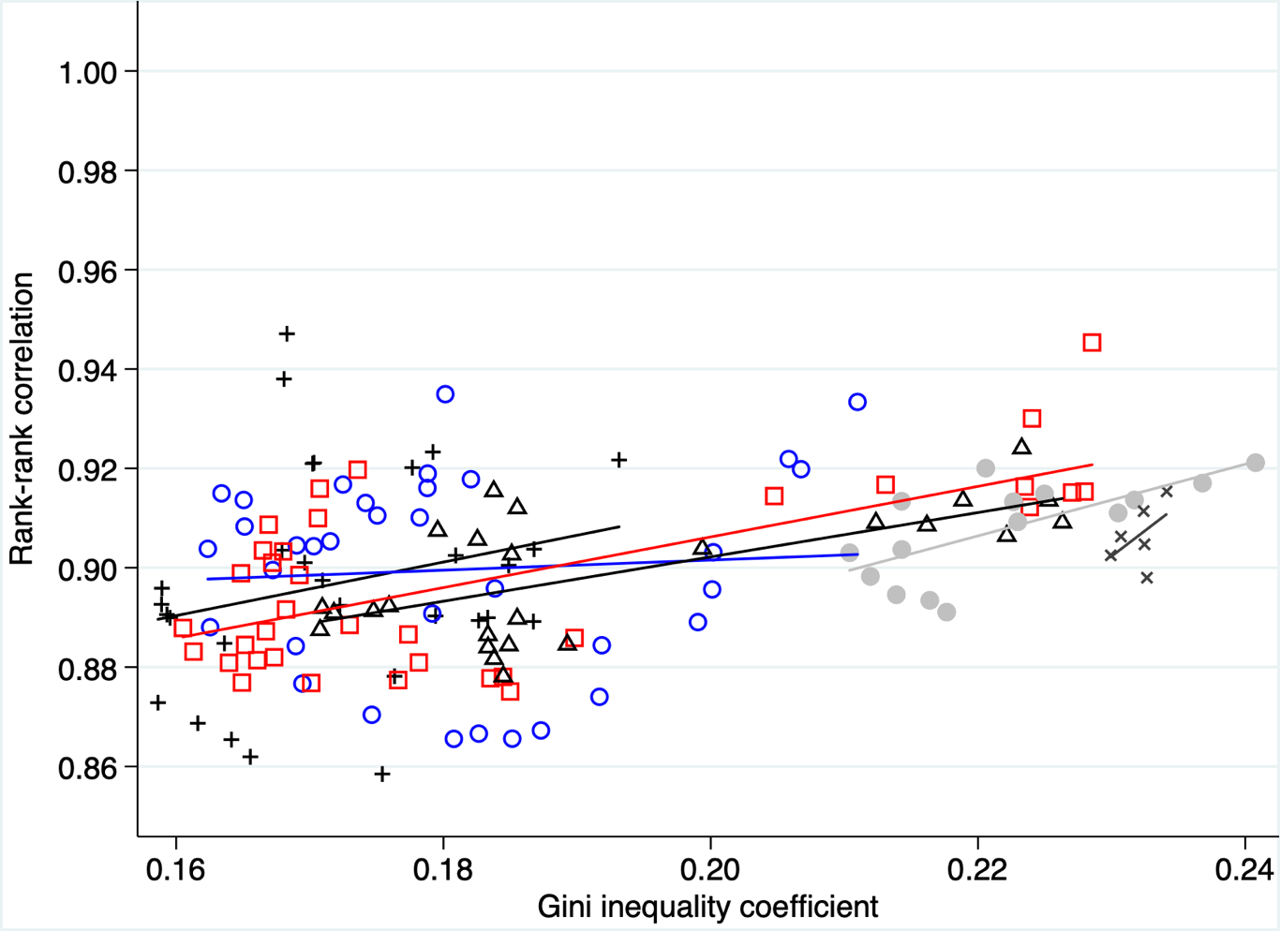
Relationship between inequality and intra- generational mobility by cohort Consumption

Slide 41
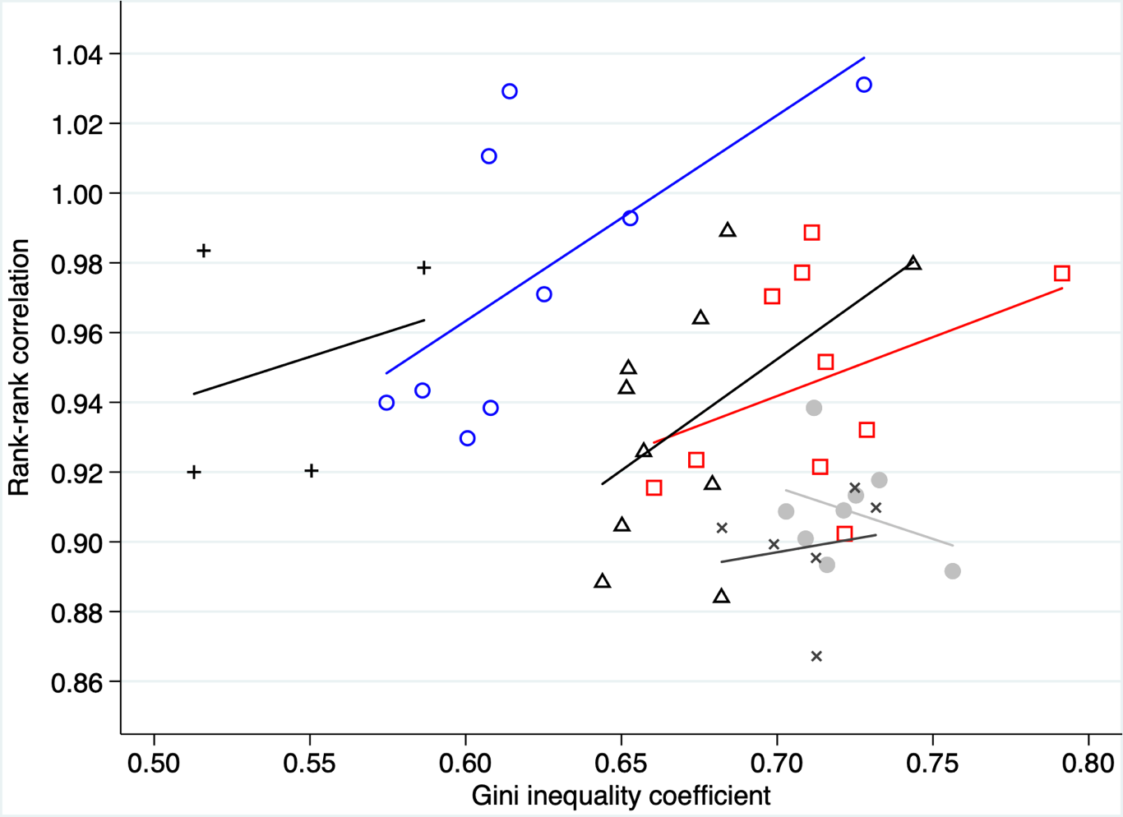
Relationship between inequality and intra- generational mobility by cohort Wealth

Slide 42
Conclusions
Subsequent cohorts experience:
a general improvement in the level of resources compared to previous cohorts, except at the 10th percentile;
a dip in the level of resources below at least one previous cohort during the Great Recession;
higher inequality within the cohort at a given age;
intra-generational mobility that is either the same or lower than previous cohorts.
Higher within cohort inequality is negatively correlated with intra-generational mobility.

