Slide 1



Recalls, Innovation, and Competitor Response:
Evidence from Medical Device Firms
George P. Ball Jeffrey T. Macher Ariel D. Stern
Indiana (Kelley) Georgetown (McDonough) Harvard (HBS)

Slide 2
Intro: bridging two streams of research
Large body of empirical research in operations management considers the causes and consequences of product recalls
  Recalls are costly & disruptive to firms
In the innovation literature, a pervasive tension:
  New product development = lifeblood of R&D-intensive firms
  But product failures can cause immense damage
  And competitors care: one firm’s product failure = another’s opportunity
To our knowledge, first study to bridge the operations management literature on product recalls with the strategy & innovation literature on competitor response

Slide 3
Recalls and Innovation
– Empirical Context (FDA)
Pre-Market Gatekeeper
Post-Market Regulator
Reviews new product submissions for safety and effectiveness
Regulates approved devices on ongoing basis via monitoring and compliance activities
Assigns devices to product codes according to use and pathway
E.g., recalls, inspections, medical device reporting
Notes:
So in what context are we going to do this? We are going to look at FDA data.
FDA as a pre-market gatekeeper as well as a post-market regulator
This is a convenient setting for empirical research because EVERYTHING IS OBSERVABLE. What I mean by that it is actually illegal to market a medical device in the US without FDA approval. So in this industry, the existence of regulation makes all of the events we care about perfectly observable and we definitely see the full set of products that ever came to market.

Slide 4

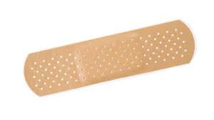
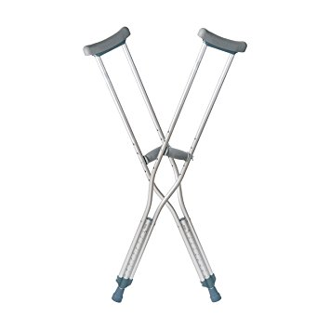
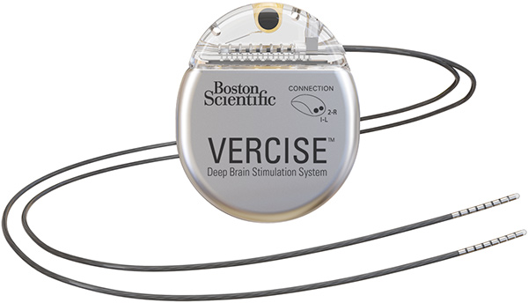
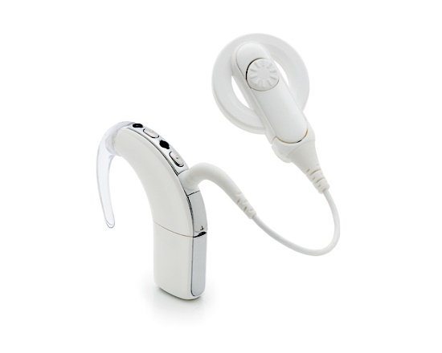
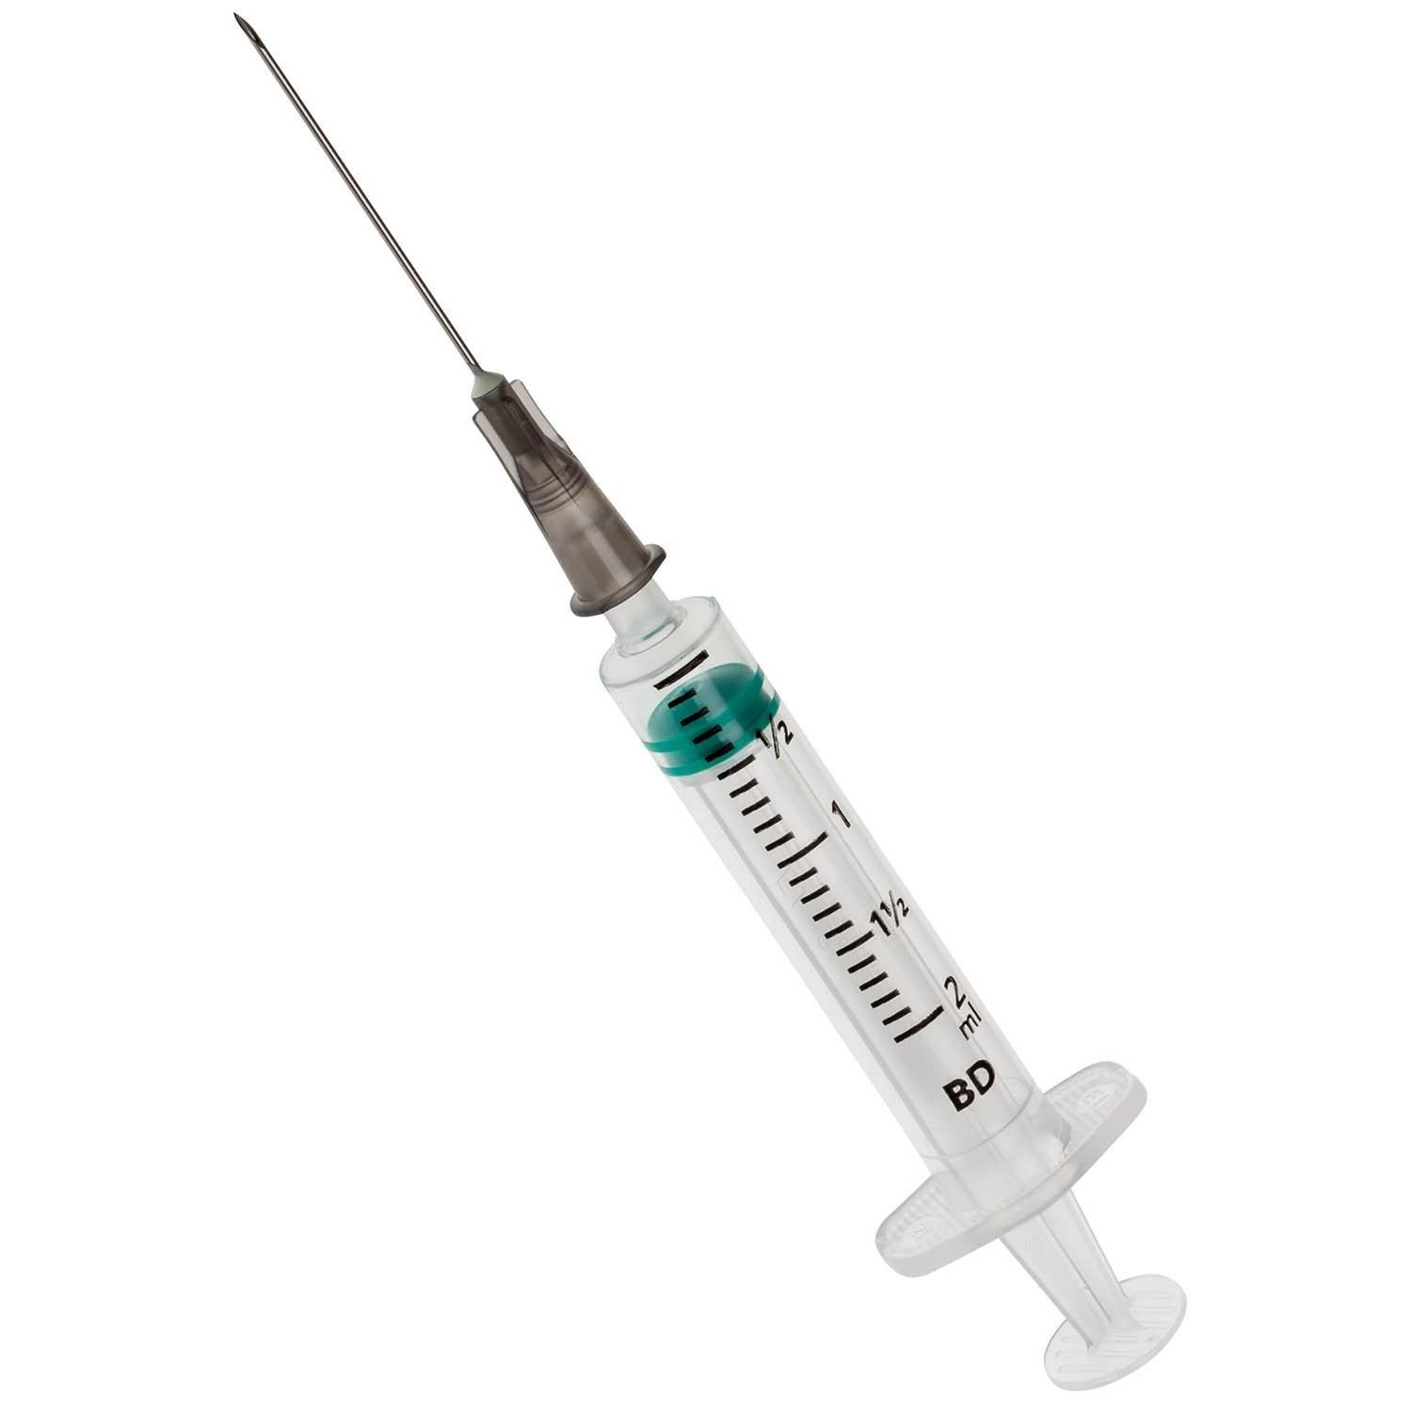
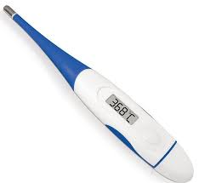
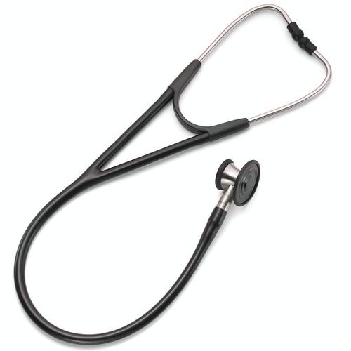
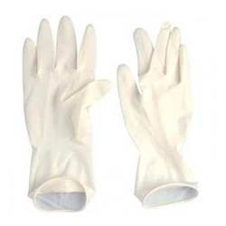
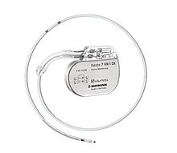
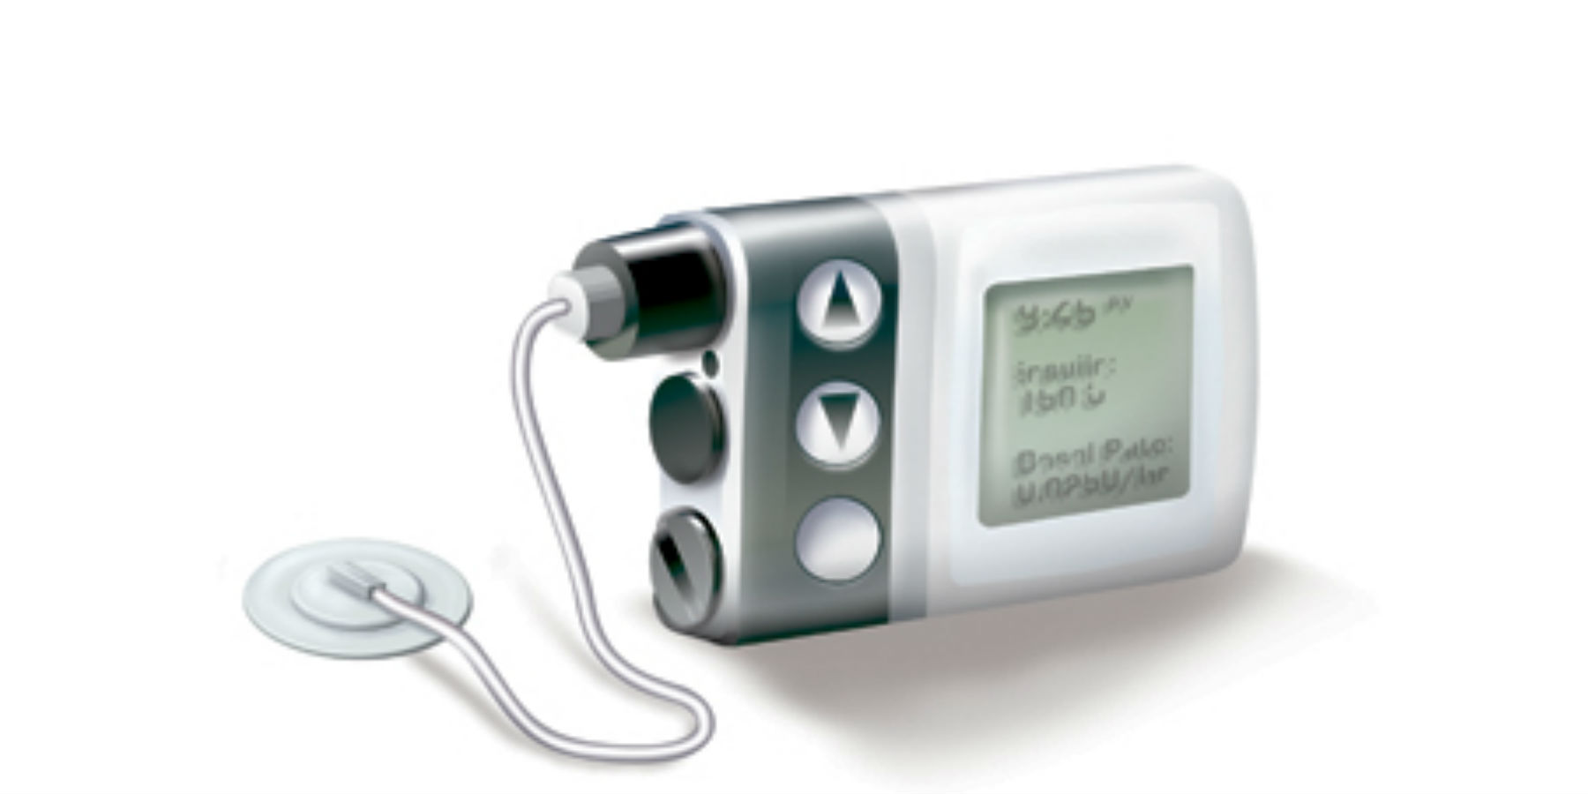
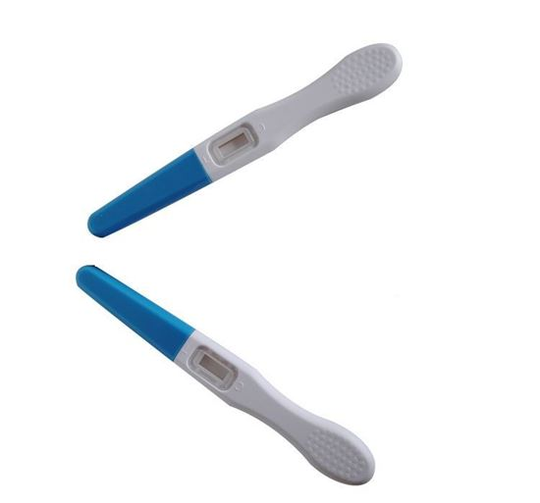
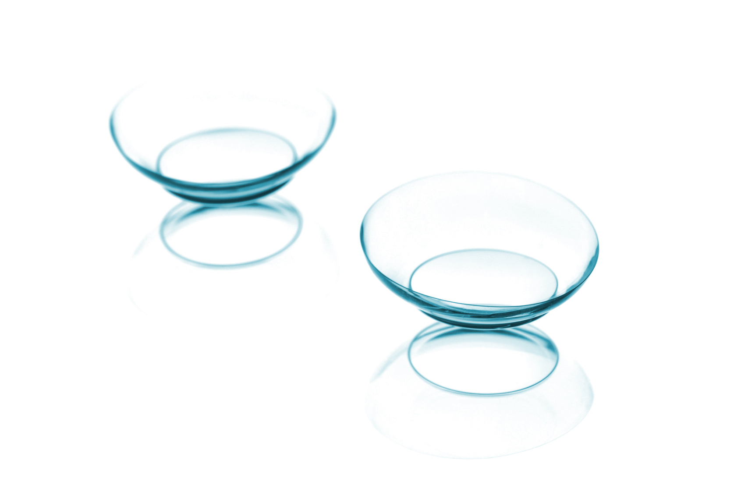
Recalls and Innovation
– Motivation, Part I
Add to life expectancy.
Correct/control certain illnesses.
Reduce average hospital stays.
Notes:
PRODUCTS
Deep brain neuro-stimulator
Cochlear ear implant
Cardiac defibrillator
Insulin pumps
RECALLS
Defibrillator – Electrode compatibility issue; wouldn’t shock when it should; leading to patient death.
Micron Filter (bacteria) – Contamination and missing filter layers.
Surgical tool – Power source had high internal pressure and potential explosion
Hip replacement – J&J had metallic debris between ball and socket caused soft tissue damage and inflammation.

Slide 5
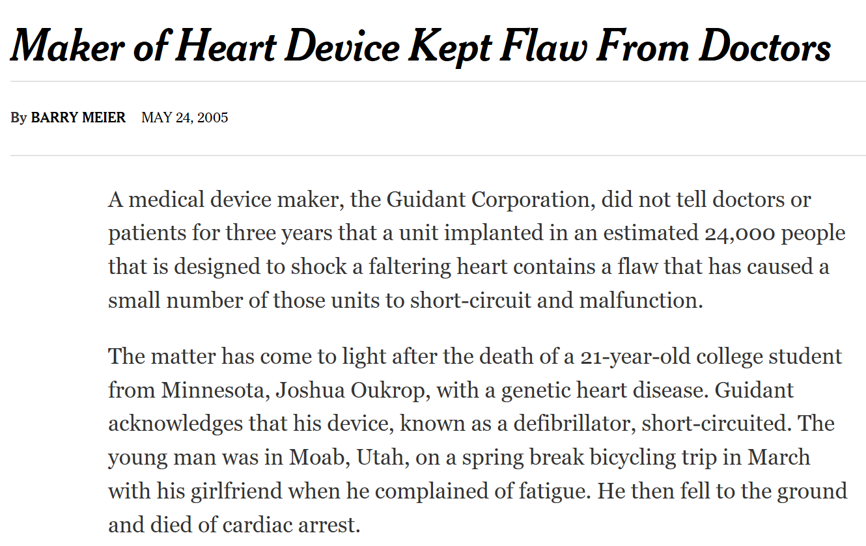

Recalls and Innovation
– Motivation, Part II
Notes:
So what do these recalls look like?
Rather dramatic example from Guidant Corporation, a major manufacturer of implantable cardiovascular devices (“major” innovations).
Occurred in 2005.
For implantable cardioverter defibrillator (Prizm, Renewal and Vitality)

Slide 6
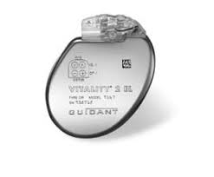

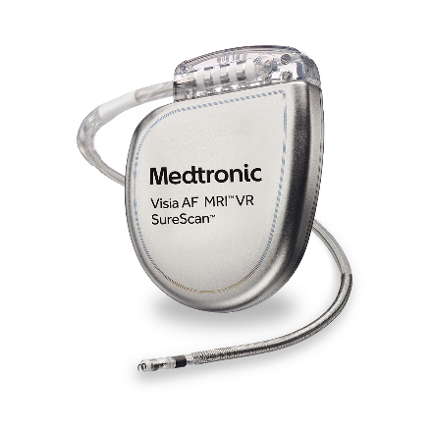

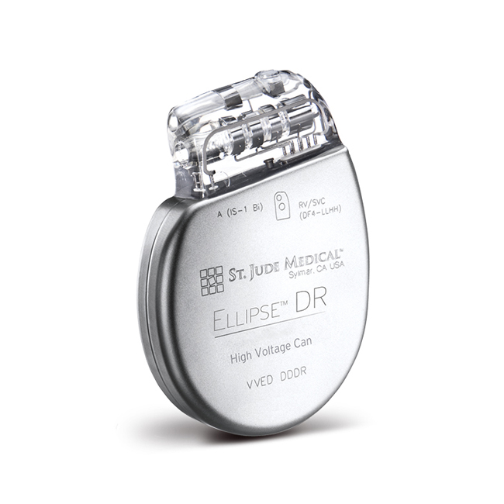
Recalls and Innovation
– Motivation, Part II
Subsequent six year gap until next product submission to FDA
Both submitted new devices for approval and in rapid succession following Guidant recall
Notes:
So Guidant had to issue a recall…
Pay attention for one minute because this story is the whole paper in a nutshell….
Average time between major innovation submissions is just under two years (w/ a SD of just under three years)
Occurred in 2005.
For implantable cardioverter defibrillator (Prizm, Renewal and Vitality)

Slide 7
Recalls and Innovation
– Motivation, Part III
Medical device industry is large: $170b/year
The stakes are high. A one-month delay in product approval for a major med-tech innovation estimated to cost up to:
$1m in expense due to product △s
$10m in lost revenue

Slide 8
Recalls and Innovation
– Research Questions
Source
Proximity
Same product type versus different product type recalls
Focal-firm versus competitor-firm recalls
Same class versus different class class recalls
Consider both major and incremental
medical device innovation
Notes:
Briefly cover PMA & 510(k) ON THIS SLIDE

Slide 9
Preview of findings
Recalls associated with significant delays in own-firm innovation, but associated with accelerated innovation by competitors.
Proximity of a recall “shock” drives these results:
Focal-firm innovation delays are driven primarily by recalls in a specific product type
Competitor response*
Extends beyond a specific product type to adjacent product types within an active class
Is strongest when competitors are best positioned to respond (e.g., firms with broader product portfolios)
*Note: these are typically well-established product categories; not a viability story

Slide 10
Recalls and Innovation
– Empirical Context (FDA)
FDA Device Recall Classes
Class I – The most serious; ongoing product use may result in serious health threat or death
Class II – Moderate severity; ongoing product use may pose serious adverse events or irreversible consequences
Class III – Lowest severity; ongoing product use unlikely to cause adverse health threat; however, marginal chance of injury may exist, so product is being recalled

Slide 11
Recalls and Innovation
– (incomplete) Literature Review
Product Recalls
Effects
Stock market, market share, customer loyalty & invention outcomes from recalls
E.g., Jarrell & Peltzman (1985); Davidson & Worrell (1992); Cheah et al. (2007); Chen et al. (2009); Fung et al. (2018)
Determinants
Leading indicators that drive recalls
R&D intensity, product or plant variety, user feedback, regulator characteristics
E.g., Thirumalai & Sinha (2011); Hora et al. (2011); Shah et al. (2016); Mukherjee & Sinha (2017); Ball et al. (2017)
Product Innovation in Healthcare
Determinants
Firm-, industry-, regulatory- and policy-level factors that affect innovation
E.g., Acemoglu & Linn (2004); DuBois et al. (2015); Budish et al. (2015); Carpenter et al. (2010); Stern (2017)
Measures
Counts of patenting, clinical trials, new product submissions

Slide 12
Recalls and Innovation
– Source of Recall
Focal Firm (FF)
Competitor Firm (CF)
Requires PR and outreach;
Disrupts operations, may divert managerial effort, necessitate resource reallocation;
Creates opportunity for learning
H1A: Focal firm recalls delay the time to new product innovation, ceteris paribus.
Aware of CF activities (e.g., failures);
Represents opportunity (demand “shocks” that Δ product market profitability);
Creates temptation to cut corners
H1B: Competitor firm recalls accelerate the time to new product innovation, ceteris paribus.

Slide 13
Notes:
How might a recall in one area impact innovation in another?

Slide 14
Recalls and Innovation
– Moderated by hierarchy of product proximity
FF Product Overlap
CF Product Overlap
Firms organized by product class, w/in each, specific product types;
Specialized human capital and management;
Innovation at product type level, but spillovers w/in class
H2A: Focal firm recalls delay the time to new product innovation—in particular, when recalls and innovation are more proximate, ceteris paribus.
Aware of CF activities (e.g., failures);
Ability to respond driven by proximity of activities
H2B: Competitor firm recalls accelerate the time to new product innovation—in particular, when recalls and innovation are more proximate, ceteris paribus.
Notes:
Provide concrete example:
If doing stent NPD and there is an insulin pump recall (pretty easy to imagine b/c insulin pumps are the most recalled devices), no real reason stent innovation should be impacted (whether FF or CF)
But if the recall is on a pacemaker, that’s now your business unit (class), so that may well have some spillovers onto your team
And then, of course, if the recall is actually on a stent, that will be most influential for the folks working on stents
So recalls are going to vary by product and class, so where the recall ”hits” is going to matter and the proximity of any given recall can be mapped to any other subsequent new device

Slide 15
Recalls and Innovation
– Data
510(k) Clearances
PMA Approvals
Major innovations
Product Recalls
Incremental innovations (16,456)
Failures (8,676 incremental; 512 major)
Products & Product Classes
19 Classes (medical specialties)
PMAs (191)
Unique number; posting / clearance dates; severity classification; firm name; 510(k) or PMA number
Unique number; submission / clearance dates; firm name; product type; product class
Unique number; submission / approval dates; firm name; product type; product class
2,068 Unique 3-letter product codes (Identify product types that are very good to excellent substitutes)

Slide 16
19 unique product classes (regulatory medical specialties)
Radiology
Cardiovascular
Dental
…
2,068 unique product types (product codes)
PNJ
NKM
MAF
LOZ
…
(Leadless Pacemaker)
(Mitral Valve Repair Device)
(Coronary Stent)
(Artificial Heart)
(Others)
Multiple unique firms
(manufacturers)
Boston Scientific
Medinol
Abbott Vascular
Biotronik
…
Notes:
Note that we went to great lengths to get the firm identity “right”

Slide 17
Recalls and Innovation
– Data Merge and Variable Creation
Assemble data on all submissions and recalls over 2003-2015
Assign all device submissions and recalls to:
(1) firm, (2) class,
(3) product type
Construct detailed firm- and product-level innovation and recall histories
Implement recurrent-event accelerated failure time models
Dependent Variables
Major Innovation – Time since last submission
Incremental Innovation
– Time since last submission
Independent Variables
Focal firm and competitor firm recall counts
Same class and different class product recall counts
Same product type and different product type recall counts
Year, Firm and Prod Code FE
Device Controls

Slide 18
Sample
Observations | 510(k) Incremental | PMA Major
Recalls | 8,676 | 512
Submissions | 16,456 | 191
Firms | 1,318 | 88ª
Total firm-event observations | 25,132 | 703

Slide 19
Recalls and Innovation
– Empirical Approach
Employ recurrent-event accelerated failure time (AFT) models (e.g. as in Harhoff and Wagner, 2009)
  Other common models estimate hazard of event occurring at any point in time
  Advantage of AFT: estimate how changes in independent variables influence time to an event
  We want to ask how past recalls speed up / slow down innovation activities → AFT models most informative
  *And if you really like Cox Proportional Hazard models, we can fully corroborate our results using these and other alternative specifications
Notes:
Other innovation studies that have looked at predictors of innovation time-to-event (Harhoff and Wagner, 2009)
We us an accelerated failure time model. Other commonly used survival models – such as the Cox Proportional Hazard Model – facilitate interpretation of the hazard of an event occurring at any point in time. However, an advantage of AFT models is that model estimates can be used to examine how changes in the independent variables influence the actual time to an event. In this setting, we are interested in determining how past recalls speed up or slow down innovation activities, rendering AFT models most informative.
We incorporate an exponential distribution, though our results are not sensitive to that choice.

Slide 20
Recalls and Innovation
– note on endogeneity
Concern: results driven by historical link between innovation and recalls / reverse causality
  E.g. association between past innovation and future recalls
  Propensity score matching to use observable features (e.g. firm, product type, year) to predict and match on likelihood of submission in past 24 months
  Actually submitting a new product in the past 24 months does not predict likelihood of firm experiencing a recall

Slide 22
Interpreting results, Part 1: focal firms
Recalls impact directly-affected firms in increasingly localized ways
For incremental innovations, a 1-SD increase in recalls leads to:
  A 37-day delay in different-class submissions
  An 80-day delay in same-class (different product type) submissions
  A 197-day delay in same-product type submissions
For major innovations, a 1-SD increase in recalls only impacts same-product type innovation & associated with a 1477-day* delay in subsequent submissions
*seems big, but remember the Guidant Corporation story from earlier…
Notes:
1477 days is approx. 4 years

Slide 23
Interpreting results, Part 2: competitor response
For incremental innovations, a 1-SD increase in recalls leads to:
  No detectable change in different-class submissions
  A 15-day acceleration in same-class (different product type) submissions
  A 13-day acceleration in same-product type submissions
  Here, response is of a similar magnitude in adjacent product types w/in the same class
For major innovations, a 1-SD increase in recalls only impacts same-product type innovation & associated with a 355-day acceleration in subsequent submissions
Notes:
Major innovation—intuitive result: these are longer-term R&D initiatives and firms are either “in” or “out” – so only response margin is intensive

Slide 24
Do Past Submissions Lead to Future Recalls?
Reverse Causality Test using a Propensity Score Model
Propensity Score Matching Model Predicting Recall Likelihood based on Past Submissions (Treatment is whether firm submitted an incremental/major innovation in past 24 months. Outcome is a recall)
Innovation Category | Treatment | Control | Average treatment effect (ATE) | Standard Error | p-value
PMA-Major Innovation | 332 | 128 | 0.23 | 0.15 | 0.14
510k-Incr. Innovation | 6,420 | 2,388 | -0.09 | 0.06 | 0.13

Slide 25
Interpreting results, Part 3: additional factors
Results are robust to controlling for measures of product class activity (i.e., how broad vs. specialized is the firm)
Splitting sample into focused vs. broadly-operating firms indicates larger effects in broadly operating firms:
  Larger-in-magnitude delays associated with a focal firm recall
  Larger and stronger association between competitor recalls and subsequent acceleration to market in broadly-operating firms
Role of competition (work in progress):
  For incremental innovations, largest competitor responses seen in product types with fewer active competitors
  Suggests competitor response is strongest when opportunity presented represents a chance to be a key player
Next steps: exploring firm learning

Slide 26
Recalls and Innovation
– Discussion (Results)
Source
Proximity
Same product type recalls are the major factor driving subsequent focal firm innovation
Focal-firm recalls associated with delays in subsequent innovation
Competitor-firm recalls associated with acceleration of subsequent innovation
(only incremental innovation models have power to estimate precise relationships without further disaggregation)
Competitor response seen as a result of both same-product type and same-class recalls, suggesting ability to capitalize on opportunities in adjacent product areas

Slide 27
Recalls and Innovation
– Discussion (Limitations)
Setting
Measures
Failures based recalls, but other varieties (e.g., malfunctions, compliance) exist
Estimation
Single industry, potentially limits generalizability of results
Reverse causality potential (approvals → recalls); but tests find no effect
Recalls may not capture public health concerns (i.e., size or effect concerns)
Do not observe early-stage innovations prior to FDA approval
Other estimation approaches (e.g., sample selection) are plausible

Slide 28
Recalls and Innovation
– Discussion (Robustness)
Time Windows
Estimation
Robust to alternative distributional assumptions
Variables
Robust to three-year estimation window
Robust to inclusion or exclusion of approval count measures
Coefficient magnitudes and statistical significance decrease somewhat with longer window, but results largely the same
E.g., Weibull, Gompertz and Logistic.
A “placebo” test of Class III recalls (the really minor ones) shows no effects

Slide 29
Recalls and Innovation
– Discussion (Implications)
Research
Regulators
Demonstrate innovation and failures are inherently linked
Industry Practitioners
Examine failures as an important but sometimes overlooked determinant of innovative activity
Focal firm recalls delay focal firm innovation
Examine recalls within and across firms; in various product markets; of different severities; and over time
Suggest ↑ regulator coordination between product approval and surveillance & compliance activities could provide benefits
Focal firm recalls lead rivals to speed innovations to market
Suggests a “double whammy” effect for impacted firms & increased value of recall prevention activities

Slide 30
Thanks!
gpball@indiana.edu
jeffrey.macher@georgetown.edu
astern@hbs.edu

