Slide 1
Impact of Vehicle Automation on Electric Vehicle Charging Infrastructure Siting and Energy Demand
Avi Chaim Mersky
(Amersky@alumni.cmu.edu)
Constantine Samaras
Carnegie Mellon University
Department of Civil and Environmental Engineering
Economics of Autonomous and Electric Vehicles
The National Bureau of Economic Research
Friday, June 7, 2019

Slide 2
Agenda
Why this Matters
How Vehicle Automation May Affect EV Charging
Trip Characteristics and Charger Selection
Optimization Methods
Results
Implications
Limitations and Future Work

Slide 3
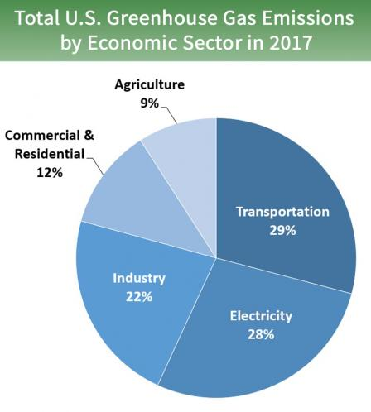
Transportation is Now The Largest Source of U.S. GHG Emissions
Source: https://www.epa.gov/ghgemissions/sources-greenhouse-gas-emissions

Slide 4
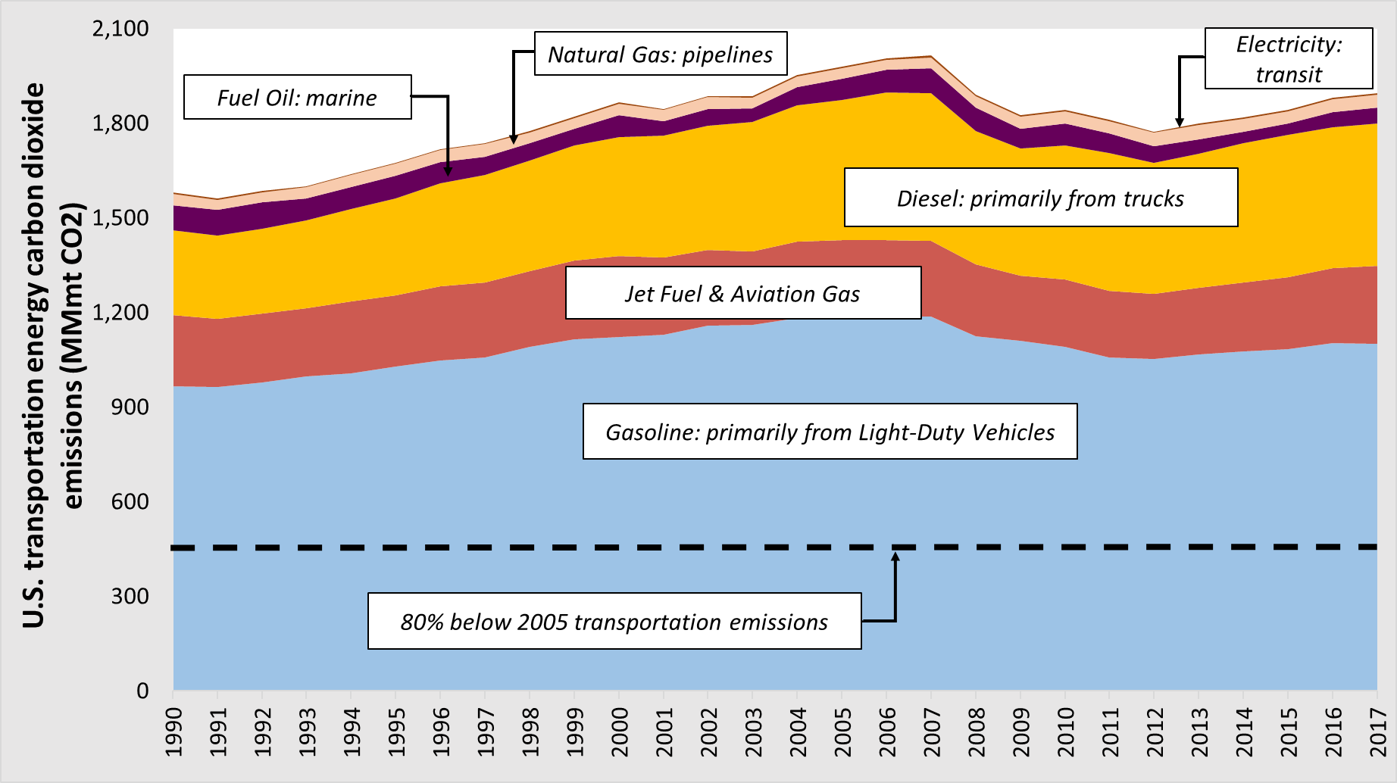
Transportation is Hard to Decarbonize
Data: DOE, Image by Abdullah Alarfaj, CMU

Slide 5
Low-Carbon Electricity Can Enable Deep GHG Reductions with EVs
0.3 kWh / mi EV
30 mpg ICV

Slide 6
Oil Use Accounts for 39% of Transportation Externalities
Noise (3 ¢)
Oil Security (21 ¢ )
Climate Change (59 ¢ )
Congestion ($1.46)
Air Pollution (49 ¢ )
Crashes (63 ¢ )
39%
Source: Updated from Anderson et al., 2014, Uses NHTSA 2017-2025 Estimates, updated SCC Costs,
GREET WTW emissions, assumes 25 mpg, $2013
Notes:
Et. Al includes Costa
Source is DOT/Nhtsa

Slide 7
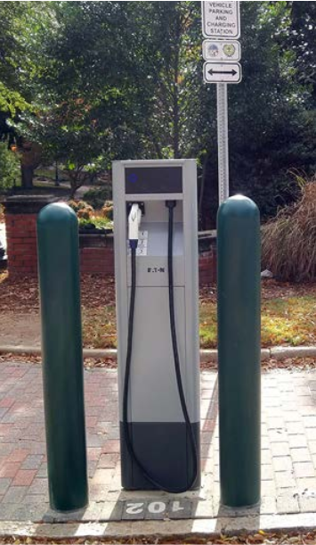
However, Public Charging Stations can be Expensive
Cost for a single vehicle 240 volt charger installed can vary between $4,000 and $20,000
DC Fast charging can cost between $40,000 and $90,000
Source: Smith, M., and Castellano, J. (2015).

Slide 8
It is Challenging to Reduce EV Charging Infrastructure Costs
Vehicles take up the chargers physical space and ports until someone moves/disconnects them
Vehicles need to either charge near the driver’s destination or must charge in comparable times to gasoline pumps
Level 4 & 5 automation could allow for a reduction in the number of necessary chargers

Slide 9
What We Mean When We Say Level “X” AV
Level | Name | Who is Driving? | Who is Monitoring? | Who Intervenes?
0 | No Automation | 😀t | 😀t | 😀t
1 | Driver Assist | 😀🤖 | 😀t | 😀t
2 | Partial Automation | 🤖😀t | 😀t | 😀t
3 | Conditional Automation | 🤖t | 🤖t | 😀t
4 | High Automation | 🤖t | 🤖t | 🤖😀
5 | Full Automation | 🤖t | 🤖t | 🤖t
Source: Adapted from NHTSA and SAE J3016

Slide 10
Research Question
How can the various levels of vehicle automation affect the economics and energy use of charging EVs?

Slide 11
How Vehicle Automation may Affect EV Charging
Level 0-3 Automation
  The charger is occupied until the commuter moves it.
  The commuter must walk from the parking spot to their destination and back

Slide 12
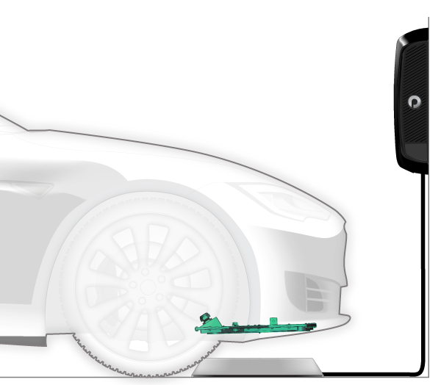
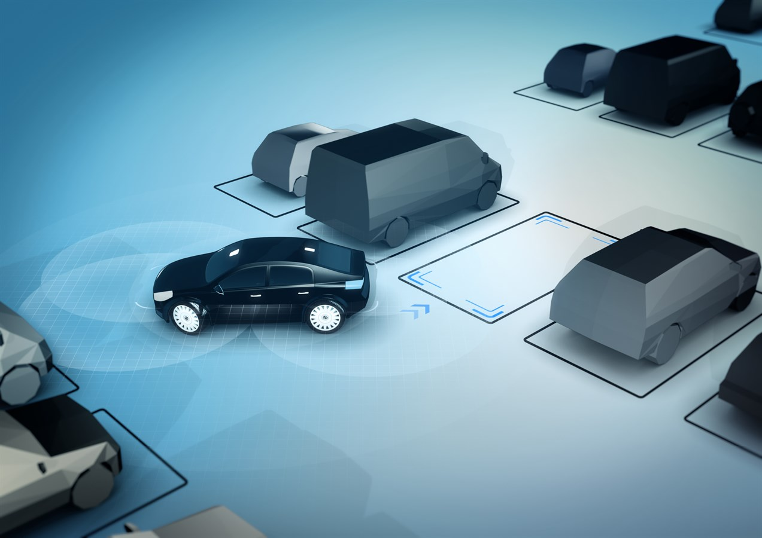
How Vehicle Automation may Affect EV Charging
Level 4 Automation
  The vehicle can move itself on and off the charger
  The commuter must still walk after parking
Level 5 Automation
  The vehicle can move itself on and off the charger
  The vehicle and drop off and pick up the commuter
https://www.pluglesspower.com/learn-about-plugless/
https://www.media.volvocars.com/global/en-gb/media/pressreleases/49569/photos
Notes:
Level 3 would require supervision

Slide 13

Data and Methods
We investigated King County, Washington
We used the 2014 Puget Sound Household travel survey data directly
Source: Google Maps

Slide 14
Trip Characteristics
2,300 trips Total
1,900 parking spaces demanded during peak hour
Max possible modeled charger utilization is 31%
  Based on commuter distances and charge switching time

Slide 15
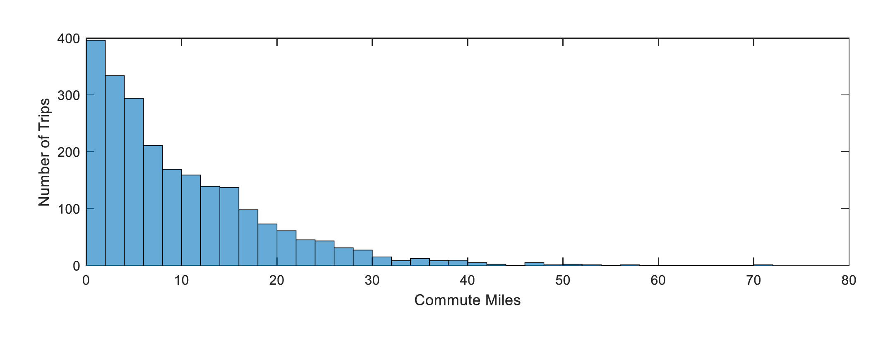
Most Drivers in the Sample Commute Short Distances
Source: 2014 Puget Sound HHTS

Slide 16
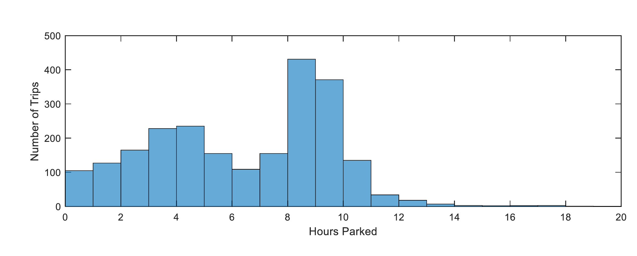
Almost All Sampled Commuters Park Long Enough to Fully Charge
Source: 2014 Puget Sound HHTS

Slide 17
Charger Selection
AC Level 1 / 120 V Charging
  About 5 miles per hour
  <$2,000 (significantly less for new construction)
AC Level 2 / 240 V Charging
  About 20 miles per hour
  About $10,000 per charger
DC Fast Charging
  About 150 miles per hour
  About $50,000 per charger
Notes:
Level 1 is not demand risk robust
DC is much too expensive per mile of charge
For charging while parked scenarios

Slide 18
Costs are Evaluated for Charger Station Owners as well as Drivers
Charger Owner Costs
  Real Estate
  Amortized Capital Equipment and Installation Costs
    Number of Chargers
    15 years with a 4.1% discount rate
Driver Costs
  Walking
    Derived from median income and time
  Additional Vehicle Depreciation and Energy Costs
Notes:
Discount rate from city bond rates

Slide 19
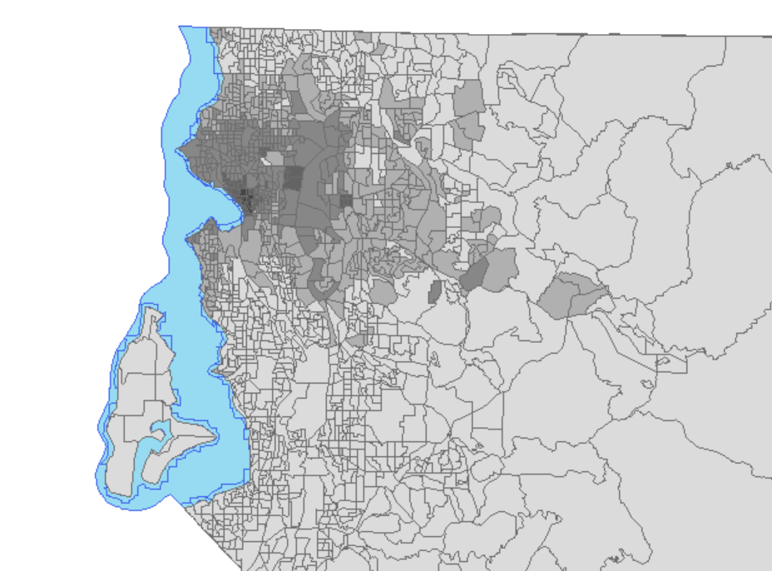
King County Assessed Real Estate Prices
Notes:
Darker more expensive per square foot

Slide 20
Optimization Methods
We know when each commuter arrives and leaves each Travel Analysis Zone (TAZ)
We assume each commuter will drive an electric vehicle
We want to minimize the total costs of Drivers and Charger Owners

Slide 21
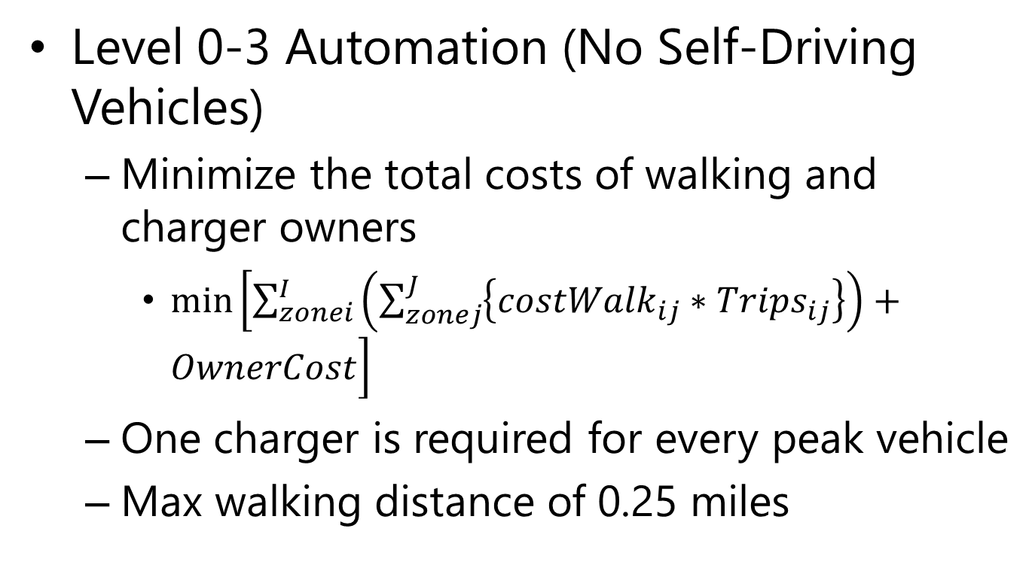
Optimization Methods
Level 0-3 Automation (No Self-Driving Vehicles)
  Minimize the total costs of walking and charger owners
    $\min\left[\sum_{zonei}^{I}{\left(\sum_{zonej}^{J}{\left\{{costWalk}_{ij}∗Trips_{ij}\right\}}\right)}+OwnerCost\right]$
  One charger is required for every peak vehicle
  Max walking distance of 0.25 miles

Slide 22
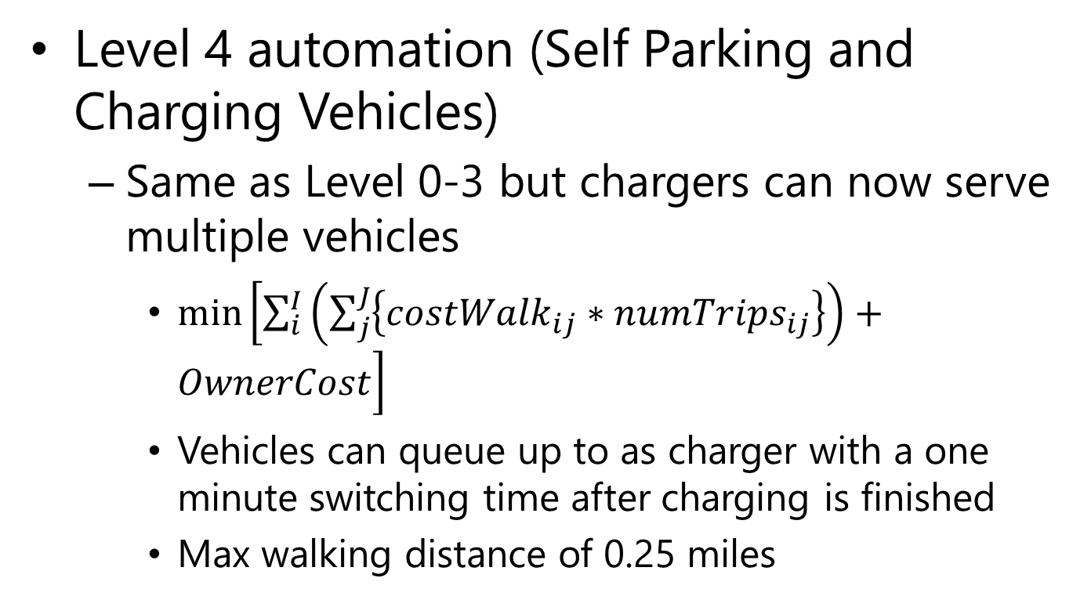
Optimization Methods
Level 4 automation (Self Parking and Charging Vehicles)
  Same as Level 0-3 but chargers can now serve multiple vehicles
    $\min\left[\sum_{i}^{I}{\left(\sum_{j}^{J}{\left\{{costWalk}_{ij}∗{numTrips}_{ij}\right\}}\right)}+OwnerCost\right]$
    Vehicles can queue up to as charger with a one minute switching time after charging is finished
    Max walking distance of 0.25 miles

Slide 23
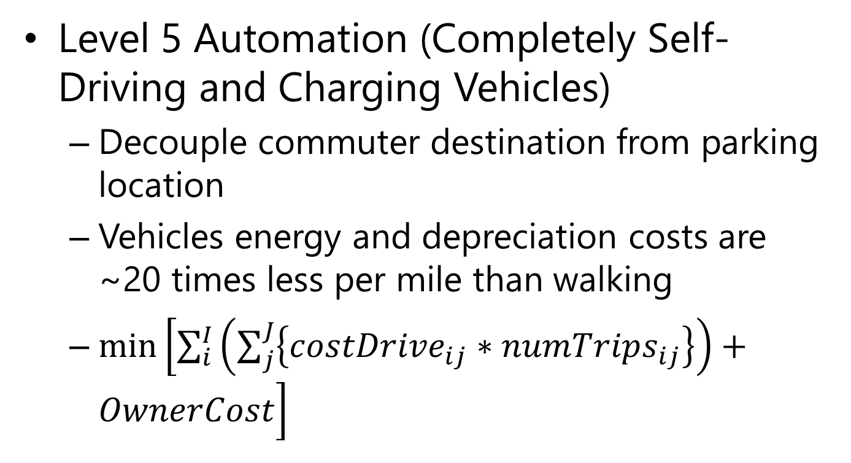
Optimization Methods
Level 5 Automation (Completely Self-Driving and Charging Vehicles)
  Decouple commuter destination from parking location
  Vehicles energy and depreciation costs are ~20 times less per mile than walking
  $\min\left[\sum_{i}^{I}{\left(\sum_{j}^{J}{\left\{{costDrive}_{ij}∗{numTrips}_{ij}\right\}}\right)}+OwnerCost\right]$

Slide 24
Results: Level 0/No Automation
$1.75 M Total Costs
  Almost all is charger owner because of single charger per vehicle and max walking distance constraint
1,900 Chargers
  1.2 trips per charger
  4.4% Utilization
    Time that the charger is actually used

Slide 25
Results: Level 4 Automation
$930,000 Charger Owner
$940,000 Total Costs
  Commuter costs remain bounded by walking distance
680 Chargers
  3.5 Trips per charger
  13% Utilization
Notes:
50% Price Decrease

Slide 26
Results: Level 5 Automation
$440,000 Charger Owner
$540,000 Total Costs
  Commuter Costs increased by a factor of 10
330 Chargers
  7.5 Trips per charger
  27% Utilization
Notes:
Additional 50% price decrease

Slide 27
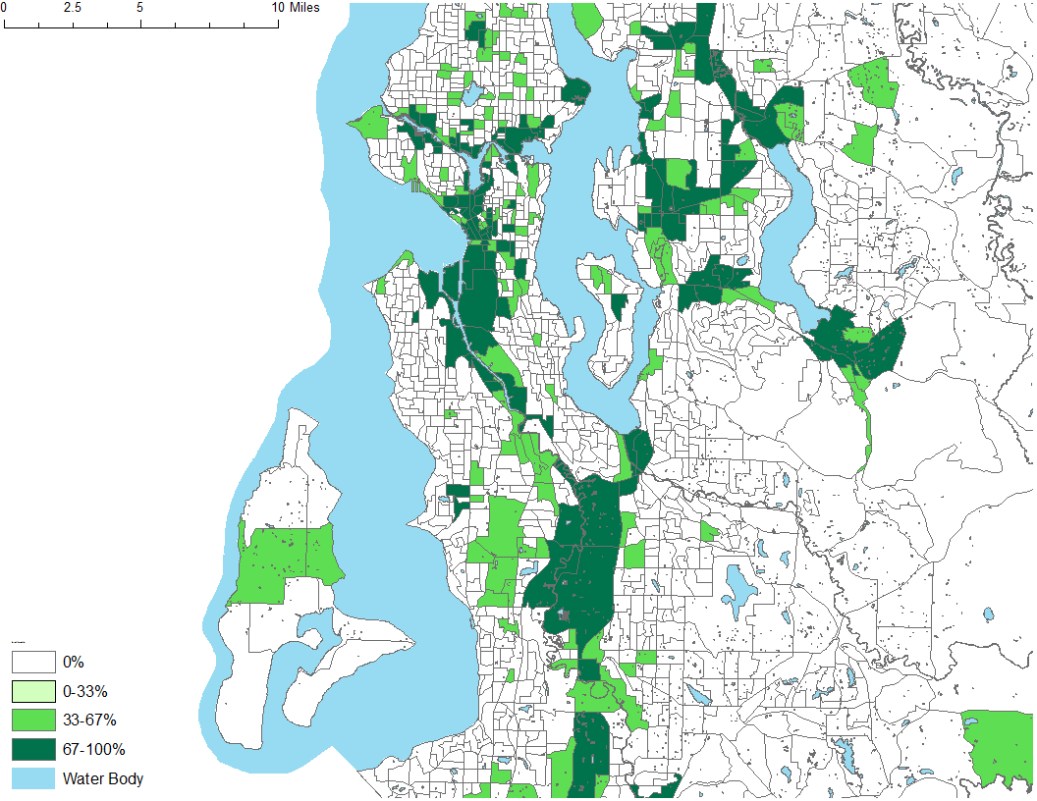
Reduction in Number of Chargers: Level 0-4 Vehicle Automation

Slide 28
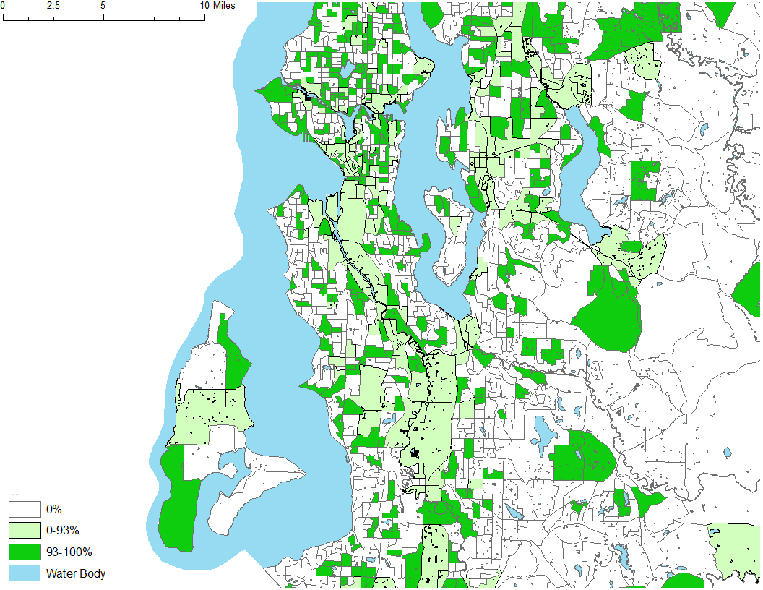
Reduction in Number of Chargers: Level 0-5 Vehicle Automation

Slide 29
Automation Enables Demand Smoothing
Assume 35 kWh / 100 mi
Notes:
Moving from levels 0-3 to level 4 automation reduces the peak electrical demand by 31%
Moving from levels 0-3 to level 5 reduces the peak electrical demand by 68%,
AV4 could be accomplished with smart charging with different equipment and some restrictions on number of vehicles per spot

Slide 30
Implications
Optimizing EV infrastructure for AVs enables smoothing of peak EV electric demand
Similar results could be gained through smart charging technology
  Though those have their own cost structures and technical limitations

Slide 31
Implications
Automation allows for considerable decreases in the total chargers and charger owner cost
  Number of chargers reduced from 1,900 to 330
  $1.8 M to $440,000
But shifts a portion of the costs to commuters
    How do we best incentivize the social good without harming travelers?
Notes:
80% reduction in number of chargers

Slide 32
Limitations
Traffic demand taken direct from HHTS
  Demand is shown to be more concentrated than reality
  Demand is much smaller than reality
Poor real estate data
Notes:
No demand regression or modeling
Limits ability to take advantage of increased utilization from Level 4 Avs
Over estimates needed infrastructure of no AVs

Slide 33
Questions?

Slide 34
Appendix Slides

Slide 35
Data Sources
Infrastructure Costs
  DOE Report
GIS Data and Trip Distribution/Characteristics
  Puget Sound Household Travel Survey
  Census Bureau
  King County GIS

Slide 36
Commuter Arrival and Departure Times

Slide 37
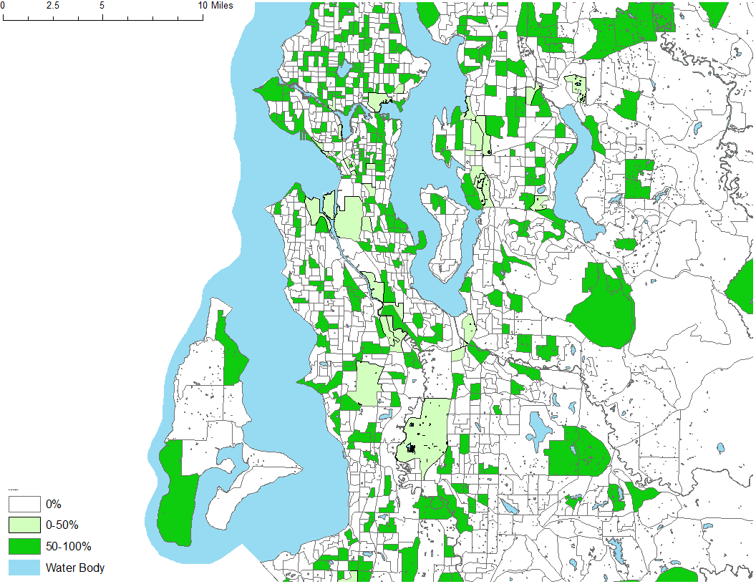
Reduction in Number of Chargers: Level 4-5 Vehicle Automation

Slide 38
Optimization Detailed
Notes:
City of Seattle’s current 4.122% 30-year bond rate

Slide 39
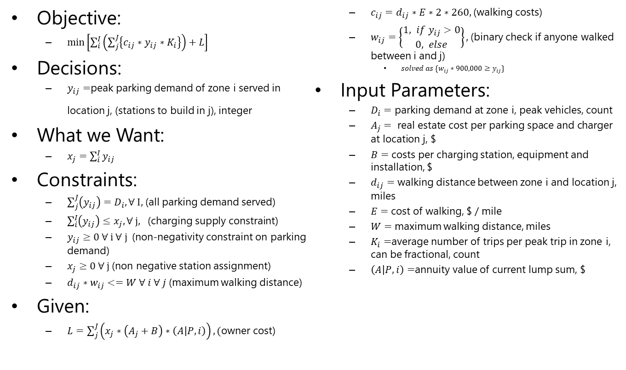
No Automation (Level 0-3 AV)
Objective:
  $\min\left[\sum_{i}^{I}{\left(\sum_{j}^{J}{\left\{c_{ij}∗y_{ij}∗K_{i}\right\}}\right)}+L\right]$
Decisions:
  $y_{ij}=$peak parking demand of zone i served in location j, (stations to build in j), integer
What we Want:
  $x_{j}=\sum_{i}^{I}{y_{ij}}$
Constraints:
  $\sum_{j}^{J}{\left(y_{ij}\right)}=D_{i},∀ I,$(all parking demand served)
  $\sum_{i}^{I}{\left(y_{ij}\right)}≤x_{j},∀ j, \text{(}\text{charging} \text{supply} \text{constraint}\text{)}$
  $y_{ij}≥0 ∀ i ∀ j$(non-negativity constraint on parking demand)
  $x_{j}≥0 ∀ j$(non negative station assignment)
  $d_{ij}∗w_{ij}<=W ∀ i ∀ j$(maximum walking distance)
Given:
  $L=\sum_{j}^{J}{\left(x_{j}∗\left(A_{j}+B\right)∗\left(A | P,i\right)\right)}, (\text{owner}$ cost)
  $c_{ij}=d_{ij}∗E∗2∗260,$(walking costs)
  $w_{ij}=\left\{\begin{aligned}1, if y_{ij}>0 \\ 0, else\end{aligned}\right\},$(binary check if anyone walked between i and j)
    $solved as \{w_{ij}∗900,000≥y_{ij}\}$
Input Parameters:
  $D_{i}=\text{parking} \text{demand} \text{at} \text{zone} \text{i}\text{, }\text{peak} \text{vehicles}\text{, }\text{count}$
  $A_{j}= \text{real} \text{estate} \text{cost} \text{per} \text{parking} \text{space} \text{and} \text{charger} \text{at} \text{location} \text{j}\text{, \$}$
  $B=$ costs per charging station, equipment and installation, $
  $d_{ij}=$ walking distance between zone i and location j, miles
  $E=$cost of walking, $ / mile
  $W=$ maximum walking distance, miles
  $K_{i}=$average number of trips per peak trip in zone i, can be fractional, count
  $\left(A | P,i\right)=$annuity value of current lump sum, $

Slide 40
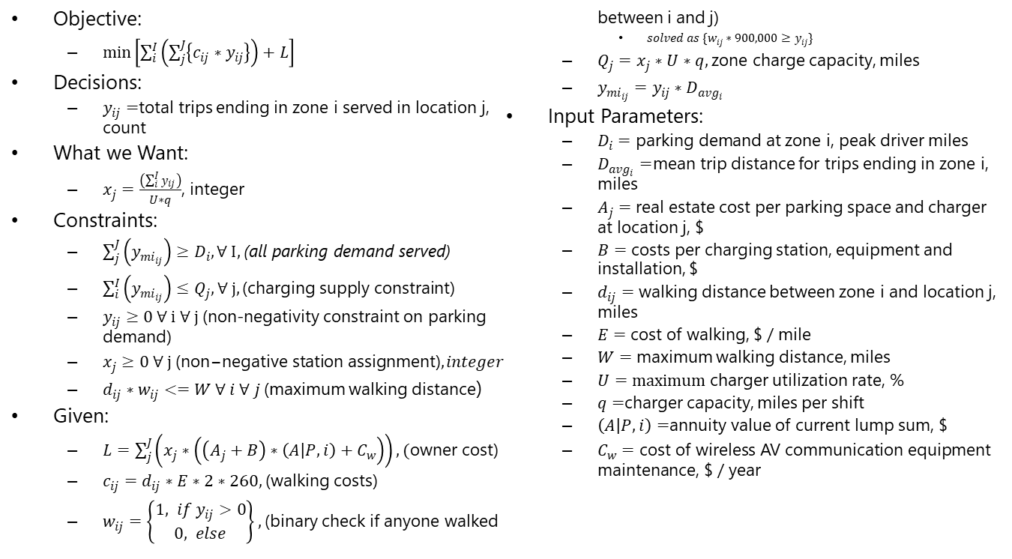
Self Parking (level 4 AV)
Objective:
  $\min\left[\sum_{i}^{I}{\left(\sum_{j}^{J}{\left\{c_{ij}∗y_{ij}\right\}}\right)}+L\right]$
Decisions:
  $y_{ij}=$total trips ending in zone i served in location j, count
What we Want:
  $x_{j}=\frac{\left(\sum_{i}^{I}{y_{ij}}\right)}{U∗q}$, integer
Constraints:
  $\sum_{j}^{J}{\left(y_{mi_{ij}}\right)}≥D_{i},∀ I,$(all parking demand served)
  $\sum_{i}^{I}{\left(y_{mi_{ij}}\right)}≤Q_{j},∀ j, \text{(}\text{charging} \text{supply} \text{constraint}\text{)}$
  $y_{ij}≥0 ∀ i ∀ j$(non-negativity constraint on parking demand)
  $x_{j}≥0 ∀ j \text{(}\text{non}\text{−}\text{negative} \text{station} \text{assignment}\text{)}, integer$
  $d_{ij}∗w_{ij}<=W ∀ i ∀ j$(maximum walking distance)
Given:
  $L=\sum_{j}^{J}{\left(x_{j}∗\left(\left(A_{j}+B\right)∗\left(A | P,i\right)+C_{w}\right)\right)}, (\text{owner}$ cost)
  $c_{ij}=d_{ij}∗E∗2∗260,$(walking costs)
  $w_{ij}=\left\{\begin{aligned}1, if y_{ij}>0 \\ 0, else\end{aligned}\right\},$(binary check if anyone walked between i and j)
    $solved as \{w_{ij}∗900,000≥y_{ij}\}$
  $Q_{j}=x_{j}∗U∗q,$zone charge capacity, miles
  $y_{mi_{ij}}=y_{ij}∗D_{avg_{i}}$
Input Parameters:
  $D_{i}=\text{parking} \text{demand} \text{at} \text{zone} \text{i}\text{, }\text{peak} \text{driver}$ miles
  $D_{avg_{i}}=$mean trip distance for trips ending in zone i, miles
  $A_{j}=$ real estate cost per parking space and charger at location j, $
  $B=$ costs per charging station, equipment and installation, $
  $d_{ij}=$ walking distance between zone i and location j, miles
  $E=$cost of walking, $ / mile
  $W=$ maximum walking distance, miles
  $U=maximum$charger utilization rate, %
  $q=$charger capacity, miles per shift
  $\left(A | P,i\right)=$annuity value of current lump sum, $
  $C_{w}=\text{cost} \text{of} \text{wireless} \text{AV} \text{communication} \text{equipment} \text{maintenance}\text{, \$ / }\text{year}$

Slide 41
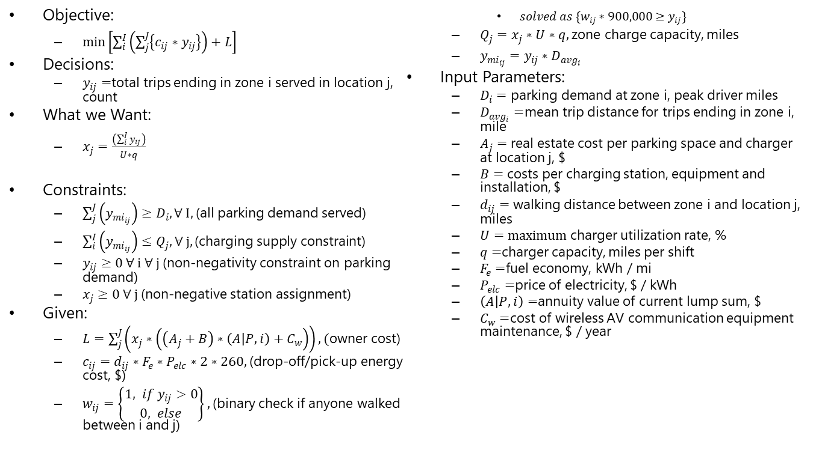
Self Driving (Level 5 AV)
Objective:
  $\min\left[\sum_{i}^{I}{\left(\sum_{j}^{J}{\left\{c_{ij}∗y_{ij}\right\}}\right)}+L\right]$
Decisions:
  $y_{ij}=$total trips ending in zone i served in location j, count
What we Want:
  $x_{j}=\frac{\left(\sum_{i}^{I}{y_{ij}}\right)}{U∗q}$
Constraints:
  $\sum_{j}^{J}{\left(y_{mi_{ij}}\right)}≥D_{i},∀ I,$(all parking demand served)
  $\sum_{i}^{I}{\left(y_{mi_{ij}}\right)}≤Q_{j},∀ j, \text{(}\text{charging} \text{supply} \text{constraint}\text{)}$
  $y_{ij}≥0 ∀ i ∀ j$(non-negativity constraint on parking demand)
  $x_{j}≥0 ∀ j$(non-negative station assignment)
Given:
  $L=\sum_{j}^{J}{\left(x_{j}∗\left(\left(A_{j}+B\right)∗\left(A | P,i\right)+C_{w}\right)\right)}, (\text{owner}$ cost)
  $c_{ij}=d_{ij}∗F_{e}∗P_{elc}∗2∗260,$(drop-off/pick-up energy cost, $)
  $w_{ij}=\left\{\begin{aligned}1, if y_{ij}>0 \\ 0, else\end{aligned}\right\},$(binary check if anyone walked between i and j)
    $solved as \{w_{ij}∗900,000≥y_{ij}\}$
  $Q_{j}=x_{j}∗U∗q,$zone charge capacity, miles
  $y_{mi_{ij}}=y_{ij}∗D_{avg_{i}}$
Input Parameters:
  $D_{i}=\text{parking} \text{demand} \text{at} \text{zone} \text{i}\text{, }\text{peak} \text{driver}$ miles
  $D_{avg_{i}}=$mean trip distance for trips ending in zone i, mile
  $A_{j}=$ real estate cost per parking space and charger at location j, $
  $B=$ costs per charging station, equipment and installation, $
  $d_{ij}=$ walking distance between zone i and location j, miles
  $U=maximum$charger utilization rate, %
  $q=$charger capacity, miles per shift
  $F_{e}=$fuel economy, kWh / mi
  $P_{elc}=$price of electricity, $ / kWh
  $\left(A | P,i\right)=$annuity value of current lump sum, $
  $C_{w}=$cost of wireless AV communication equipment maintenance, $ / year

