Slide 1
Manning up and womaning down:
How husbands and wives report their earnings when she earns more
Marta Murray-Close and Misty L. Heggeness
U.S. Census Bureau
April 4, 2019

Slide 2
Disclaimer
This presentation was prepared for the 2019 NBER Public Economics Meeting in Cambridge, MA. All results have been reviewed to ensure that no confidential information is disclosed. The Disclosure Review Board release number is DRB-B0035-CED-20190322.
It was developed to promote research and advancements in our understanding of the use of administrative records in household and person-level statistics. In that spirit and to encourage discussion and thoughtful feedback at early stages of our work, this presentation has undergone a more limited review than official Census Bureau reports. All views and any errors are solely those of the authors and do not reflect any official position of the Census Bureau.
Do not cite or distribute without author(s) permission.

Slide 3
Motivation
Economic indicators depend on the accuracy of self-reported survey data
Economists *generally* assume survey data as truth…what if they are not (and in nonrandom ways)?
We test this examining what happens to responses when gender social norms are violated.

Slide 4
Research question
Do survey respondents (mis)report earning to minimize violations of the norm that husbands outearn their wives?
Notes:
So, what did we do that was SO interested? Well, we started with a basic research question…

Slide 5
Why do we think they might?
An aversion to higher-earning wives appears to affect real-world marriage market outcomes (Bertrand, Kamenica, and Pan, 2015).
So maybe it affects earnings reporting in surveys.
But a review article concluded that “there is little evidence to support the existence of social desirability bias with respect to the reporting of annual earnings” (Bound, Brown and Mathiowetz, 2000, p. 53).

Slide 6
Data: Matched survey and income-tax records
Current Population Survey Annual Social and Economic Supplement (CPS-ASEC) |  | Social Security Detailed Earnings Record (DER)
Sample of married couples |  | Their income-tax records
Survey-reported earnings and demographic characteristics |  | “True” earnings as reported on W-2 forms
Years 2003-13 |  | Years 2002-12

Slide 7
Sample
Different-sex married couples from pooled CPS-ASEC data
Both spouses age 25 to 54
Both spouses work for pay
Spouses who work for pay are employees (not self-employed)
Exclude observations with missing, imputed, or inconsistent earnings data (and adjust CPS-ASEC sampling weights)
 | Analysis Sample | Dual-Earner Sample | Trimmed Dual-Earner Sample
Couple-years | 126,000 | 96,000 | 88,500
Unique Couples | 96,500 | 74,000 | 68,000
Proportion Non-Traditional | 0.230 | 0.258 | 0.274

Slide 8
We compare traditional and non-traditional couples
Traditional couples |  | Non-traditional couples
Husband’s earnings >= Wife’s earnings |  | Wife’s earnings > Husband’s earnings
Approximately 97,000 observations |  | Approximately 29,000 observations

Slide 9
Underreporting by wife’s share of total earnings

Slide 10
Choosing a specification: Lee and Lemieux (2010)
 | (1) | (2) | (3) | (4)
NonTrad | 0.161 | 0.162 | 0.164 | 0.158
 | (0.015) | (0.015) | (0.016) | (0.018)
N | 88,500 | 88,500 | 88,500 | 88,500
p-value | 0.000 | 0.019 | 0.006 | 0.468
Y_{i} = 1 if wife’s share less in CPS than DER
Sample: Couples where each spouse earns >=10% of combined earnings
Regressors: Dummies for 0.02-width bins of WifeShare
p-values from test of H₀: bin indicator coefficients jointly = 0
Conclusion: Quadratic with interaction is sufficient.
(1): Linear; no interaction NonTrad & Wife Share polynomial
(2): Linear; interaction NonTrad & WifeShare polynomial
(3): Quadratic model; no interaction NT & WS polynomial
(4): Quadratic model; interaction NT & WS polynomial
Notes:
p-values are from test of Ho: bin indicator coefficients jointly = 0

Slide 11
Choosing a specification: Lee and Lemieux (2010)
 | (1) | (2) | (3) | (4)
NonTrad | 0.161 | 0.162 | 0.164 | 0.158
 | (0.015) | (0.015) | (0.016) | (0.018)
N | 88,500 | 88,500 | 88,500 | 88,500
p-value | 0.000 | 0.019 | 0.006 | 0.468
Y_{i} = 1 if wife’s share less in CPS than DER
Sample: Couples where each spouse earns >=10% of combined earnings
Regressors: Dummies for 0.02-width bins of WifeShare
p-values from test of H₀: bin indicator coefficients jointly = 0
Conclusion: Quadratic with interaction is sufficient.
(1): Linear; no interaction NonTrad & Wife Share polynomial
(2): Linear; interaction NonTrad & WifeShare polynomial
(3): Quadratic model; no interaction NT & WS polynomial
(4): Quadratic model; interaction NT & WS polynomial
Notes:
p-values are from test of Ho: bin indicator coefficients jointly = 0

Slide 12
Measurement error
$$Reporting gap=\frac{CPS \text{Earnings}\text{ – }\text{DER} \text{Earnings}}{DER Earnings}$$

Slide 13
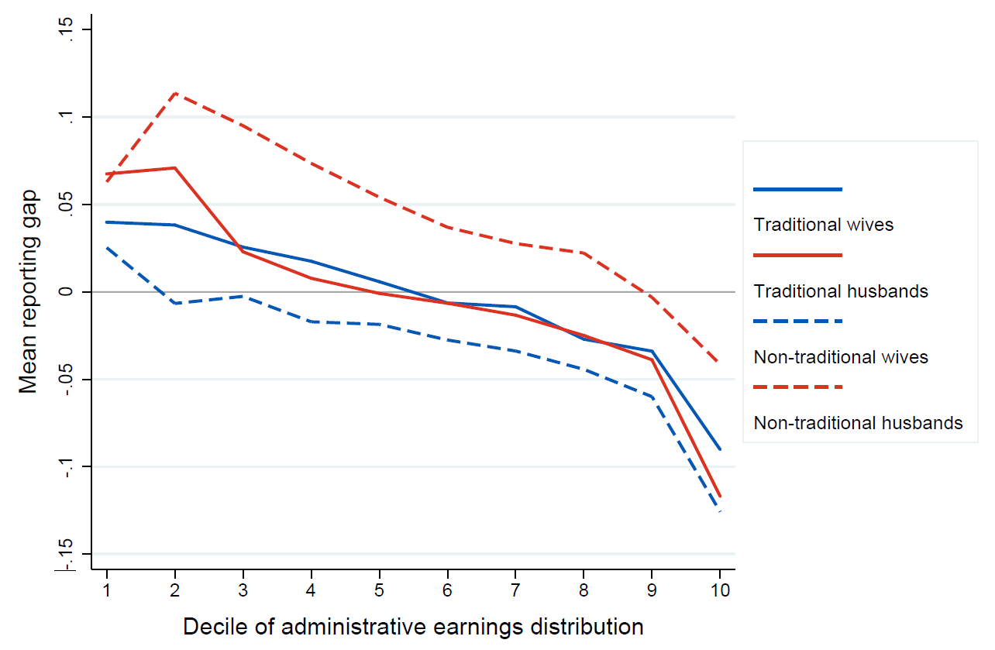
Mean reporting gap across the administrative earnings distribution, by sex and marital earnings classification of survey subject

Slide 14
Functional Form: Linear? Conclusion: Use couples where each spouse earns >= 10% of combined earnings
Notes:
Relationship is basically linear except at the tail ends.

Slide 15
Justification for trimming data Sample: couples where each spouse earns >= 10% of combined earnings

Slide 16
Estimation strategy: OLS regression
$$Y_{i}=α+βMale_{i}+ γ_{1}Nontrad_{i}+ζ_{1}Z_{i}+Male_{i}×\left(γ_{2}Nontrad_{i}+ζ_{2}Z_{i}\right)+ε_{i}$$
$$Y_{i}$$ | (a) Indicator for positive reporting gap (b) Value of reporting gap
$$Z_{i}$$ | Worker and spouse: Age, race, education, cubic polynomial in DER earnings
 | Couple: Log of total earnings, wife’s share of total earnings, region of residence, whether live in metro area, identity of household respondent
Sample | Observations of employed husbands and wives where each spouse earns >= 10% of combined earnings ($N≈88,500)$

Slide 17
Positive Reporting Gap Indicator
 |  | (1) | (2) | (3) | (4)
Wives, includes controls
 | NonTrad | -0.056 | -0.051 | -0.049 | -0.046
 |  | (0.007) | (0.009) | (0.009) | (0.010)
Wives, excludes controls
 | NonTrad | -0.056 | -0.051 | -0.049 | -0.046
 |  | (0.007) | (0.009) | (0.009) | (0.010)
Husbands, includes controls
 | NonTrad | 0.069 | 0.058 | 0.055 | 0.040
 |  | (0.007) | (0.009) | (0.009) | (0.010)
Husbands, excludes controls
 | NonTrad | 0.069 | 0.058 | 0.055 | 0.040
 |  | (0.007) | (0.009) | (0.009) | (0.010)
 | N | 88,500 | 88,500 | 88,500 | 88,500
Note: Polynomial of order 0 to 3 in wife’s share; with & without controls
To what extent is it over reporting of husband’s earnings versus the underreporting of wife’s earnings?
Answer: It’s both.

Slide 18
Positive Reporting Gap Indicator
 |  | (1) | (2) | (3) | (4)
Wives, includes controls
 | NonTrad | -0.056 | -0.051 | -0.049 | -0.046
 |  | (0.007) | (0.009) | (0.009) | (0.010)
Wives, excludes controls
 | NonTrad | -0.056 | -0.051 | -0.049 | -0.046
 |  | (0.007) | (0.009) | (0.009) | (0.010)
Husbands, includes controls
 | NonTrad | 0.069 | 0.058 | 0.055 | 0.040
 |  | (0.007) | (0.009) | (0.009) | (0.010)
Husbands, excludes controls
 | NonTrad | 0.069 | 0.058 | 0.055 | 0.040
 |  | (0.007) | (0.009) | (0.009) | (0.010)
 | N | 88,500 | 88,500 | 88,500 | 88,500
Note: Polynomial of order 0 to 3 in wife’s share; with & without controls
To what extent is it over reporting of husband’s earnings versus the underreporting of wife’s earnings?
Answer: It’s both.

Slide 19
Is it other factors? Assessing the importance of control variables
Y_{i} = 1 if wife’s share less in CPS than DER
Sample: Couples where each spouse earns >=10% of combined earnings
Controls: husband and wife(age, race, education, earnings), total earnings, region, metro, and survey respondent
Key Finding: Coefficients are statistically indistinguishable
Conclusion: Controls do not change NonTrad coefficient
 | (1) | (2)
NonTrad | 0.157 | 0.159
 | (0.011) | (0.012)
N | 88,500 | 88,500
p-value | 0.781
(1): Quadratic with interaction, without controls
(2): Quadratic with interaction, with controls
p-value from test of H₀: NonTrad coefficients equal across models

Slide 20
Estimation strategy: OLS regression
$$Y_{i}=α+βMale_{i}+ γ_{1}Nontrad_{i}+ζ_{1}Z_{i}+Male_{i}×\left(γ_{2}Nontrad_{i}+ζ_{2}Z_{i}\right)+ε_{i}$$
$$Y_{i}$$ | (a) Indicator for positive reporting gap (b) ln(CPS earnings)
$$Z_{i}$$ | Worker and spouse: Age, race, education, cubic polynomial in DER earnings
 | Couple: Log of total earnings, wife’s share of total earnings, region of residence, whether live in metro area, identity of household respondent
Sample | Observations of employed husbands and wives where each spouse earns >= 10% of combined earnings ($N≈88,500)$

Slide 21
Impact of being nontraditional on the CPS self-reported earnings, conditional on the DER reported earnings
Note: Polynomial of order 0 to 3 in wife’s share; with & without controls
Being nontraditional results in a 1.1ppt decrease on the value of earnings reported for wives and about a 1.1ppt increase on the value of husbands’ reported earnings.
Caution: Results sensitive to specification.
 |  | (1) | (2) | (3) | (4)
Wives, includes controls
 | NonTrad | -0.014 | -0.011 | -0.011 | -0.01
 |  | (0.004) | (0.004) | (0.004) | (0.005)
Wives, excludes controls
 | NonTrad | 0.616 | -0.209 | -0.032 | 0.033
 |  | (0.005) | (0.007) | (0.007) | (0.009)
Husbands, includes controls
 | NonTrad | 0.023 | 0.011 | 0.009 | 0.003
 |  | (0.003) | (0.004) | (0.004) | (0.005)
Husbands, excludes controls
 | NonTrad | -0.477 | -0.015 | 0.122 | 0.026
 |  | (0.005) | (0.007) | (0.007) | (0.008)
 | N | 88,500 | 88,500 | 88,500 | 88,500

Slide 22
Impact of being nontraditional on the CPS self-reported earnings, conditional on the DER reported earnings
Note: Polynomial of order 0 to 3 in wife’s share; with & without controls
Being nontraditional results in a 1.1ppt decrease on the value of earnings reported for wives and about a 1.1ppt increase on the value of husbands’ reported earnings.
Caution: Results sensitive to specification.
 |  | (1) | (2) | (3) | (4)
Wives, includes controls
 | NonTrad | -0.014 | -0.011 | -0.011 | -0.01
 |  | (0.004) | (0.004) | (0.004) | (0.005)
Wives, excludes controls
 | NonTrad | 0.616 | -0.209 | -0.032 | 0.033
 |  | (0.005) | (0.007) | (0.007) | (0.009)
Husbands, includes controls
 | NonTrad | 0.023 | 0.011 | 0.009 | 0.003
 |  | (0.003) | (0.004) | (0.004) | (0.005)
Husbands, excludes controls
 | NonTrad | -0.477 | -0.015 | 0.122 | 0.026
 |  | (0.005) | (0.007) | (0.007) | (0.008)
 | N | 88,500 | 88,500 | 88,500 | 88,500

Slide 23
Does it matter who answers the survey?
$$Y_{i}=α+γNontrad_{i}+ζZ_{i}+ε_{i}$$
$$Y_{i}$$ | (a) Indicator for positive reporting gap
$$Z_{i}$$ | Worker and spouse: Age, race, education, cubic polynomial in DER earnings
 | Couple: Log of total earnings, wife’s share of total earnings, region of residence, whether live in metro area
Samples | Observations of employed husbands and wives where each spouse earns >= 10% of combined earnings ($N≈87,000)$

Slide 24
Positive Reporting Gap Indicator
 | (1) | (2) | (3) | (4)
NonTrad | -0.041 | -0.083 | 0.098 | 0.054
 | (0.008) | (0.009) | (0.008) | (0.009)
N | 49,000 | 38,000 | 49,000 | 38,000
Does it matter who answered the survey?
Yes!
Wives underreport their own earnings and over report their husbands’ earnings more than he would.
Husbands over report their own earnings and underreport their wives’ earnings more than she would.
(1): Wife reporting wife’s earnings
(2): Husband reporting wife’s earnings
(3): Wife reporting husband’s earnings
(4): Husband reporting husband’s earnings

Slide 25
Positive Reporting Gap Indicator
 | (1) | (2) | (3) | (4)
NonTrad | -0.041 | -0.083 | 0.098 | 0.054
 | (0.008) | (0.009) | (0.008) | (0.009)
N | 49,000 | 38,000 | 49,000 | 38,000
Does it matter who answered the survey?
Yes!
Wives underreport their own earnings, but husbands underreport their earnings more than they do.
Husbands over report their own earnings, but wives over report their husbands’ earnings more than they do.
(1): Wife reporting wife’s earnings
(2): Husband reporting wife’s earnings
(3): Wife reporting husband’s earnings
(4): Husband reporting husband’s earnings

Slide 26
Conclusions
Gendered social norms may bias measures of seemingly objective economic outcomes in household surveys
Norms may have heterogeneous effects within gender
Measurement error in a worker’s earnings may depend on characteristics of other household members
Researchers using household surveys to understand economic phenomena should proceed with caution.

Slide 27
Misty L. Heggeness
U.S. Census Bureau
Research and Methodology Directorate
e-mail: misty.l.heggeness@census.gov
On : @m_heggeness
Website: https://sites.google.com/view/misty-l-heggeness/home

Slide 28
Appendix: Over Reporting Earnings

Slide 29
Is it other factors? Assessing the importance of control variables
Y_{i} = 1 if wife’s share less in CPS than DER
Sample: Couples where each spouse earns >=10% of combined earnings
Controls: husband and wife(age, race, education, earnings), total earnings, region, metro, and survey respondent
Key Finding: Coefficients are statistically indistinguishable
Conclusion: Controls do not change NonTrad coefficient
 | (1) | (2)
NonTrad | 0.157 | 0.159
 | (0.011) | (0.012)
N | 88,500 | 88,500
p-value | 0.781
(1): Quadratic with interaction, without controls
(2): Quadratic with interaction, with controls
p-value from test of H₀: NonTrad coefficients equal across models

